Slide 1
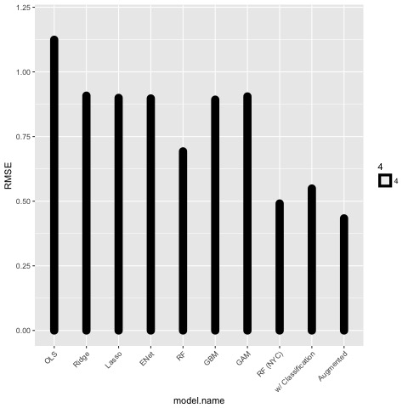
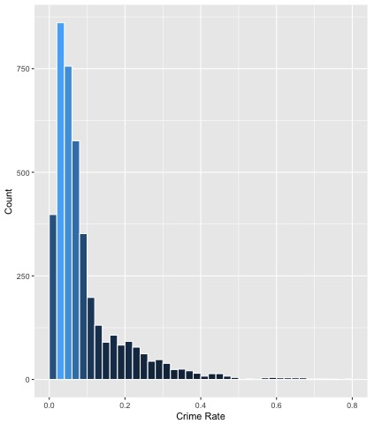
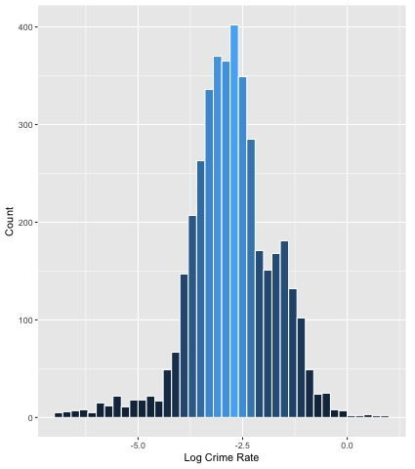
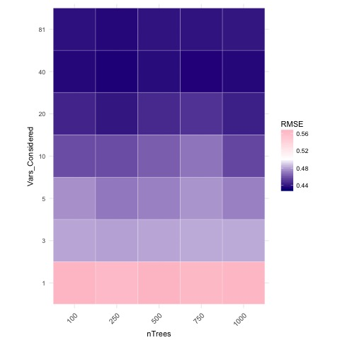
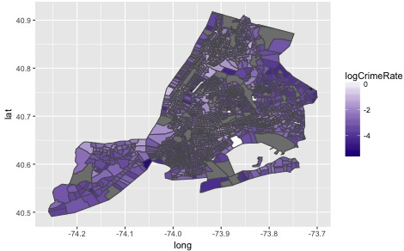
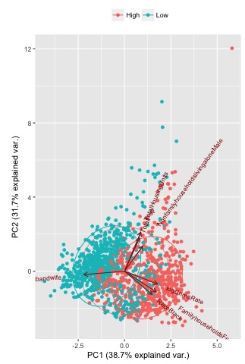
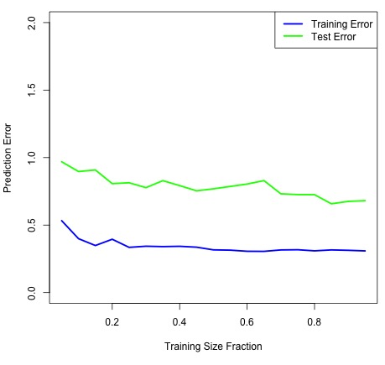
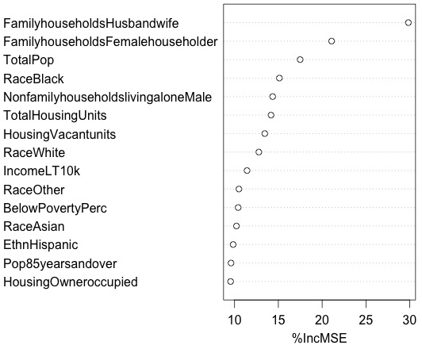
Making Our Cities Safer
A Study of Neighborhood Crime Patterns
Aly Kane
Ariel Sagalovsky
Introduction
Methodology
Results
Motivation
America’s largest cities are changing very rapidly, and we seek to make them safer by developing insights on crime patterns.
Goal
Our project will attempt to understand which demographic factors may influence crime rates. We wish to reason if key findings for specific neighborhoods in a particular city can be extrapolated to others, or if crime patterns vary widely across different cities.
Impact
The results of this project can be used for policy and planning purposes, helping cities understand if such policies should be implemented at neighborhood level (police station) or a city level (police department).
Response Variable
Our goal is to predict crime rate (ratio of crime count to number of residents) for each census tract. A histogram of this variables exhibits a heavy left tail. We chose to perform a log-transform on the crime rate to make normality assumptions for our models.
Overview
On the initial dataset, our out-of-the box Random Forest model achieved the lowest prediction error of 0.69. Linear models, even after variable selection and regularization, did not show any sign of achieving such a bound and were dropped from the list of potential choices. In the subsequent analysis of the most relevant features, we found that dummy variables denoting the city in which particular crimes occurred were the single-most relevant factors.
The adjacent diagram shows the improvement in predictive accuracy for each of the models or improvements considered.
Error Rates by Model Type
Grid Search over Hyper-parameters
Linear
Non-Linear
Single City
Single City Model
We proceed by building models for individual cities, starting with New York City. On the first pass, our Random Forest model achieved RMSE of 0.49. We attempted to improve on these initial results by splitting crimes into violent and non-violent brackets, however this did not yield a better predictive model. Next, we augmented our dataset with socio-economic features from the Census (such as median housing price, education attainment, poverty levels, and income information), achieving our lowest RMSE of 0.41.
Finally, we tuned the model’s hyper-parameters using a grid search over the number of trees and variables considered at each split. Using the tuple of values that achieved lowest CV error (250 trees, 40 variables), our test error was further reduced to our final value of 0.39.
Data
Crime rates are distributed roughly similarly across cities, however there appear to be more dangerous neighborhoods in Chicago and fewer
Boxplot of Log Crime Rate by City
Incident level crime data (2010) was pulled from the government OpenData portals for the following six cities: New York City, Chicago, Philadelphia, Washington, D.C., San Francisco, and Detroit. We saved the latitude, longitude, and crime description for each crime incident. We augmented the dataset with 2010 American Community Survey (ACS) census data. To merge the two datasets, we interfaced with the Census Bureau API in R to map the latitude/longitude of each crime to its respective census tract. Crime data was summarized at the tract level to obtain the total number of crimes per Census tract in 2010.
The map above shows crime rate by census tract in New York. As expected, crime rates vary largely across neighborhoods.
dangerous neighborhoods in NYC. Detroit has a heavy lower tail, indicating there are more dangerous neighborhoods in the city, but there is a large spread in both directions. Aside from these deviations, boxplots show we may assume data comes from similar distributions to model the cities together.
Next Steps
Crime Rates by Census Tract
Modeling
Normalized parameters with mean zero and variance one
Split data into training (80%) and test sets (20%) based on learning curve below
The variable importance plot for our best Random Forest model shows that the most relevant variable in predicting crime rate is the proportion of households inhabited by a husband and a wife.
In our attempt to understand the key factors that influence crime rates, we performed principal component analysis (PCA) and plotted each entry in the training set along its major axes. We then ran a k-means clustering algorithm to tag each point as a “high” or ”low” crime area. These results proved consistent with our earlier findings from the Random Forest model.
We are also interested in comparing how crime rates change over time. It would be interesting to create a model comparing 2010 crime rates to 2020 crime rates when the next Census data is published.
Used CV error to tune
parameters
Ran linear and non-linear methods
Original features: Race, Age and Housing demographics
Augmented feature set: Income, Education, Property Value, Poverty level
Learning Curve

