Slide 1
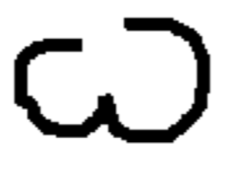
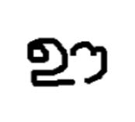
Conv2D (64,(10,10), ‘relu’)
Conv2D (256,(4,4), ‘relu’)
Fully connected layer (4096, ‘sigmoid’)
Input shape: (105,105,1)
Conv2D (128,(7,7), ‘relu’)
Conv2D (128,(4,4), ‘relu’)
Maxpooling 2D
Maxpooling 2D
Maxpooling 2D
X₁
P(X_{1,} X₂ )
64 x 96 x 96 activations
64 x 48 x 48
128 x 42 x 42
128 x 21 x 21
128 x 18 x 18
128 x 9 x 9
256 x 6 x 6
4096 x 1
Euclidean Distance ||y₁ – y₂||₂
Y’
X₂

