Slide 1

Regression
Introduction
Dr. Abolfazl Saghafi
Assistant Professor of Statistics & Data Science

Slide 2
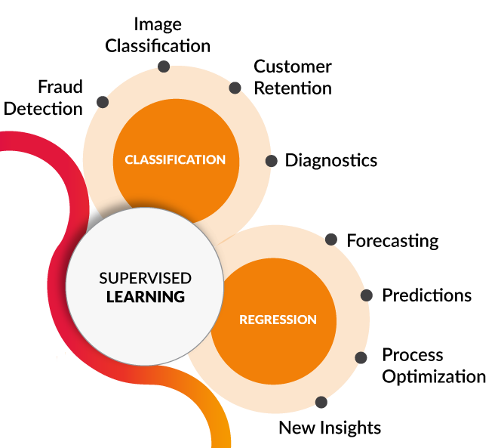




Supervised Learning
Learn a Pattern to map inputs to outputs
[1] towardsdatascience.com/coding-deep-learning-for-beginners-types-of-machine-learning-b9e651e1ed9d
m example (inputs, outputs)
$$⇒$$
$${\left\{\left(x_{i},y_{i}\right)\right\}}_{i=1}^{m}$$
Predict outputs for any given inputs
$$⇒$$
Notes:
Supervised Learning is a class machine learning techniques in which a teacher or coder, provides the computer with a set of examples, m pairs of (inputs, outputs), and the goal is to learn a pattern that maps inputs to outputs. Further, the pattern is used to predict outputs $y_{i}$ given new inputs $x_{i}$. This is actually how humans learn, we learn by examples.
Behind the scene, this is achieved through sophisticated programing and a good deal of Statistics and Optimization techniques. Supervised Learning further breaks down into Regression and Classification. This week is dedicated to regression.

Slide 3
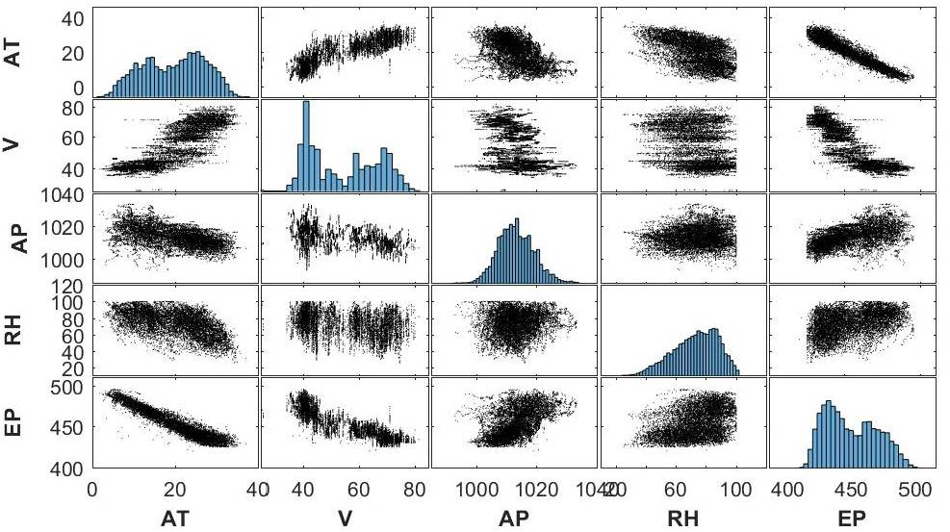
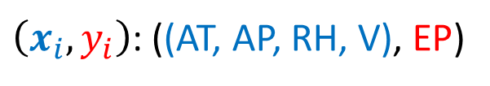

Regression
[2] Frank, A., Asuncion, A., UCI Machine Learning Repository
Input(s) - ONE output
$$\left({(x}_{1},x_{2},…,x_{n}),y_{i}\right)$$
$\left(x_{i},y_{i}\right)$: ((AT, AP, RH, V), EP)
Hourly average Ambient Temp. (T), Ambient Pressure (AP),
Relative Humidity (RH) and
Exhaust Vacuum (V) to predict the net hourly Electrical Energy Output (EP) of a power plant [2].
Notes:
In Regression problems we have one or many input variables, and ONE output variable which is REAL-VALUED. The goal is to predict the output using the inputs.
In this example, the goal is to predict Electrical Energy output of a power plant using some input variables such as Hourly Temp, etc. The relation between each input variable and output could be linear such as AT, or more complicated such as V.

Slide 4
Datasest
We will now proceed to discuss regression using the “carmpg” dataset. Variables in this dataset include:
Variable Type Description
mpg continuous mile per gallon
cylinders discrete
displacement continuous
horsepower continuous
weight continuous
acceleration continuous
model year discrete
origin categorical USA/GER/JAP
car name string unique name for each case

Slide 5
Exploratory Analysis
Step 1
Dr. Abolfazl Saghafi
Assistant Professor of Statistics & Data Science
Notes:
This week we will discuss regression analysis
Python codes to follow up the tasks are provided on D2L

Slide 6
Summary
● Qualitative Data
● Frequency Table ● Bar/Pie Chart
● Quantitative Data
● Histogram ● Box Plot
● Central & Spread Measures
● Bivariate
● Scatterplot ● Grouped Bar Chart
● Side-by-side Box Plots
Notes:
We focus separately on charts used for describe qualitative and quantitative data, then we close the session with bivariate data representation.

Slide 7
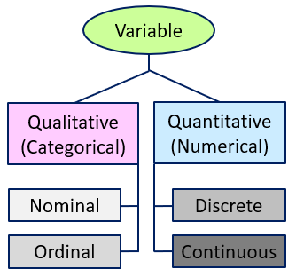
Qual Vs Quant Variables
What we are interested in studying something in the population that changes between individuals. It is called variable. There are different types of variables:
• A qualitative (categorical) variable describes quality and places individuals in different categories. A nominal variable with only two categories can be considered ordinal, i.e.. Gender.
• A quantitative (numerical) variable takes on a real value or numerical measurement for which sums, differences, and ratios have meaning.
Examples:
• Nominal: Eye color, Blood type
• Ordinal: Shoe size
• Discrete: number of children
• Continuous: weight, height
Notes:
What we are interested in studying something in the population that changes between individuals. So it is called variable. We have different types of variables:
• A qualitative (categorical) variable describes quality and places individuals in different categories. A nominal variable with only two categories can be considered ordinal, i.e.. Gender.
• A quantitative (numerical) variable takes on a real value or numerical measurement for which sums, differences, and ratios have meaning.

Slide 8
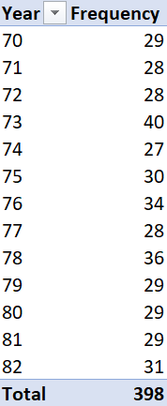
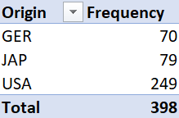
Frequency Table
A frequency table a list or table that displays the frequency of various outcomes in a sample.
Here we have a frequency table for variable Origin in the carmpg dataset.
Variable modelyaer is numerical with low number of values, we can also crate a frequency table for this variable.
Notes:
A frequency table a list or table that displays the frequency of various outcomes in a sample. Here we have a frequency table for variable Origin in the credit dataset.

Slide 9
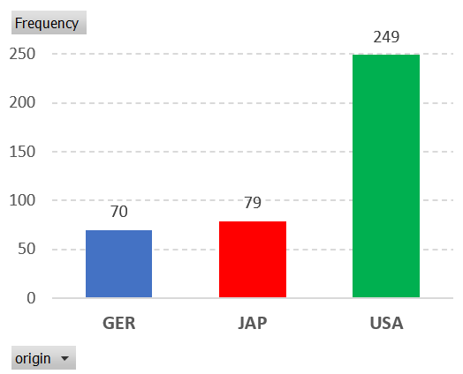
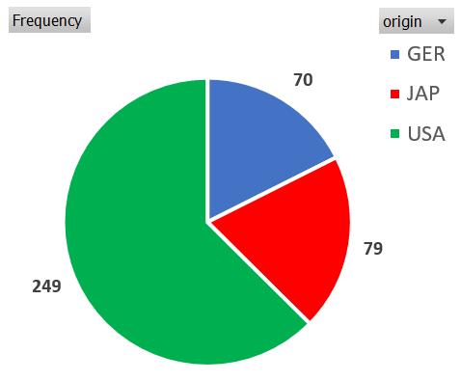
Bar/Pie Chart
• Different categories of the qualitative variable on x-axis
• Frequency or Relative Frequency of each category is on y-axis
• Bars could be horizontal as well
A bar chart presents data with rectangular bars where heights is proportional to frequencies.
A pie chart is a circular graph which divides the circle into slices to illustrate numerical proportion.
Notes:
A bar chart presents QUALITATIVE data with rectangular bars where heights is proportional to the frequencies they represent. You see an example here for variable ethnicity.
We can graph a bar chart for more than two qualitative variables in grouped or stacked formation. Here we have a grouped bar chart for the number of participants in the sample based on gender and ethnicity. For a stacked bar chart, the gender frequencies are stacked on top of each other for different ethnicity categories.

Slide 10
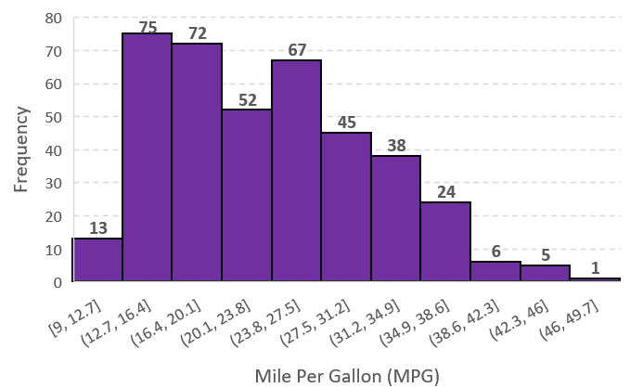
Histogram
A kernel chart is derived by connecting the centers on top of bars after adding one category to the beginning and end.
A histogram is a representation of frequency of observations within different categories.
Here we have a histogram for variable credit limit in the credit dataset.
• Number of categories is usually between 5 and 12
• We comment on the shape of a histogram, symmetric or skewed (left/right)
• We look for outliers
Notes:
A histogram is a representation of frequency of observations within different categories for QUANTITATIVE data. Here we have a histogram for variable MPG.
• Number of categories is usually between 5 and 12
• We comment on the shape of a histogram, symmetric or skewed (left/right)
• We look for outliers
A kernel chart is derived by connecting the centers on top of bars after adding one category to the beginning and end.

Slide 11
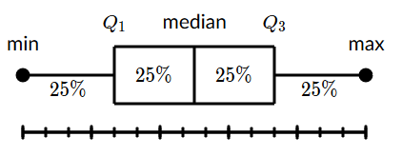
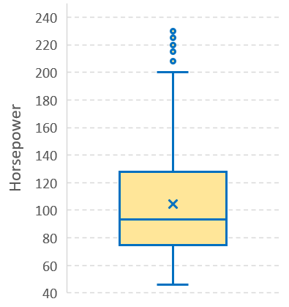
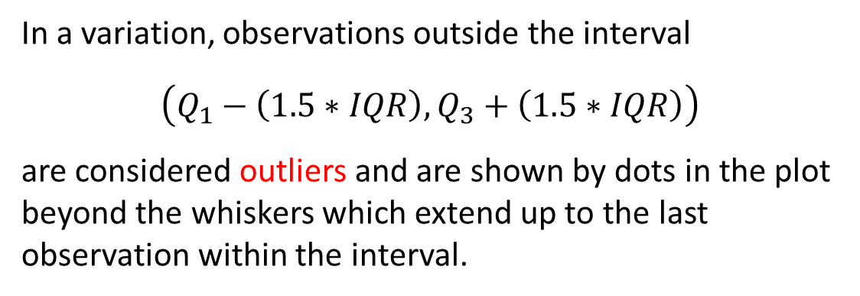
Box Plot
A box and whisker plot displays the five-number summary of a set of data. The five-number summary is the min, first quartile, median, third quartile, and max.
We draw a box from the first quartile to the third quartile. A vertical line goes through the box at the median. The whiskers go from each quartile to the min and max.
In a variation, observations outside the interval
$$\left(Q_{1}−\left(1.5∗IQR\right),Q_{3}+\left(1.5∗IQR\right)\right)$$
are considered outliers and are shown by dots in the plot beyond the whiskers which extend up to the last observation within the interval.
Notes:
A box and whisker plot, also called a box plot, displays the five-number summary of a set of QUANTITATIVE data. The five-number summary is the minimum, first quartile, median, third quartile, and maximum. We draw a box from the first quartile to the third quartile. A vertical line goes through the box at the median. The whiskers go from each quartile to the minimum or maximum.
In another variation observations outside the interval $\left(Q_{1}−\left(1.5∗IQR\right),Q_{3}+\left(1.5∗IQR\right)\right)$ are considered outliers and are shown by dots in the plot beyond the whiskers which extend up to the last observation within the interval.
This box plot here is for variable credit limit and is graphed side-by-side for the two gender groups. You see that the patterns are similar. There are a couple of outliers. The average is also shown in the plot by a cross which is close to the middle bar, representing the median.

Slide 12
Central Tendency Measures
• For qualitative data, Mode is the only central tendency that makes sense
• When the data is skewed, the median is preferred over the mean or mode since it provides a better central value
• The mean has the lowest error, variance, in a symmetric or near symmetric distribution
Statistic whose values shows a center or typical value for distribution of data. The three most important central tendency measures are
• Mean represented by $\overline{x}$ is simply the average of the observations
• Median which is the middle value after sorting the data. Therefore, 50% of the observations are less than or equal to the median and 50% are greater than or equal to it
• Mode which is the most frequent observation, distributions can have more than one mode, the mode does not exist when a distribution is flat
Notes:
Statistic whose values shows a center or typical value for distribution of data. The three most important central tendency measures are
• Mean or average represented by $\overline{x}$
• Median which is the middle value after sorting the data. Therefore, 50% of the observations are less than or equal to the median and 50% are greater than or equal to it
• Mode which is the most frequent observation, distributions can have more than one mode, the mode does not exist when a distribution is flat
• For qualitative data, Mode is the only central tendency that makes sense
• When the data is skewed, the median is preferred over the mean or mode since it provides a better central value
• The mean has the lowest error, variance, in a symmetric or near symmetric distribution

Slide 13
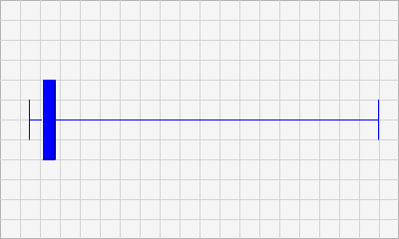
Example
Consider the wages of staff at a factory, sorted below,
12k 14k 15k 15k 15k 16k 17k 18k 90k 95k
Compute the central tendency measures and comment which value represents a better central value.
• $\overline{x}=\left(12000+…+95000\right)/10=30,700$
• Median is the average of the two observations in the middle, that is $m=\left(15000+16000\right)/2=15,500$
• Mode is $M=15,000$
Notes:
The median here is the best measures of center since the data is highly skewed to right.

Slide 14
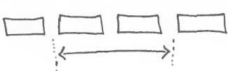

Spread Measures
Spread measures provide a value of dispersion, deviation or variability for a set of data. The most important ones for a set of data are
• Range represented by R is Max – min and shows the extent to which variation is possible
• Sample standard deviation has the same unit as the data itself and is computed using all the observations thus is favorable IF there are no outliers in the data
• ALL these measures provide a positive value representing spread of data
• If data is skewed, IQR provides a better spread measure.
• Inter-Quartile Range (IQR) is Q ₃ – Q ₁ which is computed after sorting the data and computing the first and third quartile
• Sample Variance is computed as the sum of squared deviations from the mean, i.e. $S^{2}=\frac{1}{n−1}\sum_{i}{{\left(x_{i}−\overline{x}\right)}^{2}}$
• Sample Standard deviation is the square root of the Sample Variance $S=\sqrt{S^{2}}$
Notes:
Spread measures provide a value of dispersion, deviation or variability for a set of data. The most important ones for a set of data are
• Range represented by R is Max – min and shows the extent to which variation is possible
• Inter-Quartile Range is Q ₃ – Q ₁ which is computed after sorting the data and computing the first and third quartile
• Sample Variance is computed as the sum of squared deviations from the mean, i.e. $S^{2}=\frac{1}{n−1}\sum_{i}{{\left(x_{i}−\overline{x}\right)}^{2}}$
• Sample Standard deviation is the square root of the Sample Variance $S=\sqrt{S^{2}}$

Slide 15
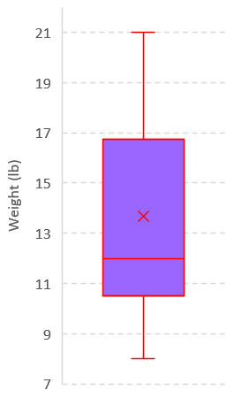
Example
The following data is from a random sample of 12 airline carry-on luggage weights rounded to the nearest pound. Compute the four discussed spread measures.
8 10 10 12 12 12 12 15 16 17 19 21
• R = Max – min = 21 – 8 = 13
• IQR = Q ₃ – Q ₁ = 16.5 – 11 = 5.5
• $S^{2}=\frac{1}{n−1}\sum_{i}{{\left(x_{i}−\overline{x}\right)}^{2}}=15.52$
• $S=\sqrt{S^{2}}=3.94$
Notes:
The box plot here uses a weighted procedure to compute the quartiles and the values are different from what we computed here.
Since the boxplot is skewed, IQR is the best spread measures.

Slide 16
Activity Part 1
1. The following is 10 sample values from 50 college students for ideal weights.
145 160 175 160 170 135 130 135 135 165
a) Enter data into your session and save in a data frame vector named “weights”.
b) Generate a proper chart and numerical summary for variable “weight”.
We have the following information on gender of the respondents (M for Male, F for Female).
F M M M M F F F F M
c) Enter data into your session and save in a data frame vector named “gender”.
d) Merge the two data frame and save it as a new data frame named “sample”.
e) Generate a frequency table for variable “gender” and graph a proper chart summarizing this variable info. Explain what the result shows.
Notes:
It’s your turn now, practice what you’ve learned today.
If you don’t know how to enter data directly into Python and save it as data frame, try entering data into excel and saving as .csv, then import to Python

Slide 17
Activity Part 1
2. The ages of females and males who died of sudden cardiac causes after 4:31 am on the day of the Northridge Earthquake are given below.
Construct a frequency distribution table that describes the composition of the sample with respect to gender.
Draw an appropriate graphical summary for the qualitative variable.
Graph a proper chart for the quantitative variable.
Compute numerical summaries separately for males and females and compare.
Female | 77 | 83 | 75 | 77 | 70 | 80 | 68 | 58 | 70 | 81 | 78 | 69 | 38
Male | 90 | 38 | 45 | 47 | 79 | 75 | 71 | 68 | 51 | 55 | 66 | 56 | 59 | 60 | 68 | 64 | 53 | 90

Slide 18
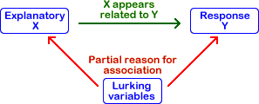
Response/Predictor Variable
A confounding variable also known as confounding factor, a lurking variable, a confound or confounder is an extraneous variable that is associated positively or negatively with both the explanatory variable and response variable.
The Response variable is the outcome of a study. A variable you would be interested in predicting or estimating. Also called a dependent variable.
A Predictor variable is any variable that explains the response variable. Often called an independent variable or explanatory variable.
In general, we are interested in finding out how changes in the predictor variables affect the values of the response variables.
Notes:
We can distinguish two main types of variables, typically called predictor and response variables. The Response variable is the outcome of a study, generally shown by letter Y. It is a variable you would be interested in predicting or estimating. It is also called a dependent variable. A Predictor variable is any variable that explains the response variable. Often called an independent variable or explanatory variable and is generally shown by X.
In general, we are interested in figuring out how changes in the predictor variables affect the values of the response variables.

Slide 19
Combination of Variables
The Response or Dependent Variable is the outcome of a study; a variable you are interested in predicting or estimating.
When trying to explore and describe information from two variables, we have different options depending on the type of response and predictor variables.
The Predictor or Independent Variable is used to explain and predict the response variable.
Response Variable
Categorical Numerical
Side-by-Side Box Plots
Scatterplot
Predictor Variable
Categorical Numerical
Cross-Table
Grouped Bar chart
Side-by-Side Box Plots
Notes:
The type of illustrative chart depends on the type of both response and predictor variable. Use this guideline to generate proper graphs.

Slide 20
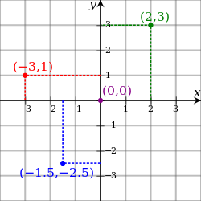
Scatterplot
A scatter plot is a graphical representation of bivariate data using a Cartesian coordinate system.
To display two numerical variables for a set of paired data, $\left(x_{1},y_{1}\right),\left(x_{2},y_{2}\right),…,\left(x_{n},y_{n}\right)$, the predictor variable is plotted on the horizontal axis and the response variable is plotted on the vertical axis.
Upon graphing a scatterplot we investigate
• the overall pattern of the plotted points
• the direction and shape of the pattern (if any)
• whether there are any outliers
On scatterplots each dot represents bivariate information for one sample unit.
Notes:
We should report whether there are any outliers, which are observations outside the overall pattern of data.

Slide 21
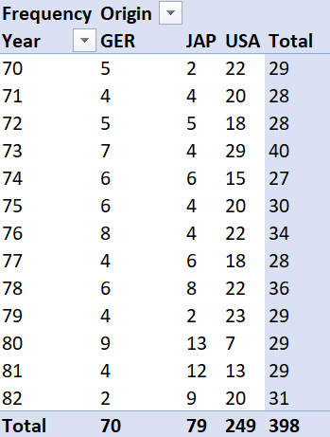
Cross Table
A Cross table is a frequency distribution for a two variables at once.
1. One variable is assigned to horizontal axis and one to vertical.
2. Joint counts within each combination of categories is placed on a matrix formation.
Notes:
Just like a typical frequency table, count the number of observations within each of the four possible categories generated by two variables. Then present the counts in a matrix form for each possible combination of the variables.

Slide 22
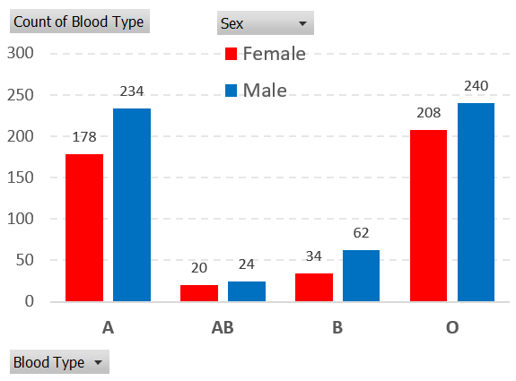
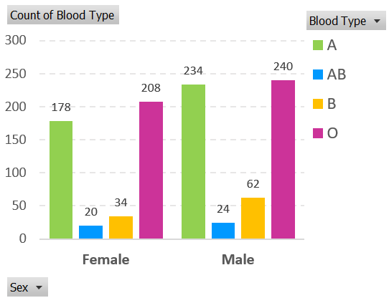
Grouped Bar Charts
Similar to bar charts, x-axis is divided into groups depending on different combinations of the response and predictor variables. Then, a bar is graphed with height proportional to frequency of observations in each combination.
In this example, Sex is the response variable and Blood type is the predictor. Do you see any relationships? Explain.
The excel charts look much nicer but you can create great looking charts in Python using ggplot package, you’ll see how in your data visualization.
Notes:
The two versions of this grouped bar chart represent the same information. Since we are interested in comparing the response variable (Sex) for given predictors, the first chart seems to be easier to investigate.

Slide 23
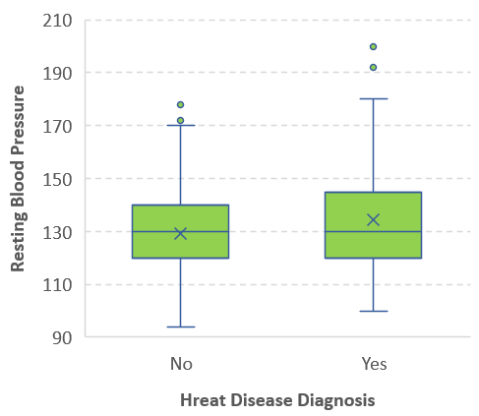
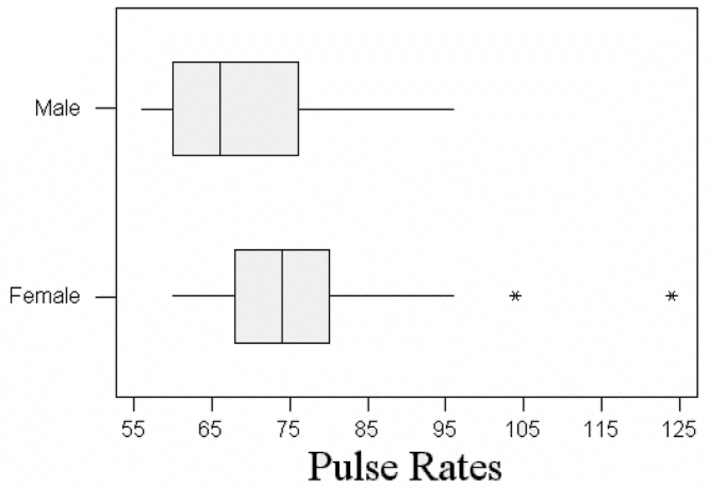
Side-by-side Box Plots
You need one qualitative and one quantitative variable to graph this chart.
Box plots generated for levels of a qualitative variable are used to investigate association between a qualitative and quantitative variable.
Notes:
The response variable in the box plots on the left is the pulse rate which is numerical. It is obvious that the pattern of pulse rate is different between the two genders. There are two outliers in the female pulse rates. After deleting them, the spread of pulse rate data in terms of both range and IQR is more in males than females. The median of pulse rates is higher for females than males.
In the box plot on the right, the response is quantitative, whether people had diagnosed with heart disease. The Predictor variable is resting blood pressure. This boxplot also shows a six numerical number, the mean, which is shown by x on the chart.

Slide 24
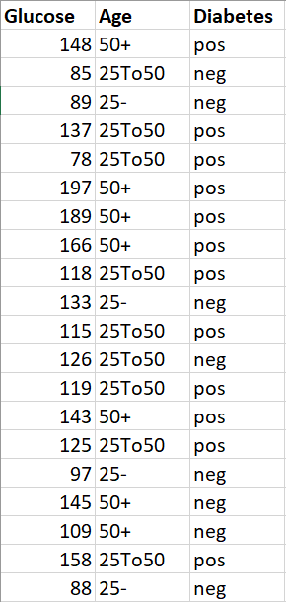
Activity Part 2
1. The table shows information on Glucose level, Age group (25-, 25To50, 50+) and Diabetes status for a random sample of 20 patients.
a) Explain which of the variables is response and which is predictor?
b) Generate a cross table representing information on Age groups and diabetes status.
c) Graph a suitable chart illustrating bivariate information on Age groups and diabetes status. Describe the chart in terms of shape and any interesting patterns.
c) Is Glucose level related to Diabetes status? Investigate any relationship using a proper chart.

Slide 25
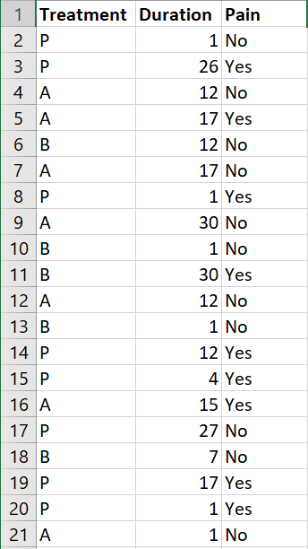
Activity Part 2
2. The table provides data on Treatment (A/B/Placebo), Duration of Neuroglia, experience of Pain for a random sample of 20 patients.
a) Generate a cross table representing information on Treatment and Pain.
b) Graph a suitable chart illustrating bivariate information on Treatment and Pain. Describe the chart in terms of shape and any interesting patterns.
c) Is Duration of Neuroglia related to experience of Pain? Investigate any relationship using a proper chart.
Notes:
cd C:\\Users\\asaghafi\\.spyder-py3\\mlcourse
## Loading required packages
import pandas as pd
import matplotlib.pyplot as plt
import seaborn as sb
## Loading data
########################################
df = pd.read_csv('W7S2Q2.csv', sep=',')
df.info() # var info
df["Treatment"] = df["Treatment"].astype('category')
df["Pain"] = df["Pain"].astype('category')
df["Duration"] = df["Duration"].astype('float')
## Exploratory Analysis - Qualitative - Univariate
########################################
tb = df['Treatment'].value_counts() # counting
print(tb)
ax = tb.plot.bar(x='Made in', y='Frequency', rot=0) # bar chart
ax = tb.plot.pie(x='Made in', y='Frequency', rot=0) # pie chart
tb = df['Pain'].value_counts() # counting
print(tb)
ax = tb.plot.bar(x='Made in', y='Frequency', rot=0) # bar chart
ax = tb.plot.pie(x='Made in', y='Frequency', rot=0) # pie chart
## Exploratory Analysis - Quantitative - Univariate
########################################
# Do for each quant var seperately
df.describe() # short summary statistics
sb.distplot(df["Duration"].dropna(), kde=False)
plt.hist(df["Duration"],bins=6,edgecolor='k')
df.boxplot(column=['Duration'], return_type='axes')
## Exploratory Analysis - Bivariate
########################################
# For multiple quant vars
pd.crosstab(index=df['Pain'], columns=df['Treatment'])
tb = pd.crosstab(index=df['Pain'], columns=df['Treatment'])
ax = tb.plot.barh()
tb = pd.crosstab(index=df['Treatment'], columns=df['Pain'])
ax = tb.plot.bar()
# For qaunt over qual values, especially response over qual
sb.boxplot(x="Treatment", y="Duration", data=df)
sb.boxplot(x="Pain", y="Duration", data=df)

Slide 26
Activity Part 2
3. Import “credit” dataset and save it as “df”. View the dataset and familiarize yourself with its variables.
a) Generate a cross table for variables “Student” and “Ethnicity”. Plot a barplot.
b) Generate a histogram for variable “Limit” which represents credit limit. Comment on the shape of the histogram.
c) Generate a boxplot for variable “Limit” grouped by “Ethnicity”. Comment.
d) Generate a scatterplot of variables “Limit” and “Age”. Comment.
e) Generate a scatterplot of variables “Limit” and “Age” grouped by “Gender”. Comment.
f) Generate a short summary statistic of the variables in “credit” dataset.
g) Compute Pearson correlation coefficient of variables “Income”, “Limit”, “Rating”. Comment.
h) Compute mean and standard deviation for “Limit” grouped over “Ethnicity”.
i) Does “credit” dataset has any missing values? In what variables? What cases?

Slide 27
Multiple Linear Regression
Step 2
Dr. Abolfazl Saghafi
Assistant Professor of Statistics & Data Science
Notes:
This week we will discuss regression analysis

Slide 28

Regression
Using Regression we can find out
● Which factors are important, which ones we can ignore.
● Rank factors based on their importance.
● How do those factors interact with each other.
● How certain we are about all of these factors.
● How we can change these factors to modify the response.
● Predict response using new sets of contributing regressor values within their investigated range
cylinders
displacement
MPG
$$⋮$$
origin
Response Variable
Dependent Variable
Explanatory Variable
Independent Variable
Predictor, Regressor
Notes:
Regression is one of the most important types of data analysis, it help us to estimate the relationships among variables, and use the discovered relationships to make predictions.
Suppose you’re a car producer trying to invent a new car with a modest mpg. You know that dozens of factors from the number of cylinders to horsepower COULD impact the mpg. Perhaps more experienced people even have a theory about what will have the biggest effect on mpg.
In this example, my response or dependent variable, is mpg, that is the variable I would like to predict or estimate. Other variables that are used to predict mpg are Explanatory variable, or independent variables.
Regression analysis is a way of statistically sorting out which of these independent variables does indeed have an impact on mpg. It answers the given questions.

Slide 29
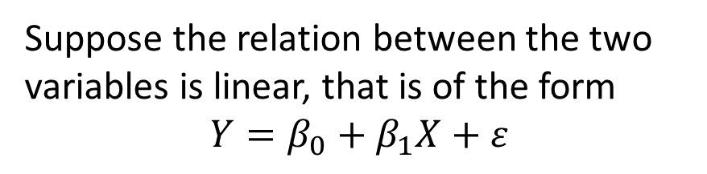
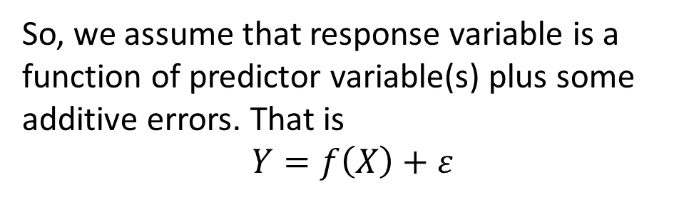
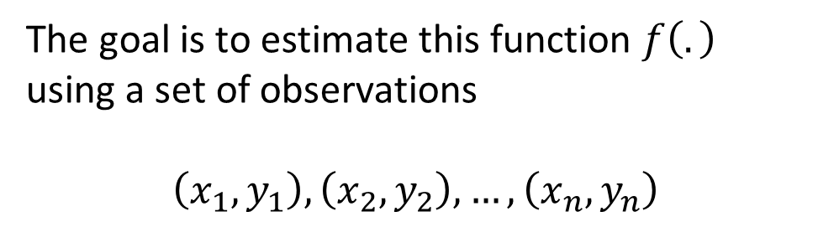



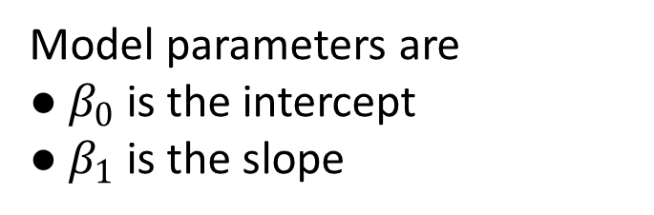
One Predictor Variable
Predictor variable
$$X$$
We are interested in finding out how changes in the predictor variables affect the values of the response variable.
$$Y=f\left(X\right)+ε$$
Response variable
$$Y$$
So, we assume that response variable is a function of predictor variable(s) plus some additive errors. That is
$$Y=f\left(X\right)+ε$$
Suppose the relation between the two variables is linear, that is of the form
$$Y=β_{0}+β_{1}X+ε$$
The goal is to estimate this function $f\left(.\right)$ using a set of observations
$$\left(x_{1},y_{1}\right),\left(x_{2},y_{2}\right),…,\left(x_{n},y_{n}\right)$$
Model parameters are
● $β_{0}$ is the intercept
● $β_{1}$ is the slope
Notes:
In general, we are interested in figuring out how changes in the predictor variables affect the values of the response variable. So, we assume that response variable is a function of predictor variable(s) plus some additive errors. The goal is to estimate this function $f\left(.\right)$ using a set of observations.
We first focus on a model which is called linear regression model that assumes the relation between the two variables is linear, that is of the form $Y=β_{0}+β_{1}X+ε$. This is the equation of a line where $β_{0}$ is the intercept, that is the value of y when x equals zero. $β_{1}$ is the slope, that is the amount of change in Y given the change in X. Epsilon is the random error which is assumed to be additive.

Slide 30
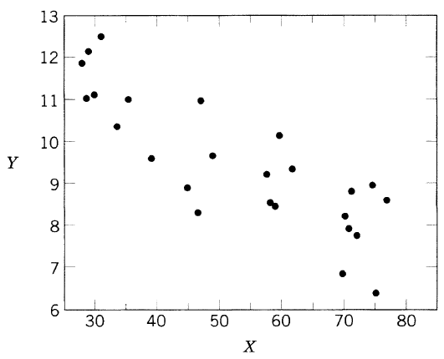



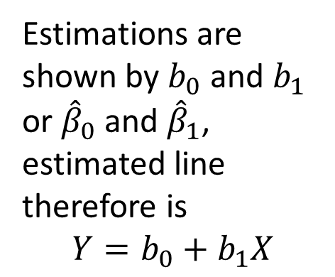


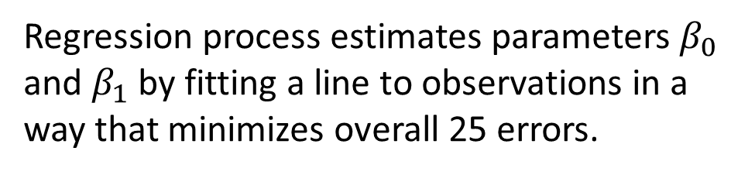

Parameter Estimation
Observation | X | Y
1 | 35.3 | 10.98
. . . | . . . | …
25 | 28.6 | 11.08
Consider 25 observations of variable Y (pressure) and X (average temperature).
Regression process estimates parameters $β_{0}$ and $β_{1}$ by fitting a line to observations in a way that minimizes overall 25 errors.
(35.3, 10.98)
10.98
$$Y_{i}=β_{0}+β_{1}X_{i}+ε_{i}$$
Estimations are shown by $b_{0}$ and $b_{1}$ or ${\hat{β}}_{0}$ and ${\hat{β}}_{1}$, estimated line therefore is
$$Y=b_{0}+b_{1}X$$
$$e_{3}$$
$$e_{4}$$
$$e_{6}$$
$$e_{5}$$
35.3
$$Y=b_{0}+b_{1}X$$
Notes:
For example, consider this dataset with 25 observations of variable Y which is pressure, and variable X which is average temperature. Data is available on D2L.
The first step in regression modeling is to graph a scatterplot of the variables. It is a simple plot where pairs of (x, y) are plotted on the xy-plane. The response variable is always set on the y-axis and the predictor on the x-axis. You can see for example, that red dot represent the first observation, graphed at x equals 35.3 and y equals 10.98.
Looking at the scatterplot, we study the overall pattern of the plotted points. If there is a pattern, we should note its direction and strength. In this plot, the relationship between the two variable seems to be linear. As x increases, y decreases linearly. There is no outlier since all the points are within a fair distance from each other.
Regression process estimates parameters $β_{0}$ and $β_{1}$ by fitting a line to observations in a way that minimizes overall 25 errors. You’ll learn this process in details in your regression and machine learning courses.

Slide 31
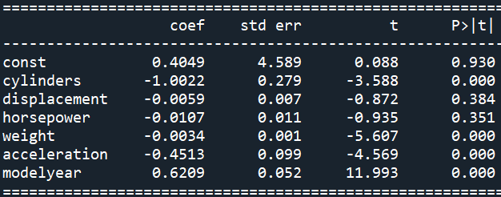
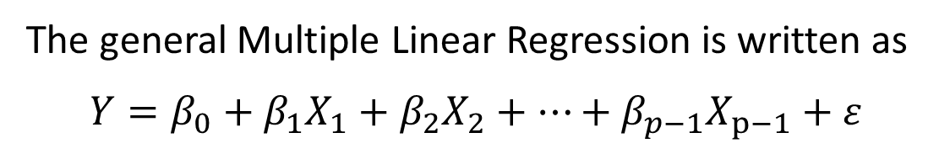
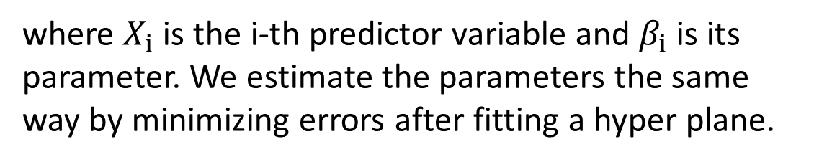
More than one Predictor Variables
Notes:
● If p-value is less than 0.05 then that variable contributes significantly to response
● Rank variables based on the absolute value of t
● The model goodness is decided using GOF measures
● Drop the insignificant variable(s) and rerun the model
● We usually always keep intercept in the model
● Predict response using new sets of contributing regressor values within their investigated range
The general Multiple Linear Regression is written as
$$Y=β_{0}+β_{1}X_{1}+β_{2}X_{2}+…+β_{p−1}X_{p−1}+ε$$
where $X_{i}$ is the i-th predictor variable and $β_{i}$ is its parameter. We estimate the parameters the same way by minimizing errors after fitting a hyper plane.
Notes:
Constant is the Intercept term, coef is the estimated parameters, std err is the standard error of the estimated parameters, t is the standardized estimations that coef/std_err, P>|t| is the p-value which shows significance of variables in predicting the response variable.

Slide 32
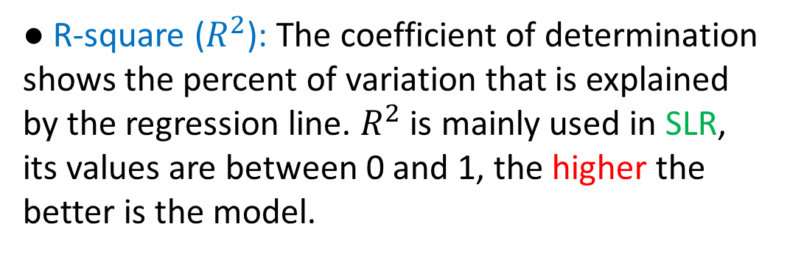
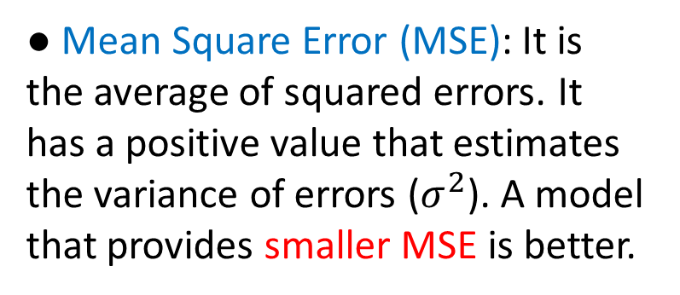
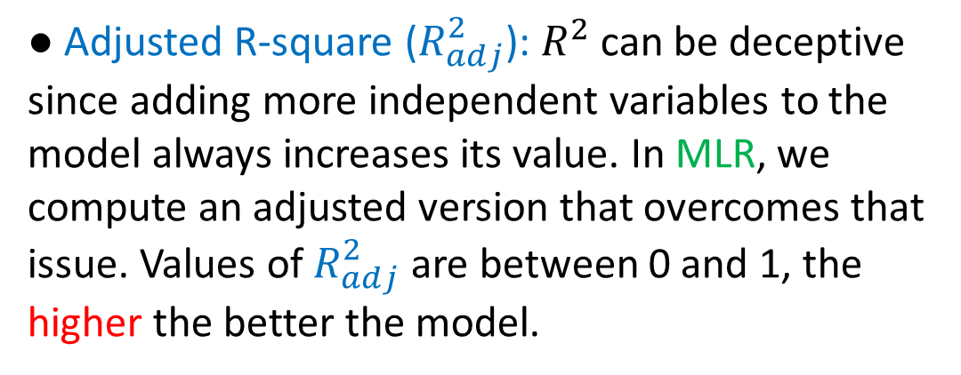
Goodness of Fit Measures
● Mean Square Error (MSE): It is the average of squared errors. It has a positive value that estimates the variance of errors ($σ^{2}$). A model that provides smaller MSE is better.
● R-square ($R^{2}$): The coefficient of determination shows the percent of variation that is explained by the regression line. $R^{2}$is mainly used in SLR, its values are between 0 and 1, the higher the better is the model.
● Akaike Information Criterion (AIC): A model with smaller AIC value is preferred.
● Adjusted R-square ($R_{adj}^{2}$): $R^{2}$can be deceptive since adding more independent variables to the model always increases its value. In MLR, we compute an adjusted version that overcomes that issue. Values of $R_{adj}^{2}$ are between 0 and 1, the higher the better the model.
● Bayesian information criterion (BIC): A model with smaller BIC is preferred. BIC tends to favor more parsimonious model.
Notes:
You’ll learn more GOF measures in your advanced courses.

Slide 33
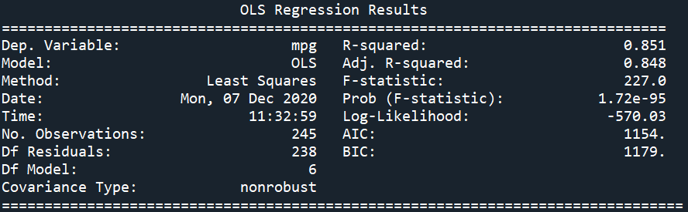
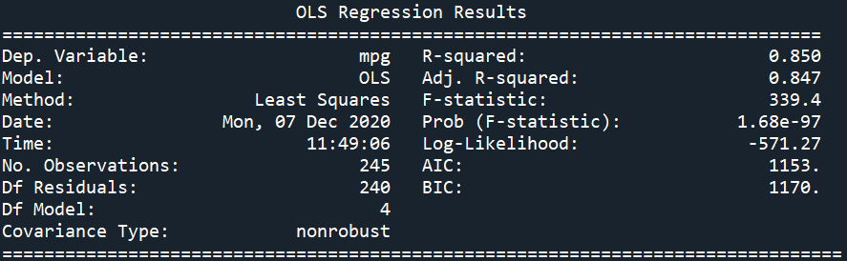
● The first model had 6 predictors and had these GOF measures.
● The second model had 4 predictors and had these GOF measures.
● Comparisons show that the second model is better than the first.
● The final estimated model is
$$mpg=−2.06−1.15∗cyl−0.0041∗weight−0.35∗acc+0.64∗modelyear$$
Notes:
Adjusted R-square is actually a bit higher in the first model with 6 variable, that difference is very tiny considering reduction of two predictors in the second model, so the gain in less complexity does worth it
There is MUCH MORE to regression models that we do not discuss here, details will be discussed in your future advanced courses.

Slide 34
Activity Part 3
1. SLR. Working with “credit” dataset.
a. Do proper univariate exploratory analysis for variables “Income” and “Limit”. Make statements on your observations.
b. Graph a scatterplot and comment on the chart.
c. Perform a simple linear regression and write down your final estimated model.
Notes:
## Changing working directory
#cd C:\\Users\\abolf\\.spyder-py3\\mlcourse
## Loading required packages
import pandas as pd
import matplotlib.pyplot as plt # to visualize
import seaborn as sb # to visualize
#from pandas.plotting import scatter_matrix
## Loading data
########################################
df = pd.read_csv('credit.csv', sep=',')
df.info() # var info
df.isnull().sum() # missing values
## Fitting a MLR
########################################
import statsmodels.api as sm
#from statsmodels.formula.api import ols
# Seperating Predictors and Response
X = df[['Income','Rating','Cards','Age','Education','Balance']]
Y = df[['Limit']]
X = sm.add_constant(X) # Adding intercept
lsfit = sm.OLS(Y,X).fit() # Fitting regression model
lsfit.summary() # GoF measures and summary
lsfit.mse_resid # MSE
# Seperating Predictors and Response
X = df[['Rating','Cards']]
Y = df[['Limit']]
X = sm.add_constant(X) # Adding intercept
lsfit = sm.OLS(Y,X).fit() # Fitting regression model
lsfit.summary() # GoF measures and summary
# Model prediction for new inputs withing its input range
X.describe() # short summary statistics
x = pd.DataFrame([[1, 784, 3]])
prediction = lsfit.get_prediction(x)
prediction.summary_frame()
prediction.table

Slide 35
Activity Part 3
2. SLR. Blood dataset* has 1000 observation on the following variables. Subject (case number), Sex (gender, (Male/Female)), Btype (blood type (A/B/AB/O)), Group (age group (Young/Old)), WBC (white blood cell count), RBC (red blood cell measure), Chol (cholesterol measure).
* Learning SAS(R) by Example: A Programmer's Guide, Ron Cody, SAS Institute Inc., 2007.
a. Import “blood” dataset into your session. Name it as “blood”.
b. Generate a detailed summary statistic for “Chol” and “RBS”. Describe the results.
c. Generate scatterplot of “Chol” vs “RBS”. What does the plot show?
d. Generate correlation coefficient between “Chol” vs “RBS”. Does this confirm what you expected?
e. Perform a linear regression for Chol on RBC. Interpret the results.

Slide 36
Activity Part 3
3. MLR. Steam dataset contains 25 data points on response variable Y (pressure, lb) and independent variables X2 (Real Fatty Acid in storage (lb)), X3 (Crude Glycerin made (lb)), X4 (Average Wind Velocity), X8 (Average outside temperature (F)) X8 (average outside temperature, F).
a. Import “steam” dataset into your session.
b. Generate a summary statistic for variables Y, X2, X3, X4, X8 ONLY. Comment on the result.
c. Generate a matrix scatterplot for the given variables ONLY and explore associations. Comment.
d. Generate correlation coefficient between the given variables. Comment.
e. Perform MLR and check what variables contribute significantly to the response variable, rank the predictors based on their contribution in explaining the response.
f. Decide on your final model, write down the estimated regression line, comment on the model fit.
g. Predict the response for an input of x2=5, x3=0.62, x4=6.1, x8=58. Generate both confidence and Prediction interval and compare the results.

