Slide 1

Unsupervised Learning
Introduction
Dr. Abolfazl Saghafi
Assistant Professor of Statistics & Data Science
Notes:
So far we learned about supervised learning, specifically regression. This week we continue with unsupervised learning and learn about two important classes of unsupervised learning algorithms

Slide 2
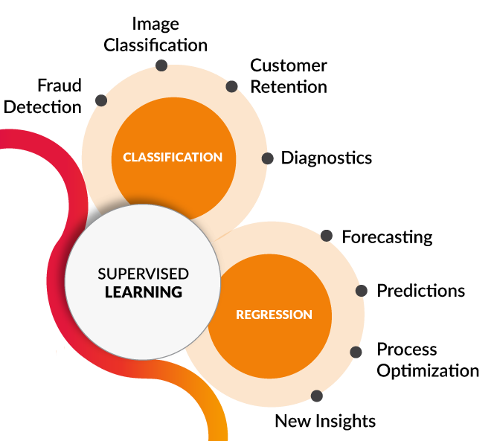




Supervised Learning
Learn a Pattern to map inputs to outputs
[1] towardsdatascience.com/coding-deep-learning-for-beginners-types-of-machine-learning-b9e651e1ed9d
m example (inputs, outputs)
$$⇒$$
$${\left\{\left(x_{i},y_{i}\right)\right\}}_{i=1}^{m}$$
Predict outputs for any given inputs
$$⇒$$
Notes:
A recap, in supervised learning, we trained the computer with pairs of (inputs, outputs), and once the computer learned a pattern between inputs to outputs, we use that to predict outputs for new inputs.

Slide 3
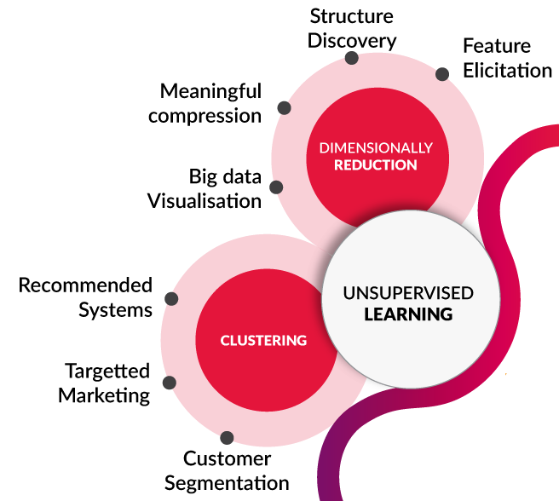

Unsupervised Learning
Learn a Pattern between inputs
Everything is (inputs)
$$⇒$$
$${\left\{\left(x_{1},x_{2},…,x_{n}\right)\right\}}_{i=1}^{N}$$
Label inputs based on the learned pattern
$$⇒$$
Notes:
In unsupervised learning, we don’t have outputs, everything is inputs. The goal here is to discover interesting structures and pattern in the data, then use this structure to make decisions.

Slide 4
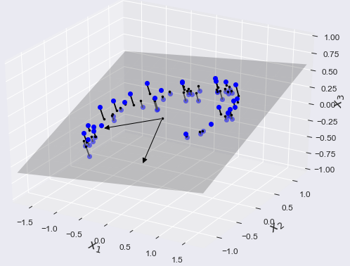
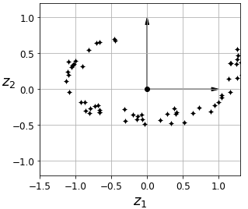
Dimension Reduction
Reducing the number of variables by mixing them together or projecting the whole data into a subspace is the goal of dimension reduction.
Mapping 3D data to a 2D space
Notes:
An important class of unsupervised learning algorithms is Dimension Reduction where aim is to reduce the number of variables by mixing them together in a linear or non-linear fashion. This process always has some information loss, but in many cases, the loss worth the reduction in problem complexity.

Slide 5
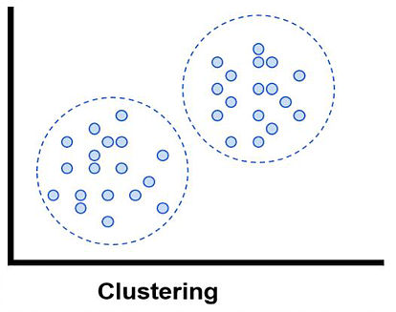
Clustering
Clustering is one of the most important unsupervised learning algorithms where the goal is to group data based on some similarity or closeness measure.
Clustering can also be used to create labels for supervised learning [2].
Notes:
It’s important to remind that we only have a number of so-called independent variables here, and there is no response variable in clustering.
However, we can use clustering to create labels and a response variable. In here for example, we can assign a label 1 and 2 to observations in different clusters, then investigate what this label means n terms of our variables. Maybe, it provides some useful information hidden in the data.

Slide 6
Datasest
We will now proceed to discuss dimension reduction and clustering using the “credit_cluster” dataset. Variables in this dataset include:
Variable Description Variable
CUST_ID An ID variable PUR_INST_FREQ
BAL Balance CASH_ADV_FREQ
BAL_FREQ Balance Frequency CASH_ADV_TRX
PUR Purchases PUR_TRX
ONEOFF_PUR Purchases made only once CREDIT_LIMIT
INST_PUR Installments Purchases PAYMENTS
CASH_ADV Cash Advance MIN_PAYMENTS
PUR_FREQ Purchases Frequency PRC_FULL_PAYMENT
ONEOFF_PUR_FREQ TENURE
Notes:
This is a real dataset.
Aside from CUST_ID that is just an ID variable, there are 17 numerical variables in this dataset. After reading the data, we remove 314 cases with missing values on MINIMUM_PAYMENTS, the total number of cases is 8,636

Slide 7
Exploratory Analysis
Dr. Abolfazl Saghafi
Assistant Professor of Statistics & Data Science
Notes:
Exploratory analysis is an essential step in any type of analysis. Here we discuss ways to explore this dataset. You are already familiar with some the techniques from last week. Python codes to follow up the tasks are provided on D2L

Slide 8
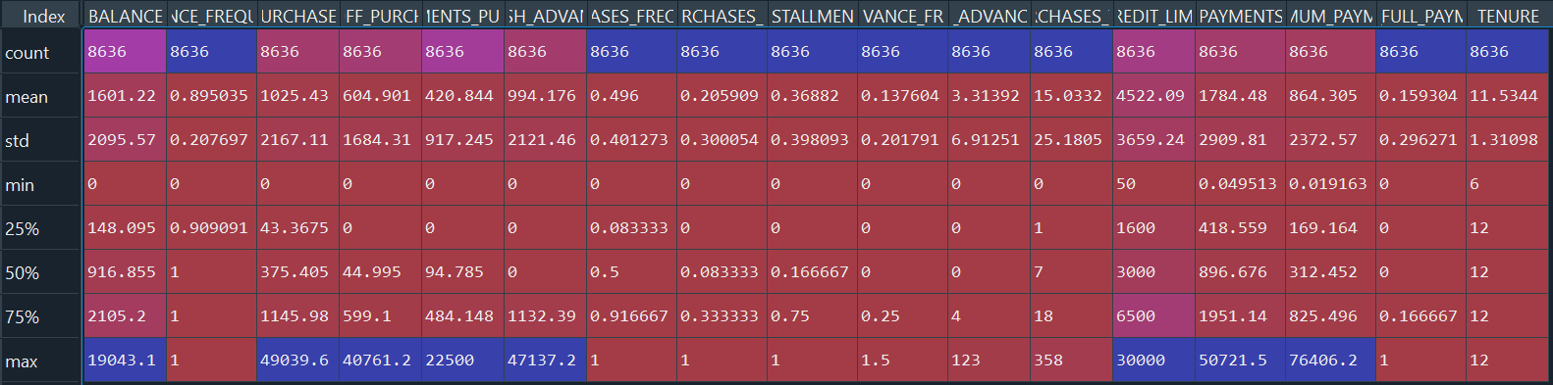
Numerical Summary
All our variables are numerical.
We start by generating univariate numerical summaries.
Notes:
All our variables are numerical. We start by generating univariate numerical summaries. We discussed numerical summaries to explore data last week, we see how you can get these numbers easily.
Obviously variable have different location and spread, and this variation is huge.

Slide 9


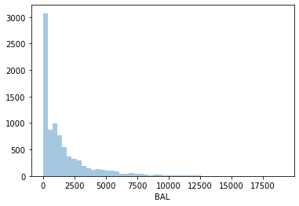
Plots
For each variable separately generate boxplots and investigate. Try to describe each in three sentences.
Reminder:
Important points are
• Location
• Spread
• Shape
• Outliers
Notes:
The distribution of balance is skewed to right, median is about 1000 dollars, there are many outliers. We do not remove outliers at this point since they could unlock useful patterns in the data. We can see that a good number of people, had a small balance, something less than 150 dollars.

Slide 10
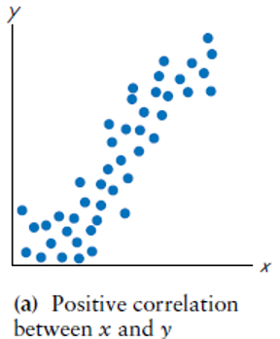
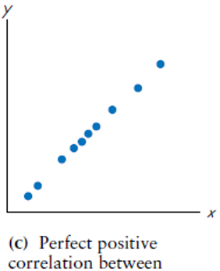
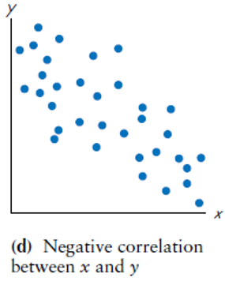
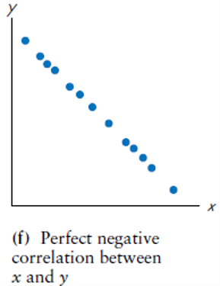
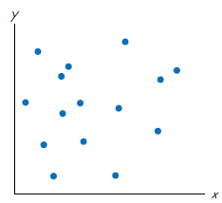
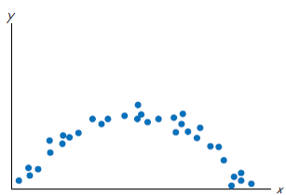
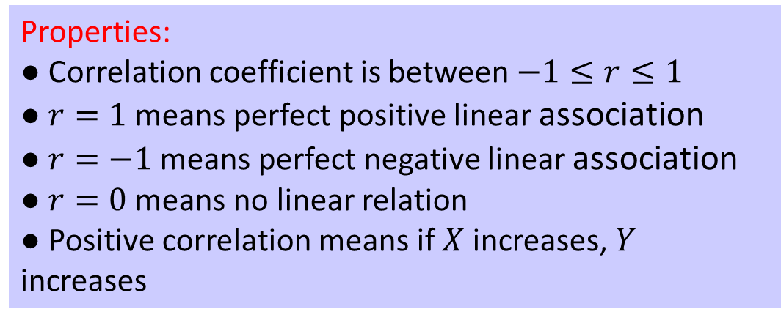
Correlation Coefficient
Correlation coefficient, r, is the most common statistic that measures the direction and strength of linear association between two variables.
Properties:
● Correlation coefficient is between $−1≤r≤1$
● $r=1$ means perfect positive linear association
● $r=−1$ means perfect negative linear association
● $r=0$ means no linear relation
● Positive correlation means if $X$ increases, $Y$ increases
(h) Non-linear association
(g) No correlation
Notes:
Because visual examinations of scatterplots are subjective, we need more objective measures to check if two variables are associated. Correlation coefficient, r, is the most common statistic that measures the direction and strength of linear association. Important points about r is that …
These graphs show what we mean by positive and negative correlation and illustrate what a strong association means.
Graph a, shows a moderate positive correlation between two random variables X and Y. Graph c, represents a perfect positive correlation. Perfect means, we can compute value of one variable exactly if had the value of the other using a linear function. These correlations are positive because by increasing X, Y increases.
Graph g, illustrates a case of no correlation and graph h, shows a non-linear association between X and Y. In that case, r could be zero or any other number. In this example it is equal to zero.

Slide 11
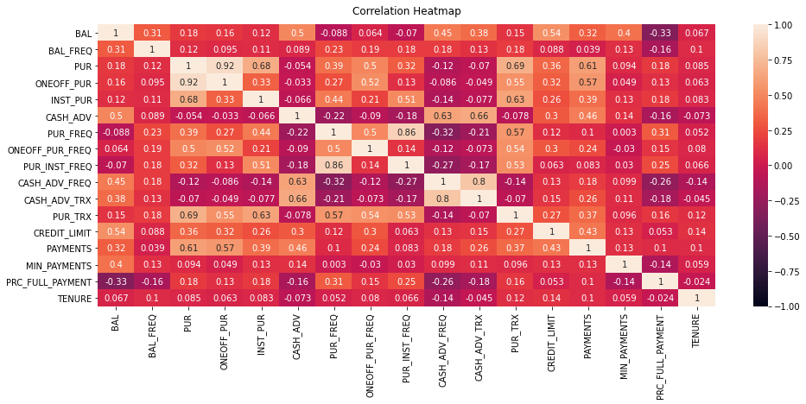
Notes:
Knowing about correlation coefficient, a plot known as heatmap as shown here, illustrates correlation coefficient between each pair of variables.
Each variable is perfectly correlated by itself, so you see 1s on the main diagonal, and this plot is symmetric since if you switch the x/y axis, it does not change the quality of their relationship.
Looking at the numbers here, we investigate the overall relationship between variables, to see if we can find interesting relationships. You can get the same feeling by looking at a matrix scatterplot. But as I said, numbers is easier.
Balance for example has a moderate correlation with credit limit, which makes sense. We report which correlations are the highest which represents strong positive correlation, purchases has a strong correlation with One Off Purchases, its value is 0.92. Which ones are the lowest which shows string negative correlation. And which ones are closer to zero.

Slide 12
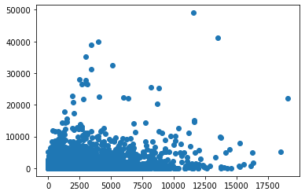
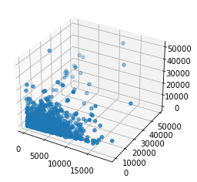
2D & 3D & Matrix Scatterplots
For each variable separately generate boxplots and investigate.
Try to describe each in two sentences.
Notes:
It is customary to generate scatterplot of pair of variables to see if there exist any pattern unlocking any relationships between two pairs. Here we have 17 variables and investigating such plot is not easy.
Considering three variables scatterplots is even more useful. At the end of the day, we are interested to find pattern between all variables at once, but with 17 variables, we cannot fathom a scatterplot with 17 dimensions. There is however a work around for this problem, dimension reduction, that will discuss in the next session.

Slide 13
Activity Part 1
1. USArrests.csv dataset shows arrests per 100,000 residents for assault, murder, and rape in each of the 50 US states in 1973. It also includes the percent of the population living in urban areas.
a) Load this dataset into your session and remove cases with missing values.
b) Generate numerical summary for available variables and describe the results.
c) Generate box plot and histogram for two variables of your choosing.
d) Generate a heatmap with correlation coefficients of all the numerical variables. Describe the results.
e) Generate matrix scatterplot and describe the plot.
Notes:
It’s your turn now, practice what you’ve learned today after going over the Python session. You can simply modify the codes to perform the requested tasks.

Slide 14
Activity Part 1
2. Carmpg.csv dataset has 9 variables, 7 of which are numerical, that show characteristics of various cars such as mpg, horsepower, etc.
a) Load this dataset into your session and remove cases with missing values.
b) Generate numerical summary for available numerical variables and describe the results.
c) Generate box plot and histogram for two variables of your choosing.
d) Generate a heatmap with correlation coefficients of all the numerical variables. Describe the results.
e) Generate matrix scatterplot and describe the plot.

Slide 15
Dimension Reduction
Dr. Abolfazl Saghafi
Assistant Professor of Statistics & Data Science
Notes:
In this session, we discuss dimension reduction using Principal Component Analysis. This technique is based on eigen value decomposition which you have or will learn in your linear algebra course. Who knew linear algebra could do such a thing! Anyways, we skip the math behind the method and focus on utilizing it.

Slide 16
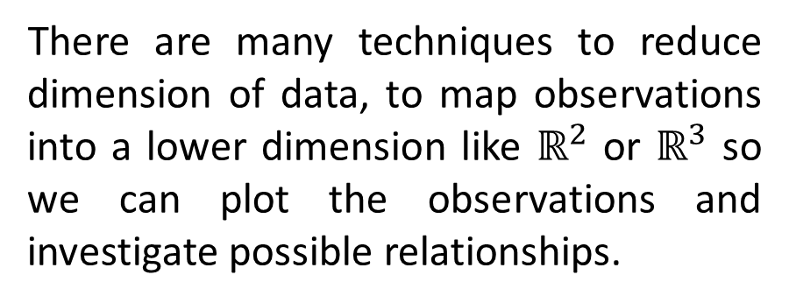
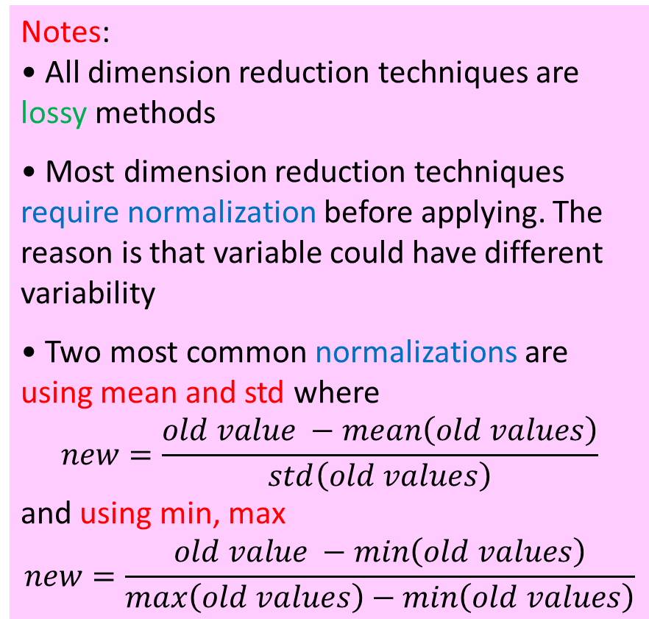
Dimension Reduction
Notes:
• All dimension reduction techniques are lossy methods
• Most dimension reduction techniques require normalization before applying. The reason is that variable could have different variability
• Two most common normalizations are using mean and std where
$$new=\frac{old value −mean\left(old values\right)}{std\left(old values\right)}$$
and using min, max
$$new=\frac{old value −min\left(old values\right)}{max\left(old values\right)−min\left(old values\right)}$$
The credit dataset has 17 numerical variables. Illustrations for data with many variables is difficult, yet visual inspection of graphs is our main tool to detect patterns and relations among variables.
There are many techniques to reduce dimension of data, to map observations into a lower dimension like $ℝ^{2}$ or $ℝ^{3}$ so we can plot the observations and investigate possible relationships.
Notes:
Both of these transformations are linear, each has some benefits. We investigate different results they produce in our lab session.

Slide 17




Principal Component Analysis
Steps:
• Normalization
• Computing Covariance Matrix of variables
• Computing Eigenvalues and Eigenvectors of the Covariance Matrix
• Bar plot of the percentage of information that new variables explain
• Deciding on the number of new variables (PCs) to use and mapping our data into our new variables
In Principal Component Analysis (PCA), new variables (PCs or Eigenvectors) are constructed as linear uncorrelated mixtures of the initial variables.
$$x_{2}$$
$${PC}_{1}$$
$${PC}_{2}$$
$$x_{1}$$
Notes:
• The aim normalization is to normalize the range of the continuous initial variables so that each one of them contributes equally to the analysis.
• Think of covariance matrix as a bivariate numerical summary that provides information on linear relationship between every two variables. You learn about covariance in your probability course.
• Eigenvectors and eigenvalues are the linear algebra concepts that you will learn in other courses. We skip the math to do that here. You can compute these with a few lines of codes. The eigenvectors that are constructed are linear combinations or mixtures of the initial variables.
As an example, look at this scatterplot of two variables $x_{1}$ and $x_{2}$, see their range of values. We could map these observations into new vectors shown by PC1 and PC2 which reduces their variability. Plus you can see that most of the variability is along PC1, so if you want to, we can map observations into PC1 and only keep this one variable. Of course we would lose some information.

Slide 18
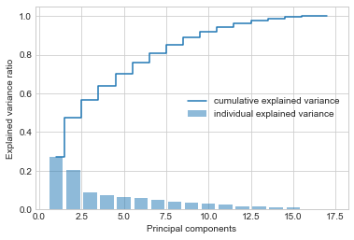
PCA
In the credit_cluster dataset, after plotting the percentage of information that new PCs explain, we can see that 7 new variables are able to explain 82% variance of data.
So, we will use first 7 PCs and reduce dimension of variables from 17 to 7.
Notes:
Heads Up: PCA can only be applied to numeric data.

Slide 19
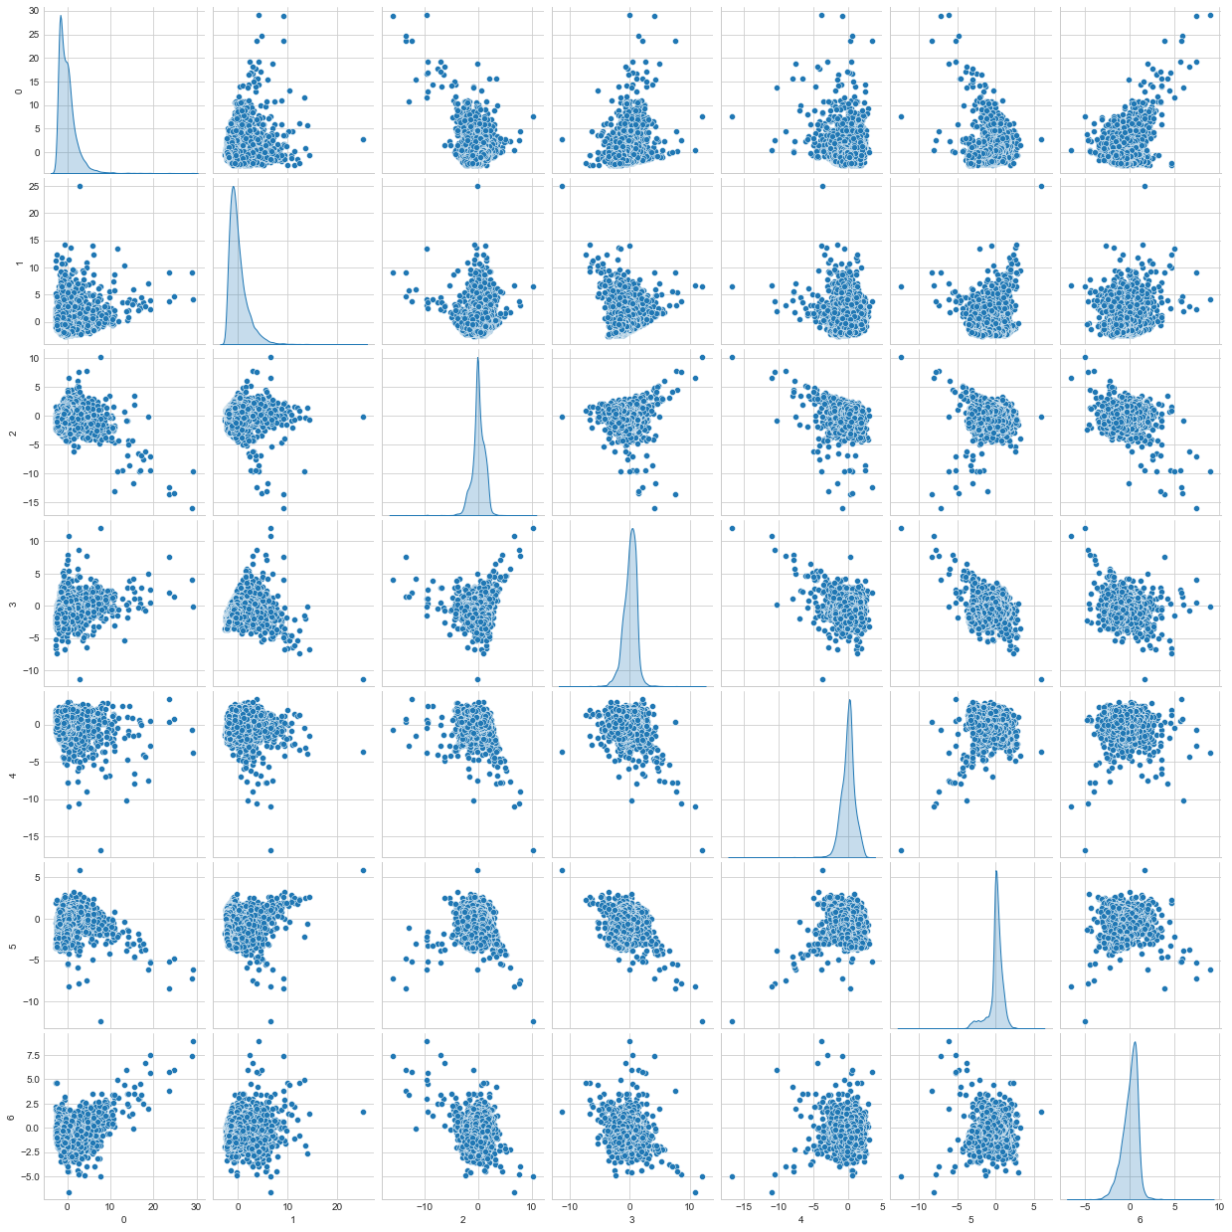
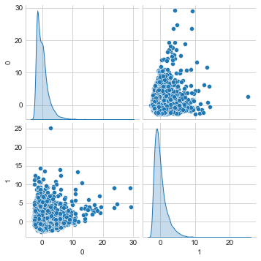
Dimensionally Reduced Data
Notes:
These are the scatterplots of data after reducing dimension to 7 (plot on the right) and 2 (plot on the left). I’m sure you all agree that focusing on 7 variables is less time consuming and easier than 17. We lost some information but the simplicity that we achieved worth the cost.

Slide 20
Activity Part 2
1. USArrests.csv dataset shows arrests per 100,000 residents for assault, murder, and rape in each of the 50 US states in 1973. It also includes the percent of the population living in urban areas.
a) Remove variable State, then standardize the remaining four variables using normalization methods.
b) Perform PCA and explain how many PCs are required to maintain 90% of variability in the dataset.
c) Project the observations into 2D space and generate a scatterplot. Label the observations in the scatterplot with the “State” names.
d) Describe the results in at least five sentences.

Slide 21
Activity Part 2
2. Carmpg.csv dataset has 9 variables, 7 of which are numerical, that show characteristics of various cars such as mpg, horsepower, etc.
a) Remove variables “origin” and “name”, then standardize the remaining variables using normalization methods.
b) Perform PCA and explain how many PCs are required to maintain 90% of variability in the dataset.
c) Project the observations into 2D space and generate a scatterplot. Label the observations in the scatterplot with the “origin” countries.
d) Describe the results in at least five sentences.

Slide 22
K-Means Clustering
Dr. Abolfazl Saghafi
Assistant Professor of Statistics & Data Science
Notes:
We will discuss clustering in this session using a method called K-means.

Slide 23
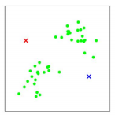
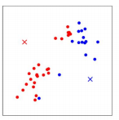
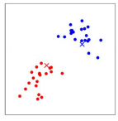
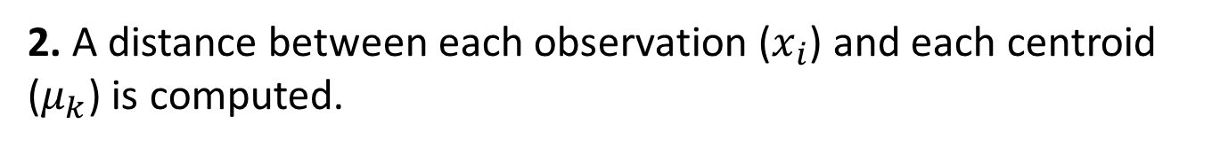
K-Means Process
The general K-means clustering process is as follows
1. Select a number of clusters to use and randomly initialize that number of centroids.
2. A distance between each observation ($x_{i}$) and each centroid ($μ_{k}$) is computed.
3. Each observation is assigned to their closest centroid, based on the defined distance between the observation and the centroid.
4. Update the centers to the average values of observations in each group.
5. Steps 2 to 4 are repeated for a pre-specified number of iterations or until the cluster centers don’t change much between iterations.
Notes:
1. We can have some prior information about suitable number of clusters or there are methods to find an optimal number of clusters. In this example, two clusters is a good choice that makes sense since observations are literally grouped into two groups. The initial centroids are shown by cross in the plots, in two different colors.
2. There are different ways to compute distance between two observations, the easiest way is the Euclidean distance, that is ${\left(x_{i}−μ_{k}\right)}^{2}$.

Slide 24

K-Means Visual Example
$$\left(x_{1},x_{2} \right)$$
This example shows how computer uses some given instructions to cluster inputs into three clusters.
Figuring out such clustering tasks in this 2D space is easy to us. When we increase the problem space, that is the number of variables, computers find the clusters way faster than we can do. It just takes a few lines of codes.

Slide 25
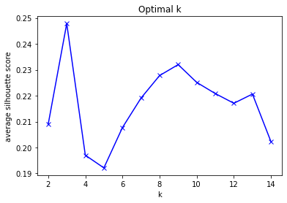
Optimal Number of Clusters
Notes:
● Normalization should be used before clustering
● Average silhouette is usually used to determine optimum number of clusters
Ideally, you have some prior knowledge on the number of clusters. If not, use the number that maximizes Average Silhouette.
Average Silhouette can be computed and plotted using one line of codes.
This plot shows average Silhouette (y-axis) for different number of clusters (x-axis) in our credit_cluster dataset.
Notes:
Based on the plot, we have maximum average Silhouette on 3 clusters. The next best option is 9 which is a lot, so we’re going to go with three.

Slide 26
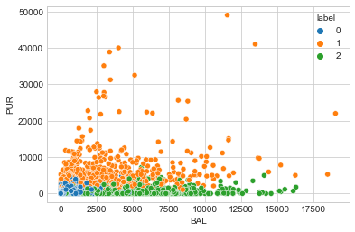
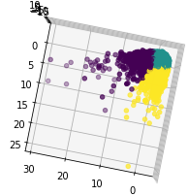
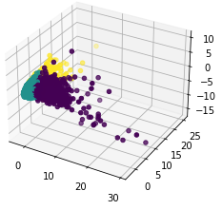
Clustering Results
This scatterplot shows the three clusters on a scatterplot of two variables, BAL & PUR, that represent Balance and Purchases.
We can also show the clustering results on dimensionally reduced space:
Notes:
In the first plot, cluster labels make sense. We have some customers with low Balance and Low Purchases, some with medium to high Balance, and many with medium to high Purchases.
We can also show the clustering results on dimensionally reduced space, so we don’t have to pick variables two by two and see how the results are. Just one 2D or 3D scatterplot and we have a good visual of the outcome. The three axes in this plot are the first three PCs.

Slide 27
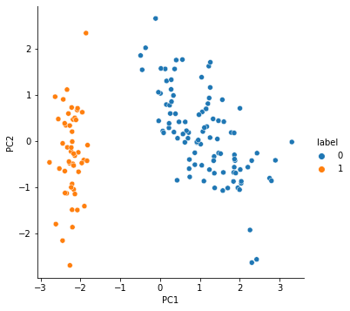
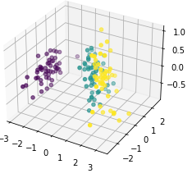
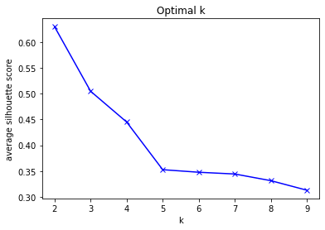
Example: Iris data
2 is the optimum number of clusters. 3 and 4 are 2nd and 3rd optimum numbers.
Results show clearly distinct groups which seems to be 2.
There are however 3 types of iris in the dataset, one is very close to another category in dimensionally reduced space.
Notes:
Iris data is used to navigate the whole process one more time. This dataset has 4 numerical and 1 categorical variable.
Follow the lab session to see the details.

Slide 28
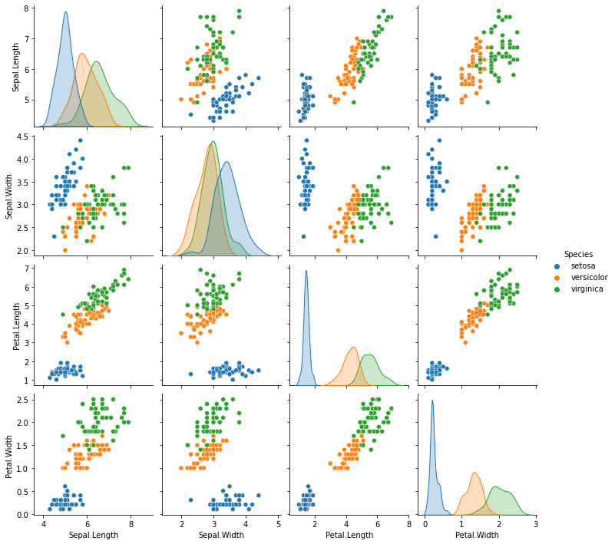
Iris data
The original data more clearly shows how variable measurements are for the three types of iris.
This also example also demonstrated how crucial it is to perform basic exploratory analysis.

Slide 29
Activity Part 3
1. USArrests.csv dataset shows arrests per 100,000 residents for assault, murder, and rape in each of the 50 US states in 1973. It also includes the percent of the population living in urban areas.
a) Remove variable State and use the remaining four variables to identify the optimum number of clusters
b) Perform Clustering with the found optimum number of clusters and generate labels for observations
c) Generate scatterplot of two variables of your choosing color coded using predicted labels
d) Perform PCA and visualize results in 2D, color coded using predicted labels
e) Interpret the plot.

Slide 30
Activity Part 3
2. Carmpg.csv dataset has 9 variables, 7 of which are numerical that show characteristics of various cars such as mpg, horsepower, etc.
a) Remove variables “origin” and “name”, then use the remaining variables to identify optimum number of clusters.
b) Perform Clustering with found optimum number of clusters and generate labels for observations.
c) Generate scatterplot of two variables of your choosing color coded using predicted labels.
d) Perform PCA and visualize results in 2D, color coded using predicted labels
e) Interpret the plot.

