Slide 1

Classification
Introduction
Dr. Abolfazl Saghafi
Assistant Professor of Statistics & Data Science
Notes:
In this session, we discuss classification, the second big category of unsupervised learning algorithms. Also, introduce Artificial Neural Networks.

Slide 2
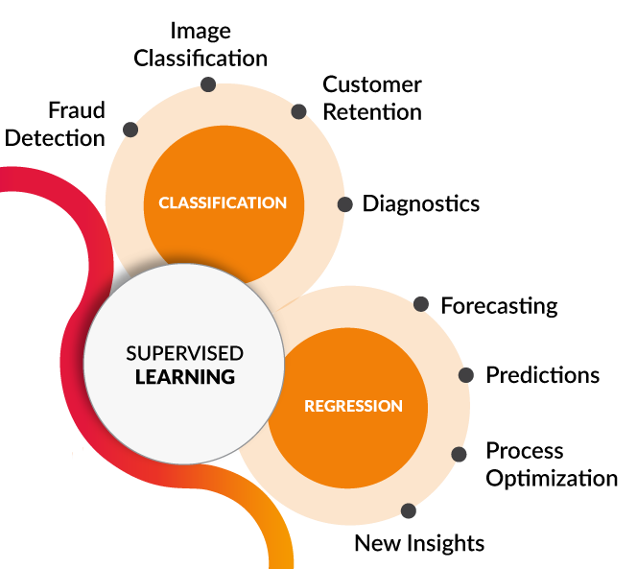




Supervised Learning
Learn a Pattern to map inputs to outputs
[1] towardsdatascience.com/coding-deep-learning-for-beginners-types-of-machine-learning-b9e651e1ed9d
m example (inputs, outputs)
$$⇒$$
$${\left\{\left(x_{i},y_{i}\right)\right\}}_{i=1}^{m}$$
Predict outputs for any given inputs
$$⇒$$
Notes:
A recap, in supervised learning, we trained the computer with pairs of (inputs, outputs), and once the computer learned a pattern between inputs to outputs, we use that to predict outputs for new inputs.

Slide 3
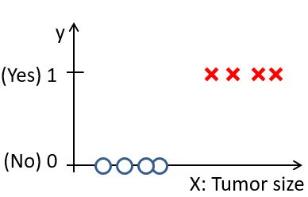
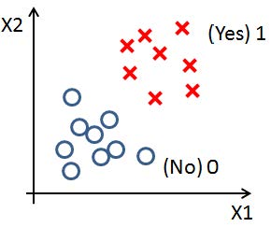
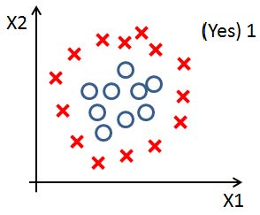
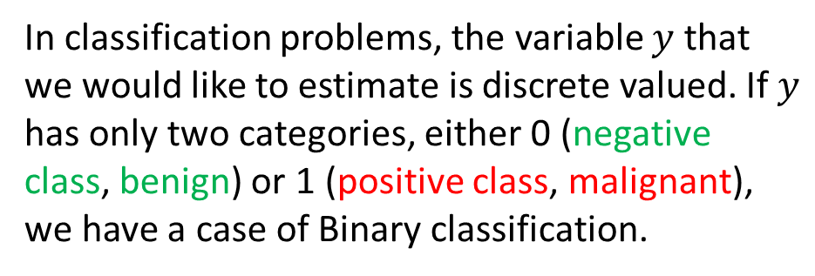



Classification (Binary)
● Some examples include deciding whether an email is spam/not-spam, whether an online transaction is fraudulent/not-fraudulent, or whether a tumor is malignant/benign.
● The classification goal is to find a decision boundary which separates the data into class categories using a set of examples.
In classification problems, the variable $y$ that we would like to estimate is discrete valued. If $y$ has only two categories, either 0 (negative class, benign) or 1 (positive class, malignant), we have a case of Binary classification.
$$\left(x_{i},y_{i}\right)$$
$$\left(x_{1},x_{2},y_{i}\right)$$
$$\left(x_{1},x_{2},x_{1}x_{2},y_{i}\right)$$
Notes:
In classification problems, in general, the response variable that we would like to estimate ($y$) is discrete valued. Starting with only two categories for $y$, either 0 (negative class, e.g. benign) or 1 (positive class, e.g. malignant), we have a case of Binary classification.
● Some examples of Binary response include deciding whether an email is spam/not-spam, whether an online transaction is fraudulent/not-fraudulent, or whether a tumor is malignant/benign.
● The classification goal is to find a decision boundary that separates the data into class categories using a set of examples.

Slide 4
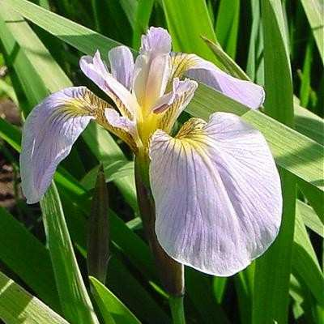
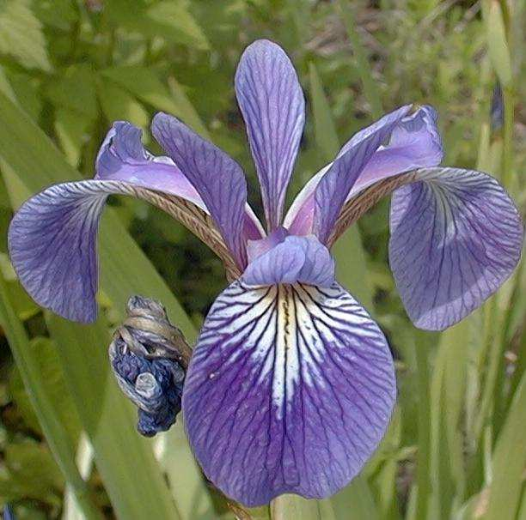
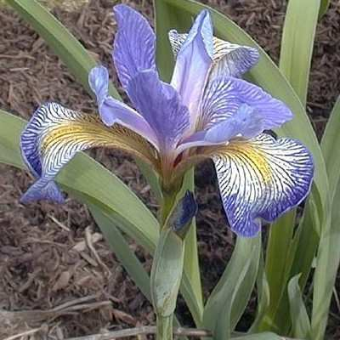
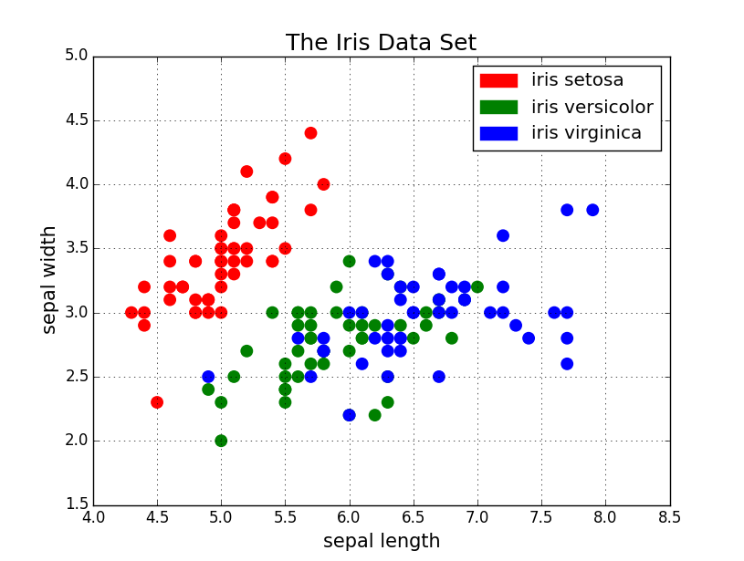
Classification (Multiclass)
In Multi-class classification, the output is categorical with more than two categories.
Versicolor
Setosa
Virginica
There are four numerical independent variables in this dataset.
This graph shows scatterplot of two of the variables color-coded for the response variable. Obviously, finding a decision boundary that perfectly separates the three iris types using these two variables is impossible.
Notes:
Iris data is a famous dataset, we have three types of Iris, and the goal is to find a decision boundary that recognizes the type of iris based on four input variables. Since the response variable has three categories, we have a multi-class classification problem.

Slide 5
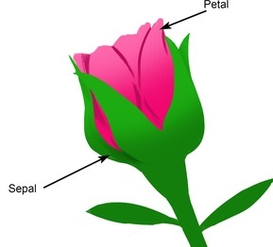
Datasest
We will now proceed to classification using the “iris” dataset. Variables in this dataset are:
Variable Description Unit
Sepal length Numerical cm
Sepal width Numerical cm
Pedal length Numerical cm
Pedal width Numerical cm
Species Categorical
(Setosa/ Versicolor/Virginica)
Notes:
This dataset has 150 cases, 50 from each types of iris, no missing values.

Slide 6
Exploratory Analysis
Dr. Abolfazl Saghafi
Assistant Professor of Statistics & Data Science
Notes:
Exploratory analysis is an essential step in any type of analysis. Here we discuss ways to explore this dataset. Python codes to follow up the tasks are provided on D2L

Slide 7
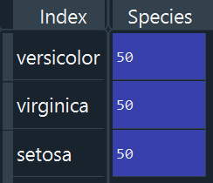
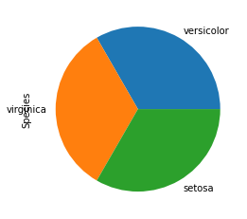
Qualitative Variable
The only qualitative variable in this dataset is iris type, that is also my response variable.
Exploratory analysis for qualitative variables include frequency tables and pie/bar charts.
The table and pie chart show that there are 50 cases in three types of iris in this dataset.
Notes:
Once you plot the charts and create the table, try to describe what they represent in a few sentences.

Slide 8
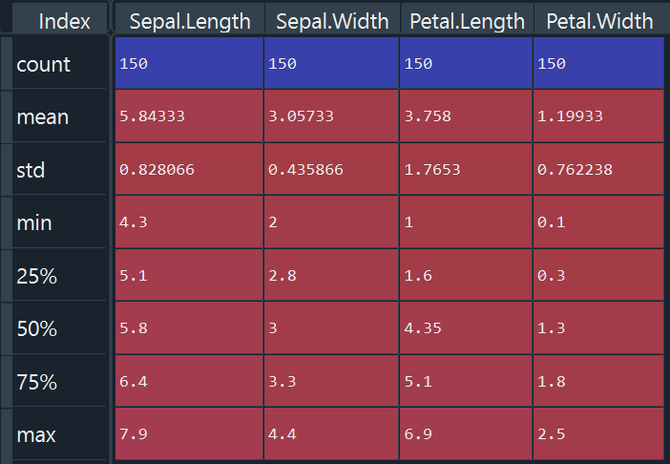


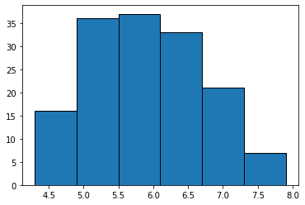
Quantitative Variable(s)
Exploratory analysis includes generating numerical summaries for each numerical variable. The first table shows such table for the four numerical variables.
Visualizations include histograms and box lots. As an example, histogram and box plot for Sepal Length is generated.
Describe the plots in terms of center, spread, and shape. Generate plots for other variables.

Slide 9
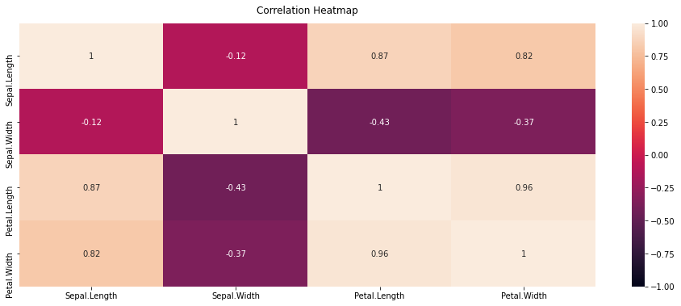
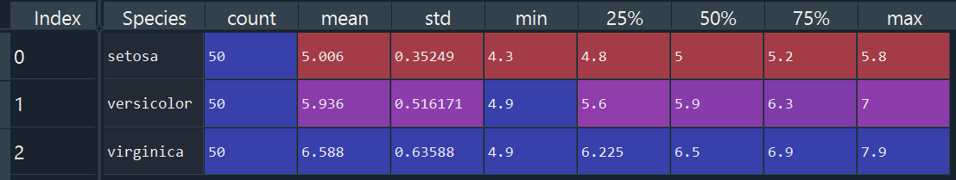
Bivariate Summaries
The first plot is mosaic plot showing correlation coefficient among numerical variables.
Summary statistics of numerical variables over values of the categorical variable is generated for variable “Sepal Length”
Best is to generate that for each variable and investigate.

Slide 10
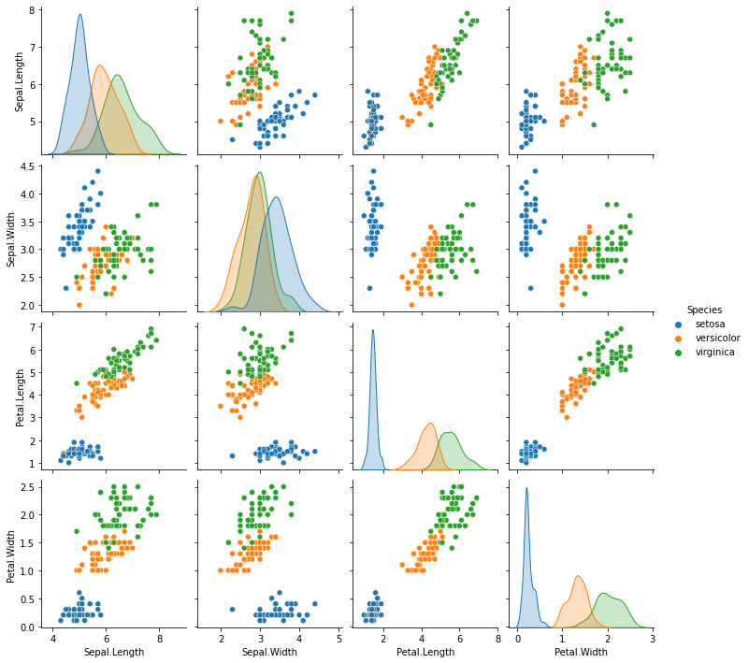
Scatterplot of numerical variables color-coded for values of the categorical variable is plotted here along with kernel density plot of each variable for levels of categorical variable.
Setosa iris is pretty detectable from virginica and versicolor in all scatterplots and more distinguishable in density plots of Petal values.
Values for virginica and versicolor are very close, finding separable boundary between these two is difficult.

Slide 11
Activity Part 1
1. Exam2 dataset provides information on grades of test1 and test2 of 118 students, some of whom were admitted (label=1) and some were not (label=0) into college.
a. Load data “exam2.csv” into your session and check whether there are any missing cases.
b. Perform proper univariate exploratory analysis for the three variables in this dataset and describe the results.
c. Perform proper bivariate/multivariate exploratory analysis for the three variables in this dataset and describe the results.
d. Graph a scatter plot of test1 vs test2, color coded for variable label. What type of decision boundary could perfectly separate the two labels?

Slide 12
Activity Part 1
2. Import “glass” dataset into your session that provides information on various components in two types (one/other) of glass.
a. Pick two of the independent variables and perform proper univariate exploratory analysis for the two variables and response variable (type) in this dataset, describe the results.
b. Perform proper bivariate/multivariate exploratory analysis for the two selected variables and response variable (type) in this dataset and describe the results.
c. Graph a scatter plot of your two chosen variables, color coded for response variable. What type of decision boundary could perfectly separate the two labels?

Slide 13
Activity Part 1
3. Download the “sim2” dataset and import it into your session.
a. Load data “sim2.csv” into your session and check whether there are any missing cases.
b. Perform proper univariate exploratory analysis for the three variables in this dataset and describe the results.
c. Perform proper bivariate/multivariate exploratory analysis for the three variables in this dataset and describe the results.
d. Graph a scatter plot of x vs y, color coded for variable class. What type of decision boundary could perfectly separate the two labels?

Slide 14
Artiﬁcial Neural Networks
Dr. Abolfazl Saghafi
Assistant Professor of Statistics & Data Science
Notes:
Here we introduce ANNs to perform classification

Slide 15
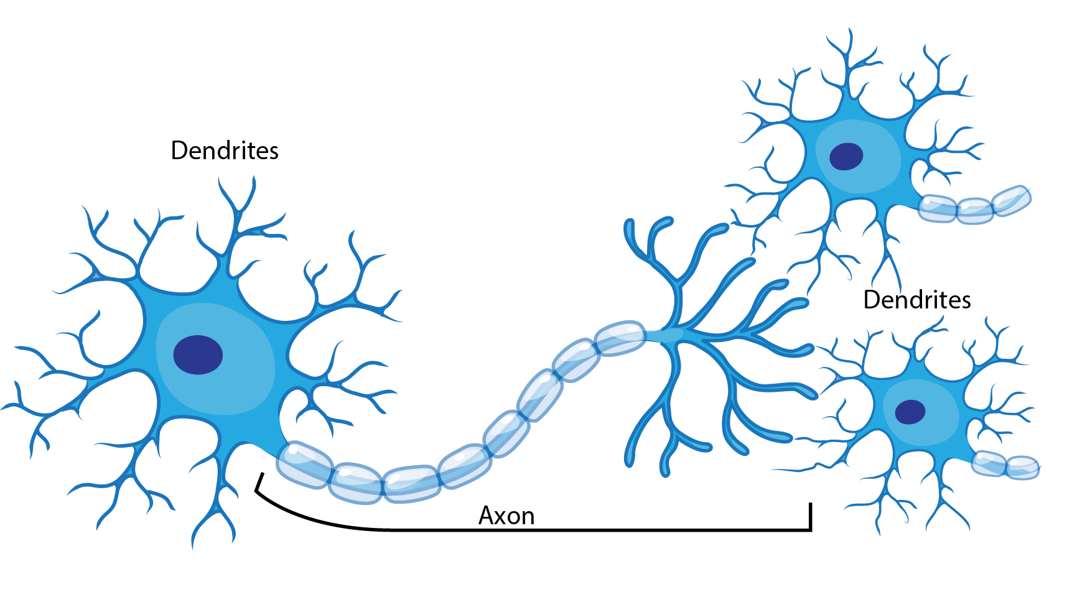
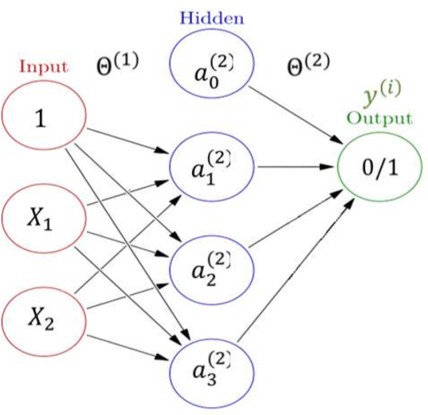
Neural Networks
Neurons in a brain are connected to each other in various patterns, to allow the output of some neurons to become the input of others.
Their network forms a directed, weighted graph. This is how information is transferred and processed in nervous tissue of most animals.
ANNs introduced in 1947, mimic this process by accepting information on input layer, weight it and pass it to hidden layers, then generate output on the last step.
A simple one hidden layer ANN can approximate complex functions.
Notes:
ANN stands for Artificial Neural Networks

Slide 16
Artificial Neural Networks
Three steps in any ANN include:
● Input layer: Accepts data vector or matrix. The number of units depends on the dimension of data.
● Hidden layer(s): They accept the output from the previous layer, weight them, and pass through a, normally, non-linear activation function. Too few hidden units and the network will not model complex decision boundaries, with too many the network will have poor generalization.
This is an example of a 2*3*2 ANN, 2 predictors excluding intercept, 3 units in one hidden layer excluding an intercept, binary (0/1) output.
● Output layer: Takes the output from the final hidden layer, weights them, and possibly pass through an output, nonlinearity, to produce the target values. The number of output units is determined by the number of output classes.

Slide 17
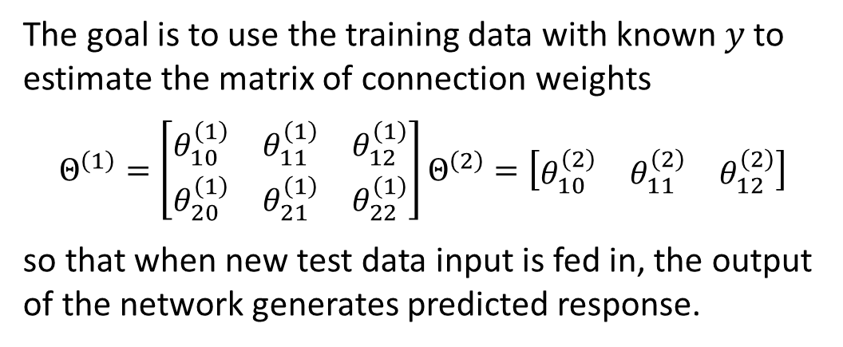
The Process
$$=1$$
$$1$$
$$θ_{10}^{\left(1\right)}$$
$$a_{0}^{(2)}$$
$$θ_{10}^{\left(2\right)}$$
$$θ_{11}^{\left(1\right)}$$
$$θ_{20}^{\left(1\right)}$$
$$θ_{11}^{\left(2\right)}$$
$$x_{1}$$
$$a_{1}^{(2)}$$
$$y$$
Suppose we have a set of $m$ training samples $(x,y)$ with $2$ features $x=\left(x_{1},x_{2} \right)$ and the response $y$ is binary (0/1).
$$θ_{21}^{\left(1\right)}$$
$$θ_{12}^{\left(2\right)}$$
$$=a_{1}^{(3)}$$
$$x_{2}$$
$$θ_{12}^{\left(1\right)}$$
$$a_{2}^{\left(2\right)}$$
The goal is to use the training data with known $y$to estimate the matrix of connection weights
$Θ^{\left(1\right)}=\left[\begin{matrix}θ_{10}^{\left(1\right)} & θ_{11}^{\left(1\right)} & θ_{12}^{\left(1\right)} \\ θ_{20}^{\left(1\right)} & θ_{21}^{\left(1\right)} & θ_{22}^{\left(1\right)}\end{matrix}\right]$ $Θ^{\left(2\right)}=\left[\begin{matrix}θ_{10}^{\left(2\right)} & θ_{11}^{\left(2\right)} & θ_{12}^{\left(2\right)}\end{matrix}\right]$
so that when new test data input is fed in, the output of the network generates predicted response.
$$θ_{22}^{\left(1\right)}$$
After estimating the weights, a decision boundary can be constructed by predicting response over all range of values for inputs.
• Normalization should be used before training a ANN.
• Response should be coded as 0, 1, … before training the ANN.
The process optimizes the connection weights by minimizing a well-defined cost function.
Notes:
http://playground.tensorflow.org/#activation=sigmoid&batchSize=10&dataset=xor&regDataset=reg-plane&learningRate=0.03&regularizationRate=0&noise=0&networkShape=4,2&seed=0.65224&showTestData=false&discretize=false&percTrainData=50&x=true&y=true&xTimesY=false&xSquared=true&ySquared=true&cosX=false&sinX=false&cosY=false&sinY=false&collectStats=false&problem=classification&initZero=false&hideText=false

Slide 18
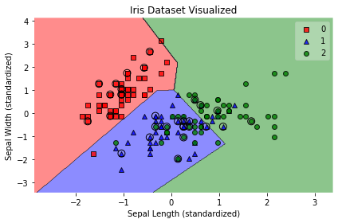
Classification of Iris Types
Using “iris” dataset, I have used two variables “Sepal Length” and “Sepal Width” to classify the three types of iris using a simple 2*4*3 ANN after 80%-20% train-test split and normalization.
Accuracy of the model was 80% that is this percent of data has been correctly classified. You can see the decision boundary.
Obviously iris Setosa has been separated well from the other two types.
Algorithm has done its best to classify versicolor from virginica, it was a difficult task as expected. Try different network structures or variables and compare their prediction accuracy.

Slide 19
Activity Part 2
1. You will build an artificial neural network to predict whether a student gets admitted into a university based on test1 and test2 score.
a. Load data “exam2.csv” into your session and normalize the two independent variables.
b. Generate a scatterplot of test1 vs test2 showing admitted and not admitted students of last year. Explain what you see and expect.
c. Perform 90%-10% train-test random split.
d. Train a 2×2×2 ANN model and test its accuracy on test set.
e. Train a 2×3×2 ANN model and test its accuracy on test set. Does the accuracy of the model change? What happens if we increase the hidden layers to 5? Which model seems to be better considering network complexity and efficiency?

Slide 20
Activity Part 2
2. Download the “glass” dataset and import it into your session.
a. Perform 90%-10% train-test random split after normalization.
b. Train an ANN model using training set to classify the two types of glass ( one/other) based on only two predictor variables and report model accuracy on test set.
c. Train an ANN model using training set to classify the two types of glass ( one/other) based on all predictor variables and report model accuracy on test set.
b. Compare the two accuracies and make a conclusion.
3. Download the “sim2” dataset and import it into your session.
a. Perform 90%-10% train-test random split after normalization.
b. Train an ANN model to classify the class variable values (0/1) based on predictor variables x & y.
c. Generate decision boundary graph and report model accuracy on test set.

Slide 21
Goodness of Fit Measures
Dr. Abolfazl Saghafi
Assistant Professor of Statistics & Data Science
Notes:
We will discuss clustering in this session

Slide 22
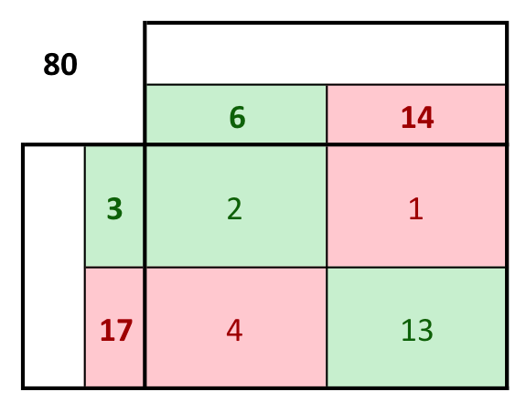
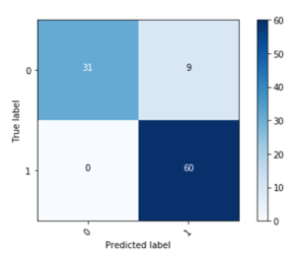
Confusion Matrix
20
Actual Class
An easy way to present prediction results of a classifier is to use a confusion matrix.
For a binary classification problem the confusion matrix generates a 2*2 table where usually the observed class labels are on top (columns) and the predicted class labels are on the sides (rows).
Each cell contains the number of predictions made by the classifier that fall into that cell.
Predicted Class
However, the confusion matrix itself can be ambiguous and misleading. It is always good to have a number that evaluates the performance of a classifier.

Slide 23
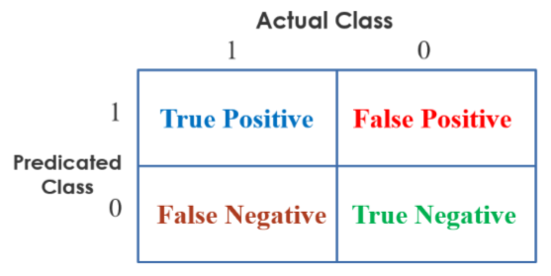
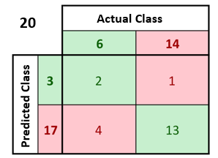
Accuracy/Precision/Recall
A very common goodness of fit measure for classification problems is accuracy defined as
$$Accuracy=\frac{\# of correct predeictions }{total number of samples}×100$$
However, accuracy alone is typically not good enough to show model performance. Two other important evaluation measures are Precision and Recall defined as
$$Precision=\frac{True Positive}{True Positive+ False Positive}×100$$
$$Recall=\frac{True Positive}{True Positive+False Negative}×100$$
Accuracy = $\frac{2+13}{20}∗100=75\%$
Precision = $\frac{2}{2+1}∗100=67\%$
Recall = $\frac{2}{2+4}∗100=33\%$
Notes:
Obviously, a classifier with high precision and recall is a good classifier

Slide 24
F-Score
 | Precison (P) | Recall (R) | F-Score
Algorithm 1 | 0.5 | 0.4 | 0.444
Algorithm 2 | 0.7 | 0.1 | 0.175
Algorithm 3 | 0.02 | 1.0 | 0.0392
If we were looking to select a model based on a balance between precision and recall, the following measure known as F-measure or F-score is best
$$F−Score=2×\frac{Precision ×Recall}{Precision+Recall}$$
In many situations such as the above table, it is not easy to decide which model performs better by comparing Precision and Recall.
F-score makes the comparison easy by proving one number that is good balance between Precision and Recall.
Selecting the best model also depends on the application.

Slide 25
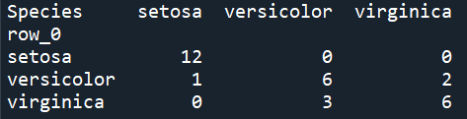
GOF in Iris Example
Confusion matrix on the test set is shown here for a 2*4*3 ANN.
Overall model accuracy is (12+6+6)/(12+6+6+2+1+3)*100= 80%
F-scores are 96%, 67%, 71% with average f-score of 78%
As an exercise, compute Precision, Recall, and F-score for Binary table of Setosa Vs Versicolor.

Slide 26
Activity Part 3
1. You will build an artificial neural network to predict whether a student gets admitted into a university based on test1 and test2 score.
a. Load data “exam2.csv” into your session and normalize the two independent variables.
b. Generate a scatterplot of test1 vs test2 showing admitted and not admitted students of last year. Explain what you see and expect.
c. Perform 90%-10% train-test random split.
d. Train a 2×2×2 ANN model and report accuracy, precision, recall, f-score on test set.
e. Train a 2×3×2 ANN model and report accuracy, precision, recall, f-score on test set.
f. Make comparisons of results in part d & e.

Slide 27
Activity Part 3
2. Download the “glass” dataset and import it into your session.
a. Perform 90%-10% train-test random split after normalization.
b. Train an ANN model using training set to classify the two types of glass ( one/other) based on only two predictor variables and generate GOF measures on test set.
c. Train an ANN model using training set to classify the two types of glass ( one/other) based on all predictor variables and generate GOF measures on test set.
b. Compare the two models and make a conclusion.
3. Download the “sim2” dataset and import it into your session.
a. Perform 90%-10% train-test random split after normalization.
b. Train an ANN model to classify the class variable values (0/1) based on predictor variables x & y.
c. Generate decision boundary graph and report GOF measures on test set.

Slide 28
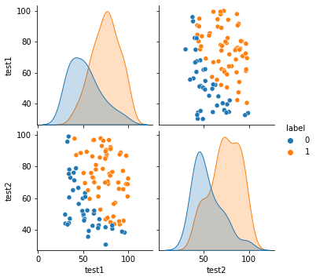
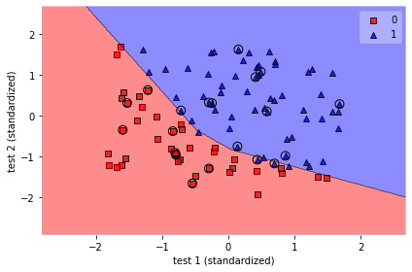
Example – Exam Data
“exam” dataset presents test1 and test2 test scores for a group of students who admitted (1) and not admitted (0) to college.
The aim is to find a decision boundary that classifies students into two groups based on their two test grades and use that to estimate admission status for future students.
I have modified given codes to train a 2*3*2 ANN using a 80% random training set. Decision boundary is found as given photo.
The model was 90% accurate with overall 90% f-score. Try to find a model that scores higher GOF measures by changing the structure of the developed ANN.
Notes:
"""
@author: Abolfazl Saghafi
Intro to Data Science 2 - Classification
"""
## Changing working directory
#cd C:\\Users\\abolf\\.spyder-py3\\mlcourse
## Loading required packages
import pandas as pd # to import data
import matplotlib.pyplot as plt # to visualize
import seaborn as sb # to visualize
## Loading data
########################################
df = pd.read_csv('exam.csv', sep=',')
df.info() # var info
df.isnull().sum() # missing values
## Exploratory Analysis - Qualitative - Univariate
########################################
# Do for each qual var seperately
tb = df['label'].value_counts()
print(tb)
ax = tb.plot.bar(x='Iris Types', y='Frequency', rot=0) # bar chart
ax = tb.plot.pie(x='Iris Types', y='Frequency', rot=0) # pie chart
## Exploratory Analysis - Quantitative - Univariate
########################################
# Do for each quant var seperately
df.describe() # short summary stat
sb.distplot(df["test1"], kde=False) # dist plot
plt.hist(df["test1"],bins=6,edgecolor='k') # histogram
df.boxplot(column=['test1'], return_type='axes') # box plot
## Exploratory Analysis - Bivariate
########################################
# Do for each combination of two vars
df.groupby("label")['test1'].describe().reset_index() # summary over Species
tb = df.groupby("label").describe().reset_index() # all at once
corr_stat = df.corr() # correlation coefficients
print(corr_stat)
# Heatmap with correlation coefficients
plt.figure(figsize=(16, 6))
heatmap = sb.heatmap(df.corr(), vmin=-1, vmax=1, annot=True);
heatmap.set_title('Correlation Heatmap', fontdict={'fontsize':12}, pad=12);
plt.show()
# Matrix Scatterplot, color coded for species
sb.pairplot(df, hue="label", diag_kind="kde")
plt.show()
## Pre-processing
########################################
from sklearn.model_selection import train_test_split
import numpy as np
from sklearn.preprocessing import StandardScaler
# Seperating Response and Independent Vars, Pick two Independent vars
X = df[['test1', 'test2']]
y = df['label']
# Recoding:
class_labels = ['Not-admitted', 'Admitted']
# Train/Test Random Split after shuffling
X_train, X_test, y_train, y_test = train_test_split(
X, y, test_size=0.2, random_state=0, shuffle=True)
# Changing to numpy arrays
X_array = np.asarray(X)
X_train_array = np.asarray(X_train)
X_test_array = np.asarray(X_test)
## Variable normalization
scale = StandardScaler() # scaler function
scale.fit(X_train) # calculate μ & σ
X_std = scale.transform(X) # apply the normalization
X_train_std = scale.transform(X_train)
X_test_std = scale.transform(X_test)
# color assignment
y_str = y.astype(np.str)
y_str[y_str == '0'] = 'red' #
y_str[y_str == '1'] = 'blue' #
# label for charts
def add_labels(standardized=False):
plt.title('')
if standardized:
plt.xlabel('test 1 (standardized)')
plt.ylabel('test 2 (standardized)')
else:
plt.xlabel('test 1')
plt.ylabel('test 2')
plt.tight_layout()
plt.show()
plt.scatter(X['test1'], X['test2'], c=y_str)
add_labels()
## Building the ANN model and train it
########################################
import numpy as np
from sklearn.neural_network import MLPClassifier
from mlxtend.plotting import plot_decision_regions
from sklearn import metrics
# Initializing the multilayer perceptron
model = MLPClassifier(hidden_layer_sizes=(3,), learning_rate_init=0.01,
max_iter=500)
# Option:
#MLPClassifier(activation='relu', alpha=0.0001, batch_size='auto', beta_1=0.9,
#beta_2=0.999, early_stopping=False, epsilon=1e-08,
#hidden_layer_sizes=10, learning_rate='constant',
#learning_rate_init=0.01, max_iter=500, momentum=0.9,
#nesterovs_momentum=True, power_t=0.5, random_state=None,
#shuffle=True, solver='sgd', tol=0.0001, validation_fraction=0.1,
#verbose=False, warm_start=False)
# Training the model using training set data
model.fit(X_train_std, y_train)
# Accuracy of trained model on test set
print("{:.1%} of the test set was correct.".format(
metrics.accuracy_score(y_test, model.predict(X_test_std))))
## Plotting the decision boundary on all data
y = pd.factorize(y, sort=True)[0]
plot_decision_regions(X_std, y, clf=model,
X_highlight=X_test_std,
colors='red,blue,green')
add_labels(standardized=True)
## Goodness of Fit Measures
########################################
import numpy as np
from sklearn.metrics import accuracy_score
from sklearn.metrics import f1_score
from sklearn.metrics import precision_recall_fscore_support as score
# Confusion Matrix
y_pred = model.predict(X_test_std)
pd.crosstab(index=y_pred, columns=y_test)
# Overall Accuracy & F-score
accuracy_score(y_test,y_pred)
f1_score(y_test, y_pred, average='macro')
# Measures for Each Category
precision, recall, fscore, support = score(y_test, y_pred)
print('precision: {}'.format(precision))
print('recall: {}'.format(recall))
print('fscore: {}'.format(fscore))
print('support: {}'.format(support)) # actual labels count
# For Decision Regions on Many other algorithms see
# https://jss367.github.io/Visualize-shallow-learning.html

