Slide 1
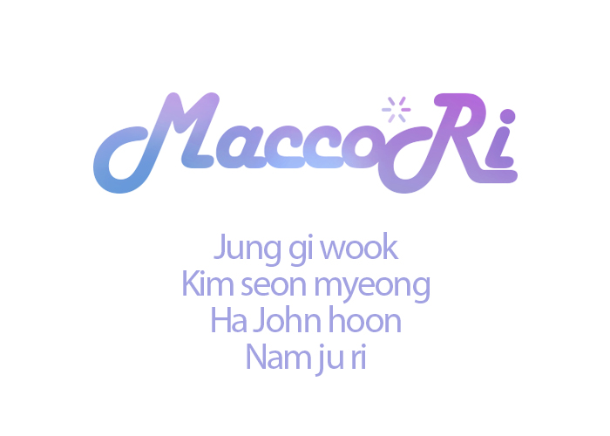

Jung giuk
Kim seon myeong
Nam juri

Slide 2
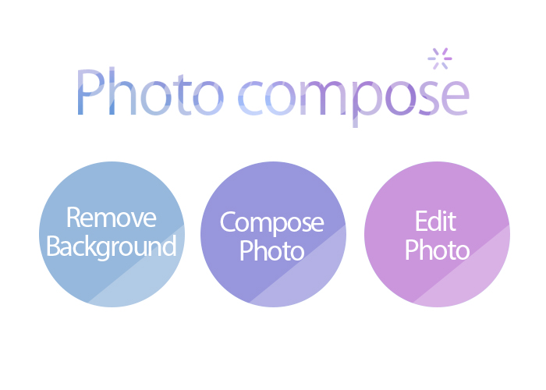
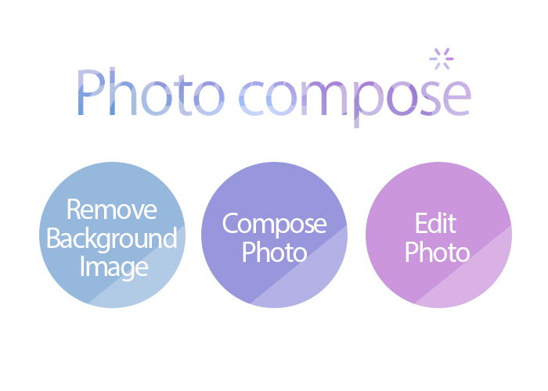
Photo Compose
feature
•remove background
•compose photo
•edit photos

Slide 3
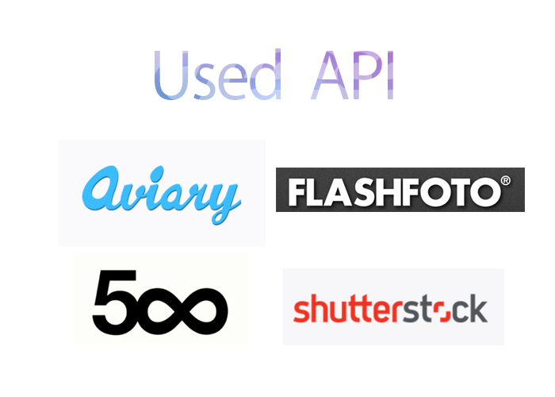





Used API

