Slide 1
Assignment 3 Implement A Digital Signature Scheme DAT510-1 20H Network security and vulnerability
University of Stavanger
Asahi Cantu moreno
Student id: 253964

Slide 2
Introduction
Analysis and results of Assignment in:
PKI (Public Key Infrastructure) Emulation
Server application
Client application
Log file generation
Application implementation and simulation

Slide 3

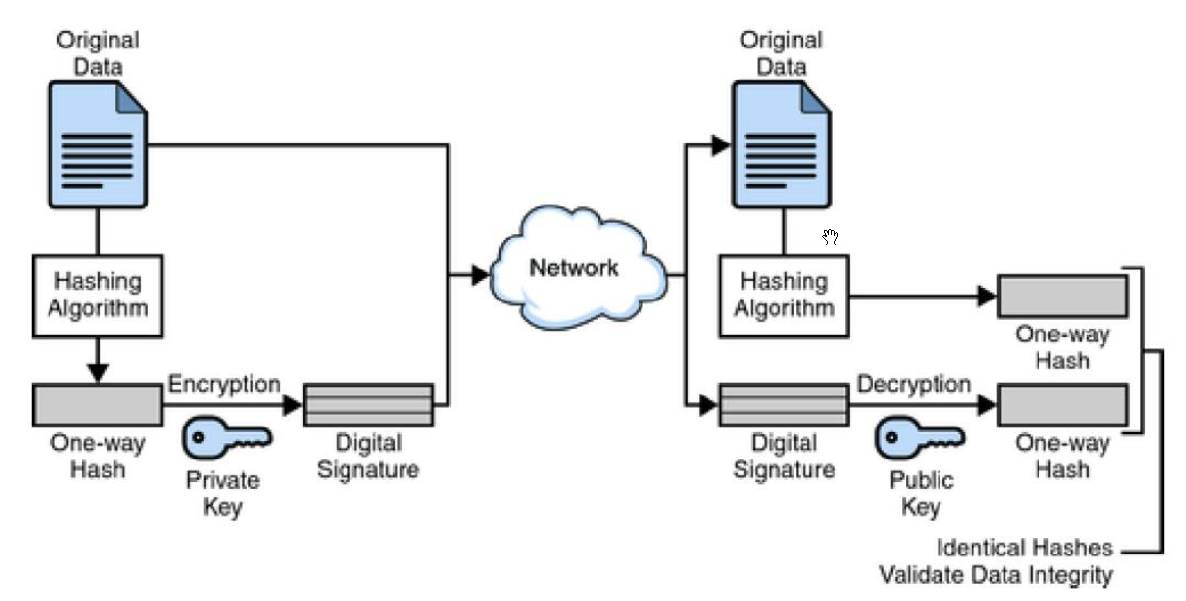



Digital Signature scheme
Alice
RSA-1024
Bob
DSS
RSA-1024
SHA-512
SEND MESSAGE
SEND FILES
SHA-512
SHA-512

Slide 4
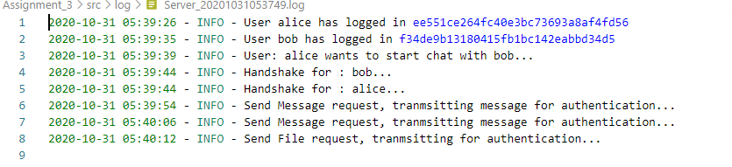
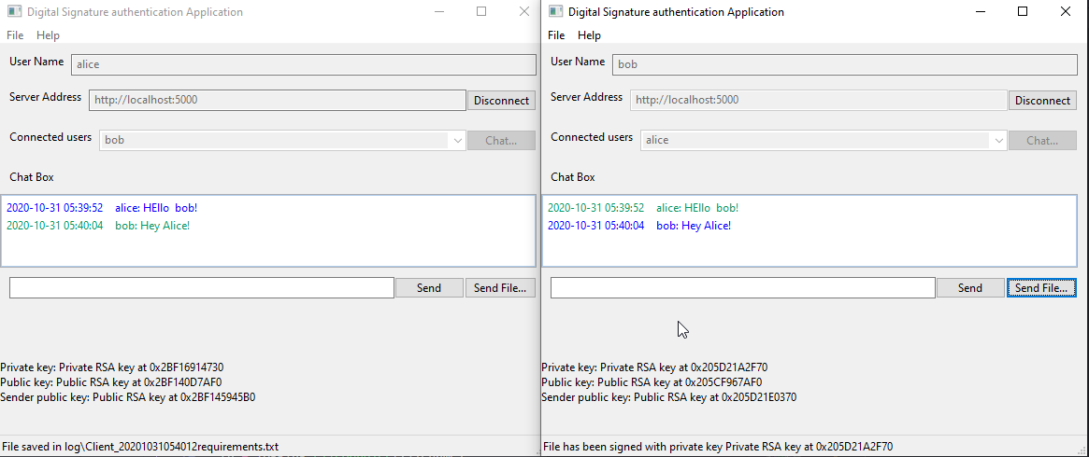
Server and client implementation for secure communication
Server
Flask
Socketio
Client
wxPython
KeyExchange [Socketio]
Signature [SHA-512]
Asymmetric key generation
RSA-1024

Slide 5
Conclusion
Understanding Digital Signature, Asymmetric encryption, RSA, SHA
Prime numbers complexity and finite field properties
Build simple communication application from scratch
Understand its limitation and tradeoff (latency, complexity, reliability)

Slide 6
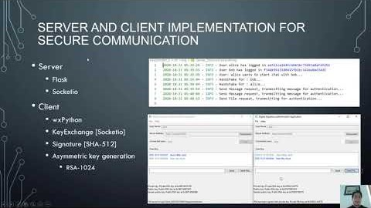
Video Link
https://youtu.be/cX2wv9rICms

