Slide 1
Assignment 1 Cryptanalysis of primitive ciphers DAT510-1 20H Network security and vulnerability
University of Stavanger
Asahi Cantu moreno
Student id: 253964

Slide 2
Introduction
Analysis and results of Assignment in:
Polyalphabetic ciphers
Text deciphering – Find encryption key
Complex Text deciphering – Find encryption key from previous task. Extra feature
SDES
Construction of SDES encryption algorithm
Construction of triple SDES encryption algorithm
SDES Cracking
3SDES Cracking
SDES server implementation

Slide 3

Polyalphabetic ciphers
Task: To build a polyalphabetic cipher algorithm
Language statistical analysis
English word, 2-gram, 3-gram frequency distribution

Slide 4
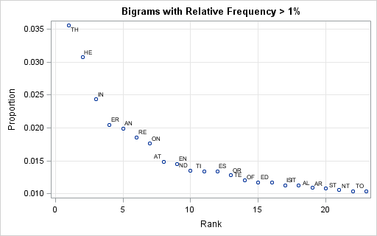
1.Polyalphabetic ciphers
Important to understand beforehand the ciphering language and word distribution

Slide 5

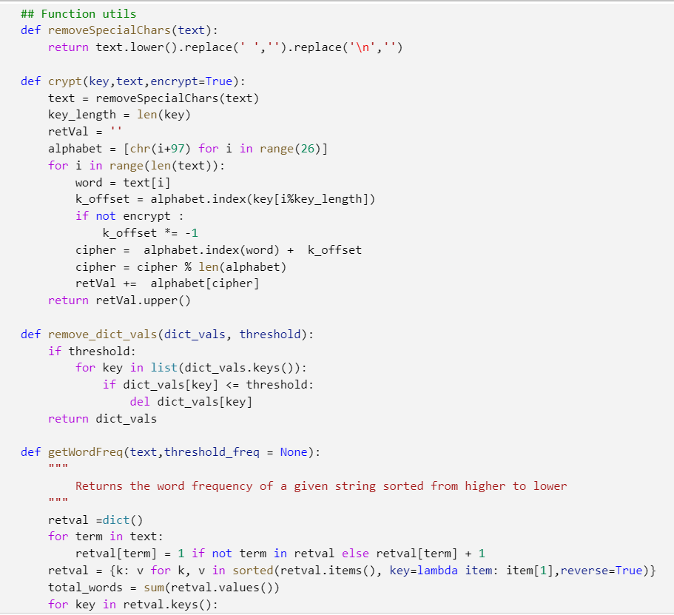
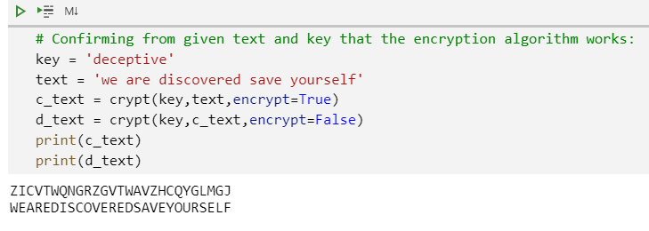
1. Polyalphabetic ciphers
Implemented code for statistical analysis and text encryption/decryption

Slide 6
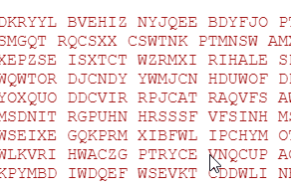
1.1 Text deciphering – Find encryption key
Given a ciphered text and by using the previous algorithms, perform statistical analysis to find the encryption key

Slide 7
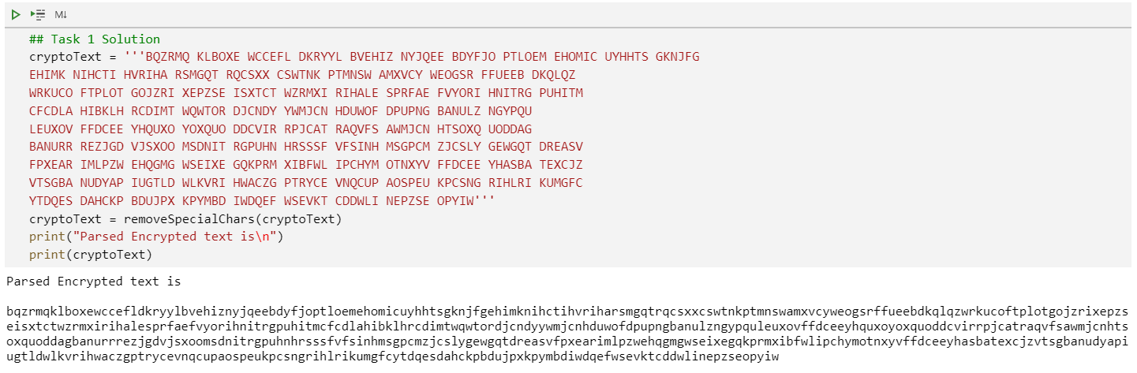
1.1 Text deciphering – Parsing text

Slide 8
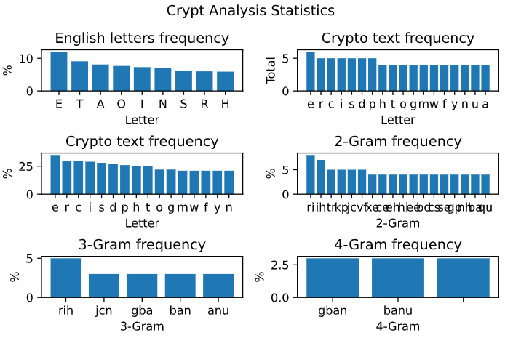
1.1 Text deciphering – Parsing text
Parsed text analyzed to find
Word frequency
2-Gram frequency
3-Gram frequency

Slide 9
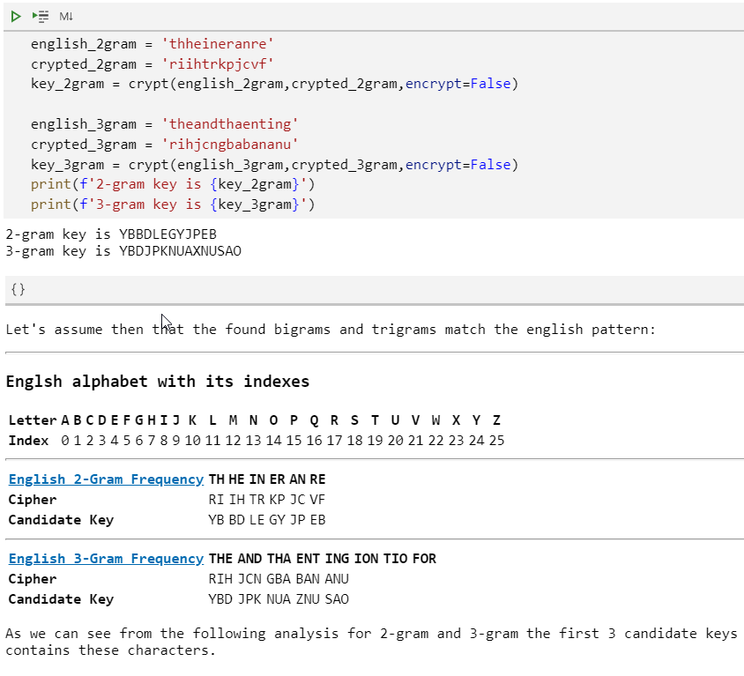
1.1 Text deciphering – Finding key insights
Assumpion: most frequent 2-gram = ‘RI’ => TH
Candidate Key = YB

Slide 10
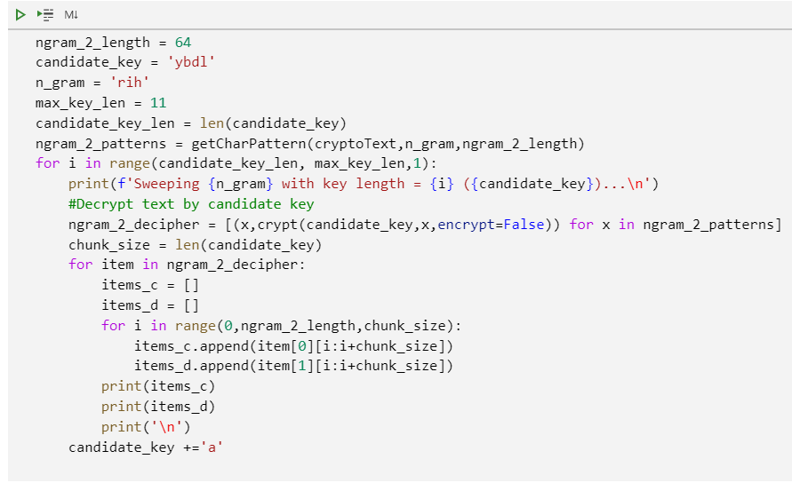
1.1 Text deciphering – Brute-force analysis
Creating an algorithm to decrypt with random keys
Try to find readable English patterns after several iterations

Slide 11
1.1 Text deciphering – Brute-force analysis
Creating an algorithm to find candidate key size
Try to find readable English patterns after several candidate key iterations

Slide 12
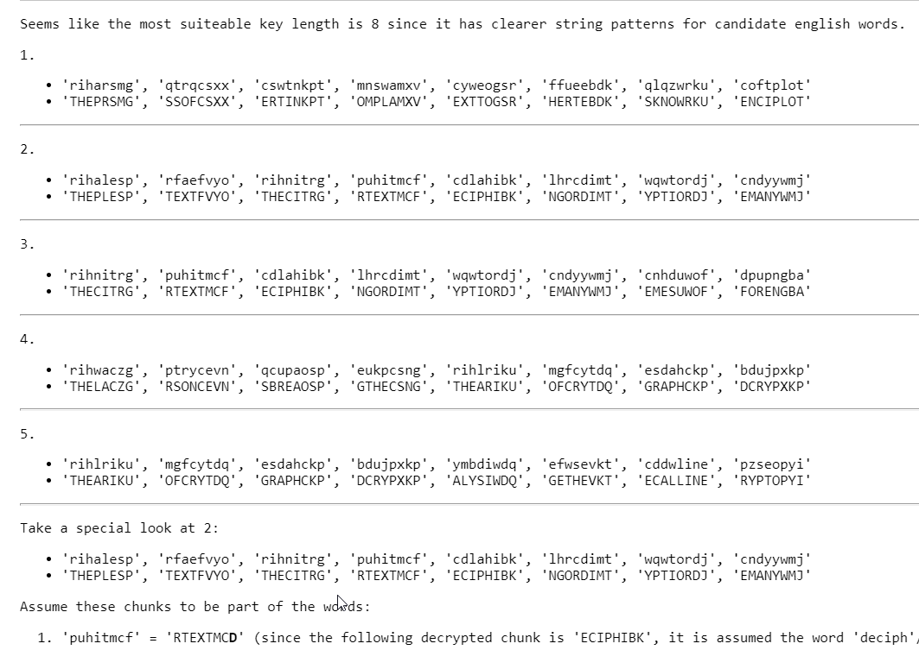
1.1 Text deciphering – Brute-force analysis
Isolate potential English word patterns. Candidate key = ybdlaaa
Keep iterating over assumed key pattens

Slide 13
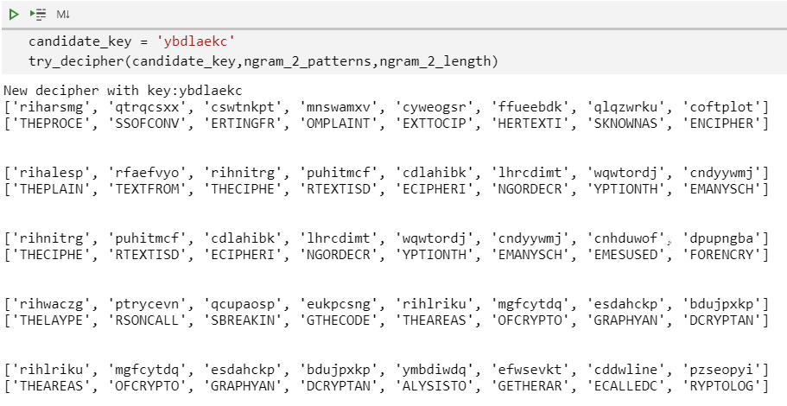
1.1 Text deciphering – Brute-force analysis
Potential key isolation with new English pattern insights
ybdlaekc
Switch the key chars to match with the beginning of the encrypted text

Slide 14
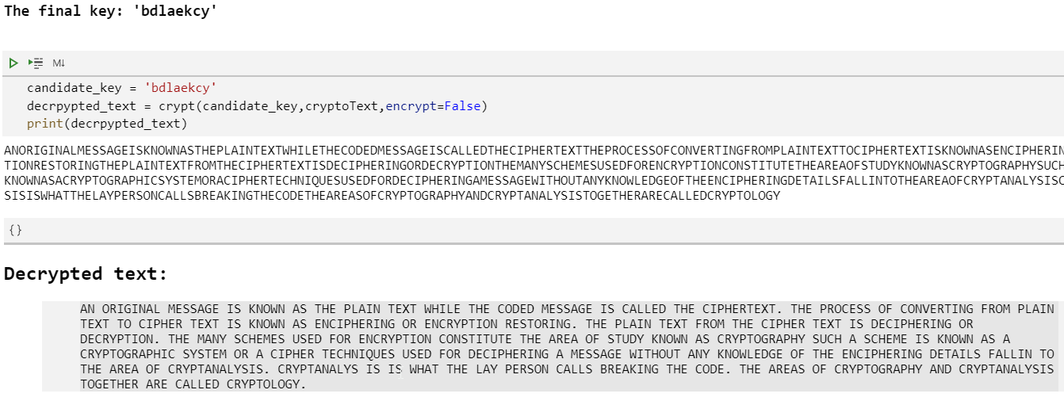
1.1 Text deciphering – Brute-force analysis
Final key found! ‘bdlaekcy’

Slide 15
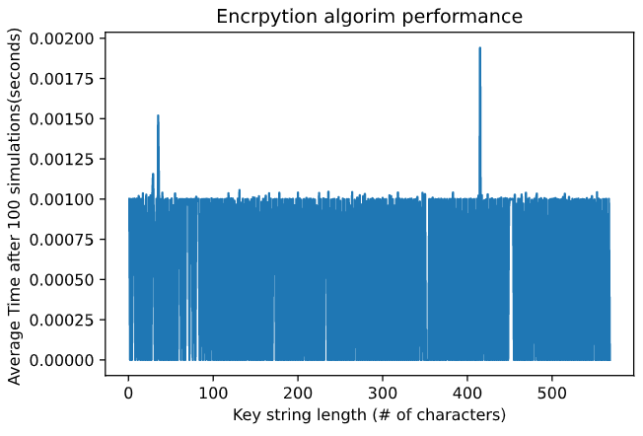
1.1 Text deciphering – Key performance
Encrypt previous text with a random key
Increase length size from 0 – n
N=max text length

Slide 16
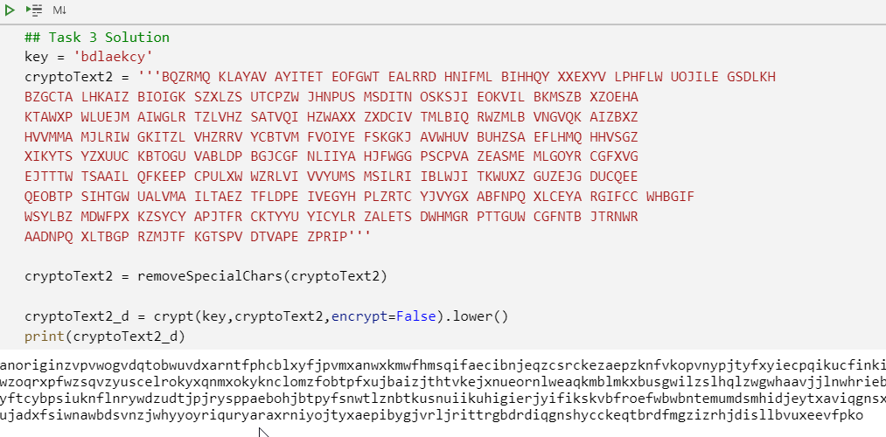
1.2 Complex Text deciphering - CryptAnalysis
New ciphered text provided
Decrypted with found key
Found first pattern to be same as previous text

Slide 17
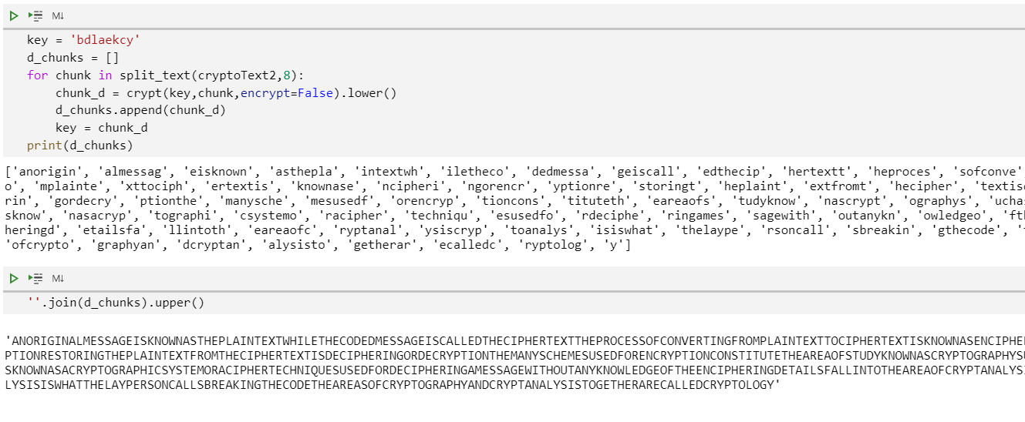
1.2 Complex Text deciphering – bruteforce
8-char pattern is decrypted by passing previous decrypted 8-char pattern

Slide 18
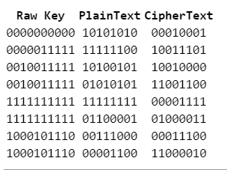
2.1 SDES – Algorithm construction
Implemented from appendix technical manual
Tested all steps and confirmed functionality
Modularized in python class for future use amongst different implementations
Implemented permutations
S boxes
Key generation
F-Function

Slide 19
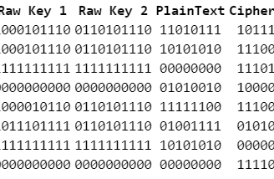
2.2 3SDES – Algorithm construction
Implemented from SDES previous function
Added two keys (k1, k2) to encrypt(k1)->Decrypt(k2),Encrypt(k1)

Slide 20
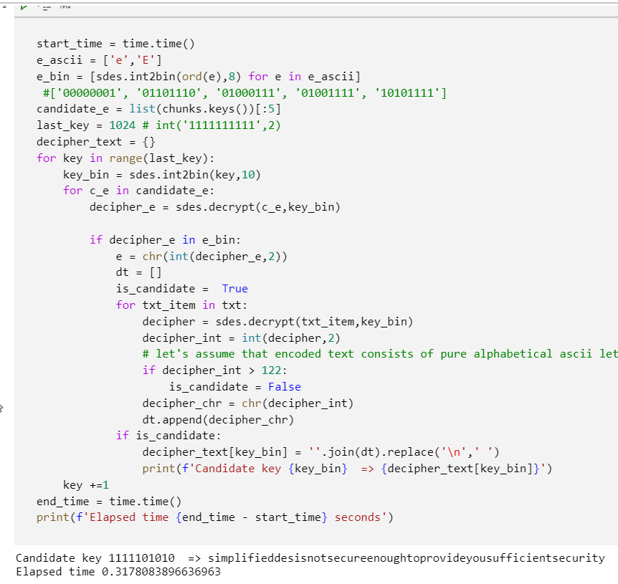
2.3 SDES – Cracking
Same statistical analysis techniques used
Created brute-force algorithm to crack code based on candidate 8-bit pattern that matched word ‘e’ or ‘E’
Key =1111101110

Slide 21
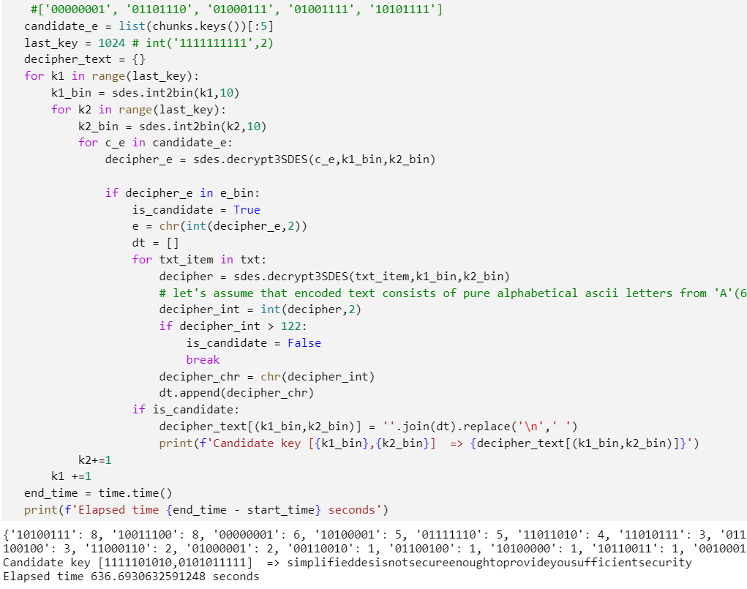
2.4 3SDES – Cracking
Same brute-force algorithm implemented than in SDES Cracking
Tried with two random increasing generating keys
K1 = 1111101010
K2 = 0101011111

Slide 22
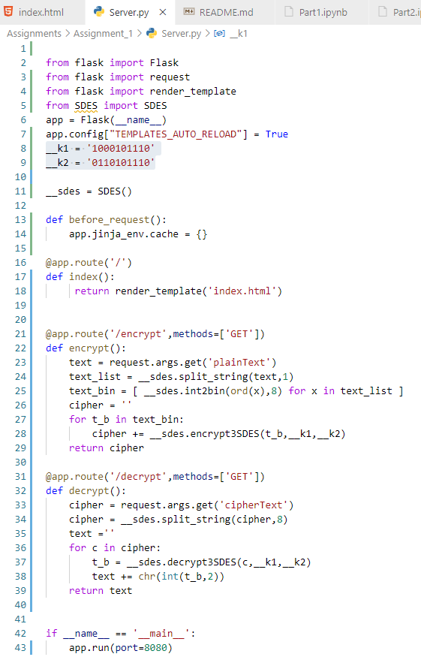
2.4 - SDES server implementation
Python-Flask package used
SDES modularized and imported from previous implementation

Slide 23
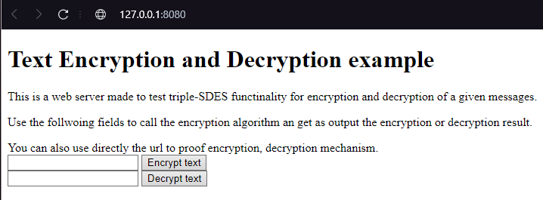


2.4 - SDES server implementation
Server encrypts on back end via 3SDES algorithm
Key stored in server (invisible for final user)
Risk and vulnerable if user has access to source code.

Slide 24
Conclusion
Statistical analysis
Crypt analysis
Brute force code development
SDES, 3SDES Algorithm understanding
Password cracking
Security conscientiousness

