Slide 1
Assignment 2 Implement secure communications DAT510-1 20H Network security and vulnerability
University of Stavanger
Asahi Cantu moreno
Student id: 253964

Slide 2
Introduction
Analysis and results of Assignment in:
Secure Communication Algorithm implementation
Construction of Diffie-Hallman key exchange algorithm
Construction of Blum Blum Shub CSPRNG algorithm
Implementation of Symmetric encryption algorithm using AES
Server and client implementation for secure communication
Construction of Server application
Construction of Client application
Log file generation
Application implementation and simulation

Slide 3

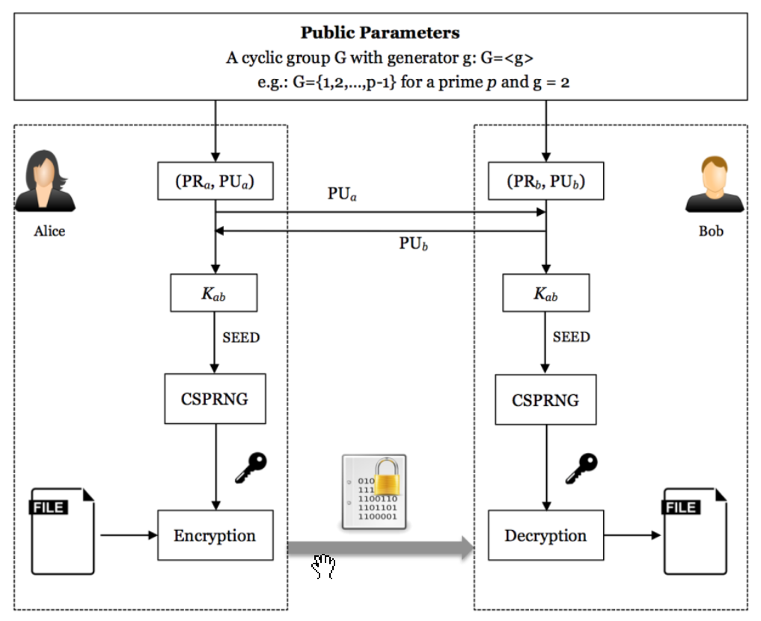
Secure Communication Algorithm implementation
DH
BBS
AES
SEND MESSAGE

Slide 4
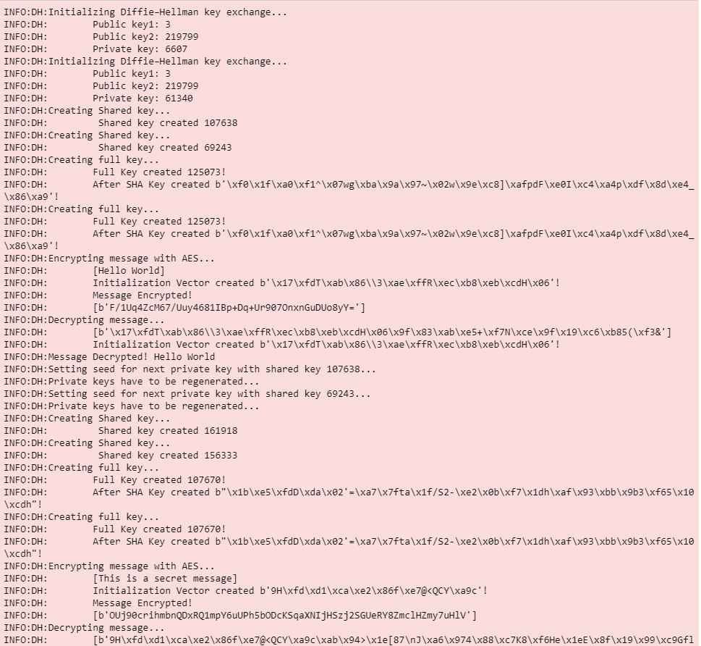
Secure Communication Algorithm implementation
Demo

Slide 5
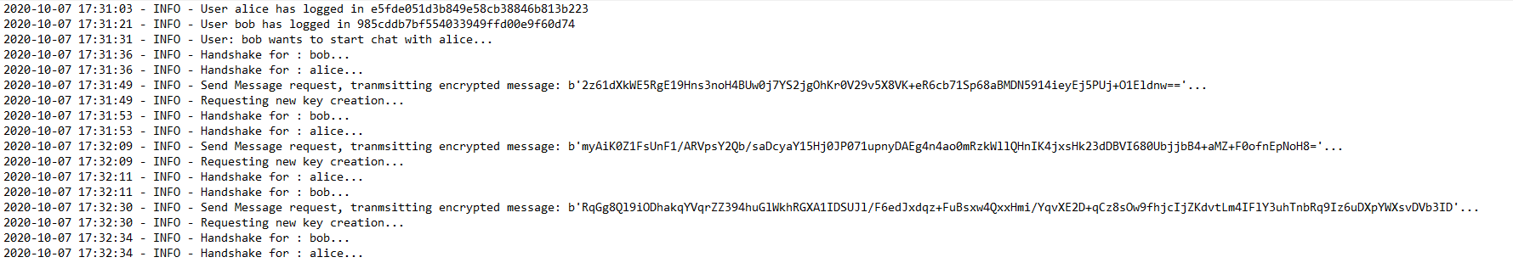
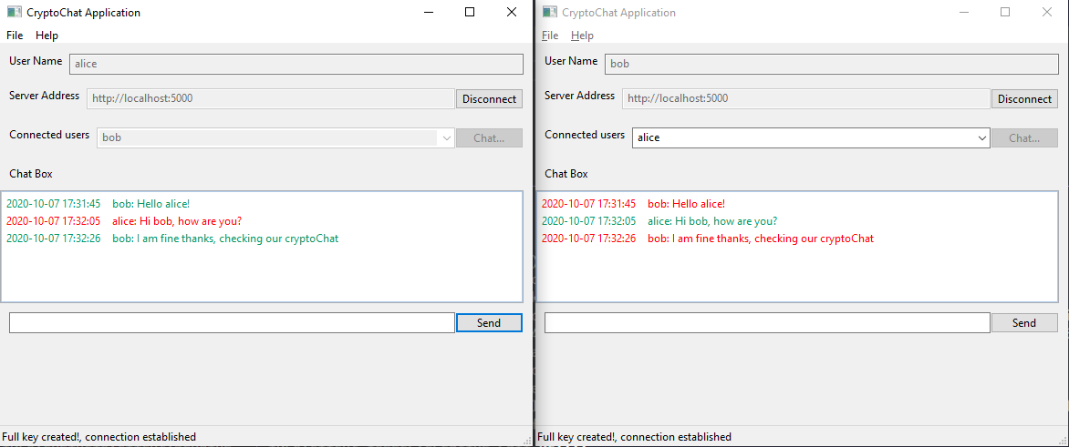
Server and client implementation for secure communication
Server
Flask
Socketio
Client
wxPython
KeyExchange
Encryption
Random key generation

Slide 6
Conclusion
Understanding Diffie-Hellman key exchange method
Understand CSPRNG-BBS
Prime numbers complexity and finite field properties
Build simple communication application from scratch
Understand its limitation and tradeoff (latency, complexity, reliability)

Slide 7
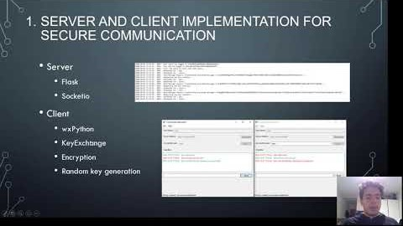
Video Link
https://youtu.be/cKevoex-4h8

