Slide 1
World Happiness Report 2020
Presented by
Akhila Saineni
Nihar Garlapati
Pranitha Chandra

Slide 2
Introduction
The mission of the following project is to evaluate the world happiness score by 156 countries and its correlation with various other key metrics such as economy, generosity, life expectancy, trust in government, freedom to make life choices, social support & corruption.
The following project would enable governments from various parts of the world to understand the correlation between the happiness score and various other scores, this can help in better policy making and ways to increase the happiness score in their respective countries.
The happiness score is obtained from polls taken by Gallup World Poll
The life evaluations from the Gallup World Poll provide the basis for the annual happiness rankings that have always spurred widespread interest.

Slide 3
Introduction
The dataset includes the following independent variables
Overall rank, Country, Region, Continent, GDP per capita, Social support, Healthy life expectancy, Freedom to make life choices, Generosity, Perceptions of corruption, .
The response variable is Happiness Score.

Slide 4
Data Screening
Accuracy check and outliers
Data looks accurate and with no missing values

Slide 5
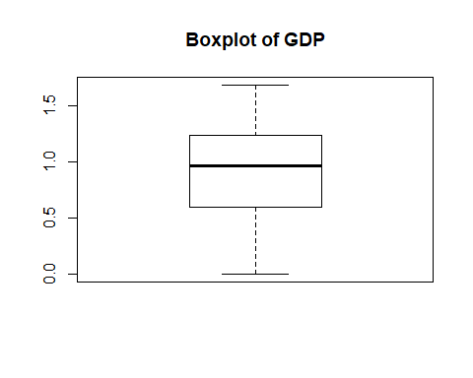
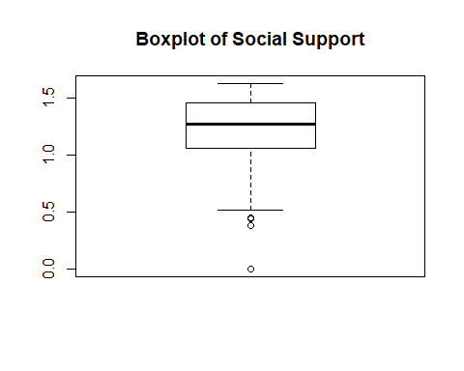
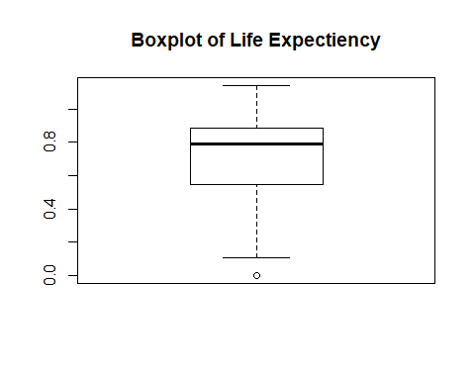
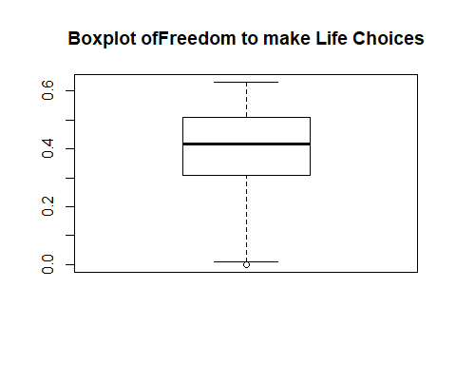
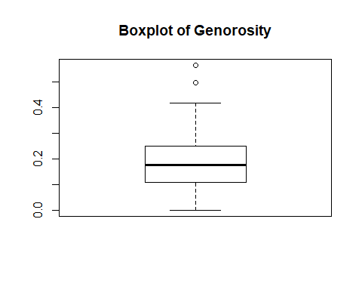
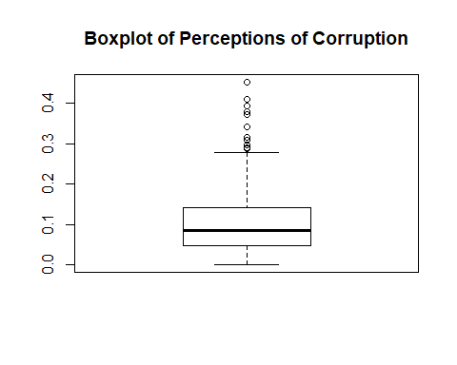
Data Screening

Slide 6
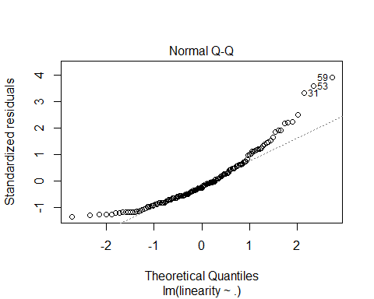
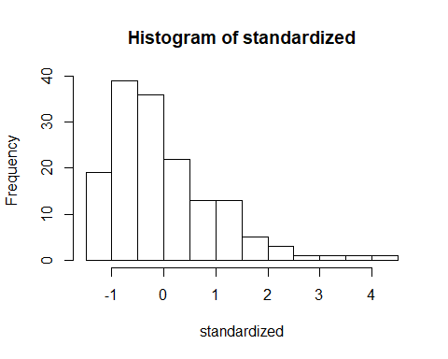
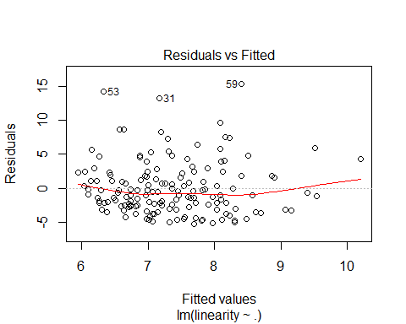
Data Screening

Slide 7
Exploratory Data Analysis
Range, Mean, SD, Skewness & Kurtosis
The Score of a country ranged from 2.8 to 7.7( M=5.42 SD=1.10 ), Score was normally distributed with skewness of 0.00 and kurtosis of 2.3
The GDP of a country ranged from 0.0 to 1.6(M=0.90 SD=0.39), GDP was normally distributed with skewness of -0.4 and kurtosis of 2.23
The Social support of a country ranged from 0.0 to 1.6(M=1.21 SD=0.29), Social support was normally distributed, left skewed with skewness of -0.00 and kurtosis of 1.14
The Freedom to make life choices of a country ranged from 0.0 to 0.63(M=0.39 SD=0.14), Freedom was normally distributed with skewness of -0.68 and kurtosis of 2.89
The Generosity of a country ranged from 0.0 to 0.56(M=0.18 SD=0.09), Generosity was normally distributed with skewness of 0.73 and kurtosis of 4.09
The Corruption of a country ranged from 0.0 to 0.45 (M=0.10 SD=0.00), Corruption was normally distributed, right skewed with skewness of 1.63 and kurtosis of 5.39
The Life Expectancy of a country ranged from 0.10 to 1.14 (M=0.73 SD=0.23), Corruption was normally distributed, left skewed with skewness of -0.54 and kurtosis of 2.44

Slide 8
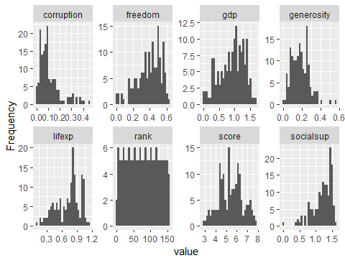
Distribution of Variables in the Dataset

Slide 9
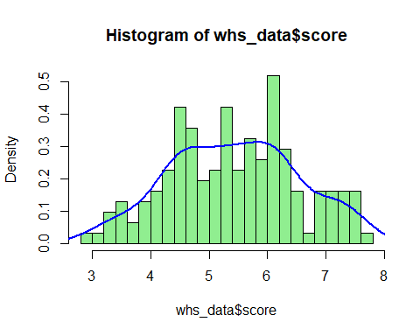
Distribution of variable score

Slide 10
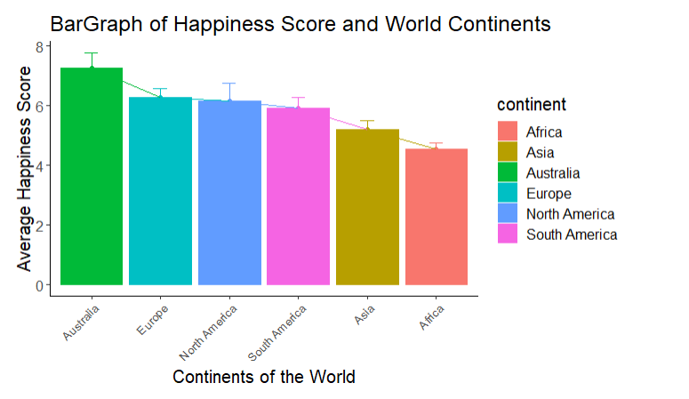
Plot of Average Score Vs Continent

Slide 11
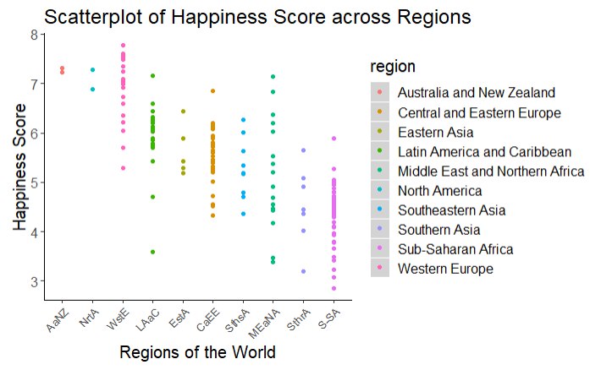
Plot of Score Vs Region

Slide 12
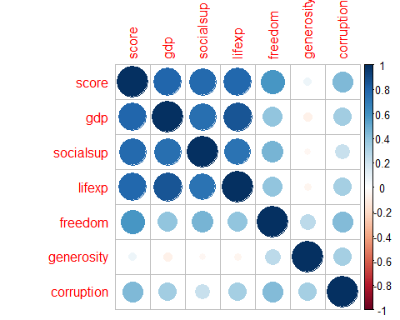
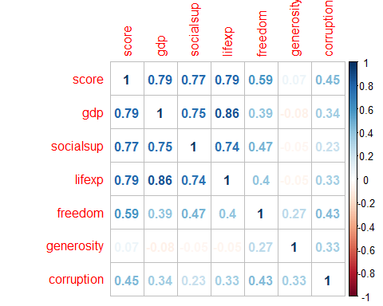
Correlation

Slide 13
Correlation
GDP, Social Support and Life Expectancy have higher positive correlation with Happiness score
Freedom and Corruption have medium positive correlation with Happiness score
Generosity has the least correlation with Happiness score

Slide 14
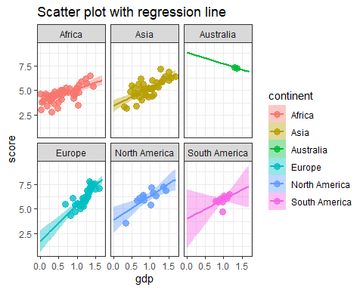
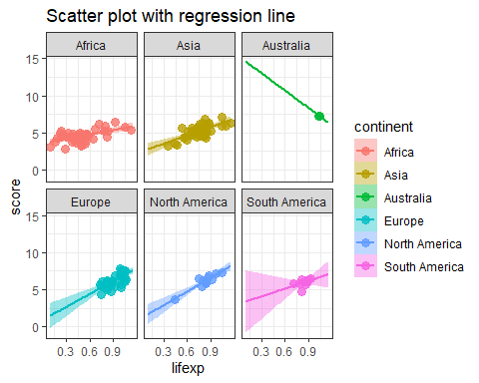
Correlation

Slide 15
Bonferroni Correction
There is a significant difference in the score between continents with higher number of developing nations such as Asia, Africa when compared to continents with fewer developing nations such as Europe or North America
Anova
Since the p value of the Anova test is less than 0.05. We can consider that the Anova test is significant, Therefore we reject the null hypothesis and conclude that there is a difference in the average happiness score between different continents and regions.

Slide 16
Modelling & Prediction
We started building model without rank and score.
Model all includes all the variables as predictor variables
After Running Backward stepwise Elimination of variables to fit the model, The final variables picked to be a part of the model are as follows.
GDP Per Capita
Social Support
Freedom to make life choices
Perceptions of corruption
Health life Expectancy
Region
Continent

Slide 17
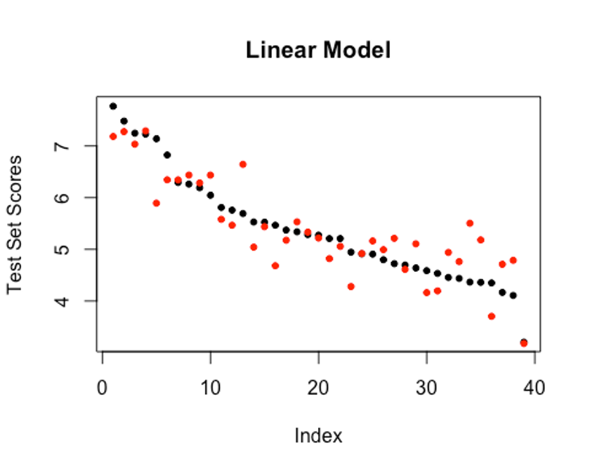
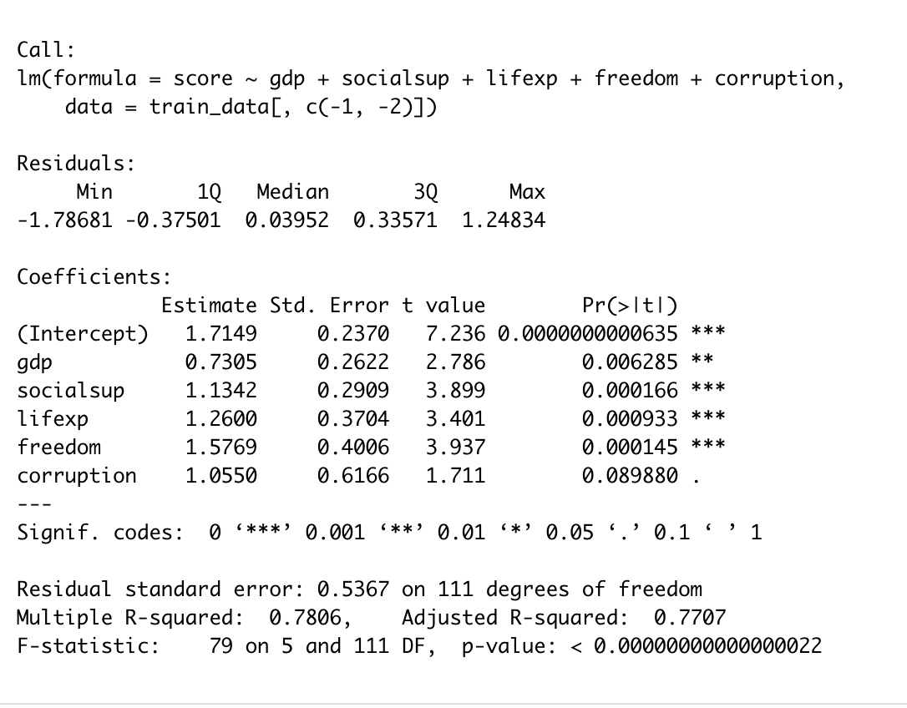
Checking the Predictive ability of the model

Slide 18
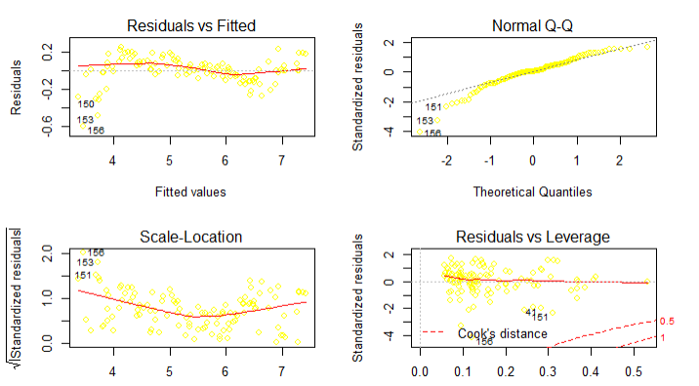
Model residual plots
Model Diagnostics

Slide 19
Conclusion
We can conclude that GDP, Social Support, Life Expectancy and Freedom play a major role in determining a countries happiness score.
If the objective of a country to keep their citizens happy, the following analysis proves that GDP itself doesn’t play a key role but metrics such as life expectancy, freedom to make life choices and perception of corruption also play a major role in improving the happiness score.
In developing continents such as Africa, Life expectancy is not heavily correlated with happiness. However GDP seems to be heavily correlated. In the north, American continent both GDP and Life expectancy play a key role in contributing to the happiness score.
Most North American countries seem to have higher freedom score when compared to Asia & Africa, which also tells us why north American countries have higher happiness score compared to Asia and Africa

Slide 20
THANK YOU

