Slide 1
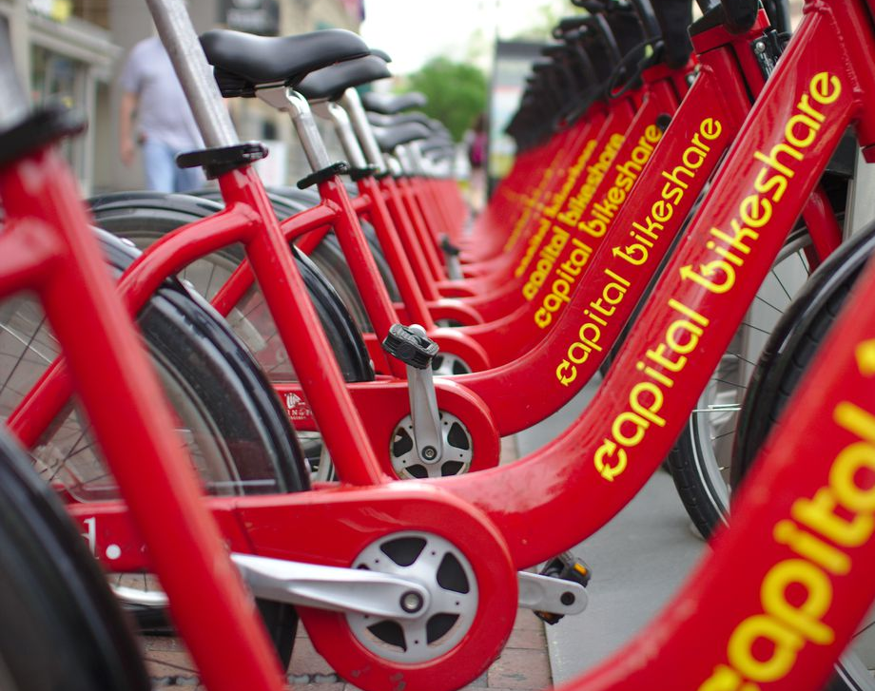

Fundamental Analysis of Bike Rentals
Group 1- Aditya Sameer Malik, Akhila Saineni, Anshul Garg, Divyani Kanawat, Eswarya Pillai Rahul Sudan

Slide 2
Agenda
Project Background
Problem Statement
Our Goal in Project
Benefits for Future
Data Background
Data Description
Data Source
Exploratory Analysis
Visualize & explore relationship of variables to y variable and one another
Data Cleaning and Manipulation
Standardize Data
Remove Data not required
Preparing Data for Modeling
Split data into train and test datasets
Perform Multiple Linear Regression Analysis
Build Linear model using train dataset
Validate the Models on test dataset
Conclusion & Future Work

Slide 3
Dataset Background
Bike sharing systems are a new generation of traditional bike rentals where the whole process from membership, rental and return has become automated.
Today, there exists great interest in these systems due to their important role in traffic, environmental and health issues.
Dataset is available on the UCI Machine Learning Repository [1].
It contains daily aggregated data from 2011 and 2012.
Data has- 731 distinct observations and 16 distinct variables
Project Background
Problem Statement: How natural factors are affecting the number of daily bike rentals in Washington DC for “Capital Bikeshare”?
Our Goal: Our goal is to build statistical model to effectively predict the number of daily counts that can be rented with availability of data.
Data Source: https://archive.ics.uci.edu/ml/machine-learning-databases/00275/Bike-Sharing-Dataset.zip

Slide 4
Dataset Description
Var. Name | Var. Type | Overview of Information
cnt | Response | Count of total rental bikes including both casual and registered
dteday | Explanatory | date
season | Explanatory | season (1:spring, 2:summer, 3:fall, 4:winter)
yr | Explanatory | year (0-2011, 1-2012)
mnth | Explanatory | month ( Jan-1 to Dec-12)
workingday | Explanatory | Workingday-1 , Not working day-0
temp | Explanatory | :Normalized temperature in Celsius. The values are divided to 41 (max)
atemp | Explanatory | Normalized feeling temperature in Celsius. The values are divided to 50 (max)
hum: | Explanatory | Normalized humidity. The values are divided to 100 (max)
windspeed | Explanatory | Normalized wind speed. The values are divided to 67 (max)
casual | Explanatory | count of casual users
registered | Explanatory | count of registered users
weathersit | Explanatory | 3 levels – very good-1, good-2, bad-3
weekday | Explanatory | Sunday to Saturday (0 to 6)
holiday | Explanatory | Holiday-1, No holiday-0

Slide 5
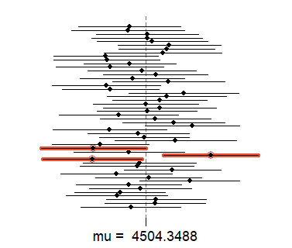
Inference
Sampling distribution with 50 random samples of size 60.
47 of the resulting confidence intervals contain the true average number of exclusive relationships.
95% proportion of confidence intervals includes the true mean.

Slide 6
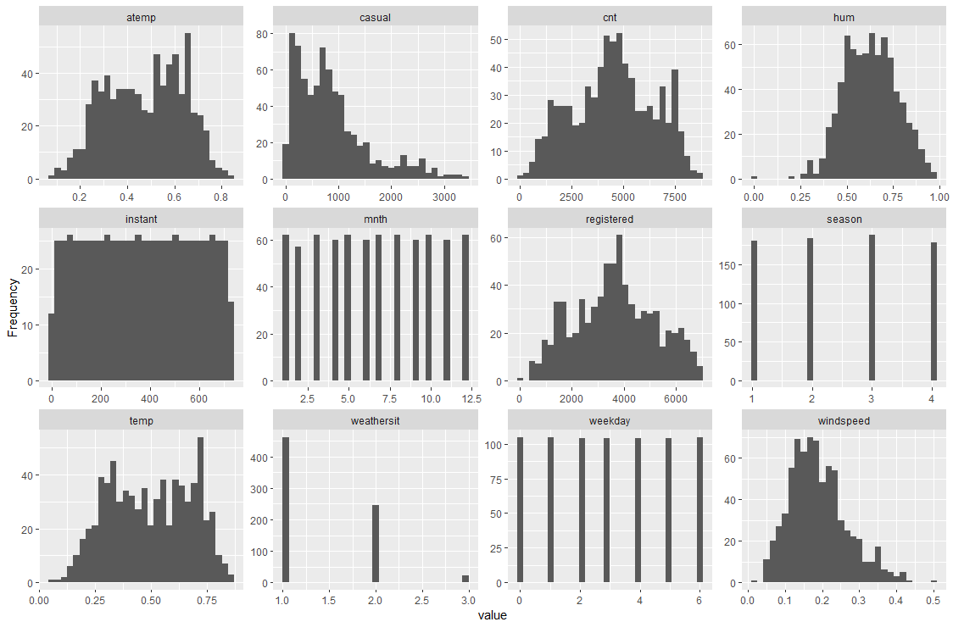
Frequency Distribution
The target variable seems normally distributed.
Mostly numerical variables are normally distributed.
Season has 4 categories of almost equal distribution.
Weather 1 has higher distribution than 2 and 3.

Slide 7
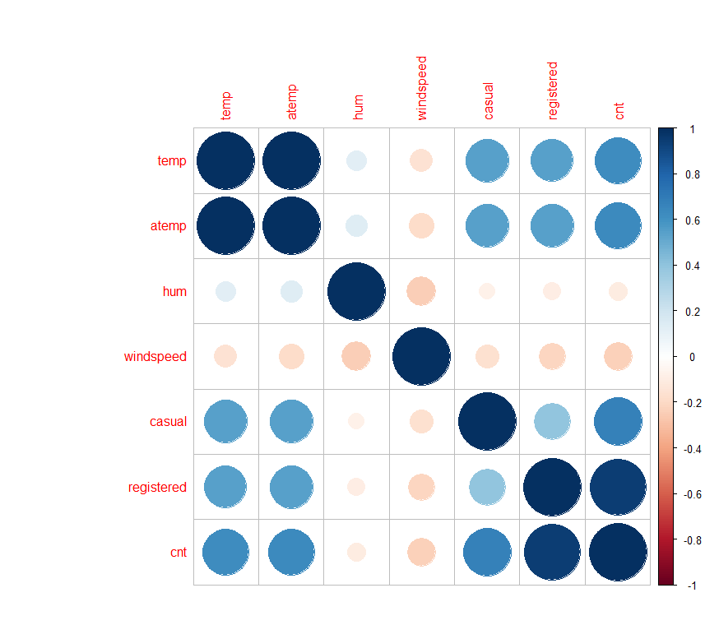
Correlation Plot of Bike Sharing Data
Temp and atemp features have strong correlation with each other. Any one of the variable must be dropped as they will exhibit multicollinearity.
Humidity and windspeed have negative correlation with counts.
Casual and registered variables are leakage variables and need to be dropped during model building.

Slide 8
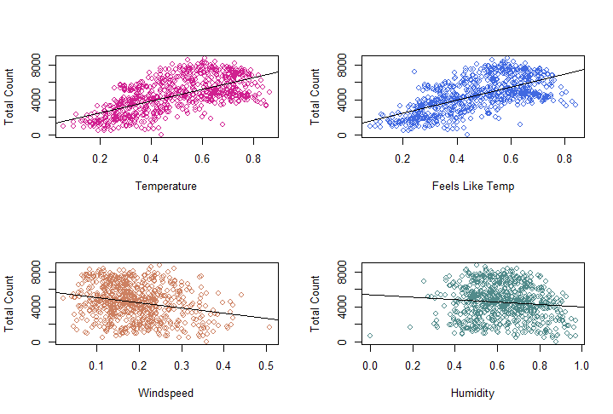
Daily weather conditions influence the daily bike rental count
Temperature and feels like temperature have almost same effect on count of bikes
The wind-speed and humidity show a negative relation with the total count of bike rentals
People mainly rent bikes on days with high temperature

Slide 9
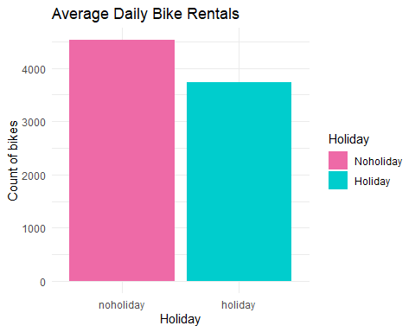
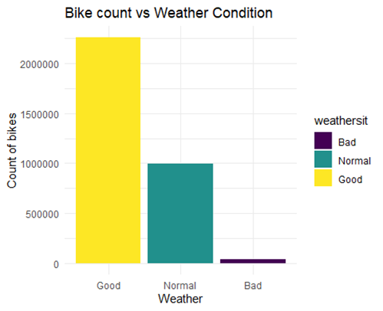
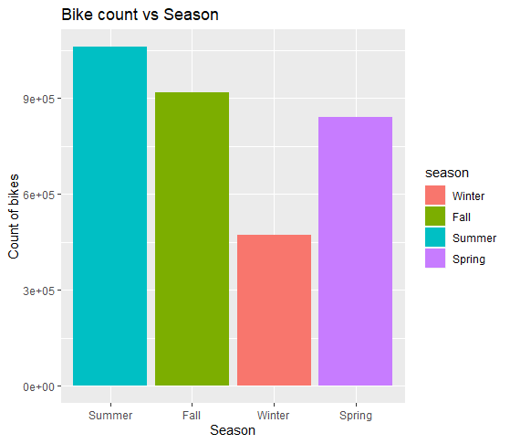
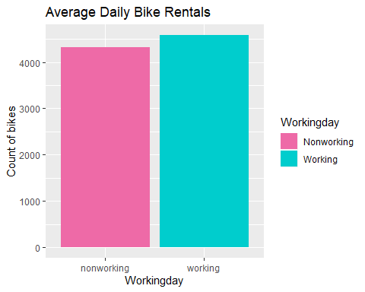
Visualizing Categorical Variables
Bike ridership is maximum during summer and fall season.
Users tend to rent bike mostly in good weather, moderately in normal weather and least in bad weather.
There is small difference in average daily bike rentals during working days and holidays.

Slide 10
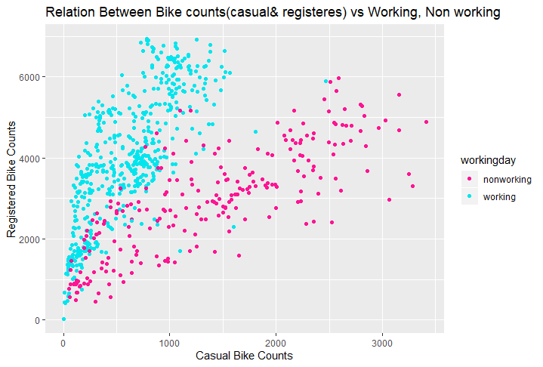
Compare casual and registered users with working days
Registered users ride bikes more on working days compared to casual users
Casual users ride bikes more on non-working days
Total number of registered bikers are more as compare to casual bikers.

Slide 11
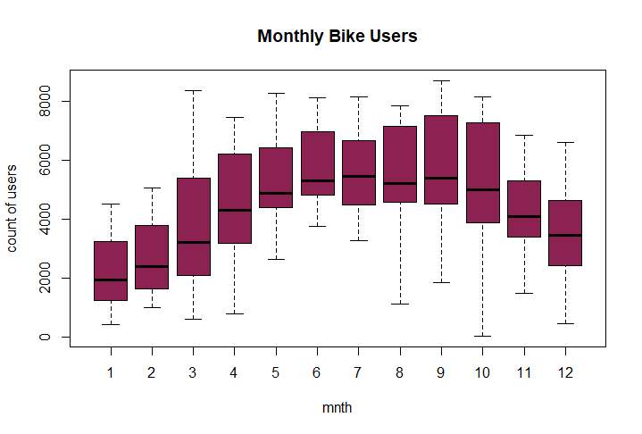
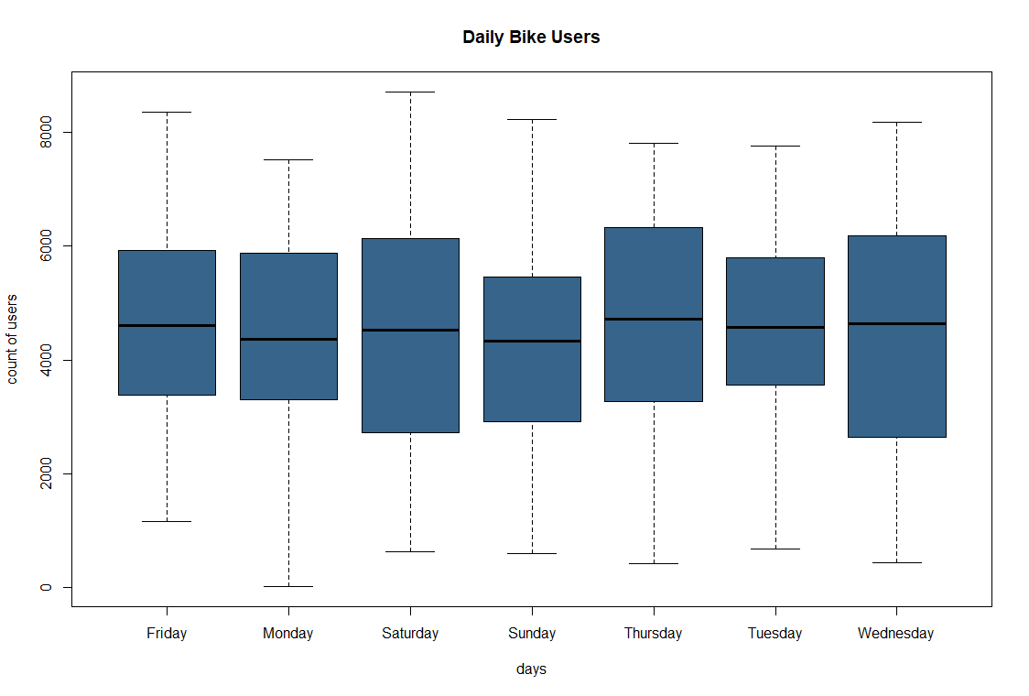
Average user counts by Monthly & Daily
Bike trend initially increase and then decrease during the month and shows a sign of cyclical behavior.
Bike rentals have increasing pattern through Spring and reach a pick in the Summer and fall starting. Then rentals decreasing in end fall and winter to meet the trend of spring.
Daily users show less effect on counts because small difference between weekdays and weekends.

Slide 12
Multiple Linear regression Analysis
Split Training and Testing dataset using original data
75% training ( & 25% testing. We have 548 rows in training set and 183 rows in testing set.
Created Dummy Variables for categorical variables.
model1<- lm(cnt ~ temp +atemp+ hum +windspeed, data = train)
## Residuals: ## Min 1Q Median 3Q Max ## -4816 -1054 -86 1028 3570 ## ## Coefficients: ## Estimate Std. Error t value Pr(>|t|) ## (Intercept) 3659.49 420.72 8.698 < 2e-16 *** ## temp 86.01 59.16 1.454 0.147 ## atemp 72.27 54.77 1.319 0.188 ## hum -30.34 4.48 -6.772 3.32e-11 *** ## windspeed -56.18 13.14 -4.275 2.26e-05 *** ## --- ## Signif. codes: 0 '***' 0.001 '**' 0.01 '*' 0.05 '.' 0.1 ' ' 1 ## ## Residual standard error: 1447 on 543 degrees of freedom ## Multiple R-squared: 0.4493, Adjusted R-squared: 0.4452 ## F-statistic: 110.8 on 4 and 543 DF, p-value: < 2.2e-16
Model 1 Interpretation:
Humidity and windspeed are good predictors as p value is < 0.05
Temp and atemp shows multicollinearity so we will remove one out of these two in next model and see the changes in results.

Slide 13
Multiple Linear regression Analysis
model2<- lm(cnt~ temp+ hum+ windspeed, data= day)
model3<- lm(cnt~ .-atemp, data = day)
Model 2 Interpretation:
We removed atemp(feels like temp) from 2nd model and we get better result with adjusted R2 0.45.
All variables are statistically significant in model2.
Coefficients: ## Estimate Std. Error t value Pr(>|t|) ## (Intercept) 4084.363 337.862 12.089 < 2e-16 *** ## temp 161.598 7.148 22.606 < 2e-16 *** ## hum -31.001 3.840 -8.073 2.83e-15 *** ## windspeed -71.745 10.581 -6.781 2.48e-11 ***
Now we will check all variables including categorical variables in our model 3. As adjusted R2 is our benchmark score, let see if we can improve it.
Model 3 interpretation:
We added all variables except atemp and we get pretty good results with adjusted R2 0.82.
Summary includes variables which are not significant and p value is greater than 0.05
Now we will run one more model which includes only significant variables from model 3 and see if we can improve it.

Slide 14
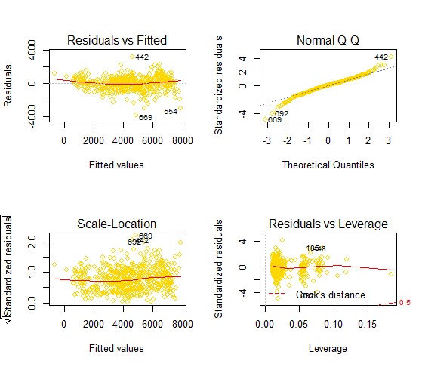
Final Model and Interpretation
Model 4 interpretation:
We get adjusted R2 0.84 in this model which is higher than other models.
Weekdays and weekends doesn’t have impact on daily counts, so we removed it.
P value for all variables are significant.
Residual plot shows the data is linear, normality Q-Q plot shows that the data is normal as mostly data is on a straight line.
Scale-location plot doesn’t show any pattern as the red line approximately horizontal.
model4<- lm(cnt~ .- atemp-workingday-weekday.tue-weekday.mon-weekday.fri- weekday.tue-weekday.wed-weekday.thur-weekday.sat, data = train)

Slide 15
Comparison of all Multiple Linear Regression Models
Results | Model 1 | Model2 | Model3 | Model 4
Residual Stan. Error | 1447 | 1425 | 808 | 773
Variables | 4 | 3 | 19 | 15
F- Statistics | 110 | 207 | 183 | 194
Adjusted R Squared | 0.44 | 0.45 | 0.82 | 0.84
R Squared | 0.44 | 0.44 | 0.83 | 0.84
Mean Square Error | 1837637 | 1831133 | 755504 | 889899
RMSE | 1355 | 1353 | 869 | 943
AIC | 9537 | 12697 | 11884 | 8862
BIC | 9563 | 12720 | 11980 | 8935
Based on these results, we selected model 4 for our prediction.

Slide 16
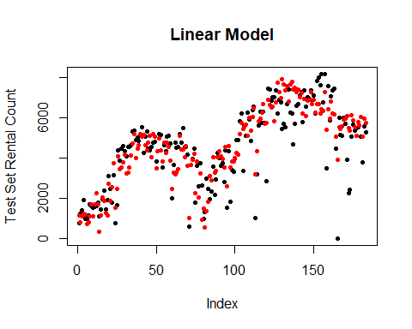
Predictive Ability of the Model
Now we use final selected model 4 on unseen data(test data).
Using model4, 80% of variance in rental bike count is explained on test data.
Still in the actual vs. predicted plot, we can see there is some scope to improve our prediction.

Slide 17
Conclusion
This study predicts the daily bike usage pattern of Washington DC. Capital Bike System.
We explored all the variables affecting bike rentals in exploratory data analysis.
Temperature, Humidity, Wind-speed, Season, and Weather are the most important factors that drive the demand of bike sharing rental
Using multiple linear models, we see that the duration prediction has a good fit of training data and small generalization error, but prediction of number of trips seems to yield periodically increasing loss, which is something that should be addressed in future work..

Slide 18
Future Work
Analyze the effects of other weather and demographic covariates on bike usages patterns.
It would also be interesting to model trips between pairs of stations and build models to predict the destination given customer information and starting station.
We will explore the hours data of Bike Sharing dataset to understand data better
We can improve our performance by applying advanced techniques such as Decision tree and Random Forest. We can use Time Series and Forecasting methods to understand our data trend better.

Slide 19
Thank You
Questions?

