Slide 1
Prediction of Absenteeism
Presented by
Akhila Saineni
Divyani Kanawat
Nihar Garlapati

Slide 2
Contents
Introduction (Project Background)
Data Profile
Models Built
Conclusion

Slide 3
Dataset Background
This project focuses on extracting the relationship between the general information about the employees (which are stored in the organization database) and the reasons for the absence
Dataset provided is a collection of absenteeism records certified with the International Classification of Diseases in a Courier Company.
Records of Absenteeism from work during the period of July/2007 to July/2010
Dataset is split into train and test datasets
Data contains 631 records of 21 features
Target Variable – ‘Absenteesim in hours’ is continuous
Project Background
Objective of this project is to predict the absenteeism at work in hours.
Our Goal is to apply multiple machine learning algorithms and determine the effective algorithm that best predicts the absenteeism at work in hours.

Slide 4
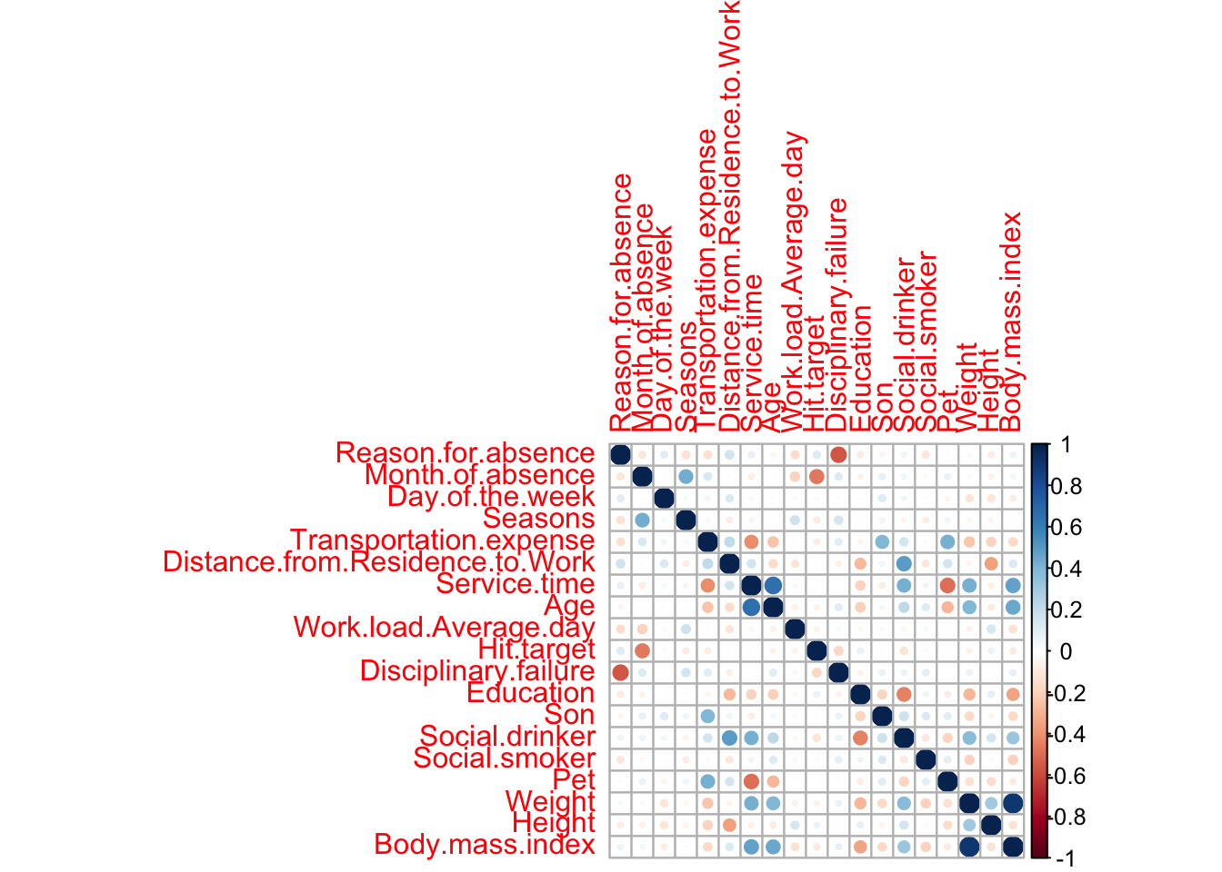
Correlation Between Variables
We build correlation plot to check Multi-Collinearity in our data
Body.mass.index is highly correlated with weight
Similarly, Service time and Age has a significant correlation too.
We will remove highly correlated variables in our modeling process
We can reduce the overfitting in our Model.

Slide 5
Preparing the Data
New attribute has been created Absenteeism group
Mean Substitution for Age, Weight and Hit target (4 Records have been updated)
Based on the variability in the work load average/ day and service time, We will be scaling the data from 0 to 1 for these 2 variables
Absent Hours | Group
0 | 1
0<x<6 | 2
x>=6 | 3

Slide 6
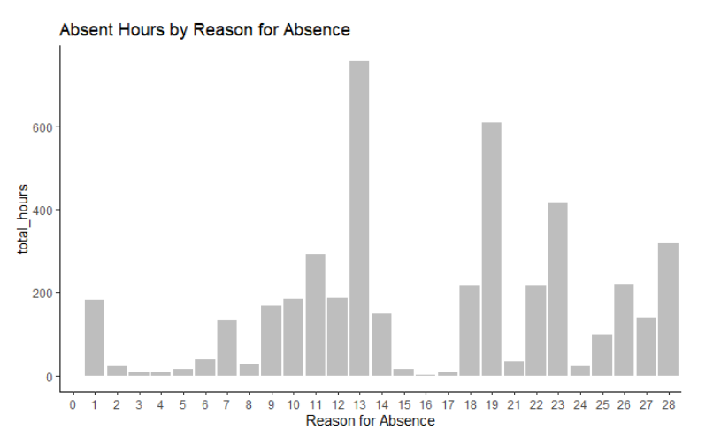
Data Exploration
The reasons most used by employees to be absent are reason 13,19,23, and 28.
These reasons include Medical consultation, Dental consultation, diseases of the musculoskeletal system and connective tissue, and causes of morbidity and mortality

Slide 7
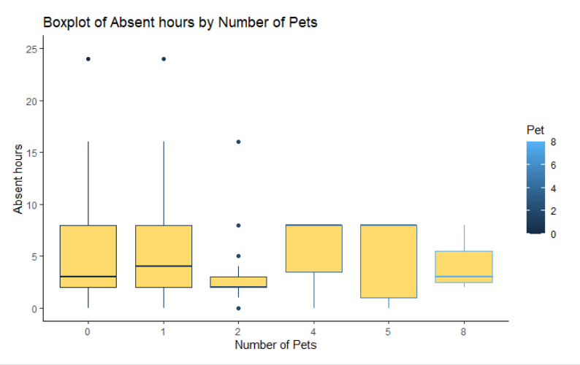
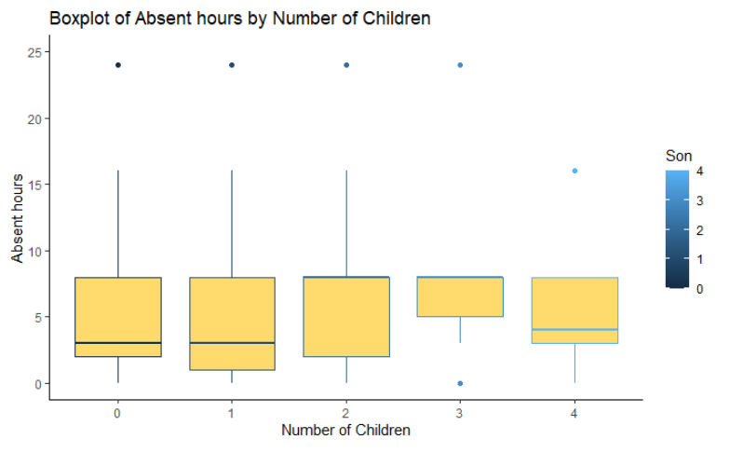
Data Exploration
With more children and pets, the number of absent hours seem to be increasing

Slide 8
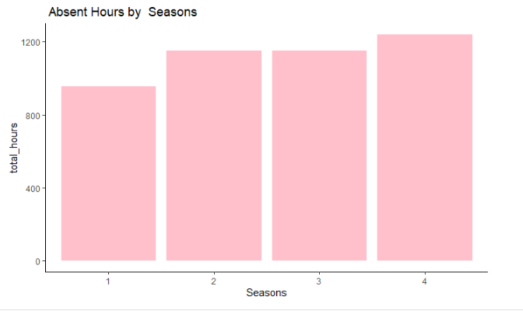
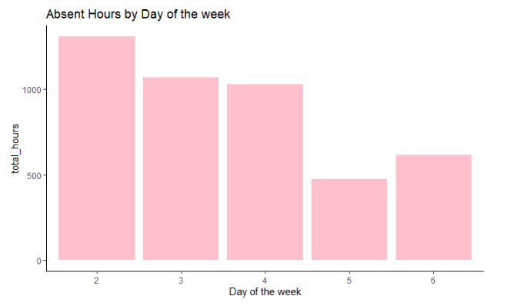
Data Exploration
Mondays have the highest total absenteeism hours while Thursdays have the lowest.
Winter has the highest absenteeism hours, which is inline with CDC

Slide 9
Machine Learning Models Used
Tree Based classification
Random forest
Regression Tree
Naïve Bayes Model
Support Vector Methods (Vanilla, poly and rbf)
K-Nearest Neighbor

Slide 10
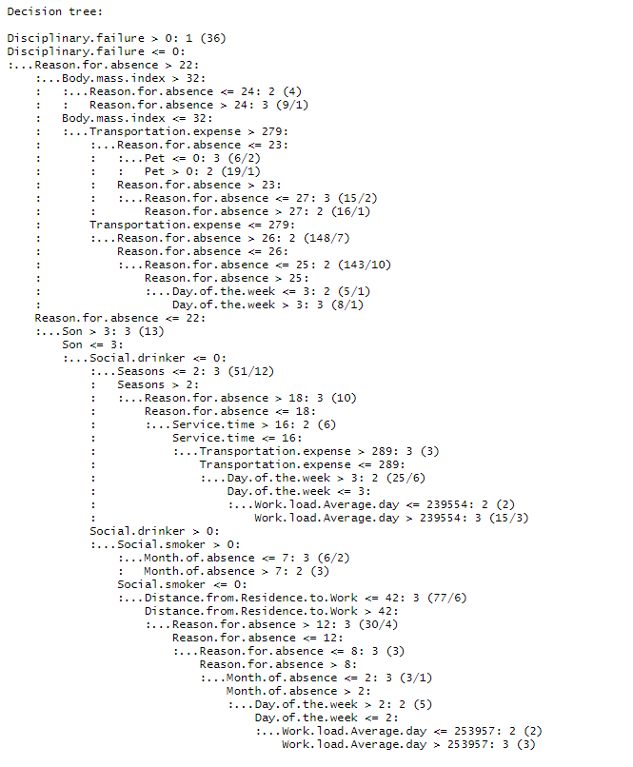
Tree Based Classification
Evaluation Metrics
Accuracy of the Model: 74.3%
Exceptions
Excluded Weight, Since weight and BMI are highly correlated
Excluded Absent hours because absent group is creating using absent hours

Slide 11
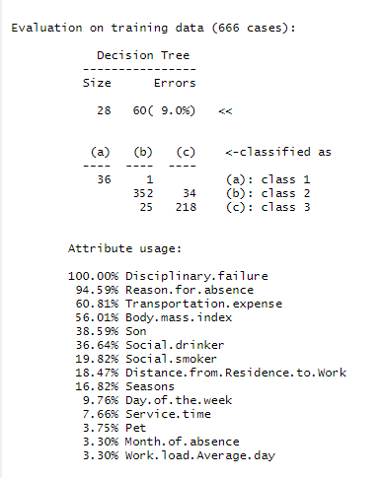
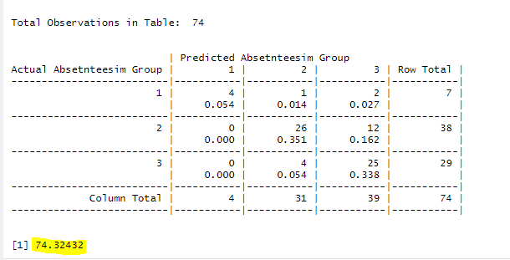
Tree Based Classification

Slide 12
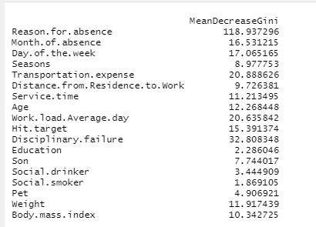
Random Forest
Gini Score
Evaluation Metrics
Accuracy of the Model: 72.9%
Exceptions
Excluded Weight, Since weight and BMI are highly correlated
Excluded Absent hours because absent group is creating using absent hours

Slide 13
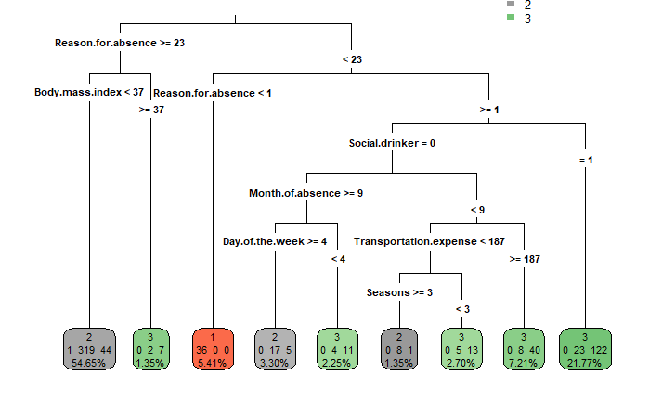
Regression Tree
Evaluation Metrics
Accuracy of the Model: 75.6%
Exceptions
Excluded the ID field from the model
Excluded Weight, Since weight and BMI are highly correlated
Excluded Absent hours because absent group is creating using absent hours

Slide 14
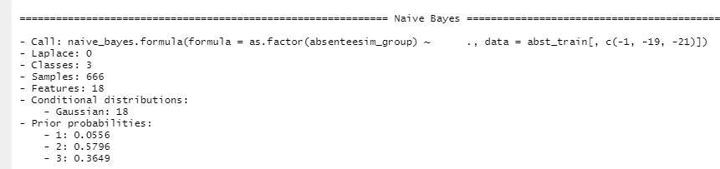
Naïve Bayes
Evaluation Metrics
Accuracy of the Model: 68.9%
Exceptions
Excluded Weight, Since weight and BMI are highly correlated
Excluded Absent hours because absent group is creating using absent hours
Prior Probabilities:
Group 1: 5%
Group 2: 57%
Group 3: 36%
5% of the individuals have 0 absent hours
57% of the records are reported as Absent hours of less than 6.

Slide 15
Naïve Bayes Feature selection
Evaluation Metrics
Accuracy of the Model: 68.9%
Exceptions
Excluded the ID field from the model
Excluded Weight, Since weight and BMI are highly correlated
Excluded Absent hours because absent group is creating using absent hours
Prior Probabilities:
Group 1: 5%
Group 2: 57%
Group 3: 36%
5% of the individuals have 0 absent hours
57% of the records are reported as Absent hours of less than 6.

Slide 16
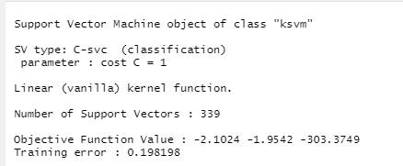
SVM Vanilla Dot
Evaluation Metrics
Accuracy of the Model: 67.5%
Exceptions
Excluded Weight, Since weight and BMI are highly correlated
Excluded Absent hours because absent group is creating using absent hours

Slide 17
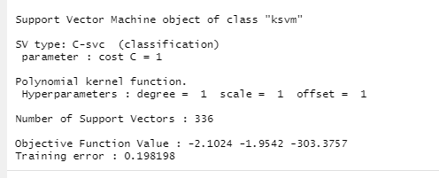
SVM Poly Dot
Evaluation Metrics
Accuracy of the Model: 67.5%
Exceptions
Excluded Weight, Since weight and BMI are highly correlated
Excluded Absent hours because absent group is creating using absent hours

Slide 18
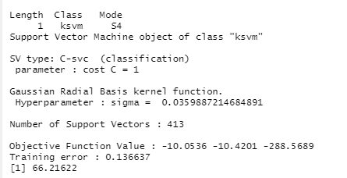
SVM RBF Dot
Evaluation Metrics
Accuracy of the Model: 66.2%
Exceptions
Excluded Weight, Since weight and BMI are highly correlated
Excluded Absent hours because absent group is creating using absent hours

Slide 19

K Nearest Neighbor
Evaluation Metrics
Accuracy of the Model: 47.2%
Confusion Matric
Exceptions
Excluded Weight, Since weight and BMI are highly correlated
Excluded Absent hours because absent group is creating using absent hours

Slide 20

Conclusion
Decision tree classification provides the highest accuracy for the following dataset.
Accuracy: 75.6%
Precision(PPV) for Group 2: 63% Group 3:86%
Recall(TPR) for Group 2: 85% Group 3:65%
F1 Score: 0.73
Very high probability that the model will differentiate individuals with less than 6 and more than 6 absence hours

Slide 21
Take Away
Based on Gini Index:
Reason for Absence (ICD Codes): Keep a close eye on individuals with preexisting conditions
Transportation Expense: Hire closer
Disciplinary Failure: Pay attention
Workload Average: Better distribution
Month of Absence: Crucial Months (March)
BMI: Healthier individuals are less absent
Children and Pets: More responsibilities
Social Drinker and Smoker: T test results (Not significant)

Slide 22
Thank you

