Slide 1
Music Style Transfer and Deep Generative Genre Remastering
Goal
• Part I: general lecture on the field, model families, formulas, and evaluation.
• Part II: our repo-backed system, what we implemented, and what the results actually say.
50-minute lecture + DGGR case study
Sahara Kaul • Kelsey Pattison • Ahmed Sajid
CMPUT 414, Winter 2026
1/34

Slide 2
Talk Map
Lecture half
• Define content, style, and genre before discussing our project.
• Cover representations, disentanglement, conditioning, codecs, diffusion, and long-form coherence.
• Explain what a good evaluation protocol must measure.
Case-study half
• Show DGGR as one concrete architecture built from those ideas.
• Walk lab by lab through architecture, metrics, decisions, and remaining failures.
• Close with audio-demo guidance, creative elements, and Lab 5.
2/34

Slide 3
Part I
General lecture: the field before our project
3/34

Slide 4
Why Music Style Transfer Is Hard
The problem is not just timbre
• Genre affects instrumentation, arrangement, articulation, groove feel, textural density, and production.
• A superficial timbre swap does not make the result sound as if it had been written in the target genre.
• Audio errors are unforgiving: phase issues, smeared attacks, clicks, and warble are obvious to listeners.
What a serious system must solve
• Separate content from style without obvious leakage.
• Represent the target genre as a usable control signal.
• Reconstruct realistic audio without destroying melodic identity.
• Maintain consistency over longer time scales.
4/34

Slide 5
Content, Style, and Genre
Working definitions
• Content: melody, harmonic motion, rhythmic backbone, phrase placement.
• Style: timbre, articulation, groove, density, attack/decay, production texture.
• Genre: a broader manifold shaped by convention, culture, era, and recurring stylistic patterns.
Why the distinction matters
• If the target signal is too weak, the model only repaints surface texture.
• If content and style are not separated, strong edits erase the identity of the song.
• A good model moves the sample toward the target genre manifold while preserving recognizable content.
5/34

Slide 6
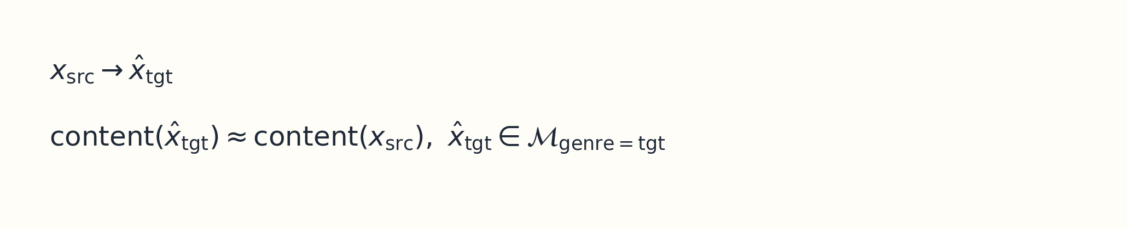
Problem Formulation
Key points
• The output should sound like a plausible target-genre performance, not a filtered source.
• This implies at least three axes of success: content preservation, style fidelity, and realism.
• Long-form systems add a fourth axis: coherence across chunk boundaries and phrases.
6/34

Slide 7
Representation Levels in Music ML
Available levels
• Waveforms capture acoustics directly but are hard spaces for semantic editing.
• Time-frequency features such as log-mel, chroma, onsets, and beat grids expose structure more explicitly.
• Symbolic formats like MIDI or note-rolls help with long-range organization but are weak for timbral realism.
Design lesson
• Strong systems usually combine levels rather than choosing only one.
• Structure is often controlled in spectrogram or symbolic spaces, while realism is delegated to learned decoders or vocoders.
• Our own project follows that hybrid logic.
7/34

Slide 8
Historical Evolution of the Field
Era | Typical approach | Core limitation
Early transfer | Direct mapping and signal tricks | Weak semantic control and obvious artifacts
Disentanglement era | Separate pitch, rhythm, timbre, or content/style | Leakage is difficult to remove and audit
High-fidelity generation | GANs, codecs, vocoders, diffusion | Control and training complexity increase sharply
Long-form systems | Hierarchical latents, anchoring, chunk policies | Drift and accumulation remain hard
8/34

Slide 9
What Evaluation Must Measure
Axis | Question | Common proxy
Content preservation | Did the song identity survive? | latent similarity, pitch or MPS-style metrics
Style fidelity | Did it move toward the target genre? | classifier confidence, centroid alignment
Audio realism | Does it sound plausible? | MR-STFT, adversarial critics, listening
Long-form coherence | Does it stay consistent over time? | boundary metrics, drift checks, human tests
9/34

Slide 10
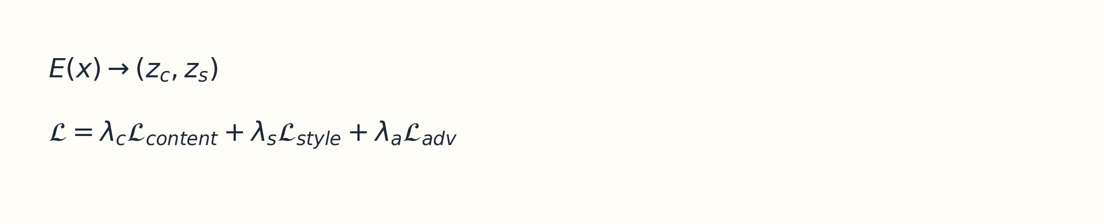
Tool 1: Disentanglement
Key points
• The content branch is rewarded for invariance and punished when style can be recovered from it.
• A gradient reversal layer makes style suppression explicit rather than implicit.
• Dual-encoder, U-Net, and sequence-analogy variants all try to separate factors, but none guarantee success without audits.
10/34

Slide 11
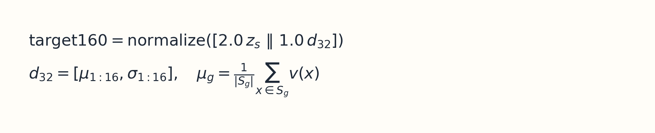
Tool 2: Target Style Spaces
Key points
• A target genre should be treated as a region in style space, not a single example or flat one-hot label.
• Good target spaces have stable centroids, useful nearest-neighbor behavior, and clear class separation.
• If the style space collapses, every later generator looks weaker than it really is.
11/34

Slide 12
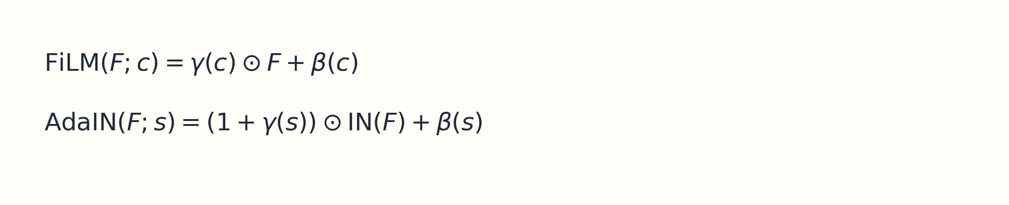
Tool 3: Conditioning Mechanisms
Key points
• FiLM allows a control vector to modulate intermediate activations throughout the network.
• AdaIN is useful when style should act more like timbre or texture than global structure.
• A good architecture decides where style and structure should interact and where they should remain separate.
12/34

Slide 13
Tool 4: Generator Families
Family | Why people use it | Tradeoff
Waveform GANs | Fast parallel generation | Phase and local coherence are difficult
Spectral GANs | Better phase handling in structured domains | Need strong inversion or vocoding
Neural codec editors | Decoder acts as a realism prior | The translator can become too conservative
Diffusion models | Stable training and rich controllability | Slow inference and long-form drift
13/34

Slide 14
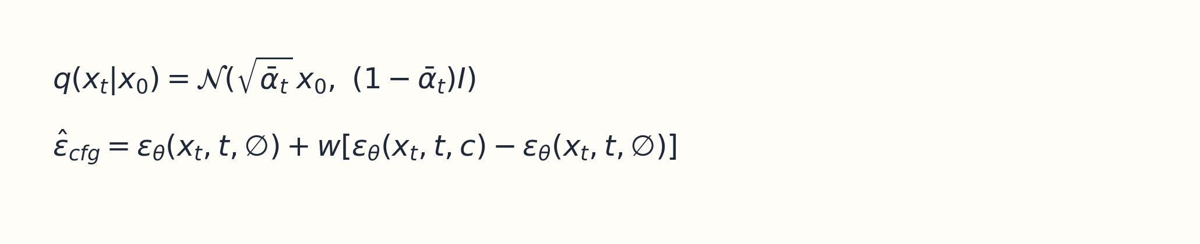
Tool 5: Diffusion and Guidance
Key points
• The forward process destroys structure gradually and the reverse model learns to reconstruct it.
• Classifier-free guidance provides a direct knob over how strongly the model should chase the condition.
• This is especially useful when style intensity and content preservation compete.
14/34

Slide 15
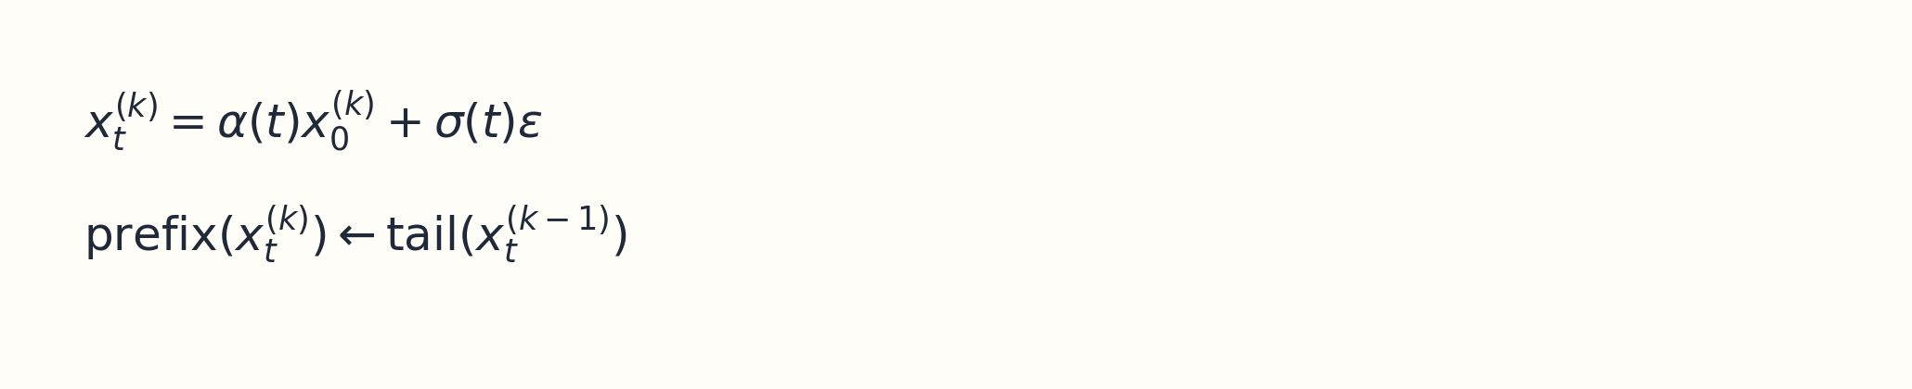
Tool 6: Long-Form Coherence
Key points
• SDEdit-style anchoring starts from a noised source rather than pure noise so macro-structure survives.
• Overlap locking tries to make adjacent chunks compatible during sampling, not only after vocoding.
• Long-form quality becomes a systems problem involving chunk policy, re-anchoring, and stabilization.
15/34

Slide 16
Field-Level Design Rules
What to do
• Measure representation quality separately from generation quality.
• Listen to checkpoints rather than trusting only scalar metrics.
• Use staged architectures when data and compute do not justify a monolithic model.
What to avoid
• Assuming a high genre score means the transfer is musically convincing.
• Treating long-form crossfades as a substitute for coherence constraints.
• Ignoring dataset-source confounds in the label design.
16/34

Slide 17
Part II
DGGR as a case study built from those ideas
17/34

Slide 18
DGGR: Project Thesis
What we set out to build
• A staged genre-remastering pipeline rather than a shallow style filter.
• Lab 1 deconstructs the source, Lab 2 builds the target blueprint, Lab 3 reconstructs audio, Lab 4 extends to long-form coherence.
• Lab 5 is the planned perceptual validation layer.
Current repo-backed status
• Labs 1 through 4 are implemented in code.
• We have saved metrics, training histories, generated clips, and long-form diagnostics.
• The strongest current evidence path is the codec branch for short-form transfer.
18/34

Slide 19
DGGR Pipeline Overview
Lab 3A
codec translator EnCodec + FiLM
Input
song or 5-second chunk
Lab 1
deconstruction z_content / z_style
Lab 2
target160 centroids
Lab 4
long-form coherence prefix lock
Lab 3B
diffusion V2 mel + BigVGAN
Thesis
The system is staged because each lab solves one field-level problem explicitly instead of hiding everything inside a single end-to-end mapping.
19/34

Slide 20
Data Universe and Label Risks
What the workflow currently uses
• Baroque/classical renders, hip-hop material, lo-fi material, open-domain CC0 music, and speech negatives for the gate.
• Observed Lab 2 class buckets: baroque_classical 411, cc0_other 1200, hiphop_xtc 1200, lofi_hh_lfbb 1200.
Why this is a real risk
• Genre labels can correlate with dataset source and recording conditions.
• A model may learn source fingerprints instead of transferable style.
• This is not a side note; it changes how we interpret every later metric.
20/34

Slide 21
Lab 1: Deconstruction Encoder
Architecture
• Input: 96-bin log-mel spectrogram from a fixed 5-second chunk.
• Backbone: 3-block Conv2D encoder with stride-2 downsampling, global pooling, and shared projection.
• Heads: z_content, z_style, style probe, adversarial style-from-content probe, and music gate.
Why this matters
• Every later module assumes style and content can be recombined cleanly.
• The training curriculum increases adversarial pressure and sharpens gate behavior over phases.
• Without this step, the later generator becomes a brittle edit network.
21/34

Slide 22
Lab 1: Measured Outcome
Best observed audit
• Style probe accuracy: 0.9417
• Content leakage above baseline: 0.1083
• Gate ROC AUC: 0.9299
• All three pass the project thresholds.
Interpretation
• z_style is informative.
• z_content is substantially style-suppressed.
• The gate separates music from non-music reliably, though thresholding still trades precision for recall.
22/34

Slide 23
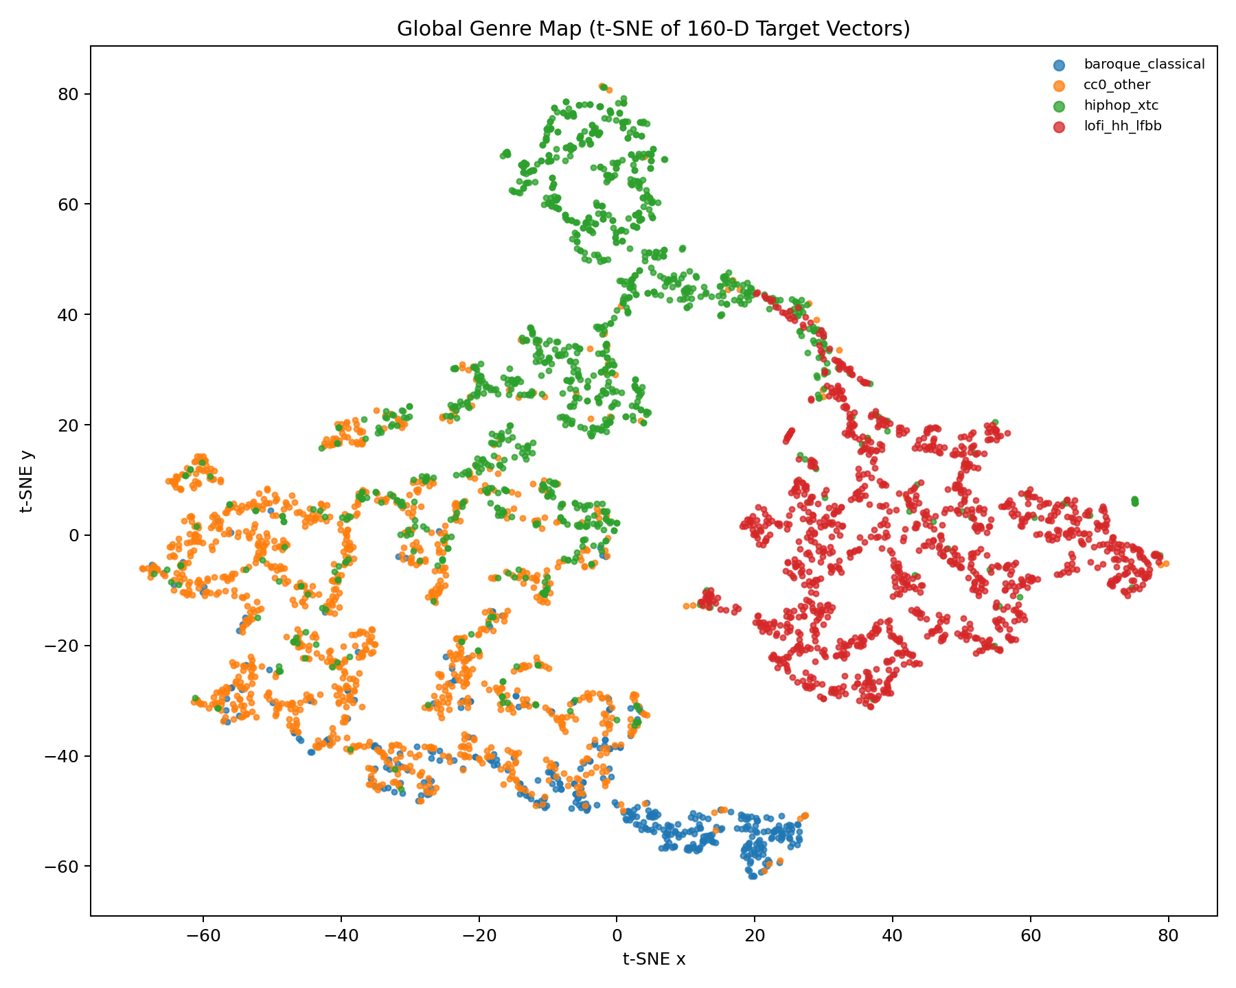
Lab 2: Building the Target160 Style Space
Why this slide matters
• target160 combines a 128D learned style vector with 32 mel-descriptor statistics.
• Per-genre centroids are computed after inlier filtering to avoid blueprint drift.
• The point of the space is not only separation but generator-usable geometry.
t-SNE from the current Lab 2 calibration artifacts
23/34

Slide 24
Lab 2: Validation
Current metrics
• Linear probe accuracy: 0.8554
• Nearest centroid accuracy: 0.8514
• Silhouette (cosine): 0.4939
• The project threshold was silhouette >= 0.45.
What the result means
• The target space is separated enough to act as a real conditioning blueprint.
• This is why later improvements in generation are believable rather than accidental.
• Lab 2 is upstream of Lab 3 quality.
24/34

Slide 25
Lab 3A: Codec-Latent Translator
Architecture
• Operate on EnCodec quantized embeddings rather than raw waveform samples.
• Conv1D in-projection, hidden width 256, 10 FiLM-conditioned residual blocks, then Conv1D back to 128 channels.
• Condition vector combines z_content, target style, and small noise.
Key decision
• The best run uses direct-output mode instead of residual mode.
• That removes the identity leash that was limiting style-shift magnitude.
• The EnCodec decoder provides a realism prior for short-form generation.
25/34

Slide 26
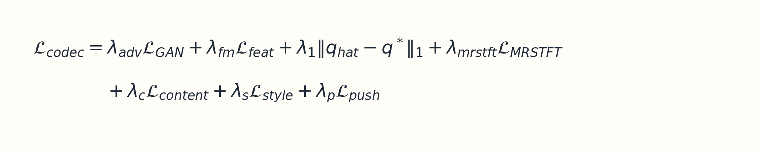
Lab 3A: Loss Stack and Best Run
Key points
• Best saved run: run1055.
• MPS 0.9565, style confidence 0.8940, style accuracy 0.9492.
• The strongest explanation is the combination of MERT-based conditioning, direct output, and explicit content preservation pressure.
26/34

Slide 27
Lab 3B: Diffusion V2
Architecture
• Input tensor: [B, 15, 80, 432] = noisy mel + chroma + onset + beat-grid channels.
• UNet channels [64, 128, 256, 256], two residual blocks per level, low-resolution attention, EMA shadow model.
• Output: [B, 1, 80, 432] velocity/noise prediction for DDIM sampling.
Condition split
• time + content -> FiLM
• style -> dedicated StyleAdaIN
• This separation is intended to keep texture control from overwhelming melody control.
27/34

Slide 28
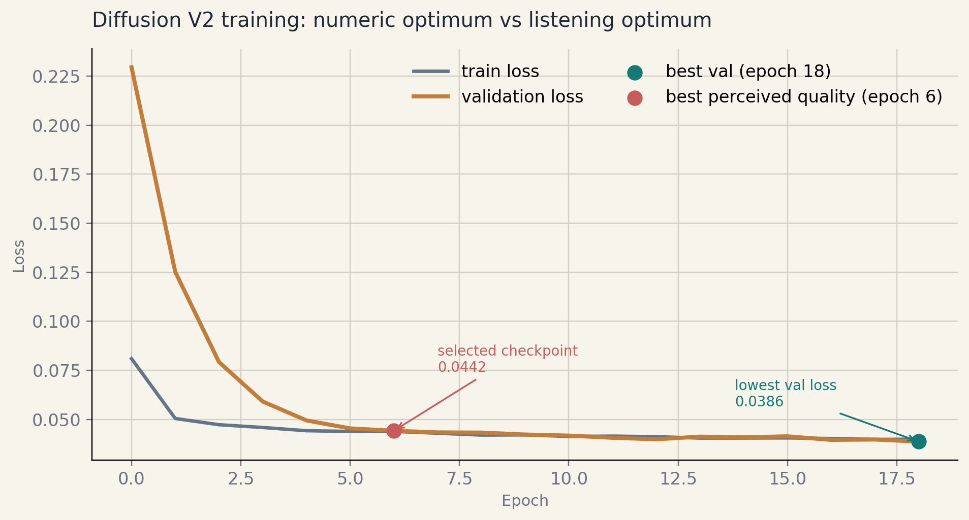
Diffusion Training Behavior
Why this slide matters
• Best numeric validation loss occurs late, but the team selected epoch 6 as the best-sounding checkpoint.
• This is a standard generative-audio lesson: the perceptual optimum can arrive before the scalar optimum.
• The diffusion branch remains the more ambitious but less reliable reconstruction path.
validation loss history for the current V2 run
28/34

Slide 29
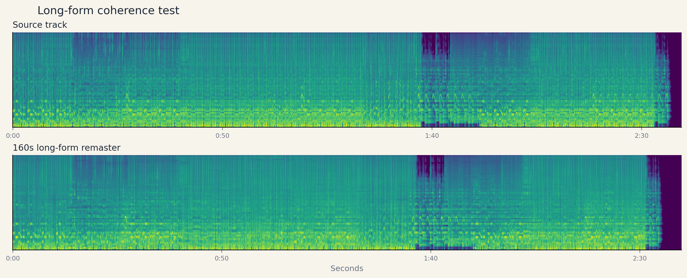
Lab 4: Long-Form Coherence Diagnostics
Why this slide matters
• 64 overlapping chunks over a 160-second song.
• Boundary mel MSE mean 0.0018347, boundary discontinuity mean 2.8691 dB.
• Seams are not the main failure mode; warble and static accumulation are harder problems now.
full-song coherence diagnostics over 160 seconds
29/34

Slide 30
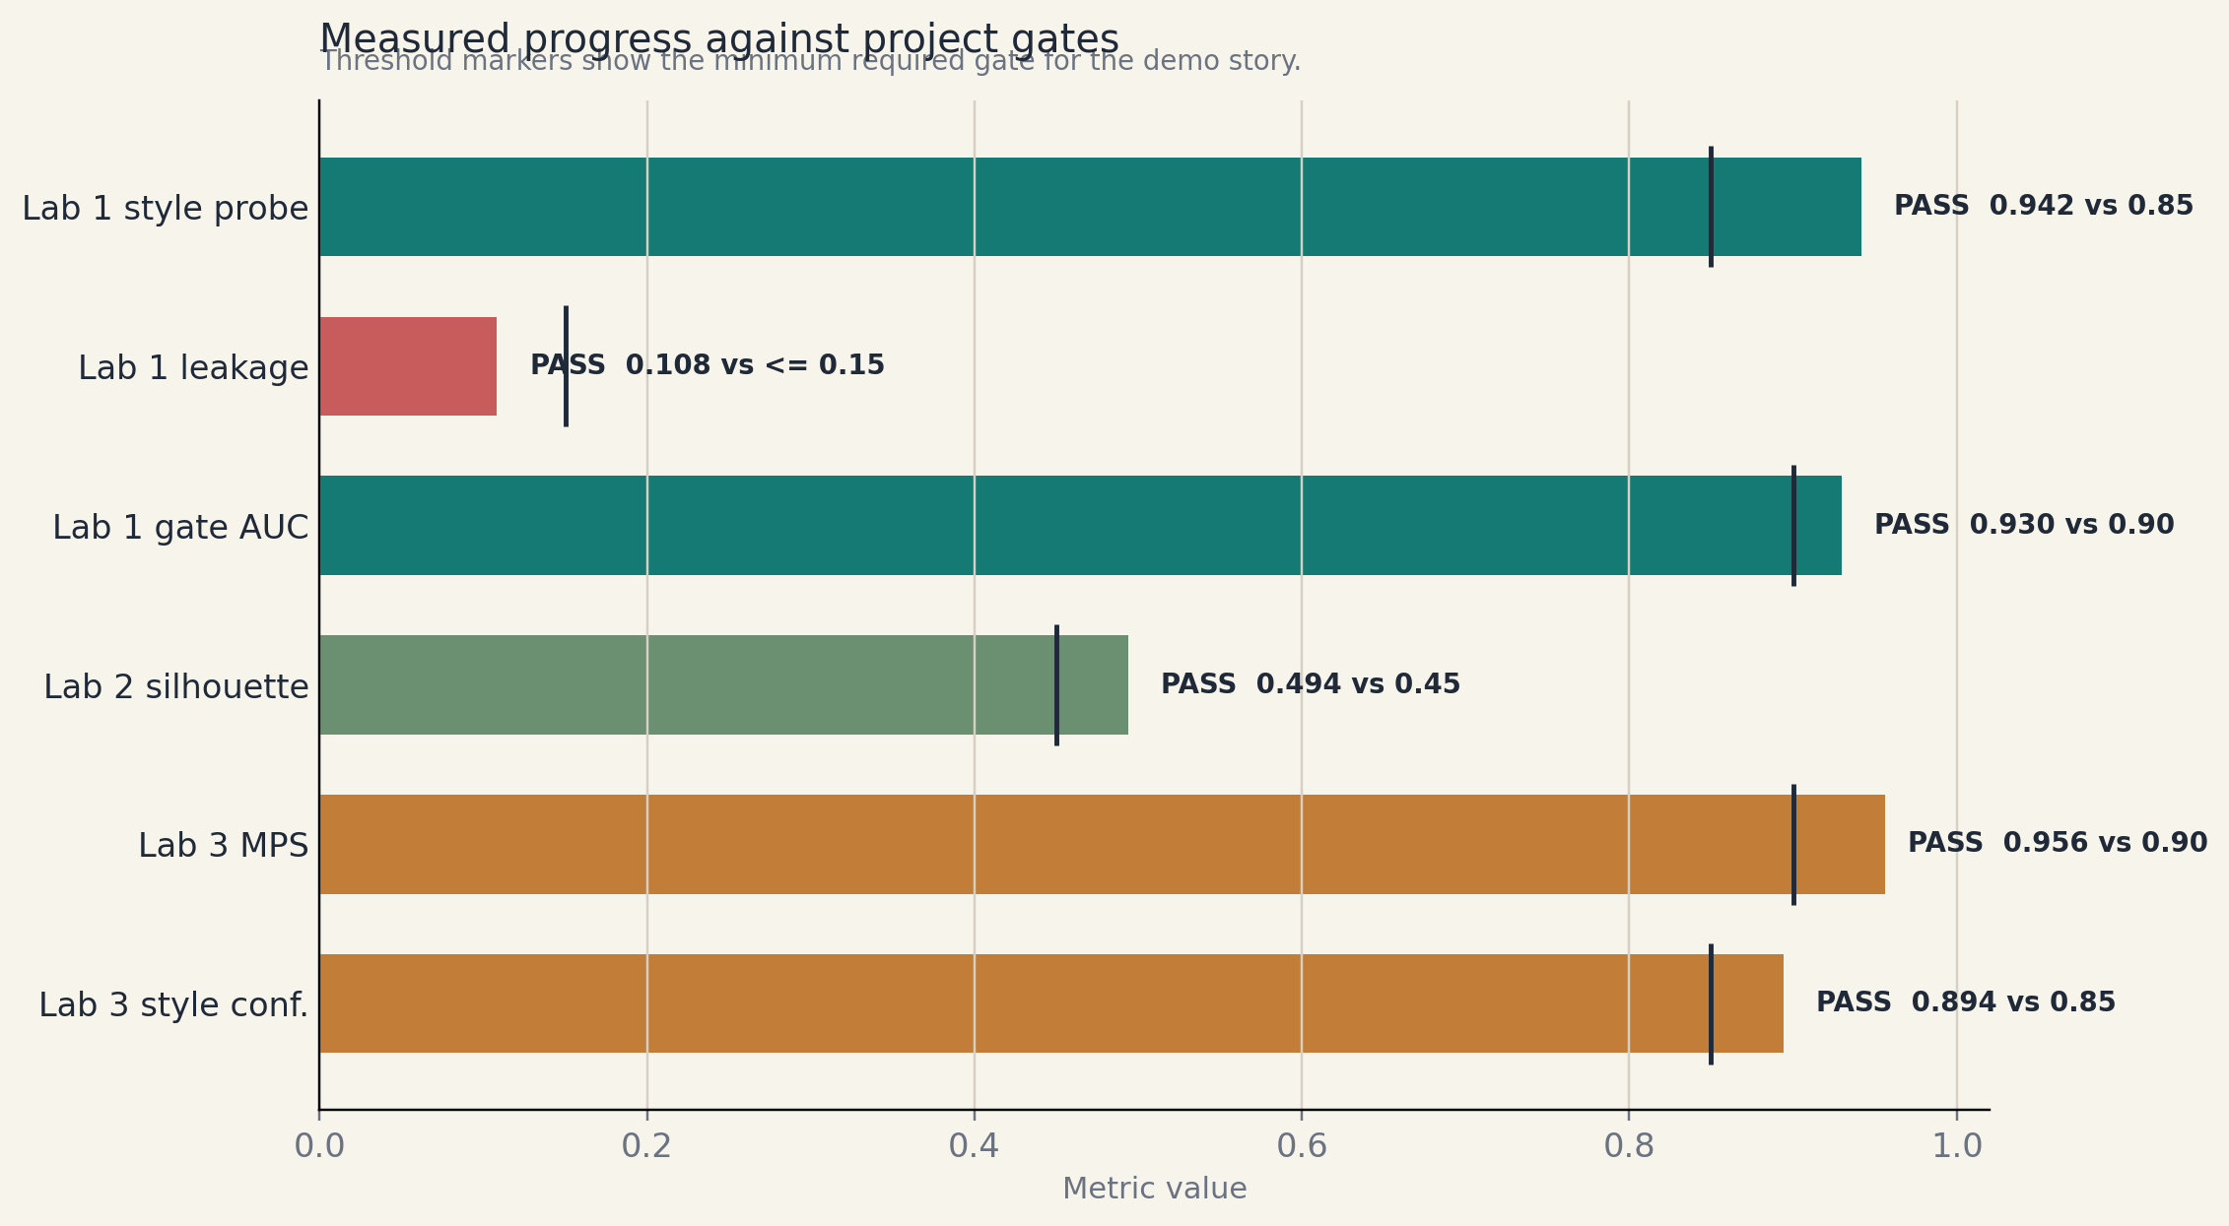
Quantitative Summary Across Labs
Why this slide matters
• Lab 1 and Lab 2 both clear their target thresholds.
• The codec branch is the strongest current short-form evidence path.
• Open gaps remain in diffusion quality, long-form texture stability, and human evaluation.
repo-backed metric summary generated from saved artifacts
30/34

Slide 31
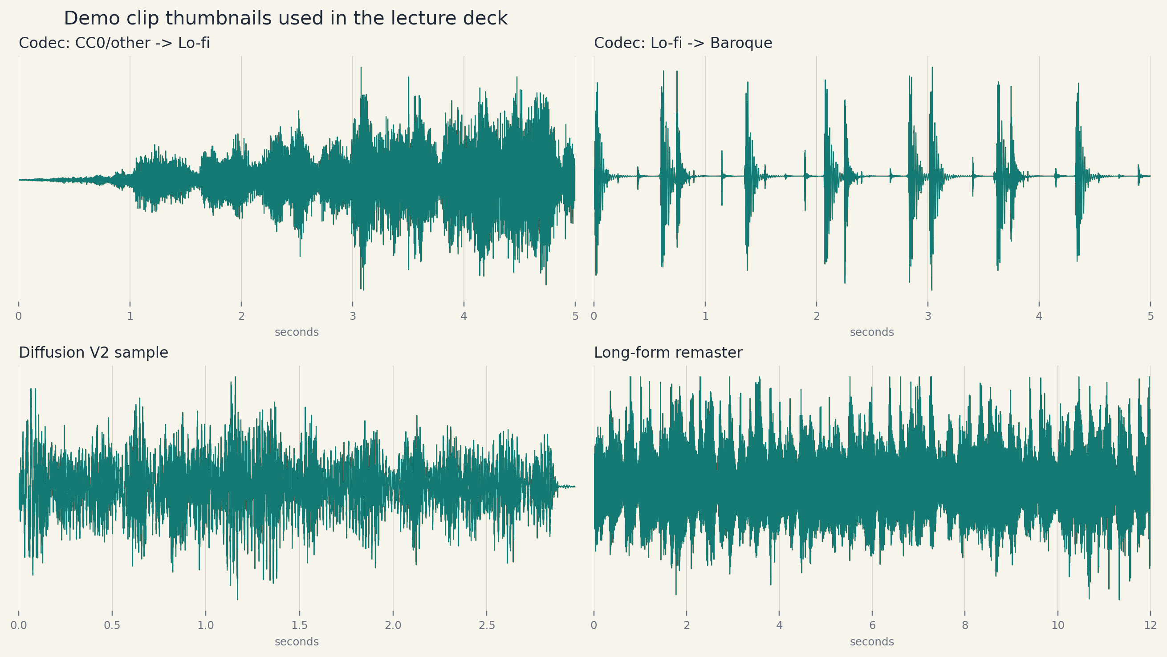

Demo Slide: Short-Form Codec Examples
Clip inventory
CC0 other to lo-fi
codec_src1_tgt3.mp3
hip-hop to open-domain other
codec_src2_tgt1.mp3
lo-fi to baroque
codec_src3_tgt0.mp3
Listen for melody survival, target-genre plausibility, and whether the output sounds like audio rather than a synthetic artifact.
spectrogram montage from the best codec run
31/34

Slide 32
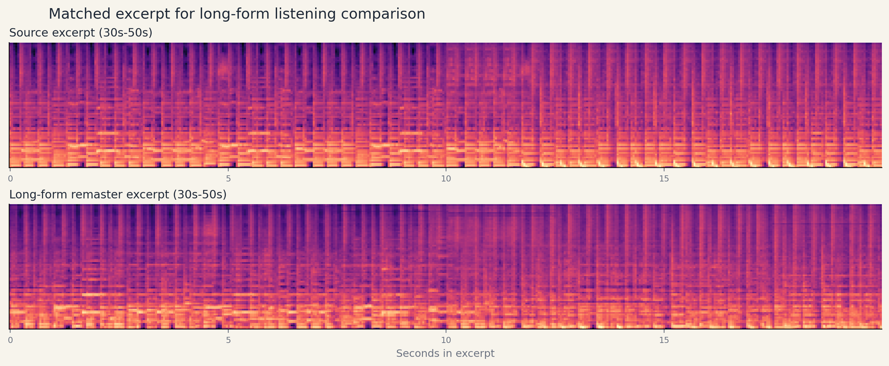
Demo Slide: Diffusion and Long-Form Excerpts
Clip inventory
Diffusion V2 sample
diffusion_v2_epoch6_gen0.mp3
Source excerpt 30s to 50s
longform_source_excerpt.mp3
Remastered excerpt same segment
longform_remaster_excerpt.mp3
Here the listening question changes: continuity, phrasing, and artifact buildup matter more than isolated short-form quality.
source/remaster excerpt comparison plus diffusion example
32/34

Slide 33
Creative Elements and Limitations
Why the project is not generic
• Structure-first framing of genre remastering rather than shallow timbre swapping.
• A staged architecture with explicit deconstruction, calibration, reconstruction, and coherence stages.
• Direct-output codec translation, MERT-based conditioning, and prefix-lock sampling controls.
Where the work remains
• Dataset-source leakage is still a real risk.
• Diffusion quality still trails codec transfer on short-form reliability.
• Long-form audio still accumulates warble and static under stronger edits.
33/34

Slide 34
Lab 5 and Conclusion
What Lab 5 must answer
• Can listeners identify the target genre?
• Can they still recognize the source melody?
• Do they prefer our remaster to a simpler filter-style baseline?
Bottom line
• The repo already supports a credible architecture story and measurable intermediate success.
• The remaining question is no longer whether the system runs.
• The real question is whether people actually hear the intended effect convincingly.
34/34

