Slide 1
Musical Style Transfer
Sahara Kaul, Ahmed Sajid, Kelsey Pattison

Slide 2
Introduction

Slide 3
Style Transfer
What is style transfer?
At a high level, style transfer means taking the content of one piece and combining it with the style of another.
In music, that means preserving the underlying musical identity while changing timbre, instrumentation, texture, articulation, or production character.

Slide 4
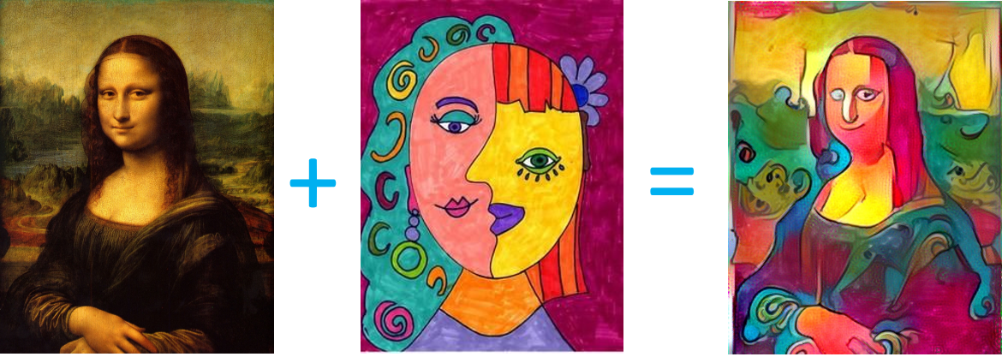
Style Transfer
Content
Style
Output

Slide 5
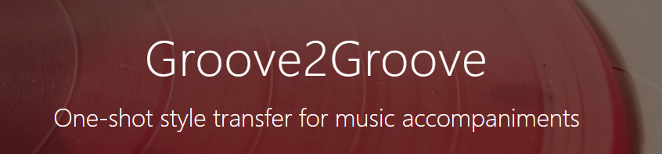
Musical Style Transfer
Demo

Slide 6
Style vs Content
Content: melody, rhythm, notes being played, harmonic path, phrase structure
Style: timbre, instrumentation, texture, dynamics, articulation, expressive details

Slide 7
The Challenge
Why music style transfer is harder than it first seems
A single recording contains melody, rhythm, harmony, timbre, texture, instrumentation, room acoustics, mixing decisions, and long-range form all at once.
Because these factors are entangled, changing one layer often damages another. That is why weak systems often produce a “coat of paint” result rather than a true re-authoring.

Slide 8
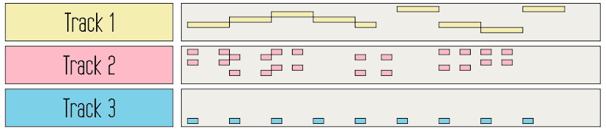
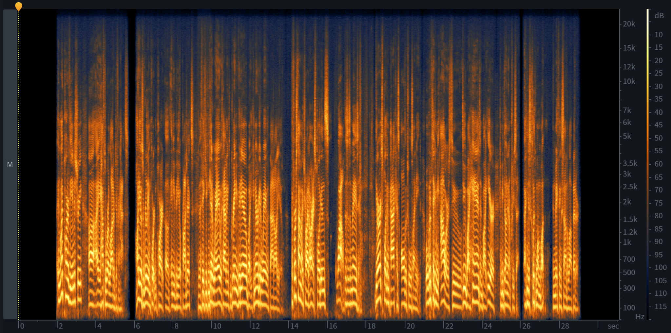
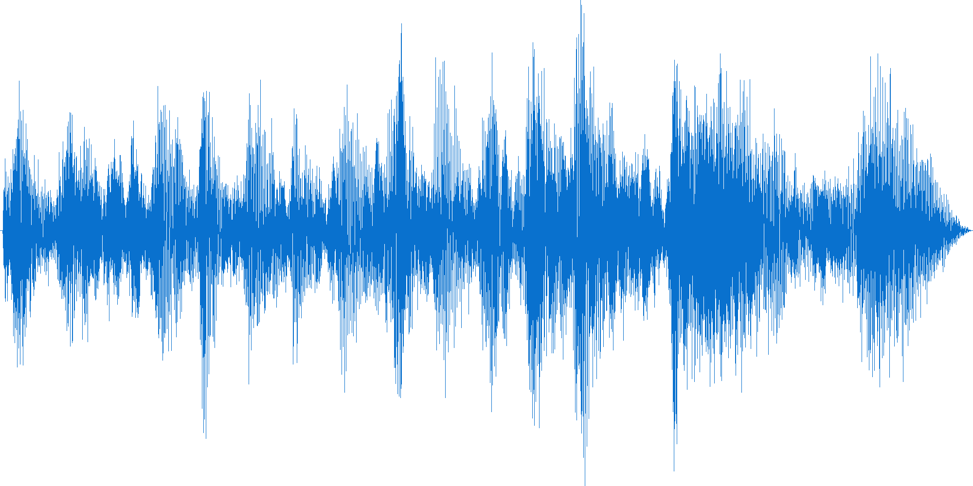
Audio Representations
Audio can be represented as:
MIDI
Spectrograms and log-mel features
Raw waveforms
Learned latent representations

Slide 9
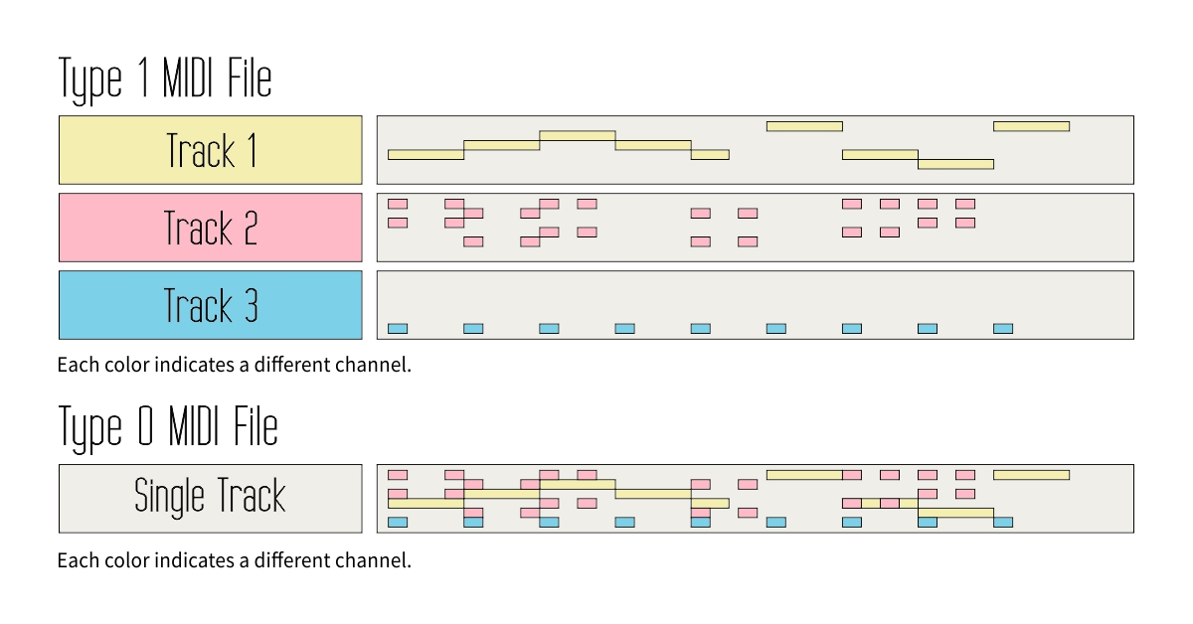
Audio Representations
MIDI
Stores note events and controller messages rather than final sound
Small file size
Easy manipulation
But a lot of timbral realism is missing

Slide 10
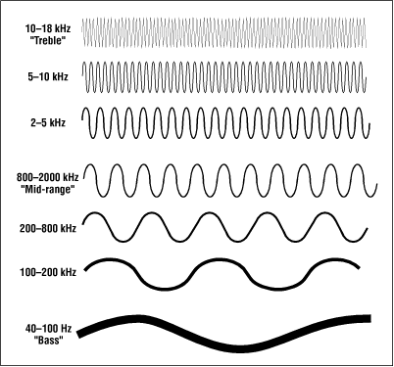
Audio Representations
Raw waveforms
Highest fidelity representation
X-axis is time, Y-axis is air-pressure displacement
Wave shape carries timbre and local acoustic detail
But it is a very dense space for semantic editing

Slide 11
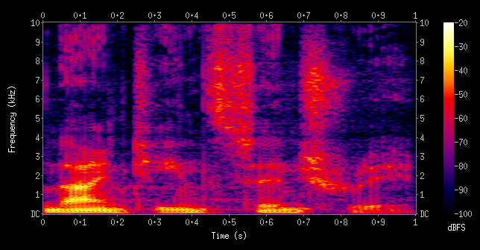
Audio Representations
Spectrograms
Commonly used in style-transfer architectures
X-axis is time, Y-axis is frequency, color intensity reflects amplitude
Computed from waveforms using the Short-Time Fourier Transform
They expose musical structure more clearly than raw waveforms

Slide 12
Short Time Fourier Transform
Fourier Transform vs STFT
The Fourier Transform tells us what frequencies are present overall.
The STFT applies the transform to short overlapping windows, giving a time-frequency representation of the signal.

Slide 13
Early Audio Generation Background

Slide 14

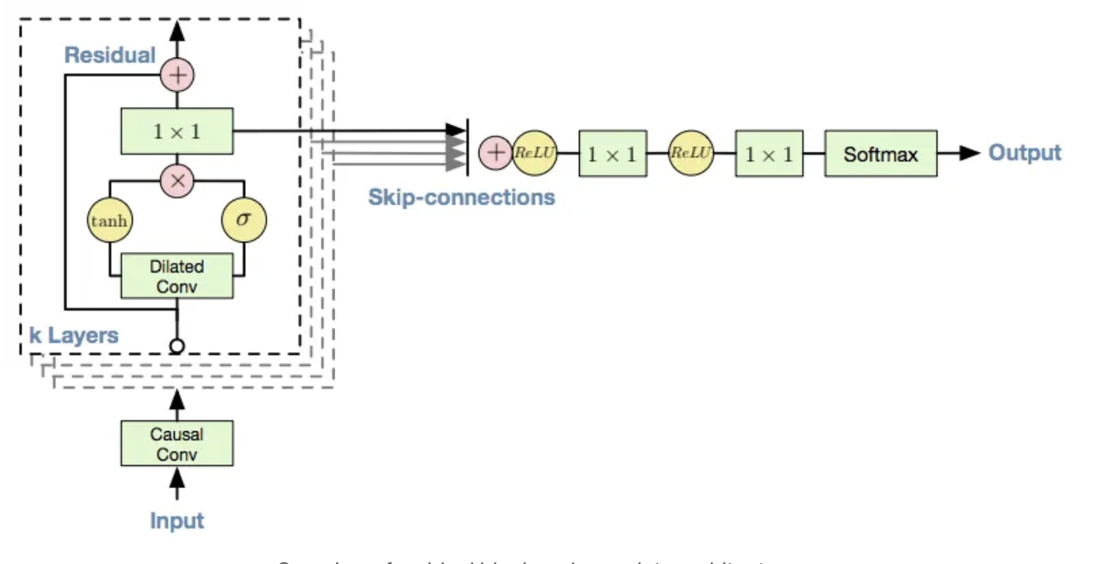
WaveNet
Introduced by DeepMind in 2016
Autoregressive model with dilated causal convolutions
A major milestone in realistic neural audio generation
But it generates one sample at a time, so inference is slow and expensive

Slide 15
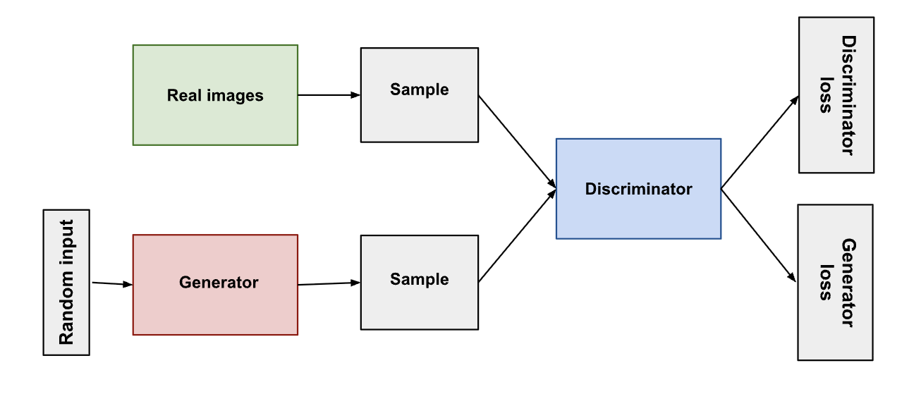
Background About GANs
Generative Adversarial Networks are built around two networks:
Generator: produces fake samples
Discriminator: distinguishes real samples from fake ones
They became popular because they often produced sharper outputs than standard autoencoder-style models.

Slide 16
WaveGAN
One of the first successful GAN-based raw-audio generators
Adapts image-GAN ideas to one-dimensional audio
Introduces phase shuffle to reduce trivial phase artifacts
Important historically, but limited by phase precession and short fixed-length output

Slide 17
GANSynth
Instead of generating raw waveforms directly, GANSynth generates log-magnitude spectrograms and instantaneous-frequency spectrograms.
Instantaneous frequency is more stable than raw phase under alignment shifts.
Magnitude + IF are converted back into waveform audio through phase reconstruction and inverse STFT.
Field lesson: representation choice matters.

Slide 18
Why Early Audio Generation Was Not Enough
WaveNet, WaveGAN, and GANSynth showed that neural audio generation was possible.
But they did not explicitly guarantee that the original musical content would be preserved.
They were strong historical steps in audio generation, but weak direct solutions to music style transfer.

Slide 19
Latent Structured Audio and Style Transfer

Slide 20
Variational Autoencoders
VAEs are attractive because they expose a latent space where musical properties might be manipulated.
Encoder compresses the input into latent variable z; decoder reconstructs from z.
Naive audio VAEs struggle with posterior collapse, weak global bottlenecks, and raw sequential complexity.
Still, the latent-space idea remains very valuable for style transfer.

Slide 21
MoVE
MoVE stands for Modulated Variational auto-Encoders for many-to-many musical timbre transfer.
It was built specifically for musical timbre transfer rather than generic audio generation.
Uses FiLM conditioning and an MMD objective to support many-to-many transfer in a single multi-domain model.
Very relevant conceptually, but still closer to timbre transfer than full genre remastering.

Slide 22
RAVE
RAVE makes high-quality latent audio practical.
Uses spectral losses instead of only raw sample-wise reconstruction.
Preserves temporal structure with sequences of latent codes rather than one weak global vector.
Improves decoder realism with adversarial sharpening and supports music-quality audio generation.

Slide 23
AudioLM
AudioLM is not a style-transfer model directly, but it addresses long-form coherence.
Treats audio generation like language modeling over discrete audio tokens.
Separates tokens for long-range structure from tokens for fine acoustic detail.
Important because long-range stability is one of the hardest downstream problems in genre remastering.

Slide 24
Modern Controllable Synthesis and Style Transfer

Slide 25
BigVGAN and FiLM
BigVGAN is a universal neural vocoder: it turns intermediate audio representations into more realistic waveform audio.
Its role is realism rather than transfer logic itself.
FiLM is a conditioning mechanism that lets a style vector scale and shift hidden features throughout the network.
Its role is style-control logic rather than final waveform synthesis.

Slide 26
DDPM
Denoising Diffusion Probabilistic Models gradually destroy a sample with noise and learn the reverse denoising process.
Diffusion matters because generation happens by gradual refinement rather than one-shot synthesis.
That usually gives more stability and more room for control than many older model families.

Slide 27
Classifier-Free Guidance and SDEdit
Classifier-Free Guidance adds a practical control knob for how strongly the generation should follow the target condition.
SDEdit starts from a noised version of an existing source instead of pure noise.
Together they make the content-versus-style tradeoff much more explicit.

Slide 28
AudioLDM and Why Diffusion Is the Modern Direction
AudioLDM shows that high-quality controllable generation can happen in learned latent audio spaces.
This makes diffusion much more relevant to editing and transformation, not only text-to-audio generation.
Diffusion is central because it combines progressive generation, conditioning, guidance, and source anchoring.

Slide 29
Overview of Field Trends
1. Disentanglement
2. Controllable latent audio
3. Diffusion-based re-authoring
4. Long-form coherence
The field moved from raw generation toward structured representations and explicit control.

Slide 30
Conclusion
Music style transfer is not just an audio-generation problem.
It is also a structure-preservation, representation, conditioning, synthesis, and coherence problem.
The field is moving from surface transfer toward structure-aware genre reconstruction.

