Slide 1
CUNY DATA 607 Final Project Lung Cancer & Air Pollution Ahmed Sajjad & Ali Harb

Slide 2
Objective / Motivation
Objective: To determine the relationship between lung cancer and air pollution
Description/Motivation: The air we breathe is filled with cancer causing substances. There is an increased risk of lung cancer with increasing level of exposure to outdoor air pollution and particulate matter.
In this project, our focus was to determine if there is any relationship between air pollution and lung cancer.

Slide 3
Background
Objective: Lung cancer is caused by many factors. One of the factors is air pollutants. There are many types of air pollutants: carbon mono-oxide, lead, ground-level ozone, nitrogen dioxide, sulfur dioxide and particulate matter.
Particulate Matter (PM) is a complex mixture of extremely small particles and liquid droplets that get into the air. Once inhaled these particles can effect the heart and lungs and can cause serious health risks.
Particulate Matter is measured with an index called PM2.5.
PM2.5 are extremely small air pollutants with a diameter of 2.5 micrometers or less.
The objective is to determine if there’s any relationship between PM2.5 and incidents of lung cancer.

Slide 4
Data sets
In this project, we used PM2.5 index and compared it with the count of lung cancer incidents for 7 different cities:
Atlanta
Detroit
Los Angeles
San Francisco
San Jose
Seattle
Pittsburgh
The data is obtained from 3 different sites:
Centers for Disease Control and Prevention (CDC)
Environmental Protection Agency (EPA)
Pennsylvania Government Health and Statistics (Pittsburgh)

Slide 5
Data sets
We obtained lung cancer incidence datasets for 7 different cities for 15 years each (from 1999 to 2013)
Also, we obtained pollution data for the same 15 years (1999-2013) for each of the above cities

Slide 6
Libraries
The following dplyr/tidyr functions are used in this project:
dplyr | tidyr
mutate | gather
filter
arrange
select

Slide 7
Load/Transform/Clean Data
Load lung cancer count data from CSV file
Transform wide format to long format
Load air pollution data for 7 cities for 15 years (from 105 CSV files)
The air pollution data is collected for each day of the year. So, we take the mean value for each year from 1999 to 2013 for each city. Since the lung cancer incidence data is available for each year, it will be easier for our analysis if the pollution data is also converted to yearly PM2.5 value.
Combine lung cancer dataset and air pollution dataset

Slide 8
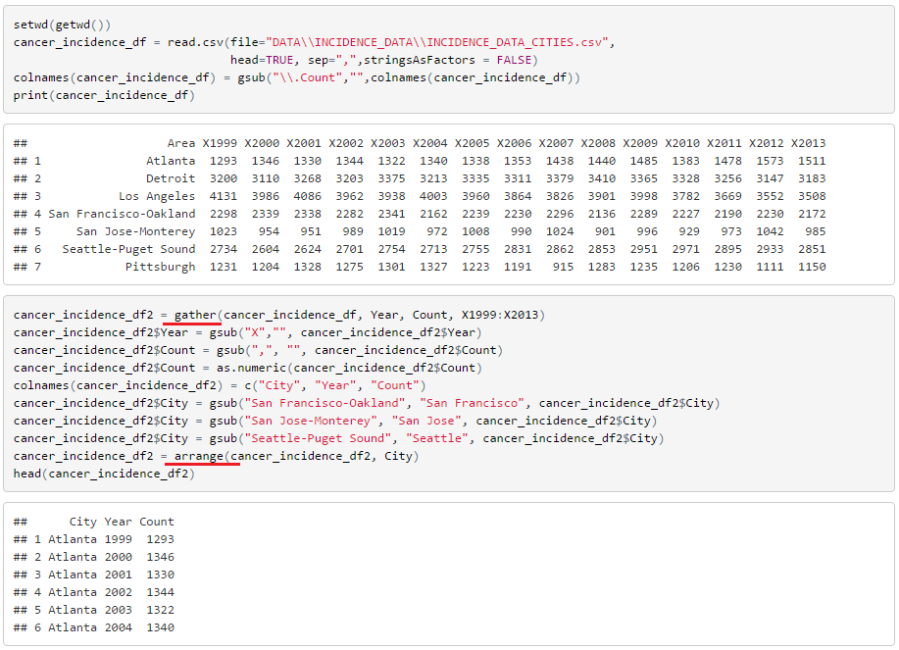
Load/Transform/Clean Data

Slide 9
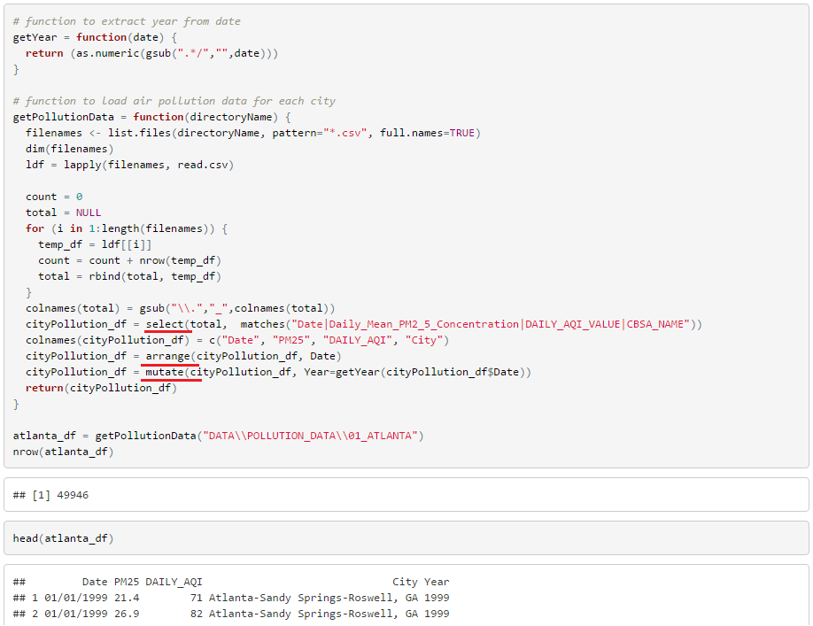
Load/Transform/Clean Data

Slide 10
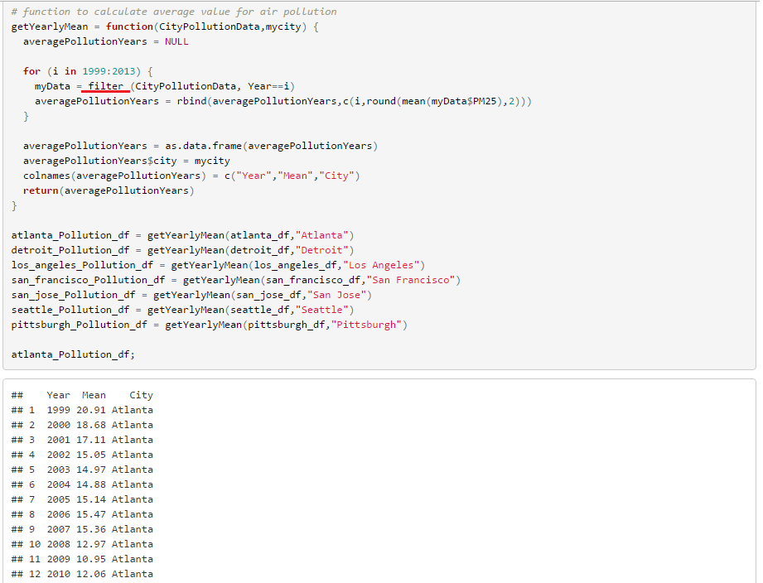
Prepare Data

Slide 11
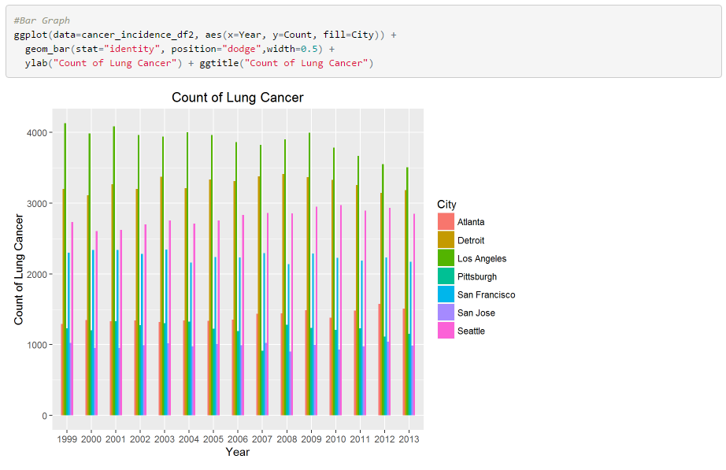
Data Visualization

Slide 12
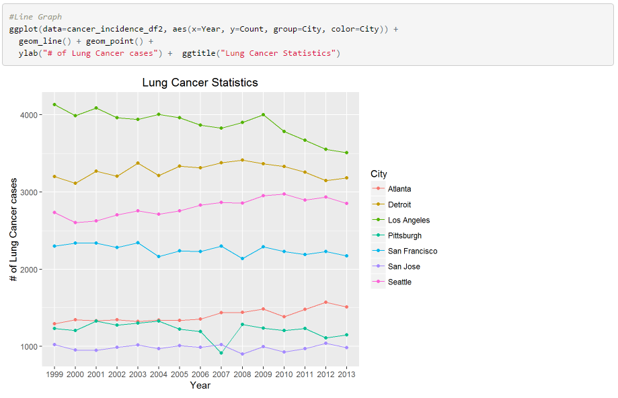
Data Visualization

Slide 13
Challenges
Data collection
Finding the right source to get lung cancer incidence data was a challenge
Data cleaning
Large amounts of Air pollution data is available but we had to match it with yearly lung cancer incidence data for analysis

Slide 14
Statistical Analysis
Statistical Analysis of the data and conclusion will be presented by other team member.

