Slide 1
JobGenie
AI-Powered Job Recommender
By: Asawari Kadam
Notes:
Asawari 1-5
Hello Everyone, I would like to ask you all one simple question. Who all are looking for a job these days? All of us, right?. I think except our Professor everyone else is looking for a job right now.
Job applications are a hectic process and considering todays market where there are very less jobs and huge candidate pool, candidate needs to stand out.
We all are applying on LinkedIn, Indeed and wherever possible but no platform actually gives us job postings according to our resume.
We have to go and look for the job on each website. You have to go to websites like Jobscan/vmock to get your resume rating and understand weak points in your resume.
Then you have to go to LinkedIn to apply for the jobs.
This is a very complicated process and you have to count all the blessings you can get during this process.
What if we bring these aspects together? Wouldnt that be great? Thats why we bring your own JobGenie. This is your own AI powered job recommender.

Slide 2
Table of contents
01
03
02
04
Introduction
Agile Development
Exec Summary, Objectives, Motivation, Project Overview
Why Agile Methodology?
Application Flow
Demo
TechStack, Model, Results
Metrics, Future scope
Notes:
This is an overview of our presentation, we will start with Introduction which will contain Executive Summary, Objectives, Motivation, Project Overview, Application flow, Our adopted model, and we will end with demo and future scope.

Slide 3
Executive Summary
Utilizes NLP and PDF parsing to extract key details from user-uploaded resumes
Scrapes job listings from LinkedIn and matches them using a similarity algorithm
AI-powered feature recommends optimized keywords based on job descriptions
Helps job seekers find relevant opportunities faster and enhance their resumes efficiently
Notes:
JobGenie uses Natural Language Processing and PDF parsing to extract the important information from your resumes.
It will take into consideration your skills and the desired job title.
It will gather the job postings from LinkedIn and will match it your skills from your own resume with the job postings.
It will give you list of jobs you should apply ,also it will tell you which jobs are the best match for your resume.
If you want to understand if your resume is strong enough or not for the job you are applying to, it will give you AI powered recommendations as well.
This will definitely help the job seeker to find the jobs fast and update their resume faster on their own.
This platform will give you the well deserved freedom to apply to as many jobs you would like.

Slide 4
Introduction
Problem Statement
“Finding the right job is overwhelming”
Challenges faced by Job Seekers:
Information Overload: Thousands of job postings to sort through
Mismatch: Lack of tailored recommendations based on individual profiles
Time-Consuming: Searching relevant jobs takes hours
Solution
Jobs recommended based on skills and preferences
Notes:
As I mentioned earlier that the job search is very overwhelming and mind numbing process.
The main reasons for this is there are various challenges faced by job seekers.
There are 1000s of Job postings to go through but not every job is tech job.
There are amusement parks entertainment jobs as well like for a mermaid or for a clown.
It is very frustrating to look for the job that matches my profile very well. Also, after each quarter, I keep updating my resume so I want feedback tailored to my profile and skills.
Also, it is very time consuming to search jobs when there are so many distracting factors as well like LinkedIn has “Reels” now.
So, you have to actually spend hours and hours to look for the right job posting and apply to it.
To all of these problems, the only solution is to have jobs recommended based on YOURS skills and preference.
Not according to what is the “Top Job” today on that platform.

Slide 5
Objectives
Simplify the job search process for users
Match jobs based on skills and preferences
Use similarity scoring for precise recommendations
Leverage external job search APIs to expand job opportunities
Provide AI recommendations to tailor resumes to enhance resume impact
using
Automated Resume Parsing Job Posting Aggregation Ranking and Recommendation
Notes:
The main objectives of our team when we started working on this project was to simplify the job search process for the job seekers.
We wanted to match the jobs based on skills and user’s preferences.
Also, we wanted to use advanced NLP techniques like similarity scoring for precise recommendations of the jobs.
Moreover, we wanted leverage the external search APIs to expand job seeker’s opportunities and chances.
Also, we intended to provide AI recommendations on how to tailor resumes based on the user preferences.
And our base idea was to achieve all of these objectives with the help of automated resume parsing, job posting aggregation and ranking and recommendations.

Slide 6
User Stories
1
2
Resume Optimization with AI
As a job applicant, I want AI suggestions for improving my resume, so that I can increase my chances of getting shortlisted for job interviews.
Job Matching & Recommendation
As a job seeker, I want to receive AI-driven job recommendations based on my resume, so that I can find relevant opportunities without manually searching through multiple platforms.
3
4
Job Search & Filtering
As a job seeker, I want to search for jobs by title and location, so that I can explore opportunities in my preferred domain and geographic area.
Resume Parsing & Keyword Extraction
As a user, I want my resume to be automatically analyzed and parsed, so that I don’t have to manually enter my skills and experience.
Notes:
Now, let’s look at some user stories that define the real-world needs JobGenie is solving.
These stories represent common challenges faced by job seekers and how our system addresses them effectively.
1️. Job Matching & Recommendation
As a job seeker, I want to receive AI-driven job recommendations based on my resume, so that I can find relevant opportunities without manually searching through multiple platforms.
Why?
Saves time by eliminating manual job searches.
Ensures job listings are tailored to the user's skills and preferences.
2️. Resume Optimization with AI
As a job applicant, I want AI suggestions for improving my resume, so that I can increase my chances of getting shortlisted for job interviews.
Why?
Helps optimize resumes with industry-relevant keywords.
Ensures compatibility with Applicant Tracking Systems (ATS).
3️. Job Search & Filtering
As a job seeker, I want to search for jobs by title and location, so that I can explore opportunities in my preferred domain and geographic area.
Why?
Provides customized job listings based on user preferences.
Enhances search accuracy using NLP-based filtering techniques
4️. Resume Parsing & Keyword Extraction
As a user, I want my resume to be automatically analyzed and parsed, so that I don’t have to manually enter my skills and experience.
Why?
Saves time by extracting details from PDF/DOCX resumes.
Ensures key qualifications and skills are properly identified.

Slide 7
Current Market Analysis
Indeed
LinkedIn
Glassdoor
Overwhelming number of irrelevant job suggestions, manual updates
Complex UI - Filtering relevant jobs is tricky
Over-reliance on manual profile updates
Generic recommendations with limited personalization
Focuses more on reviews than advanced job matching
Job suggestions are not tailored to resumes or skills
Source: Google, GoHire blog
Notes:
Let's take a look at the current job search platforms and their limitations.
Mostly job seekers use these famous ones - Linkedin, Glassdoor, Indeed.
Indeed relies heavily on manual profile updates, and its recommendations tend to be generic, lacking deep personalization.
LinkedIn is widely used, but it often presents an overwhelming number of irrelevant job recommendations, and the filtering process is not intuitive.
Glassdoor primarily focuses on company reviews, but its job matching is not personalized to a candidate's resume.
Key takeaway: These platforms do not provide a customized job search experience based on a candidate’s skills and resume.

Slide 8
Project Overview
Features:
Resume upload in PDF or DOCX format
Search jobs by title and location
Integrates job data from multiple sources
Provides downloadable job list
Provide AI-driven resume recommendations
Notes:
JobGenie - our application tends to solves these issues by introducing AI-powered job recommendations tailored to the user's profile. Now, let’s go over a brief overview of our project.
The platform is built to automate job matching using resume parsing, job aggregation.
Users can upload their resumes in PDF or DOCX format.
Our app will parse the resume and allow system to extract key details.
Now instead of generic listings, we provide job recommendations based on AI-driven similarity scoring.
The highest score job will be shown at the top.
Users can download these job recommendations in CSV or Excel format, making it easy to track and apply to suitable jobs.
Next, we will also provide AI-driven resume recommendations to enhance job applications.
This ensures that job seekers spend less time searching and more time applying for the right opportunities.
It is designed to be a one-stop solution for job seekers.

Slide 9
Project Flow
Upload resume (Pdf or Docx)
Job Aggregation form multiple portals
Scrape job portals
Output jobs based on similarity scores
Resume parsing and keyword extraction
Similarity scoring
Upload resume (Pdf or Docx)
Prompt AI to suggest recommendations
Improved resume impact
Technologies Used:
Frontend: Streamlit
Backend: Python, Python APIs, DeepSeek API
Notes:
Let me walk you through how JobGenie works step by step.
The user uploads their resume in PDF or DOCX format.
The system scrapes job portals to collect job postings from multiple sources.
Job aggregation occurs, where jobs from different sources are combined.
The AI analyzes job descriptions and compares them with the user's resume using similarity scoring.
Based on the matching score, the system outputs a list of the most relevant jobs.
The most relevant job will be displayed at the top.
Users can download this list for their reference.
Now, In addition, the AI suggests recommendations for improving the resume based on job descriptions.
Users can modify specific sections of their resume based on AI feedback to enhance their application’s impact.
This structured flow ensures job seekers receive highly relevant recommendations while also enhancing their resumes for better success rates.

Slide 10
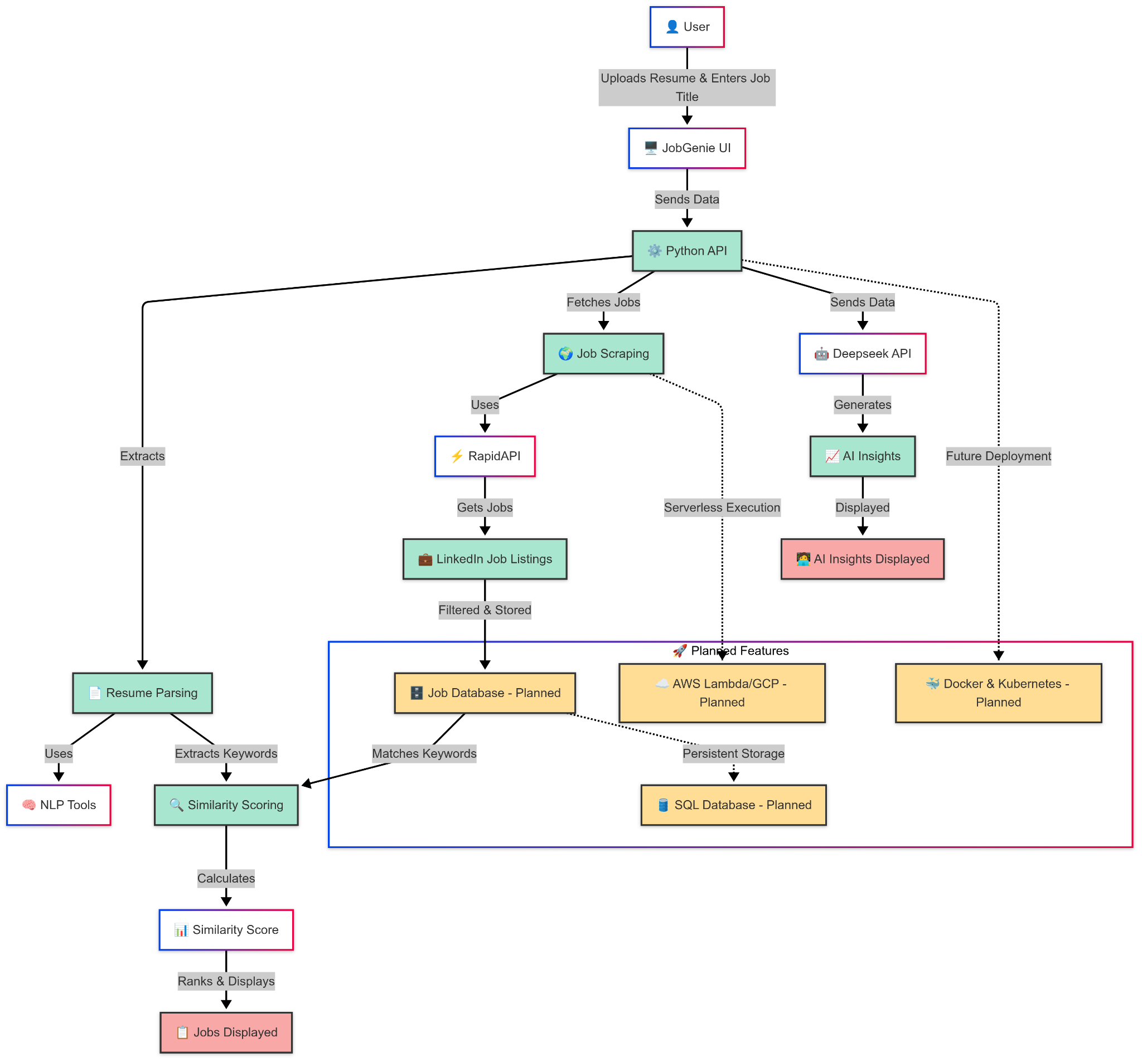
Architecture

Slide 11
Why This Project Matters
Personalization
AI recommendations
Matches jobs to the individual's resume and preferences, improving the chances of finding the right opportunity.
AI recommendations would provide exact points to improve our resume for the considered job title
Efficiency
Single platform
Reduces the effort and time spent navigating various job portals.
Single platform for job searching as well as recommendations.
Notes:
sam

Slide 12
Model - Agile
Why Agile?
Iterative Development
Flexibility
User-Centric
Parallel Development
Notes:
For our project, we decided to follow the Agile Development Methodology.
Using Agile we could develop features in small increments, test them, and improve them before moving on to the next iteration.
When working on our job search feature, we began with finding APIs for scraping the job postings and then built a basic search function. Then, in the next iteration, we added filtering options, followed by similarity scoring to improve job recommendations.
In traditional development models, making changes late in the process can be difficult and expensive, but using agile we could implement changes in the next iteration itself like adding the feature of allowing users to upload resume in multiple formats.
We also began testing early on in our development to ensure that the system truly meets user needs.
Develop features like resume upload, job search, similarity scoring, and filters in iterations.
Allows for changes based on testing and stakeholder feedback
Ensures the app meets user needs through continuous feedback
Worked simultaneously on frontend, backend, and model optimization

Slide 13
Pre game
Pre-Game (Project Planning & Setup)
Defined project goals, scope, and key deliverables
Analyzed user preferences across job portals and researched their key pain points
Created an initial backlog with prioritized features
Assigned team roles and responsibilities
Set up Kanban board
Notes:
Before diving into development, we spent some time focusing on planning, research, and laying the groundwork. We first thought of and answered questions like What problem were we solving? Who were the users? What features were essential?
We studied portals that users use frequently like LinkedIn, Indeed and Glassdoor to understand user behavior. We defined what features we could build to solve the user frustrations and prioritize them. Features of resume uploads and job search functionalities were given top priority, while secondary features like ai recommendation were planned for later iterations.
To keep track of progress and streamline our workflow, we implemented a Kanban board. It helped us visualize the stages at which each task was.

Slide 14
Development Phase
Sprint 1: Web scraping implementation & similarity scoring algorithm
Sprint 2: Frontend UI development and backend API integration
Sprint 3: AI-powered resume optimization and feature enhancements
Sprint 4: Testing, debugging, and user feedback incorporation
Used Kanban board to track progress and manage tasks
Conducted weekly stand-up meetings for team collaboration
Followed an iterative development approach, continuously refining features
Notes:
Once we completed the planning phase, we moved onto the development phase.
Our first step was to implement web scraping APIs to collect relevant job postings. We further developed filters like mentioning the desired job title and area to find relevant jobs applications.
We also used a similarity scoring algorithm to match job descriptions with user resumes based on key skills, experience, and job requirements. After this we focused on creating a interactive but simple UI so that users are not overwhelmed by too many filters while looking for these postings.
To add more value to users, we implemented AI-powered resume optimization. This feature would suggest improvements in the user’s resume, ensuring their resumes would align better with the job descriptions.
Throughout development, we used a Kanban board to organize tasks and track progress. We would update the board by having weekly meetings and address any issues we would face.

Slide 15
Gantt chart
01
02
03
04
W1
W2
W3
W4
W5
W6
W7
W8
Project Planning and setup
Web Scraping Implementation
Resume Parsing
Similarity scoring algorithm
Frontend UI Development
Backend API and AI Recommendation
Testing and Debugging
Final Deployment & Presentation
Notes:
This Gantt chart represents our project timeline, breaking down key phases over an 8-week period.
In the first 2 weeks, we focused on project planning and setup, followed by web scraping implementation and the similarity scoring algorithm.
Weeks 3 and 4 were dedicated to frontend UI development, backend API integration, and AI recommendations.
Feature development ran parallel to testing and debugging in weeks 5 and 6.
Finally, we focused on deployment and the final presentation in the last two weeks.
This structured timeline ensured a smooth development process and timely delivery of key features.

Slide 16
Kanban board
Task | To-Do | In Progress | Review | Done
Resume Parsing |  |  |  | ✅
Job Scraping API |  |  |  | ✅
Similarity Scoring Algorithm |  |  | ✅
UI/UX Development |  | ✅
AI Recommendation |  |  | ✅
Testing & Debugging |  | ✅
Deployment |  |  | ✅
User Feedback Implementation |  | ✅
Notes:
This Kanban board helped us track task progress throughout the project. We divided our workflow into four stages: To-Do, In Progress, Review, and Done. Tasks like UI/UX development, AI recommendations, and testing progressed systematically through these stages. Completed tasks, such as resume parsing and the job scraping API, are marked under Done.
This helped keep the team aligned and on track and avoid any confusion as to what task we are prioritizing.
We followed Scrum to maintain an iterative development process, breaking our project into sprints to ensure continuous improvement.With only four team members, Scrum ensured that everyone had defined roles and tasks within each sprint.While Scrum gave structure, the Kanban board helped us visualize task progress in real-time.Since we were a small team, Kanban helped us quickly adapt to changes without disrupting the Scrum framework.

Slide 17
Post game
Performed final round of testing and debugging
Collected user feedback for future improvements
Completed final deployment and presentation
Identified potential future features for upcoming releases
Notes:
As we reached the final phase of our project, we conducted a final round of testing and debugging to ensure the system functioned as expected. Functional Testing – We manually tested different features of the project to check if they performed as expected. Each team member took responsibility for specific areas to validate functionality.Peer Review – We cross-checked each other's work, looking for errors and inconsistencies that might have been overlooked.
Since we lacked external users, we asked few of our classmates to test the usability of the system and gained their feedback.

Slide 18
Key Performance Metrics
0.50
60%
90s
60s
Avg. Similarity Score
Precision
Job Recommendation Response Time
Resume Insights Response Time
Notes:
We are using the following key performance metrics to define the effectiveness of our system.
Avg. Similarity Score (≥ 0.50): This measures how closely our recommended jobs match the user's resume. A higher similarity score indicates better alignment between job descriptions and candidate profiles.
Precision @10 (≥ 60%): This metric evaluates how many of the top 10 recommended jobs are truly relevant. A precision of 60% means that at least 6 out of 10 recommendations are highly relevant.
Job Recommendation Response Time (≤ 2 minutes): measures the amount it takes to scrape 20 jobs and recommend the top 10
Resume Insights Response Time (≤ 60s): measures the amount of time the system takes to generate resume insights to improve resume impact

Slide 19
Demo
Notes:
Sayali
Moving on to the demo, we are using streamlit for our frontend
In our application, there are two tabs - Job recommendation and resume insights
First lets see job recommendations based on the user resume
To start with, the user has to upload his resume and also enter the job title he is looking for. If he fails to add any one, the system will throw an error message.
The location is optional and is set to United States by default.
We can also specify the number of linkedin pages to scrape for the jobs. If I add 2, the system will scrape 20 jobs, and recommend the top 10.
Once I have specified the essential parameters, I’ll click on find jobs
The workflow is such that:
Use Linkedin API to scrape the specified number of pages using the job title and the location
For every job, scape details including job title, company name, location, linkedin link for that job posting along with the job description
Once all job descriptions have been scraped, for each description, data cleaning and vector generation techniques will be applied and the text will be converted to a vector. Resume will also be converted to a vector. We are currently using cosine similarity to measure the similarity between jobs and resume. SO based on the calculated vectors, a cosine similarity score will be calculated. A higher similarity score indicated high relevance
After calculation the similarity score for each job description, the system will rank the jobs displaying the top 10.
As a result, the system displays the Job title, company, the similarity score, link - which will take you directly to the job posting and also the description
It also allows the user to download the job details in a csv or excel format
Coming to the second tab, this section provides actionable insights to enhance a resume's impact for specific job titles.
The process is straightforward:
I provide the resume and the target job title.
The AI, powered by DeepSeek, analyzes the resume, identifying weaker sections that may not effectively highlight relevant skills or experience.
Based on this analysis, the system suggests improvements, ranging from wording enhancements to skill additions, to better align the resume with the chosen job title.
This ensures that candidates can refine their resumes for better visibility

Slide 20
Future Scope
Enhanced Matching using Hybrid Recommendation Model
Multi-Source Job Aggregation
Deploy and Design Scalable Architecture
Job Alerts & Notifications
Notes:
In this slide, we outline the key areas for future improvements to our system.
Enhanced Matching using a Hybrid Recommendation Model: Currently, our system relies on cosine similarity for job matching. To improve accuracy, we plan to integrate deep learning models, which can better understand job descriptions and resumes in a more contextual manner.
Multi-Source Job Aggregation: Expanding our job recommendation engine to pull data from multiple sources including glassdoor, indeed and so on will increase job diversity and ensure users have access to a broader range of opportunities.
Deploy and Design Scalable Architecture: As we scale, we aim to design a robust and scalable infrastructure that can handle increased user traffic and data processing demands efficiently.
Job Alerts & Notifications: To improve user engagement, we plan to implement real-time job alerts and notifications. This feature will proactively notify users of new job postings that match their profiles, keeping them updated with the latest opportunities.

Slide 21
Thank you !
Notes:
Sayali

Slide 22
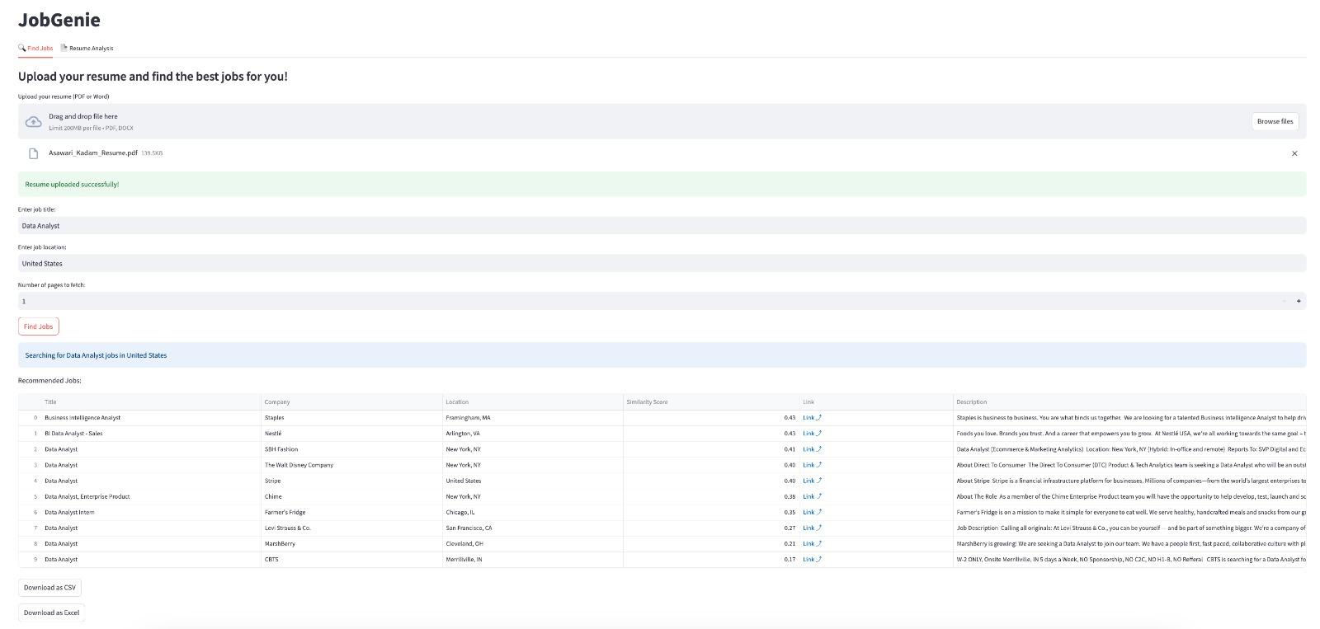
Results
Feature 1: Job postings scraped after matching with user-uploaded resume.
Notes:
Now, let’s take a look at the results achieved with JobGenie.
Our AI-powered platform was tested on multiple resumes, and the results demonstrate how effectively it matches job listings and provides resume recommendations.
The system successfully scraped job postings, analyzed resume content, and matched jobs based on similarity scores.
Additionally, AI-driven resume suggestions helped users identify missing keywords and optimize their resumes to align better with job descriptions.

Slide 23
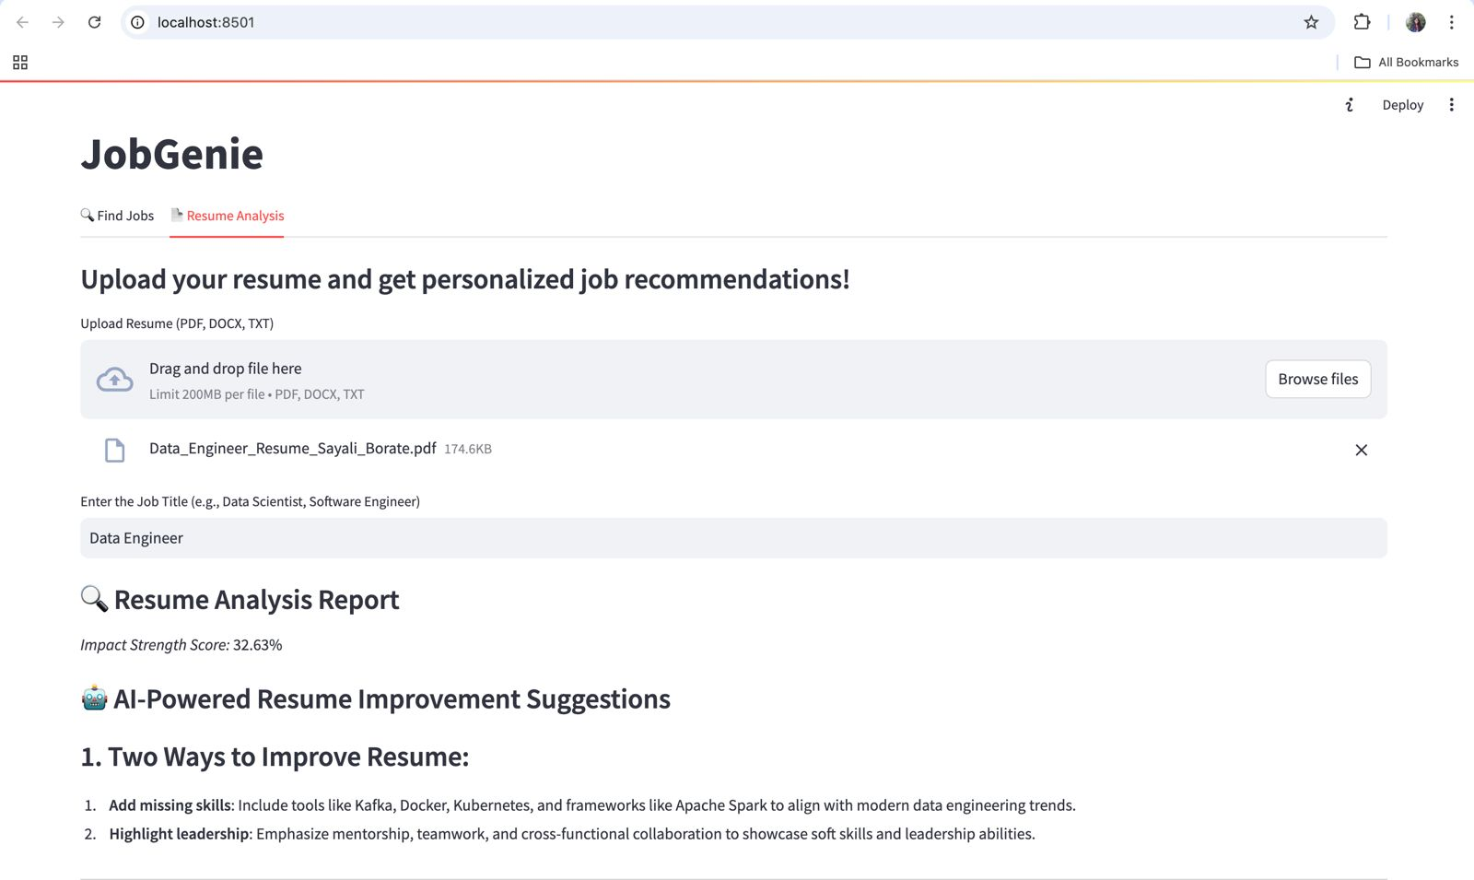
Results
Feature 2: AI suggests recommendations to improve resume using prompts.

Slide 24
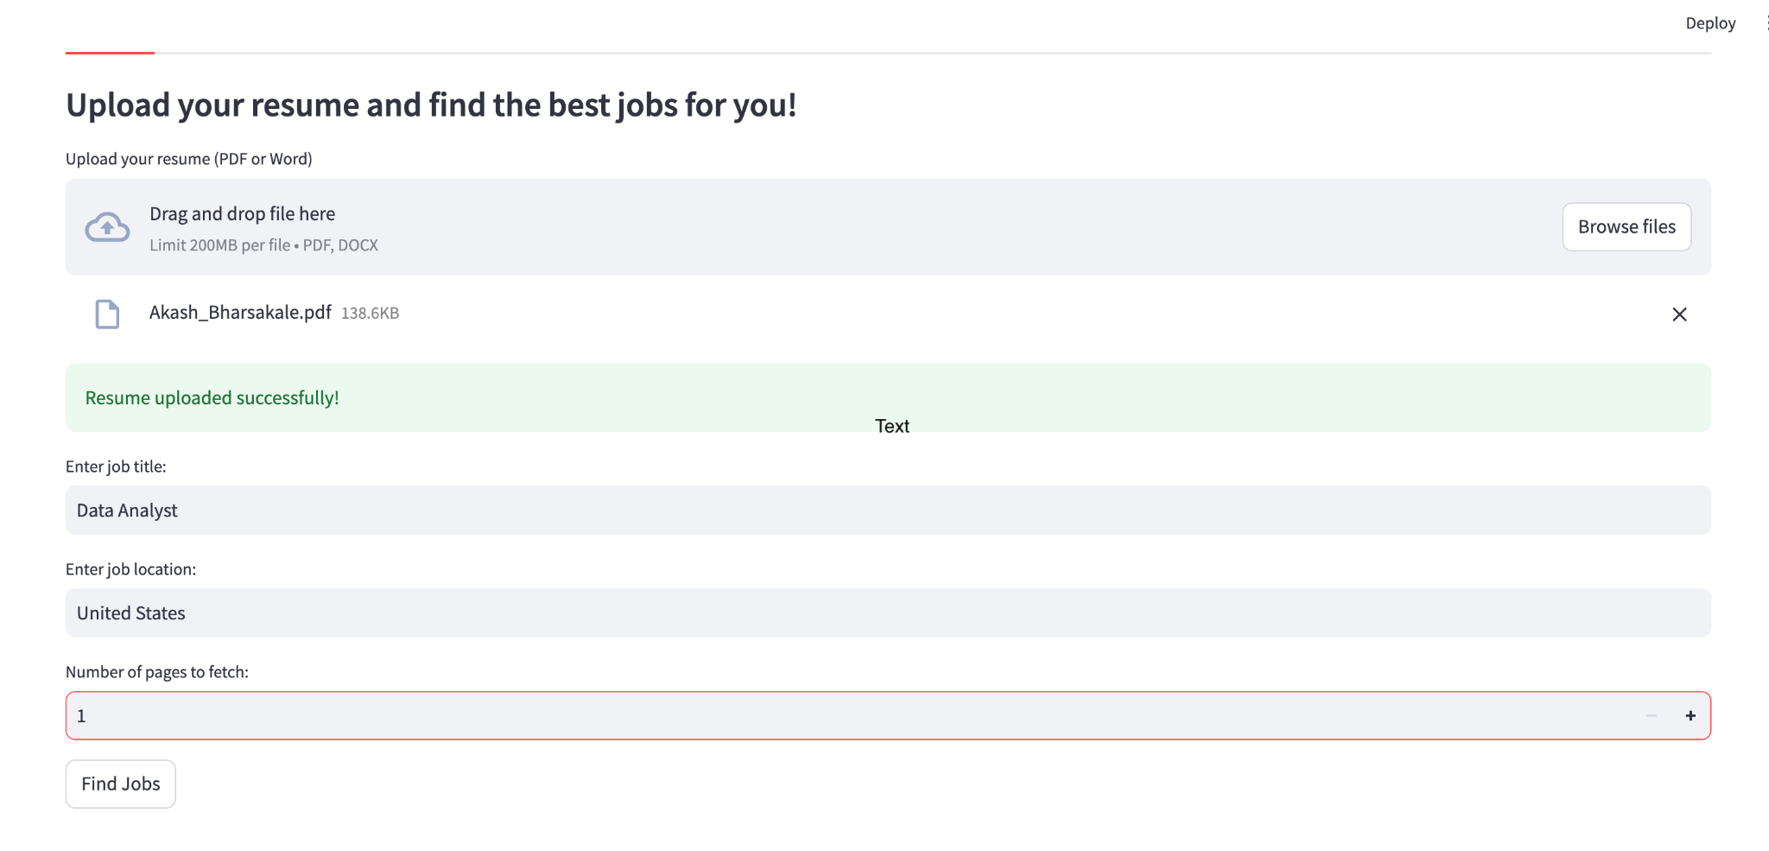
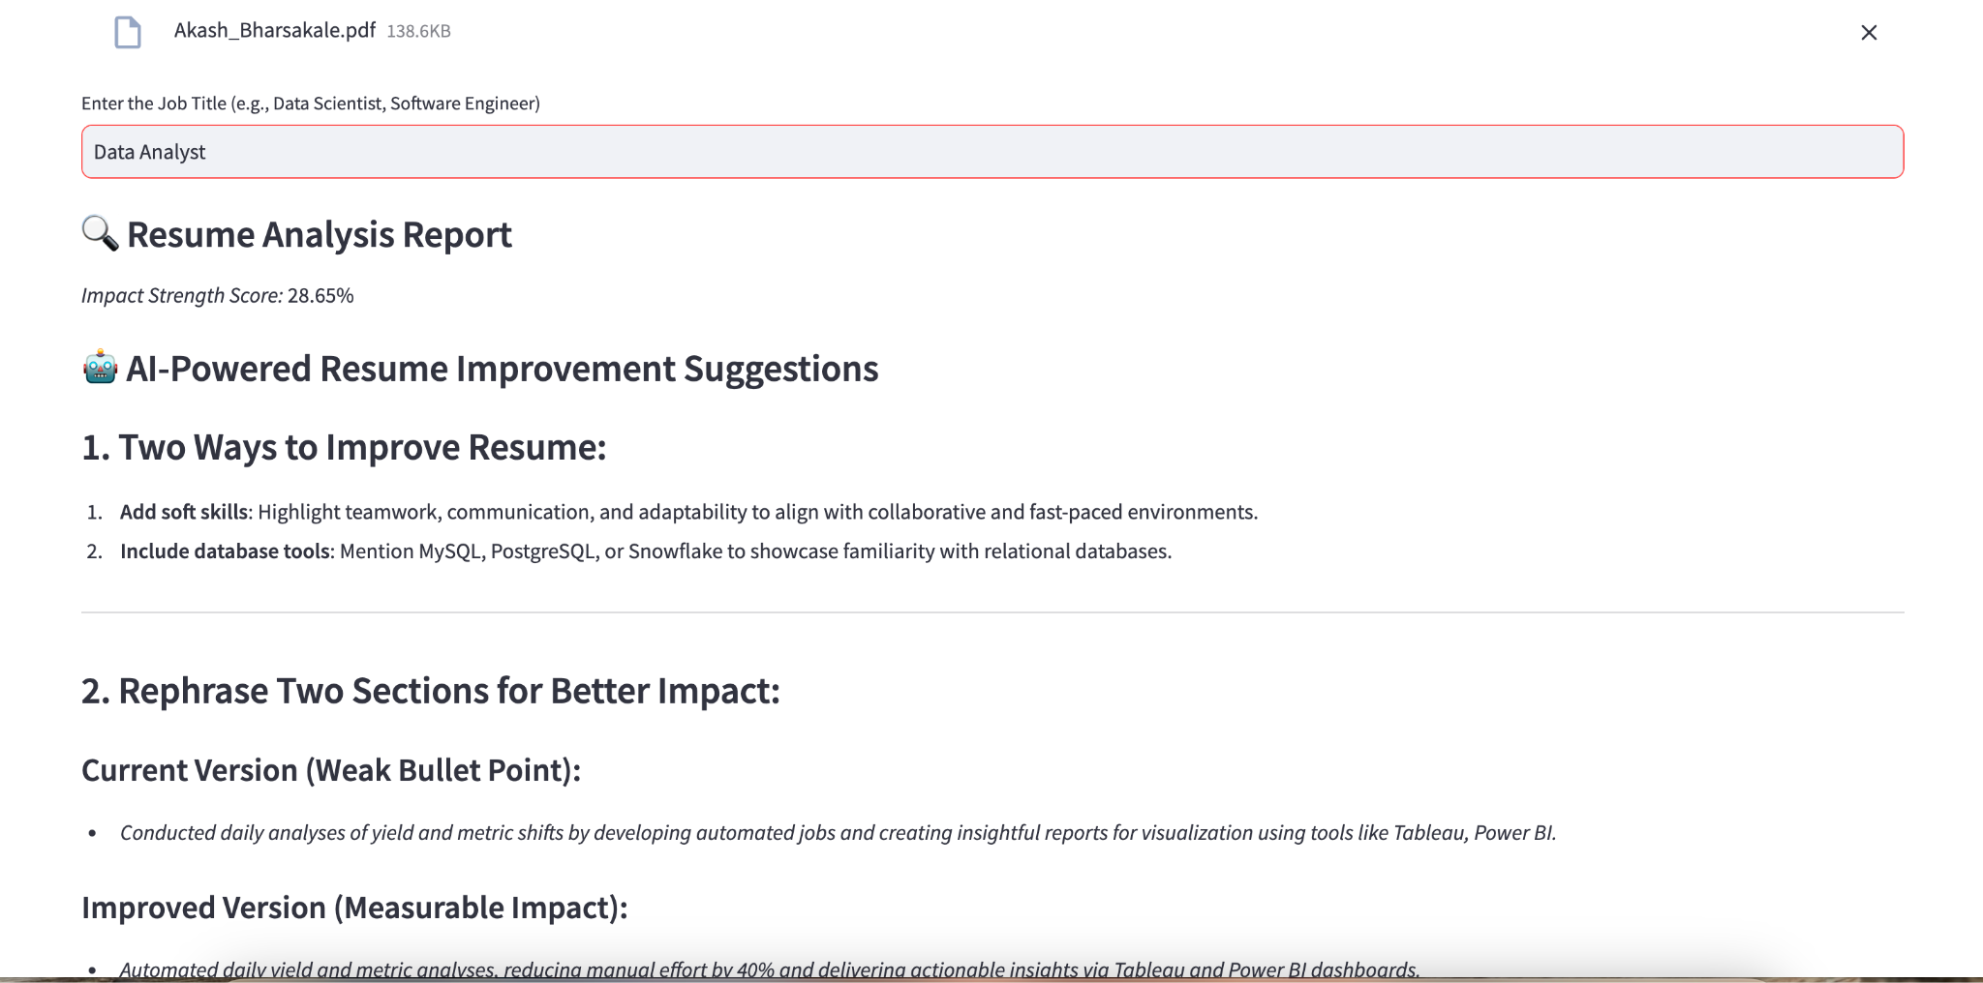
User Feedback

Slide 25
