Slide 1
Learning and Training Department
Anil Sakala

Slide 2
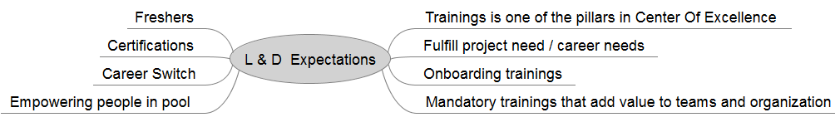
Expectations

Slide 3
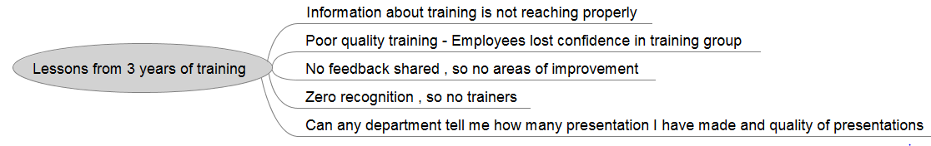
Current State

Slide 4
Concerns with current training department
I have taken one session in the recent past and there is no feedback on it
I found lot of guys coming to me asking for presentation that I have made . They are not sure where these presentations are going and who is using them
Lot of employees ask me for presentations that I have made in the past and I am not sure where they are ?
Can any department tell how many presentations I have made , quality of presentations ?
Do you recognize efforts put down by a person to make a presentation so that he will repeat the act .
I want to do PMP certification and if I approach learning department can they point me to a mentor who will help me in fulfilling my goal
As of today quality of sessions is extremely poor (especially Friday sessions) because of which trainers and listeners both of them lost interest in training department
I came across an excellent article , how can I share it with whole prokarma ?
I came across an excellent online video content ,how can I share with whole prokarma ?
I never approached training department hoping they will empower me to new levels .

Slide 5
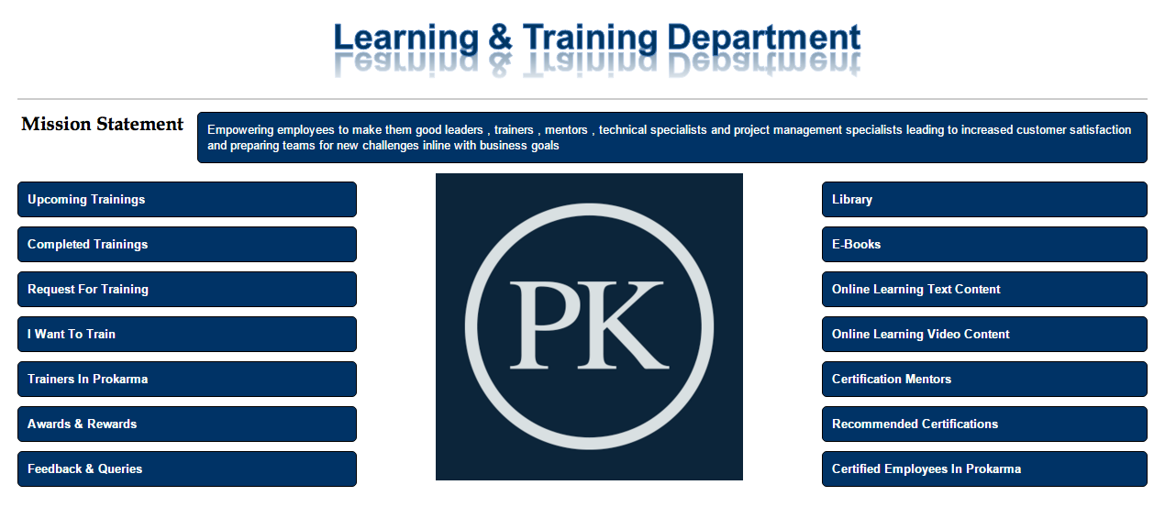
How can we fix above problems (https://wiki.prokarma.com/display/UPD/Temp)

Slide 6
Mission
I believe we require four categories of employees that will make us more successful - Great leaders , Great trainers , Great mentors , Technical & Project management experts
Our mission statement should help our people in understanding what we are doing
I have few thoughts on creating a mission statement and this is what came to my mind – “ Empowering employees to make them good Leaders , Trainers , Mentors , Technical & Project management experts leading to increased customer satisfaction and preparing teams for new challenges in line with business goals ”
Better thoughts ?

Slide 7
Upcoming Trainings
Managers are not sharing information and employees should know about trainings that are coming up and this page will be helpful for them .
Opening note talking about importance of registering to attend training (Today many are not registering)
Should contain table data with all following columns –
S.No
Presentation Topic
Presenter name
Target Audience
Timing Details
Registration link (Pointing to PKonnect )
Is manager approval required
Number of registrations (Should get updated periodically)
Status (Registration opened / Registration closed)

Slide 8
What after registration ?
Schedule a training and send out a meeting request so that it is there in their calendar and they don’t miss it out .
Attendance need to be taken for all employees who attended it .
Conduct a online survey for all the employees who attended training asking three simple questions
Good points in presentation
Areas of improvement
Overall rating
It is mandatory for an employee to attend session completely and fill survey form to get it registered with learning department
Next step is to go to completed trainings and fill it out

Slide 9
Completed Trainings
All completed trainings need to tracked here
This can be in the form of table with columns as
S.No
Presentation topic
Presenter
Completion date
Link to download PPT
Link to run video if available
No of attendees
Average rating received
Link that points to all the feedback received without names (Should be accessed only by presenter )
People come on weekends and do we really recognize them.
If there is good feedback on the training then Learning department should drop a mail to their manager and AVP appreciating the efforts of employee . This will make him repeat the act. Recognizing employees is one best way to make him repeat another good presentation
If feedback is not proper share with employee and leave it . Don’t share with manager.

Slide 10
Request for training
This page is like a product backlog list.
There should be a link to raise a request for training . All the raised requests need to be traced and Topics requested which are not fulfilled need to be displayed on this page . This can be in the form of table with columns as
S.No
Topic Requested
Pending Since
Requestor name
Vote button
Topic that are fulfilled need to be removed from this page

Slide 11
I want to train
Detailed list of guidelines for trainer
Minimum time for session
Expected quality of session
He must aware of the feedback process and average rating values
Mail details of the person to be contacted to make a session

Slide 12
Trainers in Prokarma
Main purpose of this page is to motivate employees and make them feel proud about the training work that is made
We need to display photos of all trainers who got average decent rating (3.5 and above ) and contribution made by them to training department. This approach will increase their visibility and make them feel proud.
Talk to trainers is another way of appreciating employees

Slide 13
Awards & Rewards
We have to come out with clear guidelines to give award for employees who have made outstanding contribution to learning department.
All norms and conditions for getting award need to be displayed on this page and also list to employees who received award need to be displayed.

Slide 14
E-book / Online text / Videos
Main source of learning today is e-book. For any topic there are just two or three good books and tracking those books on a single page will be useful information . I have seen few employees asking me for a good book on a specific technology .
I have any idea about format that need to be followed . I will share n meeting
On similar lines we have to go for online text and videos
Employee participation is required here . I will talk in last slide

Slide 15
Certification Mentors
We want our employees to do certification and they look for some with whom they can talk and understand process for getting certified.
This page should help such employees
Identify employees who have done certifications and if they are willing to mentor or guide people we can add them to this page

Slide 16
Recommended Certifications
All certifications as recommended by prokarma for both technical and technical areas should be displayed here .
Clear direction about certifications is present here
Few certification that are inline with organization goals need to be documented here

Slide 17
Certified employees in prokarma
Contains all employee who have done certification in technical / project management related areas .
Make employees feel proud about their certifications
Best way to sell our technical competencies to new customers.

Slide 18
Selling to employees
Once we are up and ready with our learning department
We should make a excellent presentation about
What learning department is trying to do
Explain , inspire and motivate employees to participate and contribute towards learning department
Collect feedback and make necessary changes Make employees feel proud about their certifications

