Slide 1

NLP-TOPIC MODELING

Slide 2
Overview
Topic modeling is a context of natural language processing which helps to group or cluster unlabeled texts (unsupervised process) , through hidden structure (similarities) between of them.
GOAL Use nlp to read big amount of Financial news , in real time , and provide asset managers with information advantage.
Data description Provided data by consultancy company, collected from rated as reliable sites for News -Number of text-documents: 362.871 -Time period of collection: 365 days

Slide 3
Implementation
NLP: prepare and clean our data
TOPIC MODELING: -Chosen model: LDA, Latent Dirichlet Allocation -Structural elements: 1)Dictionary: assign words to unique id --->turning words to numbers 2)Corpus:a union of sub-bags of words for each doc --->vectorization of data
NLP PIPELINE
TEXT
TOKENIZER
REMOVE PATTERNS & PUNCTUATION
REMOVE STOP WORDS
CREATE BIGRAMS & LEMMATIZATION
CLEAN DOC

Slide 4
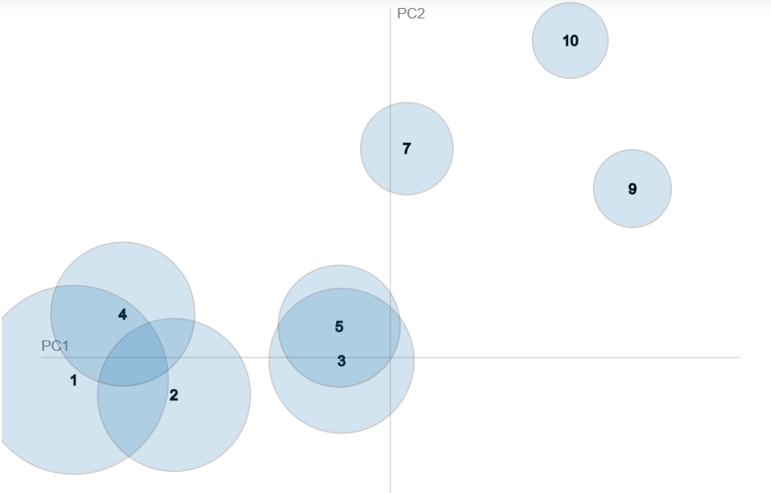
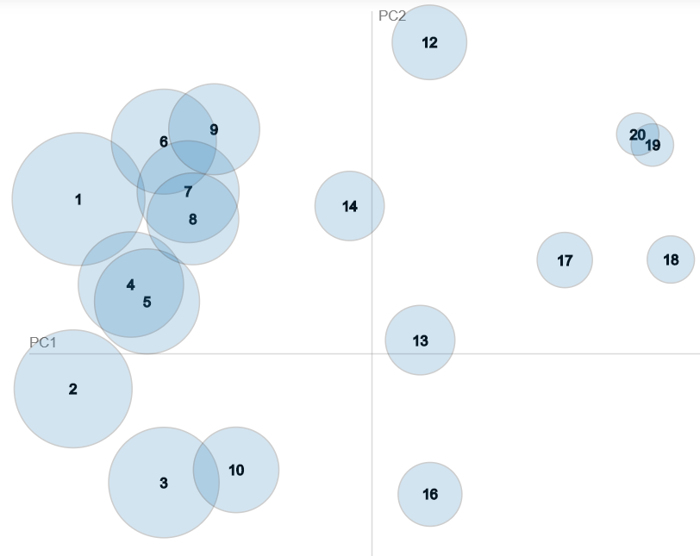
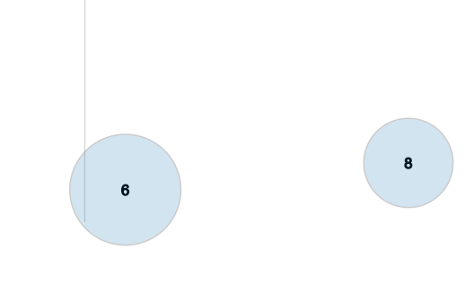
HOW MANY TOPICS?-CAN WE KNOW?
-A way to go is: 1)Through visualization
-The more segmented are, the less overlapped , the more clear Thema(Topic).
10-Topics
20-Topics

Slide 5
2) Coherence metric:
A pipeline that turns a qualitative result to quantitative.
Coherence results:
- 7 Topics = 0.484
-10 Topics = 0.502
-20 Topics = 0.495
-40 Topics = 0.428
-Looks 10 is the number of Topics we have to continue and extract further insights.
-Are these enough reliable criteria?

Slide 6
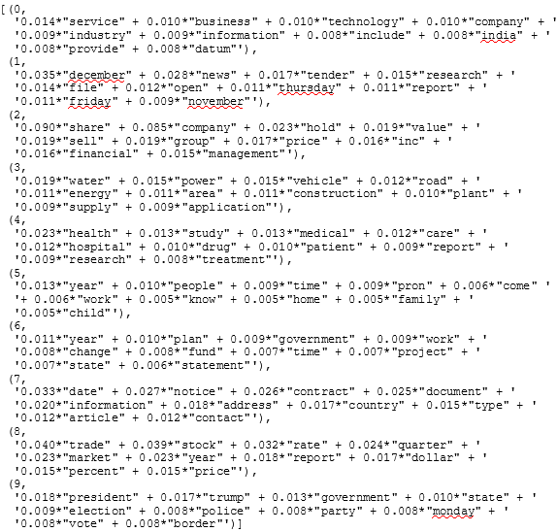
10-TOPICS VS 20-TOPICS
-A direct comparison of topic-9 of the 10-topic model with the topic-8 of the 20-topic model can show us that the thematic in the second one is more clear, and this is what we need. We need more clear and higher coherence between the words that targeting to financial news, even if most of topics are not clear but a couple of them are strong connected for potential financial investments. So in our case will continue with the 20-topics model.

Slide 7
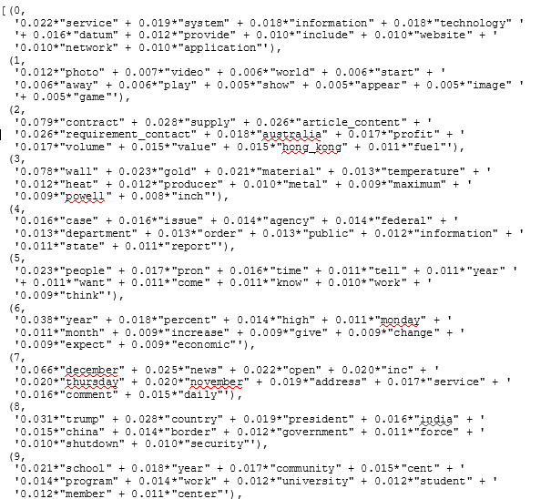
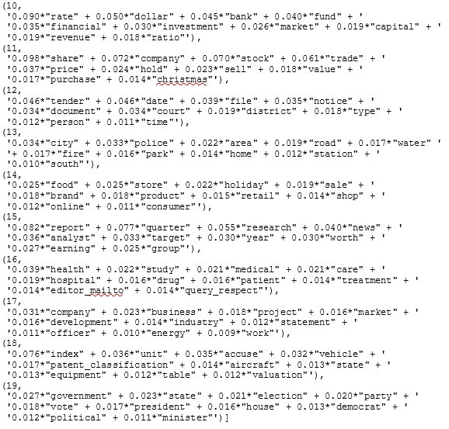
20 TOPICS

Slide 8
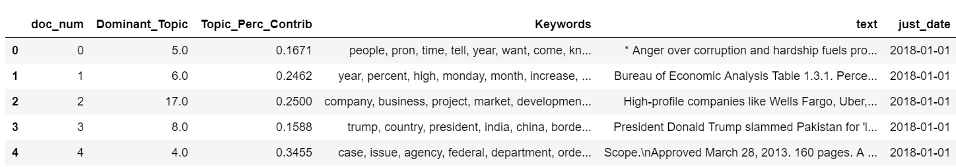
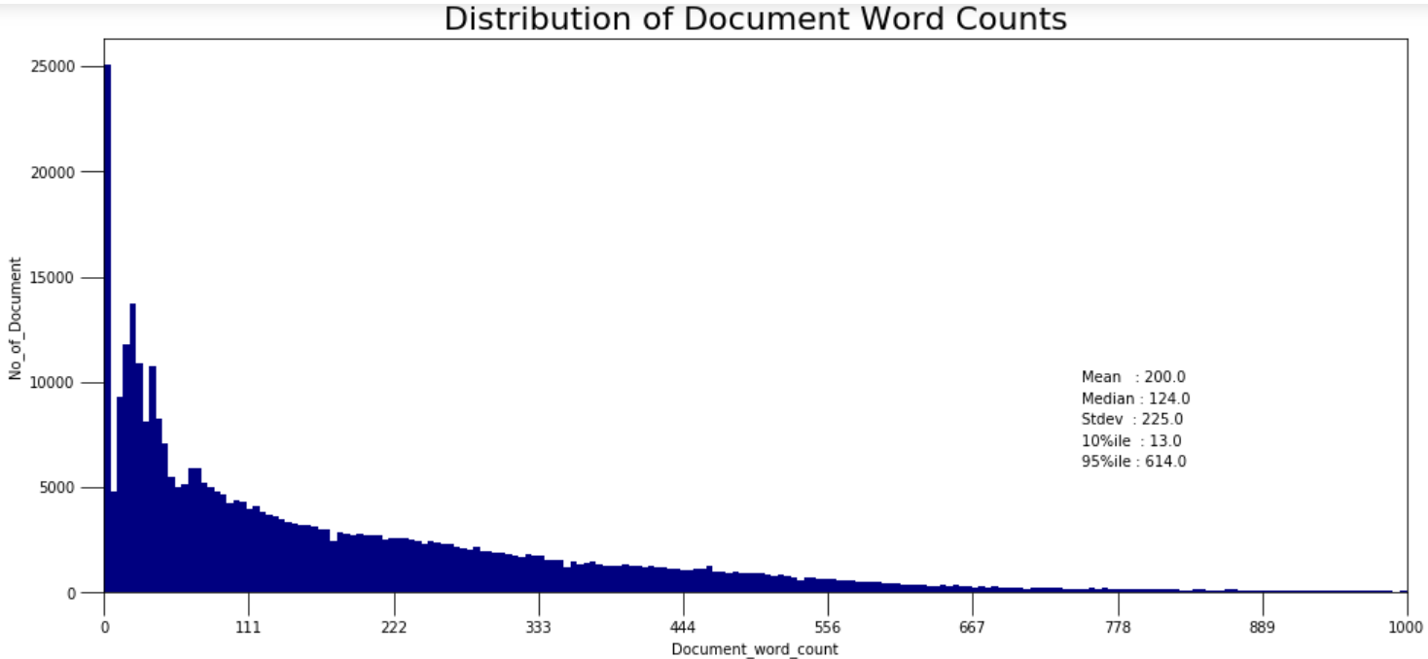
Extract info from the 20-TOPICS model

Slide 9
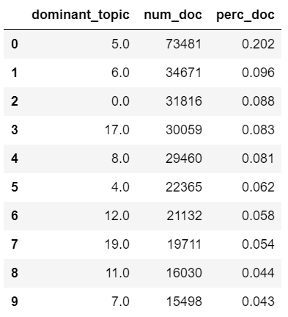
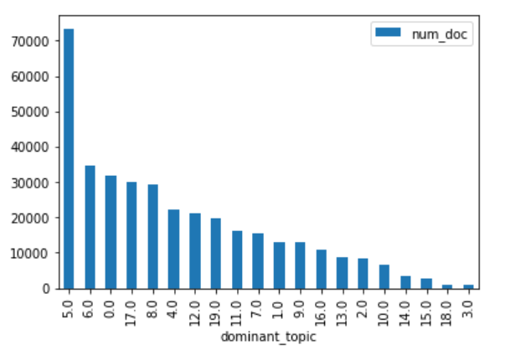
Total number of Doc per Topic

Slide 10
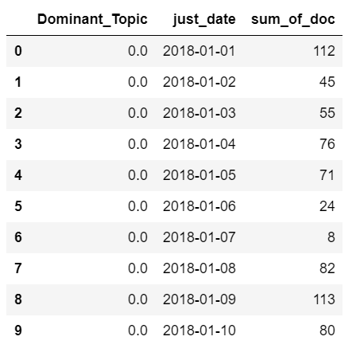
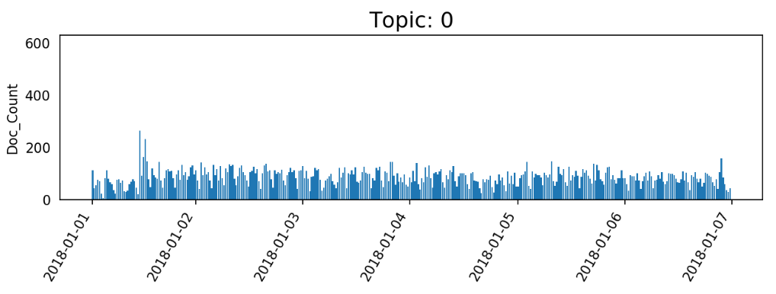
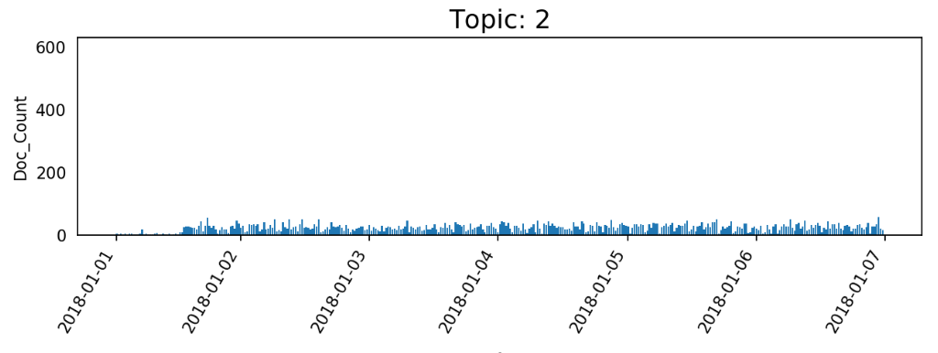
Per day / Per Topic sum of Documents

Slide 11
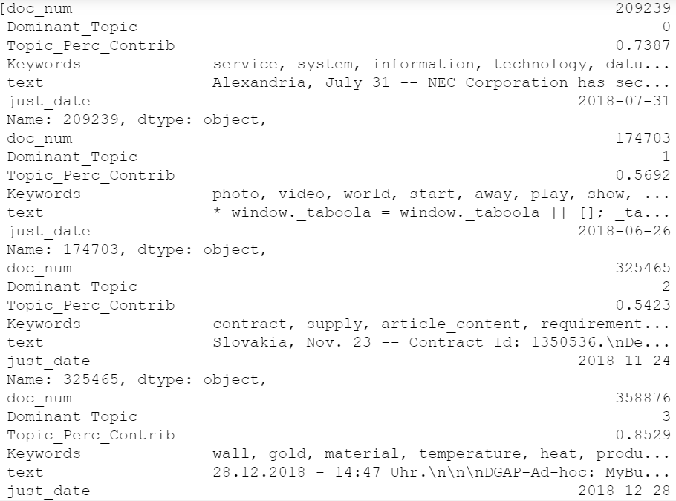
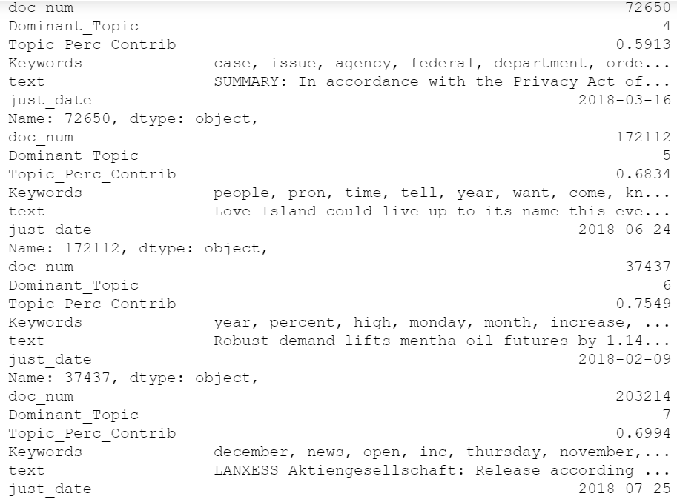
Most representative Documents

Slide 12
Insights-Results-Comments
-We found in which doc each topic is assigned with the highest percentage.So, This document is the most related with each topic.
-Slides 8,9,10 are not giving us now any insights but are very important for the maintenance and stability of the model later.(if we want to run a classification model or do sentiment analysis)
How interpret ,labeling our topics and get benefit of the output.
-Topic 0: manual-label/ information technology The context speaks about a patent on a communication device.This could be an area for potential investment.
-Topic 8: manual-label/ U.S foreign policy The context speaks about military actions of U.S. in Persian gulf

Slide 13
GOAL SUCCEED
362.871 Documents
Downsized
20
THANKS

