Slide 1
SMS Spam Detection Using AI G3
“Protecting users from digital threats through AI”

Slide 2
SMS Spam Detection Using AI
Team Members
Ahmed Salah Ebrahim
Walaa Fathy
Mohamed Hamza
Nehal Sameh
Abdelrahman Atef

Slide 3
Introduction
Why This Project? In today’s digital world, spam SMS messages are common and dangerous. They trick users into clicking harmful links or sharing personal information. Filtering them is essential for user safety.

Slide 4
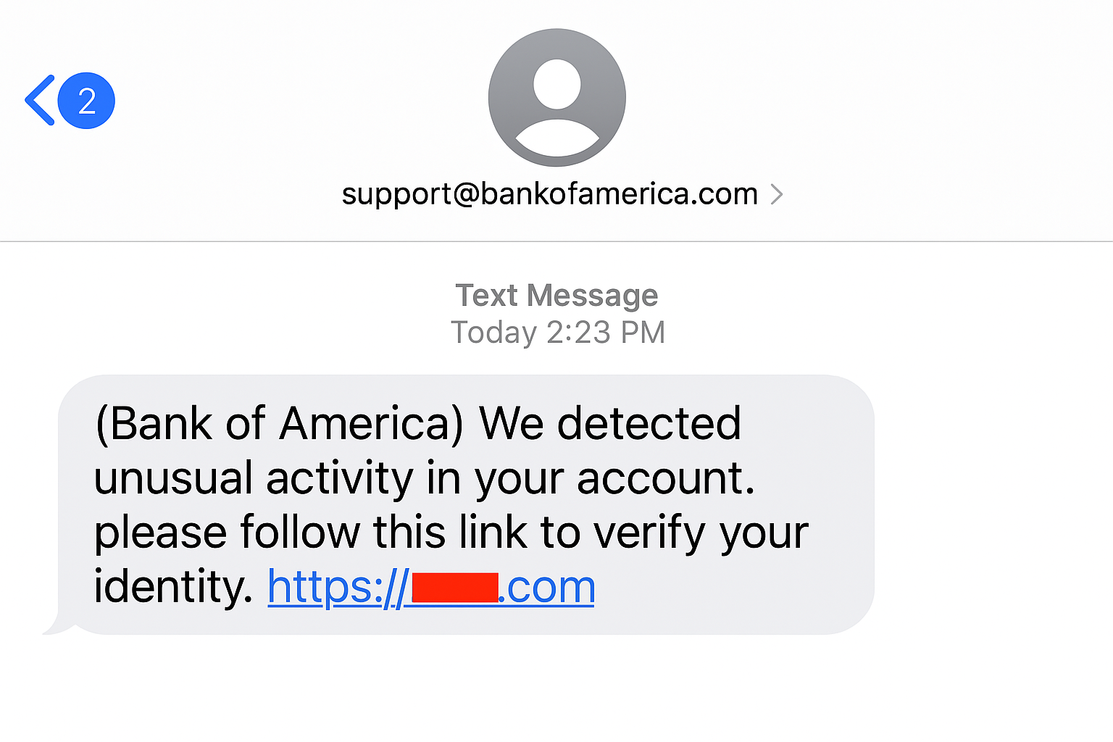
Introduction
What We Built: A lightweight, intelligent spam detector that automatically classifies SMS messages as “Spam” or “Ham” using machine learning.

Slide 5
Objectives
Detect and separate spam messages from safe ones
Raise awareness of message-based scams
Build a fast, small-scale, explainable model
Demonstrate the power of ML on a small dataset

Slide 6
Target Users
General mobile phone users
Students, parents, and employees
Any individual or small business concerned about message security

Slide 7
Key Features
Efficient Spam Detection
Fully Automated
Message Isolation
Warning & Awareness

Slide 8
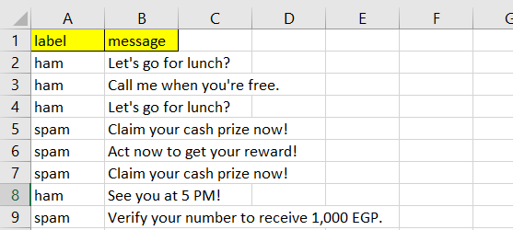
Dataset Summary
1st Dataset: Custom 200-message SMS dataset
100 labeled as “Ham”
100 labeled as “Spam”
Balanced and preprocessed
Messages are short and realistic

Slide 9
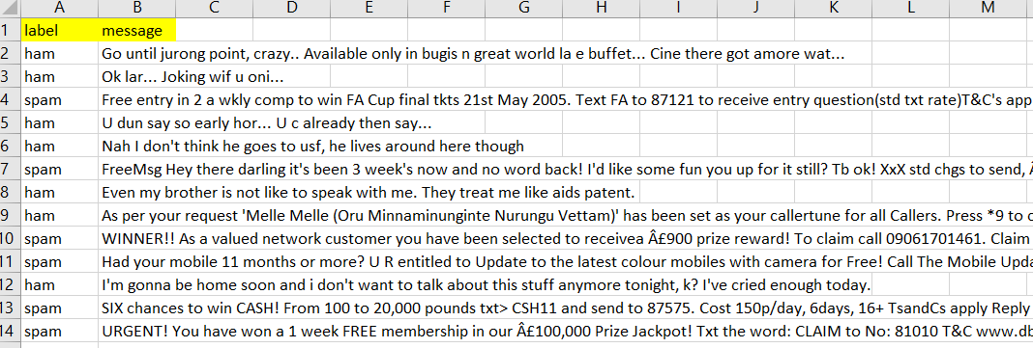
Dataset Summary
2nd Dataset: SMS Spam Collection Dataset Kaggle"
5,574 messages (ham & spam)
Balanced enough for training
Public domain

Slide 10






Tools and Technologies
Language: Python
Environment: Google Colab
Libraries:
- “pandas”: for data handling
- “scikit-learn”: methods and algorithms
like TFIDF and Naive-Bayes
- “TensorFlow” & “Keras”: for deep learning

Slide 11
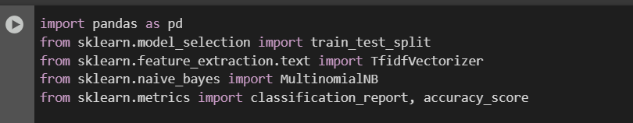

Demo / Screenshots
Libraries Importing:
Reading the dataset:

Slide 12


Demo / Screenshots
Dropping empty or NaN messages:
Ensuring all messages are strings:

Slide 13

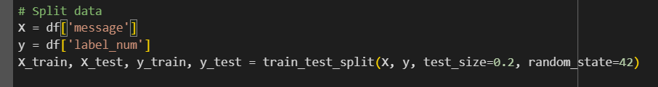
Demo / Screenshots
Converting labels (mapping):
Spliting data to training and testing:

Slide 14
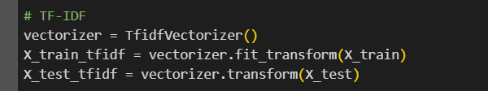

Demo / Screenshots
Vectorizing (turning text into features/weights):
Training the model using MultinomialNB:

Slide 15
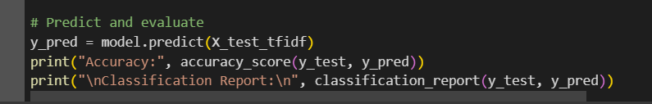
Demo / Screenshots
Prediction and evaluation

Slide 16
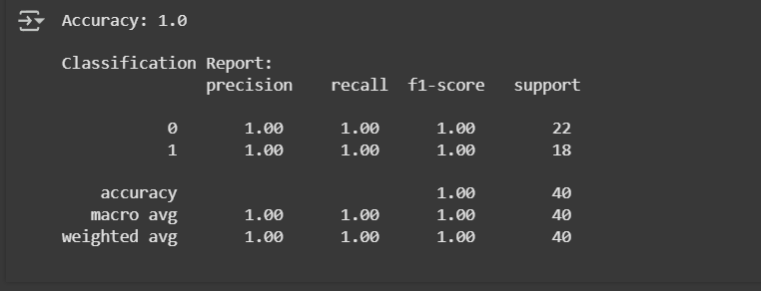
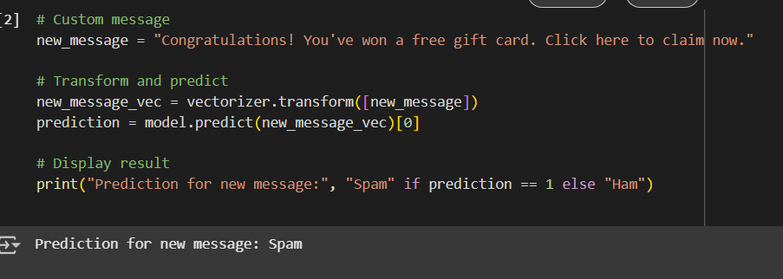
Testing and Results
Prediction and evaluation for 1st dataset:

Slide 17
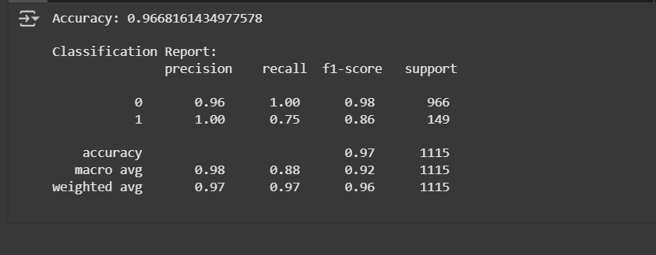
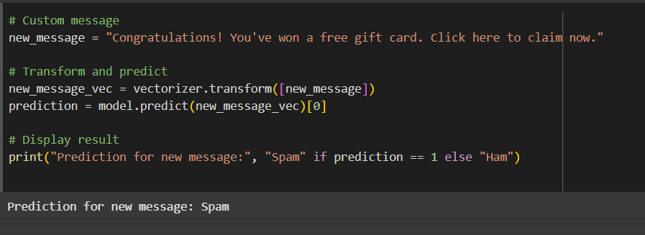
Testing and Results
Prediction and evaluation for 2nd dataset:

Slide 18
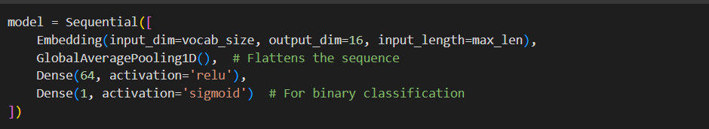
Testing and Results
We also tested a lightweight neural network using:
Tokenization + Padding
Embedding Layer
GlobalAveragePooling1D

Slide 19
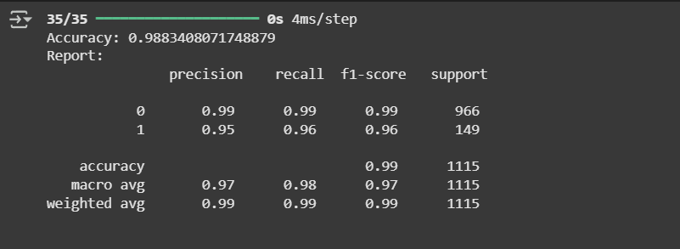
Testing and Results
Accuracy was good, but not better than Naive Bayes due to limited data.
When we tried the larger data set, it worked well with high accuracy metrices.

Slide 20
Final Output / Outcome
A fully functional spam detection model trained on real SMS messages, capable of classifying messages as Spam or Ham with high accuracy.
The user can now receive and read messages safely without hesitation.
Spam and suspicious messages are detected and flagged immediately.
The user is alerted before engaging with risky content, ensuring better protection of their personal data and digital identity.
The environment becomes clean, organized, and safer for personal or business communication.

Slide 21
Conclusion and Future Work
Built a working SMS spam detection model using MultinomialNB
Demonstrated 99% accuracy on a small but balanced dataset
Learned real-world ML skills: text preprocessing, model training, and evaluation
Ready to expand this into more complex projects

Slide 22

Conclusion and Future Work
Use a larger dataset (5k+ SMS messages)
Add UI or app front-end
Test on real-time message feeds
Compare more models: Logistic Regression, SVM, or Transformers

Slide 23
Q&A
Thank you for your time!
Any questions?

