Slide 1
Multi-Period Electric Vehicle
Charging Station Location & Sizing
A Heuristic Approach with Adaptive Large Neighbourhood Search
[Asal Homayouni] | Supervisor: [Supervisor Name] | May 12, 2025
TV11 · 3rd Speaker · 20 minutes
Notes:
Welcome. ~1 min. Introduce problem: optimizing EV charger placement over multiple years using a heuristic.

Slide 2
MOTIVATION
EV Adoption Depends on Where You Put the Chargers
↑35%
#1
T=6
EV sales growth
last year
Barrier to adoption:
range anxiety
Multi-period
installation horizon
Poor placement → fewer users → slower decarbonisation
Location decisions are irreversible — getting them right matters
Budget is spread across multiple periods (years)
User behaviour and congestion must be modelled realistically
Notes:
Why this matters. ~2 min total.

Slide 3
PROBLEM
The Multi-Period EVCS Location & Sizing Problem
Decision Variables
Objective & Constraints
Which candidate sites to open
How many chargers per site
When to install (which period)
Budget limit per period
Maximise demand served by open stations
Budget constraint per time period
Max chargers per site
Cumulative installation (no removals)
Notes:
Formal problem definition. ~3.5 min total.

Slide 4
LITERATURE
Lots of Work on EV Location — But a Clear Gap
What exists:
What is missing:
Many exact methods (MIP, Benders)
Single-period formulations
Simple coverage objectives
Small instances (N < 200)
Specialized heuristics for large instances
Multi-period with realistic user behaviour
Congestion-aware demand modelling
Scalability to N = 1000+ nodes
Our contribution: a tailored ALNS heuristic for multi-period EVCS with user equilibrium evaluation
Notes:
There is a full EV session at this conference — the gap is real. ~5 min total.

Slide 5
ALGORITHM
Adaptive Large Neighbourhood Search (ALNS)
Greedy
Initial
Destroy
(remove)
Reconstruct
(add)
Local
Search
Full
Eval (UE)
↺ Iterate until time budget exhausted
Destroy Operators
Reconstruction
Evaluation (UE)
Site swap · Local remove · Area destroy
Adaptive weight update (roulette wheel)
Greedy binary assignment
Proxy score ranks candidates fast
User equilibrium + Erlang-C queuing
~0.024s per solution — fast enough
Notes:
ALNS framework. Key insight: UE is fast enough to call at every step. ~7 min total.

Slide 6
INSTANCES
Real Italian Cities — Synthetically Generated Instances
Instance | N (nodes) | T | Role
Vicenza | 125 | 6 | Small
Verona | 250 | 6 | Small-Med
Monza | 400 | 6 | Primary ★
Palermo | 1025 | 6 | Large
Demand nodes: population-weighted grid
Candidate sites: existing fuel stations + parking
D = 2 km service radius (walkable distance)
Budget: 8 stations × up to 6 chargers each
T = 6 periods, cumulative installation
★ Main benchmark — medium size, non-trivial, exact methods applicable for comparison
Notes:
Instance generation. Monza is primary benchmark. ~8.5 min total.

Slide 7
EVALUATION
How We Evaluate Solutions: A Journey
1
Binary Proxy
~0 ms
Count demand within range of open stations. Instant but ignores congestion.
2
Gurobi (GRB)
~2–5 s
LP flow model. Accurate but slow — requires licence, 2–5s per call.
3
User Equilibrium
~0.024 s
Logit routing + Erlang-C queuing. Fast AND realistic. Current approach.
UE: users choose stations to minimise travel cost + expected waiting time (Erlang-C queue)
Notes:
The evaluation journey. We didn't start with UE. Proxy was too simple, GRB too slow, UE is the sweet spot. ~10 min total.

Slide 8
EVALUATION
User Equilibrium: How Drivers Choose Chargers
Each driver minimises: travel cost + expected wait time
Logit model: probability of choosing station j ∝ e^(−cost)
Erlang-C: realistic queue model for each station
No-option: drivers bail if nearest station > 2 km
Equilibrium: no driver improves by switching stations
Key result: concentrating chargers is penalised
(congestion raises waiting cost)
Tuned Parameters
noopt range
2 km
α_wait
10.0
penalty_dist
5.0
μ (service rate)
4.0
cap / server
4.0
UE runs at ~0.024 s/solution — fast enough to replace proxy as LS guide
Notes:
UE details. Key selling point: congestion awareness + speed. ~11.5 min total.

Slide 9
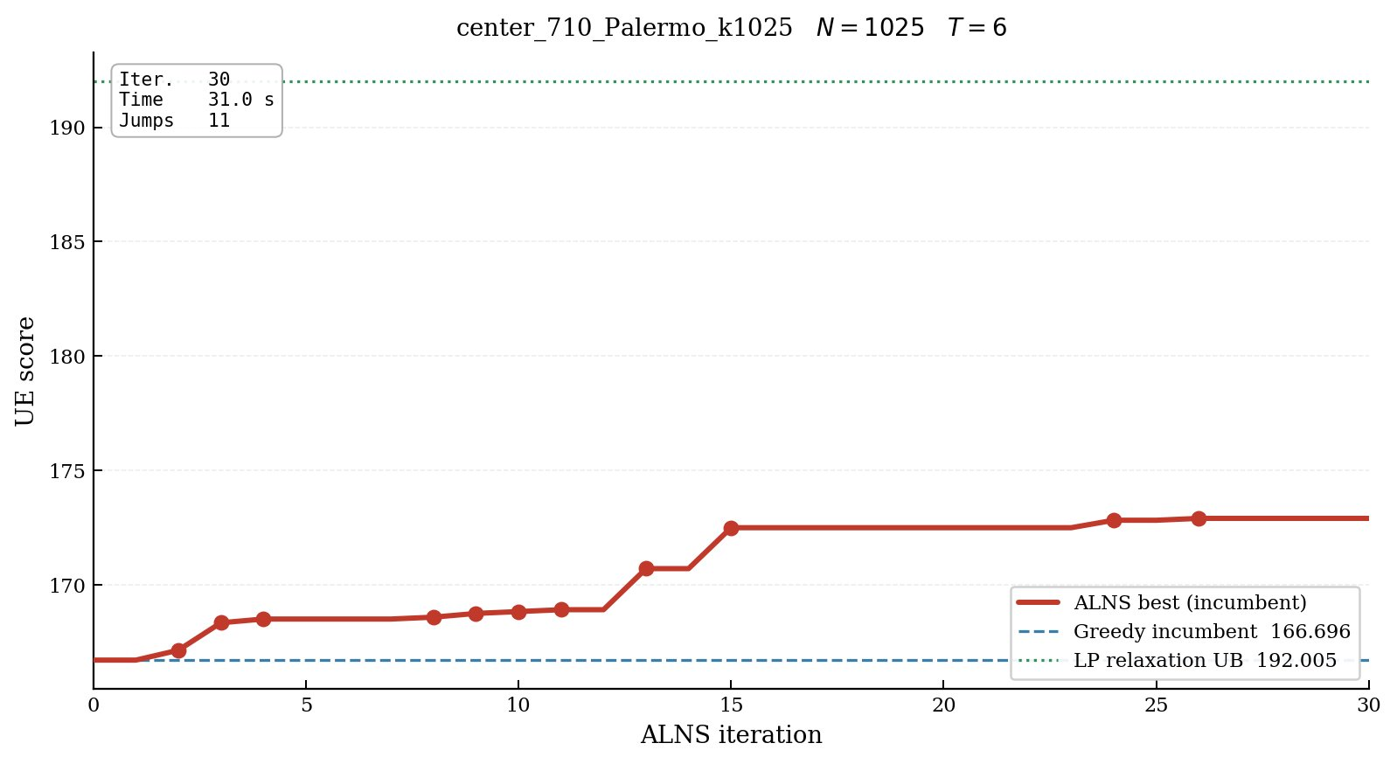
RESULTS
ALNS Converges and Beats the Greedy Baseline
✓
Monza N=400: 7 improvements
in 20s
✓
Palermo N=1025: 11 improvements
in 31s
↑
UE score: 167 → 172
(+2.5% vs greedy)
~
LP upper bound 192
(gap known, expected)
Notes:
Two convergence curves. ALNS clearly improves over greedy on both instances. Gap to LP bound expected — that bound is loose for large instances. ~13 min total.

Slide 10
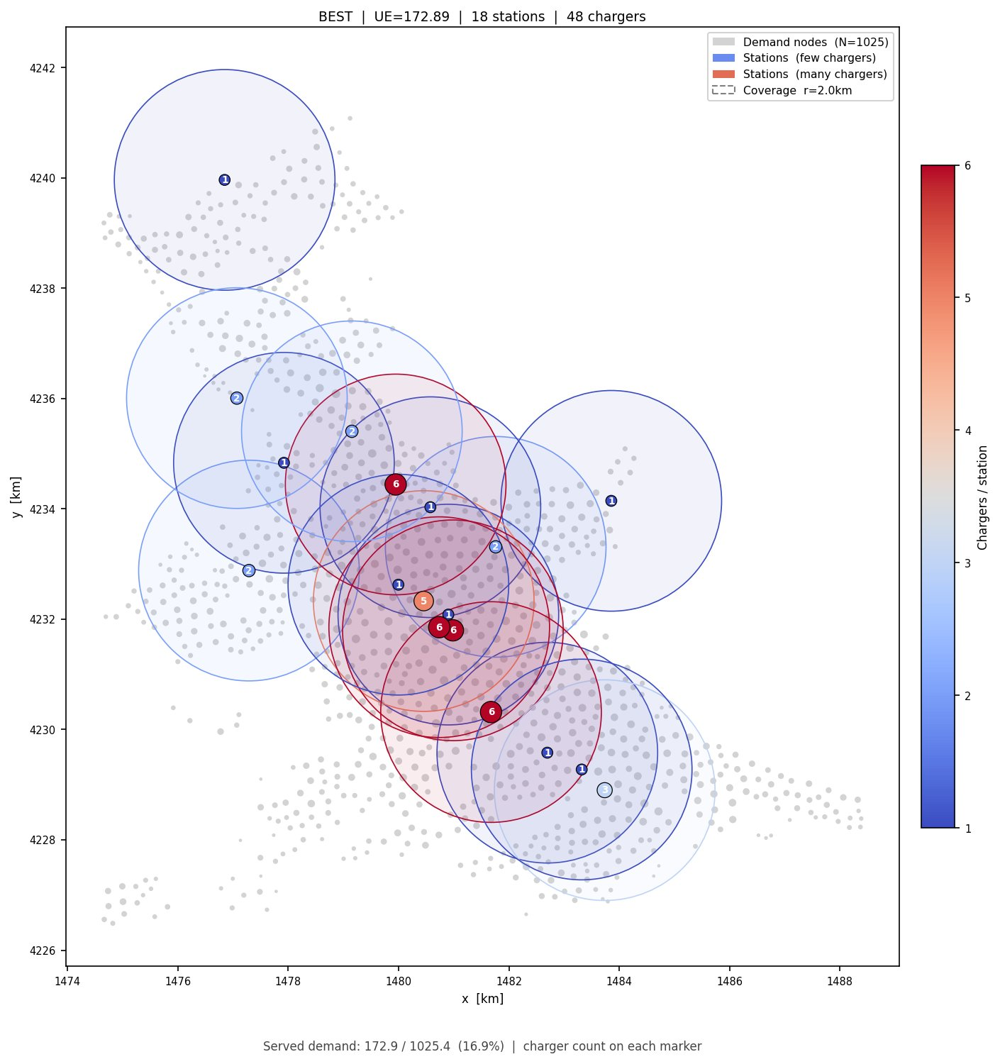
RESULTS
Solutions Look Physically Reasonable
Stations near dense demand clusters ✓
High-charger stations (red) at centre
Low-charger stations (blue) extend reach
Coverage circles (r=2km) overlap demand ✓
16.9% served — budget-constrained
(48 chargers / 1025 demand nodes)
Solutions vary across iterations — not stuck ✓
Notes:
Best solution for Palermo 1025. Visually sensible — chargers where demand is densest. ~14 min total.

Slide 11
RESULTS
Algorithm Scales to 1000+ Nodes
UE eval: ~0.024s on N=250 → ~0.1s on N=400
Roughly linear scaling — predictable
30 iterations on Palermo N=1025 — still meaningful
No Gurobi licence needed for full runs
Greedy init always feasible — no warm-start needed
Notes:
Scalability. Linear scaling is a key property. ~15 min total.

Slide 12
ONGOING
Speeding Up ALNS: A Learned Evaluation Gate
Candidate
solution
Binary proxy
gate r=0.74
1–2 step
local search
UE full
eval
↓ skip ~30% of candidates before expensive steps
Observation: LS stops at step 1–2 for 79% of trajectories — expensive for little gain
Binary proxy correlates with UE at r=0.74 — useful coarse filter
Gate filters bottom ~30% before LS starts
Structural limit: proxy (coverage) and UE (congestion) measure different things
Next step: use UE directly as the LS step guide — 0.1s/step, feasible
⚠ Preliminary — full pipeline integration in progress
Notes:
Gate work — present as ongoing. Being transparent that this is not fully integrated yet. ~17 min total.

Slide 13
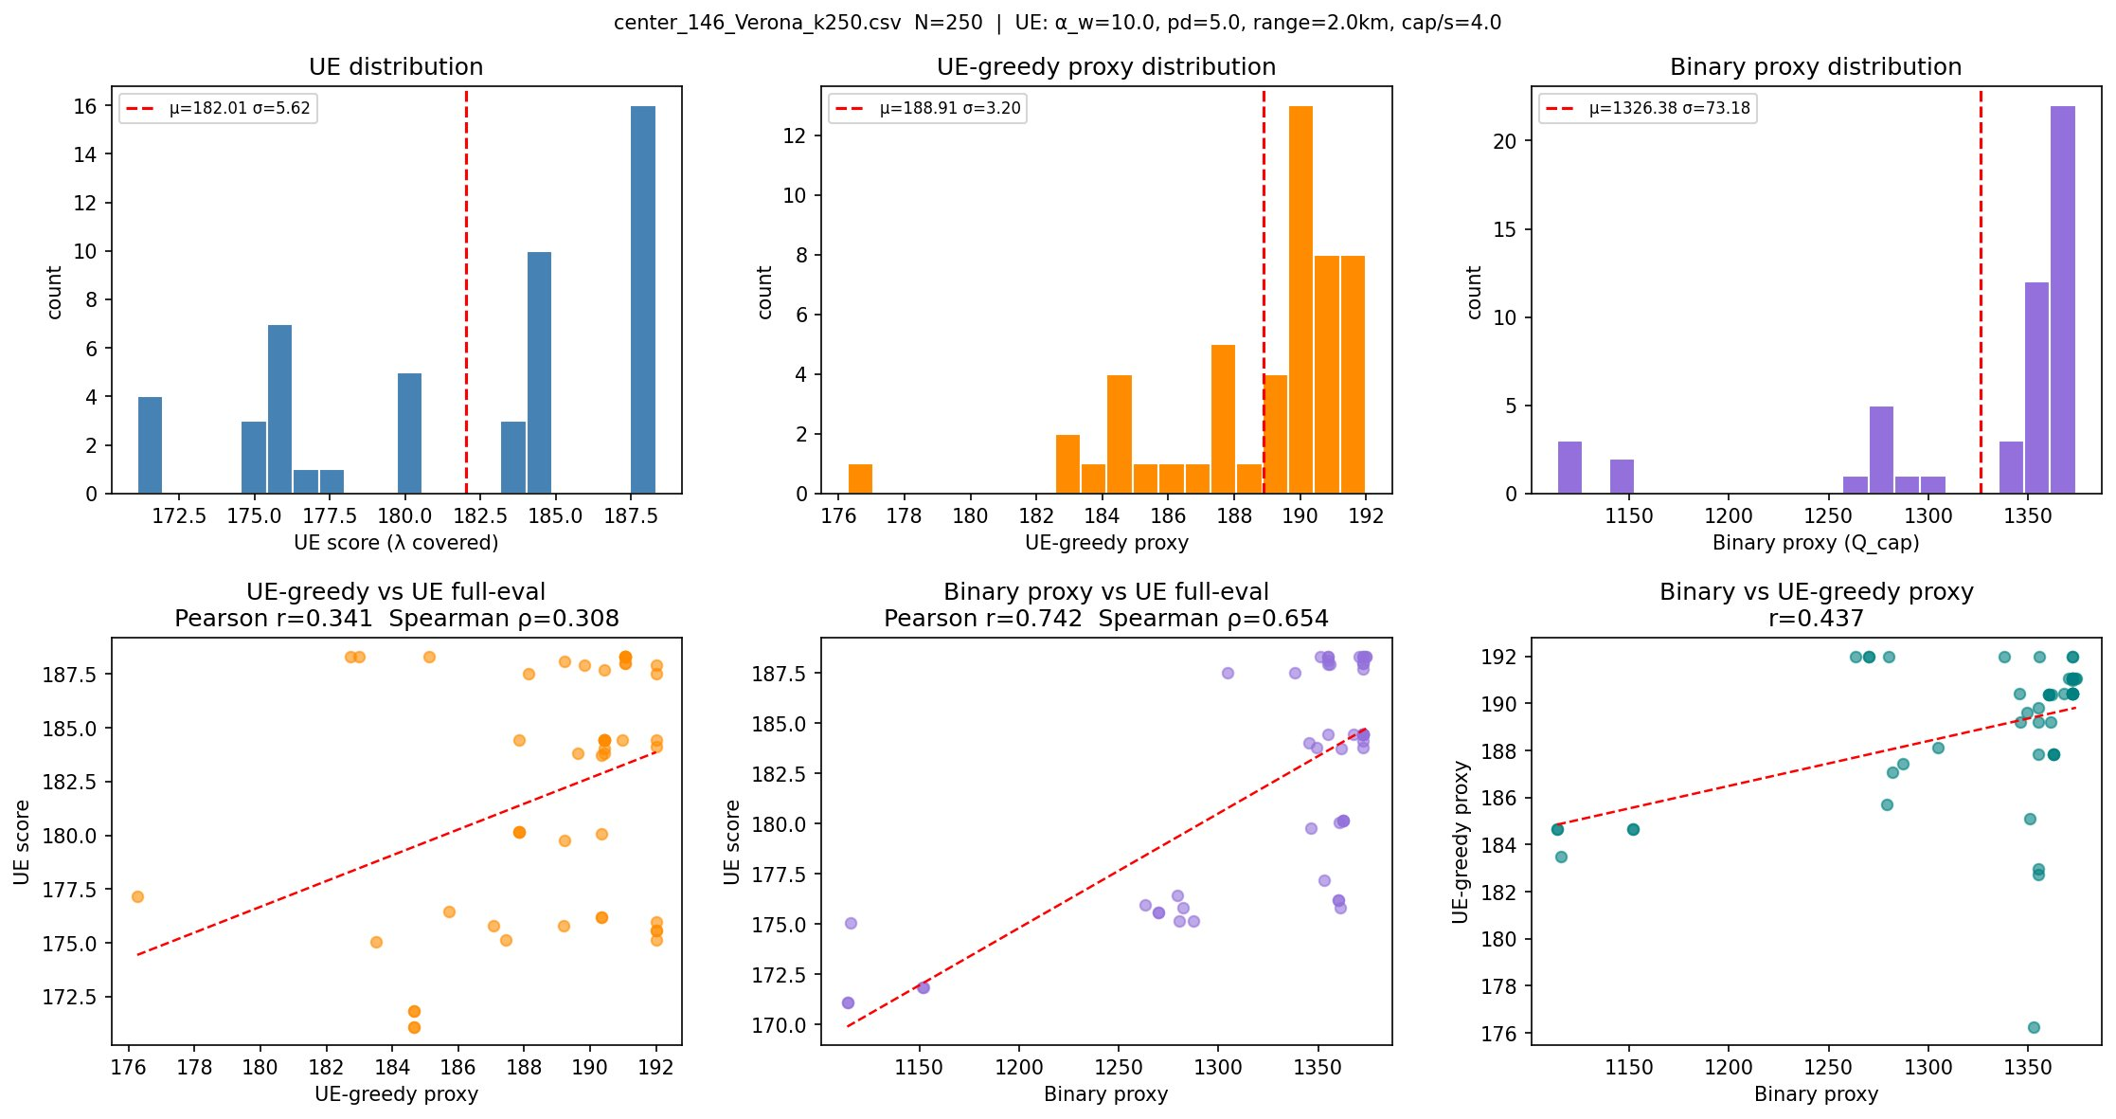
ONGOING
Proxy–UE Correlation Analysis
UE spread confirmed: std=5.6, range=17 — no saturation ✓
Binary proxy: Pearson r=0.74 with UE
UE-greedy proxy: r=0.34 — structurally misaligned
Congestion proxy: r=0.78 — marginal improvement
Proxy & UE disagree on concentrated vs distributed solutions
Decision: binary proxy as gate, UE as LS guide
Notes:
The diagnostic plot explaining why proxy-UE correlation peaks at r=0.74. ~18 min total.

Slide 14
FUTURE
What Comes Next
Full gate integration
Adaptive LS depth
Binary proxy pre-filter + UE-guided LS in the main ALNS loop
Stop LS early when improvement potential is low — more iterations/budget
Richer queuing models
Benchmark study
Bulk arrivals, time-varying demand — UE framework extends naturally
Systematic comparison across cities, varying T and budget
Notes:
Four concrete next steps. Gate and adaptive LS are near-term. ~19 min total.

Slide 15
Summary
Multi-period EVCS location is hard and practically important
ALNS provides a scalable heuristic that outperforms greedy across all instances
User Equilibrium evaluation is fast, realistic, and scales to N=1000+
Gate mechanism (ongoing): binary proxy pre-filter + UE-guided local search
Thank you
Questions welcome
Notes:
4 key takeaways. 5 min for questions. Be ready: why UE over GRB, what the gate achieves, stochastic demand extensions.

