Slide 1


Composition and Deployment of Complex Container-Based Application Architectures on Multi-Clouds
DI4R
Lisbon, Portugal
October 2018
Andy S. Alic¹, Marica Antonacci², Ignacio Blanquer¹, Miguel Caballer¹, Giacinto Donvito², Álvaro López³, Germán Moltó¹
¹Universitat Politècnica de València
²Istituto Nazionale di Fisica Nucleare
³Consejo Superior de Investigaciones Científicas
DEEP-Hybrid-DataCloud funded by the EU Horizon 2020 Framework Programme; grant agreement 777435
Notes:
Introduce yourself - what you do

Slide 2
The Problem. The Why.
Universal infrastructure support
Or at least close to
Bare clouds, Kubernetes clusters, Mesos/Marathon clusters, Docker Swarm
Let's speak the same (descriptive) language
Academia+industry standard
Extensible
Approachable to non-IT fellows

Slide 3







TOSCA
Topology and Orchestration Specification for Cloud
Applications
Standard created by the OASIS Consortium
… and others
TOSCA main web page: https://www.oasis-open.org/committees/tc_home.php?wg_abbrev=tosca#overview
Committee full list: https://www.oasis-open.org/committees/membership.php?wg_abbrev=tosca

Slide 4
TOSCA template general skeleton
tosca_definition_version: tosca_simple_yaml_1_0
description: Insert your description here
imports:
# List your imports, each on a new line, each line starting with a hyphen
topology_templates:
inputs:
# List your inputs, each on a new line
node_templates:
# List your nodes, each on a new line
outputs:
# List outputs, each on a new line

Slide 5
TOSCA example
node_templates:
mesos_master_server:
type: tosca.nodes.indigo.Compute
capabilities:
scalable:
properties:
min_instances: 1
max_instances: 1
count: 1
default_instances: 1
os:
properties:
gpu_driver: true
cuda_support: true
image: "ubuntu-16.04"
instance_type: "g5.large"
endpoint:
endpoint:
properties:
dns_name: mesosserverpublic
private_ip: true
ports:
marathon_port:
protocol: tcp
source: 8443
secure: false
network_name: PUBLIC
host:
properties:
num_gpus: 1
mem_size: "2 GB"
Num_cpus: 2
properties
Notes:
page 99-101 tosca v1.0

Slide 6
Topology building/composing
One can use
A simple text editor
Even Notepad would do
A GUI
Eclipse Winery
OpenTosca
Cloudify
Alien4Cloud

Slide 7
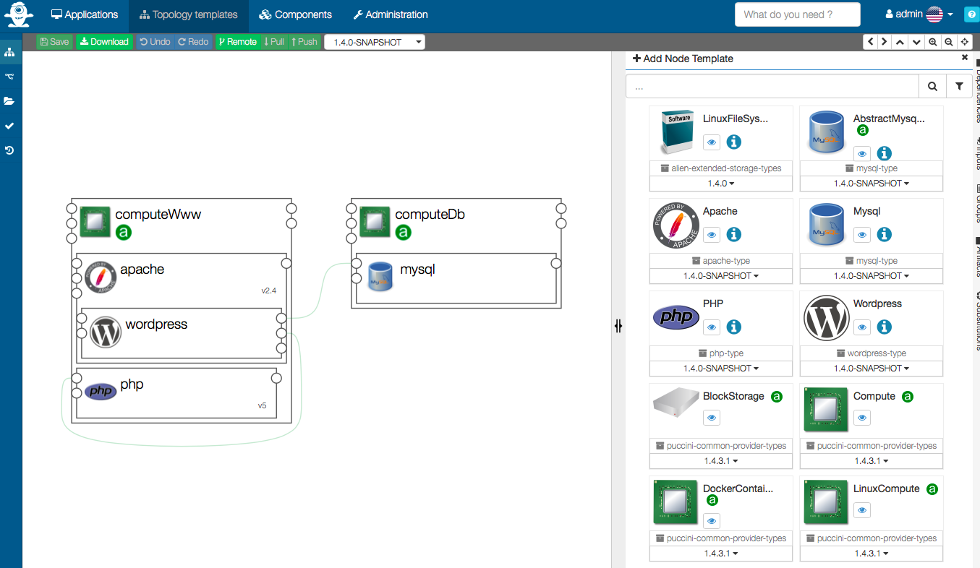
Alien4Cloud
Portal to graphically edit YAML-based TOSCA templates
Built in Java + HTML5 (Spring Boot, Angular)
Open - Source on Github; Apache 2.0
https://github.com/alien4cloud
Extensible - Plugin based
Easy to add new orchestrators
An orchestrator creates the actual
infrastructure using a TOSCA topology
Defined by the user

Slide 8
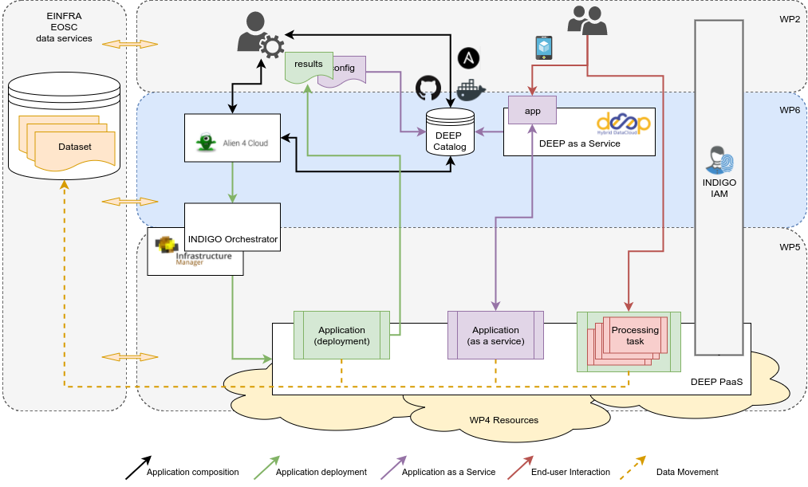
DEEP
Today’s focus

Slide 9

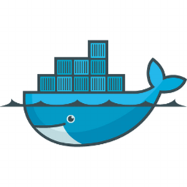
Alien4Cloud in DEEP
User’s entry point
Plugin to communicate with our Orchestrator
Freely at (as bundle Alien4Cloud + plugin, under Apache 2.0)
indigo-dc/alien4cloud-deep on
indigodatacloud/alien4cloud-deep on
Next, video deployment Jupyter+Tensorflow on Mesos/Marathon
Use GPUs
3 x Virtual Machines
1 x Mesos Master to control (running Marathon too)
1 x Mesos Slave doing the hard work
1 x Load Balancer - Marathon-LB (HAProxy) exposed to internet

Slide 10
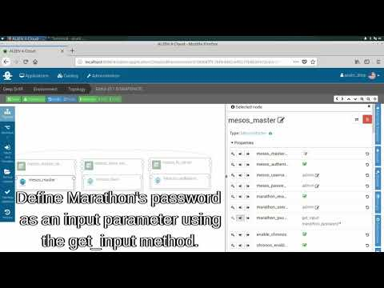
Alien4Cloud in action

Slide 11


Thank you!
Want more? Check us on:
https://deep-hybrid-datacloud.eu/
@DEEP_eu
DEEP-Hybrid-DataCloud funded by the EU Horizon 2020 Framework Programme; grant agreement 777435

Slide 12
What’s the idea
Standardizes the language to describe:
The structure of an IT Service (its topology model)
How to orchestrate operational behavior (plans such as build, deploy, patch, shutdown, etc.)
Declarative model that spans applications, virtual and physical infrastructure
Notes:
Indent aware like python, not JSON like C

