Slide 1

ASAM iLinkRT V3
Wireshark Plugin Presentation
Thilo Wenzel
ETAS GmbH

Slide 2
Agenda
1
Introduction
2
Motivation
3
Idea
4
Features
5
Open Source
6
Deliverables
7
…

Slide 3
Introduction
iLinkRT describes a multi-client / multi-server architecture for the purpose of fast channel based communication between MC-Servers (e.g. application system for electronic control units (ECU)) and MC-Clients (e.g. system for test automation).
iLinkRT defines a protocol
iLinkRT supports Ethernet as physical layer
Wireshark is a tool that allows to monitor telegrams on Ethernet
Wireshark is commonly used
Wireshark supports plugins to interpret telegrams

Slide 4
Motivation
When implementing iLinkRT in a product it is necessary to check whether the product sends and receives iLinkRT telegrams correct
Structure of telegram
Content of telegram
The telegram analysis is difficult without the support of a tool that interprets the pure telegram array

Slide 5
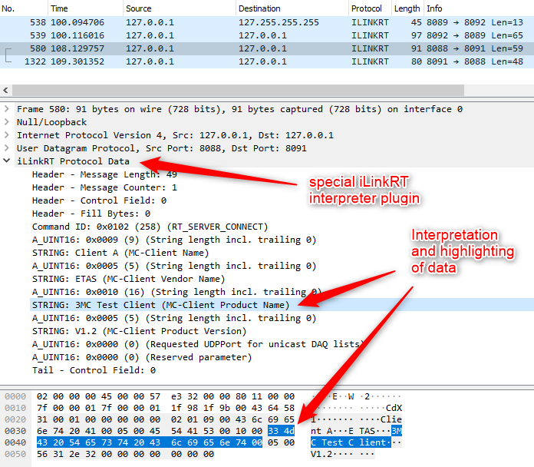
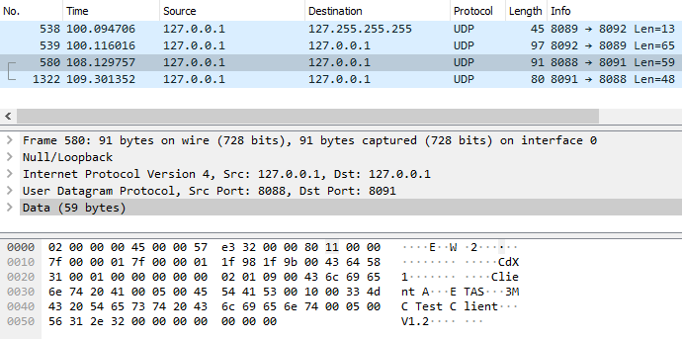
Idea
Wireshark with iLinkRT plugin
Extend Wireshark with an iLinkRT plugin
Wireshark as is

Slide 6
Features
LUA script that can be used by Wireshark as plugin
LUA is a programming language that allows to extend the Wireshark functionality
Automatic detection of iLinkRT frames
Interpretation of iLinkRT command requests (CTO)
Interpretation of iLinkRT event and data telegrams (DTO)

Slide 7
Open Source
License
GNU General Public License, version 2
Location
Github (ASAM e.V. Open Source Platform)

Slide 8
Deliverables
Lua Script
iLinkRT_Proto.lua
Readme
ReadMe.md
Disclaimer
Disclaimer.md
Contributing
Contributing.md
License
GNU General Public License, version 2

