Slide 1
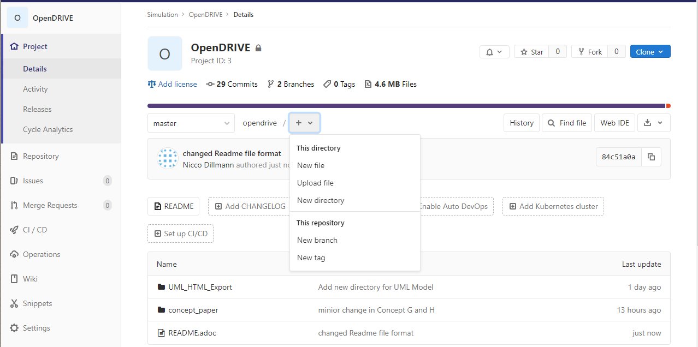
Create new branch

Slide 2
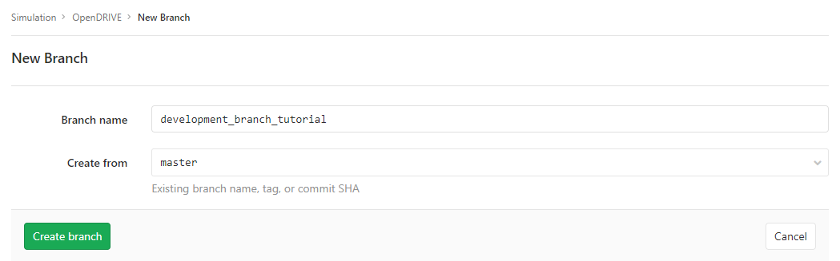
1. Create new branch name
2. Create branch

Slide 3
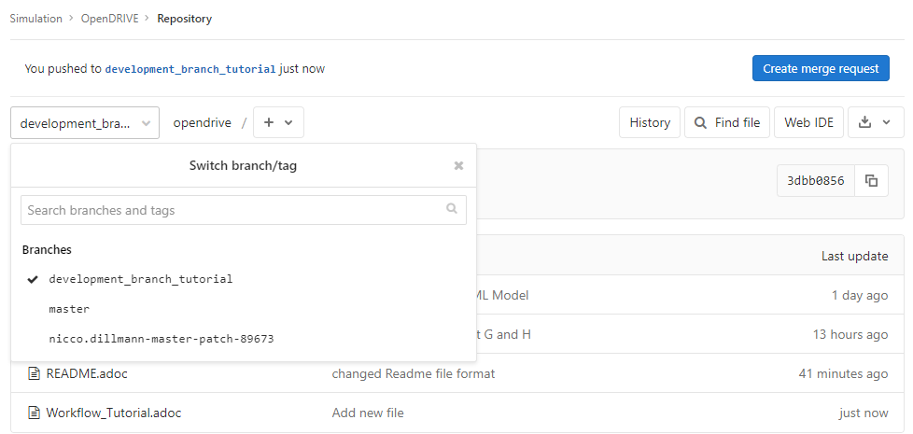
1. Dropdown menu to switch branches

Slide 4
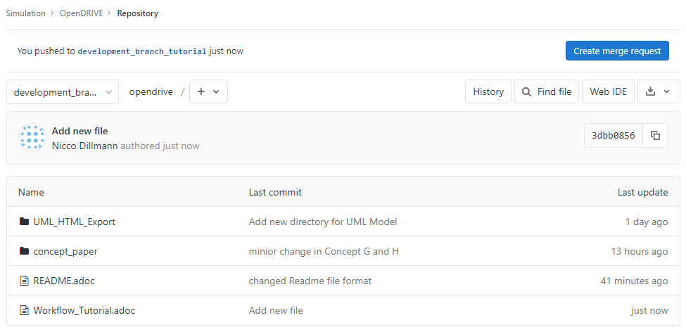
create merge request

Slide 5
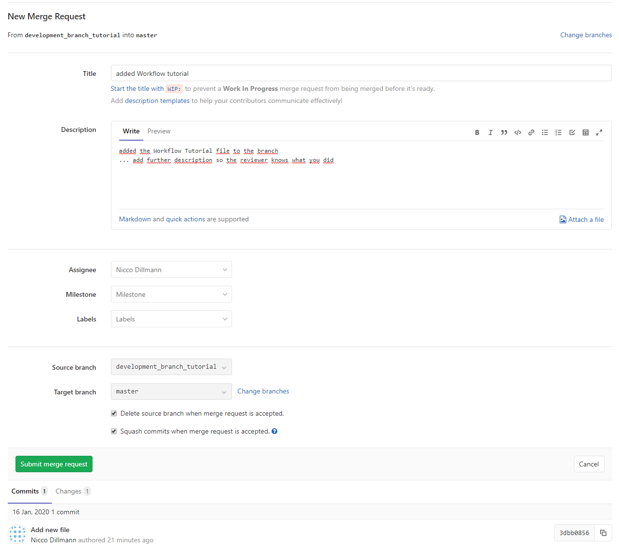
1. Add title to merge request
2. Add description
3. Add assignee
if available: milestone, labels
Select if available
4. Select merge options
5. Submit

Slide 6
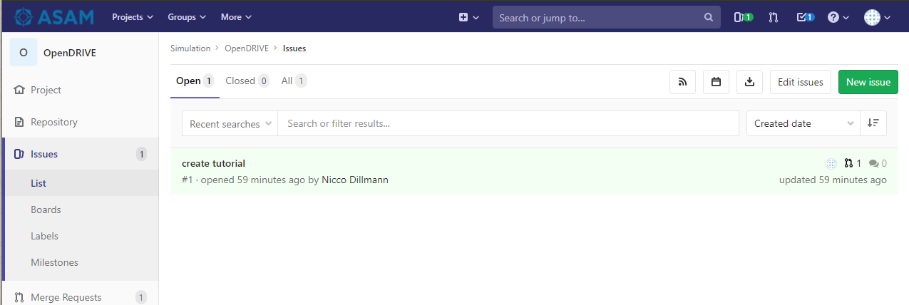
Create new issue

Slide 7
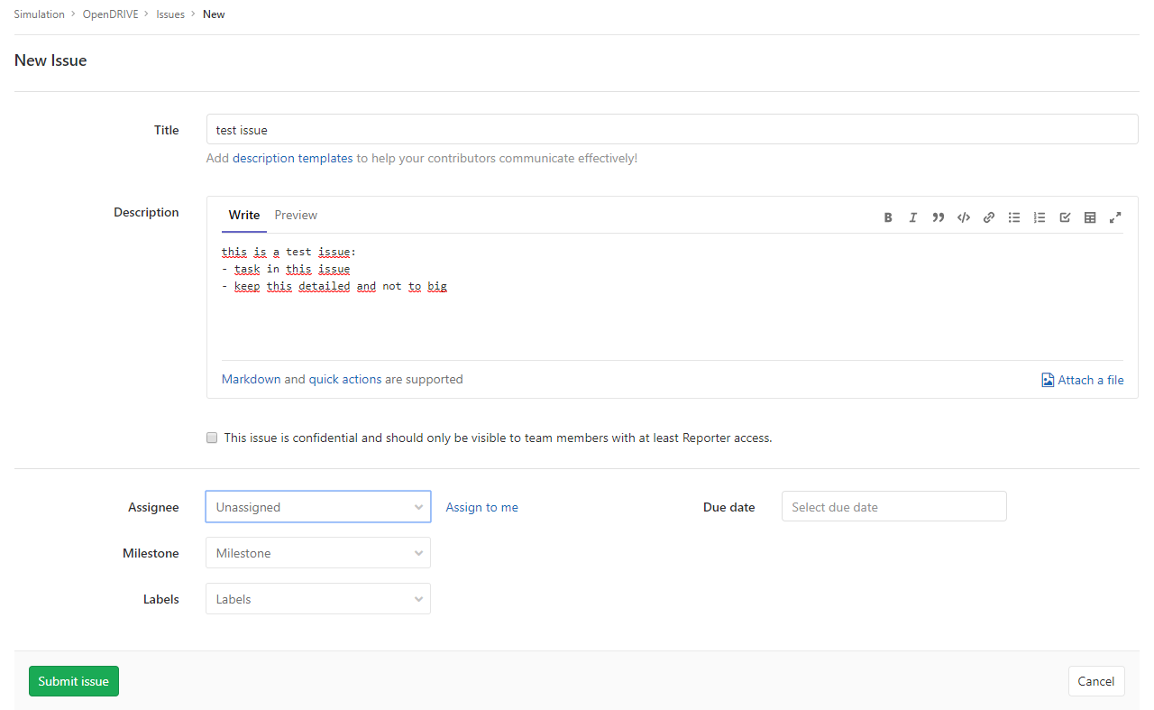
1. Add title to merge request
2. Add description
4. Select merge options
Select if available
5. Submit

Slide 8
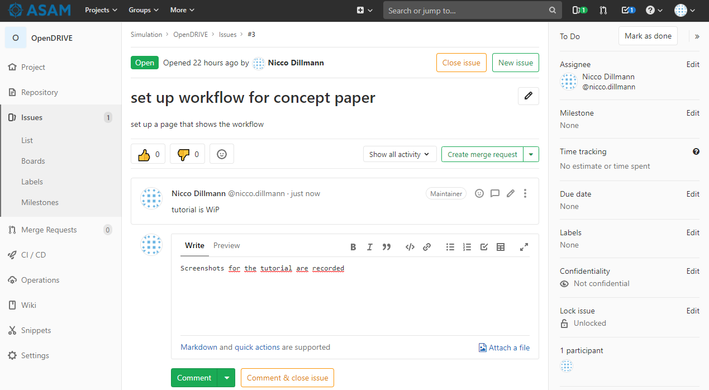
1. Add description for progress
2. Add comment and/or close issue

Slide 9
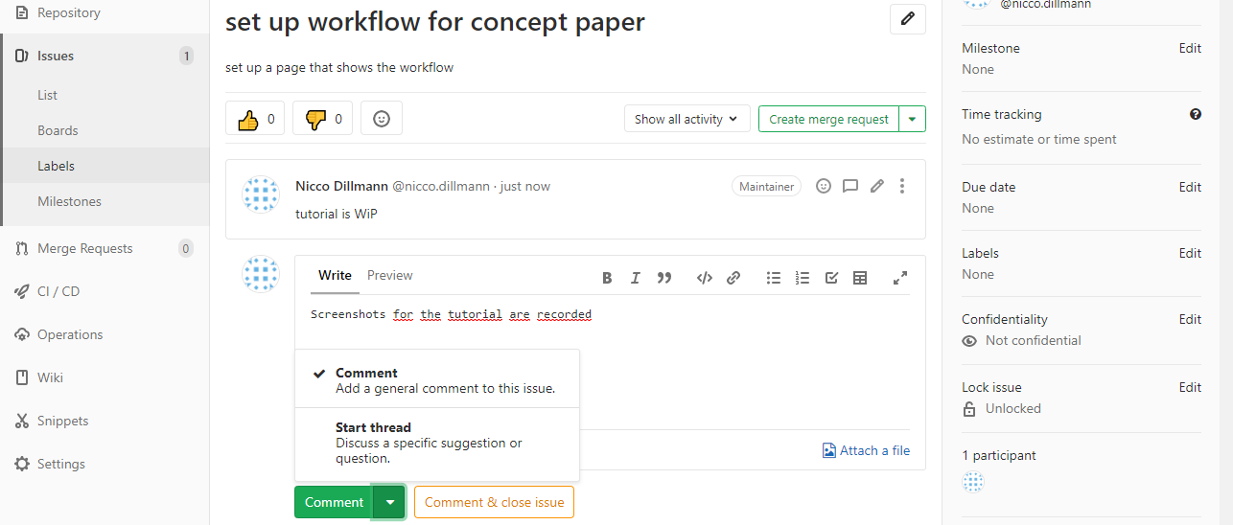
Decide if this is just a comment or a thread to claify an open point

Slide 10
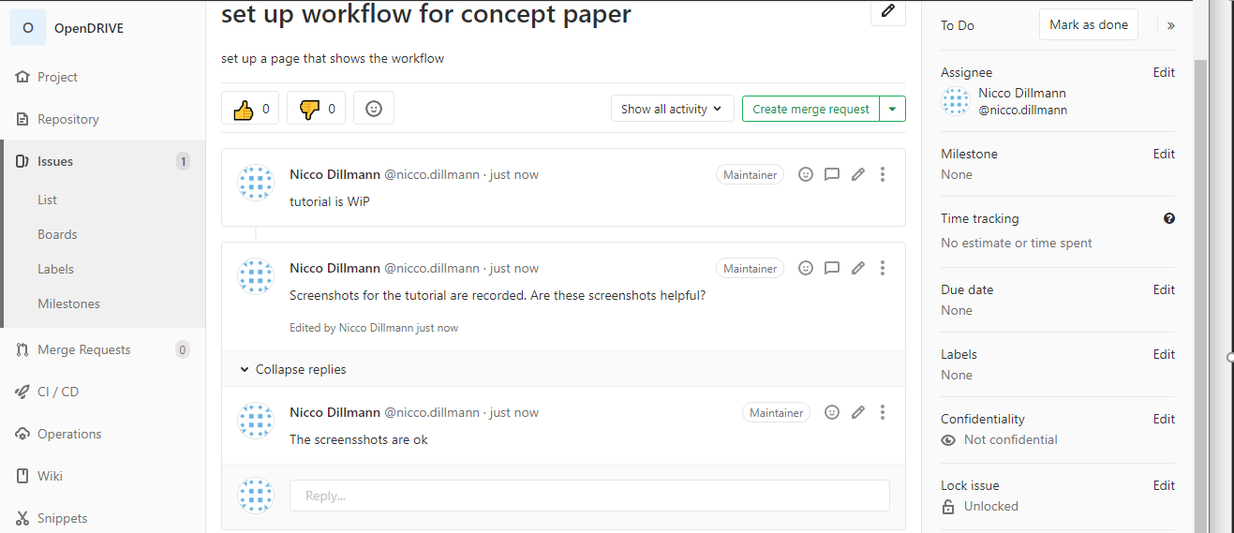
Thread in this issue, including the reply field

Slide 11
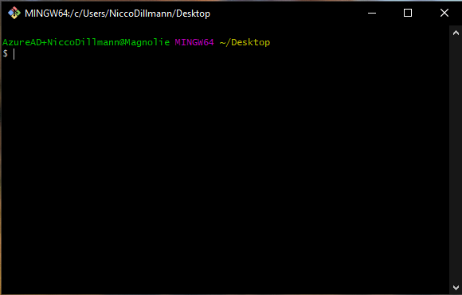

Slide 12
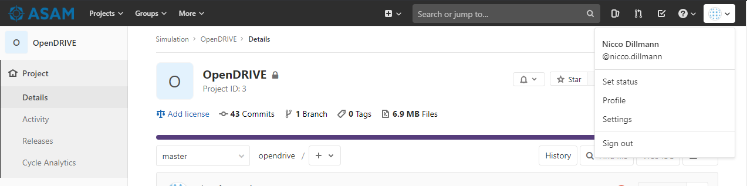
Avatar
Go to settings

Slide 13
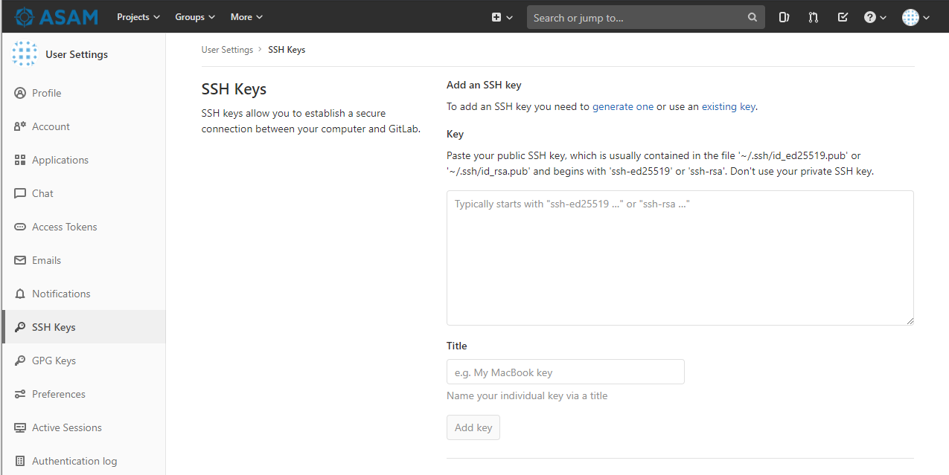
1. Enter SSH Keys Menu
2. Paste key in here
3. Paste comment of key in here
4. Add key

Slide 14
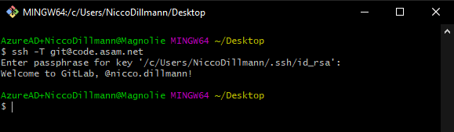
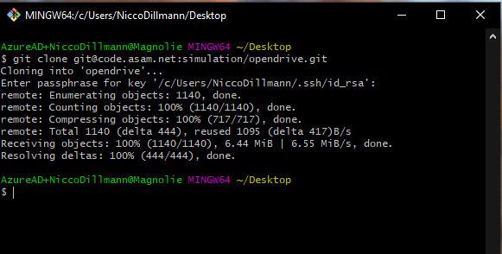

Slide 15
