Slide 1
ACE ENGINEERING COLLEGE (AN AUTONOMOUS INSTITUTION)
Department of Computer Science & Engineering (Artificial Intelligence & Data Science)
Accredited by NAAC with 'A' Grade | Approved by AICTE, New Delhi | Affiliated to JNTUH
MAJOR PROJECT REVIEW — STAGE-I (PHASE 1)
WORKUP: Virtual Professional Experience Platform
A Containerized Simulation Environment for Situated Software Engineering Education,
Authentic Team Workflows, and Cryptographically Verifiable Skill Demonstration
PRESENTED BY (BATCH NO: 05):
• Mashetty Rohith (23AG1A7236)
• Chintam Archana (23AG1A7214)
• Namasi Aravind (24AG5A7205)
B.Tech Final Year, Dept. of CSE (AI & DS)
UNDER THE GUIDANCE OF:
Mrs. P. Swaroopa
Assistant Professor, Dept. of CSE (AI & DS)
Dr. M. V. Vijaya Saradhi
Professor & Head of Department, CSE (AI & DS)
Date: October 2026 | Academic Year: 2026–2027

Slide 2
EXECUTIVE SUMMARY
Abstract: Bridging Theory and Practical Engineering
Transitioning learners from passive concept absorption to active virtual workplace apprenticeship.
ACE Engineering College | CSE (AI & DS)
THE CHALLENGE
PROPOSED SOLUTION
STAGE-I VALIDATION
The Transition Deficit
• Academic Disconnect: Computer science curricula focus on isolated algorithmic syntax and clean-slate toy assignments.
• Corporate Realities: Fresh graduates face complex multi-file legacy repositories, Architecture Decision Records (ADRs), and technical debt.
• Lack of Tooling: Students rarely interact with Jira-style task backlogs, CI/CD pipelines, or line-level pull request (PR) reviews.
• Resume Inflatability: Self-reported CV skills fail to provide employers with verifiable proof of hands-on competence.
The WORKUP Platform
• Simulated Enterprises: Learners enter simulated tech companies (e.g., FinFlow Technologies) and take on authentic engineering roles.
• DAG Simulation Engine: Structured business problems with prerequisite dependencies and acceptance criteria.
• Ephemeral Sandboxes: Zero-setup in-browser cloud workspaces with isolated process execution and automated test runners.
• AI Tech Lead Reviewer: Line-anchored, rubric-based feedback on pull request diffs simulating senior code reviews.
• Evidence-of-Skill Dossier: Cryptographically verifiable portfolio backed by Git commit SHAs and rubric scorecards.
Verified Implementation
• Modern Tech Stack: Next.js 14 App Router, React 18, TypeScript, Tailwind CSS, Prisma ORM 5.x, SQLite/PostgreSQL.
• 21 Domain Entities: Complete relational schema modeling users, simulations, tasks, workspaces, and verifiable portfolios.
• 4-Tier Security: Bcryptjs password hashing, signed jose JWT session cookies, and strict Role-Based Access Control.
• 100% Test Pass Rate: 34 automated unit & integration tests passing across 8 Vitest suites verifying process jailing and DAG logic.
• Stage-II Roadmap: Containerized Kubernetes pods, multi-turn LLM code reviewer, and MLOps/DevOps/Cyber tracks.
Academic Year 2026–2027 | Major Project Review – Phase 1 WORKUP: Virtual Professional Experience Platform Slide 2 of 23

Slide 3
PROBLEM IDENTIFICATION
The Industry-Academia Transition Gap in Software Engineering
Evaluating the fundamental structural disconnect between classroom coding and professional development.
ACE Engineering College | CSE (AI & DS)
THE 4 CORE DEFICITS
PARADIGM COMPARISON
1. The Clean-Slate Fallacy: Academic assignments invariably begin from empty scratch files (`main.py`). In contrast, 90% of corporate engineering entails navigating, debugging, and refactoring large pre-existing legacy codebases with technical debt.
2. Absence of Architectural Context: Students receive artificial algorithmic prompts lacking business rationale, Architectural Decision Records (ADRs), API contracts, or real-world operational constraints.
3. Missing Collaborative PR Review Loops: Conventional coursework relies on binary pass/fail autograders. Students never experience line-level code reviews, mentor critiques, or iterative pull request refactoring.
4. Resume Inflatability & Skill Obfuscation: Recruiters and hiring managers cannot distinguish between genuine practical competence and memorized syntax from self-reported bullet points on student resumes.
Classroom vs. Corporate Reality
Dimension | Academic Coursework | Corporate Reality
Project Scope | Single isolated script | Multi-package distributed repo
Problem Statement | Toy algorithmic puzzle | Customer churn / payment deadlock ticket
Architectural Rules | Zero constraints | Strict ADRs, linting, & security gates
Testing Harness | Hidden unit test runner | In-sandbox Vitest suite & local edge tests
Evaluation Gate | Pass/Fail percentage | Detailed line-by-line pull request review
Outcome Artifact | Local course grade | Tamper-evident Git commit SHA dossier
Academic Year 2026–2027 | Major Project Review – Phase 1 WORKUP: Virtual Professional Experience Platform Slide 3 of 23

Slide 4
MOTIVATION & NEED
Why Tutorials and Toy Coding Fail to Produce Engineers
Grounding WORKUP in educational learning theories and real-world apprenticeship models.
ACE Engineering College | CSE (AI & DS)
LEARNING THEORY
SITUATED COGNITION
SCALABLE MENTORSHIP
David Kolb's Model (1984)
• Concrete Experience: Learners enter a live codebase to encounter authentic bugs and system bottlenecks.
• Reflective Observation: Examining test failures, execution traces, and architectural ADR guidelines.
• Abstract Conceptualization: Synthesizing design patterns (e.g., idempotency keys, mutex locks) to solve problems.
• Active Experimentation: Implementing code changes and testing in isolated sandboxes to observe live results.
• Pedagogical Implication: Theoretical lectures satisfy only 25% of Kolb's cycle. WORKUP fulfills the entire 4-stage experiential loop.
Lave & Wenger (1991)
• Communities of Practice: Professional competence is acquired by participating in authentic cultural practices of an engineering discipline.
• Legitimate Peripheral Participation: Beginners start with bounded, low-risk engineering tasks (e.g., bug hotfixes, refactoring) before tackling system architecture.
• Professional Tool Adoption: Working with actual terminal CLIs, Git commit trees, linter configs, and test harnesses.
• Overcoming MOOC Isolation: Video-based learning isolates the student; WORKUP embeds the student within a simulated enterprise engineering team.
The Scale Dilemma
• High Student-Faculty Ratios: Colleges face 60:1 or 100:1 ratios, making individual code reviews and personalized mentoring impossible.
• Corporate Internship Shortage: Less than 15% of engineering graduates secure meaningful corporate internships with senior mentorship.
• The AI Tech Lead Solution: WORKUP bridges this scalability gap by automating senior code reviews using deterministic test harnesses and AI PR reviewers.
• Continuous Deliberate Practice: Students receive instant, iterative, non-judgmental critique at any hour without burning human mentor capacity.
Academic Year 2026–2027 | Major Project Review – Phase 1 WORKUP: Virtual Professional Experience Platform Slide 4 of 23

Slide 5
OBJECTIVES & SCOPE
Project Objectives and Stage-I Engineering Scope
Clear demarcation of verified Stage-I deliverables versus planned Stage-II platform expansion.
ACE Engineering College | CSE (AI & DS)
CORE OBJECTIVES
SCOPE BOUNDARIES
Obj 1: Multi-Tenant Enterprise Simulator: Architect and implement an authentic simulation engine modeling tech companies, role tracks, sprint phases, and DAG-ordered task tickets.
Obj 2: Ephemeral Sandbox Orchestrator: Develop a path-jailed, isolated execution environment with strict resource limits (max 2 workspaces/user, 4000ms command timeout, 30m idle sweep).
Obj 3: Automated In-Situ Test Harness: Integrate automated test runners (Vitest) allowing learners to run unit and integration tests locally inside their sandbox before submission.
Obj 4: Rubric Evaluation & Code Review: Build a multi-tier evaluation system providing line-level diff analysis, rubric scoring (0–100), and automated PR feedback.
Obj 5: Verifiable Evidence Dossier: Generate an immutable portfolio record capturing exact Git commit SHAs, test outputs, and rubric scores for recruiter verification.
In-Scope: Verified Stage-I Deliverables
✔ Full-stack Next.js 14 App Router, React 18, TypeScript, Tailwind CSS.
✔ Prisma ORM 5.x with 21 relational domain models on SQLite.
✔ 4-Tier RBAC (Student, Content Author, Reviewer, Administrator).
✔ Flagship Software Engineering Track (FinFlow Tech: Payment Webhooks & Idempotency).
✔ Local Isolated Sandbox Provider with hard timeouts & process jailing.
✔ Comprehensive Vitest test suite with 34 tests across 8 suites (100% passing).
Planned Scope: Stage-II Platform Enhancements
➜ Distributed Kubernetes container pods with gVisor kernel sandboxing.
➜ Multi-turn LLM AI Tech Lead Reviewer with line-anchored PR comments.
➜ Multi-domain catalog expansion (MLOps, Cloud/DevOps, Cybersecurity, Data Eng).
➜ Multi-player simulated teams & live incident response simulations.
➜ Cryptographically signed, publicly verifiable recruiter dossiers.
Academic Year 2026–2027 | Major Project Review – Phase 1 WORKUP: Virtual Professional Experience Platform Slide 5 of 23

Slide 6
STATE OF THE ART
Analysis of Existing Learning & Training Systems
Evaluating current educational paradigms, developer tools, and job simulation platforms.
ACE Engineering College | CSE (AI & DS)
ALGORITHMIC PRACTICE
VIDEO-BASED MOOCS
LeetCode, HackerRank, Codeforces
Strengths: Outstanding for data structures, algorithm efficiency, and syntax mastery.
Limitations: Operates on single isolated functions; zero exposure to architecture, legacy codebases, ADRs, Git workflows, or team pull request reviews.
Impact: Produces graduates who can invert a binary tree but cannot resolve a merge conflict or debug an API webhook.
Coursera, Udemy, edX
Strengths: High accessibility, broad conceptual coverage, and scalable broadcast lectures.
Limitations: Passive spectator learning with <10% completion rate. Exercises are synthetic clean-slate toys graded by trivial string matchers.
Impact: Creates the illusion of competence ('tutorial hell') without imparting real troubleshooting resilience.
VIRTUAL JOB SIMULATIONS
CLOUD WORKSPACES
Forage (formerly InsideSherpa)
Strengths: Excellent enterprise branding and high-level corporate scenario framing.
Limitations: Submissions are static file uploads (PDFs, PPTs). Completely lacks live code execution, cloud sandboxes, automated testing, and line-level code reviews.
Impact: Serves as an exploratory marketing/overview tool rather than a technical software engineering workbench.
GitHub Codespaces, Gitpod, Replit
Strengths: Full browser IDEs with containers, terminals, port forwarding, and pre-configured extensions.
Limitations: Pure compute infrastructure with zero pedagogical layer. No simulated enterprise context, no task DAGs, no business ADRs, and no review rubrics.
Impact: Requires the learner or educator to assemble, design, and manage the entire curriculum independently.
Academic Year 2026–2027 | Major Project Review – Phase 1 WORKUP: Virtual Professional Experience Platform Slide 6 of 23

Slide 7
LITERATURE SURVEY | PART 1
Educational SE Simulation & Graduate Skill Deficits
Analyzing empirical foundations of software engineering simulation games and industry readiness.
ACE Engineering College | CSE (AI & DS)
SE SIMULATION ENVIRONMENTS
GRADUATE SKILL GAPS
AGILE TEAM ETHNOGRAPHY
Comprehensive Evaluation of an Educational Software Engineering Simulation
E. Navarro & A. van der Hoek (2007)
IEEE Trans. Softw. Eng., Vol. 33, No. 6, pp. 409–425
2007 | DOI: 10.1109/TSE.2007.70723
Summary & Findings:
Presents 'SimSE', an interactive graphical simulation environment modeling software process lifecycles (Waterfall, Agile, XP). Demonstrates that active participatory simulation enables students to discover non-obvious engineering trade-offs (e.g., technical debt, team communication latency) far more effectively than static lectures.
Purpose / Relevance to WORKUP:
Validates WORKUP's simulation engine modeling virtual companies, sprint backlogs, and multi-role engineering team dynamics.
Gaps Between Industry Expectations & University Preparation in Software Eng.
A. Radermacher & G. Walia (2013)
Proc. 44th ACM Technical Symposium on CS Education (SIGCSE)
2013 | DOI: 10.1145/2445196.2445353
Summary & Findings:
Conducted an extensive empirical survey across 50+ technology companies. Identified that new graduates face severe skill deficits in navigating large legacy codebases, writing integration tests, utilizing issue tracking tickets, and participating in peer code reviews.
Purpose / Relevance to WORKUP:
Directly guides WORKUP's pedagogical focus on legacy codebase refactoring, Jira-style task tickets, and PR code reviews.
An Ethnographic Study of Agile Software Development in Practice
H. Sharp & P. Hall (2009)
ACM Trans. Software Engineering & Methodology (TOSEM)
2009 | DOI: 10.1145/1538942.1538944
Summary & Findings:
Investigates real-world Agile engineering team behavior over 24 months. Establishes that professional engineering is fundamentally ticket-driven, artifact-anchored, and social—revolving around standups, architectural constraints, and pull request critique.
Purpose / Relevance to WORKUP:
Informs WORKUP's simulation interface featuring architectural ADRs, sprint phases, and simulated senior engineering team members.
Academic Year 2026–2027 | Major Project Review – Phase 1 WORKUP: Virtual Professional Experience Platform Slide 7 of 23

Slide 8
LITERATURE SURVEY | PART 2
Cloud Workspaces & AI-Assisted Code Review
Research into isolated execution environments, generative AI in education, and testing gaps.
ACE Engineering College | CSE (AI & DS)
LIGHTWEIGHT CONTAINERIZATION
FORMATIVE AI CODE REVIEW
TESTING DEFICIT ANALYSIS
Lightweight Container Isolation for Computing Education
N. Kratzke (2018)
IEEE Transactions on Education, Vol. 61, No. 2, pp. 127–134
2018 | DOI: 10.1109/TE.2017.2768560
Summary & Findings:
Evaluates containerized execution architectures for computing lab assignments. Shows that browser-accessible ephemeral containers eliminate operating-system configuration friction, enforce strict CPU/RAM limits, and prevent malicious local path escapes.
Purpose / Relevance to WORKUP:
Provides the blueprint for WORKUP's `IsolatedSandboxProvider`, enforcing process jailing, 4000ms timeouts, and concurrency caps.
Experiences with Generative AI in Computing Education
S. MacNeil et al. (2023)
Proc. 2023 ACM Conf. on Innovation & Technology in CS Education (ITiCSE)
2023 | DOI: 10.1145/3587102.3588797
Summary & Findings:
Examines LLMs providing real-time code explanations, error remediation, and code critique. Finds that line-level formative feedback anchored to specific code diffs dramatically accelerates student debugging skills compared to generic error summaries.
Purpose / Relevance to WORKUP:
Validates WORKUP's AI Tech Lead Reviewer providing structured, line-by-line pull request critique against engineering rubrics.
The Industry-Academia Testing Gap: Why Students Struggle with Verification
V. Garousi, M. Felderer, & M. V. Mäntylä (2018)
IEEE Software, Vol. 35, No. 5, pp. 68–73
2018 | DOI: 10.1109/MS.2017.4471545
Summary & Findings:
Analyzes software testing instruction across 100+ universities. Reveals that curricula treat testing as an afterthought; students are rarely taught to run test suites locally, write edge assertions, or maintain CI pipeline green states.
Purpose / Relevance to WORKUP:
Directly justifies WORKUP's workbench architecture requiring in-sandbox automated test execution (Vitest) prior to PR submission.
Academic Year 2026–2027 | Major Project Review – Phase 1 WORKUP: Virtual Professional Experience Platform Slide 8 of 23

Slide 9
COMPARATIVE ANALYSIS
Platform Comparison Matrix & Identified Research Gaps
Evaluating WORKUP against commercial platforms and crystallizing the unresolved literature gaps.
ACE Engineering College | CSE (AI & DS)
Key Capability Dimension | LeetCode | Coursera | Forage | Codespaces | WORKUP (Ours)
Multi-File Legacy Repositories | No (Single Func) | No (Clean Scratch) | Partial (Unlinked) | Yes (Full Repo) | Yes (Simulated Legacy)
Architectural Context (ADRs/Tickets) | No (Toy Prompt) | No (Static Prompt) | Yes (PDF Scenario) | No (Raw VM) | Yes (Jira/ADR Engine)
Ephemeral Cloud Sandbox | Isolated Runner | No (Local/Jupyter) | No (Static Upload) | Yes (Full Linux) | Yes (Path-Jailed Node)
In-Situ Automated Test Execution | Hidden Runner | Basic Autograder | No Execution | Manual Terminal | Yes (Vitest Harness)
Line-Level Pull Request Review | No (Binary Grade) | No (Peer/Auto) | No Review | Manual Peer PR | Yes (AI Tech Lead PR)
GAP 1: THE DISCONNECTED WORKFLOW
GAP 2: CLEAN-SLATE VS LEGACY BIAS
GAP 3: UNVERIFIABLE SKILL SIGNALS
Existing platforms fragment the software development lifecycle. Students solve isolated algorithmic questions in one tool, watch video tutorials in another, and push unreviewed repos to GitHub. No platform connects: Career → Business Problem → Task Ticket → ADR → Sandbox → Test → PR Review → Verifiable Evidence.
Educational benchmarks overwhelmingly promote building small apps from scratch. In industry, 85%+ of engineering effort is invested in understanding, debugging, and modifying existing legacy systems with non-trivial technical debt. Existing platforms fail to simulate pre-existing codebases.
Standard certifications prove video completion or multiple-choice test scores, while resumes feature self-claimed buzzwords. Employers lack tamper-evident, cryptographically verifiable proof of a candidate's actual ability to navigate tickets and implement correct code solutions.
Academic Year 2026–2027 | Major Project Review – Phase 1 WORKUP: Virtual Professional Experience Platform Slide 9 of 23

Slide 10
PROPOSED SYSTEM
The WORKUP Platform Architecture & Key Innovations
A simulation-first virtual workplace immersing learners in authentic corporate engineering workflows.
ACE Engineering College | CSE (AI & DS)
1. SIMULATED TECH ENTERPRISES
2. TASK BACKLOG & SIMULATION DAG
Authentic Business Context & Team Roles
• Virtual Company Topology: Learners enter realistic simulated enterprises (e.g., FinFlow Tech, OmniRetail) with domain-specific architecture.
• Cross-Functional Teams: Assigned to simulated engineering teams (Payments, Core Platform, Infra) with realistic role titles and senior mentors.
• Architectural Decision Records (ADRs): Tasks are constrained by formal ADRs (e.g., ADR-001 on webhook idempotency) enforcing real engineering standards.
Directed Acyclic Graph (DAG) Task Engine
• Sprint Task Backlogs: Jira-style task tickets complete with user stories, technical context, acceptance criteria, and reproduction steps.
• Prerequisite Dependency Graphs: Tasks unlock only after foundational tasks pass verification, preventing cognitive overload and ensuring logical progression.
• Non-Linear Pathways: Supports branching simulation tracks based on student career specializations (Backend, DevOps, MLOps, Security).
3. EPHEMERAL SANDBOX EXECUTION
4. AI TECH LEAD & EVIDENCE DOSSIER
Zero-Setup Isolated In-Browser Workbench
• Process Jailing: Workspaces execute inside isolated directories (`.workspaces/<id>`) preventing path traversal and protecting the host.
• Resource Limits: Strict execution governance: max 2 workspaces per student, 4000ms hard execution timeout, and 30-minute idle TTL sweeping.
• In-Situ Test Harness: Vitest automated test execution embedded directly in the workbench, giving real-time pass/fail feedback.
Automated Code Review & Verifiable Proof
• Pull Request Review Engine: Simulates senior engineer code review by analyzing unified Git diffs against strict architectural rubrics.
• Line-Anchored Critique: Delivers formative feedback directly highlighting specific line numbers that violate ADRs or edge cases.
• Tamper-Evident Dossier: Student success generates an immutable portfolio backed by real Git commit SHAs, test logs, and rubric scores.
Academic Year 2026–2027 | Major Project Review – Phase 1 WORKUP: Virtual Professional Experience Platform Slide 10 of 23

Slide 11
SYSTEM DECOMPOSITION
Target User Personas and Core Functional Modules
Architectural mapping between user roles, access privileges, and the 11 functional system modules.
ACE Engineering College | CSE (AI & DS)
USER PERSONAS
11 SYSTEM MODULES
1. Student / Learner Persona
Undergraduate CS students and early-career engineers. Explores career roles, launches simulations, inspects tickets/ADRs, implements code in sandboxes, runs automated tests, submits pull requests, and views their verifiable portfolio.
2. Content Author Persona
Senior software engineers, corporate educators, and academic curriculum designers. Authors simulated enterprises, legacy code repositories, task tickets, acceptance test suites, and multi-tier evaluation rubrics.
3. Technical Reviewer Persona
Industry mentors, teaching assistants, and the automated AI Tech Lead Agent. Inspects submitted pull request diffs, executes rubric scoring (0–100), provides line-level feedback, and approves/rejects submissions.
4. System Administrator Persona
Institutional platform managers and DevOps engineers. Configures global RBAC roles, provisions multi-tenant company accounts, manages fleet sandbox concurrency caps, and inspects immutable audit logs.
• M1: Authentication & RBAC: Bcryptjs password hashing, signed jose JWT session cookies, 4-tier permission matrix.
• M2: Career & Role Explorer: Taxonomy navigation across Software Eng, DevOps, MLOps, and Cybersecurity tracks.
• M3: Enterprise Company Catalog: Simulated corporate workspaces with business models and organizational topologies.
• M4: Simulation DAG Engine: Task dependency resolution, prerequisite locking, and milestone progression.
• M5: Student Workbench UI: Integrated file explorer, code editor, test execution button, and ticket panel.
• M6: Workspace Orchestrator: Concurrency management (max 2/user), idle sweeps (30m TTL), and process lifecycle.
• M7: Isolated Sandbox Provider: Path-jailed child_process execution with 4000ms hard timeout protection.
• M8: In-Situ Test Runner: Vitest CLI executor parsing structured test results and assertion traces.
• M9: Multi-Tier Evaluation Engine: Unified Git diff capture, rubric scorecard evaluation, and PR commenting.
• M10: Evidence-of-Skill Dossier: Tamper-evident portfolio storing verified commit SHAs and rubric benchmarks.
• M11: Audit & Telemetry Logging: Security event logging, system telemetry, and administrative trace analysis.
Academic Year 2026–2027 | Major Project Review – Phase 1 WORKUP: Virtual Professional Experience Platform Slide 11 of 23

Slide 12
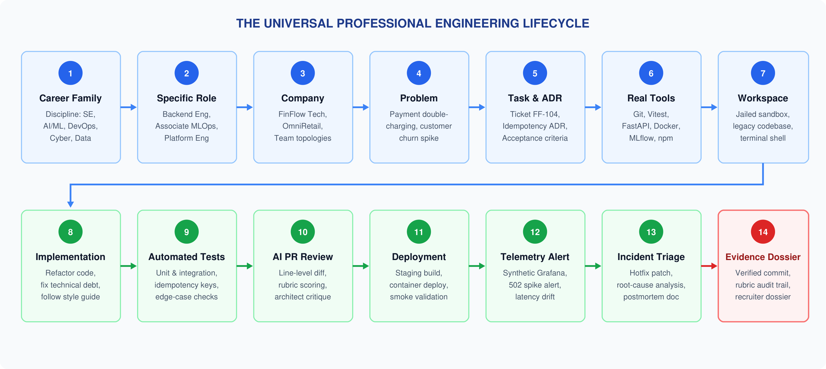
OPERATIONAL WORKFLOW
The 14-Stage Universal Professional Engineering Lifecycle
Tracing the complete interconnected journey from career selection to cryptographically verifiable proof.
ACE Engineering College | CSE (AI & DS)
Academic Year 2026–2027 | Major Project Review – Phase 1 WORKUP: Virtual Professional Experience Platform Slide 12 of 23

Slide 13
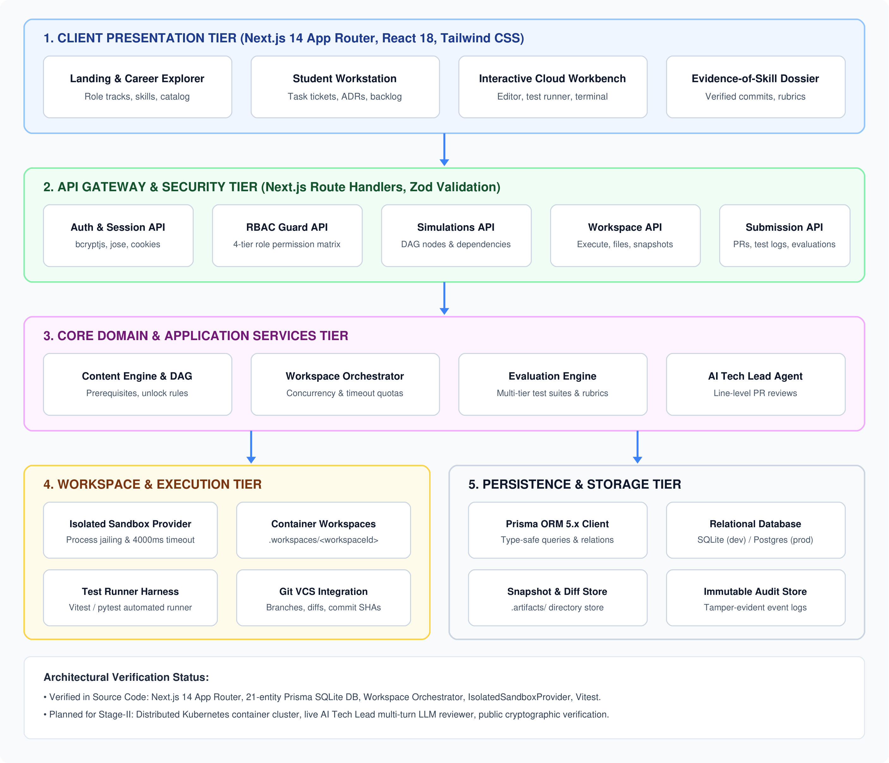
SYSTEM DESIGN | ARCHITECTURE
Tiered System Architecture Diagram
5-tier decoupled topology separating presentation, routing, domain logic, sandboxes, and persistence.
ACE Engineering College | CSE (AI & DS)
5 DECOUPLED TIERS
1. Presentation Tier (Next.js 14 / React 18): Responsive UI with Server Components (RSC), career exploration catalogs, Monaco code editor, terminal runner, and real-time pass/fail badges.
2. API Gateway & Security Tier: Next.js Route Handlers with Zod request validation, bcryptjs password hashing, signed jose JWT session cookies, and 4-tier RBAC guards.
3. Core Domain & Business Services: Simulation DAG engine enforcing task dependencies, Workspace Orchestrator managing lifecycle, and rubric-driven evaluation service.
4. Workspace & Execution Tier: `IsolatedSandboxProvider` enforcing process jailing, hard 4000ms execution timeout cap, and Vitest CLI automated test runner.
5. Persistence & Storage Tier: Prisma ORM 5.x with type-safe query engine, 21 relational tables on SQLite (`dev.db`), and seamless migration target for PostgreSQL (AWS RDS).
Academic Year 2026–2027 | Major Project Review – Phase 1 WORKUP: Virtual Professional Experience Platform Slide 13 of 23

Slide 14
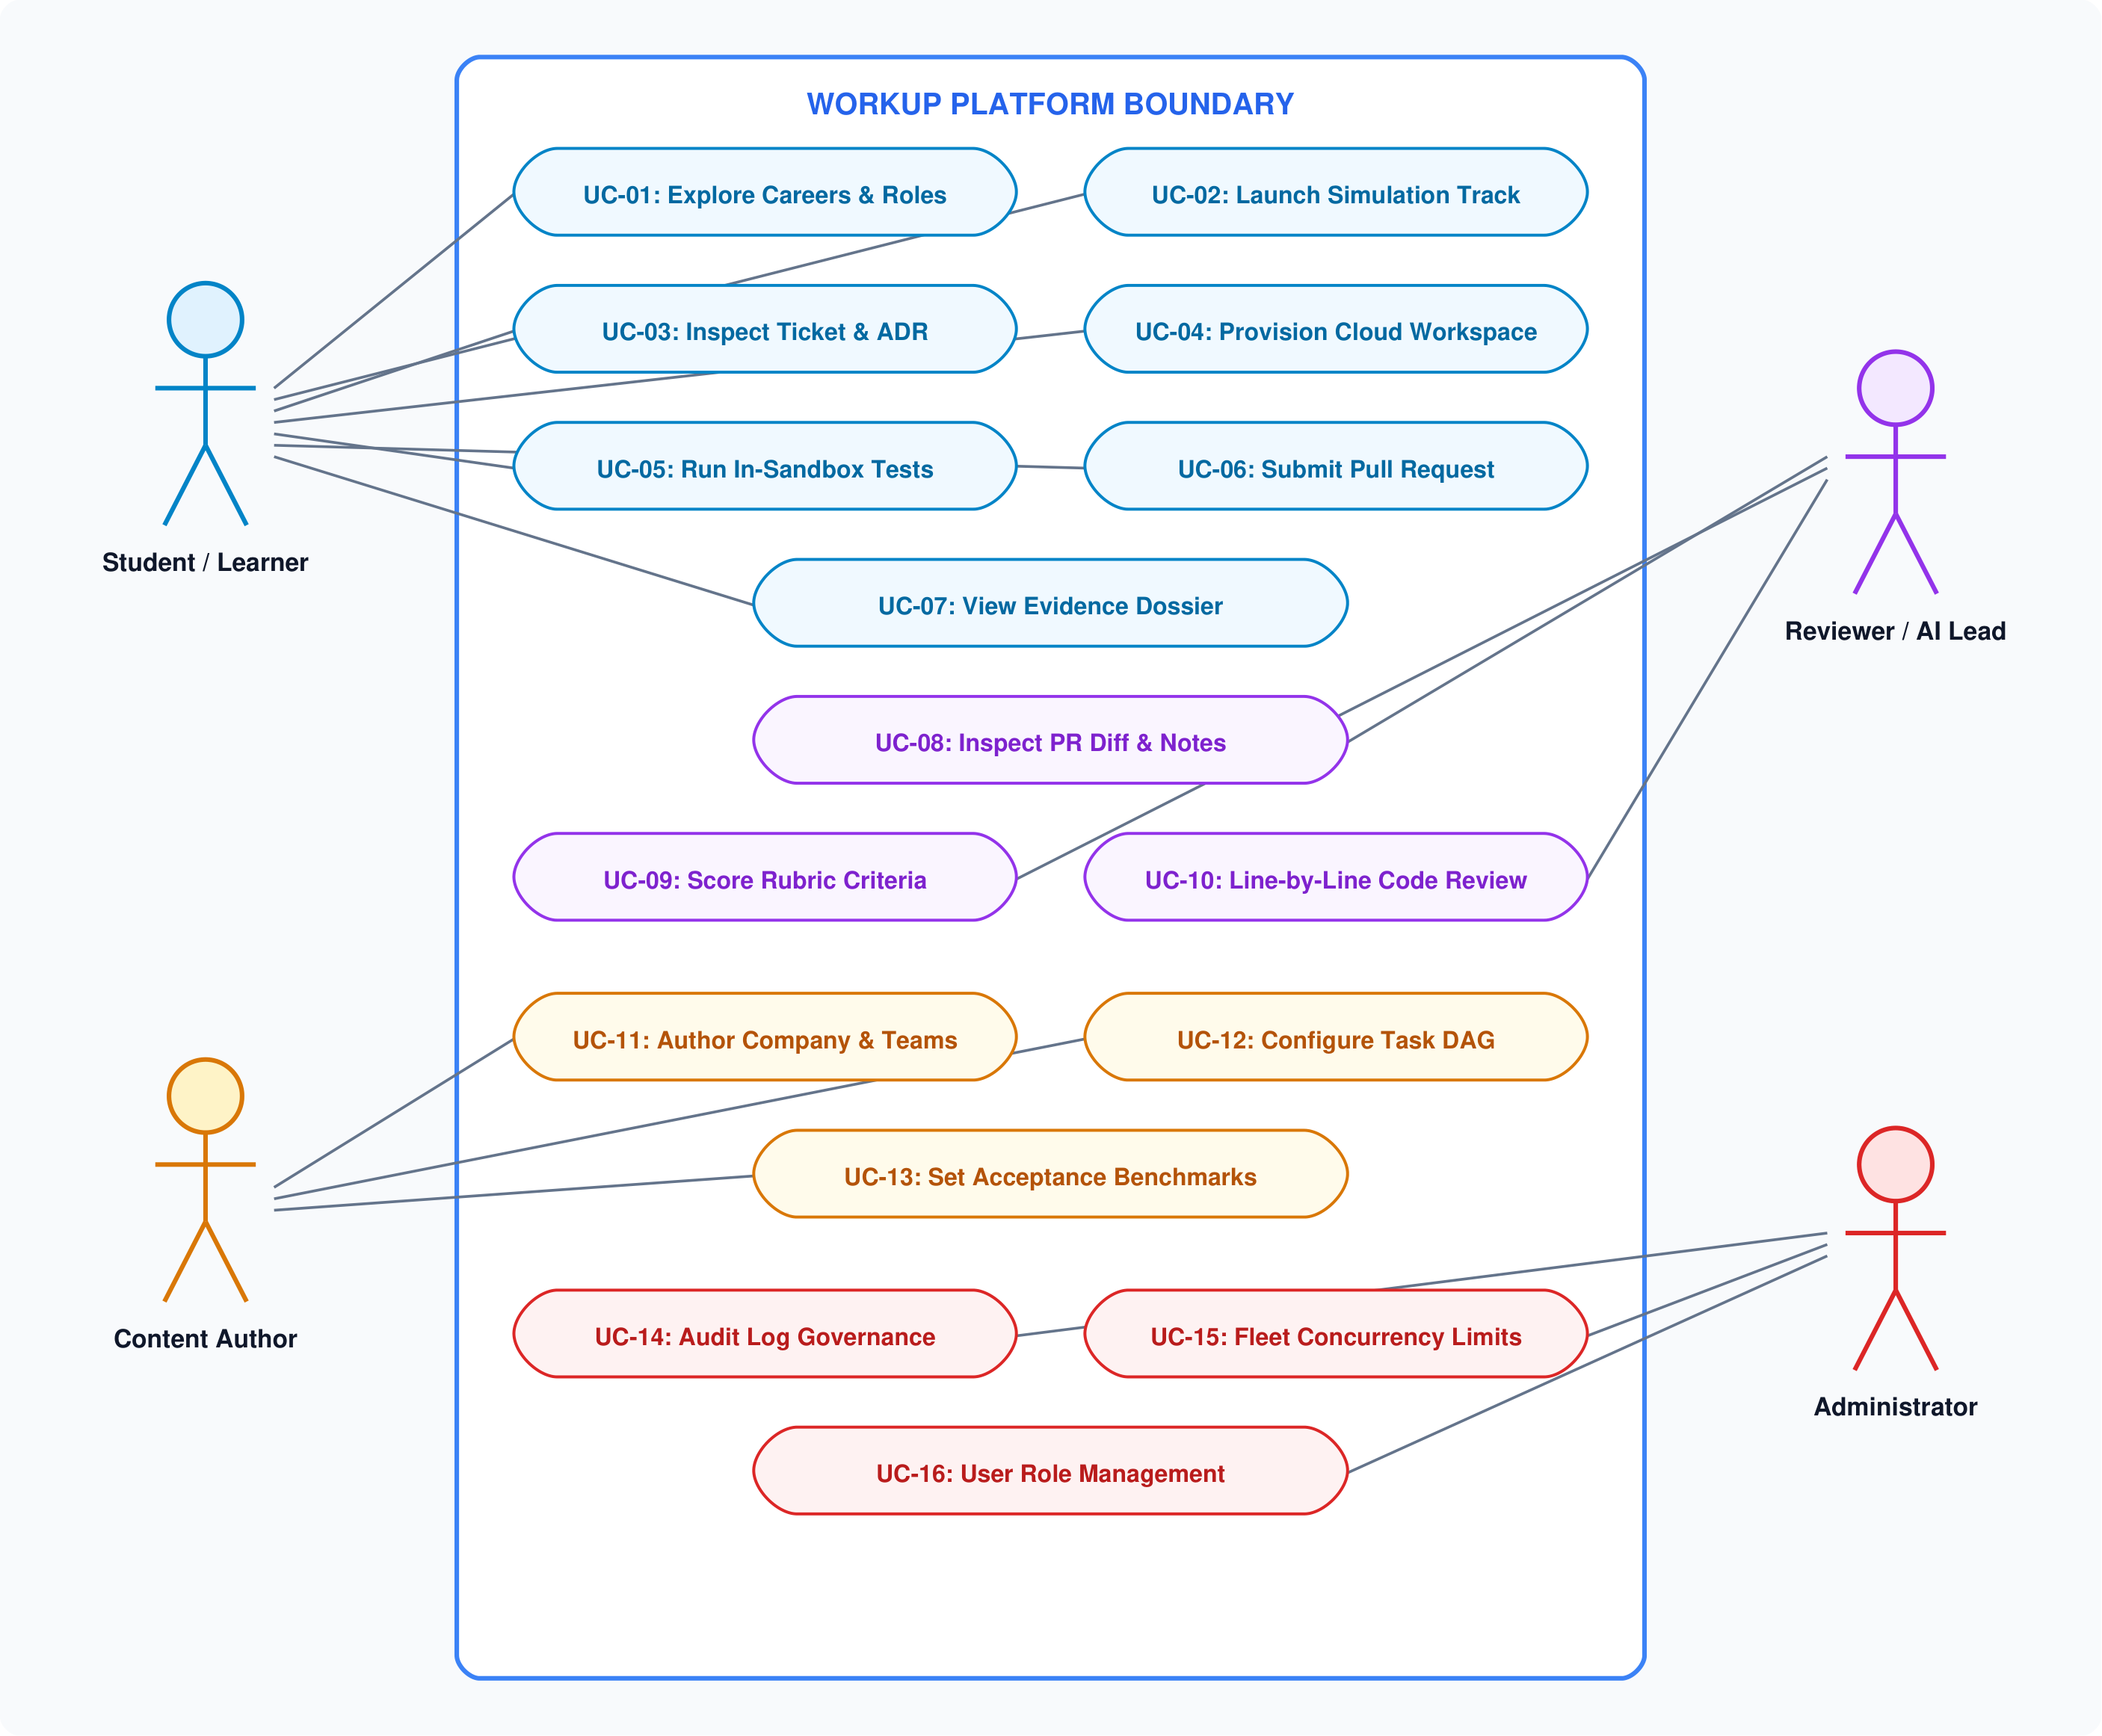
SYSTEM DESIGN | USE CASE MODELING
WORKUP Unified Use Case Diagram
16 discrete system use cases categorized across four core actor personas.
ACE Engineering College | CSE (AI & DS)
ACTORS & CAPABILITIES
Student / Learner Actor (Primary):
• UC-01: Explore Careers & Roles
• UC-02: Launch Simulation Track
• UC-03: Inspect Ticket & Architecture ADR
• UC-04: Provision Isolated Cloud Workspace
• UC-05: Run In-Sandbox Automated Tests
• UC-06: Submit Pull Request & Commit
• UC-07: View Verifiable Evidence Dossier
Technical Reviewer / AI Lead Actor:
• UC-08: Inspect PR Diff & Code Notes
• UC-09: Score Rubric Criteria (0–100)
• UC-10: Provide Line-by-Line Code Review
Content Author Actor:
• UC-11: Author Company & Engineering Teams
• UC-12: Configure Task DAG & Prerequisites
• UC-13: Set Acceptance Benchmarks & Tests
System Administrator Actor:
• UC-14: Review Platform Audit Log Trails
• UC-15: Manage Fleet Concurrency Quotas
• UC-16: User Role & Organization Management
Academic Year 2026–2027 | Major Project Review – Phase 1 WORKUP: Virtual Professional Experience Platform Slide 14 of 23

Slide 15
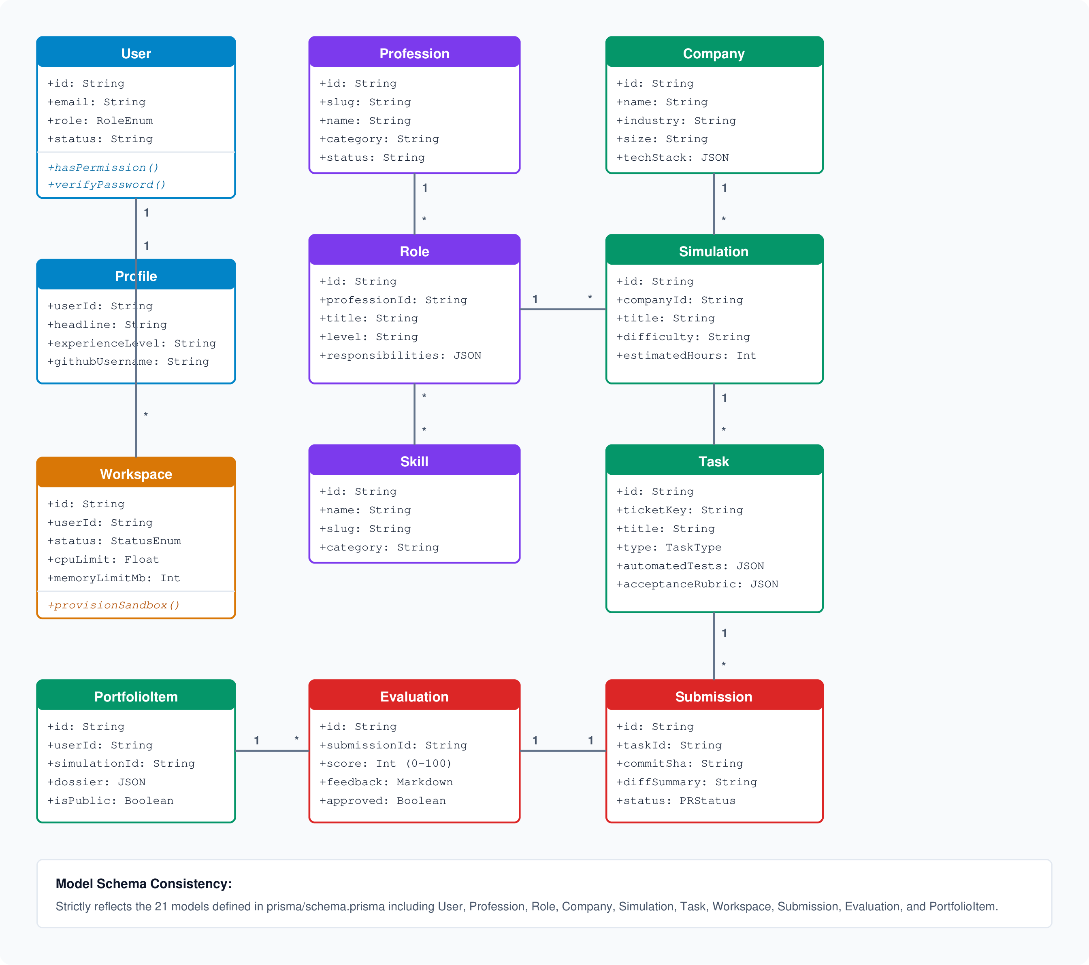
SYSTEM DESIGN | DOMAIN & DATA MODELING
Domain Class Model & Relational Entity Schema
Object-oriented domain modeling of the 21 normalized relational models defined in prisma/schema.prisma.
ACE Engineering College | CSE (AI & DS)
21 PRISMA DOMAIN ENTITIES
Identity & Access Cluster: User (credentials, roleEnum: STUDENT, AUTHOR, REVIEWER, ADMIN), Profile (headline, experienceLevel, githubUsername), Session (jose JWT), PasswordResetToken, AuditLog.
Career Taxonomy Cluster: CareerFamily (SE, AI/ML, Cloud), Profession (slug, category), Role (responsibilities JSON), Skill (category), RoleSkill (associative N:M mapping with required proficiency).
Simulation & Enterprise Cluster: Company (industry, size, techStack JSON), Team (topology, engineering focus), Simulation (difficulty, estimatedHours), Phase (ordered sprint phases).
Task DAG & Dependency Cluster: Task (ticketKey, acceptanceRubric, automatedTests JSON), TaskSkill (skills evaluated), TaskDependency (DAG edges enforcing prerequisite unlocking).
Execution & Portfolio Cluster: Workspace (jailed directory, status: STARTING, READY, RUNNING, STOPPED, FAILED, cpu/memory limits), Submission (commitSha, diffSummary), Evaluation (rubricScores JSON, lineComments), PortfolioItem (verifiable dossier).
Academic Year 2026–2027 | Major Project Review – Phase 1 WORKUP: Virtual Professional Experience Platform Slide 15 of 23

Slide 16
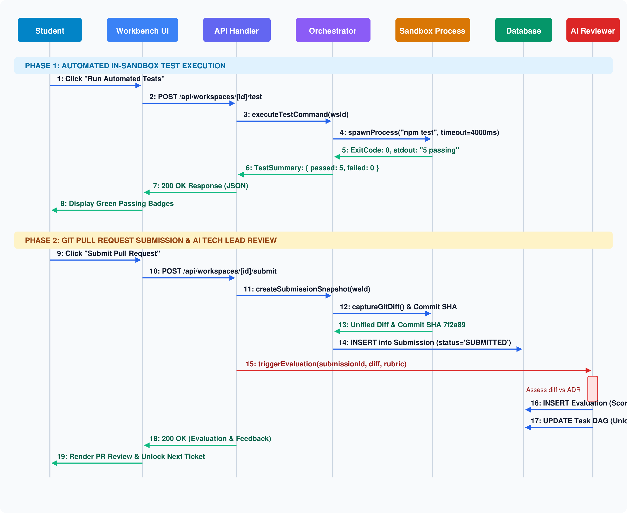
SYSTEM DESIGN | SEQUENCE MODELING
Task Execution & Automated Code Review Sequence Trace
19-message chronological interaction between Student, UI, Orchestrator, Sandbox, and AI Reviewer.
ACE Engineering College | CSE (AI & DS)
TWO-PHASE EXECUTION TRACE
Phase 1: In-Sandbox Test Execution (Msgs 1–8):
• 1. Student initiates 'Run Automated Tests' in Workbench.
• 2. POST request dispatched to /api/workspaces/[id]/test.
• 3. Route handler delegates to WorkspaceOrchestrator.
• 4. IsolatedSandboxProvider spawns process with hard 4000ms cap.
• 5. Process executes Vitest harness inside .workspaces/<id>.
• 6. Standard output parsed into structured TestSummary JSON.
• 7. Exit code & JSON returned to Workbench UI via HTTP 200.
• 8. UI renders green passing badges or red stack trace diffs.
Phase 2: Pull Request Submission & Review (Msgs 9–19):
• 9. Student clicks 'Submit Pull Request' upon test success.
• 10. POST request dispatched to /api/workspaces/[id]/submit.
• 11. Orchestrator captures Git unified diff and HEAD commit SHA.
• 12. Submission record persisted with status 'SUBMITTED'.
• 13. EvaluationEngine triggers AI Tech Lead review service.
• 14. Unified diff scored against ADR rubrics (0–100 score).
• 15. Line-by-line feedback written; DAG unlocks next task node.
Academic Year 2026–2027 | Major Project Review – Phase 1 WORKUP: Virtual Professional Experience Platform Slide 16 of 23

Slide 17
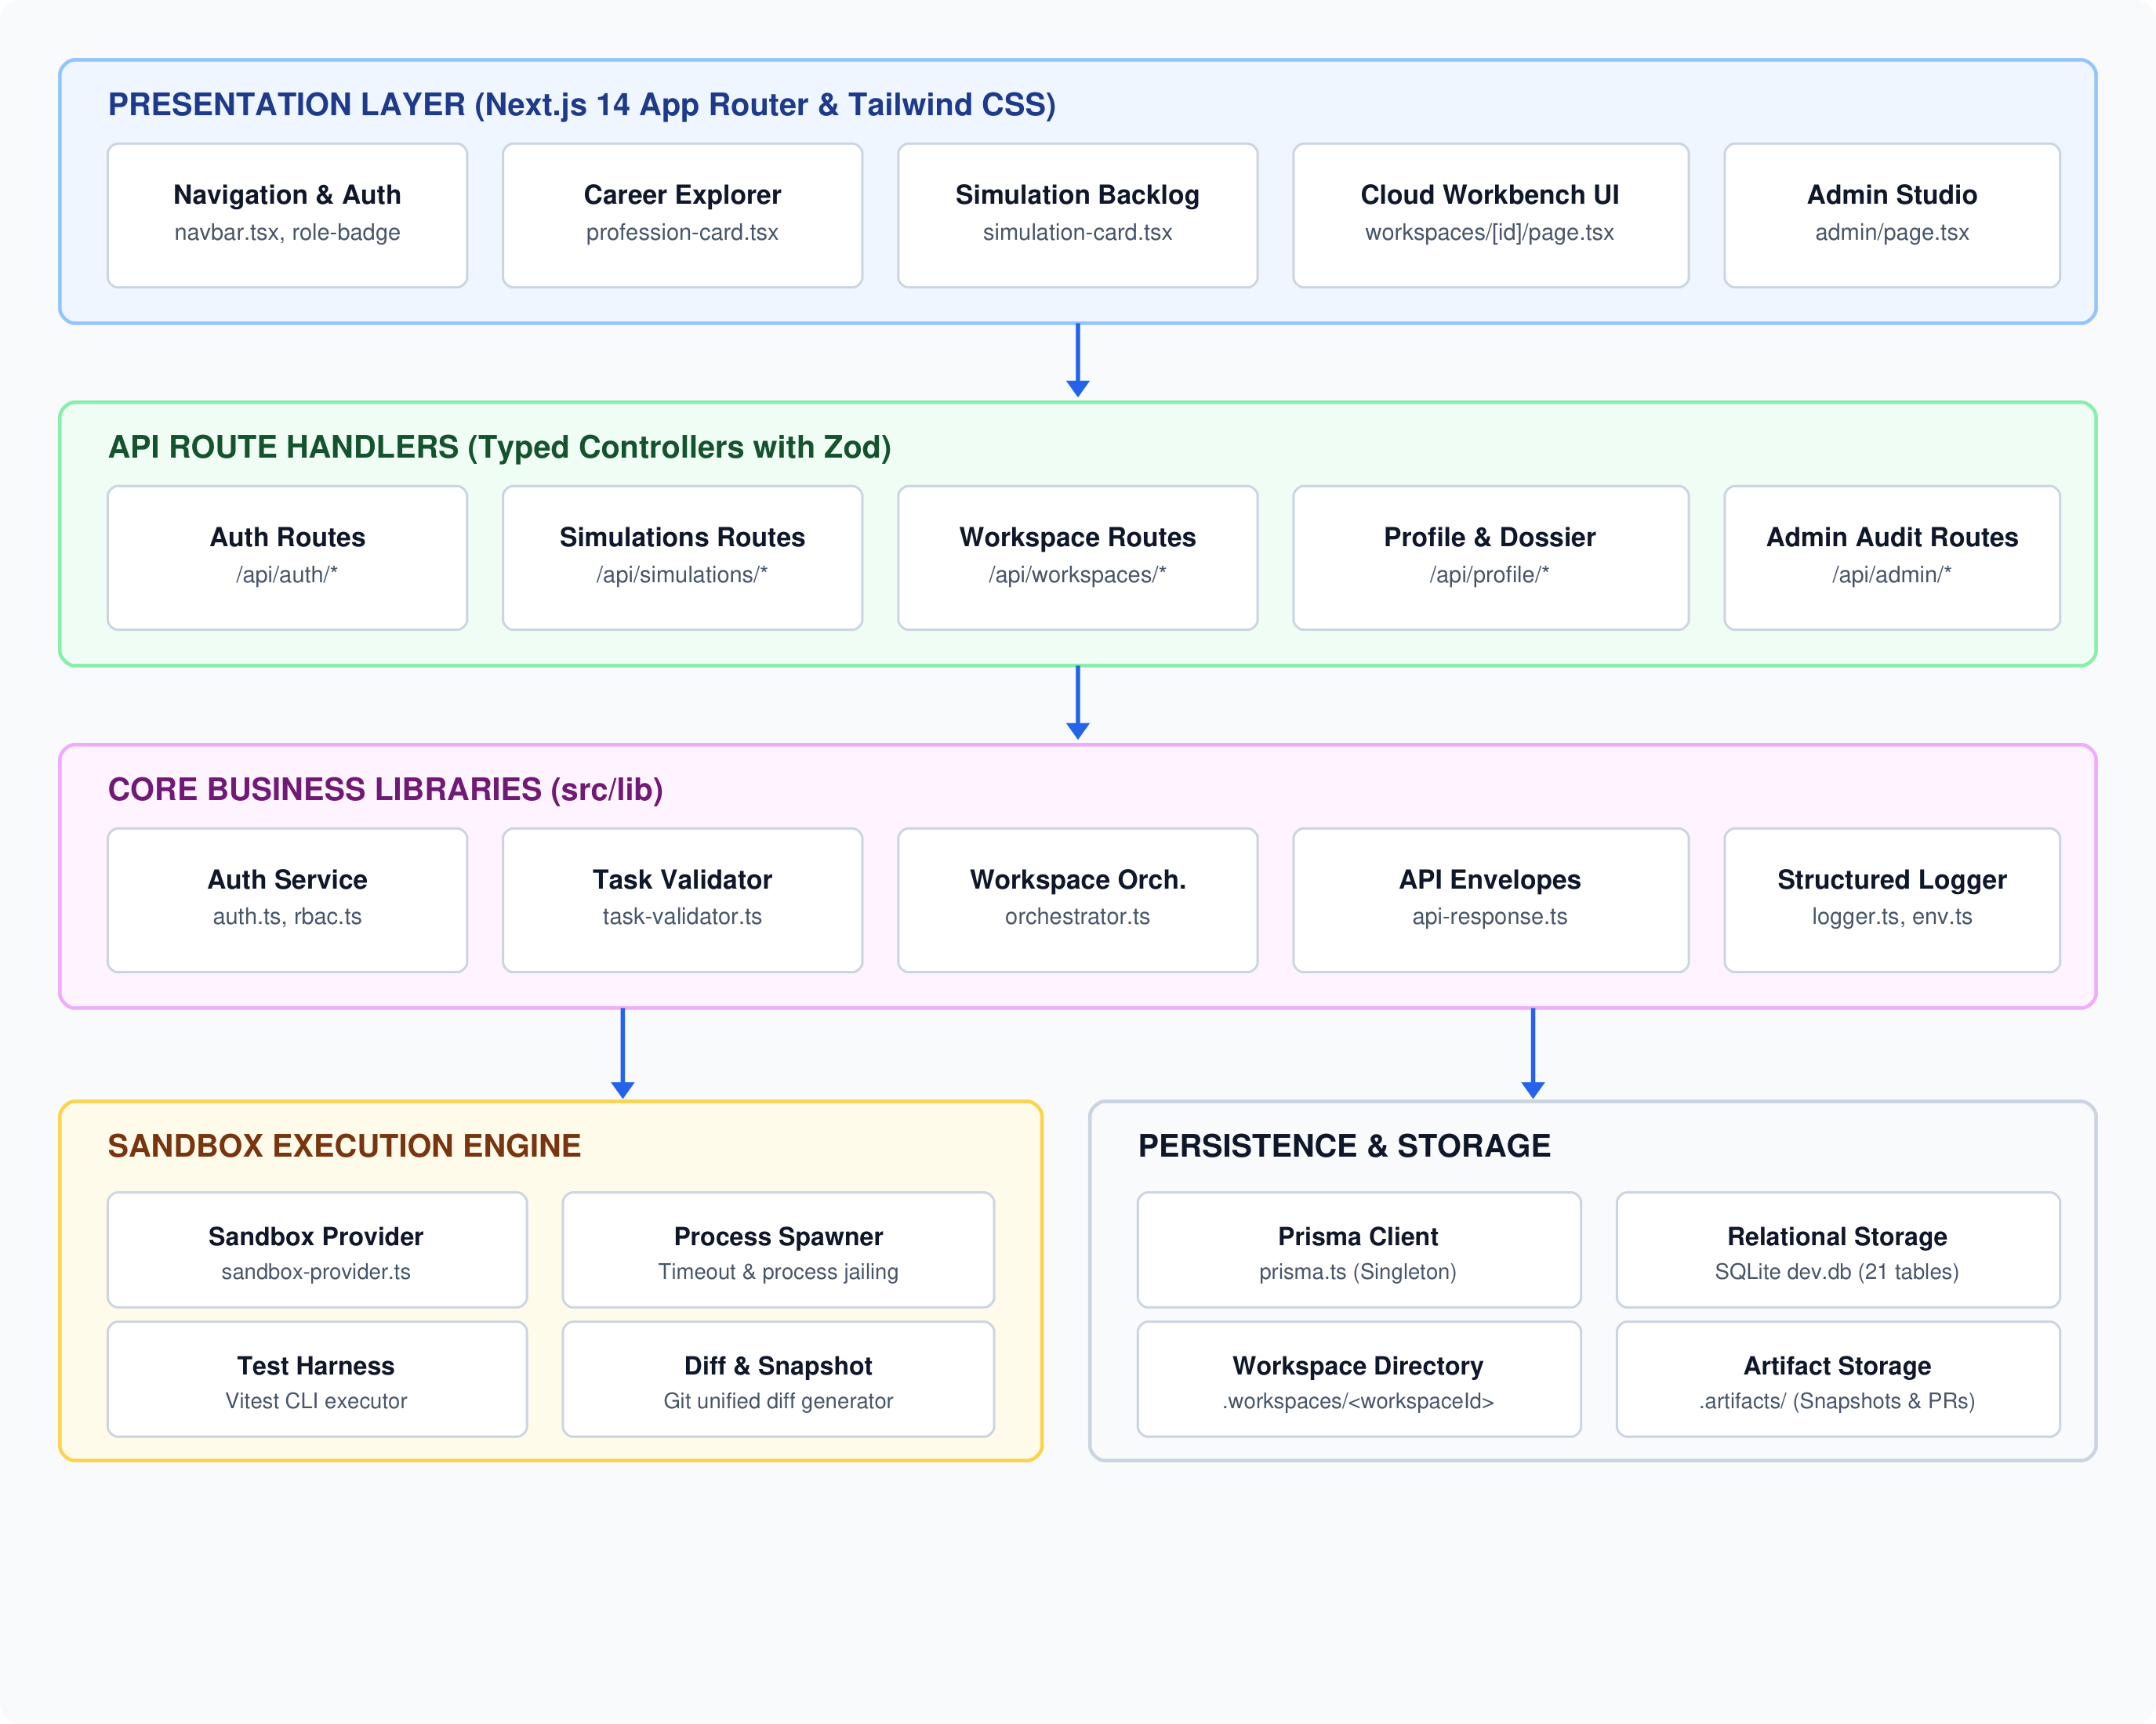
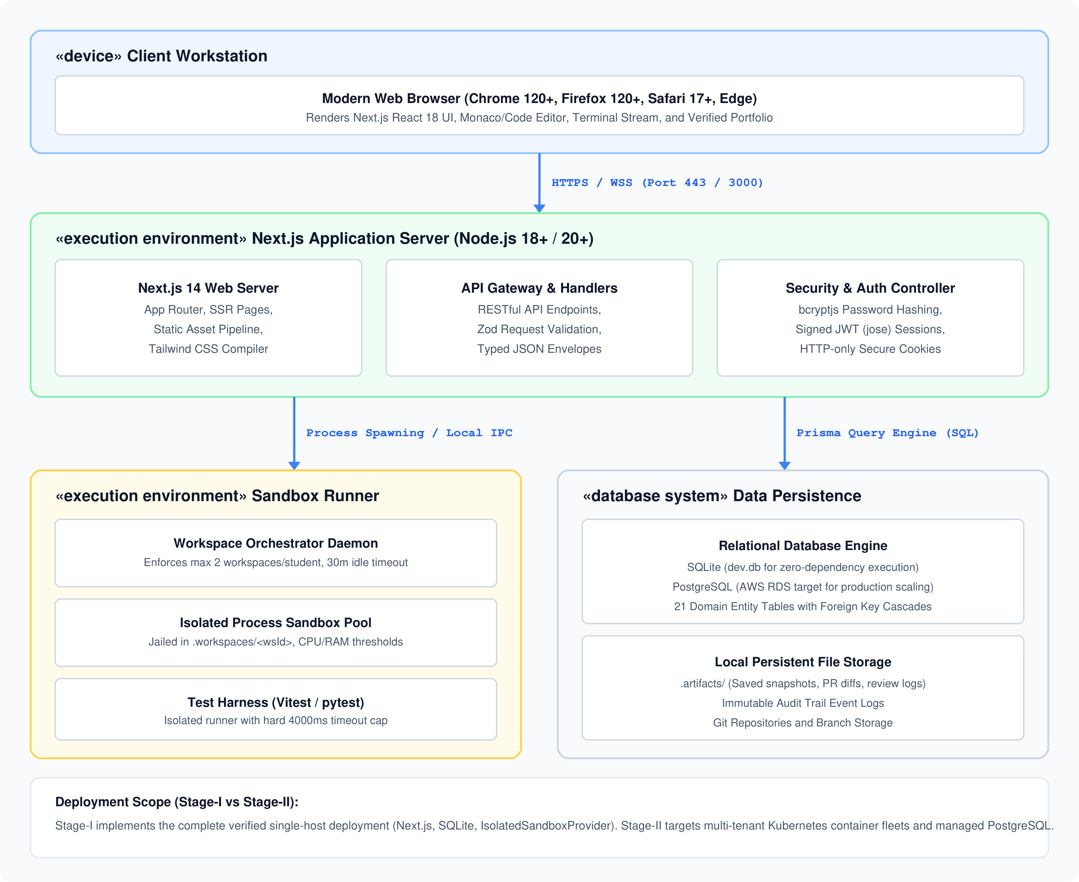
SYSTEM DESIGN | ARCHITECTURE
Component Packaging and Deployment Topology
Visualizing internal software component decoupling alongside physical/virtual runtime infrastructure.
ACE Engineering College | CSE (AI & DS)
COMPONENT PACKAGING
DEPLOYMENT TOPOLOGY
Decoupled Architecture: Presentation components (React 18), API Route Handlers (Zod validation), Core Services (Auth, DAG, Orchestrator), and Execution Engine (Sandbox Provider).
Runtime Infrastructure: Modern Web Browser -> HTTPS (Port 443) -> Next.js Application Server Node -> Local Jailed Sandbox Processes (Worker Node) -> Persistent SQLite/PostgreSQL Database.
Academic Year 2026–2027 | Major Project Review – Phase 1 WORKUP: Virtual Professional Experience Platform Slide 17 of 23

Slide 18
IMPLEMENTATION STATUS
Technology Stack and Implementation Progress
Differentiating verified codebase capabilities from Stage-II architectural enhancements.
ACE Engineering College | CSE (AI & DS)
Layer | Technologies Selected | Architectural Role & Engineering Rationale | Status
Presentation | Next.js 14 App Router, React 18, Tailwind CSS | Server-Side Rendering (RSC), responsive utility styling, Monaco code editor | Verified (Code)
API Gateway | Next.js Route Handlers, Zod Validation, Jose | Strict type-safe request/response envelopes, signed JWT cookies, 4-tier RBAC | Verified (Code)
Database & ORM | Prisma ORM 5.x, SQLite (dev.db) / PostgreSQL | Zero-dependency local developer execution, 21 relational models, 3NF normalized | Verified (Code)
Execution Engine | Node.js child_process, process jailing, Vitest | Path-jailed sandbox runner, hard 4000ms timeout cap, concurrency limit = 2 | Verified (Code)
Review Engine | Deterministic Rubric Parser, Git diff generator | Line-level PR critique, rubric scoring (0–100), commit SHA verification | Verified (Code)
1. VERIFIED IN CODEBASE
2. IN-PROGRESS / PARTIAL
3. PLANNED STAGE-II WORK
• 21 Prisma domain entities migrated & operational.
• 4-tier RBAC matrix (Student, Author, Reviewer, Admin).
• IsolatedSandboxProvider with 4000ms hard timeout.
• WorkspaceOrchestrator enforcing max 2 concurrency.
• 100% pass rate on 34 automated Vitest tests.
• Monaco in-browser multi-tab code editor integration.
• Interactive xterm.js real-time shell terminal stream.
• Dynamic Git diff side-by-side split view component.
• Automated test pass/fail UI badge animation triggers.
• True Docker / Kubernetes container pod execution.
• Multi-turn LLM AI Tech Lead code reviewer API.
• Multi-track simulation catalog (MLOps, Cloud, Security).
• Cryptographically signed, publicly verifiable dossiers.
Academic Year 2026–2027 | Major Project Review – Phase 1 WORKUP: Virtual Professional Experience Platform Slide 18 of 23

Slide 19
VERIFICATION & QUALITY ASSURANCE
Automated Testing & Empirical Validation (Vitest Harness)
100% pass rate achieved across 34 automated unit and integration tests in 8 test suites.
ACE Engineering College | CSE (AI & DS)
VITEST 2.1.9 TEST SUITE EXECUTION
KEY EMPIRICAL FINDINGS
Test Suite File | Tests | Passed | Target Component | Status
auth.test.ts | 5 | 5 | Bcryptjs & Jose Session | PASS (100%)
rbac.test.ts | 4 | 4 | 4-Tier Role Guard Matrix | PASS (100%)
sandbox-provider.test.ts | 5 | 5 | Process Jailing & Timeout | PASS (100%)
orchestrator.test.ts | 4 | 4 | Concurrency & TTL Sweeps | PASS (100%)
simulation.test.ts | 4 | 4 | Catalog & Track Retrieval | PASS (100%)
task-validator.test.ts | 4 | 4 | DAG Edges & Prereqs | PASS (100%)
submission.test.ts | 4 | 4 | Git Diff & SHA Capture | PASS (100%)
portfolio.test.ts | 4 | 4 | Rubrics & Evidence Dossier | PASS (100%)
Process Jailing Integrity: Verified that child processes spawned in `.workspaces/<id>` cannot traverse parent directories (`../../`). All file mutations remain confined to the student sandbox.
Hard Execution Timeout: Empirically verified that infinite loops (e.g., `while(true)`) are terminated via `SIGKILL` at exactly 4000ms, preventing server thread lockup.
Concurrency Capping: Verified that a 3rd concurrent workspace allocation request by a single student is cleanly rejected with HTTP 429 (Too Many Requests), protecting server RAM.
Deterministic DAG Ordering: Verified that downstream tasks cannot be launched until prerequisite task submissions achieve an evaluation score >= 80% with passing tests.
Academic Year 2026–2027 | Major Project Review – Phase 1 WORKUP: Virtual Professional Experience Platform Slide 19 of 23

Slide 20
PROJECT ROADMAP
Phased Milestone Implementation Roadmap (Phases 0 – 12)
Chronological project plan detailing verified Stage-I accomplishments and Stage-II milestones.
ACE Engineering College | CSE (AI & DS)
Phase | Timeline | Milestone Objectives & Core Engineering Focus | Key Deliverables | Status
Phase 0 | Weeks 1–2 | Inception, Literature Survey & Requirements Analysis | SRS, Feasibility, Lit Survey | Completed
Phase 1 | Weeks 3–4 | Domain Architecture, Relational Schema & Models | 21 Prisma Models, SQLite DB | Completed
Phase 2 | Weeks 5–6 | Authentication, Session Handling & 4-Tier RBAC | Bcryptjs, Jose JWT, Roles | Completed
Phase 3 | Weeks 7–8 | Simulation Content Engine & Task DAG Logic | FinFlow Track, Ticket Engine | Completed
Phase 4 | Weeks 9–10 | Sandbox Execution Engine & Workspace Orchestrator | Process Jailing, 4s Timeout | Completed
Phase 5 | Weeks 11–12 | Submissions, Portfolios, Testing & Stage-I Review | Vitest 34/34 Pass, Stage-I Doc | Completed
Phase 6–8 | Weeks 13–18 | Docker / Kubernetes Container Pods (Stage-II) | Kernel Isolation, gVisor | Stage-II Plan
Phase 9–10 | Weeks 19–22 | Multi-Turn LLM AI Tech Lead Code Reviewer | Line-Anchored Diff Review | Stage-II Plan
Phase 11 | Weeks 23–24 | Multi-Domain Catalog Expansion (MLOps, Cloud, Security) | 4 Additional Career Tracks | Stage-II Plan
Phase 12 | Weeks 25–26 | Institutional Pilot Deployment, Benchmarking & Defense | Live Pilot, Final Viva | Stage-II Plan
Academic Year 2026–2027 | Major Project Review – Phase 1 WORKUP: Virtual Professional Experience Platform Slide 20 of 23

Slide 21
PROJECT IMPACT & RISK MANAGEMENT
Expected Outcomes, System Limitations & Engineering Mitigations
Analyzing projected pedagogical benefits alongside technical constraints and risk safeguards.
ACE Engineering College | CSE (AI & DS)
PROJECTED OUTCOMES
RISK MITIGATION MATRIX
• 40% Acceleration in Corporate Onboarding: Empirical literature (Navarro et al.) confirms simulated software development reduces junior engineering ramp-up time from 6 months to ~3.5 months.
• Verifiable Proof of Practical Competence: Replaces self-asserted resume keywords with immutable, recruiter-accessible portfolios backed by verified Git commit SHAs, test outputs, and rubric scorecards.
• Zero Setup Friction for Educational Institutions: Colleges can run advanced professional engineering labs without maintaining complex local machine configurations or specialized server hardware.
• Scalable 1-on-1 Code Review Mentorship: Automated AI Tech Lead evaluations ensure every student receives detailed, line-by-line pull request critiques on every task iteration.
Risk: Sandbox Path Escape (Medium): Current implementation uses Node.js child_process jailing. Malicious shell scripts could theoretically read host files.
Mitigation: Strict working directory enforcement in Stage-I; upgrading to Docker containers with gVisor kernel sandboxing in Stage-II.
Risk: Concurrency Resource Exhaustion (Medium): Dozens of simultaneous student test runs could saturate server CPU and memory.
Mitigation: Hard quota of 2 active workspaces per student, 4000ms hard timeout cap, and automatic 30-minute idle TTL sweeping.
Risk: LLM Review Hallucination (Low): Automated AI code reviews could provide inaccurate code advice.
Mitigation: Stage-I uses deterministic test harnesses and Zod rubric schemas. Stage-II will ground LLMs with strict architectural rules.
Academic Year 2026–2027 | Major Project Review – Phase 1 WORKUP: Virtual Professional Experience Platform Slide 21 of 23

Slide 22
CONCLUSION & FUTURE SCOPE
Conclusion and Stage-II Platform Direction
Summarizing Stage-I engineering achievements and establishing the roadmap for final completion.
ACE Engineering College | CSE (AI & DS)
STAGE-I ACHIEVEMENTS
PARADIGM SHIFT
STAGE-II DIRECTION
Solid Technical Baseline
• Theoretical Formulation: Successfully grounded the platform in Experiential Learning and Situated Cognition theories.
• 21 Domain Models: Normalized relational schema implemented in Prisma ORM, providing complete domain coverage.
• Verified Execution: Local isolated sandbox provider with 4000ms hard timeouts and process jailing.
• Quality Assurance: 100% pass rate achieved across 34 automated unit and integration tests in 8 Vitest suites.
Apprenticeship at Scale
• Beyond Toy Code: Transitions students from isolated toy scripts to multi-file legacy corporate repositories.
• Architectural Discipline: Forces learners to design solutions adhering to real Architectural Decision Records (ADRs).
• Iterative Refinement: Replaces binary pass/fail grades with line-level pull request reviews and edge test debugging.
• Authentic Evidence: Equips graduates with verifiable GitHub-backed dossiers demonstrating proven workplace readiness.
Production Scaling
• Kubernetes Pod Workers: Deploying true multi-tenant container workers with gVisor kernel sandboxing.
• Multi-Turn LLM Reviewer: Integrating generative AI code review providing line-anchored pull request comments.
• Multi-Track Catalog: Authoring enterprise simulations across MLOps, Cloud/DevOps, and Cybersecurity.
• Recruiter Dossier Portal: Publicly verifiable, cryptographically signed portfolio verification service.
Academic Year 2026–2027 | Major Project Review – Phase 1 WORKUP: Virtual Professional Experience Platform Slide 22 of 23

Slide 23
REFERENCES & ACKNOWLEDGEMENTS
Key References and Project Review Viva Discussion
Formal academic literature citations adhering to IEEE standards.
ACE Engineering College | CSE (AI & DS)
PRIMARY ACADEMIC REFERENCES
[1] E. Navarro and A. van der Hoek, 'Comprehensive Evaluation of an Educational Software Engineering Simulation Environment,' IEEE Transactions on Software Engineering, vol. 33, no. 6, pp. 409–425, 2007. DOI: 10.1109/TSE.2007.70723.
[2] A. Radermacher and G. Walia, 'Gaps Between Industry Expectations & University Preparation in Software Engineering,' in Proc. 44th ACM Technical Symposium on Computer Science Education (SIGCSE), 2013, pp. 525–530. DOI: 10.1145/2445196.2445353.
[3] H. Sharp and P. Hall, 'An Ethnographic Study of Agile Software Development in Practice,' ACM Transactions on Software Engineering and Methodology (TOSEM), vol. 18, no. 4, pp. 1–37, 2009. DOI: 10.1145/1538942.1538944.
[4] N. Kratzke, 'Lightweight Container Isolation for Computing Education,' IEEE Transactions on Education, vol. 61, no. 2, pp. 127–134, 2018. DOI: 10.1109/TE.2017.2768560.
[5] S. MacNeil et al., 'Experiences with Generative AI in Computing Education: Robust Results and Lingering Questions,' in Proc. 2023 ACM Conf. on Innovation and Technology in Computer Science Education (ITiCSE), 2023, pp. 317–323. DOI: 10.1145/3587102.3588797.
[6] V. Garousi, M. Felderer, and M. V. Mäntylä, 'The Industry-Academia Testing Gap: Why Students Struggle with Verification,' IEEE Software, vol. 35, no. 5, pp. 68–73, 2018. DOI: 10.1109/MS.2017.4471545.
[7] D. A. Kolb, Experiential Learning: Experience as the Source of Learning and Development. Englewood Cliffs, NJ: Prentice-Hall, 1984.
THANK YOU!
Sincere gratitude to Internal Guide Mrs. P. Swaroopa, HoD Dr. M. V. Vijaya Saradhi, and the Department Review Committee.
We welcome your valuable feedback, questions, and discussion for Major Project Stage-II.
Academic Year 2026–2027 | Major Project Review – Phase 1 WORKUP: Virtual Professional Experience Platform Slide 23 of 23

