Slide 1
Portfolio Optimization via Markowitz Model Extensions

Slide 2
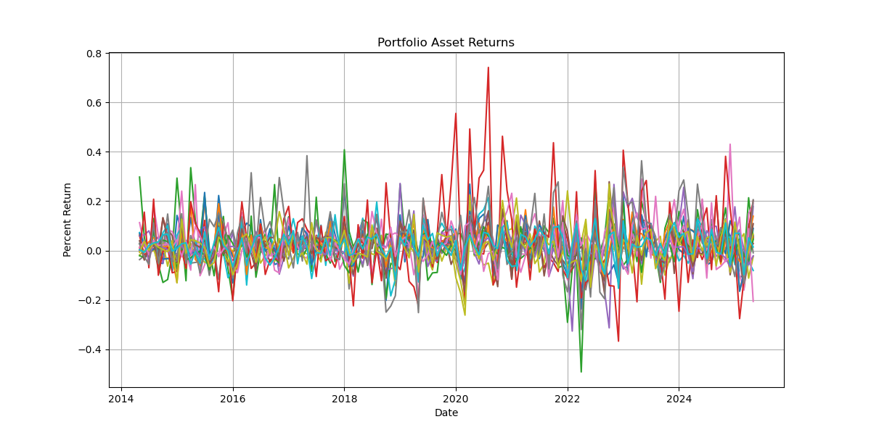

Problem/Model Formulation
The aim of this project is to create an optimal portfolio from the top 20 companies of the S&P 500 by weight. We will construct a constant returns model to minimize the risk (variance) of our portfolio investments.
x the vector of asset weights
µ the returns vector
Σ the covariance matrix
R a fixed return rate
We start with the basic vanilla model
minimize $x^{T}Σx$
subject to $μ^{T}x=R$
$\sum_{i=1}^{n}{x_{i}=1}$.
Note: there is no $x≥0$ term, i.e. shorting is allowed for this model. However, shorting stocks can create many complications that are outside of the range of this project, so we will observe this model as our basis, but quickly move to the model include the nonnegativity constraint.
Our goal is to plot and compare the efficient frontiers for the basic model and for models with extra penalty terms.
The penalties we will compare are the $ℓ_{1}$ (sparsity) and $ℓ_{2}$ (sensitivity) norms.

Slide 3





Discussion of Theory
minimize $x^{T}Σx$
subject to $μ^{T}x=R$ $\sum_{i=1}^{n}{x_{i}=1}$
$$\begin{matrix}(1) \\ (2)\end{matrix}$$
The basic model is very easy to solve; it only requires computing the inverse of the below matrix. However, this matrix can be large (in this cases $22×22$). With the Lagrangian defined to be $ℓ\left(x, λ\right)=x^{T}Σx+λ_{1}{(μ}^{T}x−R)+λ_{2}(\sum_{i=1}^{n}{x_{i}−1}),$we have
$\left(3\right) ∇ℓ\left(x, λ\right)=2Σx+λ_{1}μ+λ_{2}=0 ⇒ \left[\begin{matrix}2Σ & μ & 1 \\ μ^{T} & 0 & 0 \\ 1 & 0 & 0\end{matrix}\right]\left[\begin{matrix}x \\ λ_{1} \\ λ_{2}\end{matrix}\right]=\left[\begin{matrix}0 \\ R \\ 1\end{matrix}\right]$
However, this is not the case for the model that does not allow shorting which adds the constraint $x≥0$. For this, our problem will simply be a quadratic program for which we can construct the following Lagrange conditions:
(1), (2), (3)
$λ≥0$
$y^{T}∇^{2}ℓ\left(x, λ\right)y≥0$ for all $y∈T(x)$
As well, since the original model can be solved using only linear algebra, an optimal solution exists for any fixed R, but our new model is not so simple. We can only find an optimal solution for the no shorting model in the interval defined by
$$\left(\min_{i}{{\hat{μ}}_{i}}, \max_{i}{{\hat{μ}}_{i}}\right).$$
Hence, we restrict our new model to this
interval.

Slide 4
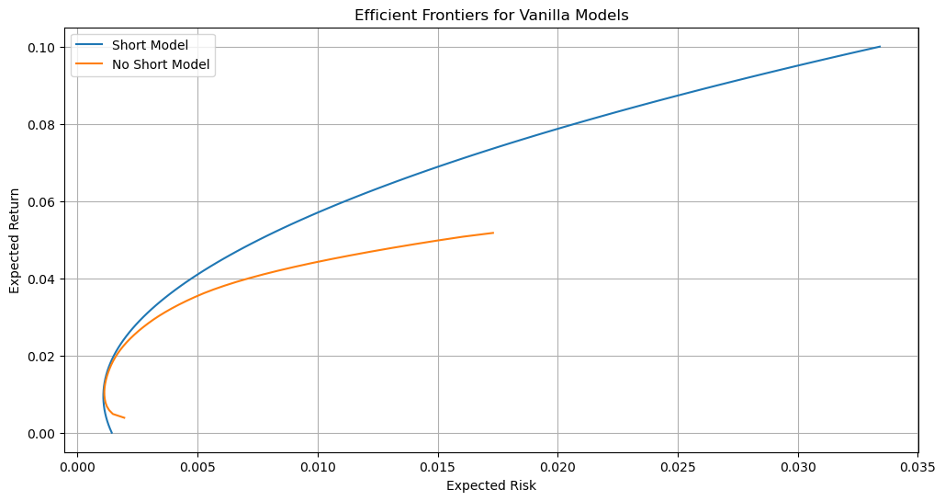
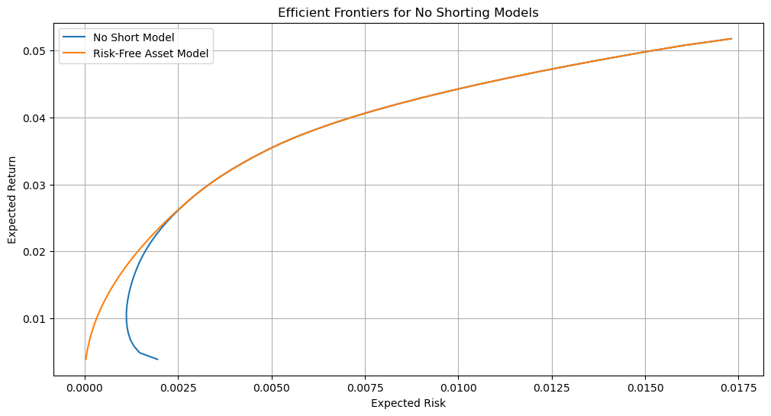
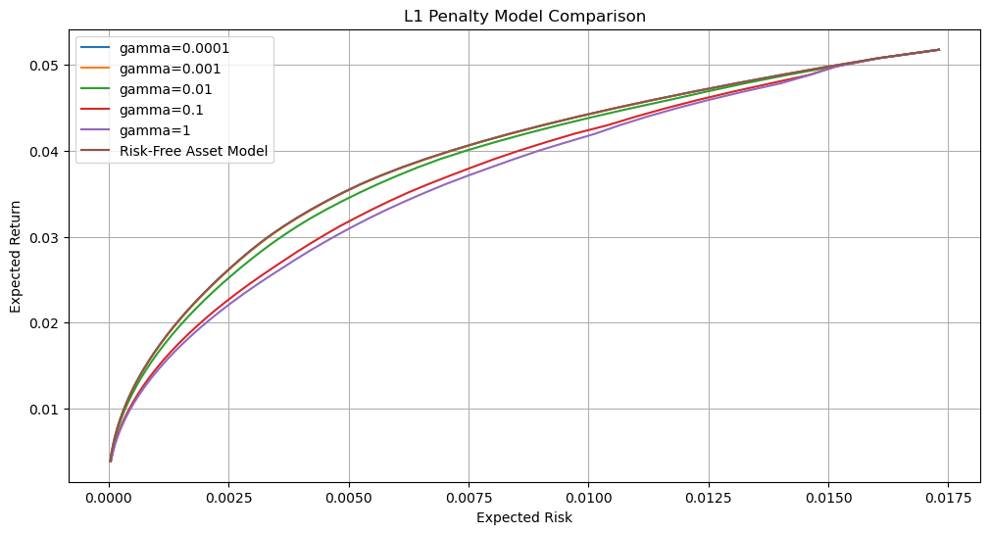

Results
After solving this problem, we can begin to extend the model to compare results. Our extensions include
a risk-free asset model:
minimize $x^{T}Σx$
subject to $μ^{T}x+r_{f}x_{cash}=R$
$\sum_{i=1}^{n}{x_{i}+x_{cash}=1}$
$x, x_{cash}≥0$
and addition of $ℓ_{1}$ and $ℓ_{2}$ penalty terms:
minimize $x^{T}Σx+γ{\left|\left|x\right|\right|}_{1}$
minimize $x^{T}Σx+γ{\left|\left|x\right|\right|}_{2}^{2}$
The only addition that improved the model after converting to the no shorting model was that of the risk-free asset. Neither the $ℓ_{1}$ nor $ℓ_{2}$ constraints improved the model which can be seen in the third graph to the left. The plot of the candidate $ℓ_{2}$ penalty models is very similar.
Key take away: Optimization and prediction of financial data requires a much more complex model that a simple Markowitz model.
Next time, it would be beneficial to compare other model types, such as a Sharpe model or CVaR model.

