Slide 1
Portfolio Optimization via Markowitz Model Extensions

Slide 2
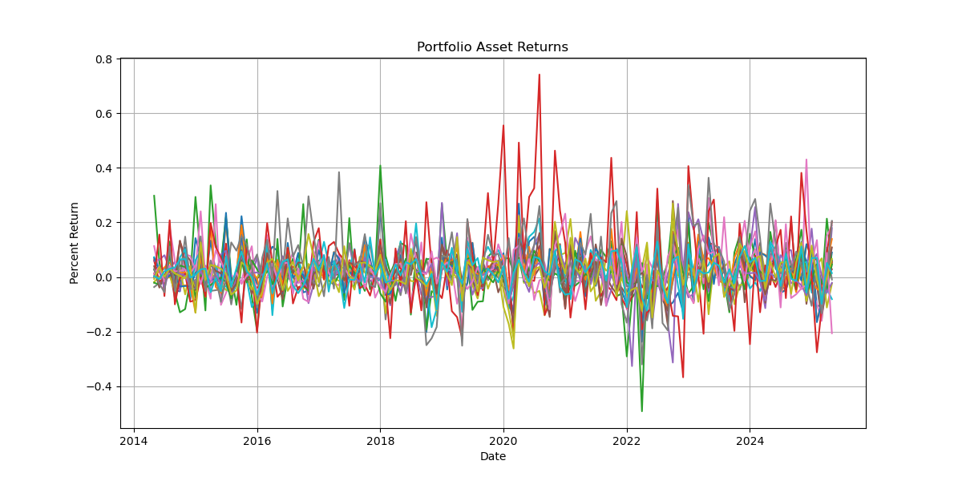

Problem/Model Formulation
The aim of this project is to create an optimal portfolio from the top 20 companies of the S&P 500 by weight. We will construct a constant returns model to minimize the risk (variance) of our portfolio investments.
We start with the basic vanilla model
minimize $x^{T}Σx$
subject to $μ^{T}x=R$
$\sum_{i=1}^{n}{x_{i}=1}$.
Note: there is no $x≥0$ term, i.e. shorting is allowed for this model. We will need to compare the models that do and do not include this constraint.
Our goal is to plot and compare the efficient frontiers for the basic model and for models with extra penalty terms.
The penalties we will compare are the $ℓ_{1}$ (sparsity) and $ℓ_{2}$ (sensitivity) penalties.
x the vector of asset weights
µ the returns vector
Σ the covariance matrix
R a fixed return rate

Slide 3





Discussion of Theory
minimize $x^{T}Σx$
subject to $μ^{T}x=R$ $\sum_{i=1}^{n}{x_{i}=1}$
$$\begin{matrix}(1) \\ (2)\end{matrix}$$
The basic model is very easy to solve; it only requires computing the inverse of the below matrix. However, this matrix can be large (in this cases $22×22$). With the Lagrangian defined to be $ℓ\left(x, λ\right)=x^{T}Σx+λ_{1}{(μ}^{T}x−R)+λ_{2}(\sum_{i=1}^{n}{x_{i}−1}),$we have
$\left(3\right) ∇ℓ\left(x, λ\right)=2Σx+λ_{1}μ+λ_{2}=0 ⇒ \left[\begin{matrix}2Σ & μ & 1 \\ μ^{T} & 0 & 0 \\ 1 & 0 & 0\end{matrix}\right]\left[\begin{matrix}x \\ λ_{1} \\ λ_{2}\end{matrix}\right]=\left[\begin{matrix}0 \\ R \\ 1\end{matrix}\right]$
However, this is not the case for the model that does not allow shorting which adds the constraint $x≥0$. For this, our problem will simply be a quadratic program for which we can construct the following Lagrange conditions:
(1), (2), (3)
$λ≥0$
$y^{T}∇^{2}ℓ\left(x, λ\right)y≥0$ for all $y∈T(x)$
After solving this problem, we can begin to extend the model the compare results. Our extensions will include
a risk-free asset model:
minimize $x^{T}Σx$
subject to $μ^{T}x+r_{f}x_{cash}=R$
$\sum_{i=1}^{n}{x_{i}+x_{cash}=1}$
$x, x_{cash}≥0$
and addition of $ℓ_{1}$ and $ℓ_{2}$ penalty terms:
minimize $x^{T}Σx+γ{\left|\left|x\right|\right|}_{1}$
minimize $x^{T}Σx+γ{\left|\left|x\right|\right|}_{2}^{2}$

Slide 4
Results
Key take away: Optimization and prediction of financial data requires a much more complex model.

