Slide 1

BLUE HAT HACKERS
GROUP PRESENTATION

Slide 2

Foundations of IP Data Networks and Network Devices
Course: Data Communications and Networking Group: Team Blue Date: 3rd June 2026
Presented By:
ASAMPANA WISDOM APEGYINE

Slide 3
What is a Network?
A computer network is a collection of devices connected together to share information and resources.
Examples:
Internet
School computer laboratories
Banking systems
Hospital information systems
Why Study Networks?
Networks allow people and devices to communicate quickly and efficiently.

Slide 4
Meaning of IP Data Networks
Definition
An IP Data Network is a network that uses the Internet Protocol (IP) to send and receive data between devices.
Simple Explanation
Just as every house has an address, every device on a network has an IP address.
Example:
Laptop → 192.168.1.10
Phone → 192.168.1.11
IP helps data find the correct destination.

Slide 5
Importance of IP Data Networks
IP Data Networks are important because they:
Enable Internet access
Support online learning
Allow email communication
Enable video conferencing
Support cloud computing
Allow file sharing
Example
A student in Ghana can attend an online lecture hosted in another country through an IP network.

Slide 6
Functions of Data Networks
Main Functions
Data Sharing
Transfer files between computers
Resource Sharing
Share printers and storage
Communication
Email, WhatsApp, Zoom
Remote Access
Work from anywhere
Security Management
Protect information

Slide 7
Data Networks in Modern Society
Education
Online classes
Learning Management Systems
Banking
ATM networks
Mobile banking
Healthcare
Electronic medical records
Telemedicine
Business
Online transactions
Video meetings
Government
Digital services
Online tax systems

Slide 8
Network Devices Overview
Major Network Devices
Router
Switch
Hub
Access Point
Firewall
These devices work together to ensure smooth communication across networks.

Slide 9
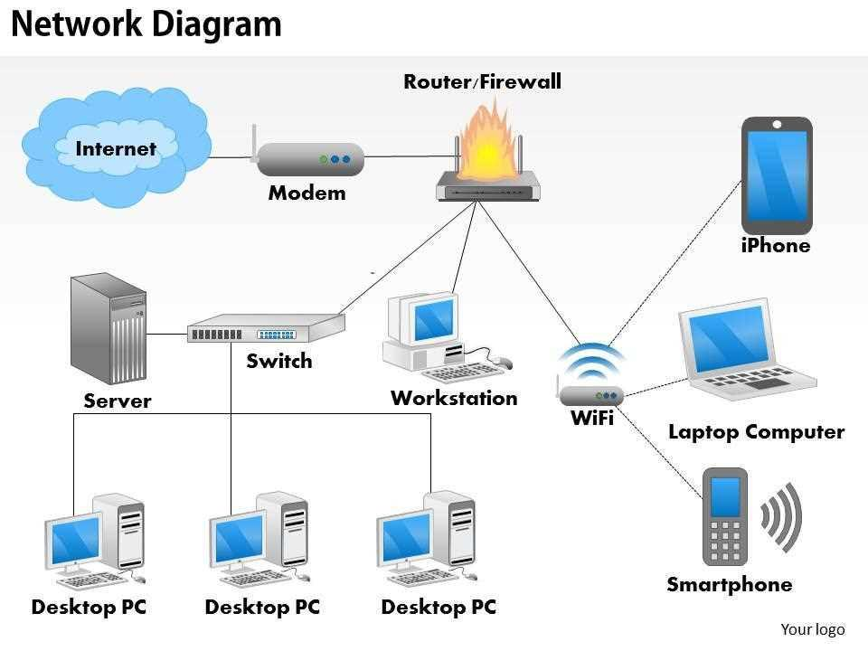
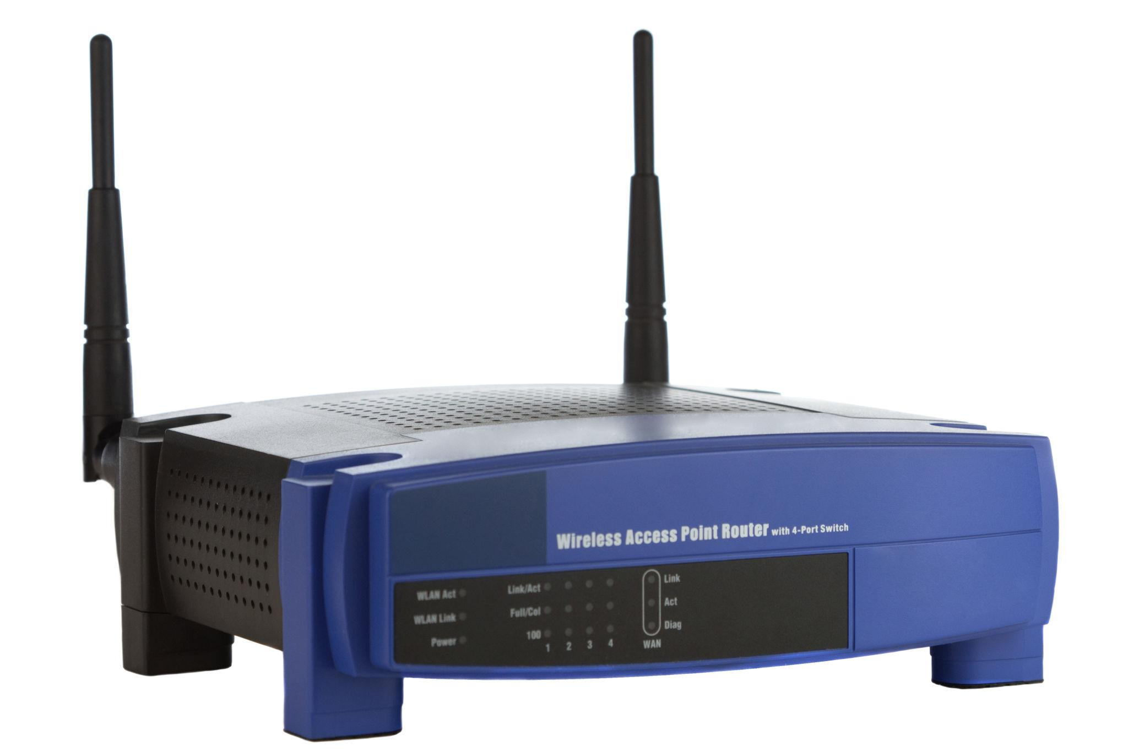
Router

