Slide 1
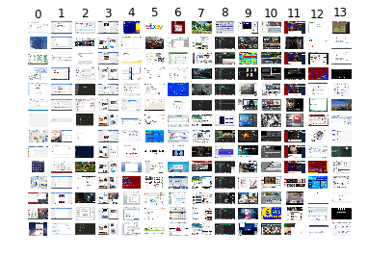
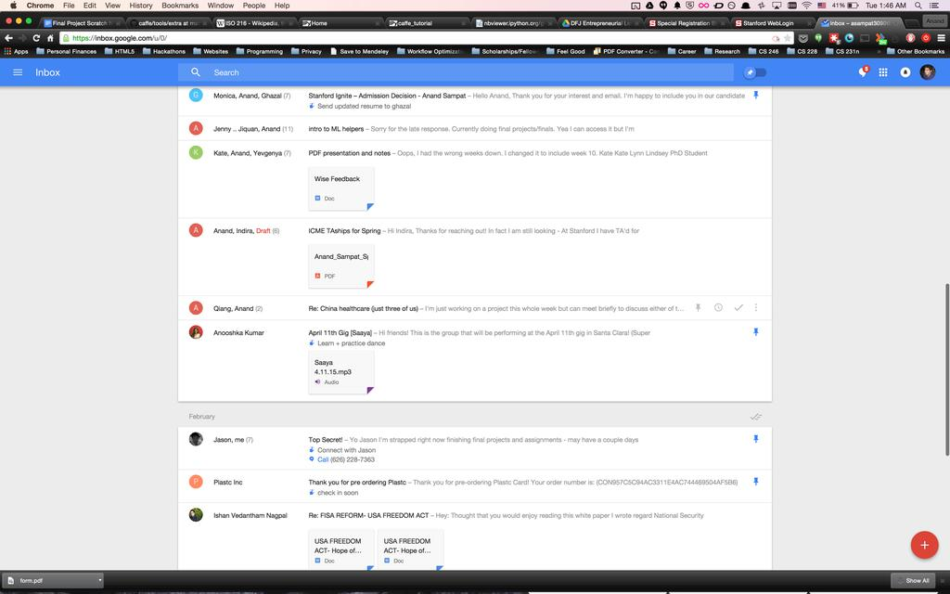

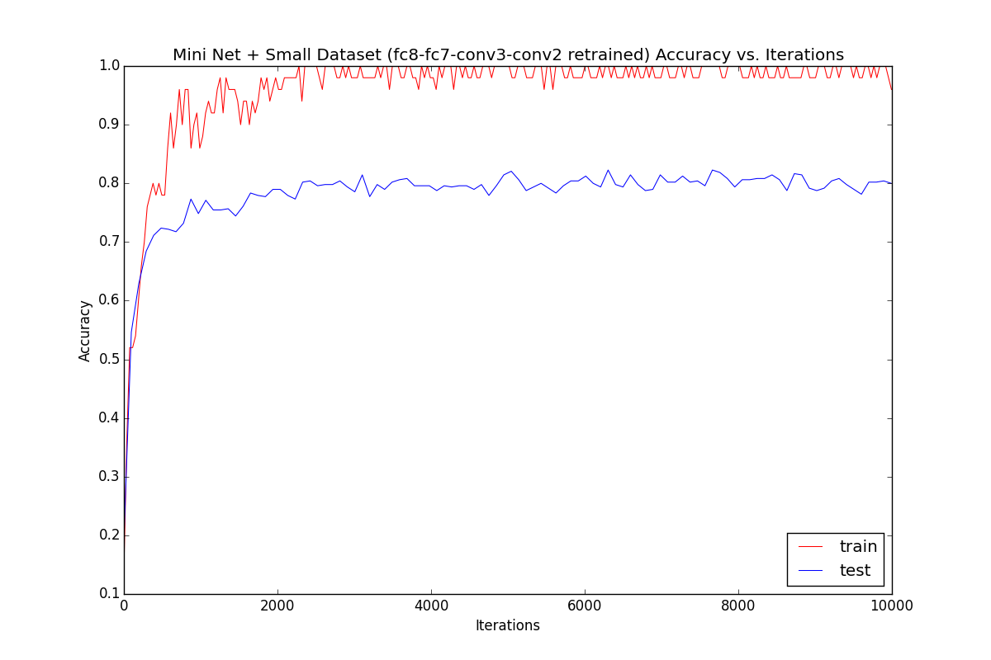
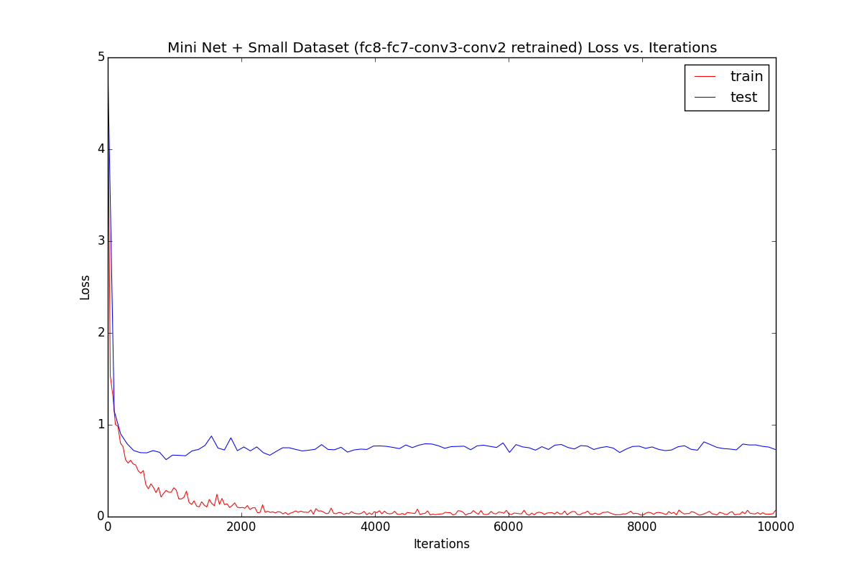
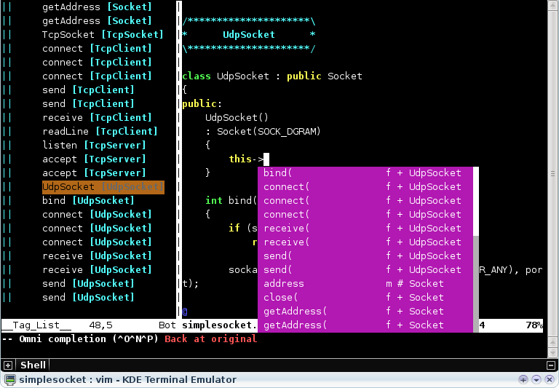
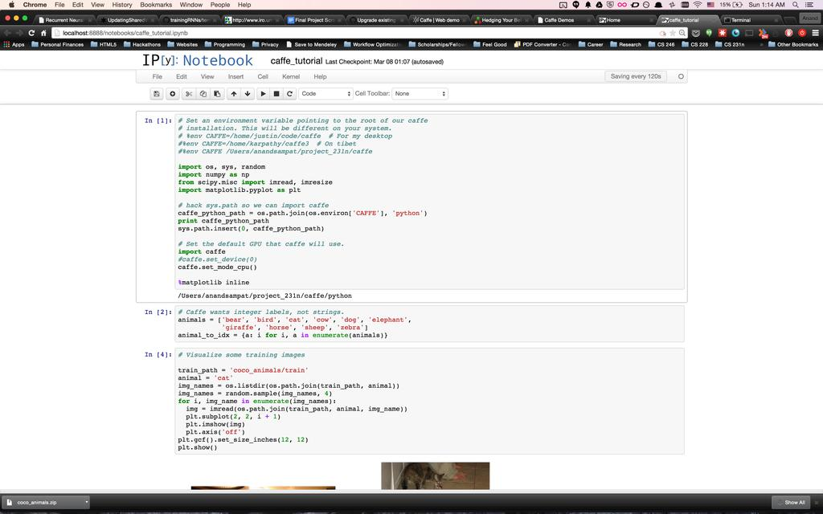
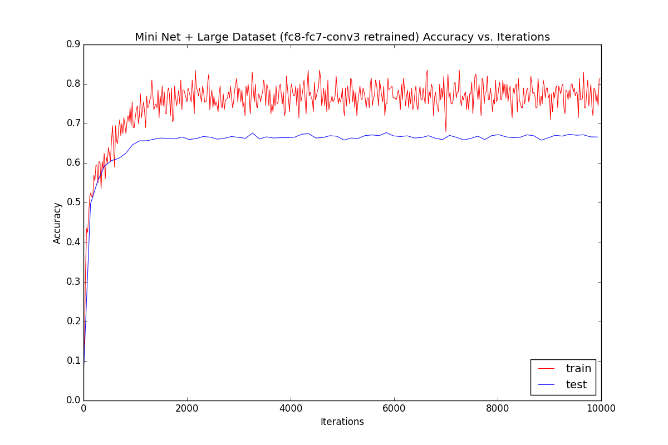
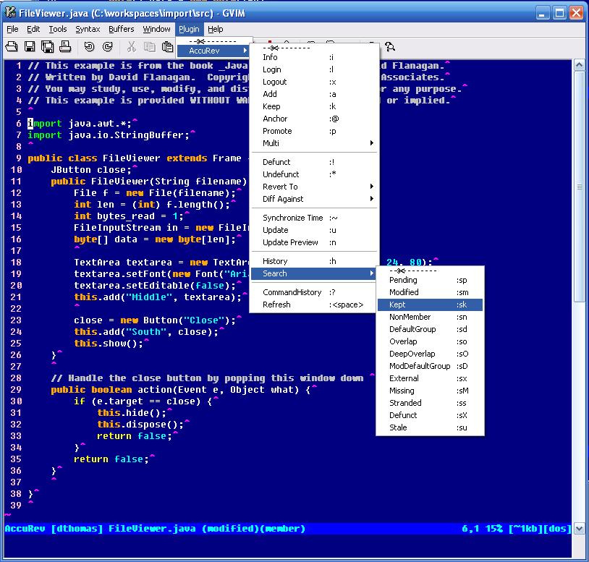
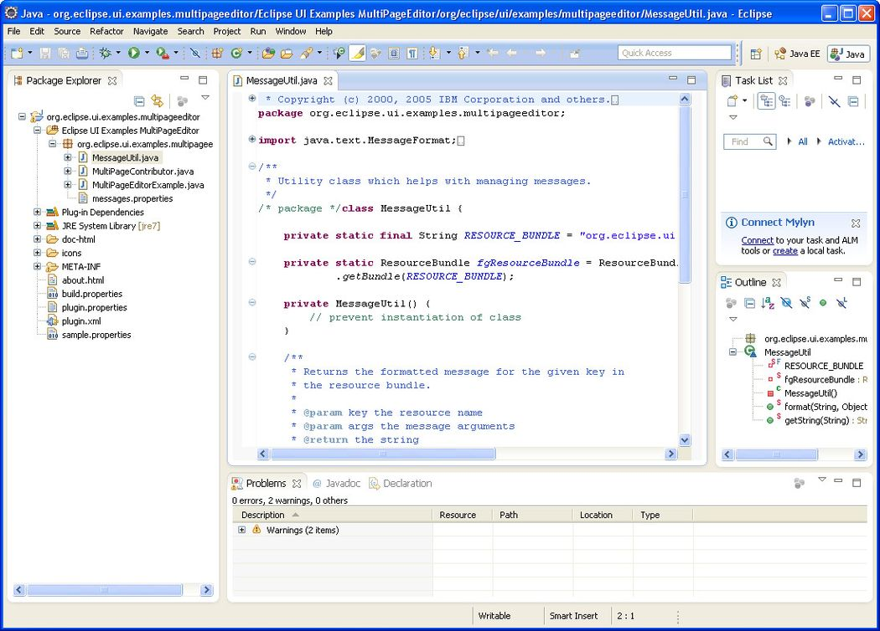
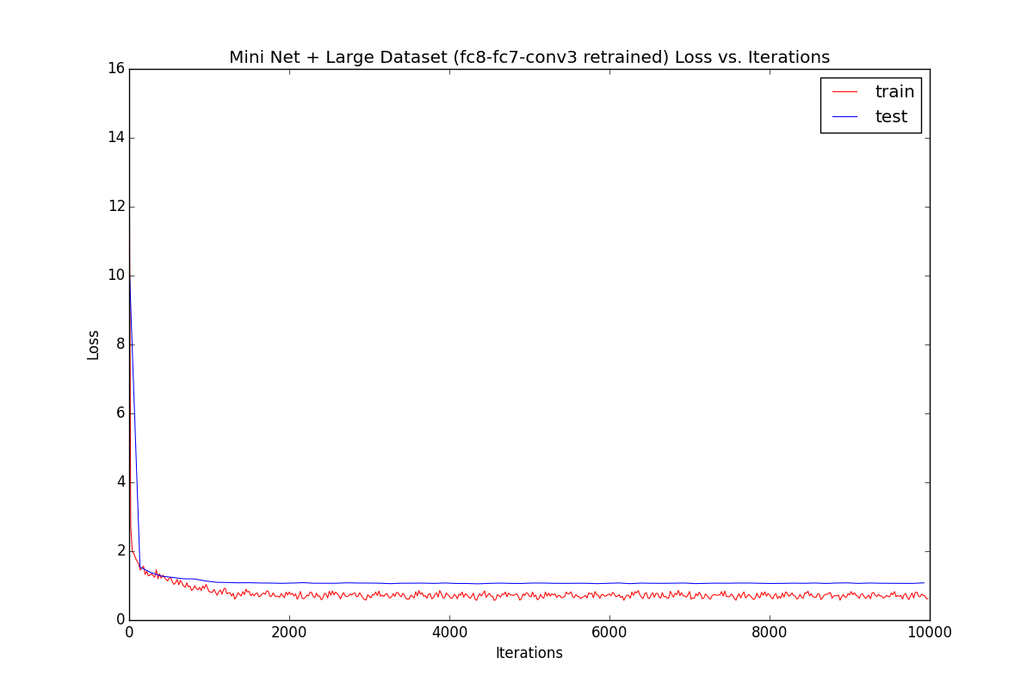
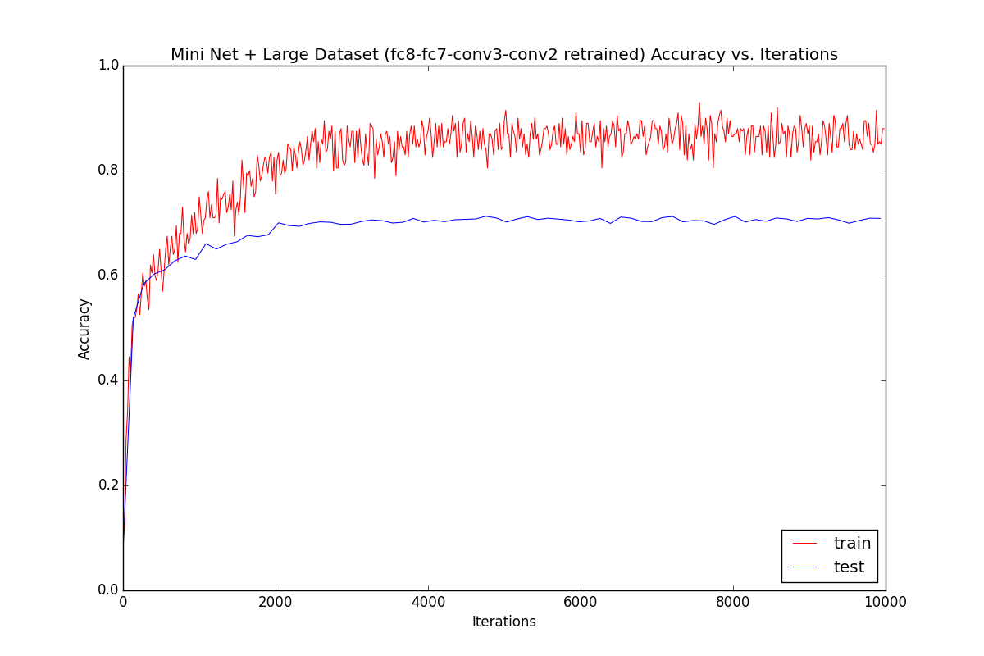
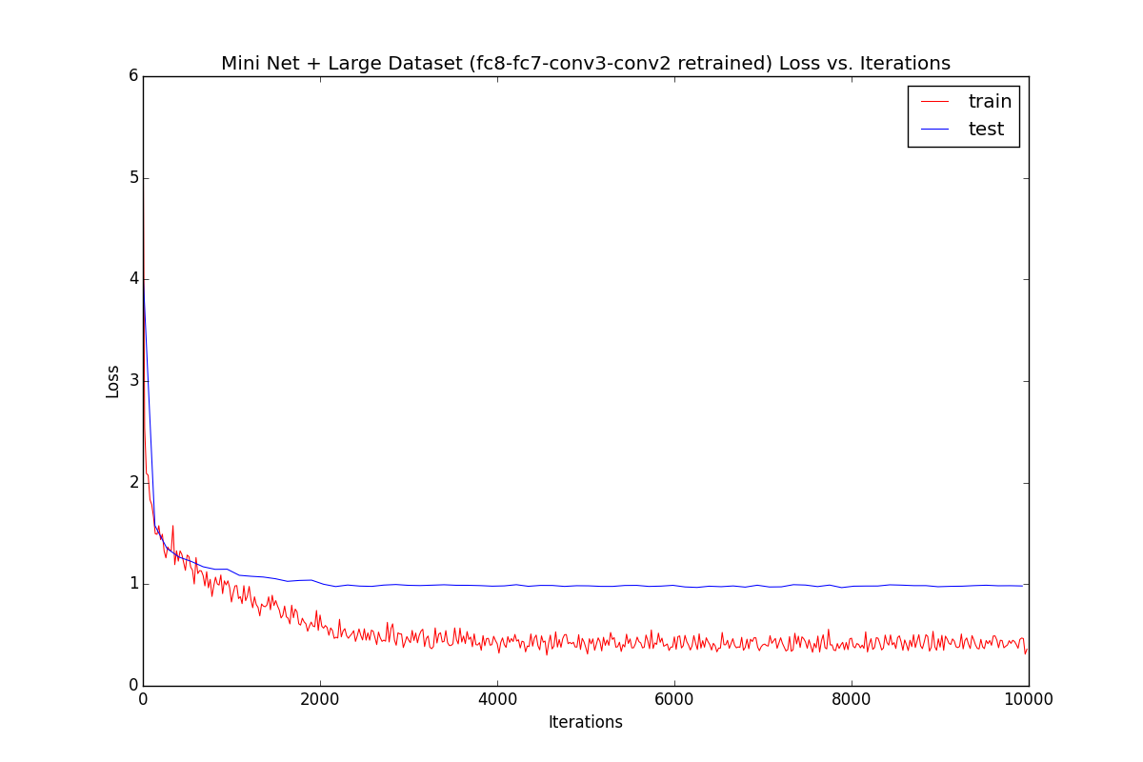
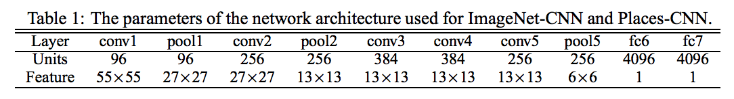
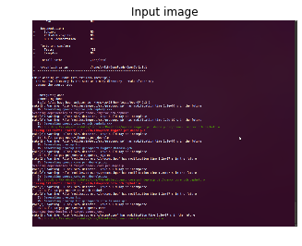
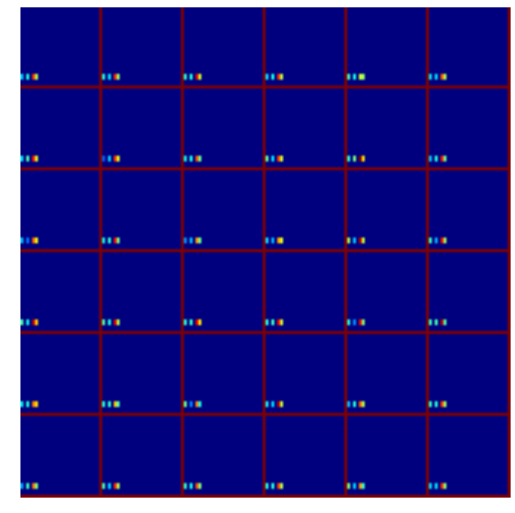
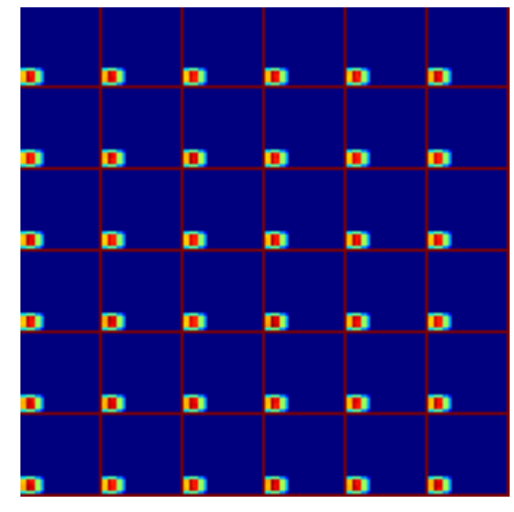
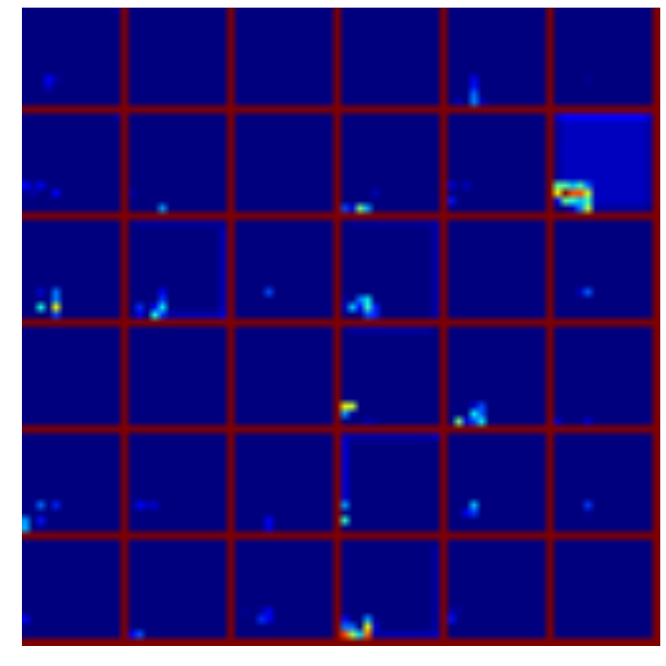
CNN for Task Classification using Computer Screenshots
Anand Sampat
Stanford University
Introduction
Data Grid
Full Model
Mini Model
Testing
Classifying high level tasks (e.g. “checking emails”, “photo editing”, “social media”) a user does on his or her computer with a high accuracy is a simple task for most human beings. However, for computers, this is still an unsolved problem. Deep CNN networks are well known for learning features specific to each class in order to better identify new images. Accurate classification can determine when users switch tasks, allowing computers to track time and ensure optimal productivity of the user. No prior work on the subject of screenshot classification exist, however transfer learning on CaffeNet[1] for objects and Places205CNN and HybridCNN [2] for scene classification, provides weights that significantly reduce training time by placing the solver in a state closer to the optimal state. We explore two datsets – one small (1900 training examples), and one larger (10,800 training images)
CONV1 – RELU1 – POOL1 – NORM1
CONV2 – RELU2 – POOL2 – NORM2
CONV3 – RELU3
CONV4 – RELU4
CONV5 – RELU5 – POOL5
FC7 – RELU7 – DROP7
FC8
FC6 – RELU6 – DROP6
Test error below is assessed over 1000 examples individually (no batches) randomly chosen from a larger test database unknown to the model. Final numbers are averaged over multiple passes.
CONV1 – RELU1 – POOL1 – NORM1
CONV2 – RELU2 – POOL2 – NORM2
CONV3 – RELU3– POOL3
FC7 – RELU7 – DROP7
FC8
Net | Dataset | Layers Retrained | Test Accuracy
Full | Small | fc8,fc7,fc6 | 0.79
Mini | Small | fc8,fc7,conv3 | 0.738
Mini | Small | fc8,fc7,conv3,conv2 | 0.641
Full | Large | fc8,fc7,fc6 | 0.33
Mini | Large | fc8,fc7,conv3 | 0.624
Mini | Large | fc8,fc7,conv3,conv2 | 0.457
Current Objectives
Higher accuracies for smaller dataset are expected to be better due to small class size (only 5, 20% error random guess)
Retraining two CONV layers reduced performance
The full net does not perform well on the data – at least not within a reasonable number of iterations. Note: we didn’t retrain any convolutional layers – but it would take 10000’s iterations to see if it actually works, at which point overfitting is more likely
The full small model does well however it likely is because for few classes, a fairly simple classifier (just fc8,fc7,fc6) can predict the result well
Construct a robust training dataset for good generalization
Build network to classify tasks from screenshot images
Fine tune the network by adjusting parameters
Improve model using object detection via R-CNN *
Improve classification via hierarchal models *
* See “Next Steps”
Data Challenges
Data Sparsity: Since the data had to be mined and curated manually, manual data augmentation in addition to the default in Caffe was employed. => DATA AUGMENTATION
Data Gathering and Cleanup
Results
Gathering
Training
Images from search engine scraping – Google, Yahoo, Bing, Baidu
Screenshots taken at regular intervals from my own computer
Small Dataset has large overfitting problem
Due to smaller batches, very “stochastic” like behavior
Data Diversity: The data may be too homogenous. There is not an equal number images from my computer vs. other computers. => SCRAPE THE WEB + HAND CURATE DATA (all pictures below are “programming”)
Next Steps (For Final Report)
R-CNN Structure to identify “objects” - i.e. windows| Reasoning: People commonly multitask with computers. It may increase accuracy to identify “important” regions. [4]
Creating a semantic tree structure for classification. [3] Reasoning: Similarly as above tasks are hierarchal.
(hopefully) Try RNN to take into account temporally close information [5] Reasoning: Tasks and important windows classification can benefit from knowing the most recent task.
Cleanup
Remove duplicates with d-hashing algorithm
Remove data < 1 kb
Remove data < 200 px in H or W
Remove data with incorrect aspect ratio (i.e. H > W)
Remove images that cannot be processed by PIL
Rename all files with class and number (e.g. “email_512.JPEG”)
Large Data set is better
Retraining fc8,fc7 were ineffective
Retrained conv3 as well
Training / Test gap is very small.
References
A. Krizhevsky,I. Sutskevar, G. Hinton. “ImageNet Classification with Deep Convolutional Neural Networks.” Advances in Neural Information Processing Systems 25 (NIPS) 2012 [link]
B. Zhou, A. Lapedriza, J. Xiao, A. Torralba, and A. Oliva. "Learning Deep Features for Scene Recognition using Places Database." Advances in Neural Information Processing Systems 27 (NIPS), 2014 [link]
Jia Deng, Jonathan Krause, Alex Berg, Li Fei-Fei. “Hedging Your Bets: Optimizing Accuracy-Specificity Trade-offs in Large Scale Visual Recognition.” IEEE Conference on Computer Vision and Pattern Recognition(CVPR), 2012. [link]
Rich feature hierarchies for accurate object detection and semantic segmentation. Ross Girshick, Jeff Donahue, Trevor Darrell, Jitendra Malik. CVPR 2014. [link]
Small Dataset
index | name
0 | calendar
1 | email
2 | programming
3 | social_media
4 | word_processing
5 | web_shopping
6 | finance
7 | news
8 | music_editing
9 | picture_editing
10 | video_editing
11 | watching_video
12 | web_browsing
13 | web_forum
To improve, try to retrain conv2 as well
Training error increases
Gap increases (see “Testing” to see worse performance)
Training: 1900; 50 batch
Test: 485, 5 batch
5 classes
Models
The models used were two-fold – the original as used in [2] as well as a reduced net with only 3 convolutional layers to reduce overfitting on the small dataset.
Large Dataset
Training: 10,800 ; 200 batch
Test: 2720 ; 20 batch
14 classes

