Slide 1

POWER BI VIZUALIZATIONS AND FILTERS
ON
ADIDAS AND US SALES DATASETS
Sasi Kumar Asam
15th October 2024

Slide 2


ABOUT ME
BACKGROUND :
I am Sasi kumar Asam , Who has Completed BTech in Electrical and Electronics Engineering at N.B.K.R institute of science and Technology .
INTREST IN POWER BI:
Power BI allows me to tackle complex data challenges, transforming raw data into compelling visual insights that drive informed decision-making.
With the growing importance of data in all industries, my expertise in Power BI enables organizations to harness data effectively for strategic outcomes..
The rapid evolution of Power BI's features excites me, as it provides innovative tools for creating interactive dashboards and reports that facilitate real-time analysis and collaboration.
: https://www.linkedin.com/in/vamsi-krishna-b-43517a222/
: https://github.com/VamsiTech-collab

Slide 3
Agenda (This should be the PPT flow)
1. Introduction
Objective and Purpose
Dataset Overview
2. Visualization Creation
Overall Performance Metrics
Profit Analysis by Retailer
Sales Trend Over Time
Product Category Sales Distribution
Units Sold by Product Category and Gender
Effective Sales Methods Comparison
Regional Sales Analysis
Top Performing Cities by Profit
3. Insights and Analysis
Key Findings
Trends and Patterns
4. Conclusion and Recommendations

Slide 4
PROJECT OBJECTIVE
Objective and Purpose of Analysis:
The primary objective of this analysis is to evaluate the sales performance of Adidas products across various dimensions and to derive actionable insights from the dataset. By employing Power BI, we aim to visualize key metrics, identify trends, and assess the effectiveness of sales strategies, enabling informed decision-making.

Slide 5
Dataset Overview
The dataset comprises various columns that capture critical aspects of sales transactions. Here’s a brief description of each column:
Retailer: The name of the retailer selling Adidas products. This helps in analyzing performance at the retailer level.
Retailer ID: A unique identifier for each retailer, facilitating detailed tracking and analysis.
Invoice Date: The date of the sale transaction, allowing for temporal analysis of sales trends.
Region: The geographical region where the sale occurred, useful for regional performance analysis.
State: The specific state of the sale, providing more granular insight into geographic sales distribution.
City: The city where the transaction took place, essential for identifying high-performing urban markets.
Product: The specific Adidas product sold, enabling product category analysis.
Price per Unit: The selling price of each product, important for calculating total sales and profit margins.
Units Sold: The number of units sold in each transaction, key for understanding volume and demand.
Total Sales: The total revenue generated from the sale, calculated as Price per Unit multiplied by Units Sold.
Operating Profit: The profit generated from the sale after accounting for operating costs, crucial for assessing profitability.
Operating Margin: The percentage of total sales that constitutes profit, providing insights into overall financial health.
Sales Method: The channel through which the sale was made (e.g., online, in-store), useful for evaluating the effectiveness of different sales strategies.

Slide 6
Overall Performance Metrics
Key Metrics
Total Sales: The cumulative revenue generated from all sales transactions, providing insight into overall financial performance.
Total Profit: The net profit after deducting costs, indicating the profitability of the business.
Average Price per Unit: The mean price at which products are sold, helping assess pricing strategies.
Total Units Sold: The total number of units sold, reflecting customer demand and sales volume.
Visualization
Chart Type: Include a bar chart or card visuals that clearly display each metric.
Bar Chart: Visually compare the metrics side by side for easy analysis.
Card Visuals: Provide a clear, individual display of each metric for emphasis.
Insights
The overall business performance of Adidas, highlighting strengths and areas for improvement:
Sales Performance: A strong total sales figure indicates a healthy demand for products.
Profitability: Analyzing total profit helps identify the effectiveness of cost management.
Pricing Strategy: The average price per unit can inform adjustments in pricing strategies to optimize sales.
Demand Insights: The total units sold provide valuable insights into customer preferences and inventory management.

Slide 7
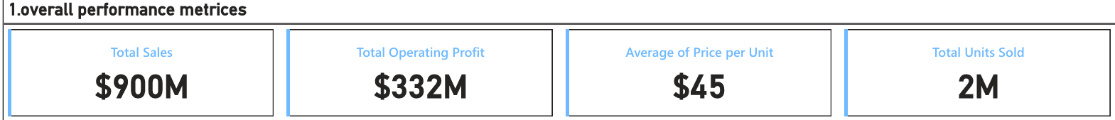
NOTE:
This summary encapsulates the overall performance of Adidas, laying the groundwork for deeper analysis in subsequent slides.

Slide 8
Profit Analysis by Retailer.
Visualization:
Chart Type:
Horizontal Bar Chart
This chart displays total profit generated by each retailer, allowing for easy comparison and identification of to performance.
Insights:
Top-Performing Retailers: The chart highlights which retailers contribute the most to overall profit, showcasing their effectiveness in sales.
Profit Contributions: Analyzing the profit contributions of individual retailers can inform strategic decisions, such as focusing marketing efforts or optimizing partnerships with high-performing retailers.
Performance Evaluation: Understanding the profitability of each retailer aids in evaluating their performance relative to others, which can guide resource allocation and sales strategies.
NOTE:
This effectively summarizes the profit distribution among retailers, providing actionable insights for enhancing business performance.

Slide 9
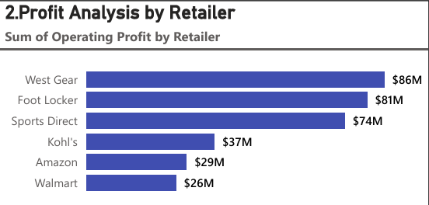

Slide 10
Sales Trend Over Time
Visualization:
Chart Type: Line Chart
This chart illustrates total sales over different timeframes (Year, Quarter, Month), allowing for a clear view of sales performance trends.
Insights:
Sales Patterns: The line chart reveals overall trends in sales, such as consistent growth, decline, or stability over time.
Seasonal Fluctuations: Identify periods of increased sales, which may correlate with seasonal events, promotions, or product launches.
Trend Analysis: Discuss any noticeable trends, such as peak sales periods or dips, which can inform future sales strategies and inventory planning.
NOTE:
A comprehensive overview of how sales performance varies over time, offering valuable insights for strategic decision-making.

Slide 11
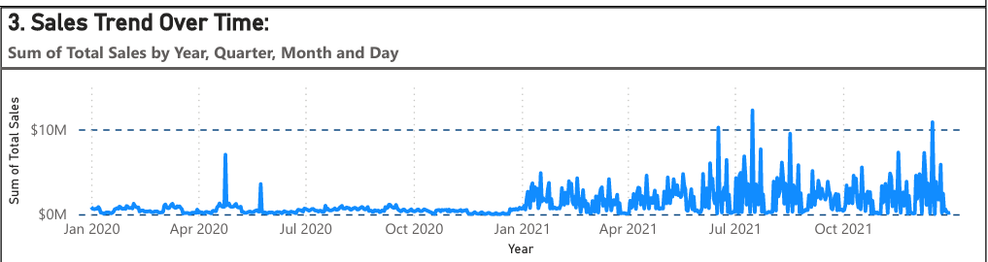
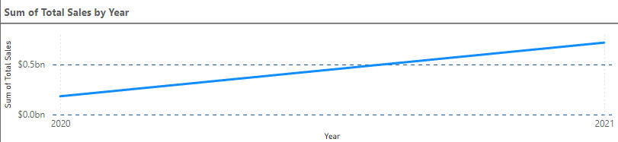
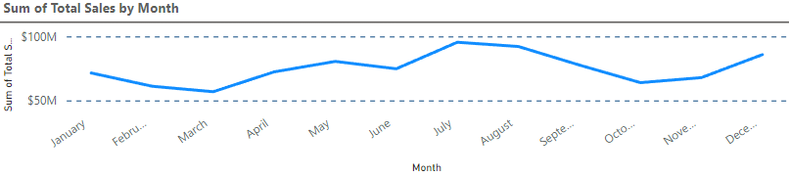
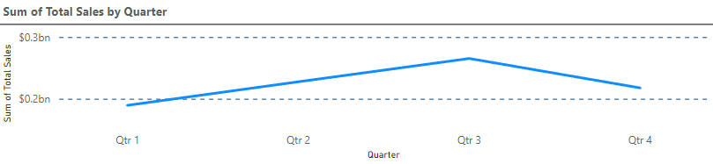
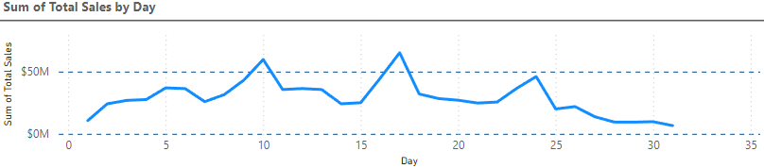

Slide 12
Product Category Sales Distribution
Visualization:
Chart Type: Pie Chart or Bar Chart
This chart displays the sales distribution across different product categories, illustrating each category's contribution to total sales.
Insights:
Top-Selling Categories: The visualization highlights which product categories are driving the most sales, helping to identify key areas of success.
Market Share Analysis: By examining the proportion of sales represented by each category, you can understand the market share dynamics within the Adidas product line.
Strategic Focus: Insights from this analysis can guide marketing efforts and inventory management, focusing on high-performing categories while exploring opportunities for underperforming ones.
NOTE:
This slide effectively summarizes the performance of different product categories, providing actionable insights for enhancing sales strategies.

Slide 13
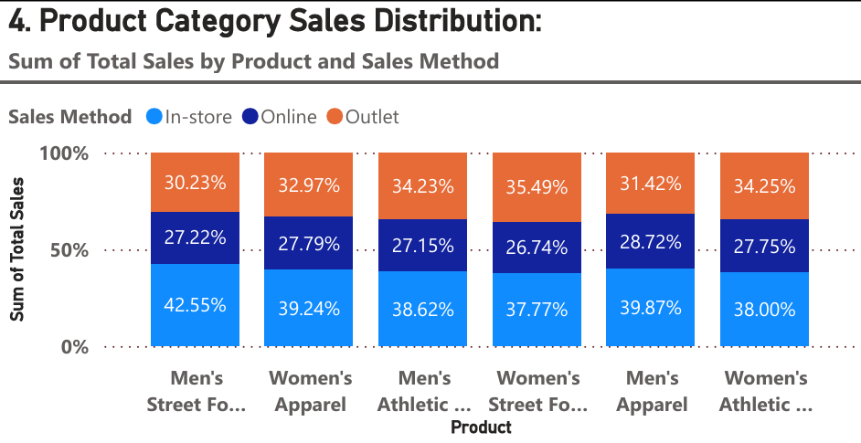

Slide 14
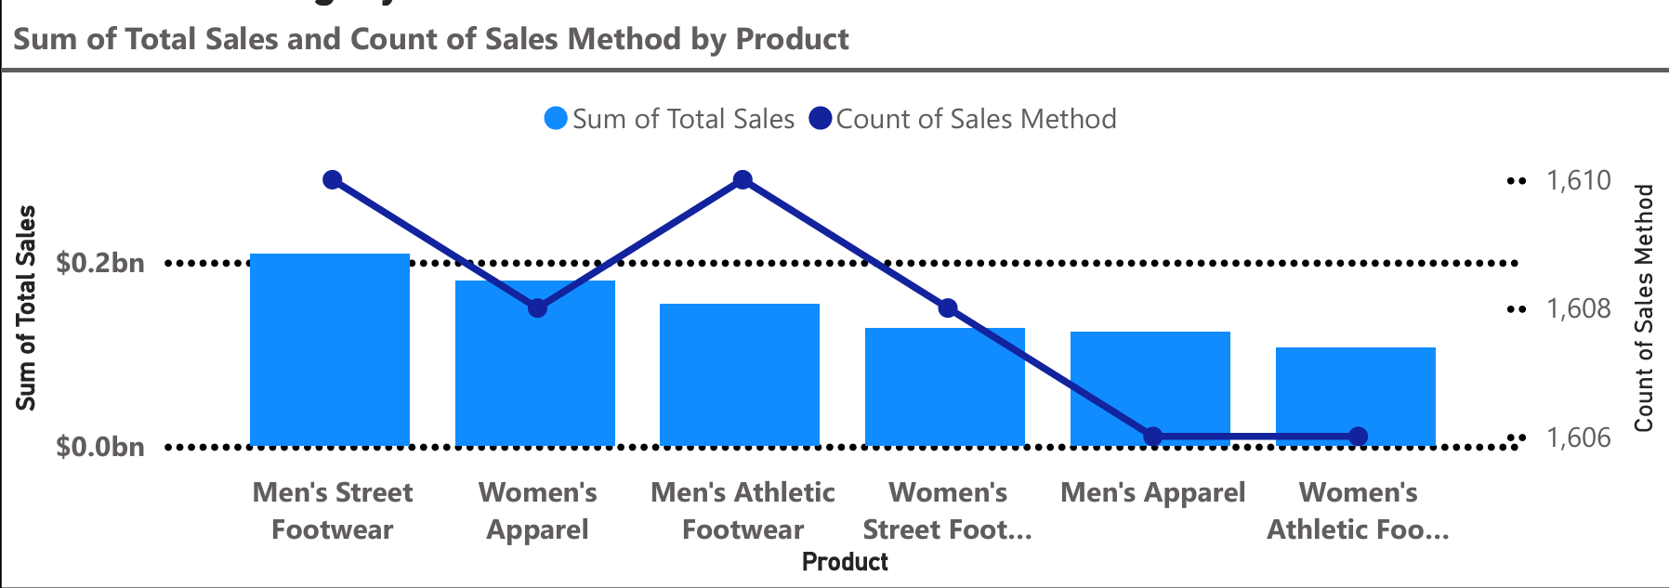

Slide 15
Units Sold by Product Category and Gender
Visualization:
Chart Type: Stacked Bar Chart
This chart presents the total units sold across various product categories, segmented by gender, allowing for a clear comparison of sales performance.
Insights:
Customer Preferences: The stacked bars reveal trends in purchasing behavior by gender, helping to identify which categories are more popular among male or female customers.
Sales Dynamics: Understanding these preferences can inform product development and marketing strategies tailored to specific demographics.
Targeted Marketing: Insights gained can guide targeted marketing campaigns, promotions, and inventory decisions to better align with customer preferences.
NOTE:
This provides valuable insights into customer demographics, enabling more informed decisions for enhancing sales strategies

Slide 16
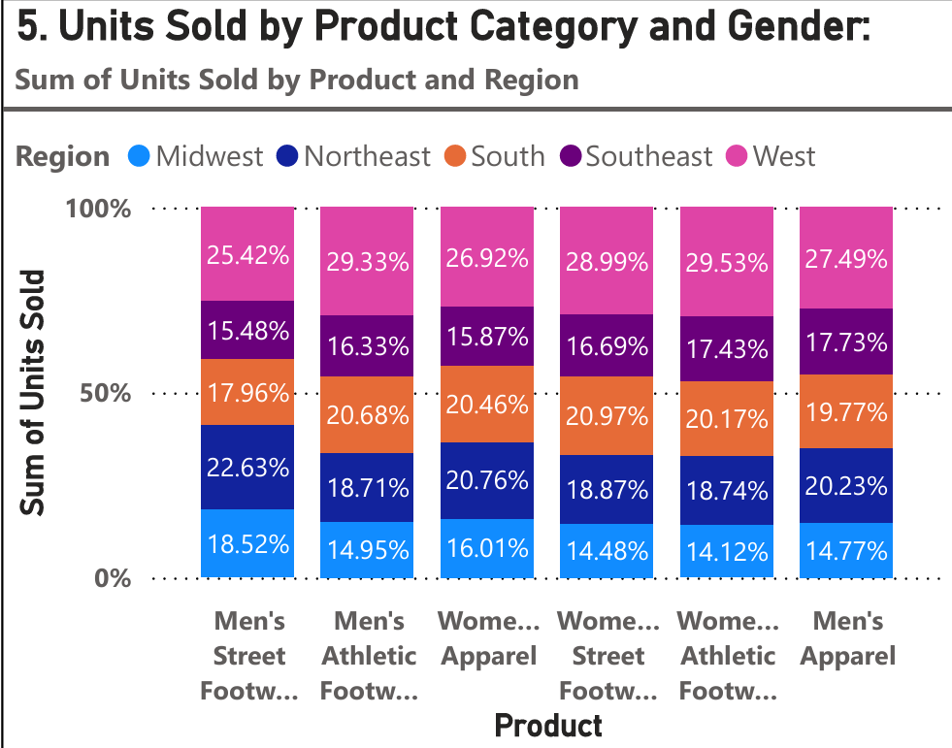

Slide 17
Effective Sales Methods Comparison
Visualization:
Chart Type: Column Chart
This chart compares the performance of various sales methods (e.g., online, in-store) based on total sales or profit.
Insights:
Performance Evaluation: The chart clearly highlights which sales methods are generating the most revenue, allowing for a straightforward assessment of effectiveness.
Strategy Optimization: Understanding the strengths and weaknesses of each sales method can guide strategic adjustments, such as increasing focus on high-performing channels or improving underperforming ones.
Resource Allocation: Insights from this analysis can inform resource allocation, marketing strategies, and training efforts to enhance sales performance across channels.
NOTE:
This slide provides a clear overview of sales method effectiveness, enabling strategic decision-making to optimize sales operations.

Slide 18
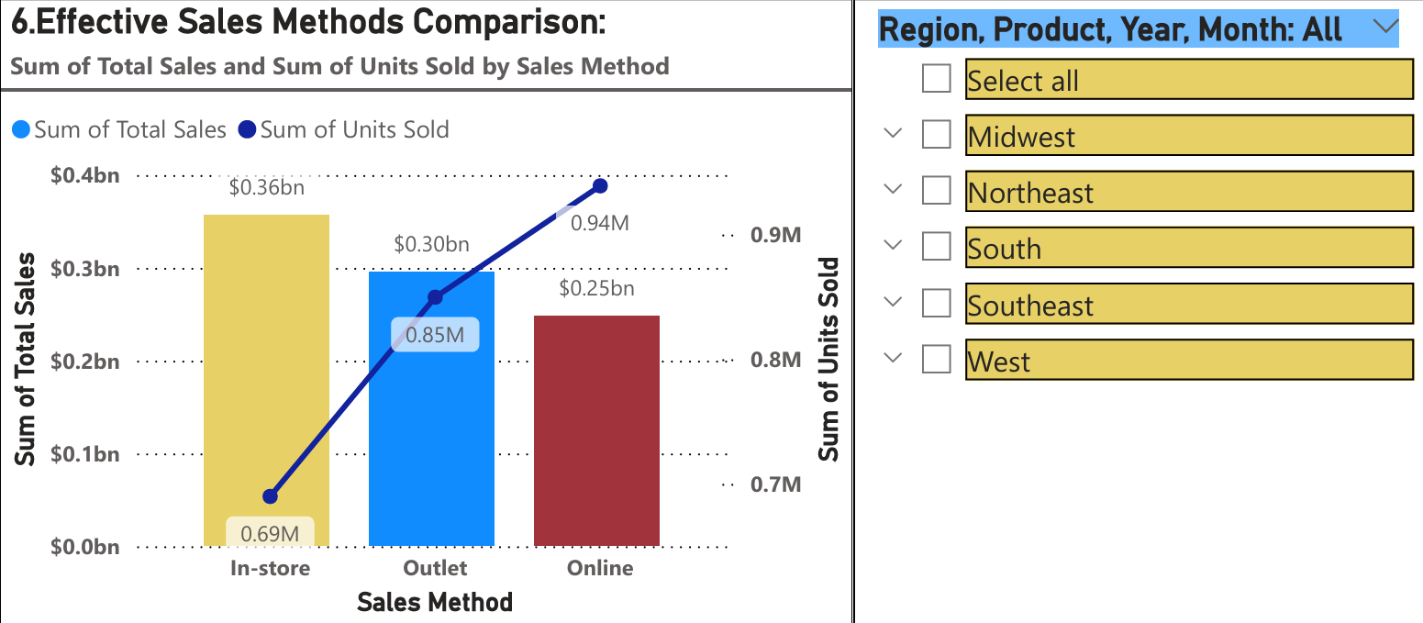

Slide 19
Regional Sales Analysis
Visualization:
Chart Type: Geographic Map
This map visualizes sales data across different regions, states, and cities, providing a clear geographical representation of sales performance.
Insights:
Sales Performance Overview: The map highlights areas of high and low sales, making it easy to identify geographic trends and regional strengths.
Target Areas for Improvement: Regions with low sales can be further analyzed to understand underlying factors, guiding targeted marketing efforts or strategic initiatives to boost performance.
Opportunities for Expansion: High-performing areas may present opportunities for further investment or expansion of retail presence.
NOTE:
This slide effectively summarizes regional sales dynamics, providing actionable insights for optimizing marketing and sales strategies based on geographic performance.

Slide 20
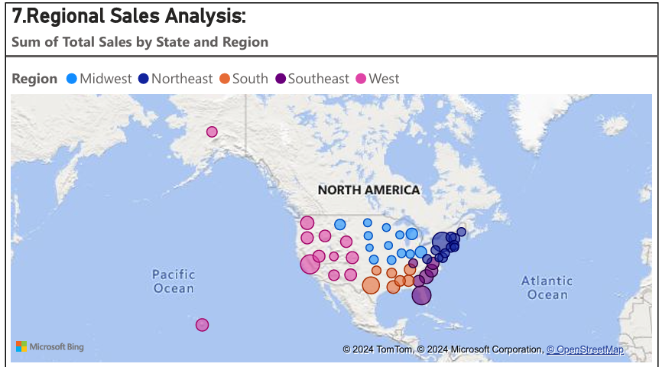
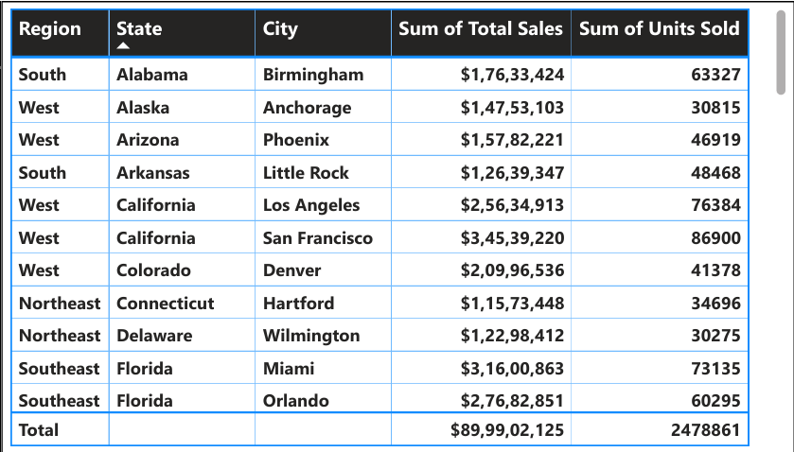

Slide 21
Top Performing Cities by Profit
Visualization:
Chart Type: Horizontal Bar Chart
This chart displays the top 5 cities ranked by total profit, allowing for a straightforward comparison of profitability across locations.
Insights:
City Performance: The chart highlights which cities are generating the highest profits, showcasing their significance in the overall business landscape.
Successful Sales Strategies: Analyze factors contributing to success in these cities, such as effective marketing campaigns, strong customer engagement, or favorable market conditions.
Replication of Success: Insights gained can guide strategies to replicate successful practices in other regions, enhancing overall profitability across the brand.
NOTE:
This slide provides a focused view on high-profit cities, offering actionable insights for leveraging successful strategies in broader markets.

Slide 22
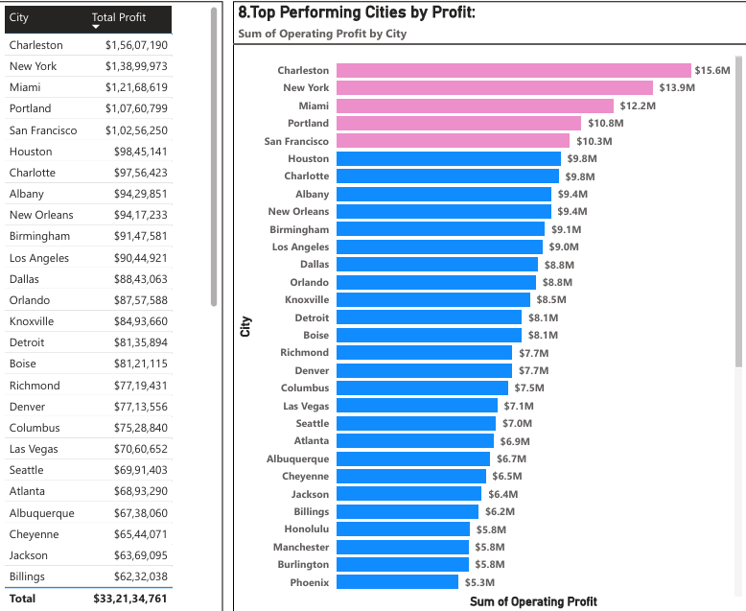

Slide 23
CONCLUSION
This analysis provided a comprehensive view of Adidas's sales performance, revealing that total sales and profit are significantly influenced by top-performing retailers and popular product categories. Seasonal trends highlighted key periods of demand, while customer preferences by gender underscored important market dynamics. Additionally, regional insights identified geographic areas of both high and low sales performance, informing potential growth opportunities.
To capitalize on these findings, it is recommended to strengthen marketing strategies in regions with lower sales while leveraging successful practices from high-profit cities. Focus on enhancing effective sales methods and consider tailoring product offerings based on customer preferences revealed in the analysis. Implementing these actionable strategies will support sustained growth and improve overall profitability for Adidas.

Slide 24

THANK YOU

