Slide 1

EDA ON CARS24 WEBSITE
BATCH NO : 319
TEAM MEMBERS :
B.Vamsi Krishna
D.V.Sriram
A.Sasi Kumar

Slide 2
ABOUT US
B.Vamsi Krishna
I have recently completed my BTech in the stream of Computer Science and Engineering, in N.B.K.R INSTITUTE OF SCIENCE AND TECHNOLOGY. Now I have done my Data Analytics course at INNOMATICS RESEARCH LABS.
D.V.Sriram
I have recently completed my BTech in the stream of Electrical and Electronics Engineering , in N.B.K.R INSTITUTE OF SCIENCE AND TECHNOLOGY. Now I have done my Data Analytics course at INNOMATICS RESEARCH LABS.
A.Sasi Kumar
I have recently completed my BTech in the stream of Electrical and Electronics Engineering , in N.B.K.R INSTITUTE OF SCIENCE AND TECHNOLOGY. Now I have done my Data Analytics course at INNOMATICS RESEARCH LABS.

Slide 3
OBJECTIVE
Analyze key factors influencing car prices using features like brand, model, year, location, and fuel type.
Perform data preprocessing by handling missing values, outliers, and encoding categorical variables.
The primary objective of this project is to analyze and predict car prices based on various features such as brand, model, manufacturing year, distance traveled, location, EMI per month, fuel type, and ownership status.
Conduct bivariate analysis to explore relationships between car price and other variables.
The project aims to uncover key factors that influence prices of a car given its specifications.
Provide insights and recommendations based on model results for car price estimation.

Slide 4
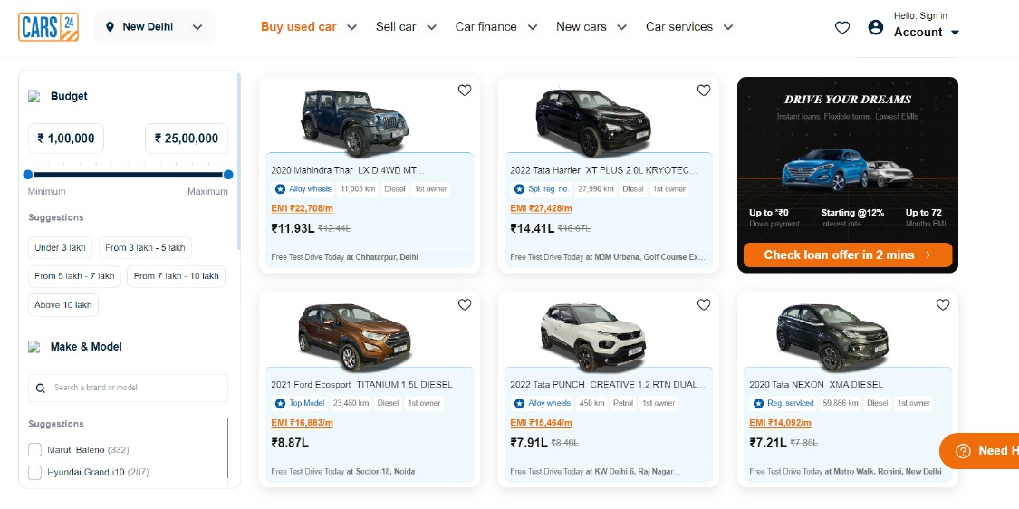
WEBSITE
We performed Scrapping on Cars24 Website to get the data.
Website Link : https://www.cars24.com/

Slide 5
DATA_PREPARATION
Web Scraping :
By Using Request Library , We extracted the HTML code of the page.
By using the BeautifulSoup Library , We parse and navigate the HTML Structure of a webpage in a simple Efficient Way.
BeautifulSoup :
Easy to use: Simple API for common scraping tasks.
Handles broken HTML: Can parse and clean malformed HTML.
Powerful search: Easily find elements by tag, class, id, or attributes.
Efficient parsing: Quickly navigate and extract data from complex web pages.

Slide 6
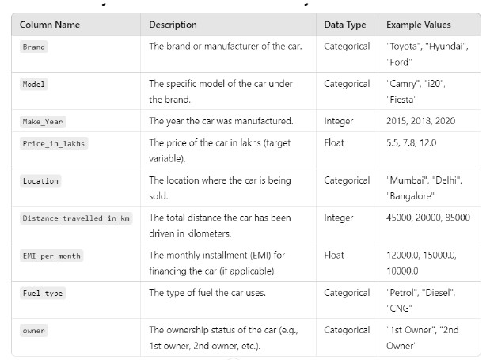
DATA DICTIONARY

Slide 7
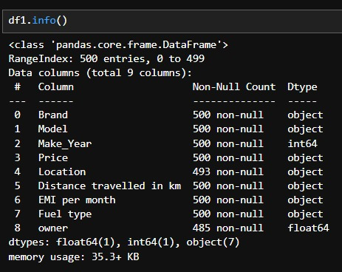
EXPLORATORY DATA ANALYSIS
Inspecting the Data :
Data frame contains 500 Rows and 9 columns
Owner column contains 15 null values.
Location column contains 7 null values .

Slide 8
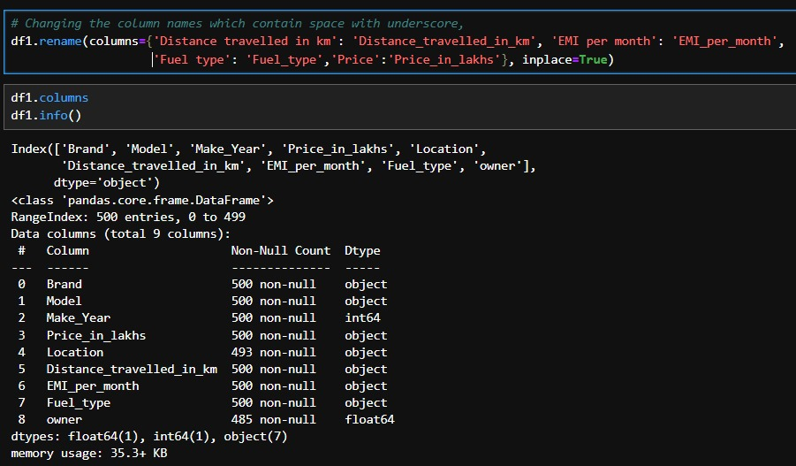
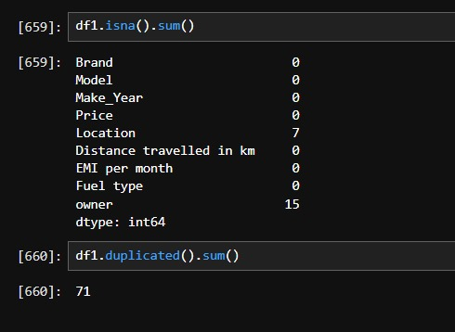
Data Cleaning & Transformation
- > Renaming the columns which contains empty spaces . -> Checking for the missing values , Location column and Owner column consists of null values.

Slide 9
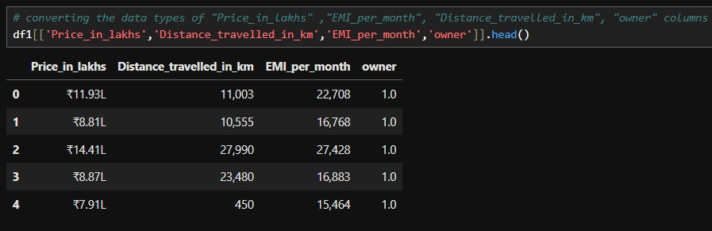
The datatypes of Price , Distance , EMI are object , where as the owner column Dtype is Float.
We need to convert price distance and EMI into numerical columns .
Since , owner column has only 2 unique values namely 1.0 , 2.0 , it should be converted into object type in format of 1,2.

Slide 10
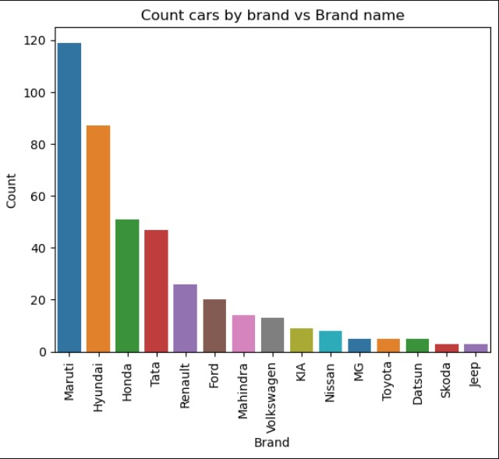
UNIVARIATE ANALYSIS
Top 5 car brands are Maruthi, Hyundai, Honda, Tata and Ford.Maruthi = 119, Hyundai = 87, Honda = 51, Tata = 47, Renault = 26 .
79 percent of the cars comes under these 5 brands.

Slide 11
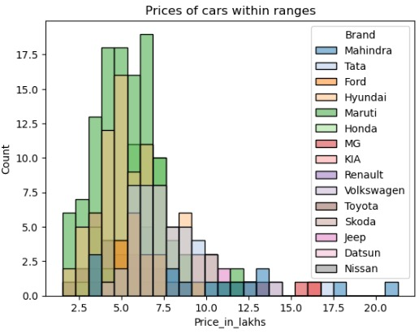
Majority of cars are within price range of 7.5 lakhs.
Most of the cars are of Brand Maruthi, Hyundai

Slide 12
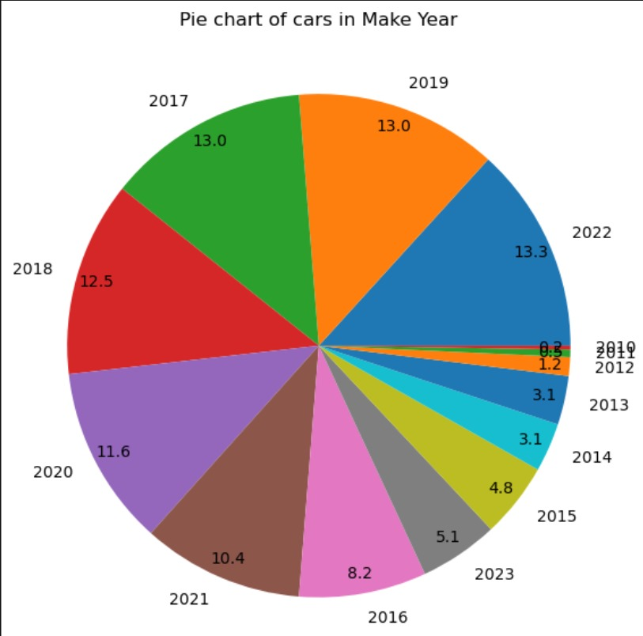
Cars which are made in years 2022, 2019, 2017, 2018, 2020 are more for resale.they occupy about 63% in the total cars present.

Slide 13
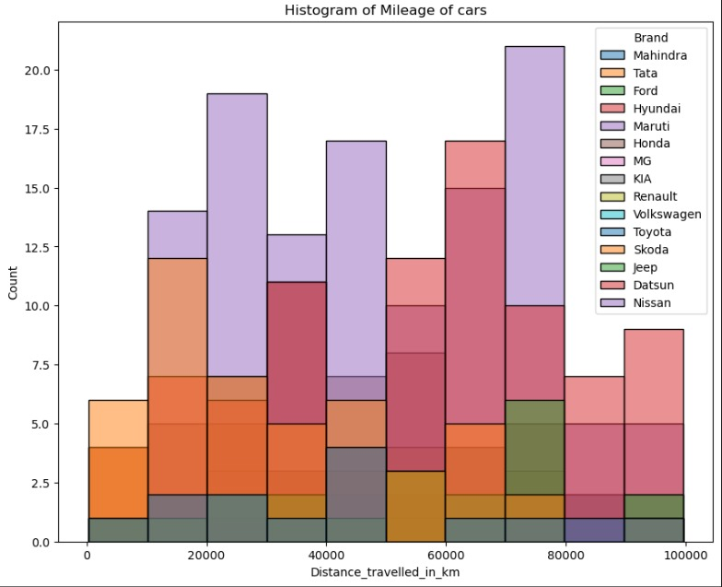
Most cars having mileage with in range 20,000km to 80,000km.Nissan, Datsun, Hyundai are brands of cars that is present inthis range

Slide 14
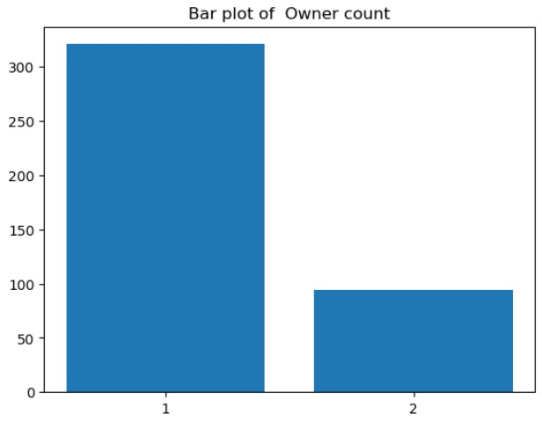
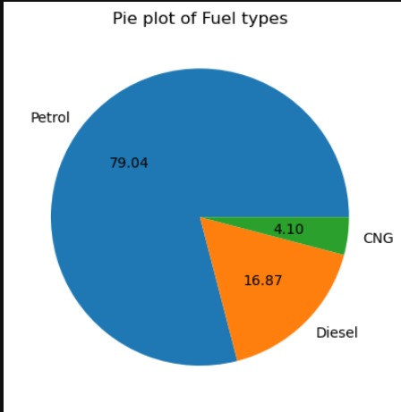
Petrol fuel type cars are most available
More 75 percent of cars are of first handed.

Slide 15
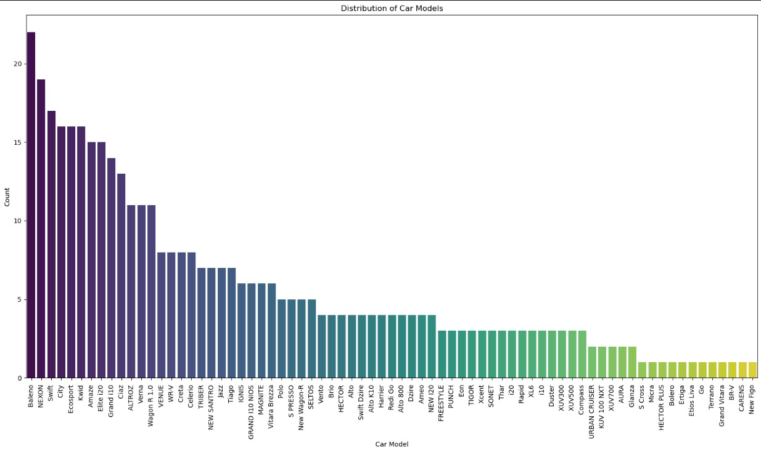
Baleno, NEXON, Swift, City and Ecosport are top 5 car models

Slide 16
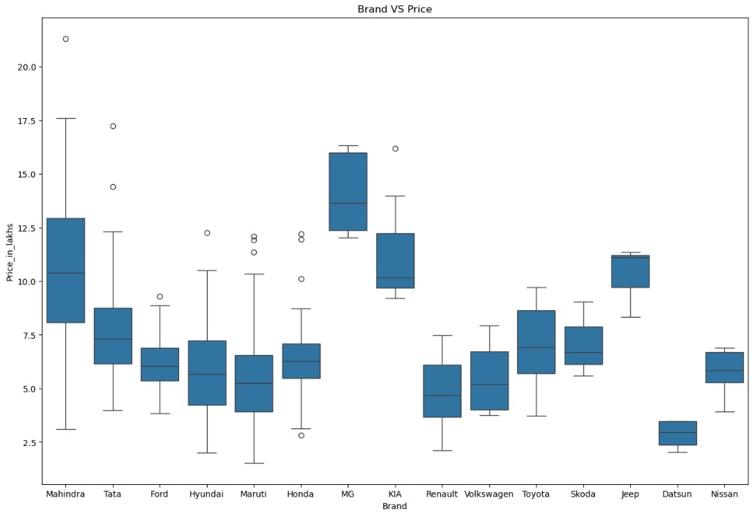
BI -VARIATE ANALYSIS
Mahindra car has more spread of data it's price range is 2.8 to 22.5 lakhs.MG branded car has the highest starting priceto buy cars.

Slide 17
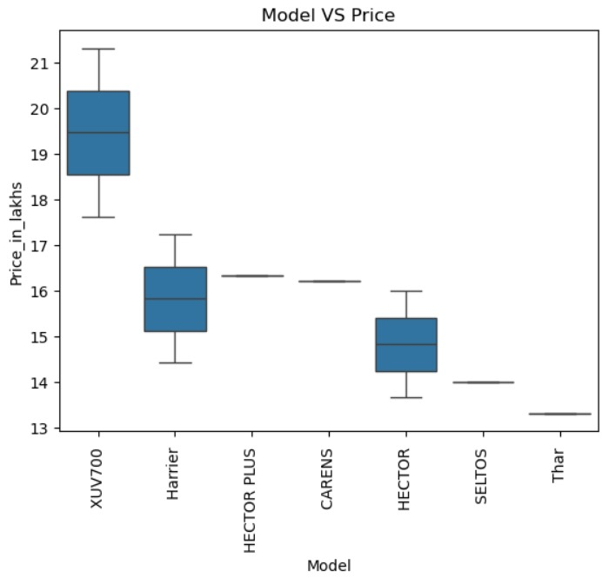
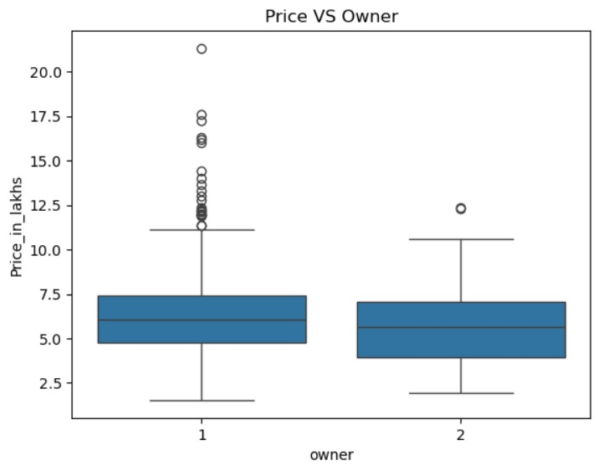
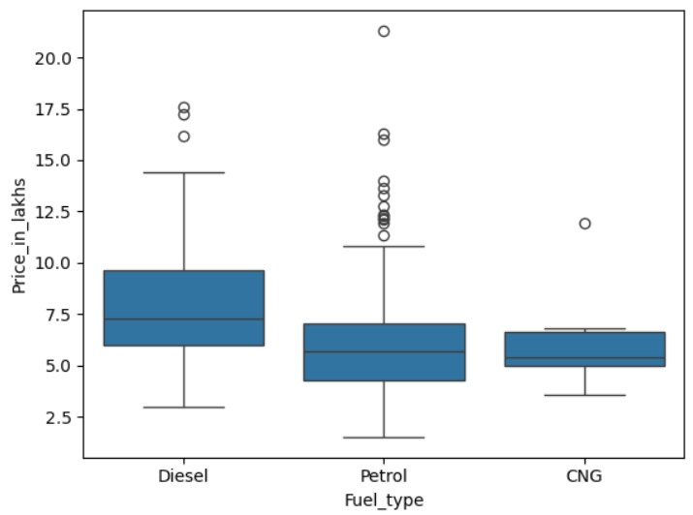
Fuel VS Price
Petrol fuel type has wide spread of price. The minimum price of the petrol fuel type cars are less comparatively. Similarly the maximum price of petrol fuel type cars are more comparatively. Diesel comes in second place and them last is CNG.
Cars which are sold by first owners has price distribution form 1.5 lakhs to 22 lakhs, whereas cars that are sold by second owners has price distribution 1.75 lakhs to 12.5 lakhs
Top 5 models with maximum price range is XUV700, Harrier, HECTORPLUS, CARENS, HECTOR

Slide 18
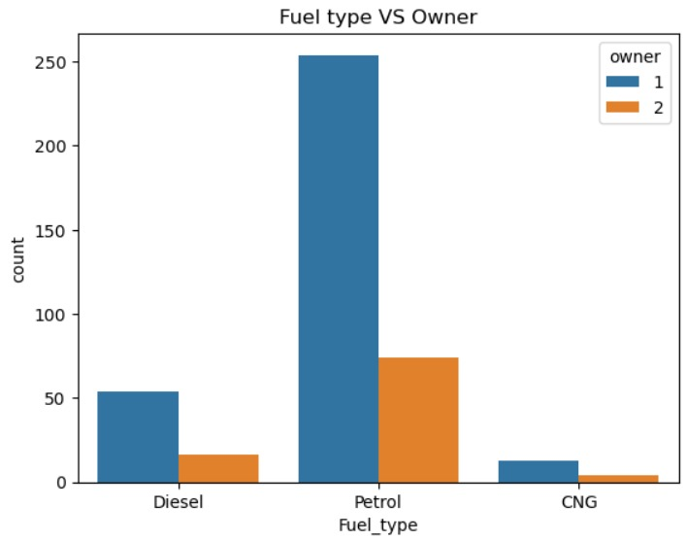
Petrol fuel type cars are maximum available for resale in both the category of 1st owner's and 2nd owner's.

Slide 19
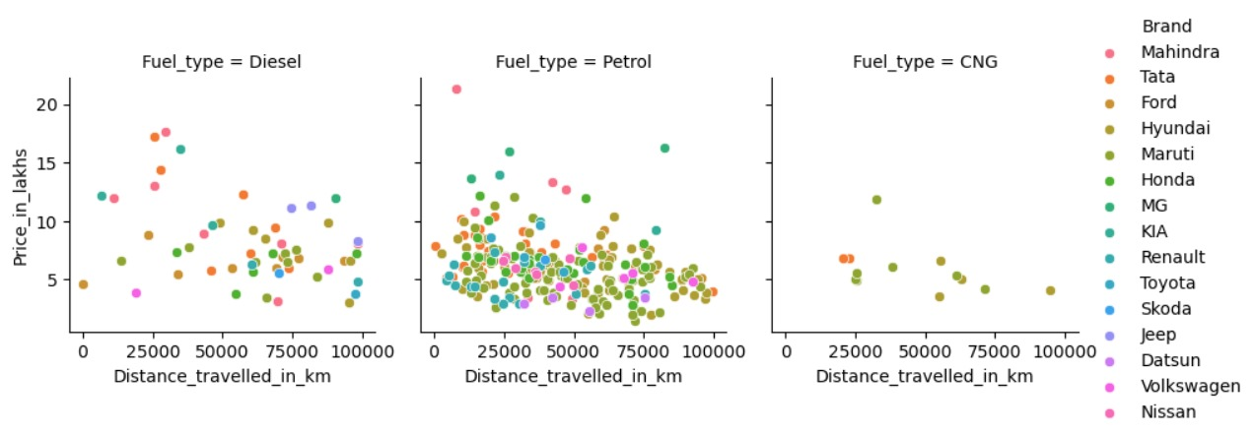
MULTIVARIATE ANALYSIS
TITLE :Price VS Distance Based on Fuel Type of cars sold by owner_1

Slide 20
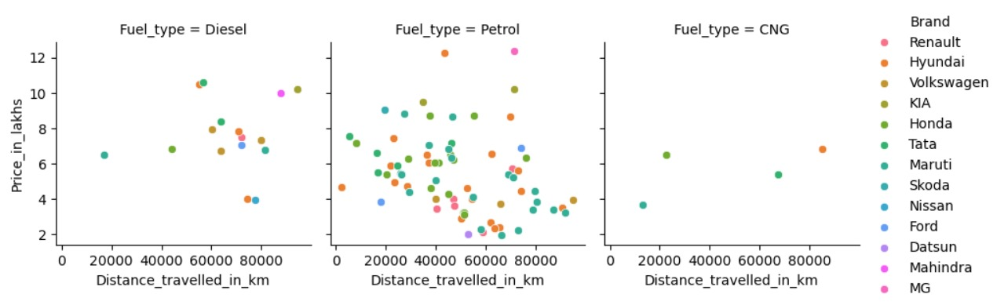
TITLE : Price VS Distance Based on Fuel Type Of cars Sold By owner_2

Slide 21
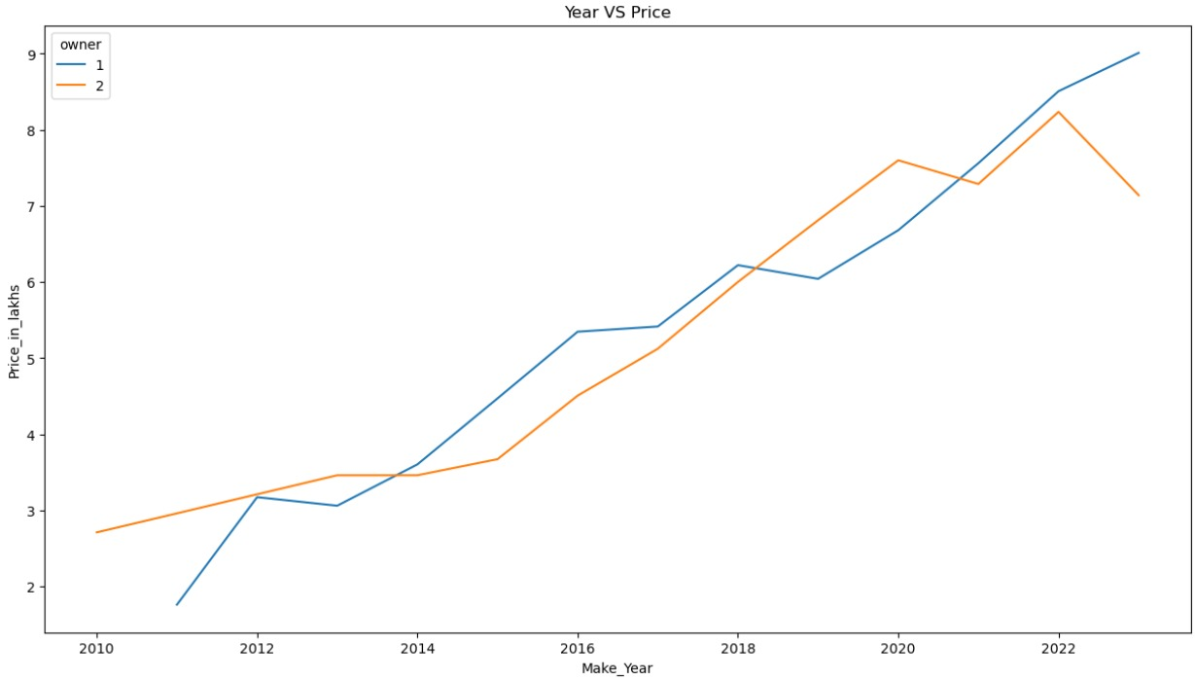

Slide 22
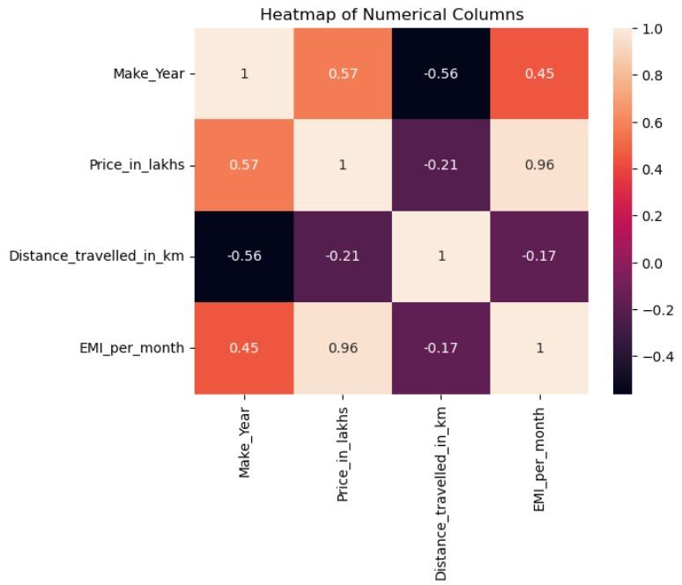

Slide 23
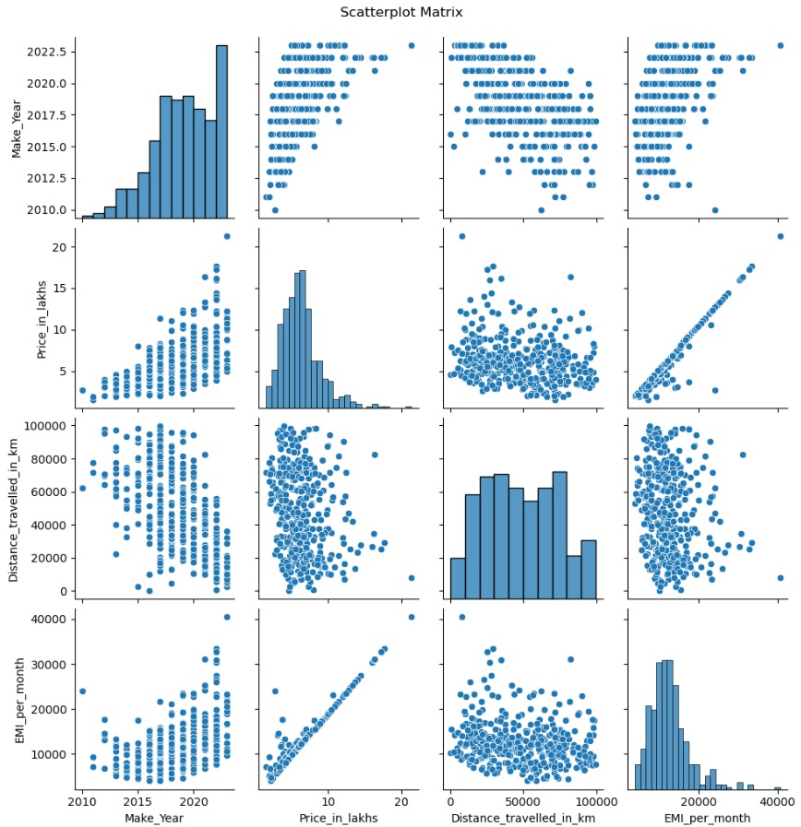

Slide 24
CONCLUSION
Maruti and Hyundai dominate the car market, indicating strong brand loyalty among consumers.
Most cars are priced under 7.5 lakhs, with prices inversely related to mileage.
Newer models (2022, 2019, 2017) retain higher resale value, comprising 63% of total cars.
First-owner cars have a wider price range and better value retention compared to second-owner cars.
Petrol vehicles are most prevalent, particularly in resale markets, with consistent price growth observed
over time.
SUGGESTION TO BUYER:
Focus on buying popular brands like Maruti or Hyundai, particularly newer models from 2022, 2019, or 2017 for better resale value.
Target petrol cars with mileage between 20,000 km and 80,000 km, as they are the most available and commonly resold.
Opt for first-owner vehicles to ensure better maintenance and wider price distribution, enhancing overall value.

Slide 25

THANK YOU

Slide 26


