Slide 1
CHAPTER-6
AWS ROUTE-53, ELASTIC LOAD BALANCING,
AND AUTO SCALING

Slide 2
AWS Route 53
Route 53 is a highly available and scalable Domain Name System (DNS) web service.
Route 53 provides three main functions:
Domain Registration
Allows domain names registration
Domain Name System (DNS) service
It translates friendly domains names like www.example.com into IP addresses like 192.0.2.1
It responds to DNS queries using a global network of authoritative DNS servers, which reduces latency
It can route Internet traffic to CloudFront, Elastic Beanstalk, ELB, or S3. There’s no charge for DNS queries to these resources

Slide 3
AWS Route 53
Health Checking
Can monitor the health of resources such as web and email servers.
Sends automated requests over the Internet to the application to verify that it’s reachable, available, and functional.
CloudWatch alarms can be configured for the health checks to send notifications when a resource becomes unavailable.
Can be configured to route Internet traffic away from unavailable resources.

Slide 4
Route 53 Hosted Zone
Hosted Zone is a container for records, which include information about how to route traffic for a domain (such as example.com) and all of its subdomains (such as www.example.com, retail.example.com, and seattle.accounting.example.com).
A hosted zone has the same name as the corresponding domain.
Routing Traffic to the Resources
Create a hosted zone with either a public hosted zone or a private hosted zone:
Public Hosted Zone – for routing internet traffic to the resources for a specific domain and its subdomains
Private hosted zone – for routing traffic within a VPC

Slide 5
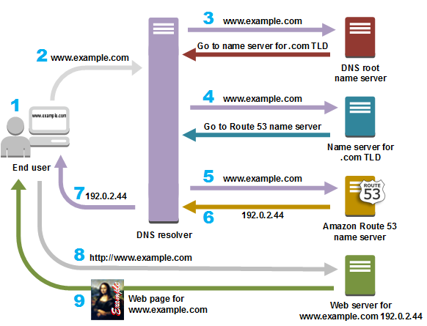
Route 53 Hosted Zone
Create records in the hosted zone
Records define where to route traffic for each domain name or subdomain name.
Name of each record in a hosted zone must end with the name of the hosted zone.

Slide 6
Thank You

