Slide 1
CHAPTER-8
AWS Databases

Slide 2

Database
A database is an organized collection of structured information, or data, typically stored electronically in a computer system. A database is usually controlled by a database management system (DBMS).
Together, the data and the DBMS, along with the applications that are associated with them, are referred to as a database system, often shortened to the just database.
Data within the most common types of databases in operation today is typically modelled in rows and columns in a series of tables to make processing and data querying efficient.
The data can then be easily accessed, managed, modified, updated, controlled, and organized. Most databases use structured query language (SQL) for writing and querying data.

Slide 3
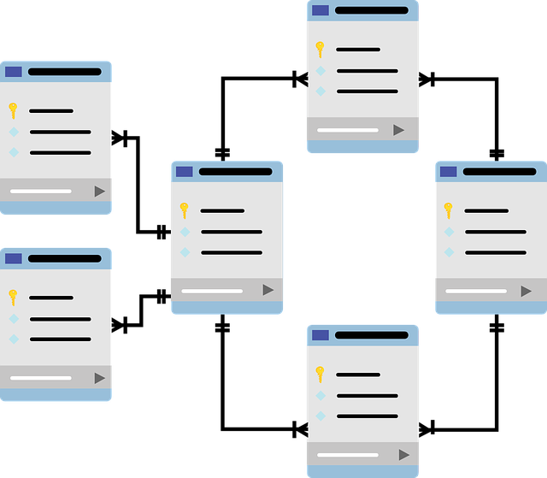
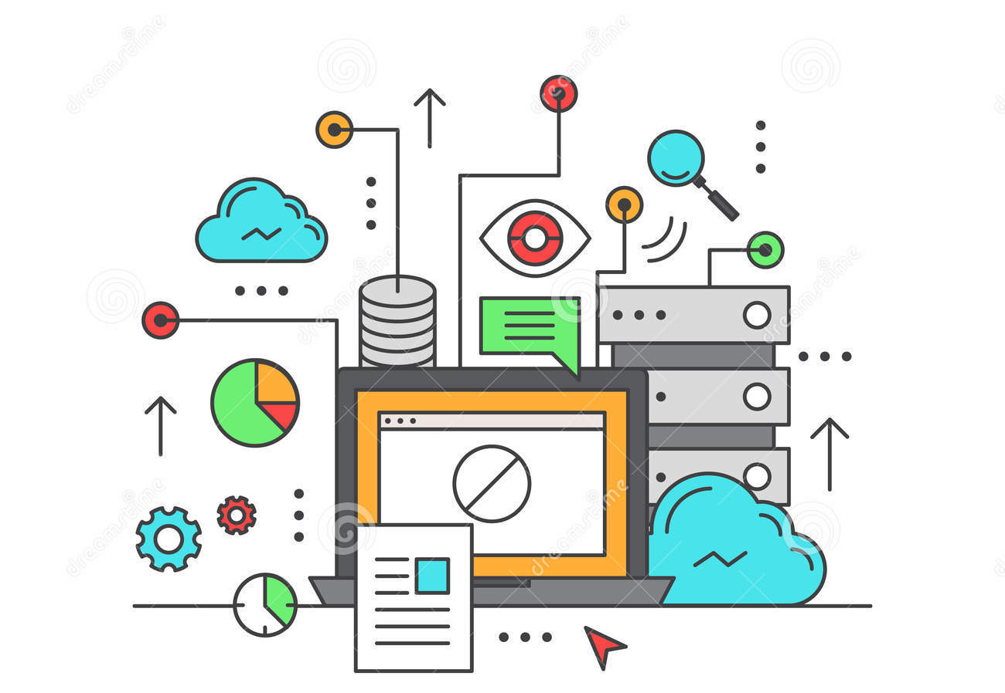
Database Types
Relational database
Non-relational database
Relational database
Non-Relational database

Slide 4

Relational Database
A relational database can store and arrange the data in tabular form like rows and columns.
Rigid schema (SQL).
Stored data can be accessed from the relational database because there is a relationship between the tables and their attributes.
Typically scaled vertically.
Supports complex queries and joins.
Example: Amazon RDS, Oracle, MySQL, IBM DB2, PostgreSQL.

Slide 5
Non-Relational Database
Non-relational databases (often called NoSQL databases) are different from traditional relational databases in that they store their data in a non-tabular form.
Flexible schema (NoSQL) – data stored in key-value pairs, columns, documents, or graphs.
Instead, non-relational databases might be based on data structures like documents. A document can be highly detailed while containing a range of different types of information in different formats.
This ability to digest and organize various types of information side by side makes non-relational databases much more flexible than relational databases.
Example: Amazon DynamoDB, MongoDB, Redis, Neo4j

Slide 6
Databases in AWS
AWS Relational Database
Use cases:
AWS services
Traditional applications, enterprise resource planning (ERP), customer relationship management (CRM), e-commerce
Amazon Aurora
Amazon RDS
Amazon Redshift

Slide 7
Amazon Aurora
Amazon Aurora is an AWS database offering in the RDS family.
Amazon Aurora is a MySQL and PostgreSQL-compatible relational database built for the cloud.
Amazon Aurora is up to five times faster than standard MySQL databases and three times faster than standard PostgreSQL databases.
Amazon Aurora features a distributed, fault-tolerant, self-healing storage system that auto-scales up to 64TB per database instance.

Slide 8
Amazon RDS
Amazon Relational Database Service (Amazon RDS) is a managed service that makes it easy to set up, operate, and scale a relational database in the cloud.
RDS uses EC2 instances, so you must choose an instance family/type.
Relational databases are known as Structured Query Language (SQL) databases.
RDS is an Online Transaction Processing (OLTP) type of database.
Easy to set up, highly available, fault-tolerant, and scalable.
Common use cases include online stores and banking systems.

Slide 9
Amazon RDS (Contd..)
You can encrypt your Amazon RDS instances and snapshots at rest by enabling the encryption option for your Amazon RDS DB instance
Encryption uses AWS Key Management Service (KMS)
Amazon RDS supports the following database engines:
SQL Server
Oracle
MySQL Server
PostgreSQL
Aurora
MariaDB

Slide 10
Amazon RDS (Contd..)
Fault tolerance/disaster recovery with Multi-AZ option
Automatic failover for Multi-AZ option
Read replicas option for read-heavy workloads

Slide 11
Amazon Redshift
Amazon Redshift is a fast, fully managed data warehouse that makes it simple and cost-effective to analyze all your data using standard SQL and existing Business Intelligence (BI) tools.
RedShift is a SQL-based data warehouse used for analytics applications.
RedShift is a relational database that is used for Online Analytics Processing (OLAP) use cases.
RedShift is ideal for processing large amounts of data for business intelligence.
RedShift uses Amazon EC2 instances, so you must choose an instance family/type.
RedShift uses columnar data storage.
RedShift always keeps three copies of your data.
RedShift provides continuous/incremental backups.

Slide 12
AWS Non-Relational Database
Use cases:
AWS services
High-traffic web applications, e-commerce systems, gaming applications, Content management, catalogs, user profiles
Amazon DynamoDB

Slide 13
Amazon DynamoDB
Amazon DynamoDB is a fully managed NoSQL database service that provides fast and predictable performance with seamless scalability.
Push button scaling means that you can scale the DB at any time without incurring downtime.
Data is synchronously replicated across 3 facilities (AZs) in a region.
Amazon DynamoDB global tables provide a fully managed solution for deploying a multi-region, multi-master database.
Amazon DynamoDB Accelerator (DAX) is a fully managed, highly available, in-memory cache for DynamoDB that delivers up to a 10x performance improvement (Microsecond Latency).

