Slide 1
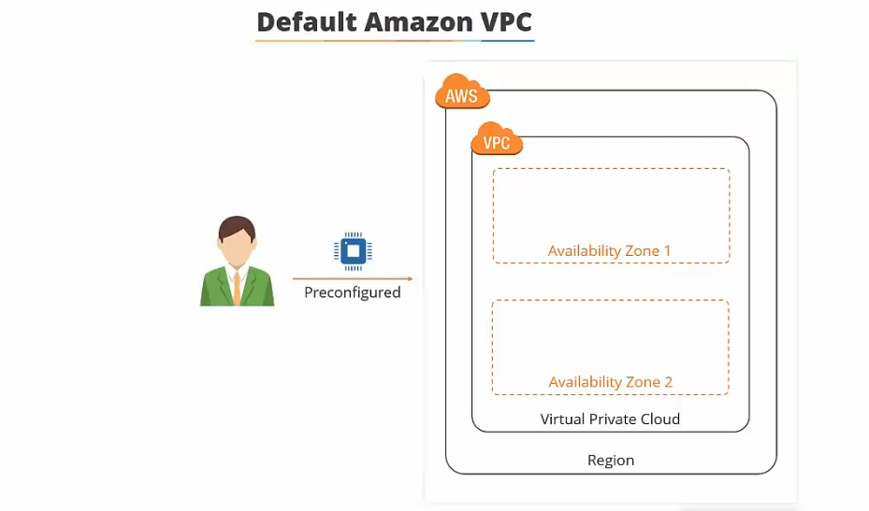
Virtual Private Cloud
A virtual private cloud is a private, isolated virtual network on the AWS cloud, Has complete control over
your virtual networking environment.

Slide 2
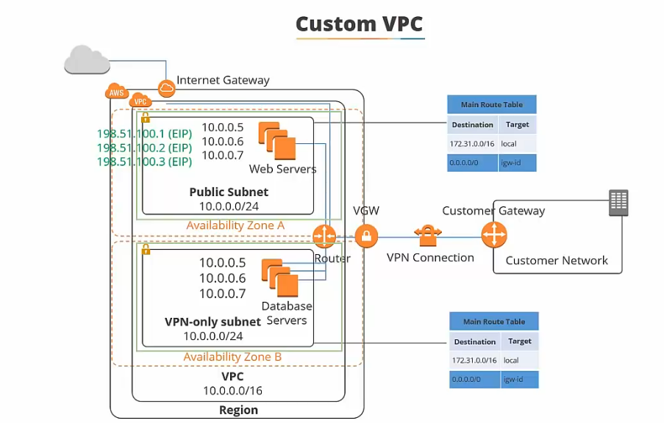
Custom VPC

Slide 3
Types of IP’S
Public IP
It is assigned to your launched instance.
A public IPv4 address is an IP address that's reachable over the Internet.
when an instance is terminated the public IP attached to it gets released and further when you relaunch the same instance new IP address is assigned.
Private IP
A private IPv4 address is an IP address that's not reachable over the Internet. You can use private IPv4 addresses for communication between instances in the same VPC.
Elastic IP
It is assigned to your AWS account.
Elastic IPs do not change and they remain the same even if you terminate the instance and later again restart the same instance.

Slide 4
Subnet
A subnet defines a range of IP addresses in your VPC. You can launch AWS resources into a subnet that you select.
A private subnet should be used for resources that won’t be accessible over the Internet.
A public subnet should be used for resources that will be accessed over the Internet.
Each subnet must reside entirely within one Availability Zone and cannot span zones.

Slide 5
Route Table
A routing table is a logical construct within an Amazon VPC that contains a set of rules (called routes) that are applied to the subnet and used to determine where network traffic is directed.
Route tables initiate communication between instances with different subnets in a VPC.
Each routing table contains a default route called the local route, which enables communication within the Amazon VPC, and this route cannot be modified or removed.
Additional routes can be added.

Slide 6
Internet Gateway
An Internet Gateway (IGW) is a horizontally scaled, redundant, and highly available Amazon VPC component that allows communication between instances in your Amazon VPC and the Internet.
An IGW provides a target in your Amazon VPC route tables for Internet-routable traffic § Performs network address translation for instances that have been assigned public IP addresses.

Slide 7
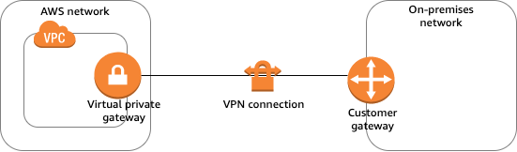
Custom Gateway
A customer gateway device is a physical or software appliance that you own or manage in your on-premises network
You or your network administrator must configure the device to work with the Site-to-Site VPN connection.

Slide 8
NAT Gateway
A NAT gateway is an Amazon-managed resource that is designed to operate just like a NAT instance.
It is simpler to manage and highly available within an Availability Zone.
To allow instances within a private subnet to access Internet resources through the IGW via a NAT gateway, you must do the following:
Configure the routing table associated with the private subnet to direct Internet-bound traffic to the NAT gateway.
Allocate an EIP and associate it with the NAT gateway.

Slide 9
NAT Instance
Managed by you (e.g. software updates)
Scale up (instance type) manually and use enhanced networking
No high availability – scripted/auto-scaled HA possible using multiple NATs in multiple subnets
Need to assign Security Group
Can use as a bastion host
Use an Elastic IP address or a public IP address with a NAT instance
Can implement port forwarding through manual customization

Slide 10
Endpoints
An Amazon VPC endpoint enables you to create a private connection between your Amazon VPC and another AWS service without requiring access over the Internet or through a NAT instance, VPN connection, or AWS Direct Connect.
You can create multiple endpoints for a single service, and you can use different route tables to enforce different access policies from different subnets to the same service.

Slide 11
Security Groups
A security group is a virtual stateful firewall that controls inbound and outbound network traffic to AWS resources and Amazon EC2 instances.
All Amazon EC2 instances must be launched into a security group.
If not specified then they are configured with the default security group.
The default security group allows communication between all resources within the security group
allows all outbound traffic and denies all other traffic.
We can change the security group rules but cannot delete them.

Slide 12
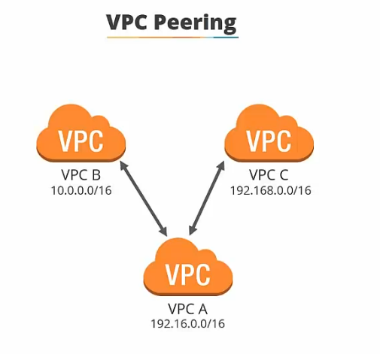
VPC Peering
It enables instances in either Amazon VPC to communicate with each other as if they are within the same network.
You can create an Amazon VPC peering connection between your own Amazon VPCs or with an Amazon VPC in another AWS account within a single region.
The owner of the requesting Amazon VPC sends a request to peer to the owner of the peer Amazon VPC. If the peer Amazon VPC is within the same account, it is identified by its VPC ID.

Slide 13
VPC Peering (Contd..)
The owner of the peer Amazon VPC has one week to accept or reject the request to peer with the requesting Amazon VPC before the peering request expires.
An Amazon VPC may have multiple peering connections, and peering is a one-to-one relationship between Amazon VPCs, meaning two Amazon VPCs cannot have two peering agreements between them.
You cannot create a peering connection between Amazon VPCs that have matching or overlapping CIDR blocks.
You cannot create a peering connection between Amazon VPCs in different regions.

Slide 14
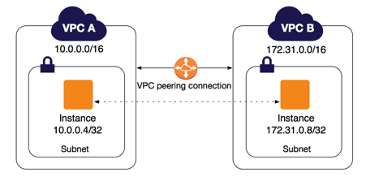
VPC Peering (Contd..)
Amazon VPC peering connections do not support transitive routing.
You cannot have more than one peering connection between the same two Amazon VPCs at the same time.

Slide 15
Connecting Securely to a VPC
Options for securely connecting to a VPC are:
AWS managed VPN – fast to setup
AWS Direct Connect – high bandwidth, low latency but takes weeks to months to setup
VPN Cloudhub – used for connecting multiple sites to AWS
Software VPN – use 3rd party software

Slide 16
Virtual Private Network
AWS Virtual Private Network solutions establish secure connections between your on-premises networks, remote offices, client devices, and the AWS global network.
AWS VPN is comprised of two services: AWS Site-to-Site VPN and AWS Client VPN.
AWS Site-to-Site VPN creates a secure connection between your data center or branch office and your AWS cloud resources. For globally distributed applications, the Accelerated Site-to-Site VPN option provides even greater performance by working with AWS Global Accelerator.
AWS Client VPN is a fully-managed remote access VPN solution used by your remote workforce to securely access resources within both AWS and your on-premises network. Fully elastic, it automatically scales up, or down, based on demand.

Slide 17
Direct Connect
AWS Direct Connect is a network service that provides an alternative to using the Internet to connect a customer’s on-premise sites to AWS.
Can be used to create a hybrid cloud.
Data is transmitted through a private network connection between AWS and a customer’s data center or corporate network.
Benefits:
Reduce cost when using large volumes of traffic.
Increase reliability (predictable performance).
Increase bandwidth (predictable bandwidth).
Decrease latency.

Slide 18
Direct Connect (Contd..)
Direct Connect is charged by port hours and data transfer.
Available in 1Gbps and 10Gbps.
Speeds of 50Mbps, 100Mbps, 200Mbps, 300Mbps, 400Mbps, and 500Mbps can be purchased through AWS Direct Connect Partners.

Slide 19







Transit Gateway
Amazon VPC
Amazon VPC
AWS Site-to-Site VPN
AWS Transit Gateway
AWS Direct Connect
Amazon VPC
Amazon VPC

Slide 20
Transit Gateway
AWS Transit Gateway connects VPCs and on-premises networks through a central hub.
Simplifies networks and puts an end to complex peering relationships.
Acts as a cloud router.
Inter-Region peering connects AWS Transit Gateways using the AWS global network.
Data is automatically encrypted, and never travels over the public internet.

Slide 21
Thank You

