Slide 1
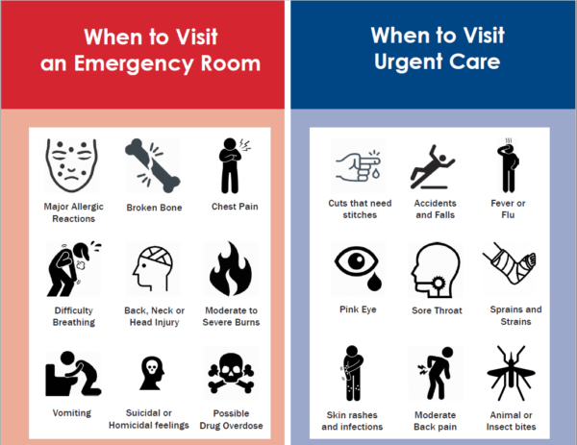

Slide 2
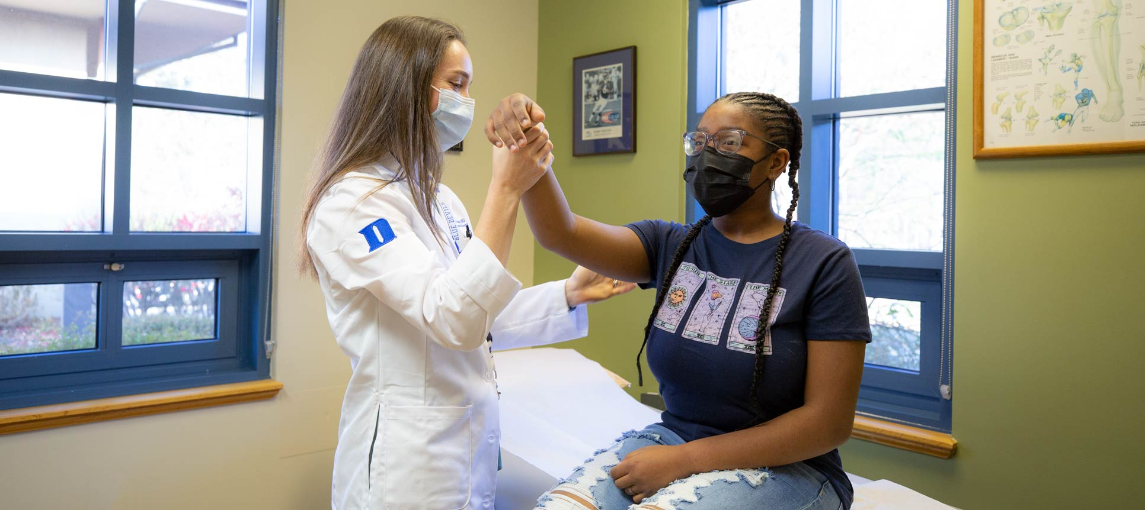
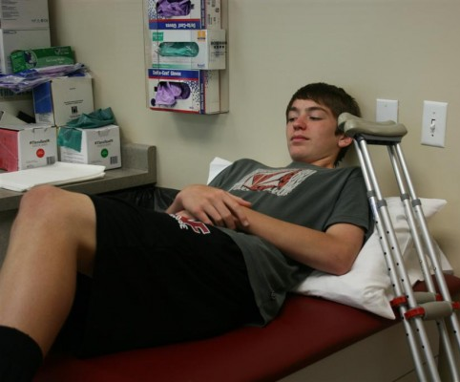
We concluded that most E.D. visits were minors, and their primary injury were in low-risk locations. Further research would need to be gathered to determine if the emergency visit was justified.

Slide 3

Strengths | NEISS Database
Limitations | We are not medical professionals

Slide 4

Injury Management Plan
Further research is necessary and will need the cooperation of public healthcare officials, healthcare professionals, coaches, parents, and patients.

