Slide 1







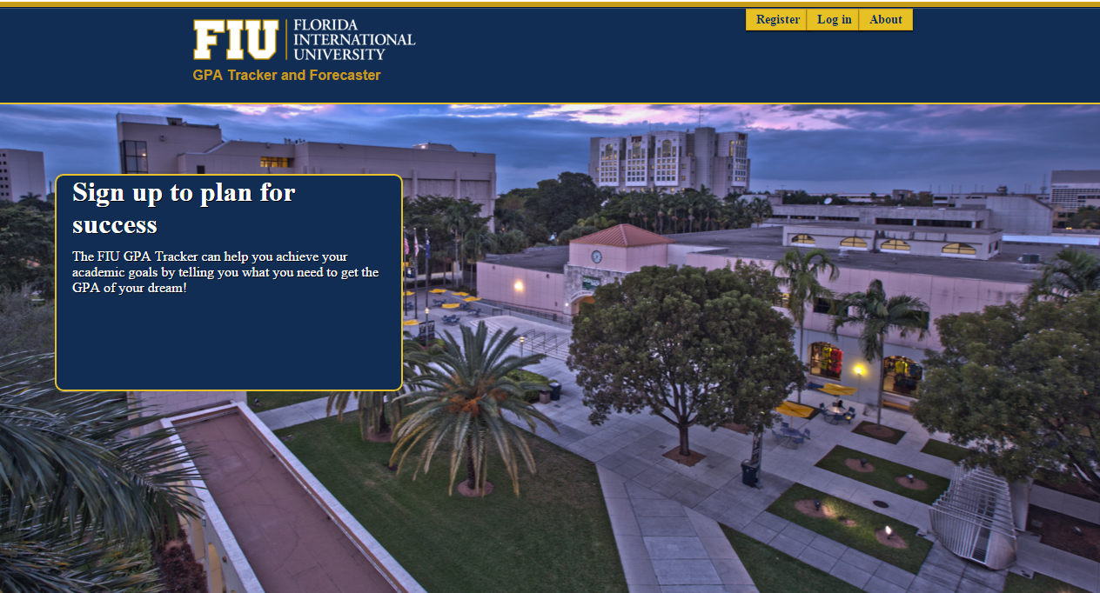
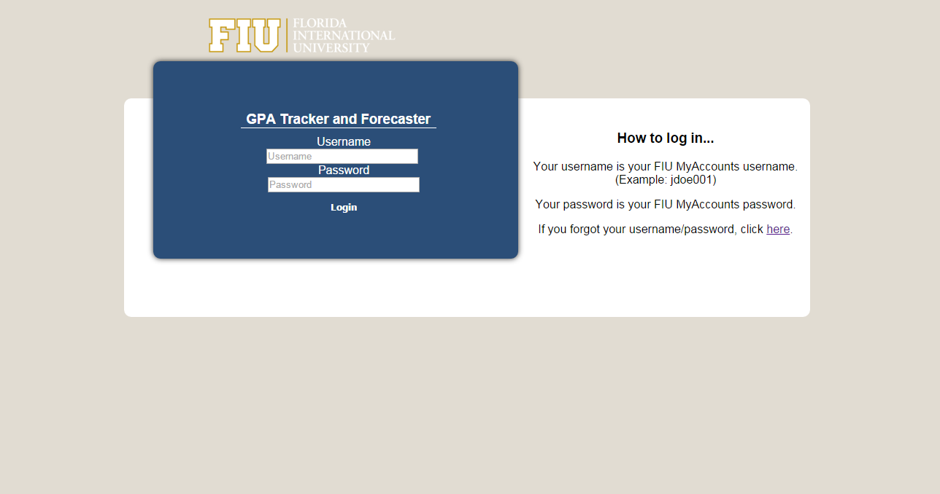
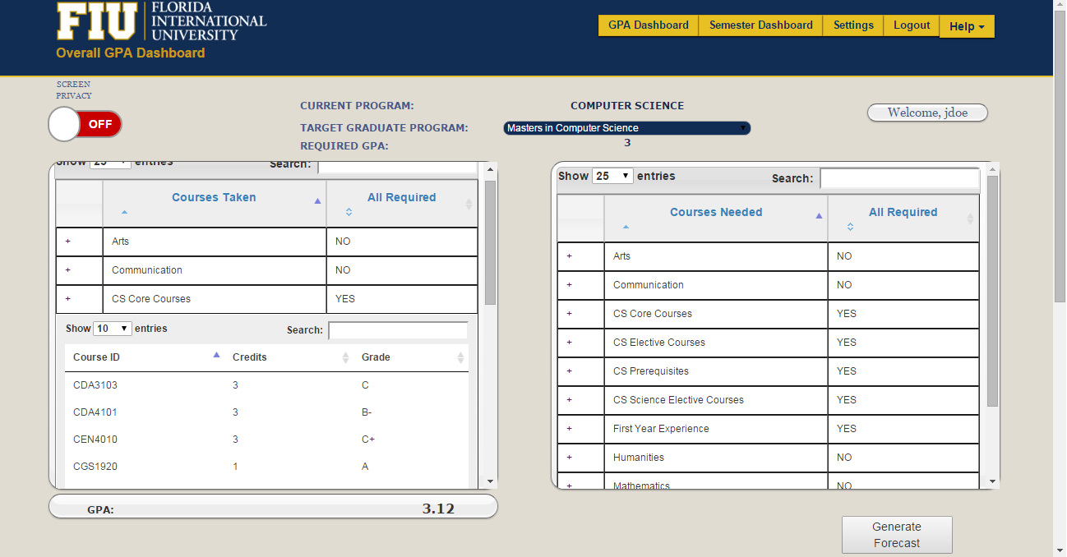
School of Computing & Information Sciences
Senior Project, 2015, Fall
FIU GPA Tracker and Forecaster
Student: Ike Ukachi-Lois, Florida International University
Mentor: Johann Henao, Florida International University
Instructor: Masoud Sadjadi, Florida International University
Problem
Current System
Requirements
With students aspiring to enter the masters program for their major, the failure to meet the required GPA needed to enter can be a huge let down. The solution necessary is to efficiently help students keep track of their GPA and know what GPA they need to maintain throughout their undergraduate career.
However, this can be a huge burden for students especially if they are unsure of how GPA is actually calculated.
Currently, no system exists, that will do what the FIU GPA Tracker and Forecaster does. Instead, students must resort to manually calculating the GPA they will need in order to reach a specified goal which includes counting the number of courses and credits left to graduate.
With this new system in place, a student will be able to become interactive with their grades and have the ability to view their progress in one centralized location.
FIU GPA Tracker and Forecaster will allow the following:
Import of a current transcript via Panthersoft’s GPA Audit PDF, to allow for automatic population of the data tables that display the students information.
Monitor current academic progress in relation to a goal GPA through a forecast generated by a users weight and relevance which determines the difficulty of a course.
- Administrative powers to edit minor discrepancies with the students data.
System Design
Object Design
Implementation
For Implementation, we mainly utilized JavaScript, JQuery and HTML to implement the front end of the website.
Whereas, when it came to the server side, we decided to utilize PHP to communicate with the database in order to retrieve data.
In addition, the android application that uses web services to communicate with the development server, was written in Java (hosted by Apache Tomcat).
Verification
Screenshots
Summary
Below are two test cases in which the adding of a course and the removal of courses were tested.
The FIU GPA Tracker and Forecaster, can ultimately lead students to success by giving them a tailor made program that guides them on their academic journey here at FIU.
The student will have the benefit of seeing how well they are doing in comparison to the GPA required for their target graduate program.
Test Case Id | addCourse 01
Purpose | -Test if addCourse method inputs the user’s record correctly
Test Setup | -Run sql query to remove courses from the database
Input | - coursed = “COP2210” -userID= “2” –(corresponds to user “mdoe”)
Expected Output | Database record in table StudentCourse with the course corresponding to the user.
Test Case Id | deleteCourse 01
Purpose | -Test if deleteCourse does change a course to have a grade of ‘ND’ (needed)
Test Setup | Run sql query to insert courses into the database with every possible grade(A-F) as well as ‘IP’
Input | - courseID = “COP2210”, “MAC2312”, “PHY2048”…etc. -userID= “2” –(corresponds to user “mdoe”)
Expected Output | Database records in table StudentCourse with the grade of ‘ND’ assigned to all courses corresponding to the specified user.
Acknowledgement
The material presented in this poster is based upon the work supported by Johann Henao I am thankful to the help that I received from my project partner, Juan Machado.

