Slide 1


Slide 2


Desarrollo Web
Con HTML y CSS

Slide 3
Agenda
Revisión de la asignación
Conceptos clave.
CSS Box Model
Intro a Flexbox
Asignación.

Slide 4
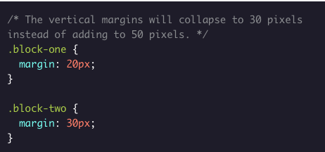
Margin Collapse:
CSS margin collapse occurs when the top and bottom margins of blocks are combined into a single margin equal to the largest individual block margin.
Margin collapse only occurs with vertical margins, not for horizontal margins.
Conceptos clave

Slide 5
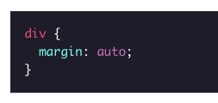
CSS auto keyword
The value auto can be used with the property margin to horizontally center an element within its container. The margin property will take the width of the element and will split the rest of the space equally between the left and right margins.
Conceptos clave

Slide 6
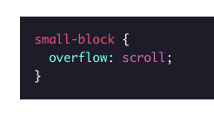
Overflow
If content is too large for its container, the CSS overflow property will determine how the browser handles the problem.
By default, it will be set to visible and the content will take up extra space. It can also be set to hidden, or to scroll, which will make the overflowing content accessible via scroll bars within the original container.
Conceptos clave

Slide 7
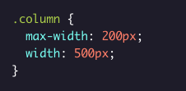
Height and Width Maximums/Minimums
The CSS min-width and min-height properties can be used to set a minimum width and minimum height of an element’s box. CSS max-width and max-height properties can be used to set maximum widths and heights for element boxes.
Conceptos clave

Slide 8
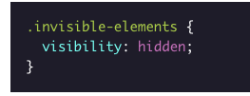
The visibility Property
The CSS visibility property is used to render hidden objects invisible to the user, without removing them from the page. This ensures that the page structure and organization remain unchanged.
Conceptos clave

Slide 9
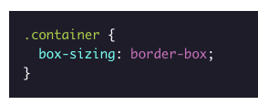
Box-sizing property
The CSS box model is a box that wraps around an HTML element and controls the design and layout. The property box-sizing controls which aspect of the box is determined by the height and width properties. The default value of this property is content-box, which renders the actual size of the element including the content box; but not the paddings and borders. The value border-box, on the other hand, renders the actual size of an element including the content box, paddings, and borders.
Conceptos clave

Slide 10
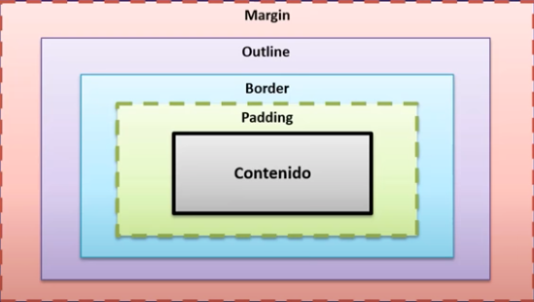
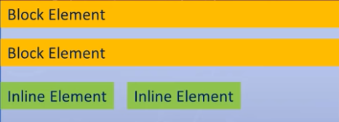
Box Model
El modelo de cajas o "box model" es seguramente la característica más importante del lenguaje de hojas de estilos CSS, ya que condiciona el diseño de todas las páginas web. El modelo de cajas es el comportamiento de CSS que hace que todos los elementos de las páginas se representen mediante cajas rectangulares.
En la web todo son cajas.
La forma en la cual el navegador renderiza esas cajas se denomina layout.
Propiedades principales (width, height)
Hay dos tipos de elementos en html (in line – block)
Inline: Solo ocupan su contenido, no cambia ni ancho ni alto
Bloque: Ocupan el ancho disponible, se les asigna ancho y alto.

