Slide 1

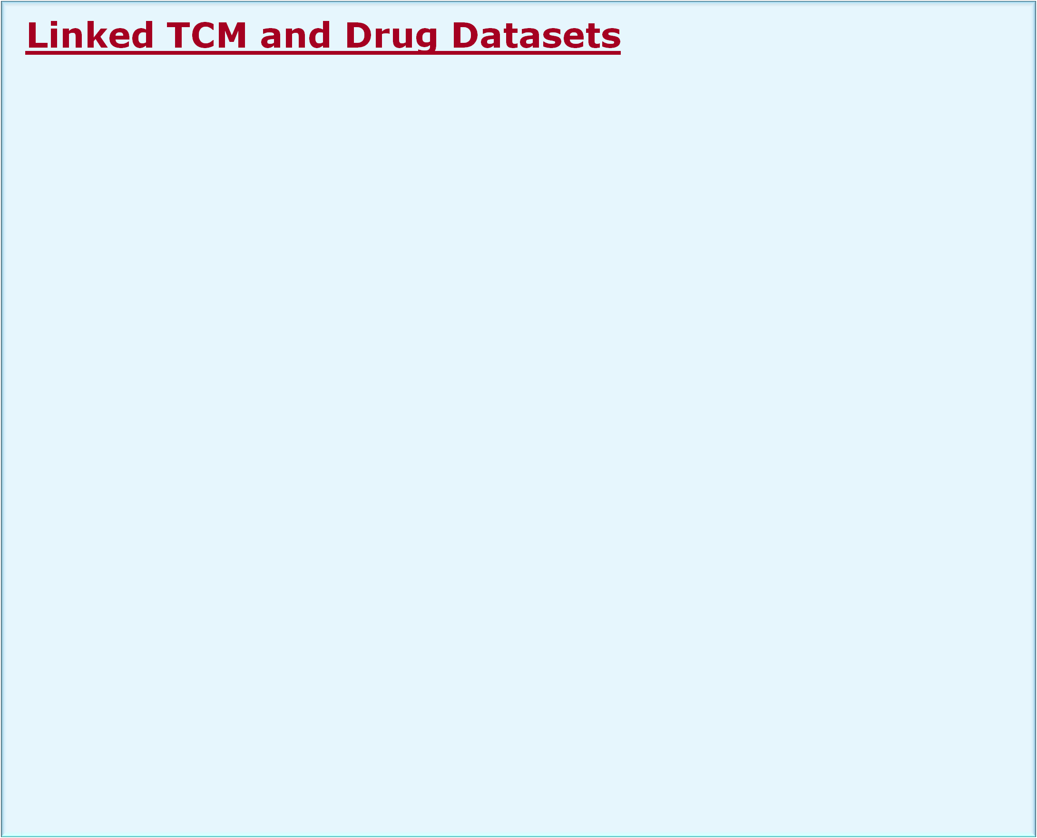

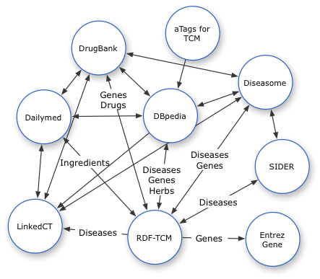
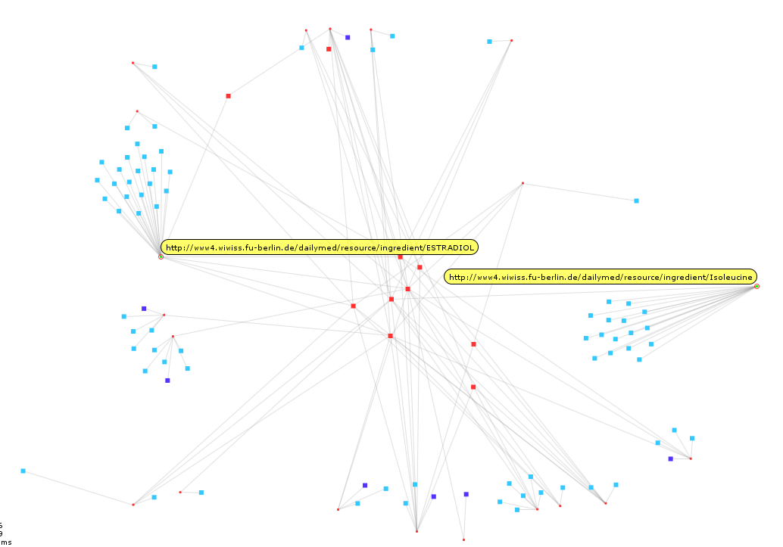

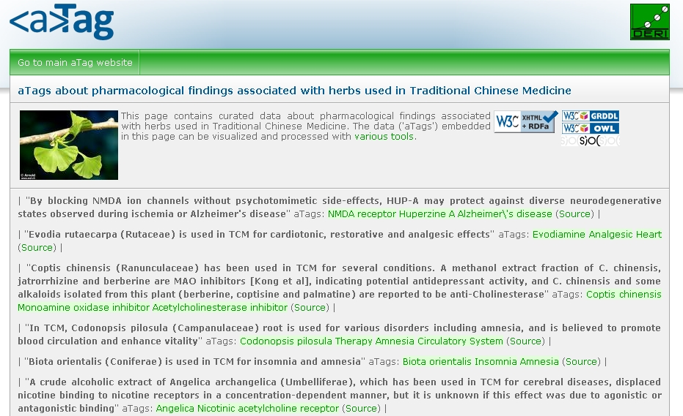

Linked Data for Connecting Traditional Chinese Medicine and Western Medicine
Author names
Author emails
Author Addresses
Background (TODO)‏
  Traditional Chinese Medicine (TCM), which is a type of alternative medicine, is receiving growing attention from patients and biomedical researchers in the western world. In spite of this growing attention, TCM has not been included as part of standard care in many western countries mainly due to a lack of scientific evidence for its efficacy and safety.
  In addition, many of the documentations about TCM are not available in English, creating a language barrier to patients, scientists, and physicians in the West.
  We re-formatted the TCMGeneDIT database in the RDF format (as Linked Open Data), making it programmatically accessible through a flexible query language (SPARQL) and a flexible Web service (SPARQL endpoint).
  This work represents collaboration between the BioRDF task force and the LODD (Linked Open Drug Data) task force of the Semantic Web for Health Care and Life Sciences Interest Group chartered by the World Wide Web Consortium (W3C).
  We demonstrate how Linked Data can be used to connect TCM and western medicine
  We also tested and evaluated a novel approach of creating links between RDF datasets in a large scale.
Entity | Data Source | Count
Gene | RDF-TCM | 945
 | Diseasome | 3919
 | Drugbank | 4553
Medicine/Drug | RDF-TCM | 848
 | Drugbank | 4772
 | Dailymed | 4308
 | SIDER | 924
Ingredient | RDF-TCM | 1064
 | Dailymed | 1240
Disease | RDF-TCM | 553
 | Diseasome | 4213
Effect | RDF-TCM | 241
SideEffect | SIDER | 1738
ClinicalTrial | LinkedCT | 61,920
For patients
Search for clinical trials of a given herb (clinicaltrial.gov)
Find out side-effect information about a given herb
For researchers
Confirm target genes
  Find target genes of a herb for a given disease, as reported by alternative medicine researchers
  Find diseases associated with these target genes, as reported by western medical researchers
Drug discovery
  Search for the chemical compounds of the herb ingredients
  Search for target proteins of these compounds
  Identify interesting proteins from this network of proteins
Table1.
Entity | Data Source | Count | %
Disease | DBPedia | 255 | 46.1
 | SIDER | 171 | 30.9
 | Diseasome | 63 | 11.4
Medicine | DBPedia | 438 | 51.6
 | Drugbank | 1 | 0.12
Gene | EntrezGene | 944 | 99.9
 | DBPedia | 649 | 68.7
 | Drugbank | 384 | 40.6
 | Diseasome | 313 | 33.1
Ingredient | Dailymed | 21 | 1.97
The interlinking data cloud of RDF-TCM and LODD datasets. Table 1 summaries the number of triples of key entities in each dataset. Table 2 summaries the number of links to RDF-TCM for different types of entities, and the percentage of each type of RDF-TCM entities being linked to another dataset.
All 10 herbs are with possible side effects
65% ingredients with no reported side effects
Table 2.
Creation of Data Interlink
Silk: discovers RDF links between data sources [1]
- Provides a declarative language for specifying the link types as well as the conditions entities must fulfill in order to be interlinked
Link conditions may be based on various similarity metrics
- Implemented similarity metrics include string, numeric, data, URI, and set comparison methods as well as a taxonomic matcher that calculates the semantic distance between two concepts within a concept hierarchy
- Each metric evaluates to a similarity value between 0 or 1 (higher values indicating a greater similarity)
Representation of Data Interlink
Two levels:
* For each pair of interlinked data item
* For the whole set of data links
Ingredient | # of side effects
Progesterone | 100
Testosterone | 100
Adenosine | 57
Mannitol | 40
Folic_acid | 22
Lactulose | 11
Acetic_Acid | 4
Alzheimer’s herbs with side effects. Red: Alzheimer’s herbs. Blue: drugs with no side effects reported. Purple: drugswith reported side effects.
aTags are a simple convention for formulating statements on the Semantic Web.
Several tools for creating and searching aTags exist.
Statements formulated with aTags are interlinked with the large cloud of linked data that is already available on the web.
Discussions about the creation of interlinks
Cost and gain of different interlink creation rules
Indirect and redundant interlinks
An example of an aTag in Turtle syntax:
<http://hcls.deri.org/atag-data/pastebin.html#49ddfee65f7f4> a sioc:Item ;
sioc:content "Ginkgolide B from G. biloba is a platelet-activating factor (PAF) antagonist";
sioc:topic <http://dbpedia.org/resource/Ginkgolide> ,
<http://dbpedia.org/resource/Platelet-activating_factor>,
<http://dbpedia.org/resource/Receptor_antagonist> ,
rdfs:seeAlso <http://example.org/document1.html> .
Future work
Acknowledgement
Ref: Volz, J,. Bizer, C,. Gaedke, M,. and Kobilarov, G. Silk – A Link Discovery Framework for the Web of Data, LDOW 2009, Madrid, Spain

