Slide 1
Linked Data for Connecting Traditional Chinese Medicine and Western Medicine
Jun Zhao, University of Oxford
Anja Jentzsch, Freie Universität Berlin
Matthias Samwald, DERI
Kei-Hoi Cheung, Yale University

Slide 2
Background
Connect the knowledge about alternative medicine and western drugs
Demonstrate the value of Linked Data
Demonstrate a novel technique for creating interlinks between datasets on a large scale
A joint effort of the BioRDF and LODD (Linked Open Drug Data) task forces of the World Wide Web Consortium (W3C) Health Care Life Science Interest Group

Slide 3
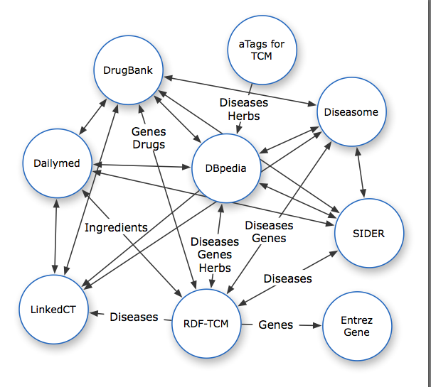

Slide 4
Demo
Search for herbs associated with a particular disease ...

Slide 5
Demo
Search for additional aTags of a given herb
http://hcls.deri.org/atag/data/tcm_atags.html

Slide 6
Demo
Identify side-effects of alternative medicine
Notes:
All 10 herbs may produce side effects
65% ingredients with no reported side effects

Slide 7
http://esw.w3.org/topic/HCLSIG/AlternativeMedicineUseCase/

Slide 8
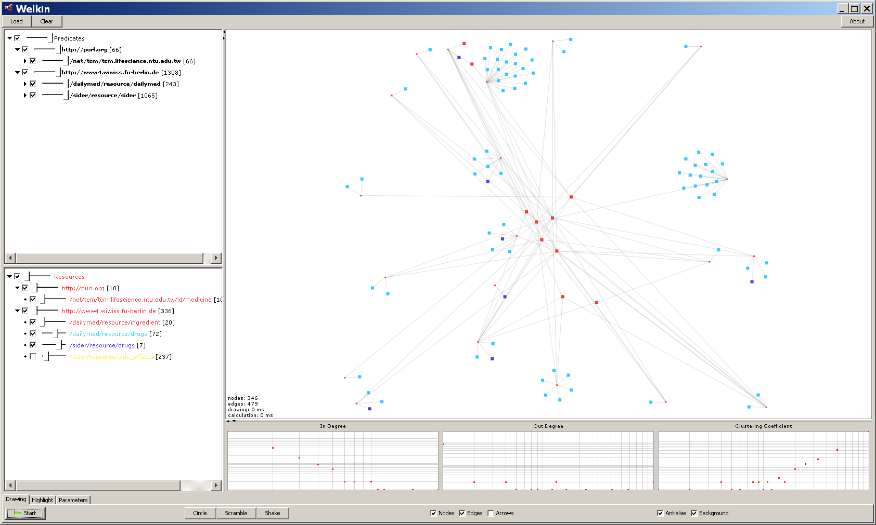
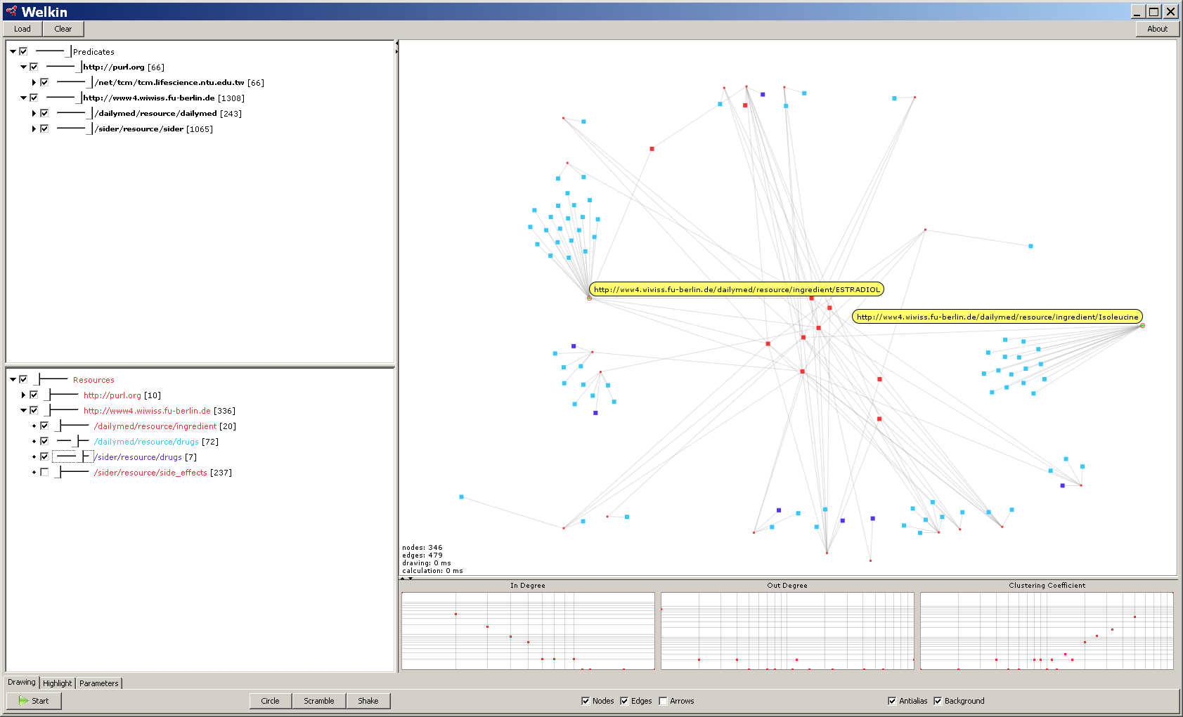
Notes:
Alzheimer’s herbs with side effects. Red: Alzheimer’s herbs. Blue: drugs with no side effects reported. Purple: drugswith reported side effects.
<number><number>

Slide 9
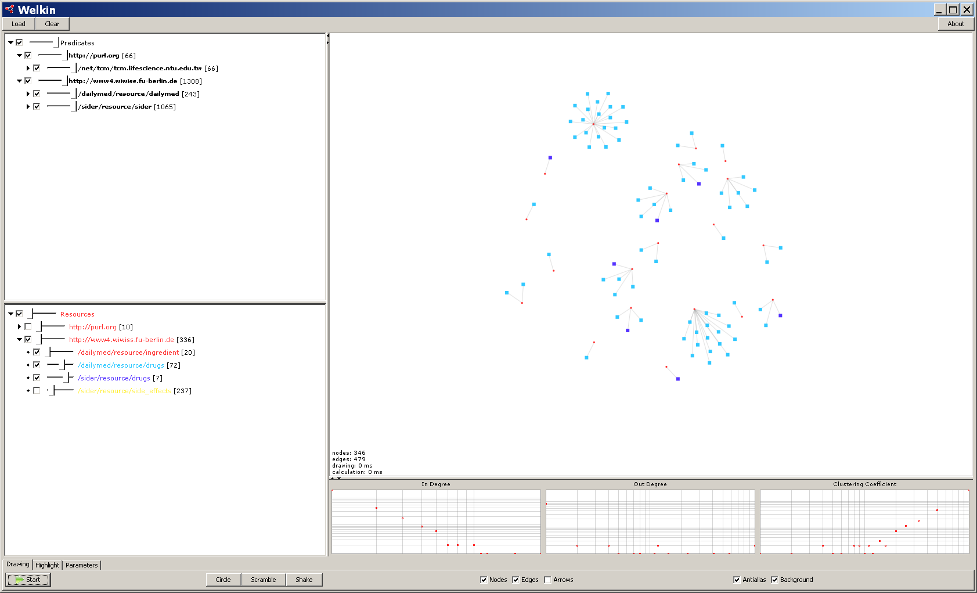
Notes:
Side effects of ingredients of herbs associated with the Alzheimer’s Disease
<number><number>

Slide 10
Notes:
To be able to manipulate the datasets in different ways.
We need to figure out how side effects are collected. If there are more information about these side effects, if they are common, we might not need to ignore them. Boss will go and have a look.
<number><number>

