Slide 1


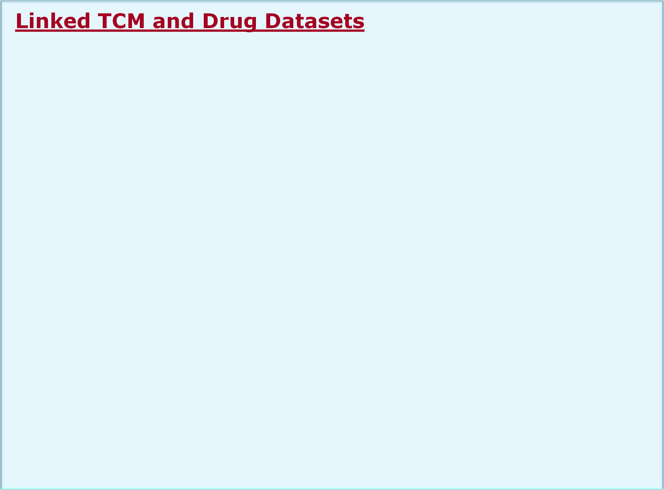

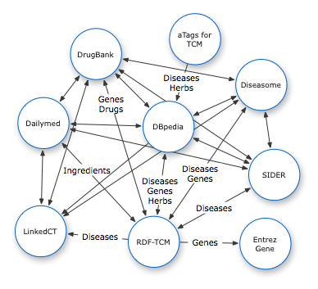

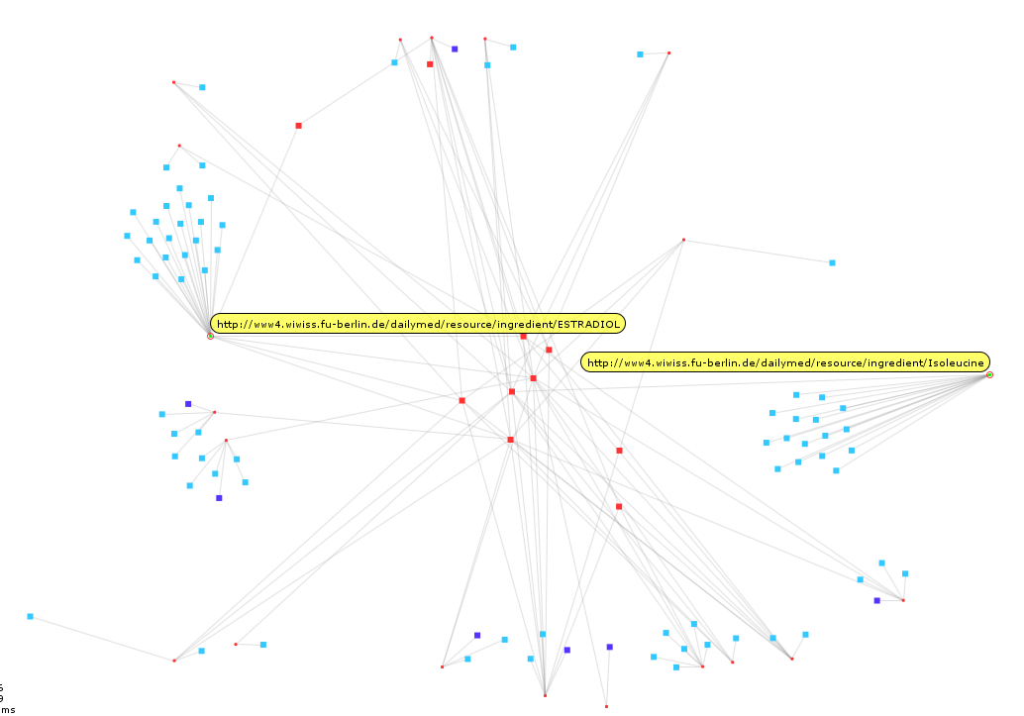


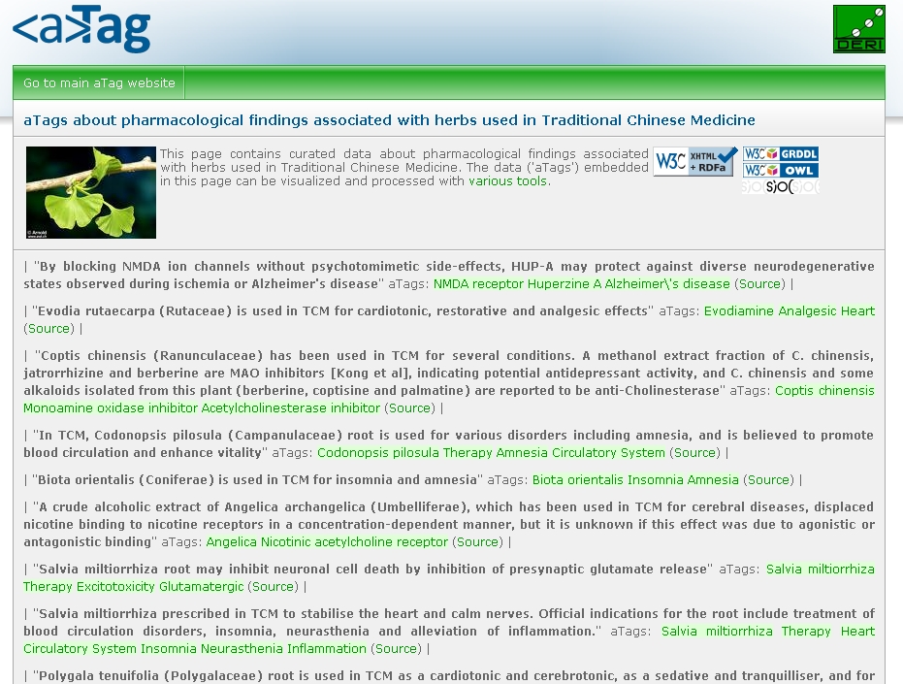



Linked Data for Connecting Traditional Chinese Medicine and Western Medicine
Jun Zhao¹, Anja Jentzsch², Matthias Samwald³ and Kei-Hoi Cheung⁴
¹Department of Zoology, University of Oxford, Oxford, UK (jun.zhao@zoo.ox.ac.uk)
²Web-based Systems Group, Freie Universität Berlin, Berlin, Germany (mail@anjajentzsch.de)
³Digital Enterprise Research Institute, National University of Ireland Galway, Galway, Ireland //
Konrad Lorenz Institute for Evolution and Cognition Research, Altenberg, Austria (samwald@gmx.at)
⁴Center for Medical Informatics, Yale University School of Medicine, New Haven, Connecticut, USA (kei.cheung@yale.edu)
Background
  Traditional Chinese Medicine (TCM), which is a type of alternative medicine, is receiving growing attention from patients and biomedical researchers in the western world.
  In spite of this growing attention, TCM has not been included as part of standard care in many western countries mainly due to a lack of scientific evidence for its efficacy and safety.
  In addition, many of the documentations about TCM are not available in English, creating a language barrier to patients, scientists, and physicians in the West.
  We re-formatted the TCMGeneDIT database (http://tcm.lifescience.ntu.edu.tw/) in the RDF format (as Linked Open Data), making it programmatically accessible through a flexible query language (SPARQL) and a flexible Web service (SPARQL endpoint).
  This work represents collaboration between the BioRDF task force and the LODD (Linked Open Drug Data) task force of the Semantic Web for Health Care and Life Sciences Interest Group chartered by the World Wide Web Consortium (W3C).
  We demonstrate how Linked Data can be used to connect TCM and western medicine .
  We describe a novel approach of creating links between RDF datasets in a large scale.
  More information can be found at: http://esw.w3.org/topic/HCLSIG/AlternativeMedicineUseCase/
Entity | Data Source | Count
Gene | RDF-TCM | 945
 | Diseasome | 3919
 | Drugbank | 4553
Medicine/Drug | RDF-TCM | 848
 | Drugbank | 4772
 | Dailymed | 4308
 | SIDER | 924
Ingredient | RDF-TCM | 1064
 | Dailymed | 1240
Disease | RDF-TCM | 553
 | Diseasome | 4213
Effect | RDF-TCM | 241
SideEffect | SIDER | 1738
ClinicalTrial | LinkedCT | 61,920
Application Use Cases
For patients
Search for clinical trials of a given herb (clinicaltrial.gov)
Find out side-effect information about a given herb
For researchers
Confirm target genes
  Find target genes of a herb for a given disease, as reported by alternative medicine researchers
  Find diseases associated with these target genes, as reported by western medical researchers
Drug discovery
  Search for the chemical compounds of the herb ingredients
  Search for target proteins of these compounds
  Identify interesting proteins from this network of proteins
Table1.
Entity | Data Source | Count | %
Disease | DBPedia | 255 | 46.1
 | SIDER | 171 | 30.9
 | Diseasome | 63 | 11.4
Medicine | DBPedia | 438 | 51.6
 | Drugbank | 1 | 0.12
Gene | EntrezGene | 944 | 99.9
 | DBPedia | 649 | 68.7
 | Drugbank | 384 | 40.6
 | Diseasome | 313 | 33.1
Ingredient | Dailymed | 21 | 1.97
The interlinking data cloud of RDF-TCM and LODD datasets. Table 1 summaries the number of triples of key entities in each dataset. Table 2 summaries the number of links to RDF-TCM for different types of entities, and the percentage of each type of RDF-TCM entities being linked to another dataset.
All 10 herbs may produce side effects
65% ingredients with no reported side effects
Table 2.
Creation of Data Interlinks
Silk: discovers RDF links between data sources [1]
Provides a declarative language for specifying the link types and conditions
Implemented similarity metrics include string, numeric, data, URI, and set comparison methods as well as a taxonomic matcher that calculates the semantic distance between two concepts within a concept hierarchy
Each metric evaluates to a similarity value between 0 or 1 (higher values indicating a greater similarity)
Customized SPARQL queries for mapping genes names
Firstly, search for mapping Entrez genes from SPARQL endpoint [http://hcls.deri.org/sparql] using exact gene name mapping as filters
Manually correct many to one gene mappings using Entrez and TCM database web pages
Ingredient | # of side effects
Progesterone | 100
Testosterone | 100
Adenosine | 57
Mannitol | 40
Folic_acid | 22
Lactulose | 11
Acetic_Acid | 4
Alzheimer’s herbs with side effects. Alzheimer’s herbs. drugs with no side effects reported. drugs with reported side effects.
aTags
A simple convention for formulating statements on the Semantic Web.
Statements formulated with aTags are interlinked with the large cloud of linked data that is already available on the web.
Statements are manually generated and extracted from literature
Representation of Data Interlinks
<http://purl.org/net/tcm/id/linkset/3> rdf:type void:Linkset ;
void:target <http://lod.openlinksw.com/sparql> ;
void:target <http://hcls.deri.org:8080/sparql> ;
void:linkPredicate owl:sameAs .
<http://purl.org/net/tcm/id/linkage_run/3>
oddlinker:linkage_date "2009-05-27"^^xsd:date ;
oddlinker:linkage_method :silk ;
rdf:typeoddlinker:linkage_run .
<http://purl.org/net/tcm/id/interlink/966>
oddlinker:link_source dbpedia:Retinal_detachment ;
oddlinker:link_target tcm;Retinal_Detachment ;
oddlinker:linkage_score 1 ;
oddlinker:link_type owl:sameAs ;
oddlinker:linkage_run <http://purl.org/net/tcm/id/linkage_run/3> ;
dcterms:isPartOf <http://purl.org/net/tcm/id/linkset/3> ;
rdf:type oddlinker:interlink .
For the set of links created for any two datasets:
  voiD:LinkSet [2]
  oddlinker:linkage_run [3]
For each link:
  oddlinker:interlink [3]
An example of an aTag in Turtle syntax:
<http://hcls.deri.org/atag-data/pastebin.html#49ddfee65f7f4> a sioc:Item ;
sioc:content "Ginkgolide B from G. biloba is a platelet-activating factor (PAF) antagonist";
sioc:topic <http://dbpedia.org/resource/Ginkgolide> ,
<http://dbpedia.org/resource/Platelet-activating_factor>,
<http://dbpedia.org/resource/Receptor_antagonist> ,
rdfs:seeAlso <http://example.org/document1.html> .
Future work
Incorporate additional data sources, e.g., herbal and/or TCM related sources as well as genomic/clinical/drug data sources
Explore multi-lingual interlinking
Develop new use cases and user-facing applications
Automatic notification on interlink updates between datasets
[1] Julius Volz, Christian Bizer, Martin Gaedke, and Geogi Kobilarov. Silk – A Link Discovery Framework for the Web of Data. LDOW’09, Madrid, 2009
[2] Keith Alexander, Richard Cyganiak , Michael Hausenblas, and Jun Zhao, voiD- Vocabulary of Interlinked Datasets. http://rdfs.org/ns/void
[3] Oktie Hassanzadeh and Mariano Consens, Linked Movie Data Base, LDOW’09 Madrid, 2009

