Slide 1
EGFR-Mediated Reactivation of MAPK Signaling Contributes to Insensitivity of BRAF-Mutant Colorectal Cancers to RAF Inhibition with Vemurafenib
Ryan B. Corcoran, Hiromichi Ebi, Alexa B. Turke, Erin M. Coffee, Michiya Nishino, Alexandria P. Cogdill1, Ronald D. Brown, Patricia Della Pelle, Dora Dias-Santagata, Kenneth E. Hung, Keith T. Flaherty, Adriano Piris, Jennifer A. Wargo, Jeffrey Settleman, Mari Mino-Kenudson and Jeffrey A. Engelman
Massachusetts General Hospital
Harvard Medical School
Genentech
Cancer Discovery
March 2012
2:227-235

Slide 2
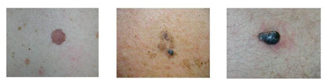
Vemurafenib
132,000 new cases of melanoma per year in US
9,500 deaths
Relapse rates are relatively high for late-stage disease
89% for stage IIIC
68% for stage IIIB
37% for stage IIIA
Stage IV has median survival of 9 months from diagnosis
What causes metastatic melanoma?
~50% of tumor have a mutation in BRAF
~80% of those mutations are V600E
16% are V600K and 3% are V600R
these mutations seem to arise early – often found in benign nevi
The same BRAF mutations are also found in other tumor types

Slide 3
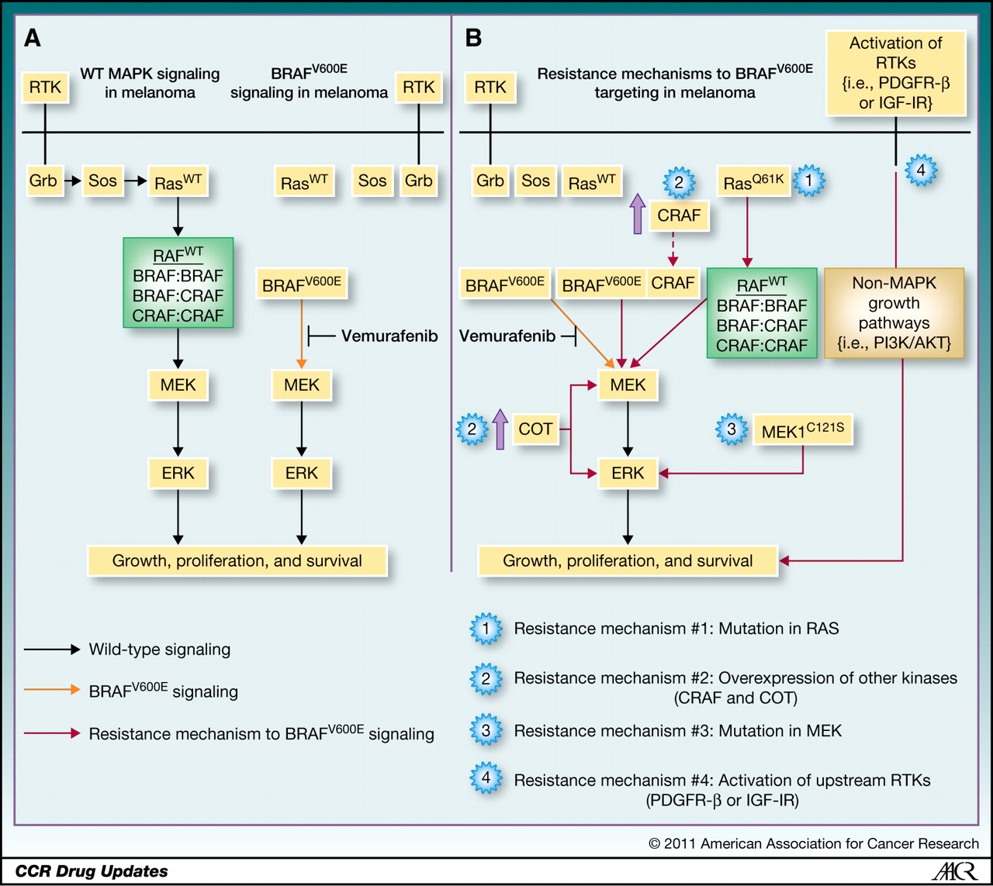
Vemurafenib

Slide 4
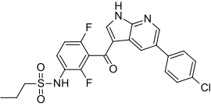
Vemurafenib
BRAF inhibtor developed by Plexicon
and later Genentech
PLX4032 or Vemurafenib (V600E mutant Raf inhibitor)
Works well in vitro and in lab animals
Human trails begun 2008. Enrolled only patients with BRAF^{V600E}
Phase I: 16 patients with stage IV cancers
Median survival increased 9 → 15 months
Phase II: 132 patients with stage IV cancers
53% of patients responded. Similar increase in survival
Phase III: 675 patients with stage III or IV cancers
compared vemurafenib to dacarbazine
Stopped early. Dacarbazine patients moved to vemurafenib
FDA approval August 2011

Slide 5
Vemurafenib
Not really a cure!
Increases progression-free survival
Increases relapse time
Increases overall survival
But nearly all patients eventually relapse
Furthermore, vemurafenib is largely ineffective in BRAF^{V600E} colorectal cancers
1 in 19 patients had a positive response
What’s the source of the vemurafenib-resistance in these tumor cells?

Slide 6
Vemurafenib

Slide 7
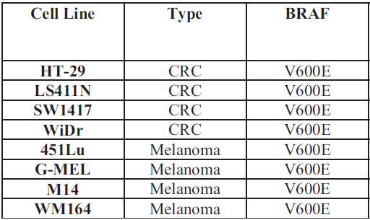
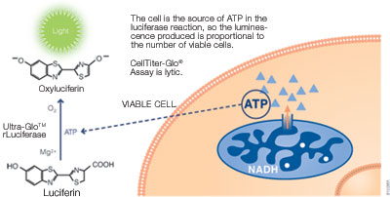
Vemurafenib Treatment of BRAF^{V600E} Colorectal Cancer Cells
Comparing melanoma and colorectal cancer cell lines
Measured living cells with Cell TiterGlo Assay
Table S1

Slide 8
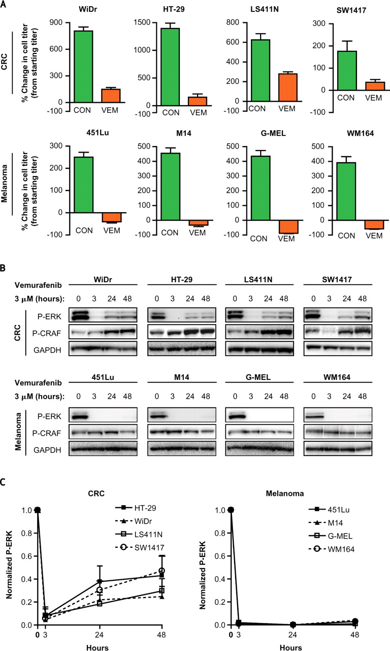
Vemurafenib Treatment of BRAF^{V600E} Colorectal Cancer Cells
Cultured for 3 days with or without 3 μM vemurafenib
Look at those y-axes! Don’t try this at home…
Fig. 1A

Slide 9
Vemurafenib Treatment of BRAF^{V600E} Colorectal Cancer Cells
Is vemurafenib shutting down the Raf/Mek/Erk pathway?
Drug treatment
Western blots for
phospho-Erk
Fig. 1BC

Slide 10
Vemurafenib Treatment of BRAF^{V600E} Colorectal Cancer Cells
Is vemurafenib shutting down the Raf/Mek/Erk pathway?
Colorectal tumor cells may be less sensitive to vemurafenib due to the inability to sustain Raf/Mek/Erk pathway inhibition
Fig. 1B

Slide 11
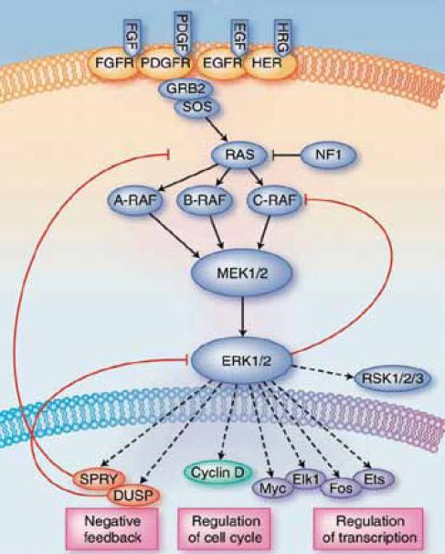
Vemurafenib Treatment of BRAF^{V600E} Colorectal Cancer Cells
Why might blocking BRaf lead
to higher activity of CRaf?
Several known feedback loops,
including the Sprouty proteins

Slide 12
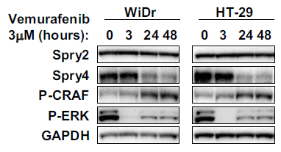
Vemurafenib Treatment of BRAF^{V600E} Colorectal Cancer Cells
Loss of Sprouty-4 may explain the loss of feedback inhibition in colorectal cells
Fig. S9

Slide 13
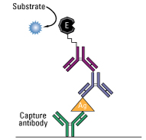
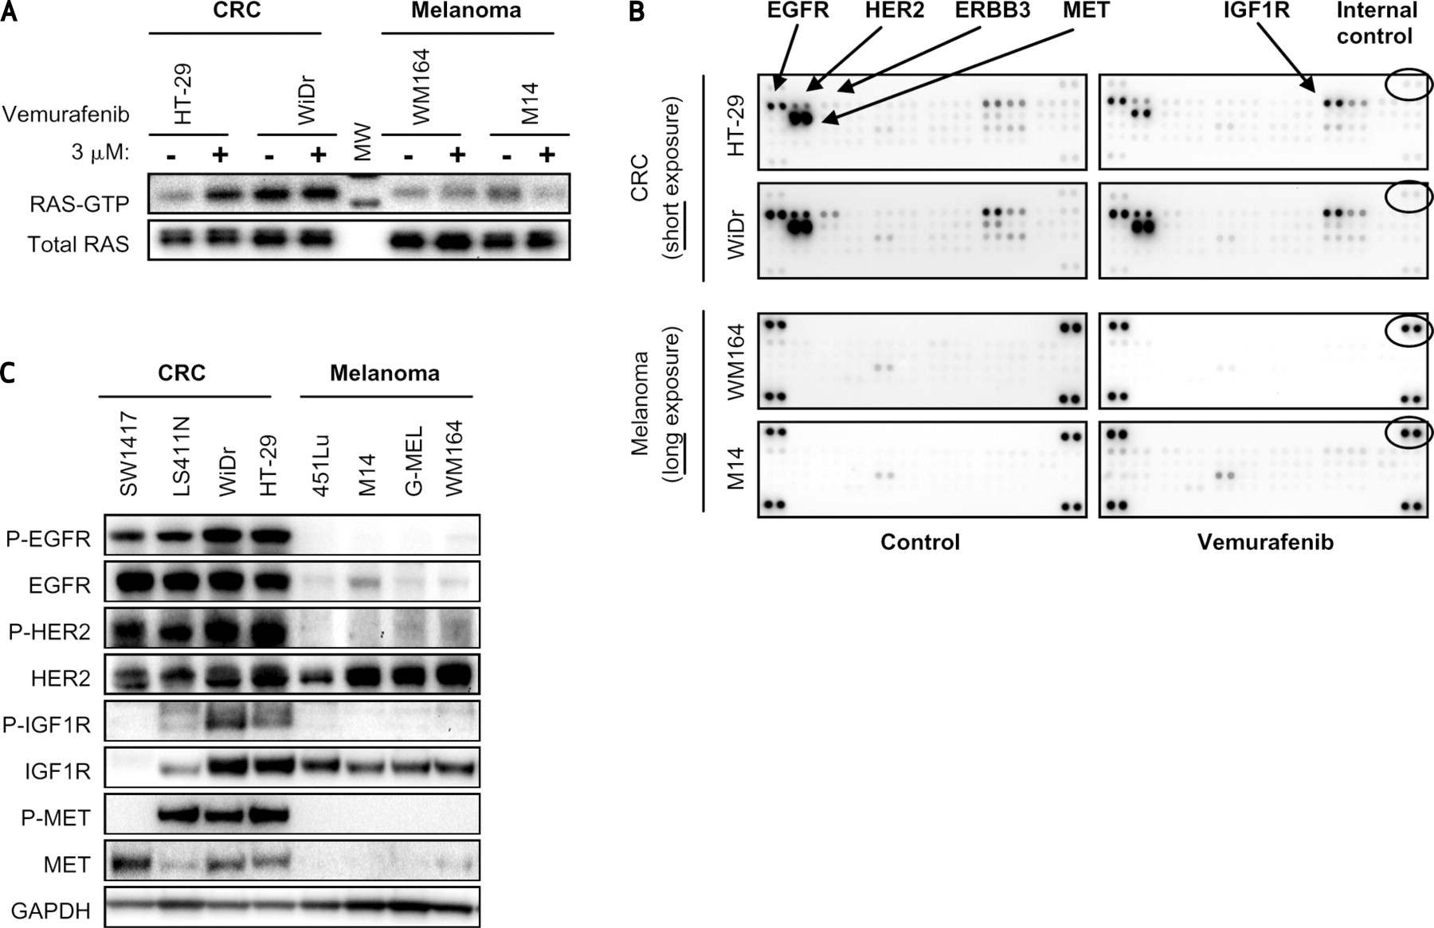
Vemurafenib Treatment of BRAF^{V600E} Colorectal Cancer Cells
Does Vemurafenib lead to more active Ras?
Measure Ras-GTP complex purified by binding to Raf
(similar to Kapoor et al.)
Ras
Raf
Fig. 2A

Slide 14
Vemurafenib Treatment of BRAF^{V600E} Colorectal Cancer Cells
Why is Ras more activated? Due to Receptor Tyrosine Kinase activation?
Phospho-RTK array
49 different anti-RTK antibodies spotted on membrane, in duplicate
add cell lysate, incubate & wash
add anti-phospho-tyrosine antibody and detect like a western blot
control
vemurafenib
Fig. 2B

Slide 15
Vemurafenib Treatment of BRAF^{V600E} Colorectal Cancer Cells
Why is Ras more activated? Due to Receptor Tyrosine Kinase activation?
1. phospho-RTK
levels are lower
in melanoma
cells.
2. Vemurafenib
does not induce
phospho-RTK,
except IGF1R.
Fig. 2B

Slide 16
Vemurafenib Treatment of BRAF^{V600E} Colorectal Cancer Cells
RTK and phospho-RTK levels
are higher in colorectal tumor cells compared to melanoma cells.
Fig. 2C

Slide 17
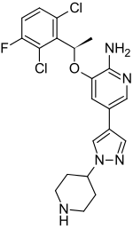
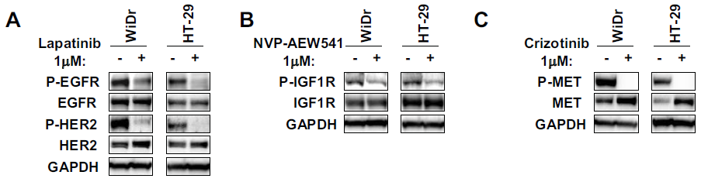
Inhibiting BRAF and RTKs
Which RTK leads to increased Ras activation?
Disable RTKs with various drugs.
Lapatinib inhibits EGFR and HER2
NVP-AEW541 inhibits IGF1R
Crizotinib inhibits Met
Fig. S2ABC

Slide 18

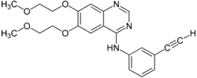
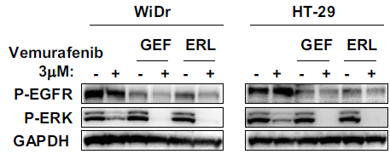
Inhibiting BRAF and RTKs
Which RTK leads to increased Ras activation?
Disable RTKs with various drugs.
Gefitinib and erlotinib inhibit EGFR only (and not HER2)
Fig. S2D

Slide 19
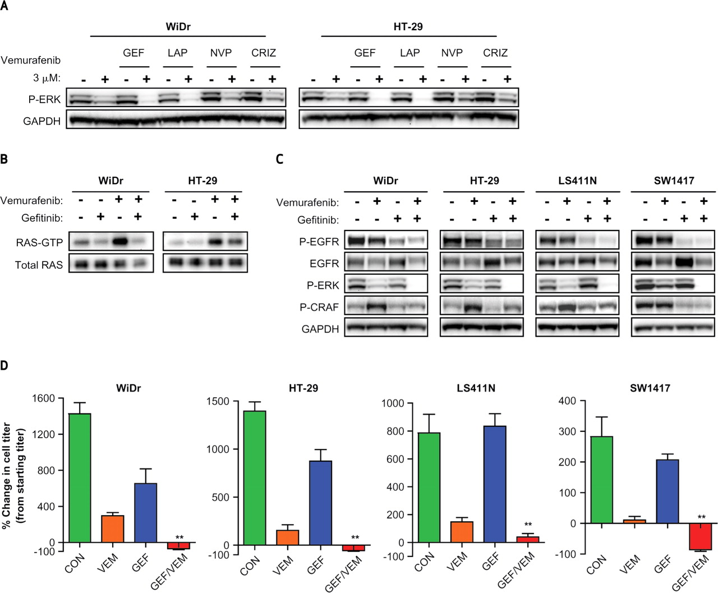
Inhibiting BRAF and RTKs
Which RTK is important for pathway re-activation?
Cell lines treated for 24 hours.
Disable RTKs with drugs, one at a time.
Lapatinib inhibits EGFR and HER2
NVP-AEW541 inhibits IGF1R
Crizotinib inhibits Met
Gefitinib inhibits EGFR only
Fig. 3A

Slide 20
Inhibiting BRAF and RTKs
Does this observation also extend to the activation state of Ras?
Gefitinib blocks the activation of Ras
that is caused by vemurafenib
Fig. 2A, 3B

Slide 21
Inhibiting BRAF and RTKs
Does this observation also extend to the phosphorylation of CRaf?
Gefitinib blocks the activation of Craf that is caused by vemurafenib
Fig. 1B, 3C

Slide 22
Inhibiting BRAF and RTKs
Does this observation also extend to the total proliferation?
Gefitinib and vemurafenib show a synergistic effect on colorectal tumor cells
Fig. 1A, 3D

Slide 23
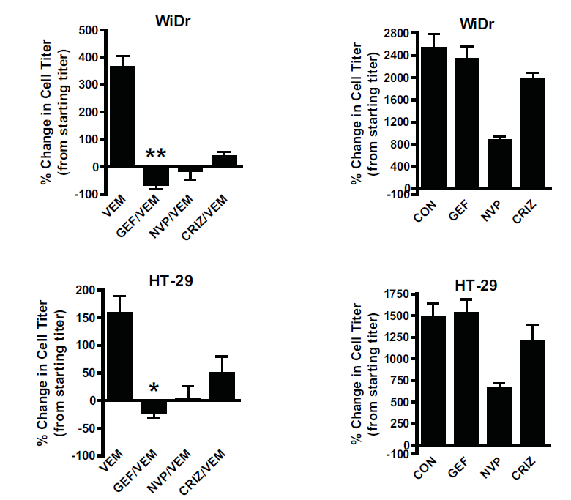
Inhibiting BRAF and RTKs
But would we see synergism with any two inhibitors?
“The decrease in cell viability achieved with combined vemurafenib and gefitinib was significantly greater than that achieved with vemurafenib in combination with other inhibitors …”
Fig. S4

Slide 24
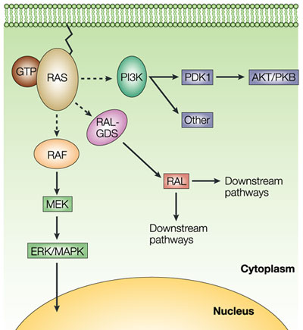
Inhibiting BRAF and RTKs
Of course, RTK → Ras activation affects more than just Raf!
Is there an effect on the PI3K/Akt pathway?

Slide 25
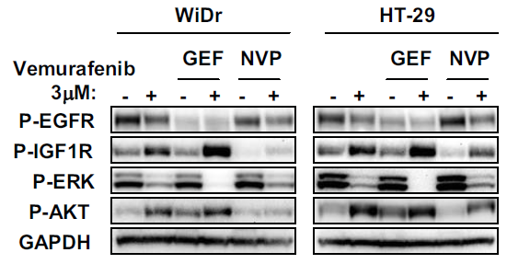
Inhibiting BRAF and RTKs
Vemurafenib treatment causes increased Akt activation in colorectal tumor cells.
This activation is not blocked by EGFR inhibition, but is blocked by IGF1R inhibtion
Gefitinib inhibits EGFR
NVP-AEW541 inhibits IGF1R
Fig. S5

Slide 26
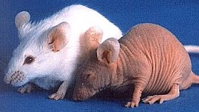
Combining drugs in vivo
Would this synergism still occur in an intact animal?
500,000 HT-29 or WiDr cells injected into an athymic (“nude”) mouse.
When tumor was between 100-200mm³, animals were placed in groups
Control
75 mg vemurafenib per kg of mass, twice daily
100 mg erlaotinib per kg of mass, daily
both
Follow tumor size for 3 weeks

Slide 27
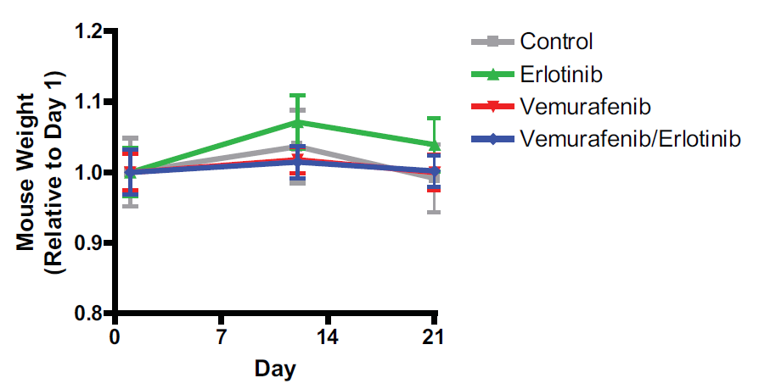
Combining drugs in vivo
Was the drug combination toxic?
Fig. S6

Slide 28
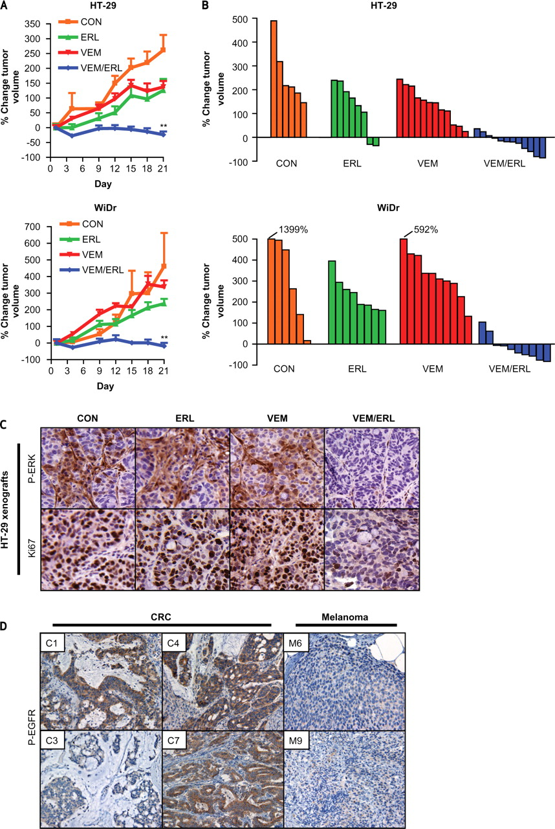
Combining drugs in vivo
Averaged Data
Individual Data
Fig. 4AB

Slide 29
Combining drugs in vivo
IHC staining of phospho-Erk and Ki67
Fig. 4D

Slide 30
Combining drugs in vivo
Curing cancer in mice is nice, but what about people!
Do BRAF^{V600E} tumors have activated EGFR?
10 colorectal tumors;
all had high P-EGFR.
6 were very high.
C3 is lowest;
C7 is highest.
2 of 11 melanomas
had similar levels
of P-EGFR
Fig. 4E

Slide 31
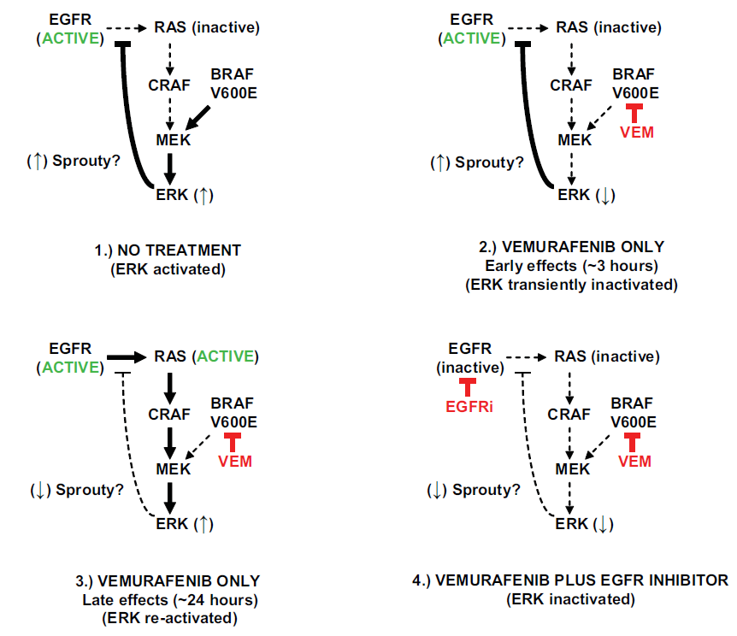
The Model

