Slide 1
Please note, these are the actual video-recorded proceedings from the live CME event and may include the use of trade names and other raw, unedited content. Select slides from the original presentation are omitted where Research To Practice was unable to obtain permission from the publication source and/or author. Links to view the actual reference materials have been provided for your use in place of any omitted slides.

Slide 2
RTP TV: Current Controversies and Emerging Data Sets in Melanoma and Nonmelanoma Skin Cancers
Thursday, April 11, 2013 7:30 PM – 8:45 PM ET
Notes:
2

Slide 3


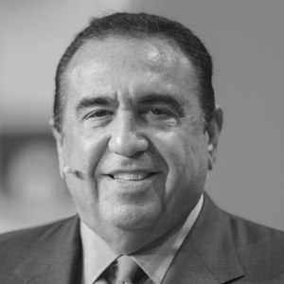
Keith T Flaherty, MD
Director, Henri and Belinda Termeer Center for Targeted Therapies
Massachusetts General Hospital Cancer Center
Associate Professor, Harvard Medical School
Director of Developmental Therapeutics
Boston, Massachusetts
Anna C Pavlick, MS, DO
Associate Professor of Medicine and Dermatology
Director, NYU Melanoma Program
Director, NYU Clinical Trials Office Assistant Director for Clinical Research and Education
New York University Langone Medical Center
New York, New York
Neil Love, MD Research To Practice Miami, Florida
Notes:
3

Slide 4

Agenda
Module 1: Melanoma
Sequencing of systemic treatments/management of toxicity
Immunotherapy – High-dose IL-2, ipilimumab
BRAF inhibition – Vemurafenib
Chemotherapy – Nab paclitaxel
Emerging agents/regimens and ongoing clinical trials
Novel BRAF inhibitor – Dabrafenib
MEK inhibitor – Trametinib
Immunotherapy – Nivolumab, talimogene laherparepvec
Notes:
4
4
4
4

Slide 5
Agenda (continued)
Module 2: Basal Cell Carcinoma (BCC)
Vismodegib for locally advanced or metastatic BCC
Neoadjuvant vismodegib for inoperable BCC
Ongoing clinical trials
Module 3: Cutaneous Squamous Cell Carcinoma (CSCC)
Incidence and death rates from CSCC
RAS mutant versus RAS wild type
Notes:
5
5
5
5

Slide 6
Case 1: From the Practice of Dr Keith Flaherty
A 63-year-old retired airline executive s/p wide excision for primary melanoma in 2007
Presents in 2010 with bulky lymphadenopathy in the groin
Workup reveals retroperitoneal nodal disease and liver mets from BRAF wild-type melanoma

Slide 7
In general, what is your most likely first- and second-line nonprotocol systemic treatment recommendation for a 63-year-old asymptomatic patient with low-volume lung metastases from BRAF wild-type melanoma (assuming slow progression on first-line therapy)?
HD IL-2 → Ipilimumab
Ipilimumab → HD IL-2
HD IL-2 → Chemotherapy
Ipilimumab → Chemotherapy
Other

Slide 8
In general, what is your most likely first- and second-line nonprotocol systemic treatment recommendation for a 63-year-old asymptomatic patient with low-volume lung metastases from BRAF wild-type melanoma (assuming slow progression on first-line therapy)?
HD IL-2 → Ipilimumab
Ipilimumab → HD IL-2
HD IL-2 → Chemotherapy
Ipilimumab → Chemotherapy
Other

Slide 9
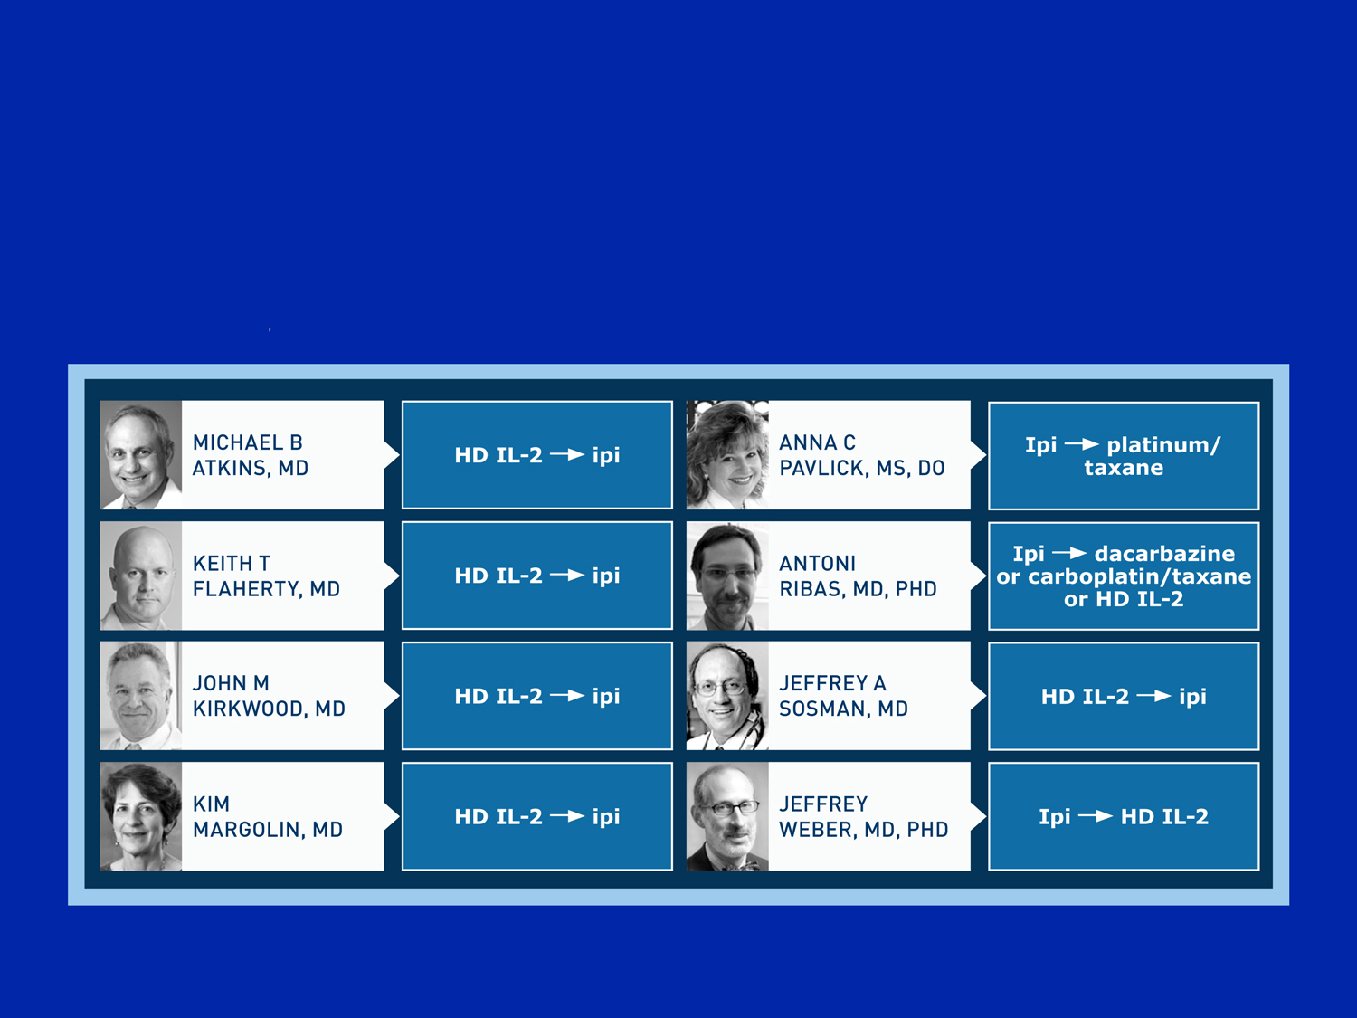
First- and second-line nonprotocol treatment recommendations for a 63 yo asymptomatic pt w/ low-volume lung mets from BRAF V600E wild-type melanoma (assuming slow progression on first-line therapy)?

Slide 10
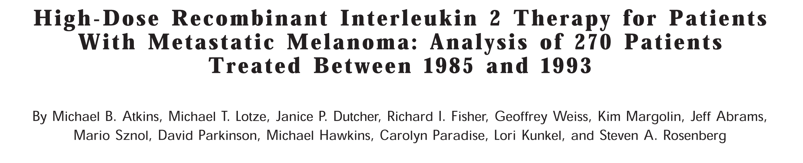

Slide 11
HD IL-2: Response Durations and Survival Based on Response
47% of responding pts alive (median F/U: 62 mo) Disease did not progress in any pt responding >30 mo
CR = 6%, median DoR not reached at 40 mo Range up to 106+ mo
PR = 10%, median DoR 5.9 mo Range up to 92+ mo
Atkins MB et al. J Clin Oncol 1999;17(7):2105-16.

Slide 12
High-Dose IL-2: Common ≥3 AEs
Cardiovascular
Hypotension
Gastrointestinal
Vomiting/diarrhea
Neurologic
Confusion
Pulmonary
Dyspnea
Renal
Oliguria
Hematologic
Thrombocytopenia
General
Fever/chills
Malaise
Toxicities generally reversed rapidly after therapy completion
2% of patients died from AEs, all related to sepsis
Atkins MB et al. J Clin Oncol 1999;17(7):2105-16.

Slide 13
Correlation of NRAS Mutations with Clinical Response to High Dose IL-2 in Patients with Advanced Melanoma
Joseph RW et al.
J Immunotherapy 2012;35(1):66-72.

Slide 14
Response to High-Dose IL-2 by Mutation Status
Retrospective review (N = 103) of patients who received high-dose IL-2
NRAS and BRAF wild type
CR/PR: 12%
NRAS mutation-positive
CR/PR: 47%
BRAF mutation-positive
CR/PR: 23%
Ongoing Confirmatory Clinical Trial
SELECT: A Prospective Tissue Collection Protocol to Investigate Predictive Models of Response to High-Dose IL-2 Treatments in Patients with Advanced Melanoma (NCT01288963)
Joseph RW et al. J Immunotherapy 2012;35(1):66-72.

Slide 15
Case 2: From the Practice of Dr Flaherty
A 58-year-old lawyer presents with hemoptysis, SOB
Workup reveals metastases to lung, mediastinal nodes from melanoma of unknown primary
BRAF wild type
Ipilimumab x 4
Pruritic rash, AST/ALT elevated ~2x ULN
Tumor regression 4+ months followed by stable disease

Slide 16
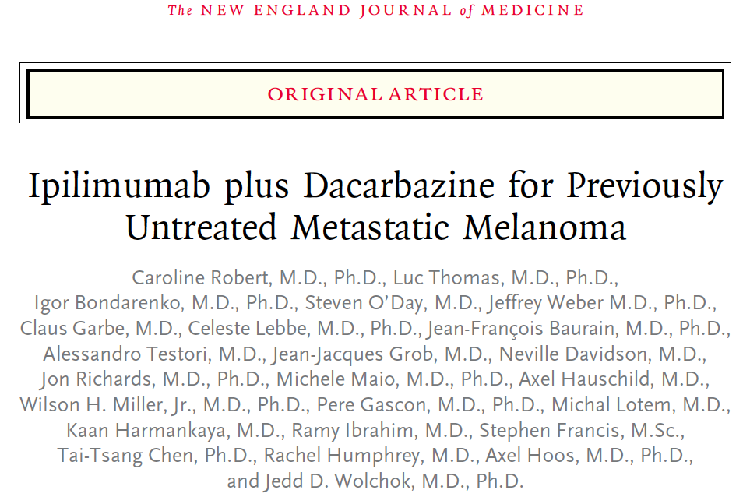
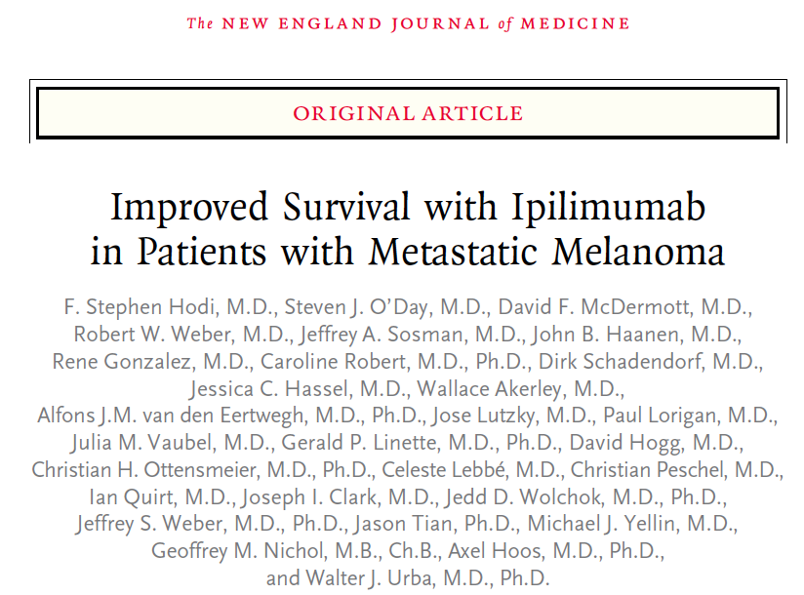
NEJM 2011 June 30;364(26):2517-26.
NEJM 2010 August 19;363(8):711-23.

Slide 17
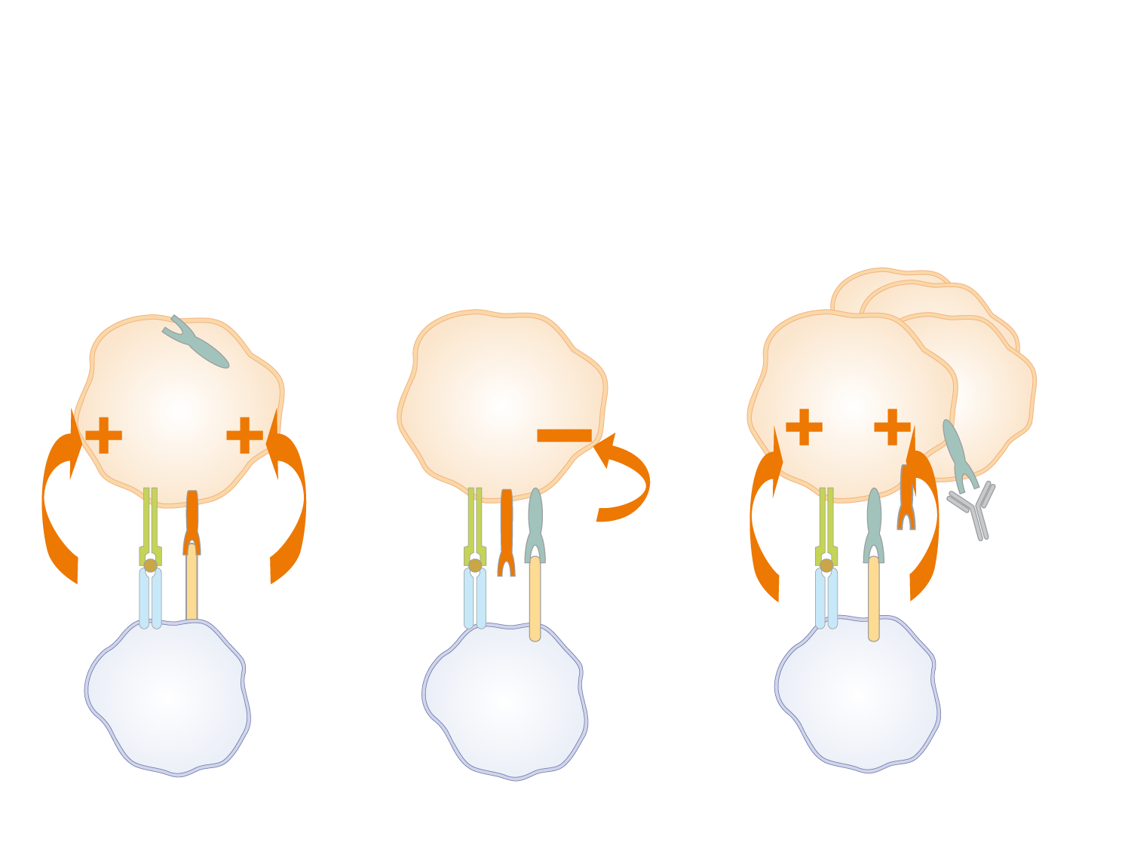
Ipilimumab, a CTLA-4 Blocking Monoclonal Antibody, Augments T-Cell Activation
T-Cell Activation
T-Cell Inactivation
T Cell Remains Active
CTLA-4
T cell
T cell
resting
T cell
TCR
CD28
CTLA-4
CTLA-4
HLA
B7
Ipilimumab
APC
APC
APC
Adapted from Korman AJ et al. Adv Immunol 2006;90:297-339.

Slide 18
Improved Survival with Ipilimumab for Patients with Unresectable Stage III or IV Metastatic Melanoma Whose Disease Progressed While Receiving Prior Treatment with Chemo or IL-2
 | Ipilimumab + gp100 (N = 403) | Ipilimumab Alone (N = 137) | gp100 Alone (N = 136)
Overall survival | 10 mo | 10.1 mo | 6.4 mo
Hazard ratio (versus gp100 alone) | 0.68 | 0.66 | —
p-value | <0.001 | 0.003 | —
Hodi FS et al. N Engl J Med 2010;363(8):711-23.

Slide 19
Ipilimumab Risk Evaluation and Management Strategy (REMS)
GASTROINTESTINAL
Any changes in normal bowel habits or changes from baseline (eg, last week, last visit)
Diarrhea
Abdominal pain
Blood or mucus in stool with or without fever
Peritoneal signs consistent with bowel perforation
Ileus
LIVER
Elevations in liver function tests
AST >2.5 times upper limit of normal (ULN)
ALT >2.5 times ULN
Total bilirubin >1.5 times ULN
Note: Always check lab values prior to each infusion.
SKIN
Pruritus
Rash
NEUROLOGIC
Monitor for symptoms of motor and sensory neuropathy
Unilateral or bilateral weakness
Sensory alterations
Paresthesia
ENDOCRINE
Fatigue
Headache
Mental status changes
Abdominal pain
Unusual bowel habits
Hypotension
Abnormal thyroid function tests and/or serum chemistries
https://www.hcp.yervoy.com/pages/rems.aspx

Slide 20
Case 3: From the Practice of Dr Anna Pavlick
An 82-year-old man s/p wide local excision of primary melanoma in 2007 presents with a nonproductive cough in 2012
Workup reveals lung metastases from melanoma
LDH normal
IPI x 3
Develops muscle girdle weakness
Learned patient had prior polymyalgia rheumatica (PMR) 10 years ago
Steroids initiated, PMR resolves
Completes IPI
CR of pulmonary nodules, >50% reduction in adenopathy
Currently asymptomatic and off treatment

Slide 21
Management of BRAF V600-Mutant Advanced Melanoma

Slide 22
Case 4: From the Practice of Dr Pavlick
A 60-year-old man s/p excised primary melanoma in 2005 presents with a persistent cough 4 years later
Workup reveals lung metastases from melanoma
BRAF V600E-mutant

Slide 23
In general, what is your most likely first- and second-line nonprotocol systemic treatment recommendation for a 60-year-old asymptomatic patient with low-volume lung metastases from BRAF V600E-mutant melanoma (assuming slow progression on first-line therapy)?
HD IL-2 → Ipilimumab
HD IL-2 → Vemurafenib
Ipilimumab → HD IL-2
Ipilimumab → Vemurafenib
Vemurafenib → HD IL-2
Vemurafenib → Ipilimumab
Other

Slide 24
In general, what is your most likely first- and second-line nonprotocol systemic treatment recommendation for a 60-year-old asymptomatic patient with low-volume lung metastases from BRAF V600E-mutant melanoma (assuming slow progression on first-line therapy)?
HD IL-2 → Ipilimumab
HD IL-2 → Vemurafenib
Ipilimumab → HD IL-2
Ipilimumab → Vemurafenib
Vemurafenib → HD IL-2
Vemurafenib → Ipilimumab
Other

Slide 25
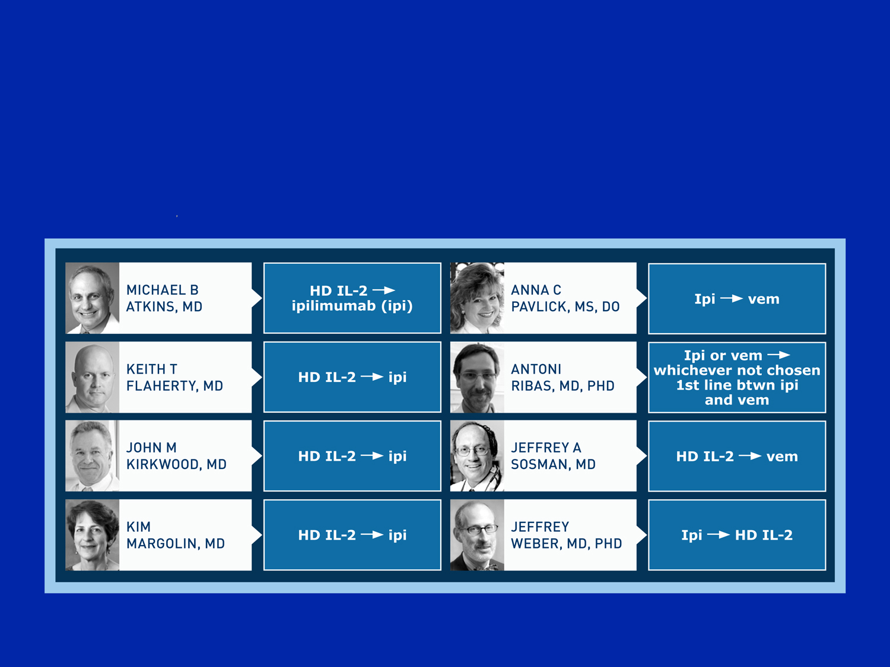
First- and second-line nonprotocol treatment for a 60 yo asymptomatic pt w/ low-volume lung mets from BRAF V600E-mutant melanoma (assuming slow progression on first-line therapy)?

Slide 26
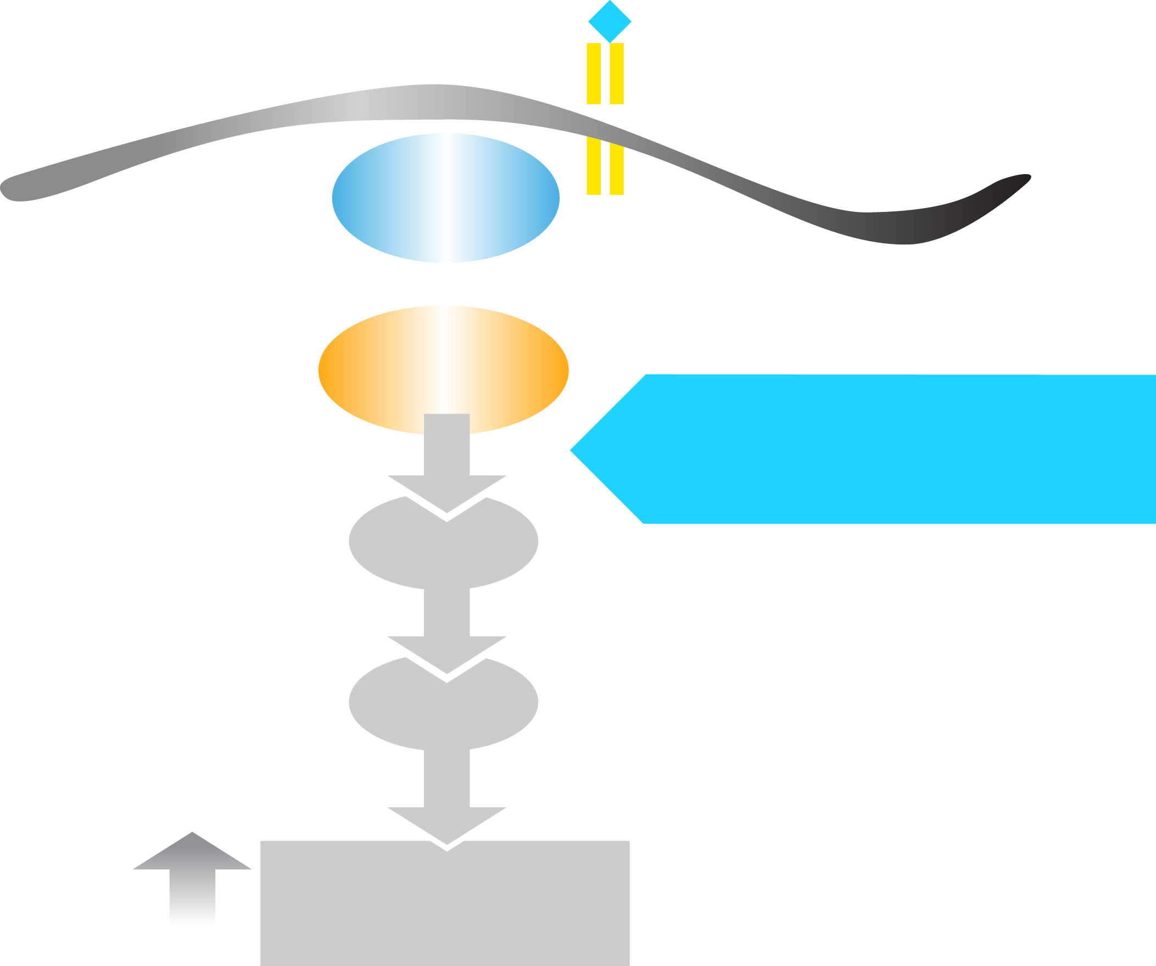
Vemurafenib Inhibits BRAF^{V600E} Kinase
RTK
RAS
40-60% of melanomas
BRAF^{V600E}
VEMURAFENIB
ATP
MEK
ATP
ERK
Cellular Proliferation
Chapman PB et al. Proc ASCO 2011;Abstract LBA4.

Slide 27
Updated overall survival (OS) results for BRIM-3, a phase III randomized, open-label, multicenter trial comparing BRAF inhibitor vemurafenib (vem) with dacarbazine (DTIC) in previously untreated patients with BRAF^{V600E}-mutated melanoma.
Chapman PB et al.
Proc ASCO 2012;Abstract 8502.

Slide 28
BRIM3: Vemurafenib Front-Line Trial – Phase III Study Design
Screening
BRAF^{V600E} mutation
Stratification:
Stage
ECOG PS (0 vs 1)
LDH (elevated vs normal)
Geographic region
Vemurafenib
960 mg PO bid
(n = 337)
Randomization
n = 675
Dacarbazine
1000 mg/m² IV q3wk
(n = 338)
Co-primary endpoints were OS and PFS

Slide 29
BRIM3: Best Tumor Response by Individual Patient
Vemurafenib: 48.4% confirmed objective response (ASCO 2011)
>100
M1c
Percent Change From Baseline in Sum of Tumor Diameters
57.0% confirmed objective response (ASCO 2012)
50
0
-50
-100
Dacarbazine
5% confirmed objective response (NEJM 2011)
8.6% confirmed objective response (ASCO 2012)
From The New England Journal of Medicine, Chapman PB et al, Improved Survival with Vemurafenib in Melanoma with BRAF V600E Mutation, Volume 364, Pages 2507-16. Copyright © 2013 Massachusetts Medical Society. Reprinted with permission from Massachusetts Medical Society
Chapman PB et al. Proc ASCO 2012;Abstract 8502.

Slide 30
BRIM3: Overall Survival at February 1, 2012 Cutoff, Censored at Crossover
 | Vemurafenib (n = 337) | Dacarbazine (n = 338) | Hazard ratio | Post-hoc p-value
Overall survival | 13.6 mo | 9.7 mo | 0.70 | <0.001
Chapman PB et al. Proc ASCO 2012;Abstract 8502.

Slide 31
Efficacy of Vemurafenib in BRAFV600K Mutation-Positive Melanoma Disease – Results from the Phase 3 Clinical Study BRIM3
GA McArthur, A Hauschild, C Robert, J Larkin, JB Haanen, A Ribas, D Hogg, O Hamid, P Ascierto, A Testori, P Lorigan, R Dummer, JA Sosman, K Flaherty, M Yin, I Caro, F Shieh, R Schilling, K Trunzer, P Chapman
Society for Melanoma Research, November 8-11, 2012, Hollywood, California

Slide 32
BRIM3: Summary of Efficacy Data by BRAF Mutation Genotype
 | BRAF V600E |  | BRAF V600K
 | Dacarbazine | Vemurafenib | Dacarbazine | Vemurafenib
Median OS | 10.0 mos | 13.3 mos | 7.6 mos | 14.5 mos
 | Hazard ratio: 0.75 |  | Hazard ratio: 0.43
Median PFS | 1.6 mos | 6.9 mos | 1.7 mos | 5.9 mos
 | Hazard ratio: 0.39 |  | Hazard ratio: 0.30
Best ORR | 11% | 59% | 4% | 45%
 | Odds ratio: 11.2 |  | Odds ratio: 19.2
Comparable effects with vemurafenib in BRAF V600E and BRAF V600K mutation-positive disease
McArthur GA et al. Society for Melanoma Research 2012.

Slide 33
Selected Adverse Events (% of Patients)
 | BRAF V600E (n = 295) | BRAF V600K (n = 33)
Total patients with at least 1 AE | 100% | 100%
Arthralgia | 58% | 39%
Rash | 42% | 39%
Fatigue | 45% | 58%
Photosensitivity | 41% | 36%
Cutaneous SCC | 19% | 24%
Keratoacanthoma | 10% | 21%
Skin papilloma | 29% | 27%
Nausea | 40% | 24%
McArthur GA et al. Society for Melanoma Research 2012.

Slide 34
Case 5: From the Practice of Dr Pavlick
An 87-year-old man s/p resected Stage IIIC melanoma in 2011
Presents 10/2012 with decreased appetite, weight loss, abdominal fullness
Workup reveals multiple small lung mets and several large liver mets from melanoma
LDH: 3500
BRAF V600E m+
Vemurafenib
Dramatic response, resolution of symptoms
Dose reduction for Grade 3 rash and itching
On treatment 5 months with excellent QOL
Grand mal seizure
Innumerable hemorrhagic brain mets

Slide 35
Are there situations in which you would delay local treatment with radiation therapy for brain metastases and instead administer vemurafenib for a patient with a BRAF V600E-positive tumor?
Yes
No
I don’t know

Slide 36
Are there situations in which you would delay local treatment with radiation therapy for brain metastases and instead administer vemurafenib for a patient with a BRAF V600E-positive tumor?
Yes
No
I don’t know

Slide 37
Chemotherapy in the Management of Advanced Melanoma

Slide 38
Case 6: From the Practice of Dr Flaherty
A 41-year-old with a history of excision/adjuvant interferon for primary melanoma (2008) presents with lung and liver mets, pleural effusion in 2011
BRAF V600E m+
Vemurafenib (7/2011)
9/2011: 80% reduction in lung, liver, lymph nodes
Marked reduction in pleural effusion
HD IL-2 initiated (14/14) w/o progression on vemurafenib
1 month later: Increase in size of mets, new mets
Carbo/paclitaxel

Slide 39
Phase 3, Randomized, Open-Label, Multicenter Trial of Nab-Paclitaxel (nab-P) vs Dacarbazine (DTIC) in Previously Untreated Patients with Metastatic Malignant Melanoma (MMM)
Hersh E et al.
Society for Melanoma Research, November 8-11, 2012, Hollywood, California

Slide 40
Response, Survival and Common Adverse Events: Nab-P vs DTIC
Efficacy Endpoint | Nab-P (n = 264) | DTIC (n = 265) | Hazard ratio (p-value)
Progression-free survival, ITT | 4.8 mos | 2.5 mos | 0.792 (0.044)
Interim overall survival | 12.8 mos | 10.7 mos | 0.831 (0.094)
Objective response rate | 15% | 11% | 0.239
Disease control rate | 39% | 27% | 0.004
Grade >3 Treatment-Related AEs | Nab-P | DTIC | p-value
Neuropathy | 25% | 0% | <0.001
Neutropenia | 20% | 10% | 0.004
Hersh E et al. Society for Melanoma Research, November 8-11, 2012.

Slide 41
Case 7: From the Practice of Dr Flaherty
A 69-year-old retired gastroenterologist with prior excisions of numerous scalp melanomas
Workup reveals bilateral pulmonary nodules, solitary liver lesion
Biopsy-proven metastases from melanoma
6/2012: Enrolls on a Phase I study of anti-PD-1 agent
No required biopsy
3/2013: Continued PR in lung and liver

Slide 42
Clinical Activity and Safety of Anti-PD-1 (BMS-936558, MDX-1106) in Patients with Advanced Melanoma
Hodi FS et al.
Proc ASCO 2012;Abstract 8507.

Slide 43

Activity of Anti-Programmed Death 1 (PD-1) Antibody in Refractory Melanoma
First occurrence of new lesion
Patient off study
24 weeks: PFS assessment: 41%
Objective response rate: 28%
Duration of response: 1.9-24.9 mos
Change in Target Lesions from Baseline (%)
Weeks since Treatment Initiation
From The New England Journal of Medicine, Topalian SL et al, Safety, Activity, and Immune Correlates of Anti–PD-1 Antibody in Cancer, Volume 366, Pages 2443-54. Copyright © 2013 Massachusetts Medical Society. Reprinted with permission from Massachusetts Medical Society.

Slide 44
Drug-Related Adverse Events
Grade 3 or 4 drug-related AEs: 14%
Treatment discontinuation due to drug-related AE: 5%
3 deaths from pulmonary toxicity
Common AEs
Fatigue
Rash
Diarrhea
Pruritus
Decreased appetite
Nausea
AEs with Potential Immune-Related Causes
Pneumonitis
Vitiligo
Colitis
Hepatitis
Hypophysitis
Thyroiditis
Topalian SL et al. New Engl J Med 2012;366(26):2443-54.

Slide 45

Notes:
45
45

Slide 46
Basal Cell Carcinoma (BCC)

Slide 47
Case 8: From the Practice of Dr Pavlick
A 62-year-old woman with an extensive history of BCC undergoes WLE for a large ulcerated lesion in 2009
Recurs 1 year later with extensive popliteal fossa nodes
Above-knee amputation
9 months later: Pelvic pain, decreased urination
Workup: Extensive pulmonary mets, hilar nodes, intra-abdominal nodes and pelvic mass
Extensive BCC covering her skin
Vismodegib
50% reduction in tumor volume, remains on treatment

Slide 48
What would you tell a patient who asks what his or her chances would be of “cruising” through vismodegib treatment (almost like a placebo)?
<10% (very high chance of toxicity)
10-20%
21-40%
41-60%
61-80%
81-100% (very low chance of toxicity)
I don’t know

Slide 49
What would you tell a patient who asks what his or her chances would be of “cruising” through vismodegib treatment (almost like a placebo)?
<10% (very high chance of toxicity)
10-20%
21-40%
41-60%
61-80%
81-100% (very low chance of toxicity)
I don’t know

Slide 50
Vismodegib for Basal Cell Cancer
2.8 million cases of BCC yearly in the United States
Exposure to UV radiation from the sun is the biggest risk factor
Mutations leading to loss of function of PTCH1, or patched homolog 1
Increased activity of smoothened homolog, or SMO
Uncontrolled proliferation of basal cells
Vismodegib was approved in 2012 for metastatic or recurrent locally advanced BCC

Slide 51
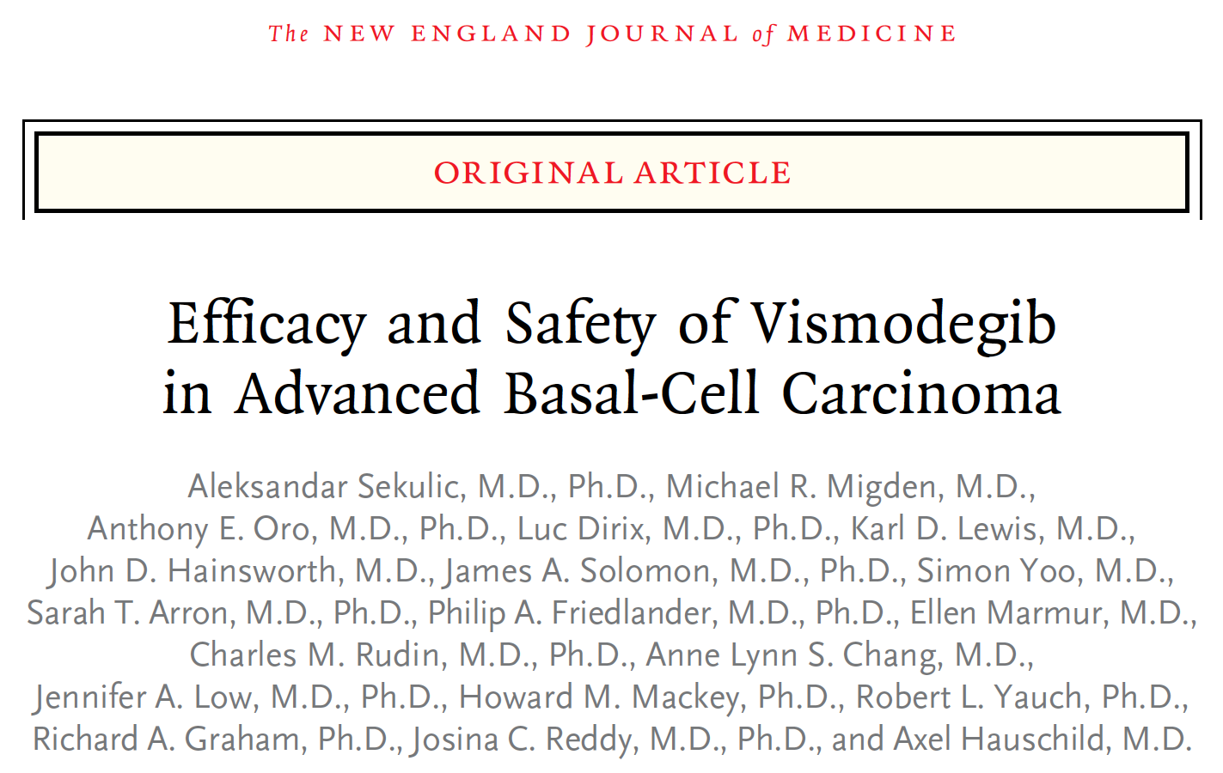

Slide 52
ERIVANCE BCC: Pivotal Phase II Study in Advanced BCC
Metastatic BCC (RECIST-measurable)
RECIST
Progression
Intolerable toxicity
Withdrawal from study
Vismodegib
REGISTRATION
Composite endpoint
Locally advanced BCC
Locally advanced BCC:
≥1 cm and inoperable
Surgery inappropriate
Recurrence after ≥2 surgeries and curative resection unlikely and/or anticipated substantial morbidity and/or deformity from surgery
RECIST = Response Evaluation Criteria In Solid Tumors
Notes:
52

Slide 53
Clinical Efficacy of Vismodegib in BCC
 | Metastatic BCC (n = 33) | Locally Advanced BCC (n = 63)
Objective response rate | 30% | 43%
Stable disease | 64% | 38%
Median duration of response | 7.6 mos | 7.6 mos
Median PFS | 9.5 mos | 9.5 mos
Sekulic A et al. New Engl J Med 2012;366(23):2171-79.

Slide 54

Clinical Efficacy of Vismodegib in BCC
Metastatic BCC
From The New England Journal of Medicine, Sekulic A et al, Efficacy and Safety of Vismodegib in Advanced Basal-Cell Carcinoma, Volume 366, Pages 2171-9. Copyright © 2013 Massachusetts Medical Society. Reprinted with permission from Massachusetts Medical Society.

Slide 55
Clinical Efficacy of Vismodegib in BCC
Locally Advanced BCC
From The New England Journal of Medicine, Sekulic A et al, Efficacy and Safety of Vismodegib in Advanced Basal-Cell Carcinoma, Volume 366, Pages 2171-9. Copyright © 2013 Massachusetts Medical Society. Reprinted with permission from Massachusetts Medical Society.

Slide 56
Commonly Reported Adverse Events (N = 104)
Event | Any Grade | Grade 3 or 4
Muscle spasms | 68% | 4%
Alopecia | 63% | 0%
Dysgeusia | 51% | 0%
Decrease in weight | 46% | 5%
Fatigue | 36% | 4%
Nausea | 29% | 1%
Decrease in appetite | 23% | 3%
Diarrhea | 22% | 1%
12% of patients had an AE leading to drug discontinuation
25% of patients experienced serious AEs
7 patients had fatal AEs
Sekulic A et al. New Engl J Med 2012;366(23):2171-79.

Slide 57
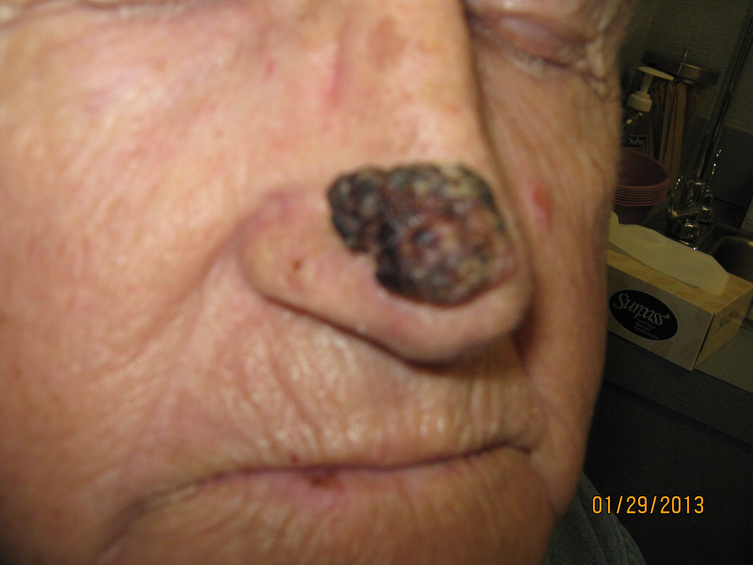
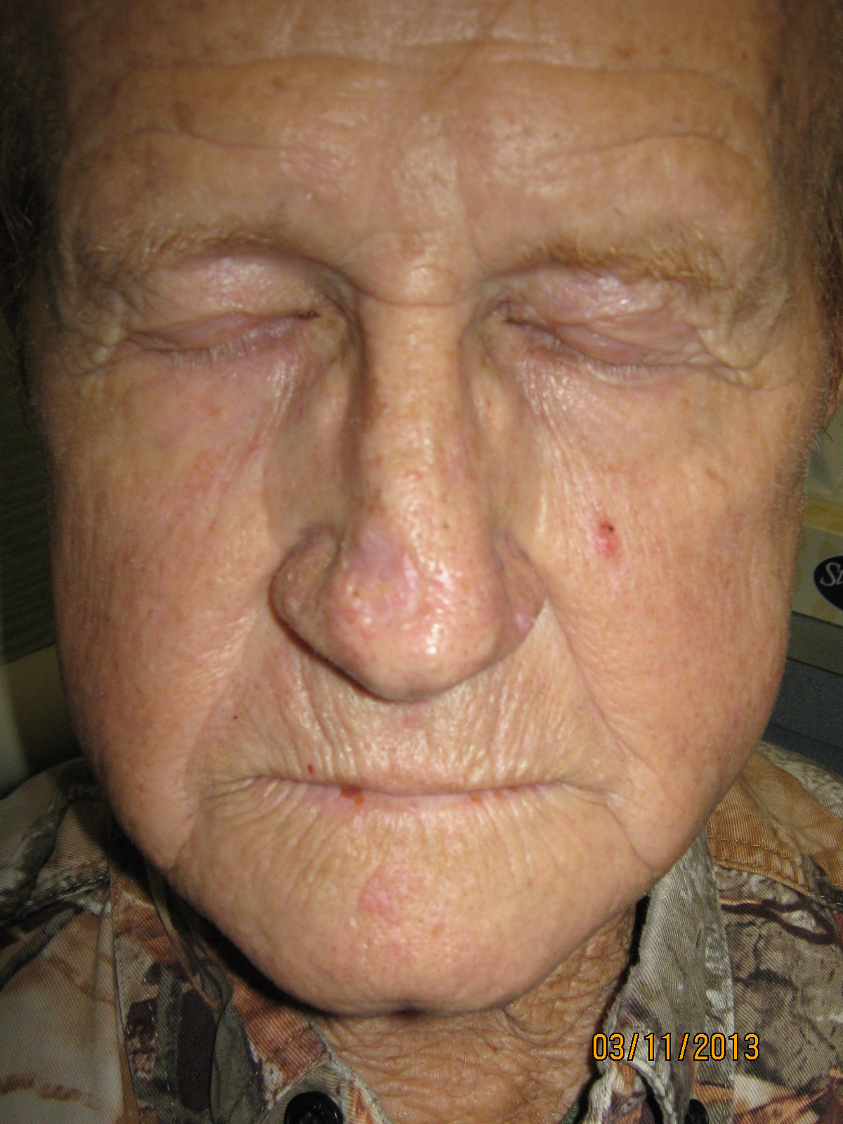
70-Year-Old Man with BCC (from the practice of Allan Freedman, MD, Snellville, Georgia)
1/29/2013
3/11/2013
Surgeon intended to remove his nose
Tumor disappeared after 2 weeks of vismodegib
Surgeon will perform smaller, nose-preserving excision

Slide 58
Vismodegib as an Adjuvant to Surgery for Basal Cell Carcinomas
Ally M et al.
American Academy of Dermatology;Abstract S018
March 1-5, 2013, Miami Beach, Florida
Single-arm study of neoadjuvant vismodegib prior to MMS (N = 5)
Reduction in surgical defect size: 38%
Reduction in tumor from baseline: 46%
No BCCs in 3 tumors, residual BCC in 1, equivocal diagnosis in 3
No recurrence after median of 3 months of follow-up

Slide 59
Ongoing Studies of Vismodegib in BCC
Trial identifier | Phase | N | Protocol Information
NCT01201915 | II | 74 | Neoadjuvant vismodegib in operable BCC prior to MMS
NCT01543581 | II | 81 | Neoadjuvant vismodegib in operable BCC prior to MMS
NCT01631331 | Pilot | 20 | Vismodegib as adjuvant prior to MMS for BCC
NCT01700049 | II | 36 | Vismodegib in various histologic subtypes of high-risk and/or locally advanced BCC
NCT01367665 | II | 800 | Vismodegib in locally advanced or metastatic BCC
MMS = Mohs micrographic surgery
www.clinicaltrials.gov, March 2013

Slide 60
Cutaneous Squamous Cell Carcinoma (CSCC)

Slide 61
In the past year, how many patients with metastatic CSCC have you treated?
None
1-2
3-5
6-10
>10

Slide 62
In the past year, how many patients with metastatic CSCC have you treated?
None
1-2
3-5
6-10
>10

Slide 63
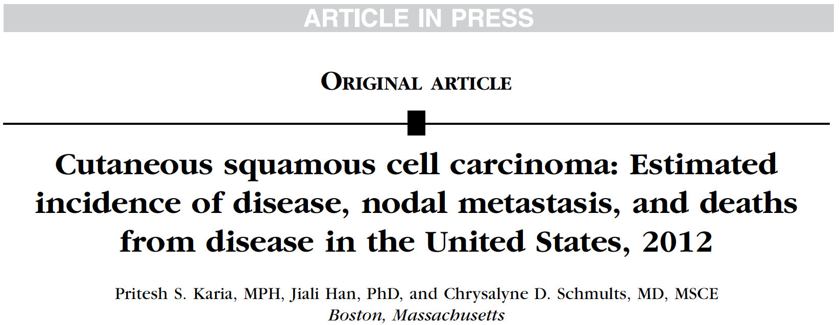
J Am Acad Dermatol 2013 Jan 31
Estimated Incidence of CSCC in the United States in 2012
New cases: 190-420,000
Nodal metastases: 6-13,000
Deaths: 4-9,000

Slide 64
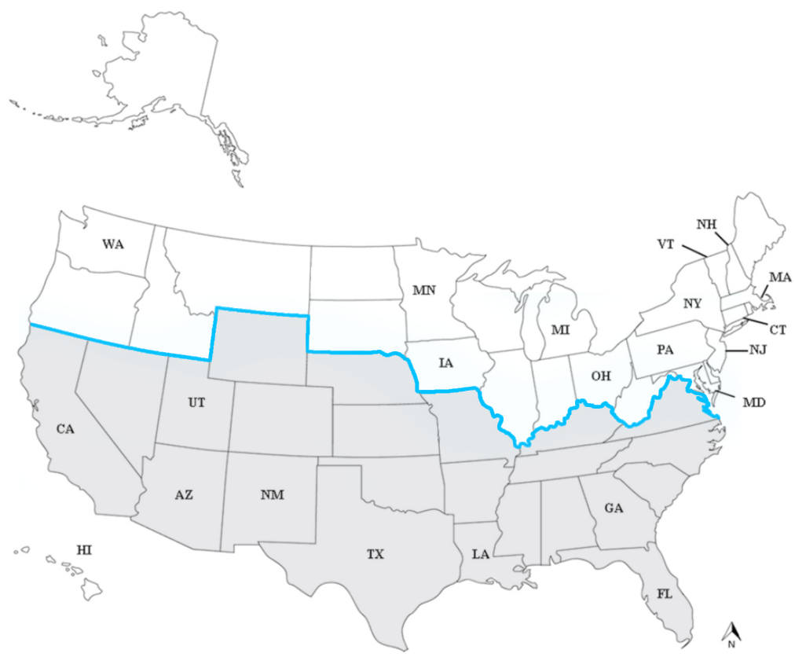
CSCC Incidence Study Sites Divided into 2 Sun Zones Based on UV Climatological Means
Sunzone 1(UV<7)
Sunzone 2 (UV>7)
Karia PS et al. J Am Acad Dermatol 2013;[Epub ahead of print].

Slide 65
Deaths from CSCC in Perspective
“The incidence of CSCC (and presumably metastases and deaths arising from it) was much higher in the southern and central United States.
In these regions, the number of deaths from CSCC rivals deaths from renal cell carcinoma, oropharyngeal carcinoma (in men), and melanoma as reported in SEER mortality statistics.”
Karia PS et al. J Am Acad Dermatol 2013;[Epub ahead of print].

Slide 66
Notes:
66
66

