Slide 1
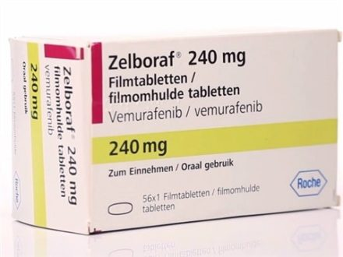
#202429 NDA workshop Vemurafenib (Zelboraf, Roche)
Submission: 2011-05-11 | Approval: 2011-08-17
Sungpil Han
Dept. of Clinical Pharmacology & Therapeutics
Asan Medical Center
2018-03-02

Slide 3
Introduction
Zelboraf (vemurafenib) Tablet, 240 mg for the
treatment of unresectable or metastatic melanoma with the BRAFV600 mutation as detected by an FDA approved test

Slide 4
Clinical Trial Phase I
Clinical Trial Phase II
Clinical Trial Phase III

Slide 5
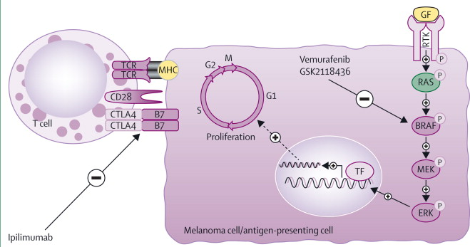
Bombeli, Lancet, 2014
Notes:
http://www.thelancet.com/journals/lanonc/article/PIIS1470-2045(13)70333-4/fulltext
Figure 1
Present strategies to manage advanced stage melanomas include inhibition of the mutant form of BRAF kinase (a common mutation being BRAFV600E ; vemurafenib and GSK2118436) and T-cell activation (ipilimumab)
TCR=T-cell receptor. GF=growth factor. MHC=major histocompatibility complex. RTK=receptor tyrosine kinase. CTLA4=cytotoxic T lymphocyte antigen 4. TF=transcription factor.
View Large Image | View Hi-Res Image | Download PowerPoint Slide

Slide 6
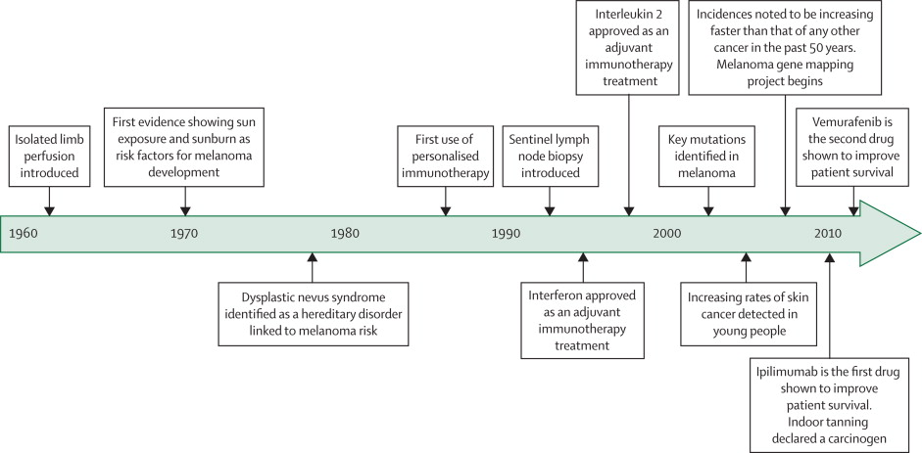
Timeline highlighting key events of the treatment of melanoma
Bombeli, Lancet, 2014
Notes:
Timeline highlighting key events since the 1960s that have directly affected the prevention and treatment of melanoma
Based on information made available from the American Society of Clinical Oncology.

Slide 7
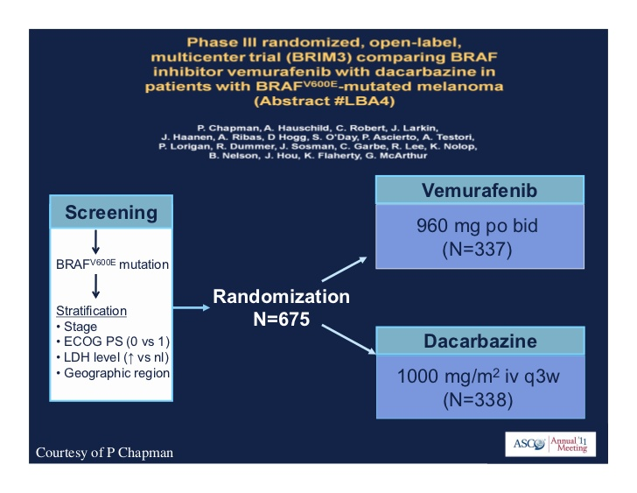

Slide 8
On August 17, 2011, the U.S. Food and Drug Administration (FDA) approved vemurafenib tablets (Zelboraf, Hoffmann-LaRoche Inc.) for the treatment of patients with unresectable or metastatic melanoma with the BRAF(V600E) mutation as detected by an FDA-approved test. The cobas 4800 BRAF V600 Mutation Test (Roche Molecular Systems, Inc.) was approved concurrently. An international, multicenter, randomized, open-label trial in 675 previously untreated patients with BRAF(V600E) mutation-positive unresectable or metastatic melanoma allocated 337 patients to receive vemurafenib, 960 mg orally twice daily, and 338 patients to receive dacarbazine, 1,000 mg/m(2) intravenously every 3 weeks. Overall survival was significantly improved in patients receiving vemurafenib [HR, 0.44; 95% confidence interval (CI), 0.33-0.59; P < 0.0001]. Progression-free survival was also significantly improved in patients receiving vemurafenib (HR, 0.26; 95% CI, 0.20-0.33; P < 0.0001). Overall response rates were 48.4% and 5.5% in the vemurafenib and dacarbazine arms, respectively. The most common adverse reactions (≥30%) in patients treated with vemurafenib were arthralgia, rash, alopecia, fatigue, photosensitivity reaction, and nausea. Cutaneous squamous cell carcinomas or keratoacanthomas were detected in approximately 24% of patients treated with vemurafenib. Other adverse reactions included hypersensitivity, Stevens-Johnson syndrome, toxic epidermal necrolysis, uveitis, QT prolongation, and liver enzyme laboratory abnormalities.

Slide 9
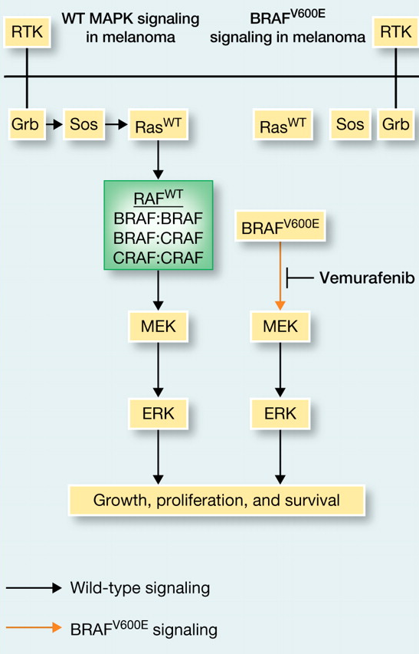
Introduction – metastatic melanoma
132,000 new cases of melanoma per year in US
9,500 deaths
Relapse rates are relatively high for late-stage disease
89% for stage IIIC
68% for stage IIIB
37% for stage IIIA
Stage IV has median survival of 9 months from diagnosis
What causes metastatic melanoma?
~50% of tumor have a mutation in BRAF
~80% of those mutations are V600E
16% are V600K and 3% are V600R
these mutations seem to arise early – often found in benign nevi
The same BRAF mutations are also found in other tumor types
132,000 new cases of melanoma per year in US
9,500 deaths
Relapse rates are relatively high for late-stage disease
89% for stage IIIC
68% for stage IIIB
37% for stage IIIA
Stage IV has median survival of 9 months from diagnosis
What causes metastatic melanoma?
~50% of tumor have a mutation in BRAF
~80% of those mutations are V600E
16% are V600K and 3% are V600R
these mutations seem to arise early – often found in benign nevi
The same BRAF mutations are also found in other tumor types

Slide 10
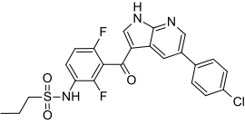
Introduction
BRAF inhibtor developed by Plexicon
and later Genentech
PLX4032 or Vemurafenib (V600E mutant Raf inhibitor)
Works well in vitro and in lab animals
Human trails begun 2008. Enrolled only patients with BRAF^{V600E}
Phase I: 16 patients with stage IV cancers
Median survival increased 9 → 15 months
Phase II: 132 patients with stage IV cancers
53% of patients responded. Similar increase in survival
Phase III: 675 patients with stage III or IV cancers
compared vemurafenib to dacarbazine
Stopped early. Dacarbazine patients moved to vemurafenib
FDA approval August 2011

Slide 11
BCS

Slide 12
Safety
Safety results
The primary safety population included 336 patients in the BRIM-3 trial who received at least one dose of vemurafenib and 287 patients who received at least one dose of dacarbazine. Dose reductions were reported in 33% and 15% of patients receiving vemurafenib and dacarbazine, respectively. Dose delays were reported in 44% of patients receiving vemurafenib and 2% of patients receiving dacarbazine. Treatment discontinuations due to adverse drug reactions occurred in 7% of patients receiving vemurafenib and 4% of patients receiving dacarbazine. The most common adverse reactions leading to treatment discontinuation on the vemurafenib arm were arthralgia, dysphagia, and pneumonia.
As shown in Table 2, the most common (≥10%) grade 1–4 adverse reactions in patients receiving vemurafenib were nausea, diarrhea, vomiting, constipation, fatigue, pyrexia, peripheral edema, asthenia, increased lactate dehydrogenase (LDH), increased alkaline phosphatase, increased alanine aminotransferase (ALT), increased aspartate aminotransferase (AST), increased γ-glutamyl transpeptidase (GGT), increased bilirubin, increased creatinine, decreased appetite, arthralgia, pain in extremities, myalgia, skin papilloma, cuSCC, headache, dysgeusia, rash, alopecia, pruritus, erythema, photosensitivity reaction, hyperkeratosis, and dry skin. The most common (≥5%) grade 3–4 adverse reactions in patients receiving vemurafenib were cuSCC, increased GGT, and rash. Other notable toxicities included uveitis, blurred vision, iritis, and photophobia.

Slide 13
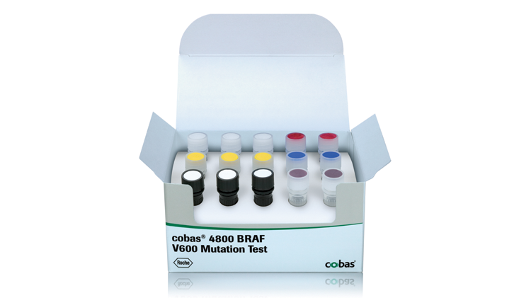
Companion Diagnostic for Vemurafenib
In vitro diagnostic: The cobas 4800 BRAF V600 Mutation Test
real-time PCR-based in vitro diagnostic
DNA from formalin-fixed, paraffin-embedded human melanoma tissue
It is intended for the selection of patients with BRAF^{V600E}-mutated melanoma for treatment with vemurafenib. The cobas and bidirectional Sanger sequencing results were compared in 449 evaluable cases (16). By the cobas test, there were 216 “mutation detected” cases. However, 35 of these were not V600E mutations by sequencing: 8 were wild-type, 25 were V600K, 1 was V600E2, and 1 was V600D. Six specimens were identified as “mutation not detected” by cobas but were V600E by sequencing. The positive percent agreement was 97.3%, the negative percent agreement was 84.6%, and the overall percent agreement was 90.9%. Seven of 16 (44%) patients with tumors positive for the V600E mutation by the cobas test but V600K by sequencing received vemurafenib and had a confirmed response, a response rate similar to that seen in the V600E population. The applicant agreed to a postmarketing commitment to develop an Investigational Use Only Companion Diagnostic (IUO CoDx) that reliably detects the BRAF^{V600K} mutation in tumors of patients with unresectable or metastatic melanoma and to conduct an open-label, single-arm trial in a population identified by this test with ORR and duration of response as the primary endpoints.
Notes:
https://molecular.roche.com/assays/cobas-4800-braf-v600-mutation-test/
A companion diagnostic for vemurafenib
The cobas® 4800 BRAF V600 Mutation Test detects the BRAF V600E mutation in formalin-fixed, paraffin-embedded (FFPET) human melanoma tissue. It is designed to help select patients for treatment with vemurafenib, an oral medicine designed to treat patients whose melanoma tumors harbor a mutated form of the BRAF gene.
Features and Benefits
The cobas® BRAF Mutation Test was used in pivotal clinical trials for vemurafenib, to select patients whose tumors harbor the V600E mutation in the BRAF gene.
In pre-clinical and clinical investigations, the cobas® BRAF Mutation Test had 97.3% positive agreement in detecting the BRAF V600E (1799 T>A) mutation, which represents >~85% of all BRAF mutations reported in the COSMIC database.
The cobas® BRAF Mutation Test is more sensitive in the detection of V600E mutations than Sanger sequencing.*
In formalin-fixed, paraffin-embedded tissue (FFPET), the cobas® BRAF Mutation Test can detect V600E mutations at >5% mutation level.*
The test may also detect other V600 mutations such as V600D and V600K.*
The cobas® BRAF Mutation Test has a low failure rate and is highly reproducible across operators, reagent lots and testing days.*
The cobas® BRAF Mutation Test can be performed in <8 hours from receipt of specimen.
Liquid, ready-to-use reagents are provided in the test kit to increase laboratory efficiency.
The test kits have >12 months shelf life from date of manufacture and upon opening each reagent maintains open-vial stability for up to 90 days.

Slide 14
References
https://www.cancer.gov/about-cancer/treatment/drugs/fda-vemurafenib
FDA Approval for Vemurafenib
Brand name: Zelboraf
Approved to treat late-stage or unresectable melanoma.
Full prescribing information is available, including clinical trial information, safety, dosing, drug-drug interactions and contraindications.
On August 17, 2011, the Food and Drug Administration (FDA) approved vemurafenib tablets (ZELBORAF, made by Hoffmann-La Roche Inc.) for the treatment of patients with unresectable or metastatic melanoma with the BRAFV600E mutation as detected by an FDA-approved test.
The approval was based primarily on an international randomized open-label trial in patients with previously untreated metastatic or unresectable melanoma with the BRAFV600E mutation as detected by the cobas 4800 BRAF V600 Mutation Test (made by Roche Molecular Systems, Inc.). This companion diagnostic test was approved by the FDA concurrently with vemurafenib’s approval.
The trial enrolled 675 patients; 337 patients were randomly assigned to vemurafenib, 960 mg orally twice daily, and 338 were randomly assigned to dacarbazine, 1000 mg/m2 intravenously, every three weeks. Treatment continued until disease progression, unacceptable toxicity, and/or consent withdrawal. All patients had an ECOG performance status of 0 or 1, and 95 percent of patients had metastatic disease. The major efficacy outcome measures of the trial were overall survival (OS) and investigator-assessed progression-free survival (PFS). Other outcome measures included confirmed investigator-assessed best overall response rate.
The median follow-up at the time of the overall survival analysis was 6.2 months for patients treated with vemurafenib and 4.5 months for patients treated with dacarbazine. Overall survival was significantly improved in patients receiving vemurafenib compared with those receiving dacarbazine (HR=0.44; 95 percent CI: 0.33, 0.59; p< 0.0001, log-rank test). The median survival of patients receiving vemurafenib had not been reached (95 percent CI: 9.6 months, not reached) and was 7.9 months (95 percent CI: 7.3, 9.6) for those receiving dacarbazine.
Progression-free survival (PFS) was also significantly improved in patients receiving vemurafenib (HR=0.26; 95 percent CI: 0.20, 0.33; p<0.0001, log-rank test). The median PFS was 5.3 months (95 percent CI: 4.9, 6.6) for patients receiving vemurafenib and 1.6 months for patients receiving dacarbazine (95 percent CI: 1.6, 1.7). Overall response rate (complete plus partial response rates) was 48.4 percent for patients receiving vemurafenib (95 percent CI: 41.6 percent, 55.2 percent) and 5.5 percent (95 percent CI: 2.8 percent, 9.3 percent) for patients receiving dacarbazine.
Vemurafenib was also evaluated in a single-arm multicenter trial that enrolled 132 patients with BRAFV600E mutation-positive metastatic melanoma who had received at least one prior systemic therapy. An independent review of treatment responses demonstrated a confirmed best overall response rate of 52 percent (95 percent CI: 43 percent, 61 percent), with a median response duration of 6.5 months (95 percent CI: 5.6, not reached).
The most common adverse reactions (at least 30 percent) in patients treated with vemurafenib were arthralgia, rash, alopecia, fatigue, photosensitivity reaction, and nausea. Cutaneous squamous cell carcinomas (cuSCC), including squamous cell carcinomas of the skin and keratoacanthomas, were detected in approximately 24 percent of patients treated with vemurafenib. CuSCCs were managed with excision in clinical trials, and patients were able to continue treatment without dose adjustment. Other adverse and sometimes severe reactions reported in patients treated with vemurafenib included hypersensitivity, Stevens-Johnson syndrome, toxic epidermal necrolysis, uveitis, QT prolongation, and liver enzyme laboratory abnormalities.
The recommended dose of vemurafenib is 960 mg, orally twice daily administered approximately 12 hours apart, with or without a meal.
Confirmation of BRAFV600E mutation-positive melanoma using an FDA-approved test is required before treatment with vemurafenib. Vemurafenib is not recommended for use in patients with wild-type BRAF melanoma. The approval also contains a Medication Guide to inform health care professionals and patients of vemurafenib’s potential risks.

Slide 15
감사합니다.
Thank you for your attention.

Slide 16
References
FDA CDER, Approval Package 202429Orig1s000 https://www.accessdata.fda.gov/drugsatfda_docs/nda/2011/202429Orig1s000Approv.pdf
https://www.accessdata.fda.gov/drugsatfda_docs/nda/2011/202429Orig1s000ClinPharmR.pdf
https://www.accessdata.fda.gov/drugsatfda_docs/nda/2011/202429Orig1s000PharmR.pdf
FDA Approval Summary: Vemurafenib for Treatment of
Unresectable or Metastatic Melanoma with the BRAF
V600E
Mutation

