Slide 1
Development of Crizotinib
for the Treatment of ALK-positive NSCLC
Accelerated Approval August 26, 2011
Regular Approval November 20, 2013
YS CHO, M.D., Ph.D.
September 30, 2017
Notes:
18-Jan-00
CDDS

Slide 2
Crizotinib (Trade name: XALKORITM)
Product Profile
U.S. Sponsor: Pfizer, Inc.
Indication:
  metastatic NSCLC whose tumors are ALK-positive as detected by an FDA-approved test
  metastatic NSCLC whose tumors are ROS1-positive.
Capsules: 250 mg and 200 mg
250 mg orally, twice daily
Notes:
18-Jan-00
CDDS

Slide 3
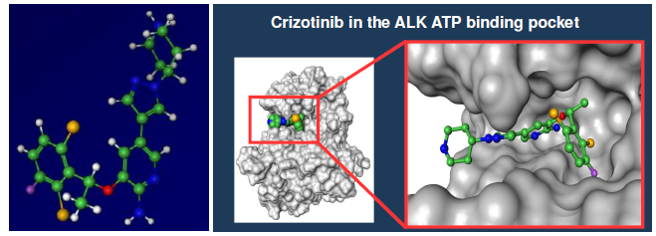
Mechanism of Action:
ATP competitive kinase inhibitor
Main targets: c-Met, ALK, ROS

Slide 4
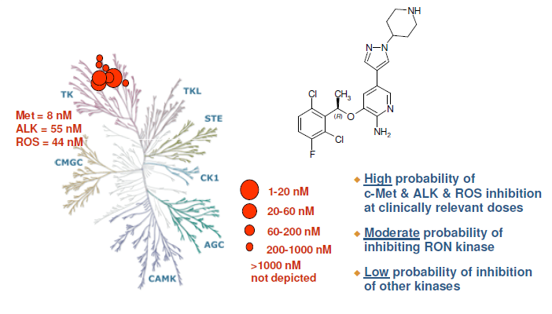
Target Profile

Slide 5
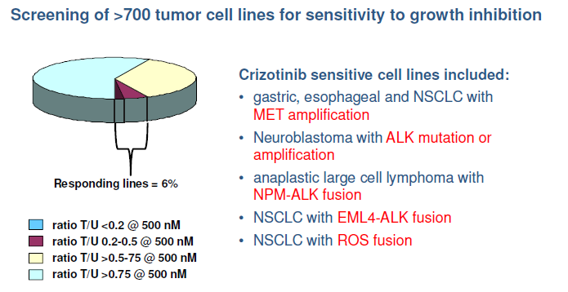
Understanding Molecular Correlates with
Response To Crizotinib
Notes:
18-Jan-00
CDDS

Slide 6
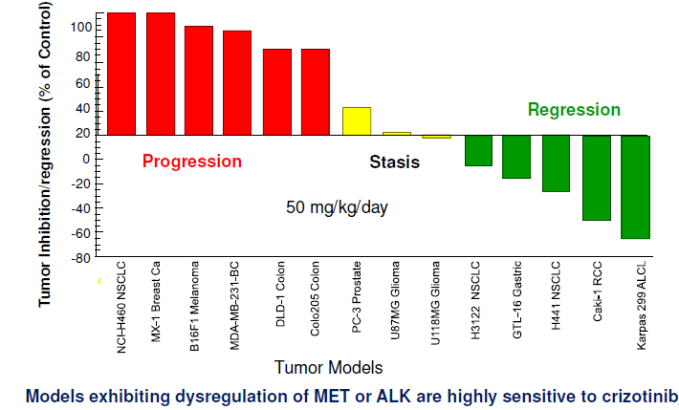
Spectrum of Response to Crizotinib in
Preclinical Tumor Models

Slide 7
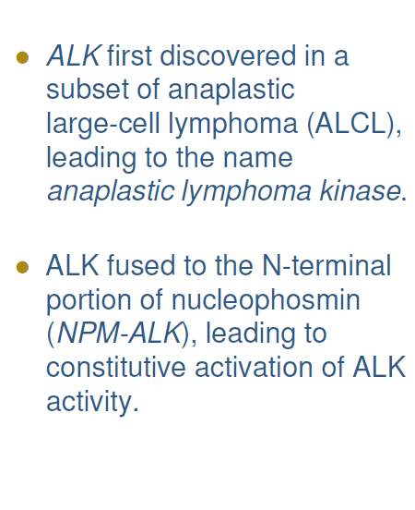
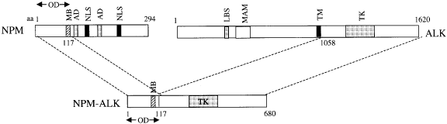
Discovery of ALK in Lymphoma

Slide 8
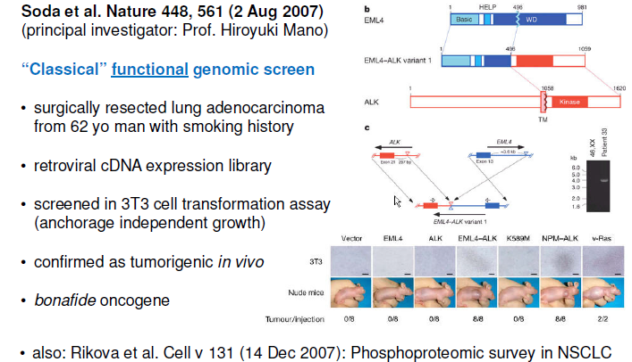
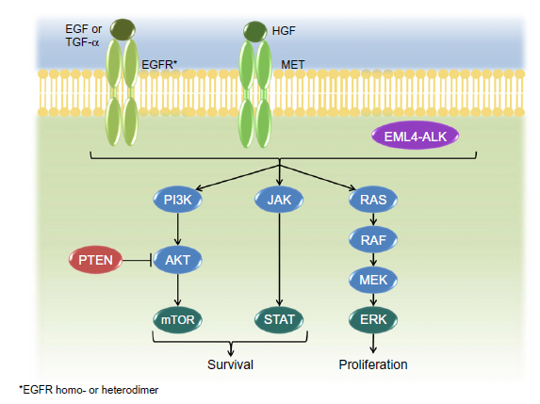
Functional Genomic Screen Leading
to ALK in NSCLC

Slide 9
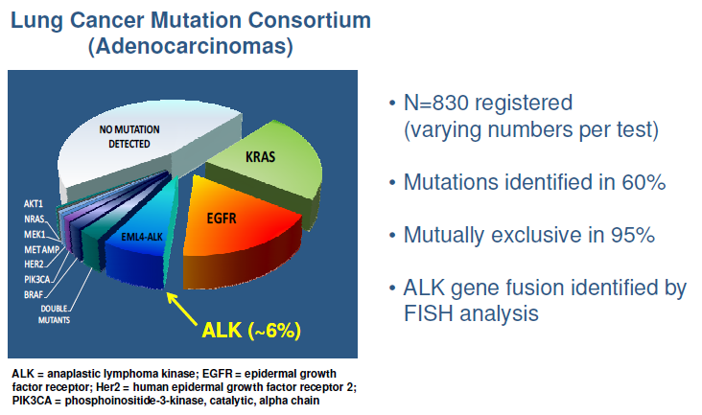
Challenges: low frequency population

Slide 10
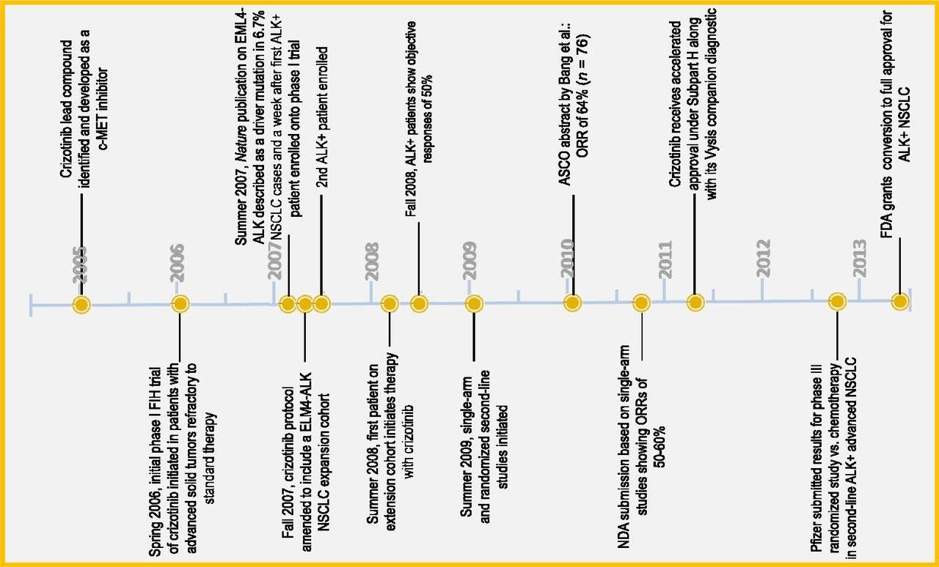
Clinical Trials of Crizotinib against ELM4-ALK NSCLC
Timeline for Crizotinib deleopment

Slide 11
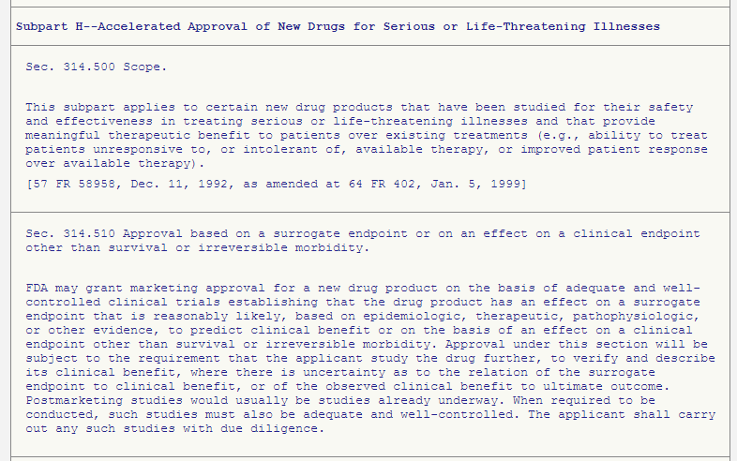
Clinical Trials of Crizotinib against ELM4-ALK NSCLC
2 Early Clinical Trials →
Accelerated Approval
Subpart H--Accelerated Approval of New Drugs for Serious or Life-Threatening Illnesses
(August 26, 2011)
1 Phase 1 Trials
(119 patients with ALK (+) NSCLC)
1 Phase 2 Trials
(136 patients with ALK (+) NSCLC)

Slide 12
Clinical Trials of Crizotinib against ELM4-ALK NSCLC
Accelerated Approval
+ 2 Clinical Trials →
Full Approval
(November 20, 2013)
2 Phase 3 Trials
Prospective comparison
1st line(343 patients with ALK (+) NSCLC)
2nd line(347 patients with ALK (+) NSCLC)

Slide 13
Phase 1 Clinical Trials
Multicenter, single arm
1st Part
Any solid tumor refractory to standard TX
Dose-escalation study (MTD) :
50 ~ 2000mg, once or twice/day
2 patients with ALK (+) NSCLC
→ dramatic improvement in symptoms
→ large-scale prospective screening for
ALK(+) NSCLC
→ enrollment into an expanded molecular
cohort :2nd Part
Notes:
any tumor type except leukemia
Expansion cohort
The need for improvement in the efficiency of cancer drug development has led to new innovative phase I trial designs (1, 2). One strategy is the use of expansion cohorts, in which additional patients are enrolled in a phase I trial after the MTD or recommended phase II dose has been defined. The main goals of expansion cohorts are more accurate estimation of the MTD and more accurate assessment of drug activity. On the other hand, the use of expansion cohorts has been criticized (3, 4) because many trials using expansion cohorts lack clear objectives, proper statistical design, and independent data and safety monitoring boards. The actual value of expansion cohorts for drug development remains unknown.
18-Jan-00
CDDS

Slide 14
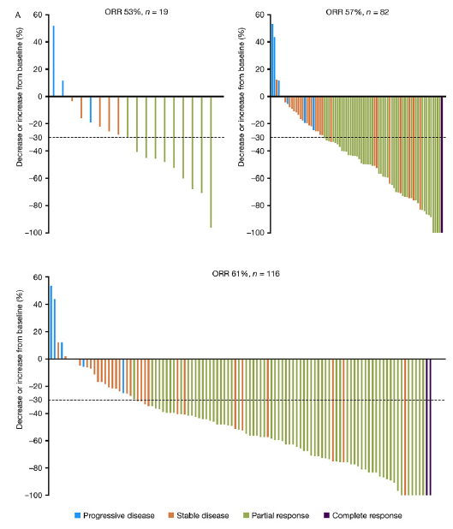
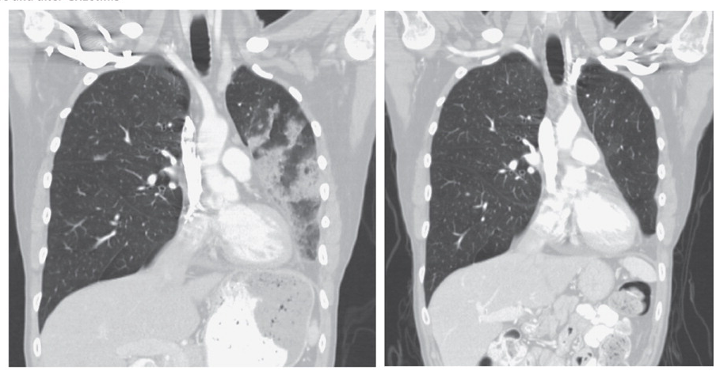
Phase 1 Clinical Trials
2nd Part
Expanded molecular cohort :ALK (+) NSCLC
250mg, twice/day
ORR: 61%
DOR: 48.1 weeks

Slide 15
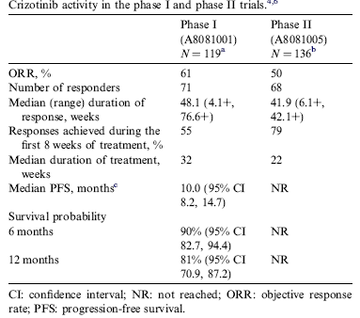
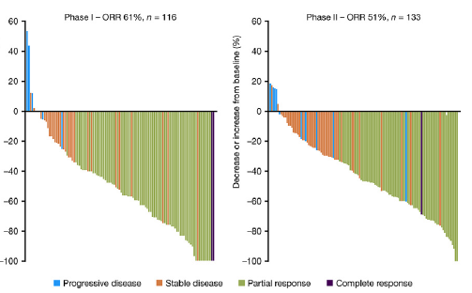
Phase 2 Clinical Trials
Advanced ALK (+) NSCLC after tumor progression on at least 1 line of chemotherapy, Multicenter, single arm
250mg, twice/day
ORR: 51%
DOR: 41.9 weeks
Notes:
the shape of the waterfall plot has been largely unchanged
phaseII very similar to the plots from the various data cuts of the phase I study waterfall plot has been largely unchanged
18-Jan-00
CDDS

Slide 16
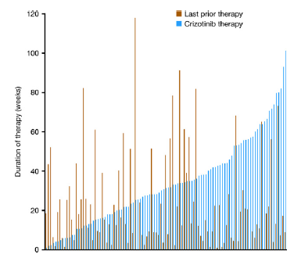
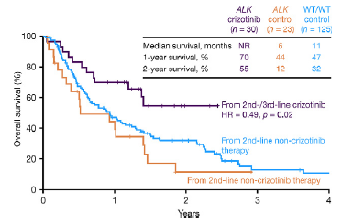
Phase 1 & 2 Clinical Trials
Retrospective comparison of the duration of crizotinib TX with previous lines of TX:
  lacking prospective comparative data
  allowing patients to act as their own controls
Historical case-match analysis of OS
Notes:
Available data are from single-arm
studies and although randomised trials comparing crizotinib
with standard chemotherapy in the first- and
second-line settings are underway, prospective comparative
data are currently lacking. Comparison of the duration
of crizotinib therapy with previous lines of therapy
allows patients to act as their own controls. Data from
the phase I and phase II crizotinib studies show that
patients remained on crizotinib longer than they
remained on their preceding therapy
18-Jan-00
CDDS

Slide 17
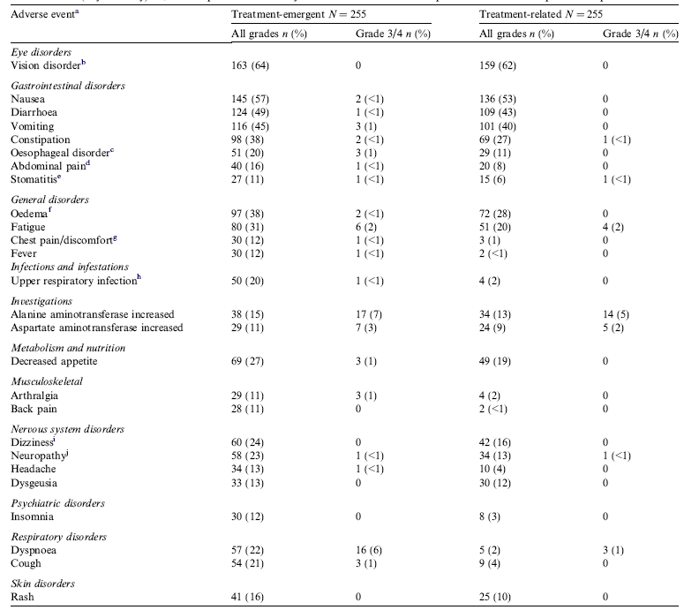
Phase 1 & 2 Clinical Trials
Adverse events (any causality) in >10% of patients
Notes:
Common treatment-related adverse
events (AEs) were gastrointestinal and visual events majority was of grade 1 or 2 severity
Visual events were distinctive and included transient
problems with light/dark adjustment; shimmering, flashing
lights and/or trailing lights; strings, streaks and/or
floaters; overlapping shadows or after images.
Gastrointestinal events such as diarrhoea, nausea
and vomiting
Discontinuations due to treatment-related
AEs were rare: 2 patients due to pneumonitis and 1
patient due to increased ALT on the phase I study,
and 2 patients due to pneumonitis and 3 patients due
to increased ALT on the phase II study.
18-Jan-00
CDDS

Slide 18
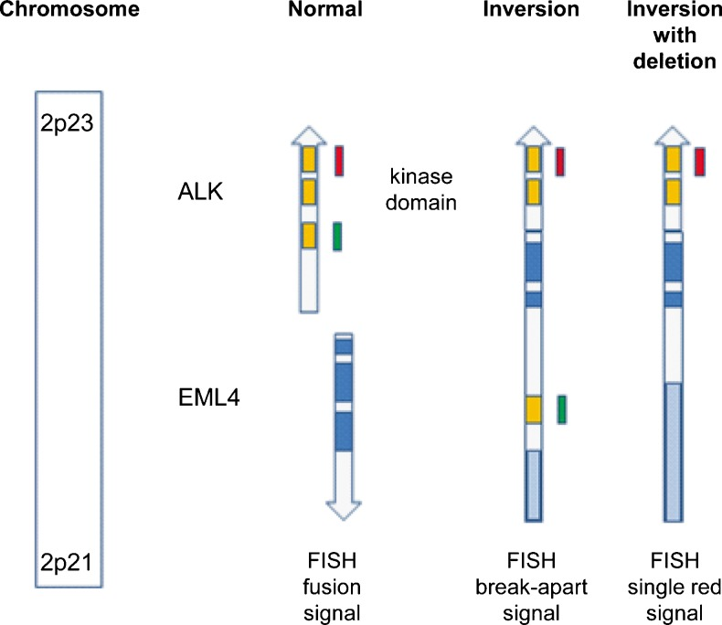
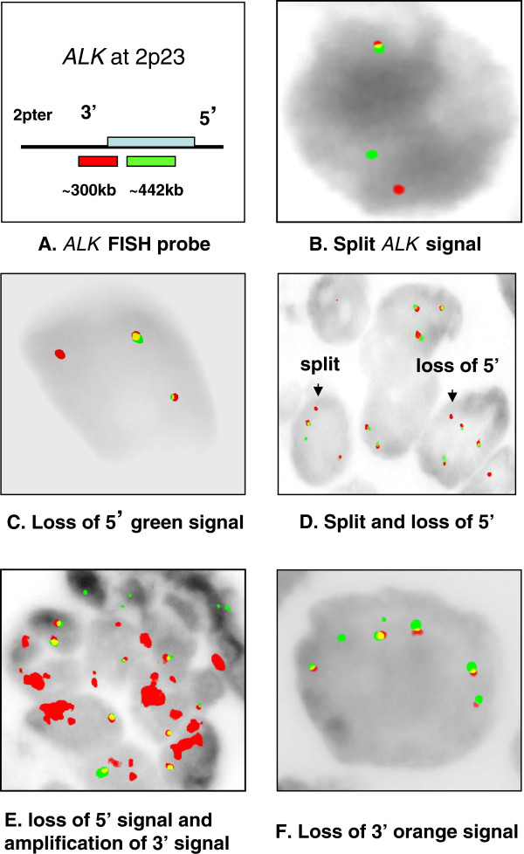

Accelerated Approval
(August 26, 2011)
Vysis ALK Break-Apart FISH Probe Kit (Abbott Molecular, Inc.) was approved concurrently
Available methods for detecting ALK (+)
FISH
IHC
RT PCR
Notes:
fluorescence in situ hybridisation
Immunohistochemistry
To date, FISH has been the test most
commonly used in clinical trials and is the test approved
by the FDA, but it is labour intensive and may be associated
with false negatives.49,50 IHC is widely used for
surgical pathology specimens and the detection of
ALK-positivity is improving as methods of signal
enhancement and more sensitive antibodies are developed.
48 Typically, an IHC score of P3 has shown
100% concordance with FISH positivity and a score of
0 has demonstrated 100% concordance with FISH negativity.
A two-tier screening system for ALK has been
proposed, comprising an initial IHC screening step followed
by FISH evaluation of IHC cases scoring 1, or
both 1 and 2.51–55 Although sensitive in itself, RT
PCR detection of ALK is limited by primer coverage
due to incomplete knowledge of ALK variants/fusion
partners. This method has the advantage of identifying
the specific fusion present, but requires high-quality
samples and several sets of PCR primer sets to cover
all known ALK rearrangements
18-Jan-00
CDDS

Slide 19
Phase 3 Clinical Trials
2nd line(347 patients with metastatic ALK (+) NSCLC): A8081007
1st line(343 patients with metastatic ALK (+) NSCLC): A8081014
Notes:
18-Jan-00
CDDS

Slide 20
Phase 3 Clinical Trials
A8081007
Previously treated with 1 platinum-based
chemoTX
Randomized, Multicenter, Open label, Active
controlled (Pemetrexed or Docetaxel)
Primary efficacy endpoints: PFS
Option!!
At the time of progression,
chemoTX → Crizotinib
Notes:
A total of 112 (64%) patients randomized to the chemotherapy arm subsequently received XALKORI after disease progression.
18-Jan-00
CDDS

Slide 21
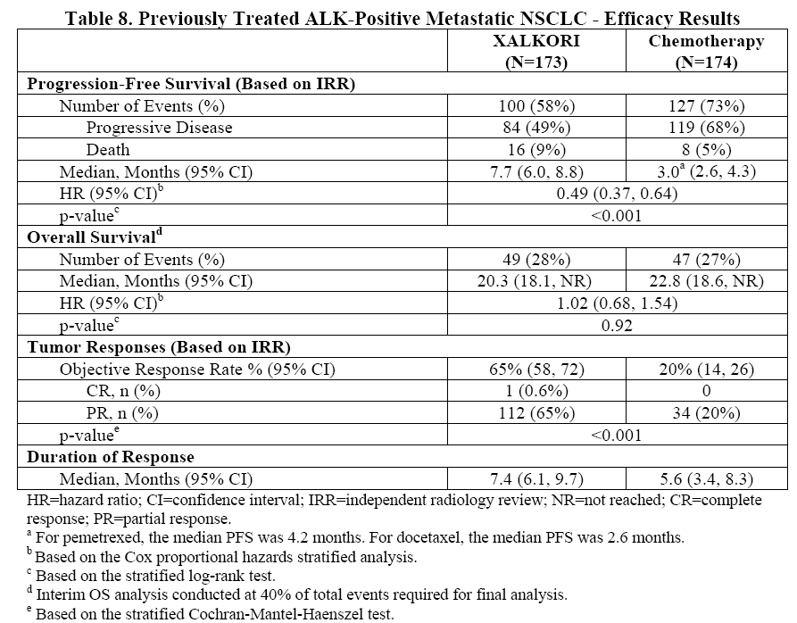
Phase 3 Clinical Trials
A8081007
Notes:
1.an improvement in median PFS of 4.7 months compared with chemotherapy (HR: 0.49; 95% CI: 0.37–0.64; p < .0001)
2.a threefold increase in ORR compared with chemotherapy.
3. Although the planned interim analysis of OS did not demonstrate a statistically significant difference, treatment effects on survival may have been confounded because 64% of patients in the chemotherapy arm received crizotinib on disease progression.
3.1 The median survivals in this trial were 20.3 and 22.8 months for the crizotinib and chemotherapy arms, respectively. These results are much longer than those observed in historical trials of single-agent docetaxel or pemetrexed as second-line therapy.
3.2 It appears that survival may be prolonged by crizotinib therapy and that receiving crizotinib at any time (second or third line) is beneficial (i.e., patients who crossed over to receive crizotinib).
18-Jan-00
CDDS

Slide 22
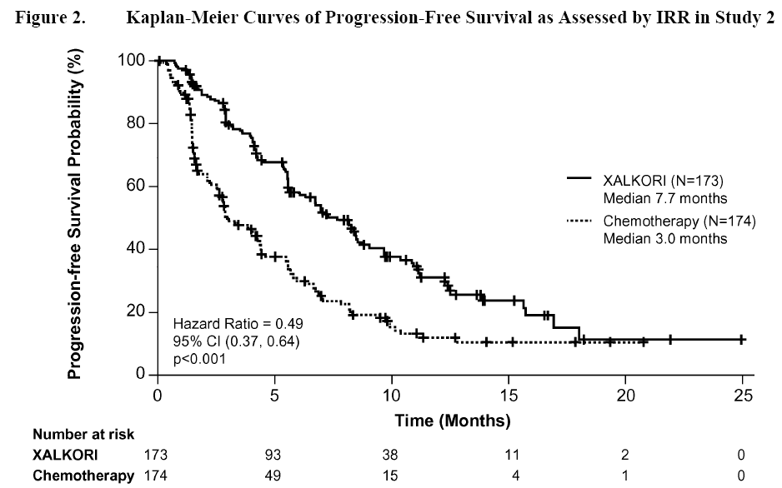
Phase 3 Clinical Trials
A8081007
Statistically significant improvement in PFS
Longer Tx duration, with a tolerable safety
Notes:
18-Jan-00
CDDS

Slide 23
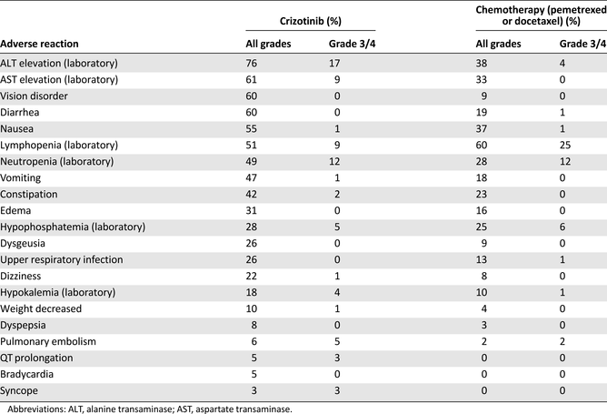
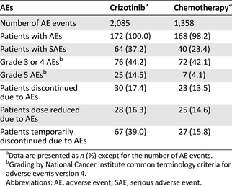
Phase 3 Clinical Trials
A8081007
Statistically significant improvement in PFS
Longer Tx duration, with a tolerable safety
Notes:
Severe or life-threatening adverse drug reactions of crizotinib included ILD or pneumonitis, drug-induced liver injury, and QT-interval prolongation. Fatal adverse reactions occurred in nine patients (5%)
Compared with chemotherapy, although it appears that the incidence of adverse reactions was higher for crizotinib, it should be noted that patients receiving crizotinib were on therapy three times longer than patients receiving chemotherapy, and this may introduce a bias favoring chemotherapy.
18-Jan-00
CDDS

Slide 24
Phase 3 Clinical Trials
A8081014
not received previous systemic treatment for advanced disease
Randomized, Multicenter, Open label, Active
controlled (Pemetrexed/Cisplatin or
Pemetrexed/Carboplatin)
Primary efficacy endpoints: PFS
Option!!
At the time of progression,
chemoTX → Crizotinib
Notes:
18-Jan-00
CDDS

Slide 25
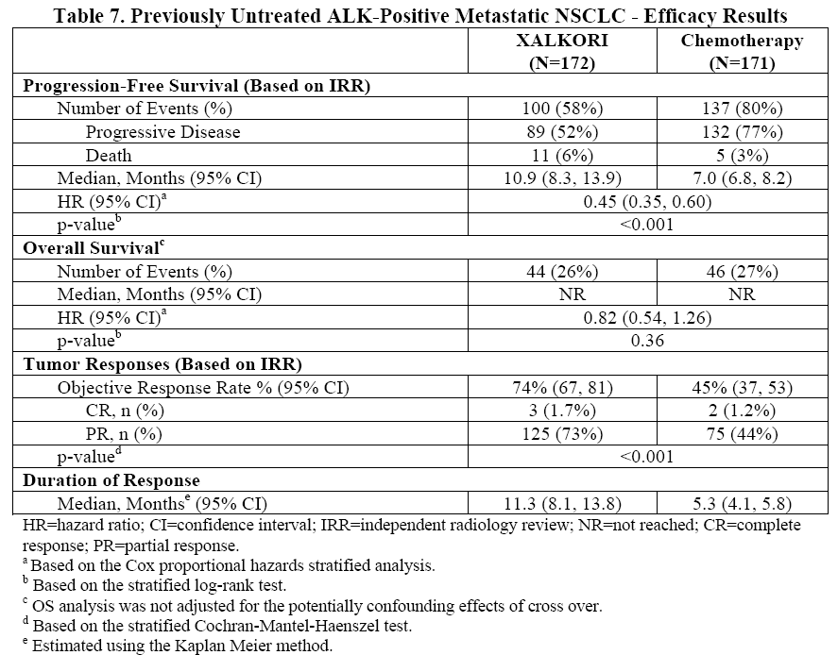
Phase 3 Clinical Trials
A8081014
Notes:
1.an improvement in median PFS of 3.9 months compared with chemotherapy (HR: 0.49; 95% CI: 0.37–0.64; p < .0001)
2. 1.5fold increase in ORR compared with chemotherapy.
3. Although the planned interim analysis of OS did not demonstrate a statistically significant difference, treatment effects on survival may have been confounded
18-Jan-00
CDDS

Slide 26
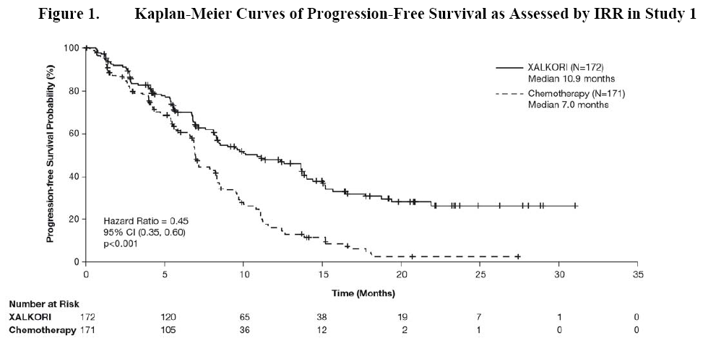
Phase 3 Clinical Trials
A8081014
Statistically significant improvement in PFS
Longer Tx duration, with a tolerable safety
Notes:
18-Jan-00
CDDS

Slide 27
Safety profile
Hepatotoxicity
Interstitial Lung Disease (Pneumonitis)
QT Interval Prolongation
Bradycardia
Severe Visual Loss
Notes:
18-Jan-00
CDDS

Slide 28
Clinical Pharmacology
Absorption
  BA : 43%(32, 66)
  Tmax : 4-6h
  Accumulation index : 4.8
Distribution
  Vss: 1772L
  Protein binding: 91%
  Blood/Plasma concentration ratio:1
Notes:
18-Jan-00
CDDS

Slide 29
Clinical Pharmacology
Elimination
  t1/2 : 42h
  Fraction of excreted unchanged drug in Urine or Feces: 2.3% 53%
Metabolism
  Major metabolic CYP: CYP3A4/5
Notes:
https://www.accessdata.fda.gov/scripts/cder/daf/index.cfm?event=BasicSearch.process
18-Jan-00
CDDS

Slide 30
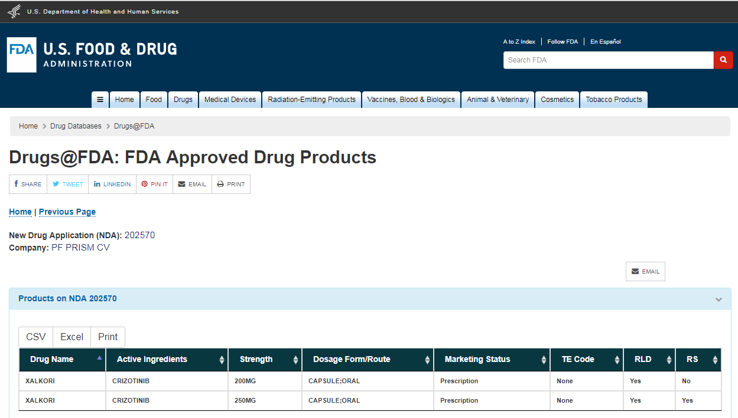
FDA
https://www.accessdata.fda.gov/scripts/cder/daf/index.cfm?event=BasicSearch.process
Notes:
https://www.accessdata.fda.gov/scripts/cder/daf/index.cfm?event=BasicSearch.process
18-Jan-00
CDDS

Slide 31
Discussions
Key to the outstanding results for crizotinib
Drug target was a key oncogenic driver in the selected population
Molecular identification of patients with disease suitable for treatment → the effect of treatment was not diluted out by the inclusion of patients who were unlikely to respond
Notes:
Such trial design should allow rapid clinical evaluation, minimise
the exposure of patients to therapies unlikely to be of
benefit and, potentially, allow accelerated drug approval
in molecularly specified patient populations.
18-Jan-00
CDDS

Slide 32
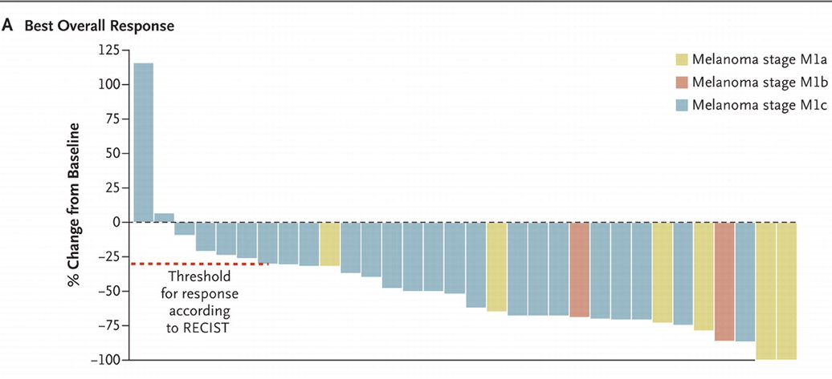
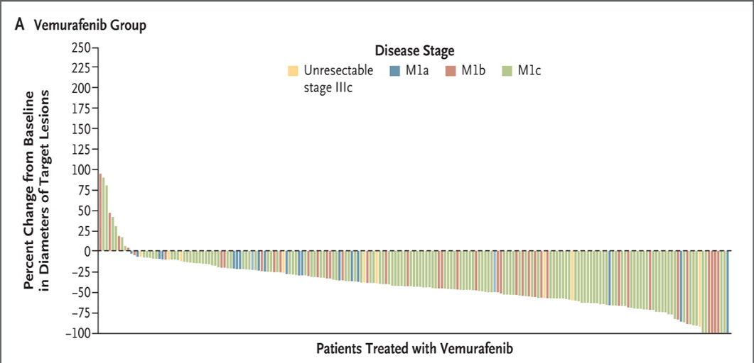
Discussions
Key to the outstanding results for crizotinib
Clinical trials conducted in the molecularly selected populations will quite likely lead to similar results in other targeted agents
ex) vemurafenib in patients with BRAF V600E-mutated melanoma
Notes:
18-Jan-00
CDDS

Slide 33
Discussions
Supporting accelerated development of
targeted agents demonstrating strong
efficacy signals early in the development in
molecularly selected patient populations
Notes:
환자들은 crizotinib과 같은 약제의 중요성을 점점 더 잘 알고 있으며 약물 개발을위한 일반적인 시간보다 앞서 접근하기를 원합니다.
18-Jan-00
CDDS

Slide 34
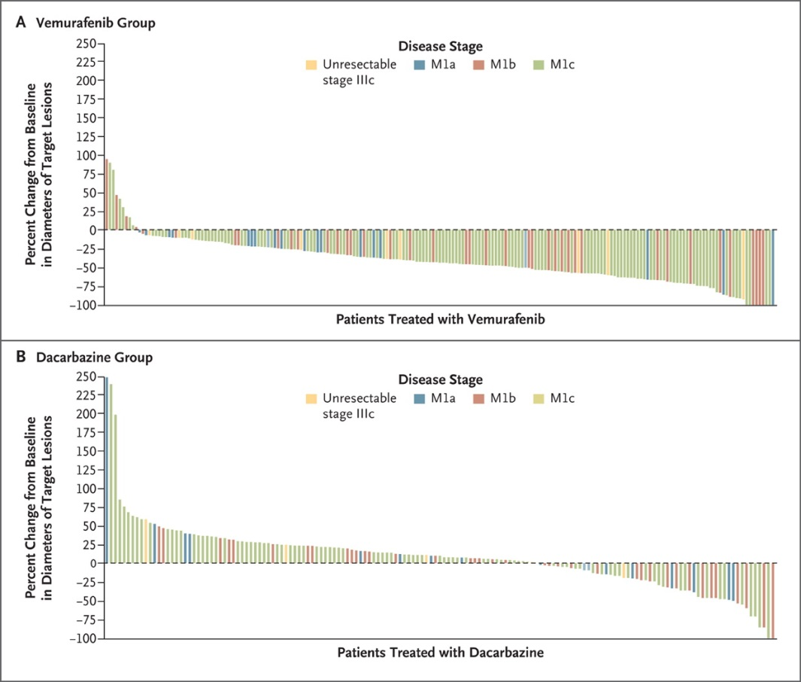
Discussions
Controversy over ethical aspects of employing a comparator arm (ex) chemoTX), widely acknowledged as suboptimal
ex) vemurafenib phase III trial in melanoma
Notes:
18-Jan-00
CDDS

Slide 35
Discussions
Controversy over study design
Designing clinical trials to allow cross-over to investigational therapy following disease progression on the control arm, as is the case for the ongoing crizotinib phase III trials → impacts on the assessments of overall survival potentially confounding a key study endpoint
Notes:
18-Jan-00
CDDS

Slide 36
T H E E N D
Notes:
18-Jan-00
CDDS

