Slide 1
CDDS NDA Workshop
Ditropan XL
(oxybutynin chloride)
NDA 20-897
Approved December 16, 1998
Teruyoshi Ehara
January 18, 2000

Slide 2
Ditropan XL:
Product Profile
U.S. Sponsor: Alza Corporation
Indication: The treatment of overactive bladder with symptoms of urge urinary incontinence, urgency, and frequency
Extended release formulation of oxybutynin chloride
Once daily oral administration
5mg - 30mg per day (dose titration)
Notes:
Aug 98 = non-USA market since FDA approved Jul 98

Slide 3
Program Goal
Ditropan XL Development
Control Release Product
Superior Adverse Reaction Profile
Drug Development Strategy
    Technology Driven
    Market Driven

Slide 4
Regulatory History
Immediate Release Form
Oxybutynin Chloride
Ditropan
Approved in 1976 (NDA 17-577)
NDA transferred to Alza Corporation from Hoescht Marion Roussel
in January 1998

Slide 5
Oxybutynin Chloride
Immediate Release Form
Indication: The relief of symptoms of bladder instability associated with voiding in patients
Dosage: 10mg -30mg per day
2 - 3 times a day
Dose titration/Starting at 5mg TID

Slide 6
Oxybutynin Chloride
Immediate Release Form
Clinical Pharmacology
Muscarinic receptor antagonist
Antispasmodic effect on smooth muscle
Relax bladder muscle
Increase bladder capacity
Diminish the frequency of uninhibited contraction of the detrusor muscle
Delay initial desire to void

Slide 7
Oxybutynin Chloride
Pharmacokinetics
5mg Ditropan IR; TID Steady State
Cmax (ng/mL) 12.4
Cmin (ng/mL) 1.4
Tmax (hr) (Est) 1.5
AUC 0-24 (ng.hr/mL) 80.6
T 1/2 (hr) 9.0
Absolute Bioavailability* 6.0 %
* Douchamps et al., 1988

Slide 8
Oxybutynin Chloride
Immediate Release Form
Pharmacokinetics (cont’)
Fast absorption
Extensive first pass effect
cytochrome P450 3A4
Low bioavailability (6%)
The major metabolite (active):
N-desethyloxybutynin

Slide 9
Oxybutynin Chloride
Immediate Release Form
Adverse Reactions
General: headache, asthenia, pain
Digestive: dry mouth, constipation, diarrhea, nausea, dyspepsia
Nervous: somnolence, dizziness
Special senses: blurred vision, dry eyes

Slide 10
Controlled Release
Delivery Capsule (OROS)
Characteristics
Zero-order drug delivery
Major drug delivery site is colon
The depleted system does not dissolve and is excreted in the feces

Slide 11
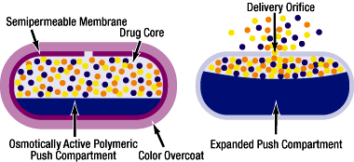
Diagram of Controlled Release
Delivery Capsule (OROS)
http://www.ditropanxl.com/pros/oros.htm

Slide 12
US Marketed Products
OROS technology
ACUTRIM (phenylpropanolamine)
COVERA-HS (verapamil hydrochloride)
DYNACIRC CR (isradipine)
EFIDAC 24 Chlorpheniramine
(chlorpheniramine maleate)
EFIDAC 24 Pseudoephedrine
(pseudoephedrine hydrochloride)
GLUCOTRAL XL (glipizide)
PROCARDIA XL (nifedipine)
VOLMAX (albuterol sulfate)

Slide 13
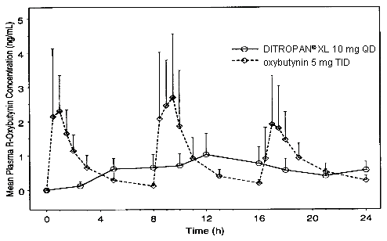
R-oxybutynin Plasma Concentrations
Ditropan XL (controlled release) 10mg QD
Oxybutynin immediate release 5mg TID

Slide 14
Clinical Trials of Ditropan XL
8 Clinical Trials
4 Phase 1 Trials
(151 Healthy Subjects)
4 Phase 2/3 Trials
(670 Patients)

Slide 15
Phase 1 Clinical Trials
C96-010 Pharmacokinetic & Safety
Ditropan XL and IR oxybutynin
Single and multiple dose
Open label, randomized
two-way crossover
Healthy subject n=13 (all female)

Slide 16
Phase 1 Clinical Trials
C96-068 Dose Proportionality/XL
Ditropan XL 5mg, 10mg
Single dose
Open label, randomized
3-treatment, 3-period,
2-sequence crossover
Healthy subject n=36
(Male n=18, female n=18)

Slide 17
Phase 1 Clinical Trials
C96-074 Food Effect/XL
Ditropan XL 5mg, 10mg
Open label, randomized
4-treatment, 4-period,
6-sequence crossover
Healthy subject n=48
(Male n=18, female n=18)

Slide 18
Phase 1 Clinical Trials
C97-015 Bioequivalence/XL
Ditropan XL 10mg (clinical)
and Ditropan XL (to be marketed)
Single dose
Randomized
2-period crossover
Healthy subject n=54
(Male n=32, female n=22)

Slide 19
R-oxybutynin Plasma Concentrations
Ditropan XL (controlled release) 10mg QD
Oxybutynin immediate release 5mg TID

Slide 20
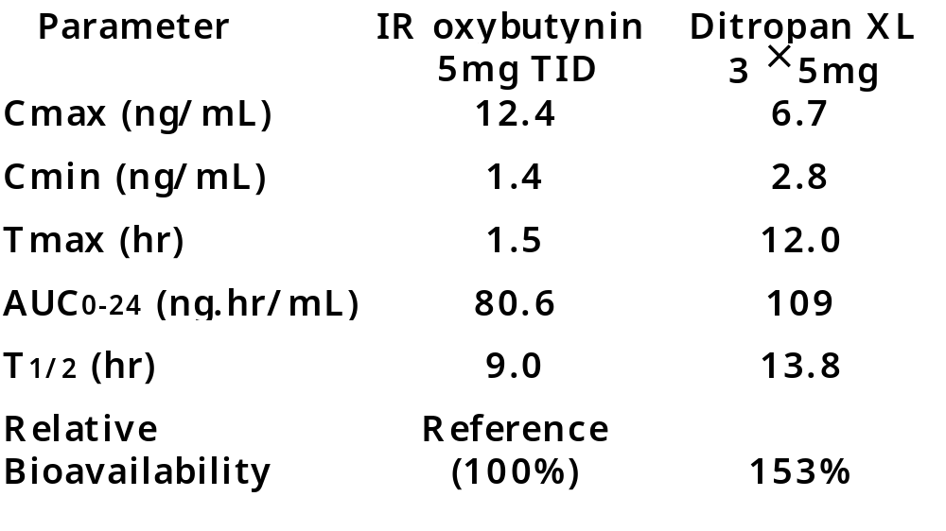
Pharmacokinetic Parameters
Steady State Pharmacokinetic Parameters and Relative Bioavailability of oxybutynin

Slide 21
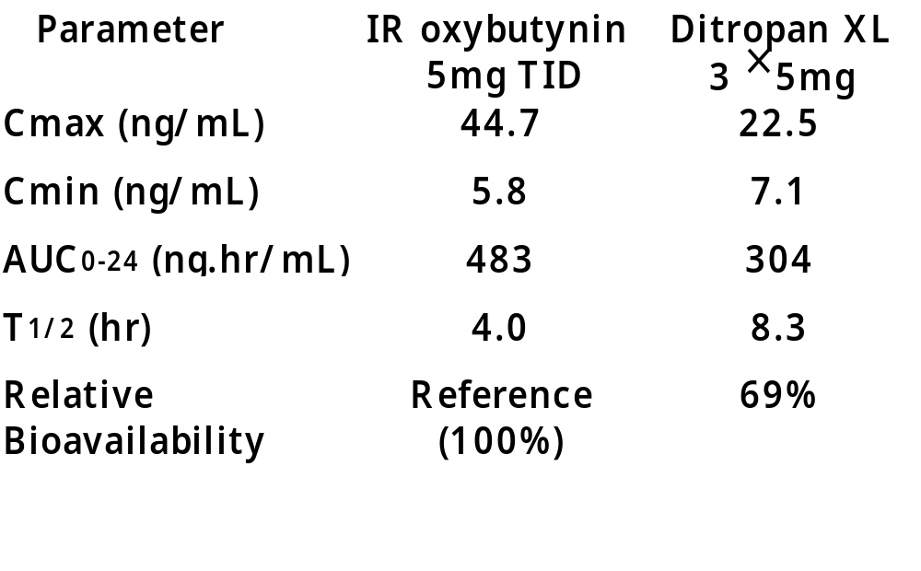
Pharmacokinetic Parameters
Steady State Pharmacokinetic Parameters and Relative Bioavailability of
active metabolite desethyloxybutynin

Slide 22
Difference of Relative Bioavailability
IR XL
oxybutynin 100% 153%
desethyloxybutynin 100% 69%
Major Drug Release Site
stomach small intestine colon
IR ✓ ✓
XL ✓ ✓ ✓
CYP3A4 activity
colon < small intestine

Slide 23
FDA Reviewer’s Comment
Because of differences in pharmacokinetics, methabolism and bioavailability, dose by dose comparisons between IR oxybutynin and Ditropan XL are not appropriate

Slide 24
Results of
Phase 1 Clinical Trials
Dose proportionality of Ditropan XL
10mg to 20mg was demonstrated
Bioequivalence of clinical and
commercial scale batches was
demonstrated.
No significant food effect

Slide 25
Other Notations
by FDA Reviewer
Race and Gender
No Significant Difference was found
Age
No Significant Difference was found
Metabolism Well Defined
Drug Interactions
No studies were done with Ditropan XL

Slide 26
Pivotal Clinical Trials of Ditropan XL
NDA 12/17/97
C95-031
12/2/95
12/2/96
C95-049
6/30/96
2/26/97
C97-020
IND 10/2/95
12/3/97
5/18/98

Slide 27
Phase 2/3 Clinical Trials
C95-031
Double Blind, Placebo and Active (IR)
Controlled (Double Dummy)
Multi-center (9 centers in US)
n=82 (all female) + Experimental Arm
Ditropan XL n=34
Immediate Release (IR) n=32
Placebo n=16
Forced Dose Escalation
(5mg - 15mg a day)

Slide 28
Clinical Trial C95-031 (Cont’)
Patients with Urge Incontinence
Enriched Trial
(Only Responders to Oxybutynin)
Primary Efficacy Parameter:
The mean number of weekly episodes of urge urinary incontinence
(Difference from Baseline)
Patient Urinary Diary

Slide 29
Study Flow Schema
C95-031
15mg
Randomize
10mg
5mg
Ditropan XL
Washout
15mg
10mg
5mg
Immediate release
Placebo
Baseline
1 week
Placebo

Slide 30
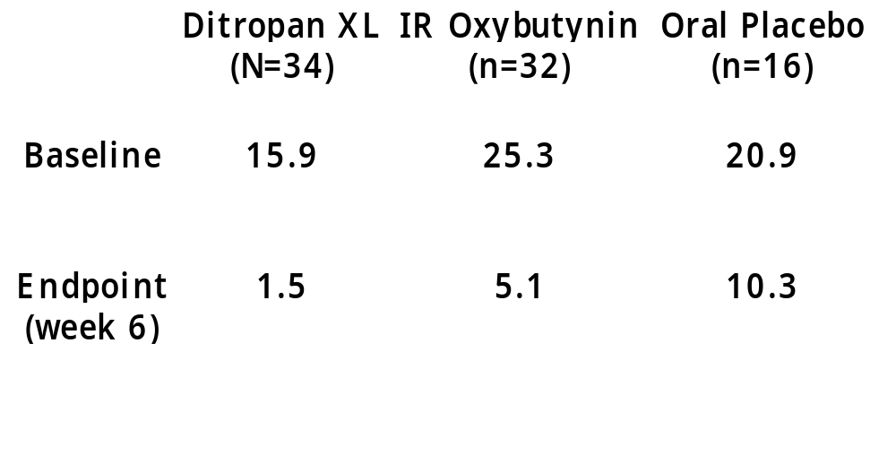
Clinical Trial C95-031 (Cont’)
Mean Number of Weekly Urge Incontinence Episodes

Slide 31
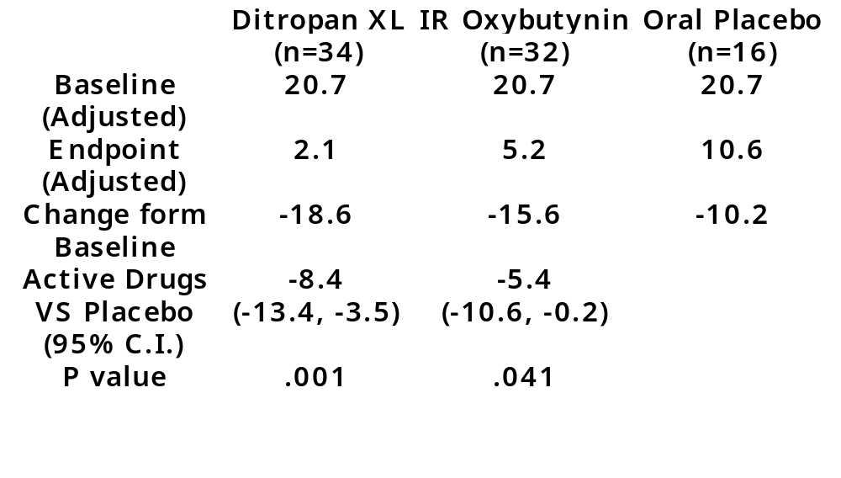
Clinical Trial C95-031 (Cont’)
Adjusted with ANCOVA/ANOVA models
XL vs. IR (95% C.I.) -3.0 (-7.5, 1.4) p=0.181

Slide 32
Phase 2/3 Clinical Trials
C95-049
Double Blind, Active (IR) Controlled
(Double Dummy)
Multi-center (13 centers in US)
n=105 (female n=97, male n=8)
Ditropan XL n=53
Immediate Release (IR) n=52
Dose titration

Slide 33
Clinical Trial C95-049 (Cont’)
Patients with Urge Incontinence
Enriched Trial
(Only Responders to Oxybutynin)
Primary Efficacy Parameter:
The mean number of weekly episodes of urge urinary incontinence
(Difference from Baseline)
Patient Urinary Diary

Slide 34
Clinical Trial C95-049 (Cont’)
Dose Titration
Starting dose 5mg of oxybutynin
(IR or XL)
Dose increase:
In increments of 5mg
At intervals of 5 to 7 days
Dose increase were discontinued when either MED, MTD, or MAD was reached

Slide 35
Clinical Trial C95-049
Dose Titration (Cont’)
MED: Minimum Effective Dose
    Patient had no episodes of urge urinary incontinence during the final 2 days of the 4-7 days dosing interval
MTD: Maximum Tolerated Dose
    5mg lower than the dose at which patient had reported intolerable anticholinergic effect
MAD: Maximum Allowable Dose
    20mg/day of IR oxybutynin
    30mg/day of Ditropan XL

Slide 36
Study Flow Schema
C95-049
Randomize
5mg
Washout
Ditropan XL
Dose Titration
Period
Maintenance
Period
Sensitivity
Test Period
Placebo
Baseline
5mg
Immediate release

Slide 37
Clinical Trial C95-049 (Cont’)
The primary hypothesis to be tested
  The difference between the change in mean number of urge urinary incontinence per week form baseline to end of study between Ditropan XL and IR oxybutynin group would be zero
Revised objective of the study
  To demonstrate the therapeutic equivalence of Ditropan XL and IR oxybutynin

Slide 38
Clinical Trial C95-049 (Cont’)
Agreement with FDA
The therapeutic equivalence:
  95% confidence interval of the difference between Ditropan XL and IR oxybutynin in the reduction of mean urge urinary incontinence episode did not exceed 4 episodes in favor of IR

Slide 39
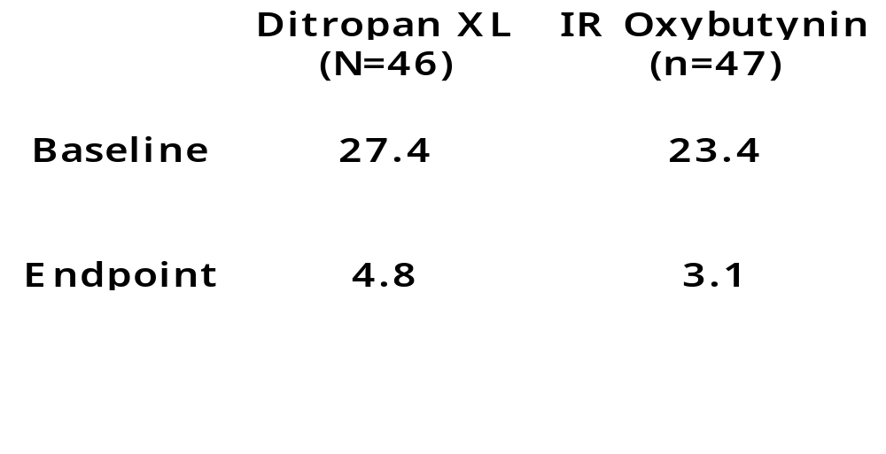
Clinical Trial C95-049(Cont’)
Mean Number of Weekly Urge Incontinence Episodes

Slide 40
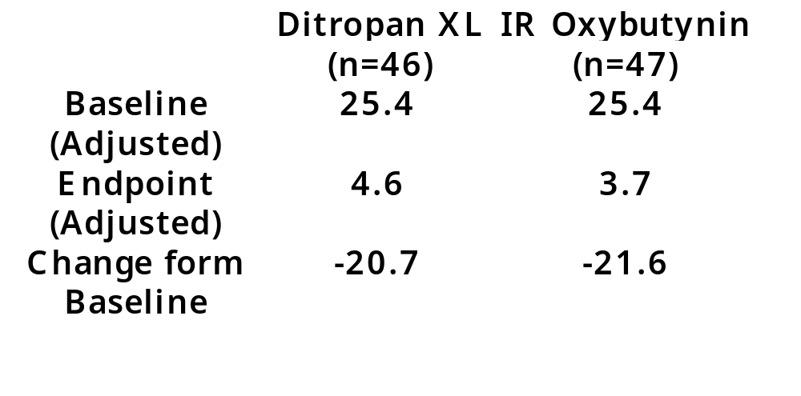
Clinical Trial C95-049(Cont’)
Adjusted with ANCOVA/ANOVA models
XL vs. IR (95% C.I.) .9 (-2.8, 4.6) p=0.636
Equivalence (95% C.I.) -4.0, 4.0

Slide 41
Phase 2/3 Clinical Trials
C97-020
Double Blind, Active (IR) Controlled
(Double Dummy)
Multi-center (20 centers in US)
n=226
Ditropan XL n=111
Immediate Release (IR) n=115
Dose titration

Slide 42
Clinical Trial C97-020 (Cont’)
Patients with Urge Incontinence
Enriched Trial
(Only Responders to Oxybutynin)
Primary Efficacy Parameter:
The mean number of weekly episodes of urge urinary incontinence
(Difference from Baseline)
Patient Urinary Diary

Slide 43
Clinical Trial C97-020 (Cont’)
Dose Titration
Starting dose 5mg of oxybutynin
(IR or XL)
Dose increase:
In increments of 5mg
At intervals of 5 to 7 days
Dose titration criteria
Next slide

Slide 44
Clinical Trial C95-020
Dose Titration (Cont’)
Patient had achieved a target endpoint of no urge urinary incontinence episodes of the last three days of the period
The patient received the maximum allowable dose (20mg/day)
Tolerable anticholinergic effect but the symptom would be intolerable if the medication were increased
Dose Decrease
Intolerable anticholinergic effect: In this case, the dose was decreased to the next lower dose or the patient was discontinued from the study at the discretion of the study physician

Slide 45
Study Flow Schema
C97-020
Randomize
5mg
Washout
Ditropan XL
Dose Titration
Period
Maintenance
Period
Sensitivity
Test Period
Placebo
Baseline
5mg
Immediate release

Slide 46
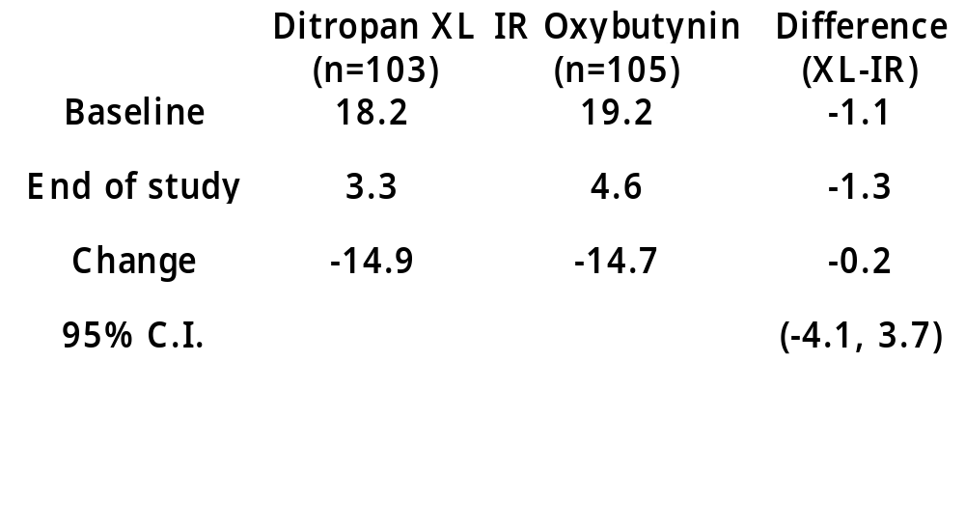
Clinical Trial C95-020 (Cont’)
Mean Number of Weekly Urge Incontinence Episodes (adjusted)

Slide 47
Phase 2/3 Clinical Trials
C96-070
Uncontrolled, Open-labeled
Long Term Safety Trial
Up to 23 weeks
Minimum 12 weeks
Ditropan XL n=256

Slide 48
Conclusion from the Trials
The sponsor demonstrated that
Superiority of the XL formulation over placebo
Equivalence to the IR formulation
for the management of incontinence
Claims of superiority regarding dry mouth for the XL are not supported by the data in the application

Slide 49
Evaluation of Dry mouth
Sponsor attempts to prove that Ditropan XL has increased tolerability in terms of dry mouth compared to IR oxybutynin at equally efficacious dose
Data from the controlled trials does not demonstrate that either a statistical or clinical meaningful difference in incidence of dry mouth

Slide 50
Evaluation of Dry mouth (cont’)
Clinical Trial Design Flaws
FDA reviewer’s comments
Maintenance period is too short
(6 - 12 weeks is appropriate)
Lack of visual analogue scale
Clinical meaningfulness
Should be determined in a trial separate from the efficacy trial

Slide 51
Pivotal Clinical Trials and Regulatory History of Ditropan XL
NDA 12/17/97
C95-031
12/2/95
12/2/96
IR Purchase
C95-049
6/30/96
2/26/97
C97-020
IND 10/2/95
12/3/97
5/18/98
TC with FDA

Slide 52
Ditropan XL
Clinical Development
Issues
Competitive Drugs
Superiority on Dry Mouth over Ditropan Immediate Release
Failure to Prove Equivalence in Trial C95-049

Slide 53
Pivotal Clinical Trials and Regulatory History of Ditropan XL
NDA submitted
12/17/97
Approval
12/16/98
C95-031
12/2/95
12/2/96
C95-049
6/30/96
2/26/97
C97-020
IND submitted
10/2/95
12/3/97
5/18/98

Slide 54
Competitive Drugs
Detrol (tolerodine tartrate)
Pharmacia & Upjohn
Approved in March 1998
Duloxetine in Phase 2
Darifenacin in Phase 3
From Pharmaceutical Approval Monthly
September 1997

Slide 55
Pivotal Clinical Trials and Regulatory History of Ditropan XL
C95-031
NDA submitted
12/17/97
Approval
12/16/98
12/2/95
12/2/96
C95-049
6/30/96
2/26/97
C97-020
IND submitted
10/2/95
12/3/97
5/18/98
NDA of Detrol
submitted
3/18/97

Slide 56
Pivotal Clinical Trials and Regulatory History of Ditropan XL
C95-031
NDA submitted
12/17/97
Approval
12/16/98
12/2/95
12/2/96
C95-049
6/30/96
2/26/97
C97-020
IND submitted
10/2/95
12/3/97
5/18/98
NDA of Detrol
submitted
3/18/97
Approval of
Detrol
3/18/98

Slide 57
Sales of Similar Drugs
(March 1998-Dec. 1998)
Ditropan IR $5.4 million
Generic Ditropan $15.6 million
Detrol $74.1 million
Detrol (tolerodine tartrate)
Pharmacia & Upjohn
Approved in March 1998
Sales Data from Pharmaceutical Approval Monthly

Slide 58
Cost of Pharmaceuticals
Minimum Dosage Basis, Per day
Ditropan XL 5mg $2.10
Ditropan 5mg TID $1.85
Generic Ditropan 5mg TID $0.74
Detrol 1mg BID $2.24
Detrol (tolerodine tartrate)
Pharmacia & Upjohn
Approved in March 1998
Price Data from Eckeurd Pharmacy website

Slide 59
Sales of Ditropan XL and Detrol
(Jan. - Sept. 1999, Million Dollars)
Ditropan XL* Detrol**
First Quarter 99’ $25.4 $64.9
Second Quarter 99’ $14.4 $86.0
Third Quarter 99’ $22.0 $85.0
Total $72.8 $235.9
* From Alza Corporation Sales Report
** From Pharmacia & Upjohn Sales Report
(Sales of Detrol include sales in Sweden)

Slide 60
Evaluation of Dry mouth (cont’)
Clinical Trial Design Flaws
FDA reviewer’s comments
Maintenance period is too short
(6 - 12 weeks is appropriate)
Lack of visual analogue scale
Clinical meaningfulness
Should be determined in a trial separate from the efficacy trial

Slide 61
Ditropan XL: Questions
Why did it take 7 month to start second pivotal trial?
What is the reason they did not include placebo arm in trial C95-049?
Notes:
Mechanistic understanding of drug in dogs may have indicated that the findings were likely unique to that species. Better analysis of inter-species results.
Make explicit what questions FDA wants answered. What tests?
Analysis of data?

Slide 62
Use of a Placebo Arm
Advantage:
Option to market earlier without superiority claim on dry mouth
Disadvantage:
More patients, longer clinical trial

Slide 63
Ditropan XL: Questions
With other better new drugs in development, is the superiority claim over IR oxybutynin important than early marketing?

Slide 64
Ditropan XL: Questions
Can this clinical development program be described as front-loaded with clinical pharmacology?

Slide 65
Ditropan XL: Questions
How well has the “ideal dose” been characterized?
Notes:
Determination of a reasonable dosing strategy based on available data is not straightforward. The dosing strategy used in study 85A does not permit one to infer the minimum effective citalopram dose since patients were rapidly titrated to their maximum tolerated dose within the first two weeks of the study; it is quite possible that many patients received a higher dose than that necessary to produce a therapeutic response.
Over half (28 of 48) of these completers (of 85A) were treated with mean doses above the max daily dose as proposed by the sponsor (60mg/day).
Results of study 91206 support the efficacy of 40 and 60mg/daydoses while the 10 and 20 mg/day doses failed to convincingly demo efficacy in this study. However, study 89304 provides evidence that 20mg/day is efficacious in preventing relapse in responders.
Conclusion: Neither the bottom nor the top of the effective dose range are reasonably dlineated by these data.

Slide 66
Ditropan XL: Questions
How could the clinical development program have been conducted?

Slide 67
T H E E N D

