Slide 1
Malignant Melanoma – selecting, sequencing, and combining therapeutic agents
Antoni Ribas, M.D., Ph.D.
Professor of Medicine
Professor of Surgery
Professor of Molecular and Medical Pharmacology
Director, Tumor Immunology Program,
Jonsson Comprehensive Cancer Center (JCCC)
University of California Los Angeles (UCLA)
Chair, Melanoma Committee at SWOG

Slide 2
BRAF
BRAF inhibitor
MEK
ERK
Oncogenic cell
proliferation
and survival

Slide 3
Indirect comparison of vemurafenib and dabrafenib in patients with BRAF^{V600} mutant metastatic melanoma
>100
BRIM3
Chapman et al.
NEJM 2011
Vemurafenib
(960 mg po bid)
50
0
-50
-100
BREAK3
Hauschild et al.
Lancet 2012
Dabrafenib
(150 mg po bid)

Slide 4
BRAF
BRAF inhibitor
MEK
ERK
Oncogenic cell
proliferation
and survival

Slide 5
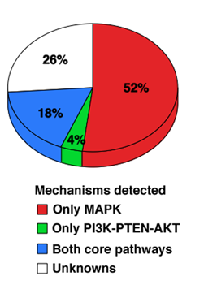
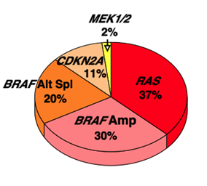


Overview of acquired resistance mechanisms
Core pathways
MAPK pathway
Nazarian, Shi… Ribas, Lo. Nature 2010
Shi… Ribas, Lo. Nature Communications 2012
Poulikakos… Ribas, Lo, Rosen, Solit. Nature 2011
Shi, Hugo… Ribas, Lo. Cancer Discovery 2013
Acquired resistance
according to Roger Lo

Slide 6
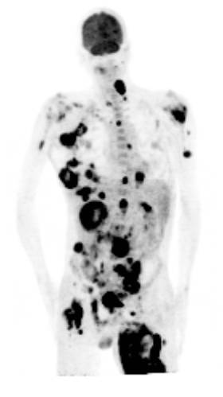
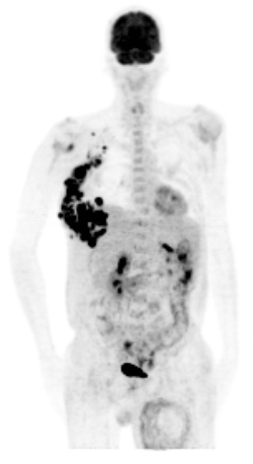
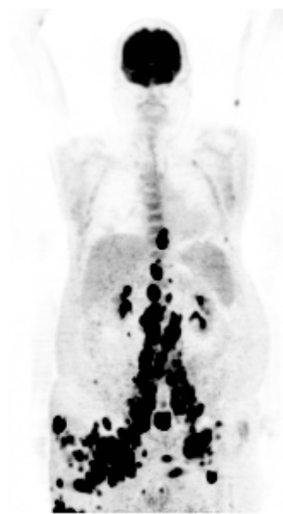
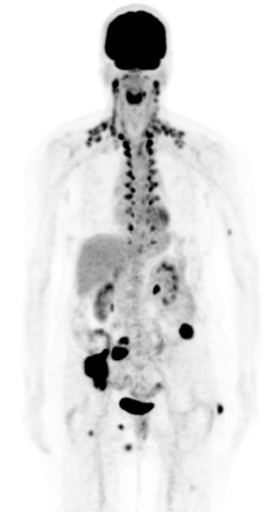
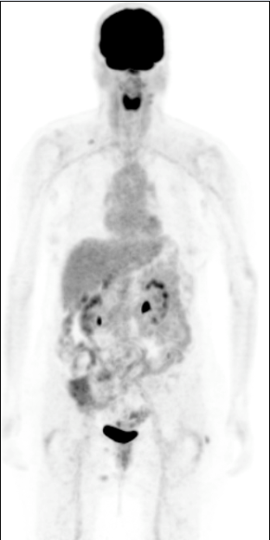
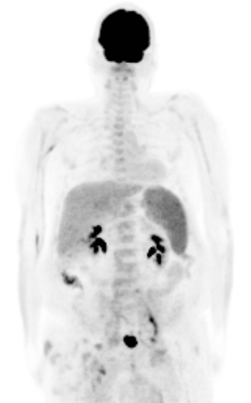
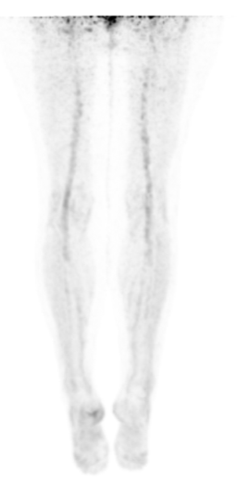
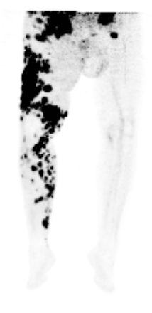
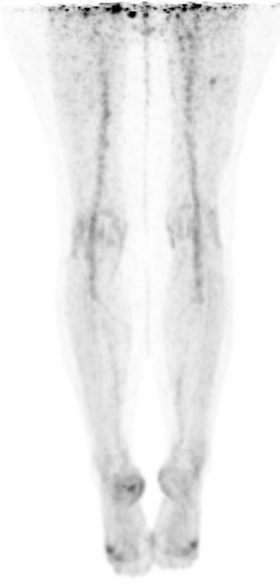
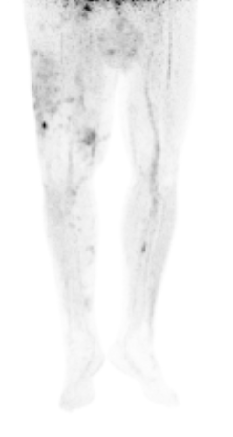
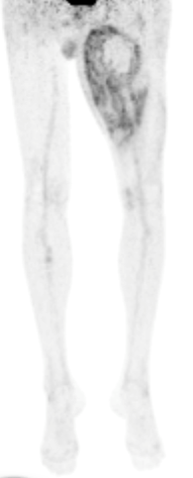
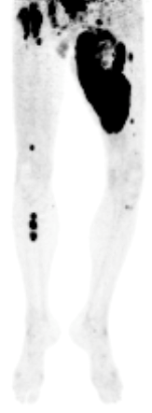
Adding the MEK inhibitor GDC0973 to continued vemurafenib after progressing on single agent vemurafenib
Vem
Vem+GDC
Day +15
Vem+GDC
Day +15
Vem+GDC
Day +15
Vem
Vem
BRAF^{V600E} amplification
CDKN2A del, AKT1^{E17K}
BRAF^{V600E} amplification
BRAF^{V600E} alternative splicing
Cases from UCLA

Slide 7
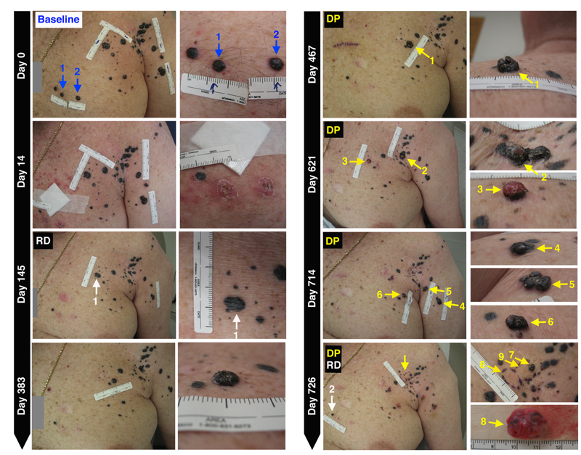
Patient #37: durable response followed by resistance

Slide 8
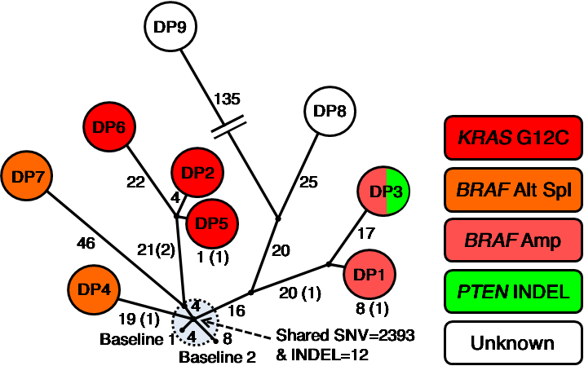
Branched evolution underlying acquired BRAF inhibitor resistance
Unambiguous somatic mutations private in any tumor (360 SNVs & 5 INDELs)
Last common ancestral (LCA) node (2393 SNVs & 12 INDELs wrt normal and shared by all baseline & DP tumors)
Branched rather than linear evolution
Most genetic alterations & mechanisms of resistance not shared
Evolutionary diversification of DP tumors not co-linear with timing of clinical emergence

Slide 9
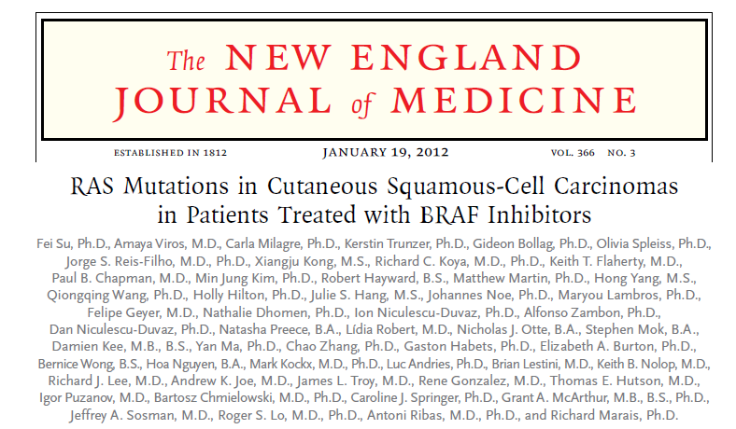
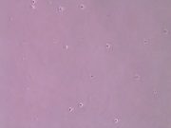
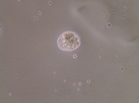
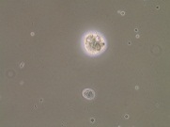
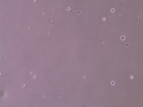
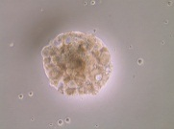
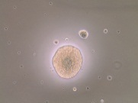
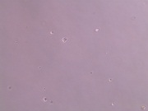
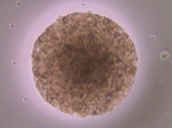
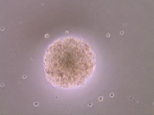
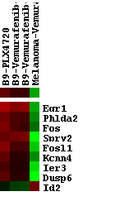
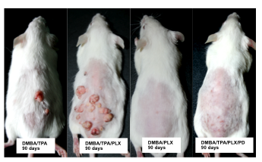
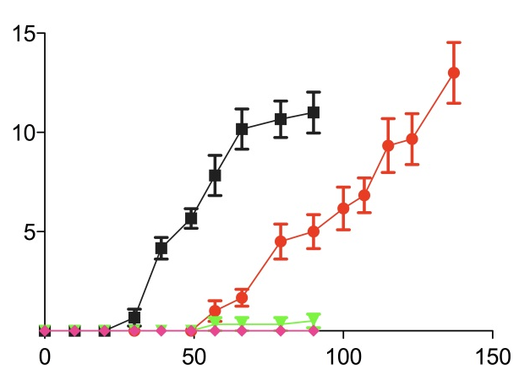
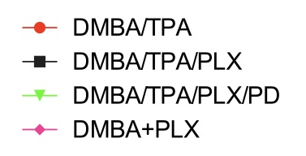
Paradoxical MAPK activation resulting in RAS-induced cuSCC
NIH3T3-
Vector
NIH3T3-HRAS^{Q61L}
DMSO
vemurafenib
0.2 µM
vemurafenib
1 µM
Cultured for 24 days
B9-PLX4720
B9-Vemurafenib-A
B9-Vemurafenib-B
Melanoma-Vemurafenib
Tumors/mouse
MAPK pathway output compared to Josep et al. PNAS 2010
Time (days)
BRAFi
BRAFi+MEKi

Slide 10
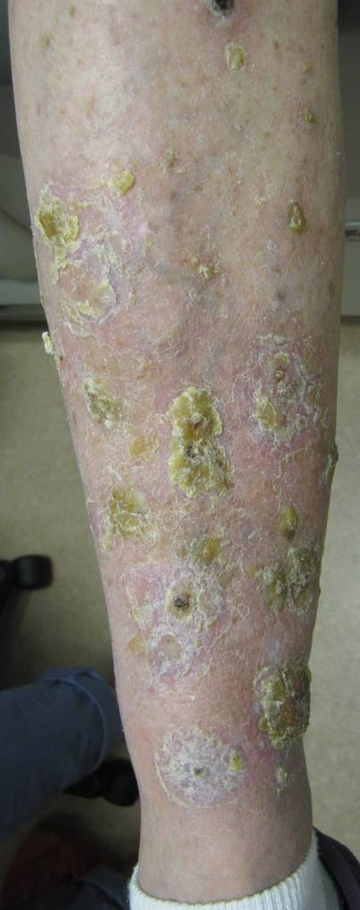
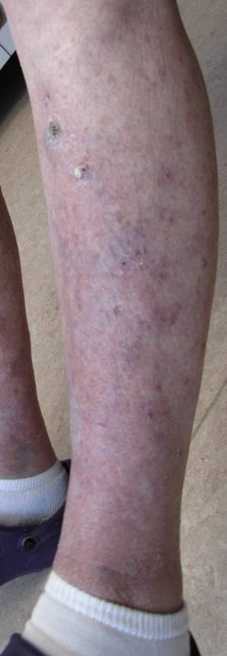
Improvement of hyperproliferative skin Lesions with addition of the MEK inhibitor GDC-0973 to vemurafenib
On vemurafenib alone
On vemurafenib
+ GDC-0973
HRAS^{Q61}
BRAFi
HRAS^{Q61}
BRAFi
CRAF
BRAF
CRAF
BRAF
MEKi
MEK1/2
MEK1/2
P
P
ERK
ERK
P
P
MAPK signaling
MAPK signaling
BRAFi
Case from UCLA
MEKi

Slide 11

Toxicity | Dabrafenib | Dabrafenib+ trametinib 150/1 | Dabrafenib+ trametinib 150/2
Hyperkeratosis | 30% | 6% | 9%
cuSCC | 19% | 2% | 7%
Papillomas | 15% | 7% | 4%
Pyrexia | 26% | 69% | 71%
Higher efficacy, lower toxicity related to paradoxical MAPK activation

Slide 12
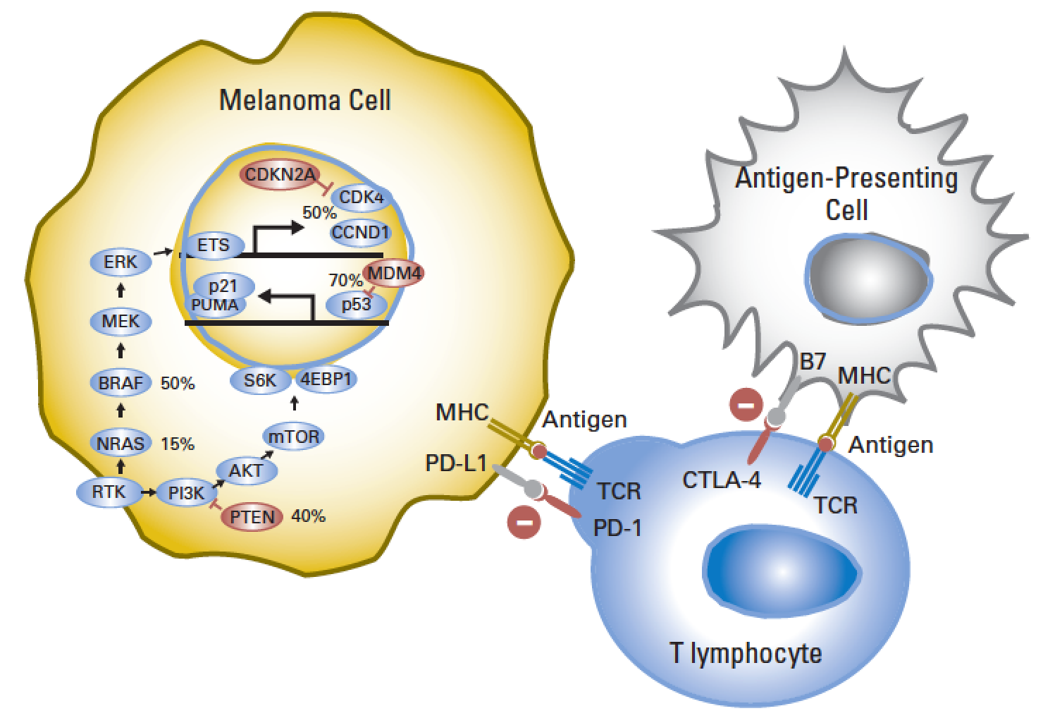
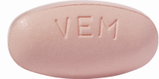
Advances in the treatment of metastatic melanoma
ipilimumab
McArthur & Ribas, J Clinical Oncology 2013
Notes:
12

Slide 13
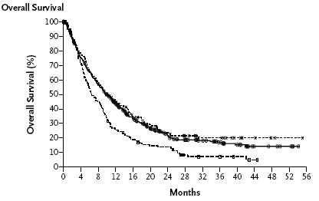
Combining immunotherapy and targeted therapy for melanoma?
Immunotherapy
Targeted therapy
Combination???
Percent alive
Percent alive
Percent alive
0
1
2
3
0
1
2
3
0
1
2
3
Years
Years
Years

Slide 14

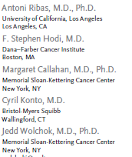
Clinical trial of vemurafenib + ipilimumab stopped early due to increased frequency of grade 3 elevations in transaminases (higher than the expected rate with each agent alone)
NEJM 2013; 368 (14): 1365 (letter)

Slide 15

Paradoxical Activation in Lymphocytes
↑ TILs (CD8+)^{4,5,6}
↑ Clonality of rearranged TCRß ⁷
↑ Paradoxical Activation ^{8,9}
↑pERK
ERK
MEK
↓IL-1³⁶, IL-6, IL-10, IL-6, VEGF^{10,15}
↑ TNF-ɑ rescues apoptosis¹⁶
↓ CCL-2 ¹⁷ ↓ MDSCs
BRAF
TCR
BRAF inh
TNF
HLA
↑ T-cell recognition^{3,4,15}
Tumor melanoma cell
BRAF V600E
↓pERK
MEK
Melanoma Antigen Expression
ERK
↑Mart
↑Tyr
↑gp100
Macrophage
IL-6
↑MITF
Immunosupressive cytoquines
Survival Proliferation NUCLEUS
Tumor Microenvironment
IL-10
CCL2
IL-6
VEGF
PD-1
↑Antigen expression^{1,2,3,4}
↑ HLA Expression ²
IL-1
PD-L1
↑ PD1 = exhausted⁴
↑ PD-L1 = resistance⁴
↓ PD-L1 with MEKi ^{4,12-14}
TAF
Immune Checkpoints
↓ IL-1¹¹ → ↓ TAF immunosupression → ↓ PD-L1
1.Kono M. Mol Cancer Res 2006 2. Sapkota B. Oncoimmunology 2013. 3. Boni A. Cancer Res 2010. 4. Frederick DT. Clin Cancer Res 2013. 5. Long GV. Pigment Cell Melanoma Res 2013. 6. Wilmott JS. Clin Cancer Res 2012. 7. Cooper ZA. Oncoimmunology 2013. 8. Comin-Anduix B. Clin Cancer Res 2010. 9. Koya Cancer Research 2012. 10. Sumimoto H. J Exp Med 2006. 11 Khalili JS. Clin Cancer Res 2012. 12. Yamamoto R. Cancer Sci 2009. 13. Berthon C. Cancer Immunol Immunother 2010. 14 Knight DA. J Clin Invest 2013. 15.Liu CCR 2013. 16. Gray-Schopfer VC. Cancer Res 2007. 17. Landsberg, Nature 2012.

Slide 16
Conclusions
BRAF inhibitors result in high initial response rates in BRAF^{V600E} mutant metastatic melanoma
Resistance to BRAF inhibitors is mediated by different mechanisms, and the mechanism of resistance may predict for sensitivity to the addition of secondary treatments:
MEK inhibitors
PI3K/AKT/mTOR inhibitors
Combinations of targeted therapies and immunotherapy need to be carefully evaluated

