Slide 1
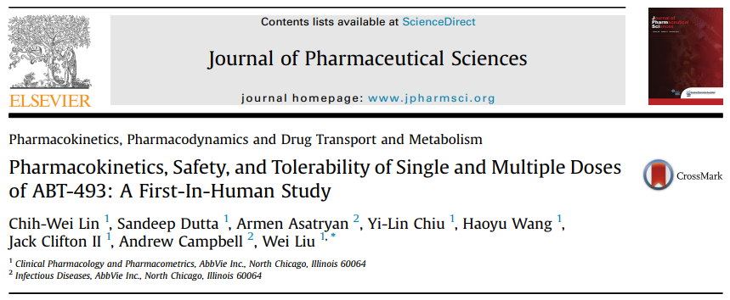
A First-In-Human Study of ABT-493
Pharmacokinetics, Safety, and Tolerability of Single and Multiple Doses
임상약리학과
서브인턴 서인석

Slide 2
Contents
Introduction
Methods
Results
Discussion
Conclusions

Slide 3
Introduction
Hepatitis C virus (HCV) infection is a global health problem.
Between 10% and 40% of patients with chronic HCV infection will develop cirrhosis.
Cirrhosis caused by HCV is the most common indication for liver transplantation.
Successful eradication of HCV has been shown to significantly reduce the risk of disease progression and related mortality and the development of hepatocellular carcinoma.

Slide 4
Introduction
More efficacious and better tolerated anti-HCV treatment regimens - Interferon-free Direct-Acting Antiviral Agent (DAA) regimens ex) Nonstructural (NS) protein 3/4A protease inhibitor - Previous : PEG-interferon and ribavirin combination treatment - NS3/4 protease inhibitor, NS5A inhibitor, and a NS5B inhibitor, with or without ribavirin combination therapies allowed for the complete removal of pegylated interferon from the HCV treatment paradigm. - Drastically shortened the treatment duration with high efficacy and tolerability. - Lower resistance barrier, mainly for HCV genotype 1 infection.

Slide 5
Introduction; ABT-493
Pangenotypic NS3/4A protease inhibitor
Acceptable pharmacokinetic behavior
Well absorbed
Eliminated via biliary with limited metabolism
Exhibits a high genetic barrier to resistance in major genotypes
Strong antiviral effect
Potential to cure all major types of HCV infections in combination with other DAAs.

Slide 6
Focus of the study
Pharmacokinetics, safety, and tolerability of single and multiple escalating doses in healthy adult subjects.
The effect of food and ritonavir coadministration.

Slide 7
Methods
Subjects
Study Design
Study Drug Treatment
Assessments - Pharmacokinetics - Safety - Statistical Analysis

Slide 8
Subjects
Adult men and women (postmenopausal or surgically sterile) aged 18-55 years and in general good health.
Excluded - Positive test for hepatitis A, B, or C or HIV - ALT/AST above the upper limit of normal - Any tobacco or nicotine products within 6 months - Any investigational product within 42 - Any drug by injection within 30 days - Any over-the-counter prescription medication, vitamin, or herbal supplement within 14 days - Any grapefruit, grapefruit products, Seville oranges, or starfruit within 3 days - Any alcohol within 3 days

Slide 9
Study Design
Single center study; 3 substudies
Substudy 1 : Single escalating doses - Randomized, double-blind, placebo-controlled study
Substudy 2 : Multiple escalating doses for 10 days - Randomized, double-blind, placebo-controlled study
Substudy 3 : Effect of food and ritonavir coadministration - Open-label, 3-period crossover study - Periods 1 & 2 : fasting / nonfasting - Period 3 : with ritonavir under nonfasting conditions
Starting dose : no-observed-adverse-event-level (NOAEL) exposure from rat and dog studys.
Final maximum dose : C_{max} and AUC not exceed the NOAEL exposure.

Slide 10
Study Drug Treatments
All study drugs (ABT-493, placebo, and ritonavir) were administered orally under nonfasting conditions. (With the exception of the fasting portion of substudy 3.)
Standardized diet
All meals during confinement
25 to 800 mg in the single-dose substudy
200 to 800 mg in the multiple-dose substudy
200 mg in the food effect substudy.

Slide 11
Assessment; Pharmacokinetics
Blood Samples - Substudy 1 ① Before the morning dose on day 1 ② 0.5, 1, 2, 3, 4, 5, 6, 8, 10, 12, 15, 18, 24, 30, 36, 48, 60, and 72 hours after dose. - Substudy 2 ① Before the morning dose on day 1 ② 0.5, 1, 2, 3, 4, 5, 6, 8, 10, 12, and 16 hours after dose. ③ Day 10 : Before dosing + 0.5, 1, 2, 3, 4, 5, 6, 8, 10, 12, 16, 24, and 72 hours after dose. - Substudy 3 ① Before the morning dose on study day 1 (in each period) ② 0.5, 1, 2, 3, 4, 5, 6, 8, 10, 12, 15, 18, 24, 30, 36, 48, 60, and 72 hours after dose.
Trough samples Before the morning dose on study days 2, 3, 5, 7, 8, and 9.
Urine samples (collected in substudy 2 only) ① Before dosing ② 0 to 6, 6 to 12, and 12-24 hours after dosing on study day 10.

Slide 12
Assessments; Pharmacokinetics
Pharmacokinetic parameters were estimated using noncompartmental methods.
Substudies 1 and 3 - C_{max}, T_{max}, t_{1/2}, AUC∞
Substudy 1 only - dose-normalized C_{max} and AUC∞
Substudy 2 - C_{max}, T_{max}, C_{trough}, AUC₀₋₂₄ - dose-normalized C_{max}, C_{trough}, and AUC₀₋₂₄, R_{ac}

Slide 13
Assessments; Safety
Safety was assessed through adverse event monitoring, vital signs, physical examinations, electrocardiogram (ECG) measurements, and clinical laboratory test assessments.

Slide 14
Assessments; Statistical Analysis
Substudy 1 - Statistical analyses : dose-normalized C_{max} and AUC - Analysis of covariance (ANCOVA) → Dose proportionality and linear kinetics for the single-dose regimens. - Possible covariates : body weight, age, sex
Substudy 2 - Repeated-measures analysis : steady state C_{trough} - ANCOVA : dose-normalized C_{trough}, C_{max}, and AUC₀₋₂₄ on study day 10 → Dose proportionality - Possible covariates : body weight, age, sex
Substudy 3 - Analysis of variance (ANOVA) : T_{max}, natural logarithms of C_{max}, AUC → Bioavailabilty (nonfasting / fasting) - Paired t-test : T_{max}, natural logarithms of C_{max} and AUC → Effect of ritonavir (Bioavailability of ABT-493)

Slide 15
Results
Subject Disposition and Demographics
Pharmacokinetics - Single-Dose Study - Multiple-Dose Study - Food Effect and Coadministration with Ritonavir study
Safety

Slide 16
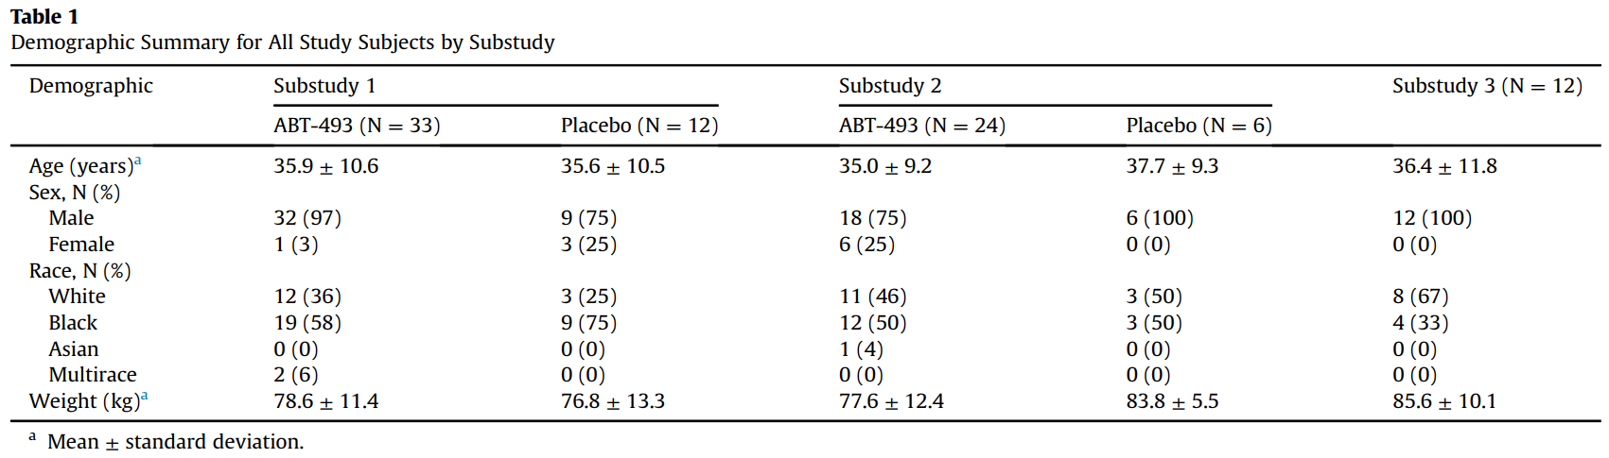
Subject Disposition and Demographics
69 subjects were included in the statistical analyses.
Total of 18 subjects received placebo and were not included in the statistical analyses of the pharmacokinetic parameters.

Slide 17
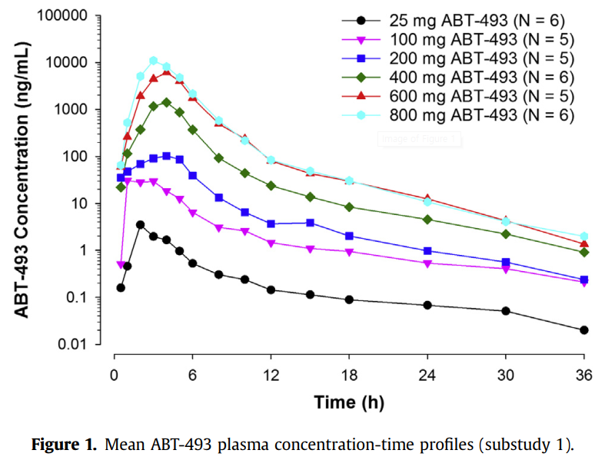
PK; Single-Dose Study (Substudy 1)
Plasma concentrations reached peak levels within 3-4 hours.

Slide 18
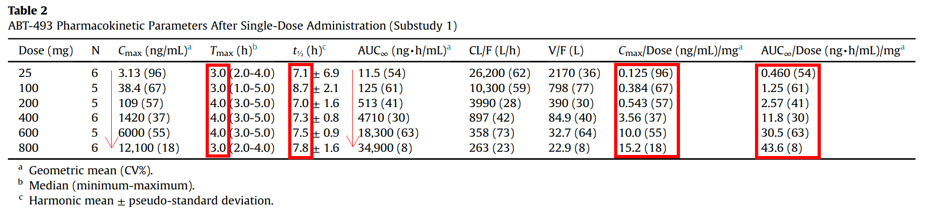
PK; Single-Dose Study (Substudy 1)
Half-lives were approximately 7-9 hours. No increasing or decreasing trend across doses.
Increasing dose from 25 to 800 mg increased C_{max} and AUC by approximately 3880-and 3030-fold, respectively.
Dose-normalized C_{max} and AUC values for ABT-493 were statistically significantly different across the doses of 25-800 mg. Statistically significant linear trend when the dose increased from 25 to 800 mg.
Dose proportionality and linear kinetics for the single-dose regimens of ABT-493 showed that the highest and lowest dose groups were statistically significantly different for dose-normalized C_{max} and AUC∞.

Slide 19
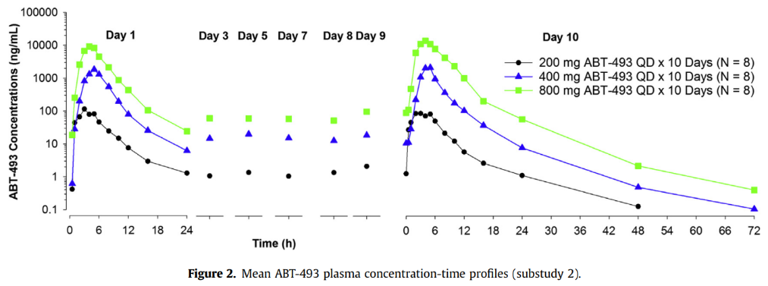
PK; Multiple-Dose Study (Substudy 2)

Slide 20
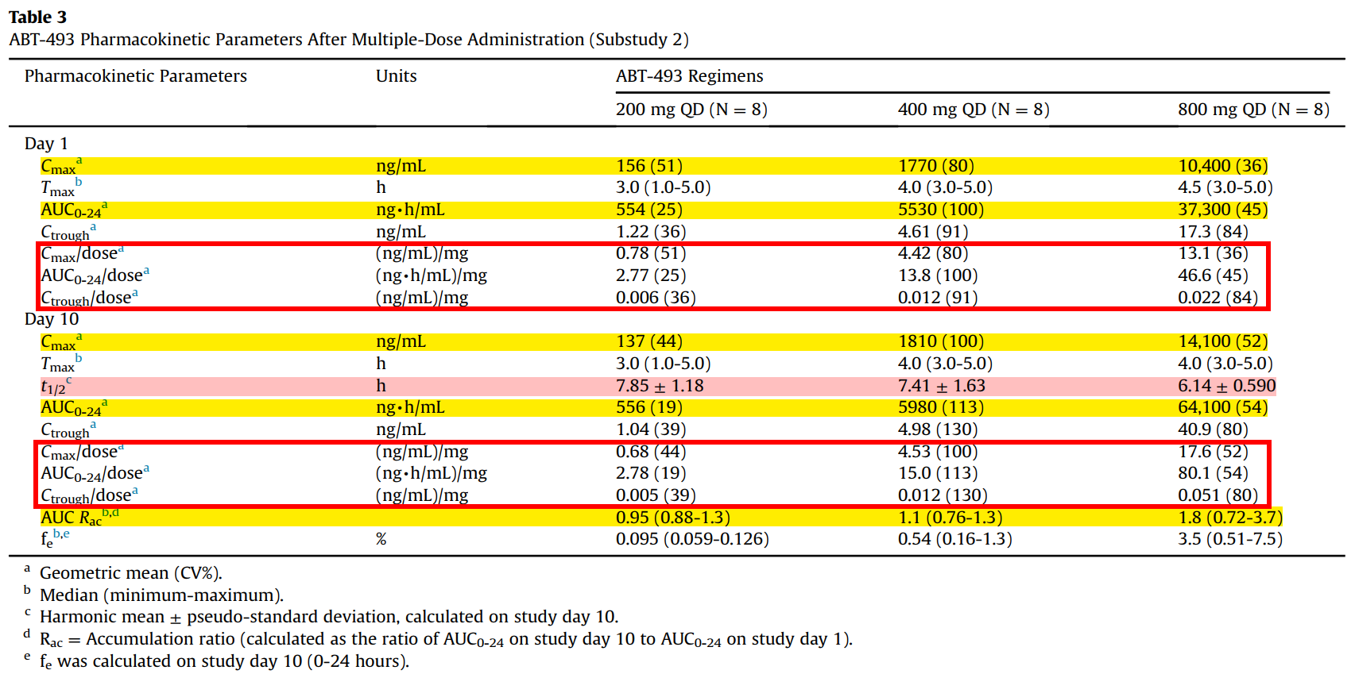
PK; Multiple-Dose Study (Substudy 2)

Slide 21
PK; Multiple-Dose Study (Substudy 2)
C_{max} and AUC₀₋₂₄ for 800-mg once-daily (QD) dose were 103- and 115-fold, respectively.
Half-life values after multiple dosing were approximately 6-8 hours.
Dose-normalized C_{max}, AUC₀₋₂₄, and C_{trough} values increased in a greater than dose-proportional manner from a range of 200- to 800-mg QD.
ABT-493 200-mg vs. 800-mg QD regimen - Dose-normalized C_{max}, AUC₀₋₂₄, and C_{trough} values were statistically significantly different on day 10. - The difference in half-life (<2 hours) was not clinically meaningful.
Steady state within 10 days of multiple dosing.
Minimal accumulation for 200- and 400-mg QD doses. (AUC R_{ac}) At the 800-mg QD dose, the exposures on study day 10 were approximately 80% higher than those on study day 1.

Slide 22
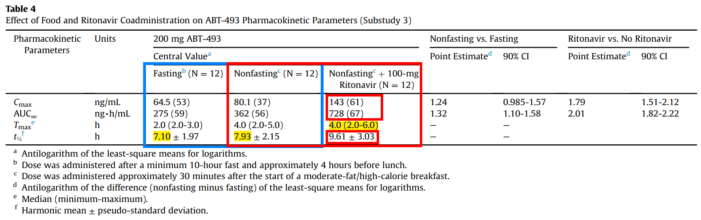
PK; Food Effect, Coadministration With Ritonavir (Substudy 3)
Effect of Food - T_{max} and the natural logarithms of AUC∞ values were significantly different. - T_{max} was delayed by 1.5 hours when administered after a moderate-fat breakfast. - 24% to 32% increase in exposures (C_{max} and AUC) relative to fasting conditions.
Effect of Ritonavir - Statistically significant impact on the natural logarithms of C_{max} and AUC∞ - Half-life was prolonged by about 1.7 hours when coadministered. - Increased C_{max} and AUC by 80% and 100%, respectively. - T_{max} was not significantly affected.

Slide 23
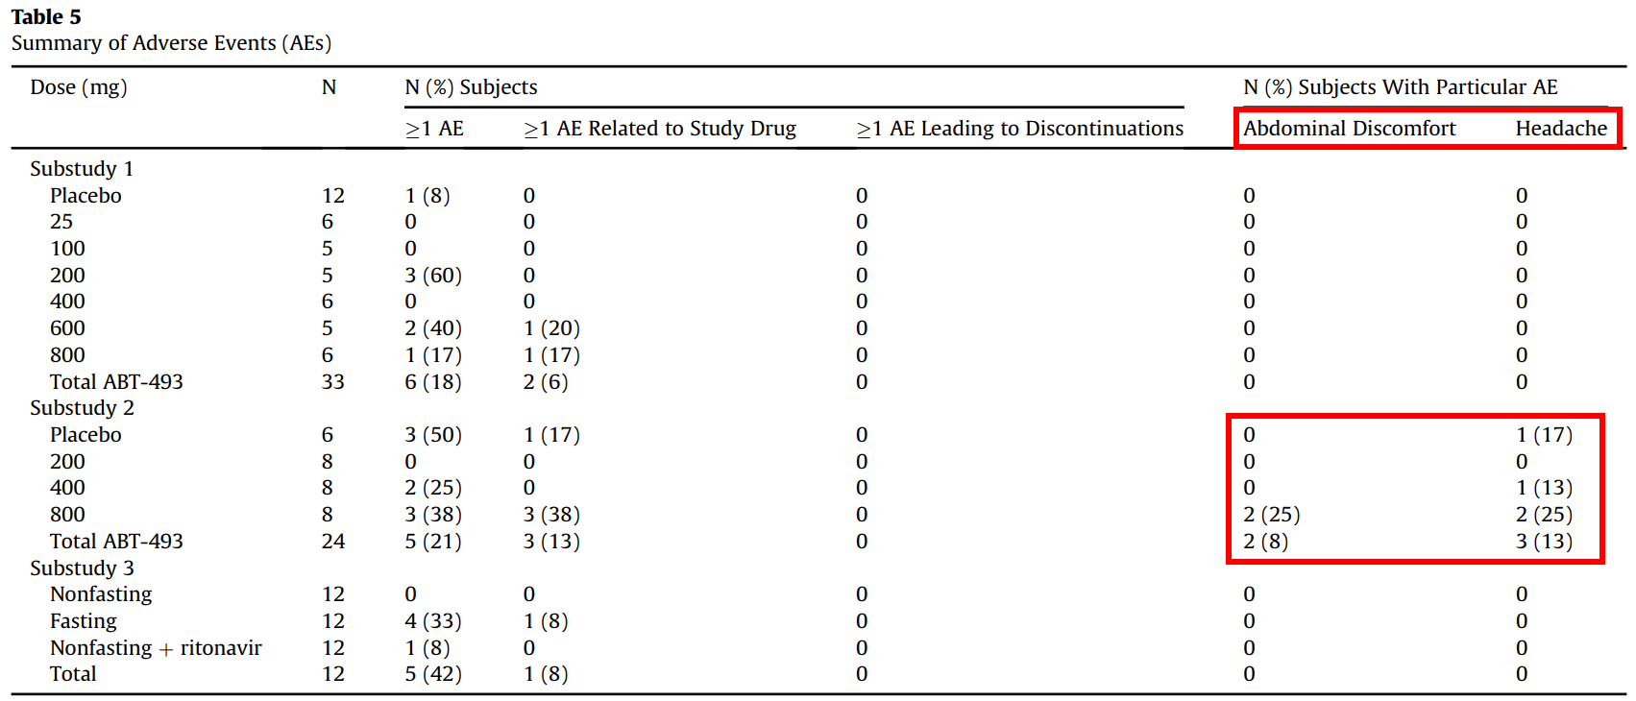
Safety
- 20 subjects reported at least 1 treatment-emergent adverse event during the study. - Abdominal discomfort and headache were the only adverse events reported in ≥2 subjects. (both occurred in substudy 2) - All adverse events were assessed as mild except 1 event of headache.

Slide 24
Discussion; Potency
Potent antiviral activity in vitro against all major HCV genotypes with a higher barrier to resistance.
No or little loss of potency against resistance mutants. → combination therapy with other DAAs.

Slide 25
Discussion; Nonlinearity
Significant nonlinear pharmacokinetics with greater than dose-proportional increases.
Terminal half-lives remained similar at all evaluated doses. → Higher accumulation at the 800-mg on day 10.
Dose-dependent inhibition on the efflux transporters in the gastrointestinal system?
Dose-dependent inhibition of transporter-mediated uptake processes in the liver? → Similar decrease in both clearance and distribution volume. → Systemic exposure may increase without significant changes in half-life.
Short half-life, but strong antiviral effect → due to high liver accumulation? → supports once daily dosing
Renal elimination was minor → potential to be used for HCV patients with renal impairment.

Slide 26
Discussion; Ritonavir coadministration
Inhibitor of CYP3A, OATP1B1, OATP1B3, P-gp, and BCRP
Many protease inhibitors for HCV are substrates of CYP3A, P-gp, OATP1B1, and OATP1B3.
Coadministration increased ABT-493 C_{max} and AUC about 80%-100%. → inhibition effect on the transporters in the gastrointestinal system. (because half-life of ABT-493 was only slightly delayed)
Effect on pharmacokinetics is considered to be weak. (cf. simeprevir 5-7 fold, paritaprevir 30-50 fold)
No ALT elevations were reported.
Mild maculopapular rash was reported in 1 subject (600 mg single dose)

Slide 27
Conclusions
PK shows significant nonlinearity across a wide dose range.
Food had a minimal effect.
Once daily administration.
Minimal accumulation with multiple dosing.
All doses administered were well tolerated.
No SAE, changes in clinical laboratory parameters, vital signs, or ECGs noted.
Maximum tolerated dose was not reached.

