Slide 1
R Programming Week 10: dplyr & tidyr
윤석규 M.D
2017-05-12

Slide 2
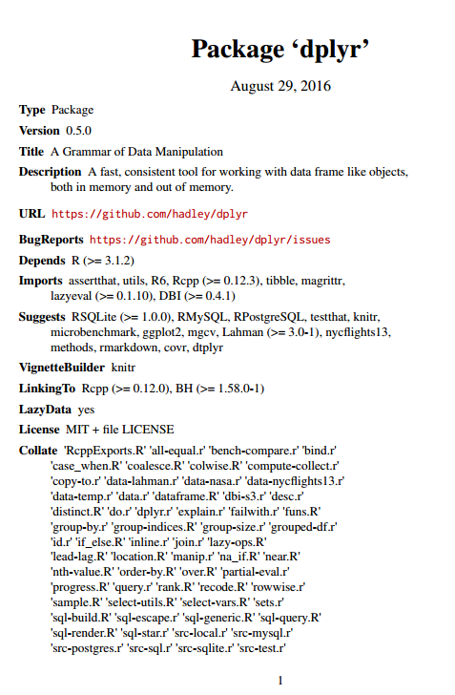
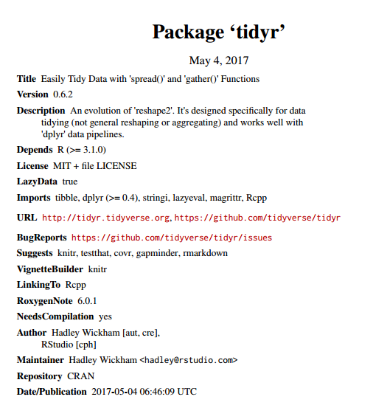

Slide 3

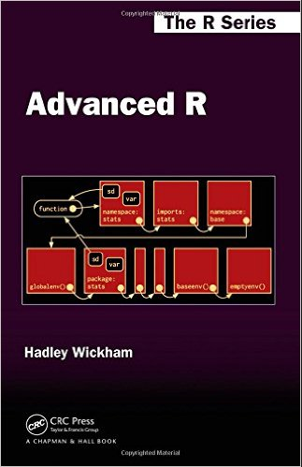

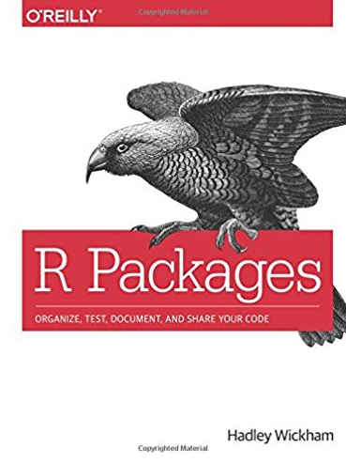
Fig 1. Hadley Wickham, Chief scientist at studio,
and his book

Slide 4
데이터 처리에 특화된 R 패키지
Hadley Wickham이 개발.
filter
select
rename
slice
distinct
rename
replace
-group_by
-gather
-spread
-arrange
-mutate
-join
-etc…

Slide 5
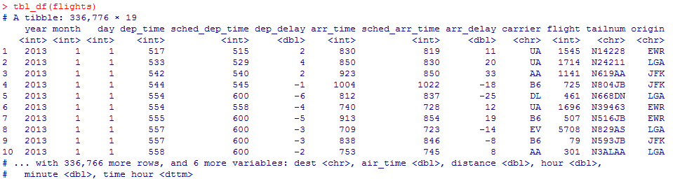
1. tbl_df
각 column의 type
첫 10개의 column
스크린에 보여지지 않은 column

Slide 6
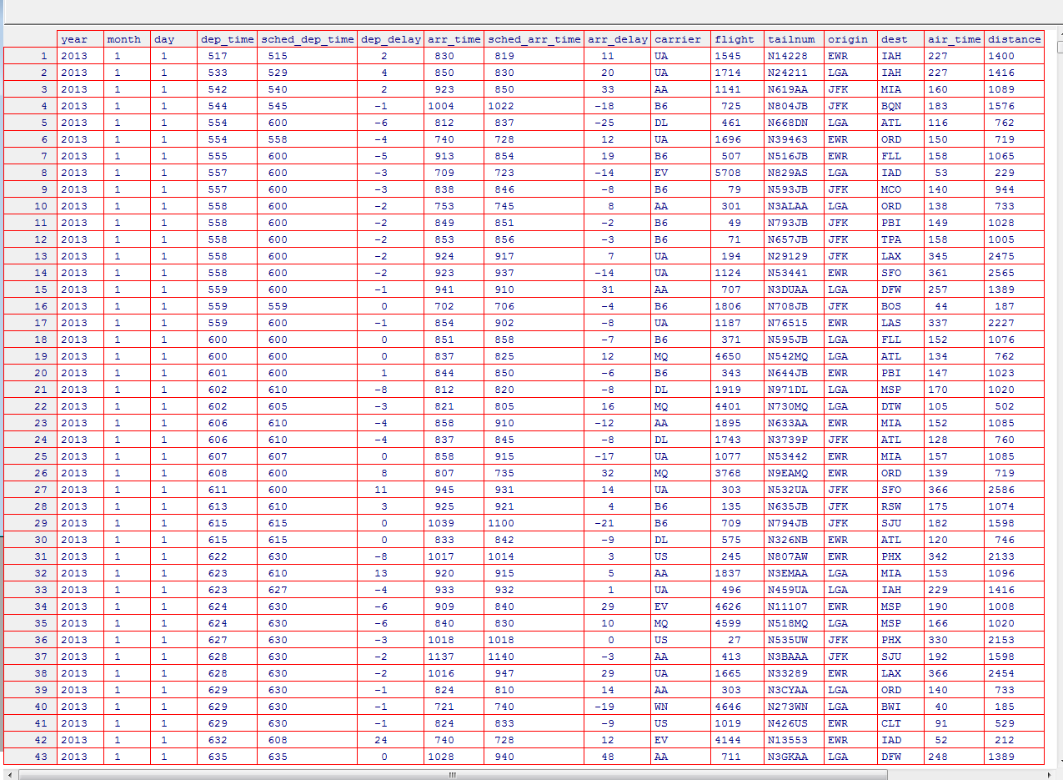
View(flights)

Slide 7
2.Convenience(%>%)
flights[flights$month == 1 & flights$day == 1, ]
while( filter(flights, month == 1 | month == 2))
F <- flights[flights$month == 1 & flights$day == 1, ] -> F[order(F$year, F$month, F$day), ]
while(F <- flights %>% filter(month == 1 | month == 2) %>% arrange(year, month, day))

Slide 8
R내에서 dplyr과 tidyr을 쓰지 않아도 모두 구현 가능
Dataset의 편집을 좀 더 편하게 할 수 있다는 장점
%>%의 기호를 통하여 여러 function을 이어서 모두 구현할 수 있다.
flights %>% filter(month == 1 | month == 2) = filter(flights, filter(month == 1 | month == 2)

Slide 9
3.filter
Logic in R
< | Less than | != | Not equal to
> | Greater than | %in% | Group membership
== | Equal to | is.na | is NA
<= | Less than or equal to | !is.na | is not NA
>= | Greater than of equal to | &, | , any, all | Boolean operator’s

Slide 10
3.filter
X
Y

Slide 11
4.distinct
X
Number | Alphabet
1 | A
1 | A
1 | A
2 | B
2 | B
3 | C
3 | C
Y
Number | Alphabet
1 | A
2 | B
3 | C

Slide 12
5.slice
X
Row | Number | Alphabet
1 | 1 | A
2 | 1 | A
3 | 1 | A
4 | 2 | B
5 | 2 | B
6 | 3 | C
7 | 3 | C
8 | 4 | D
9 | 5 | E
10 | 6 | F
Row | Number | Alphabet
1 | 1 | A
4 | 2 | B
7 | 3 | C
Slice(X,c(1,4,7))

Slide 13
6.select
X

Slide 14
7.arrange
X
Number | Alphabet
1 | A
2 | B
1 | A
3 | C
2 | B
3 | C
1 | A
Number | Alphabet
1 | A
1 | A
1 | A
2 | B
2 | B
3 | C
3 | C

Slide 15
8.rename
Number | Alphabet | Money
1 | A | 100
2 | B | 100
1 | A | 40
3 | C | 50
2 | B | 70
3 | C | 80
1 | A | 110
Number | Alphabet | Cost
1 | A | 100
2 | B | 100
1 | A | 40
3 | C | 50
2 | B | 70
3 | C | 80
1 | A | 110

Slide 16
9.gather
X

Slide 17
10.spread
X

Slide 18
11.Separate & Unite
X
Number | Alphabet
1-1 | A
1-2 | B
1-3 | A
Numb | SubN | Alphabet
1 | 1 | A
1 | 2 | B
1 | 3 | A
X
Numb | SubN | Alphabet
1 | 1 | A
1 | 2 | B
1 | 3 | A
Number | Alphabet
1-1 | A
1-2 | B
1-3 | A

Slide 19
3.group_by & mutate
X

Slide 20
3.Combine Data Sets(join)
x1 | x2
A | 1
B | 2
C | 3
x1 | x3
A | T
B | F
C | T

Slide 21
x1 | x2
A | 1
B | 2
C | 3
x1 | x3
A | T
B | F
C | T
X1 | X2 | X3
A | 1 | T
B | 2 | F
C | 3 | NA
left_join(a,b,by=“x1”): Join matching rows from b to a
X1 | X2 | X3
A | T | 1
B | F | 2
C | T | NA
right_join(a,b,by=“x1”): Join matching rows from a to b

Slide 22
x1 | x2
A | 1
B | 2
C | 3
x1 | x3
A | T
B | F
C | T
X1 | X2 | X3
A | 1 | T
B | 2 | F
inner_join(a,b,by=“x1”)
:Join data. Retain only rows in both sites
X1 | X2 | X3
A | 1 | T
B | 2 | F
C | 3 | NA
D | NA | T
full_join(a,b,by=“x1”)
:Join data. Retain all values, all rows

