Slide 1
R에 대하여
Sungpil Han, M.D/Ph.D
2017-12-21

Slide 2
Outline
R / Rstudio (20 min)
dplyr (20 min)
ggplot2 (20 min)

Slide 3
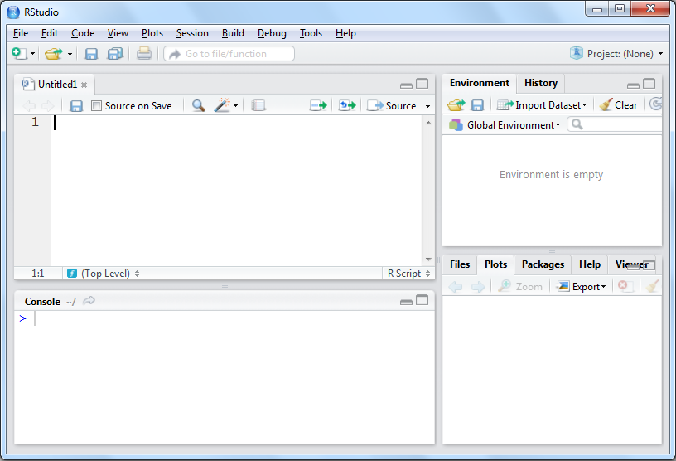
RStudio
Active Coding Area
Some Point-and-Click
Place to Enter Single Commands
View Some Output

Slide 4
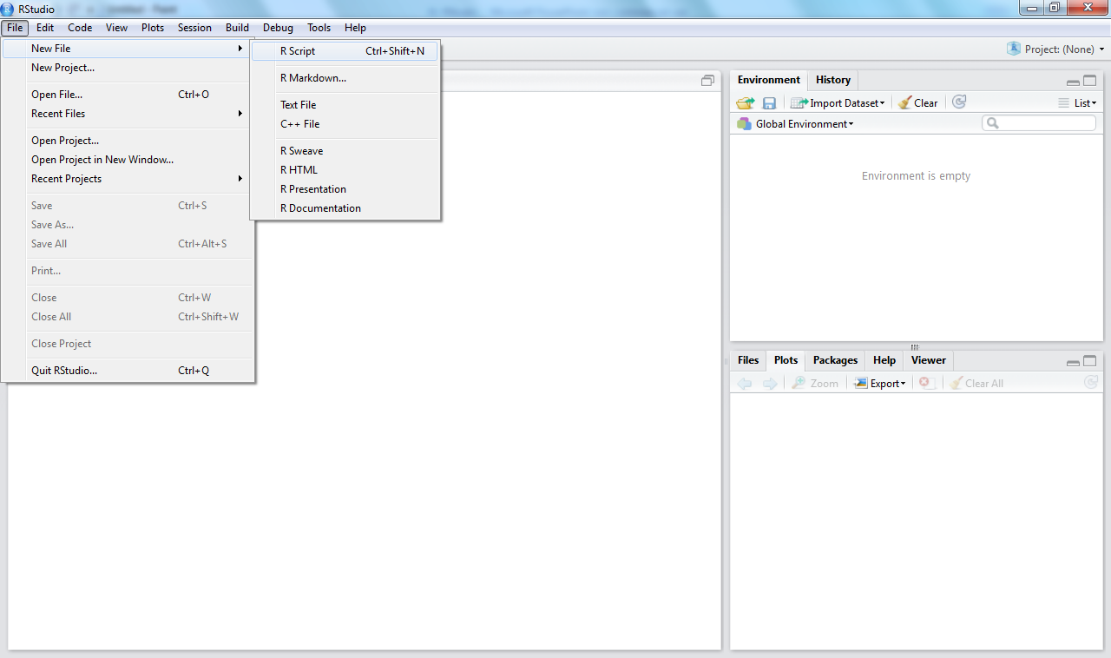
Open up a New Script Window

Slide 5
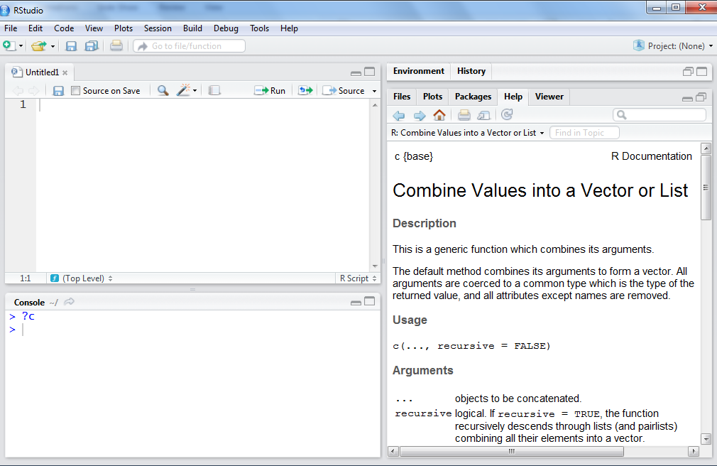
How to Get Help on a Function
?c

Slide 6
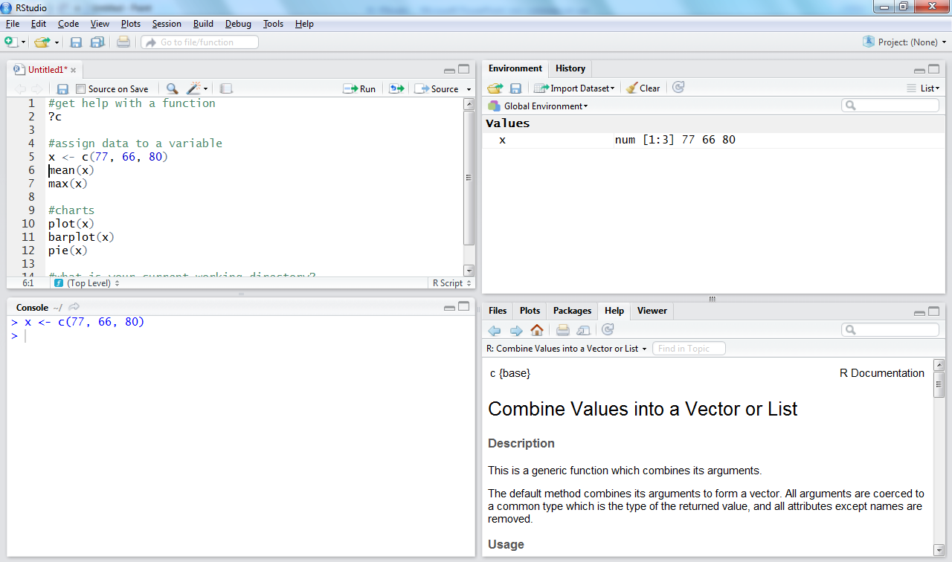
RStudio Environment
1
Enter Code
2
Run
4
Variable shows up in the environment panel
Or CTRL-Enter
Code is Ran
in the Console
3

Slide 7
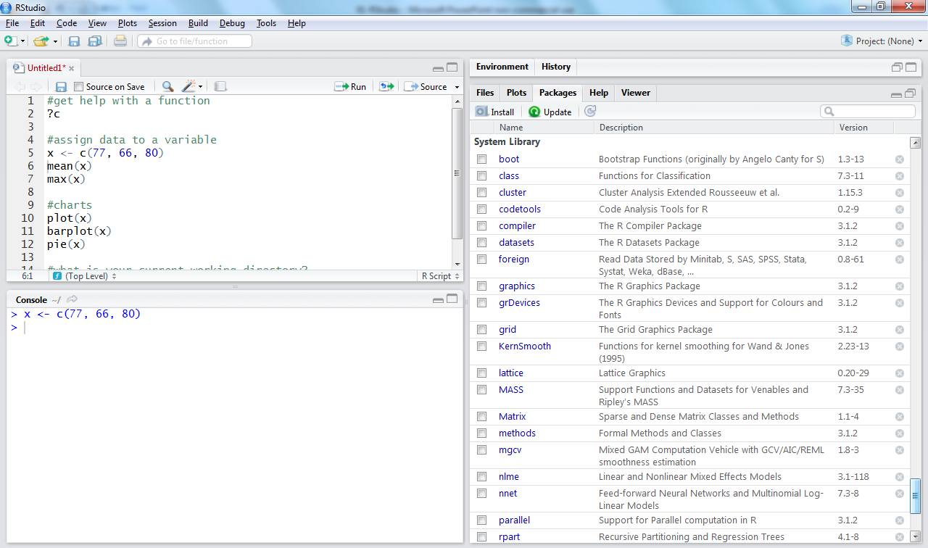

Slide 8
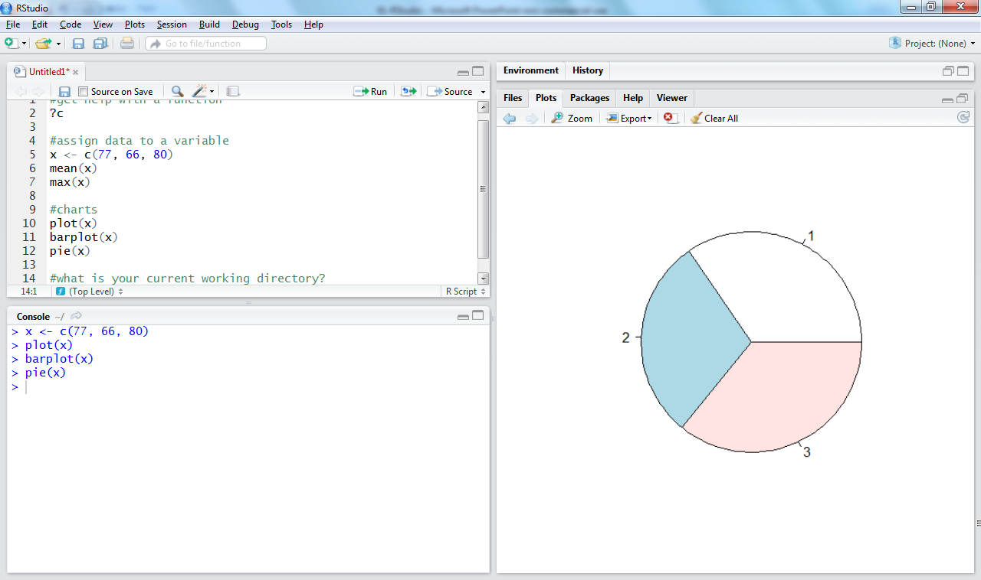
Plots
Page Back
Zoom or Export
To Clear Console:
CTRL-L

Slide 9
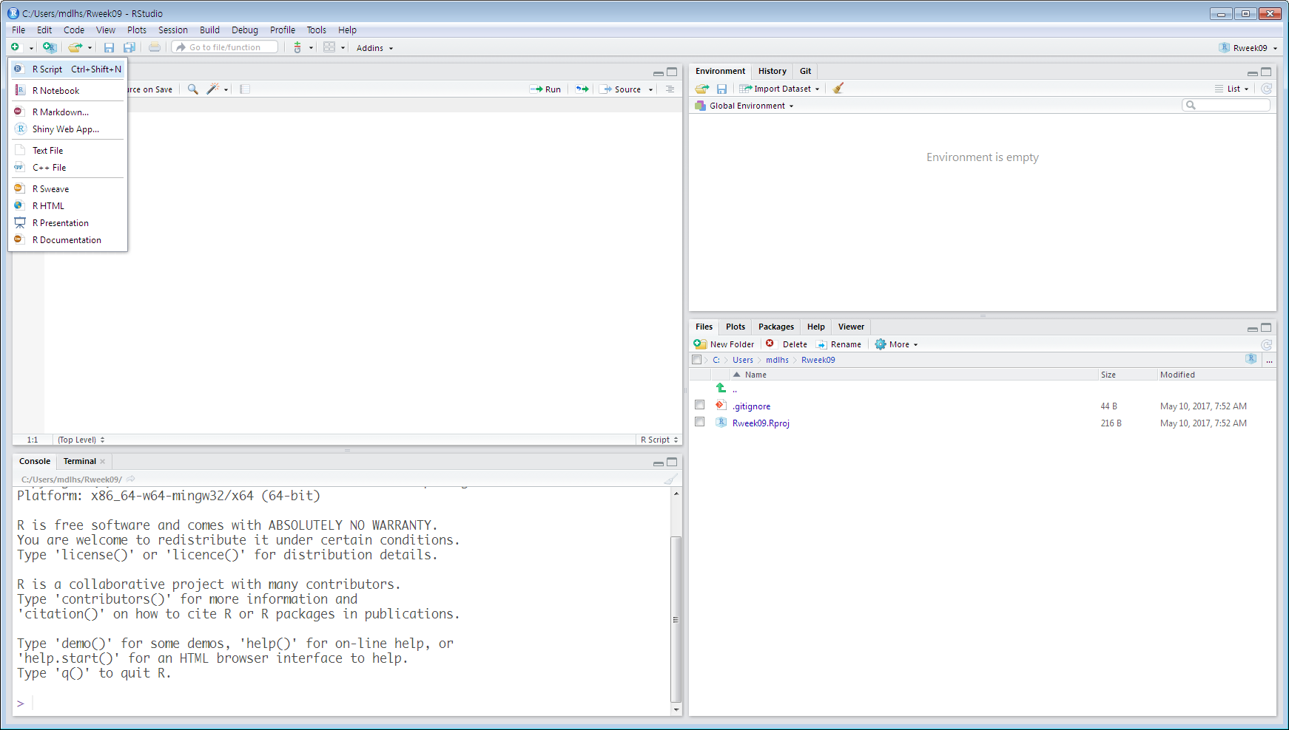
Getwd()

Slide 10
Demo: Rstudio and R

Slide 11
dplyr

Slide 12
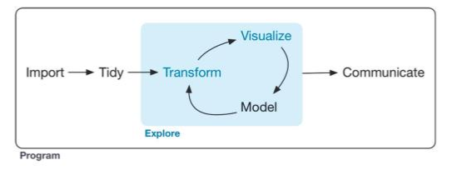
Data Science

Slide 13
Dataset의 편집을 좀 더 편하게 할 수 있다는 장점
%>%의 기호를 통하여 여러 function을 이어서 모두 구현할 수 있다.

Slide 14
3.filter
X
Y

Slide 15
4.distinct
X
Number | Alphabet
1 | A
1 | A
1 | A
2 | B
2 | B
3 | C
3 | C
Y
Number | Alphabet
1 | A
2 | B
3 | C

Slide 16
5.slice
X
Row | Number | Alphabet
1 | 1 | A
2 | 1 | A
3 | 1 | A
4 | 2 | B
5 | 2 | B
6 | 3 | C
7 | 3 | C
8 | 4 | D
9 | 5 | E
10 | 6 | F
Row | Number | Alphabet
1 | 1 | A
4 | 2 | B
7 | 3 | C
Slice(X,c(1,4,7))

Slide 17
6.select
X

Slide 18
7.arrange
X
Number | Alphabet
1 | A
2 | B
1 | A
3 | C
2 | B
3 | C
1 | A
Number | Alphabet
1 | A
1 | A
1 | A
2 | B
2 | B
3 | C
3 | C

Slide 19
8.rename
Number | Alphabet | Money
1 | A | 100
2 | B | 100
1 | A | 40
3 | C | 50
2 | B | 70
3 | C | 80
1 | A | 110
Number | Alphabet | Cost
1 | A | 100
2 | B | 100
1 | A | 40
3 | C | 50
2 | B | 70
3 | C | 80
1 | A | 110

Slide 20
9.gather
X

Slide 21
10.spread
X

Slide 22
11.Separate & Unite
X
Number | Alphabet
1-1 | A
1-2 | B
1-3 | A
Numb | SubN | Alphabet
1 | 1 | A
1 | 2 | B
1 | 3 | A
X
Numb | SubN | Alphabet
1 | 1 | A
1 | 2 | B
1 | 3 | A
Number | Alphabet
1-1 | A
1-2 | B
1-3 | A

Slide 23
3.group_by & mutate
X

Slide 24
3.Combine Data Sets(join)
x1 | x2
A | 1
B | 2
C | 3
x1 | x3
A | T
B | F
C | T

Slide 25
x1 | x2
A | 1
B | 2
C | 3
x1 | x3
A | T
B | F
C | T
X1 | X2 | X3
A | 1 | T
B | 2 | F
C | 3 | NA
left_join(a,b,by=“x1”): Join matching rows from b to a
X1 | X2 | X3
A | T | 1
B | F | 2
C | T | NA
right_join(a,b,by=“x1”): Join matching rows from a to b

Slide 26
x1 | x2
A | 1
B | 2
C | 3
x1 | x3
A | T
B | F
C | T
X1 | X2 | X3
A | 1 | T
B | 2 | F
inner_join(a,b,by=“x1”)
:Join data. Retain only rows in both sites
X1 | X2 | X3
A | 1 | T
B | 2 | F
C | 3 | NA
D | NA | T
full_join(a,b,by=“x1”)
:Join data. Retain all values, all rows

Slide 27
What is ggplot2?
An implementation of the Grammar of Graphics by Leland Wilkinson
Written by Hadley Wickham (while he was a graduate student at Iowa State)
A “third” graphics system for R (along with base and lattice)
Available from CRAN via install.packages()
Web site: http://ggplot2.tidyverse.org

Slide 28
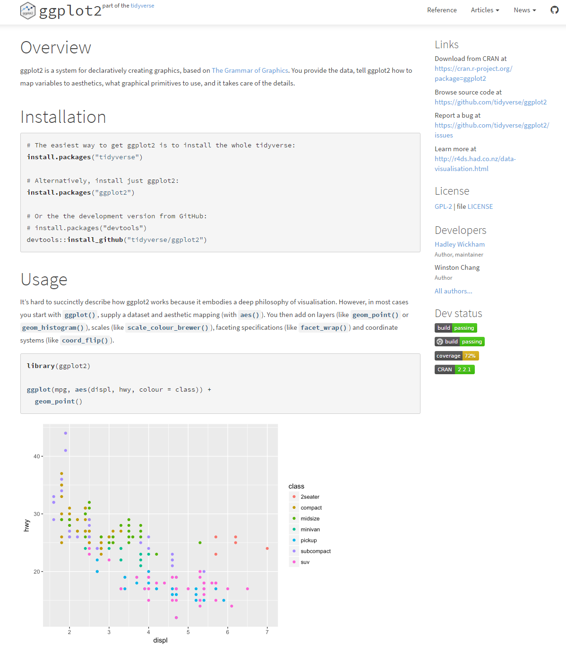
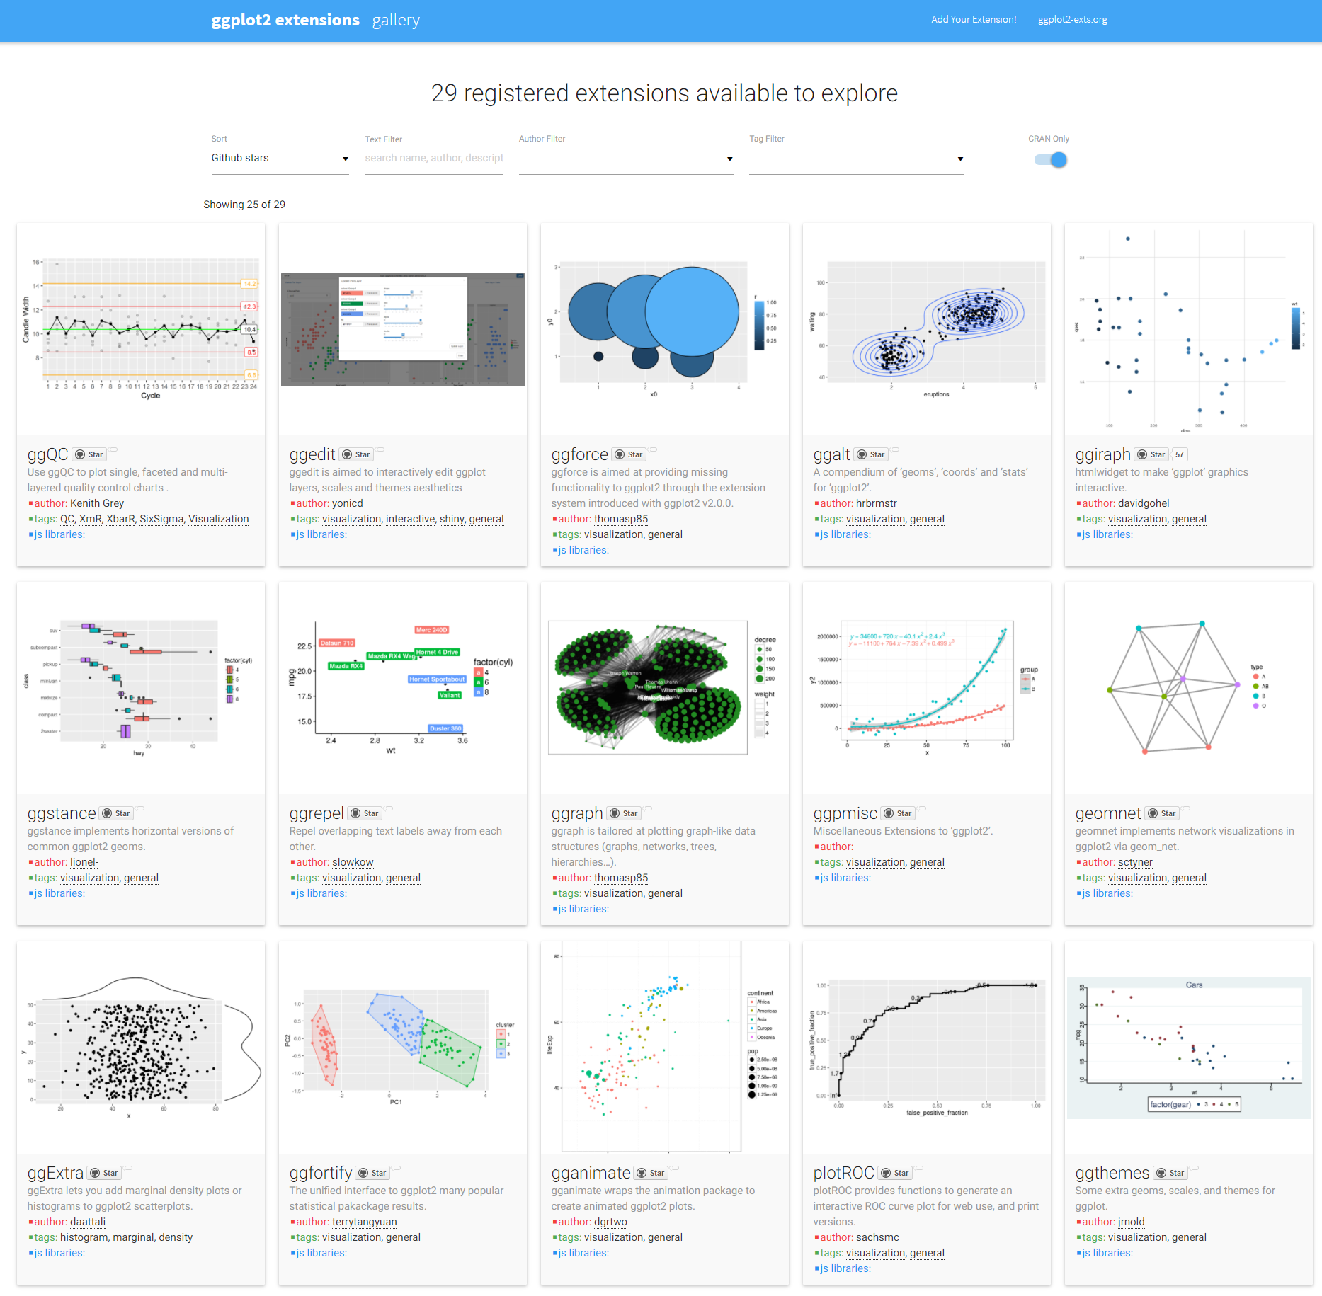

Slide 29
What is ggplot2?
Grammar of graphics represents and abstraction of graphics ideas/objects
Think “verb”, “noun”, “adjective” for graphics
Allows for a “theory” of graphics on which to build new graphics and graphics objects
“Shorten the distance from mind to page”

Slide 30
Grammar of Graphics
“In brief, the grammar tells us that a statistical graphic is a mapping from data to aesthetic attributes (colour, shape, size) of geometric objects (points, lines, bars). The plot may also contain statistical transformations of the data and is drawn on a specific coordinate system”
from ggplot2 book

Slide 31
Plotting Systems in R: Base
“Artist’s palette” model
Start with blank canvas and build up from there
Start with plot function (or similar)
Use annotation functions to add/modify (text, lines, points, axis)

Slide 32
Plotting Systems in R: Base
Convenient, mirrors how we think of building plots and analyzing data
Can’t go back once plot has started (i.e. to adjust margins); need to plan in advance
Difficult to “translate” to others once a new plot has been created (no graphical “language”)
Plot is just a series of R commands

Slide 33
Plotting Systems in R: Lattice
Plots are created with a single function call (xyplot, bwplot, etc.)
Most useful for conditioning types of plots: Looking at how y changes with x across levels of z
Thinks like margins/spacing set automatically because entire plot is specified at once
Good for putting many many plots on a screen

Slide 34
Plotting Systems in R: Lattice
Sometimes awkward to specify an entire plot in a single function call
Annotation in plot is not intuitive
Use of panel functions and subscripts difficult ot wield and requires intense preparation
Cannot “add” to the plot once it’s created

Slide 35
Plotting Systems in R: ggplot2
Split the difference between base and lattice
Automatically deals with spacings, text, titles but also allows you to annotate by “adding”
Superficial similarity to lattice but generally easier/more intuitive to use
Default mode makes many choices for you (but you can customize!)

Slide 36
The Basics: qplot()
Works much like the plot function in base graphics system
Looks for data in a data frame, similar to lattice, or in the parent environment
Plots are made up of aesthetics (size, shape, color) and geoms (points, lines)

Slide 37
The Basics: qplot()
Factors are important for indicating subsets of the data (if they are to have different properties); they should be labeled
The qplot() hides what goes on underneath, which is okay for most operations
ggplot() is the core function and very flexible for doing things qplot() cannot do

Slide 38
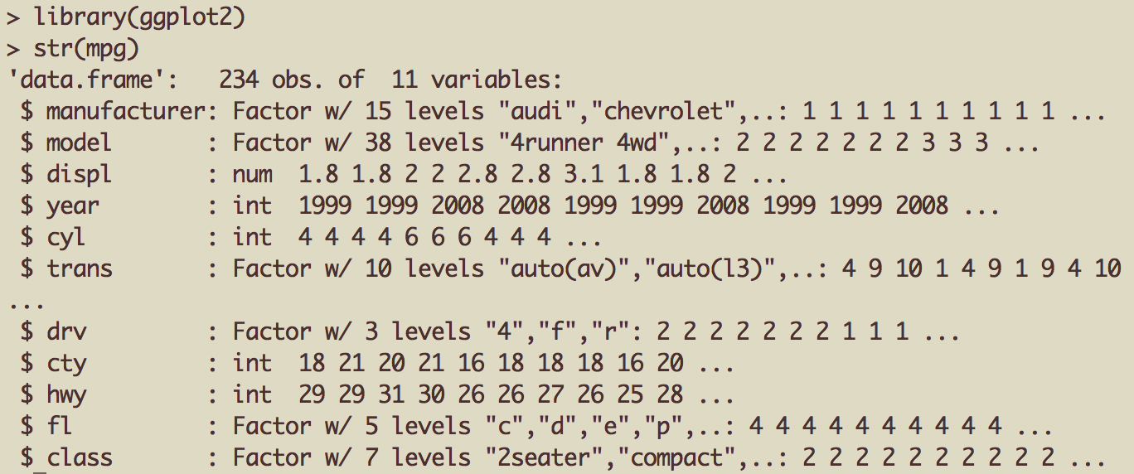
Example Dataset
Factor label information important for annotation

Slide 39

ggplot2 “Hello, world!”
x coord
y coord
data frame

Slide 40
Modifying aesthetics
auto legend placement
color aesthetic
qplot(displ, hwy, data = mpg, color = drv)

Slide 41
Adding a geom
qplot(displ, hwy, data = mpg, geom = c("point", "smooth"))

Slide 42
Histograms
qplot(hwy, data = mpg, fill = drv)

Slide 43
Facets
qplot(displ, hwy, data = mpg, facets = . ~ drv)
qplot(hwy, data = mpg, facets = drv ~ ., binwidth = 2)

Slide 44
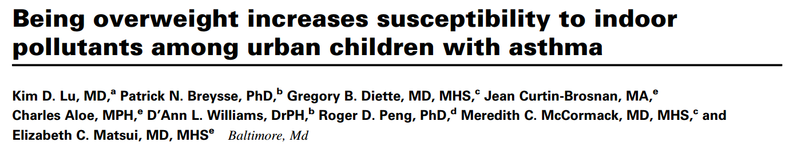
MAACS Cohort
Mouse Allergen and Asthma Cohort Study
Baltimore children (aged 5—17)
Persistent asthma, exacerbation in past year
Study indoor environment and its relationship with asthma morbidity
Recent publication: http://goo.gl/WqE9j8

Slide 45
Example: BMI, PM_{2.5}, Asthma
Does BMI (normal vs. overweight) modify the relationship between PM_{2.5} and asthma symptoms?

Slide 46
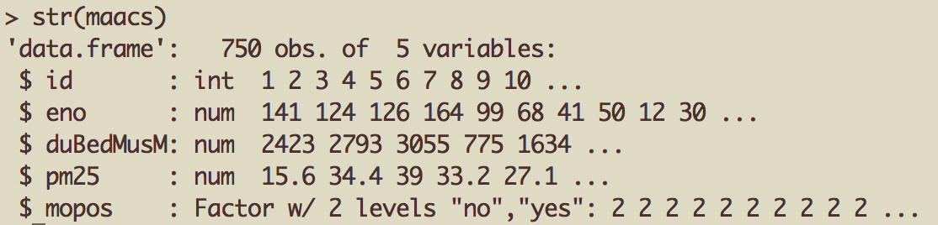
Example: MAACS
Exhaled nitric oxide
Fine particulate matter
Sensitized to mouse allergen

Slide 47
Histogram of eNO
qplot(log(eno), data = maacs)

Slide 48
Histogram by Group
qplot(log(eno), data = maacs, fill = mopos)

Slide 49
Density Smooth
qplot(log(eno), data = maacs, geom = "density")
qplot(log(eno), data = maacs, geom = "density", color = mopos)

Slide 50
Scatterplots: eNO vs. PM_{2.5}
qplot(log(pm25), log(eno), data = maacs)
qplot(log(pm25), log(eno), data = maacs, shape = mopos)
qplot(log(pm25), log(eno), data = maacs, color = mopos)

Slide 51
Scatterplots: eNO vs. PM_{2.5}
qplot(log(pm25), log(eno), data = maacs, color = mopos, geom = c("point", "smooth"), method = "lm")

Slide 52
Scatterplots: eNO vs. PM_{2.5}
qplot(log(pm25), log(eno), data = maacs, geom = c("point", "smooth"), method = "lm", facets = . ~ mopos)

Slide 53
Summary of qplot()
The qplot() function is the analog to plot() but with many built-in features
Syntax somewhere in between base/lattice
Produces very nice graphics, essentially publication ready (if you like the design)
Difficult to go against the grain/customize (don’t bother; use full ggplot2 power in that case)

Slide 54
Basic Plot
qplot(logpm25, NocturnalSympt, data = maacs, facets = . ~ bmicat, geom = c("point", "smooth"), method = "lm”)

Slide 55
Building Up in Layers
> head(maacs)
logpm25 bmicat NocturnalSympt
2 1.5361795 normal weight 1
3 1.5905409 normal weight 0
4 1.5217786 normal weight 0
5 1.4323277 normal weight 0
6 1.2762320 overweight 8
8 0.7139103 overweight 0
> g <- ggplot(maacs, aes(logpm25, NocturnalSympt))
> summary(g)
data: logpm25, bmicat, NocturnalSympt [554x3]
mapping: x = logpm25, y = NocturnalSympt
faceting: facet_null()
Data Frame
Aesthetics
Initial call to ggplot
Summary of ggplot object

Slide 56
No Plot Yet!
> g <- ggplot(maacs, aes(logpm25, NocturnalSympt))
> print(g)
Error: No layers in plot
> p <- g + geom_point()
> print(p)
> g + geom_point()
Explicitly save and print ggplot object
Auto-print plot object without saving

Slide 57
First Plot with Point Layer
g <- ggplot(maacs, aes(logpm25, NocturnalSympt))
g + geom_point()

Slide 58
Adding More Layers: Smooth
g + geom_point() + geom_smooth()
g + geom_point() + geom_smooth(method = "lm”)

Slide 59
Adding More Layers: Facets
Labels from facet variable
Add facets
Faceting (factor) variable
g + geom_point() + facet_grid(. ~ bmicat) + geom_smooth(method = "lm")

Slide 60
Annotation
Labels: xlab(), ylab(), labs(), ggtitle()
Each of the “geom” functions has options to modify
For things that only make sense globally, use theme()
Example: theme(legend.position = "none")
Two standard appearance themes are included
theme_gray(): The default theme (gray background)
theme_bw(): More stark/plain

Slide 61
Modifying Aesthetics
g + geom_point(color = "steelblue”, size = 4, alpha = 1/2)
g + geom_point(aes(color = bmicat), size = 4, alpha = 1/2)
Constant values
Data variable

Slide 62
Modifying Labels
labs() function for modifying titles and x-, y-axis labels
g + geom_point(aes(color = bmicat)) + labs(title = "MAACS Cohort") + labs(x = expression("log " * PM[2.5]), y = "Nocturnal Symptoms")

Slide 63
Customizing the Smooth
Modified smoother
g + geom_point(aes(color = bmicat), size = 2, alpha = 1/2) + geom_smooth(size = 4, linetype = 3, method = "lm", se = FALSE)

Slide 64
Changing the Theme
g + geom_point(aes(color = bmicat)) + theme_bw(base_family = "Times”)

Slide 65
A Notes about Axis Limits
testdat <- data.frame(x = 1:100, y = rnorm(100))
testdat[50,2] <- 100 ## Outlier!
plot(testdat$x, testdat$y, type = "l", ylim = c(-3,3))
g <- ggplot(testdat, aes(x = x, y = y))
g + geom_line()

Slide 66
Axis Limits
Outlier missing
Outlier included
g + geom_line() + ylim(-3, 3)
g + geom_line() + coord_cartesian(ylim = c(-3, 3))

Slide 67
Demo: ggplot2

Slide 68
Summary
ggplot2 is very powerful and flexible if you learn the “grammar” and the various elements that can be tuned/modified
Many more types of plots can be made; explore and mess around with the package

