Slide 1
Exploiting Undefined Behaviors for Efficient Symbolic Execution
Asankhaya Sharma National University of Singapore

Slide 2

Motivation

Slide 3
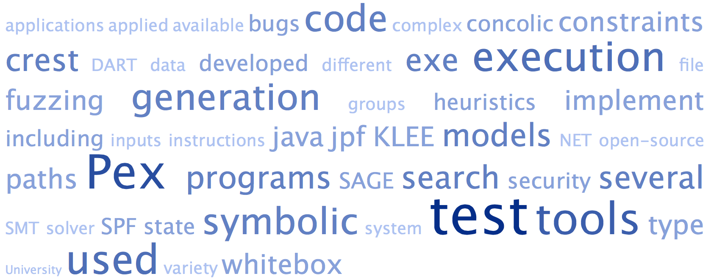

Rainbow Pony

Slide 4
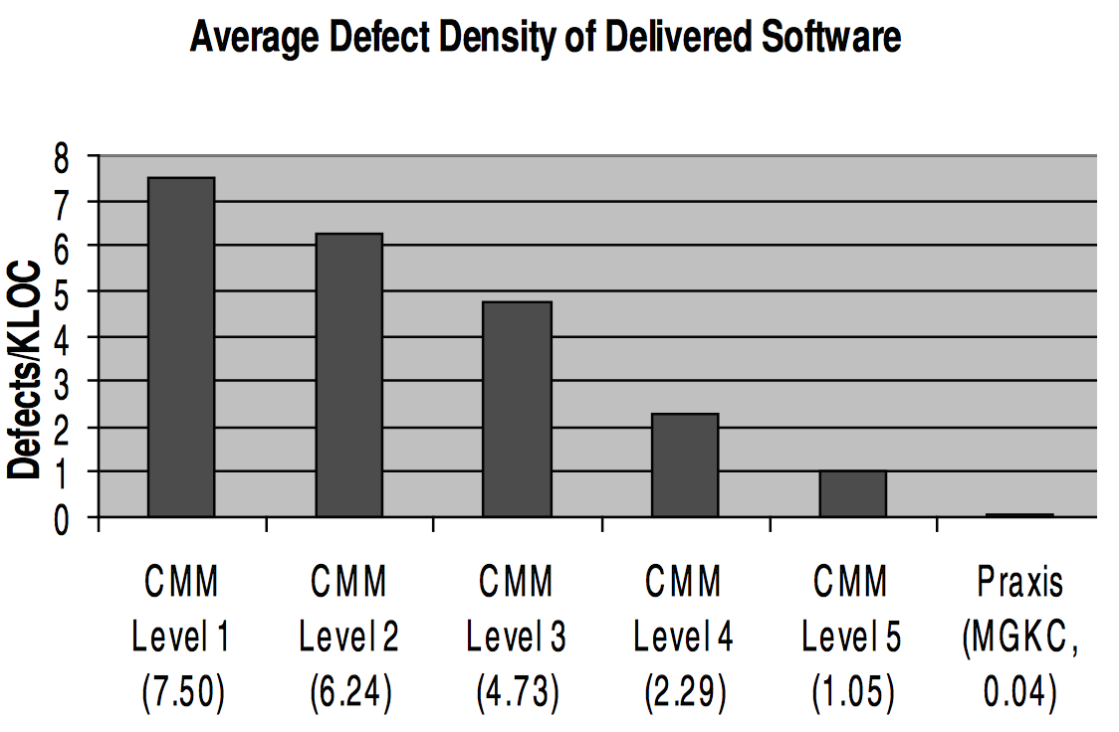
Software Engineering Works
Hall, Anthony. "Realising the Benefits of Formal Methods." J. UCS 13.5 (2007): 669-678.

Slide 5
Symbolic Execution
Software engineering tools (KLEE, PEX, Klover etc.) routinely use symbolic execution for
Test case generation
Bug finding
Debugging
Performance analysis
Verification
Improving the performance can have big impact

Slide 6
Efficient Symbolic Execution
Bottlenecks for performance
Path explosion
Complexity of generated constraints
Existing approaches
Constraint subsumption and simplification
Concoclic execution
State merging, caching and reusing constraints
Static analysis

Slide 7
Key Idea
Compilers are really good at optimization based on undefined behaviors
Design a static analysis (Change Value Analysis) to introduce undefined behaviors in programs
Use the optimized binaries for symbolic execution

Slide 8
Main Benefits
Does not require any change in the underlying symbolic execution engine to use the results from static analysis for dynamic path exploration
Allows reduction in size of compiled binaries and prevents generation of irrelevant constraints

Slide 9
Overview of Approach
Change Value Analysis of Program
Program with Undefined Behaviors
Compiler Optimizations
Binary for Symbolic Execution

Slide 10
Change Value Analysis
int foo (int x, int y, int z)
{
int a;
a = z;
if (x – y > 0)
a = x;
else
a = y;
if (z > a)
printf(“z is max”);
return a;
}
Changed
Unchanged
Undefined

Slide 11
Change Value Analysis
int foo (int x, int y, int z)
{
int a;
a = z;
if (x – y > 0)
a = x;
else
a = y;
if (z > a)
printf(“z is max”);
return a;
}
Changed
a
Unchanged
Undefined

Slide 12
Change Value Analysis
int foo (int x, int y, int z)
{
int a;
a = z;
if (x – y > 0)
a = x;
else
a = y;
if (z > a)
printf(“z is max”);
return a;
}
Changed
a, x, y
Unchanged
z
Undefined

Slide 13
Introduce Undefined Behaviors
int foo (int x, int y, int z)
{
int a;
a = *;
if (x – y > 0)
a = x;
else
a = y;
if (* > a)
printf(“z is max”);
return a;
}
Changed
a, x, y
Unchanged
z
Undefined
Replace Unchanged variables with nondeterministic value *

Slide 14
After Compiler Optimizations
int foo (int x, int y, int z)
{
int a;
a = *;
if (x – y > 0)
a = x;
else
a = y;
if (* > a)
printf(“z is max”);
return a;
}
int foo (int x, int y, int z)
{
int a;
if (x – y > 0)
a = x;
else
a = y;
return a;
}
Eliminates 3 lines from the program

Slide 15
Experiments
Change Value Analysis implemented as a compiler pass in LLVM
Use an existing tool Fuzzgrind for symbolic execution of binaries
Benchmarks from Software-artifact Infrastructure Repository (SIR)

Slide 16
Results
30% Reduction in Number of Constraints

Slide 17
Results
48% Reduction in Time taken for Symbolic Execution

Slide 18
Conclusions
Systematically introducing undefined behaviors in programs can speed up symbolic execution
Compilers already optimize code for efficiency and size, we show that they can also optimize code for use in symbolic execution and testing

Slide 19
Thank You !
Questions ?
Source Code (GPL 3)
https://github.com/codelion/pathgrind
https://github.com/codelion/pa.llvm
Contact
asankhaya@nus.edu.sg

Slide 20
Comparison with Slicing
x = a;
y = 5;
if (a > 0)
b = x + y;
if (*)
x = 1;
else
y = 0;
if (y > 0)
z = x;
x = a;
y = 5;
if (a > 0)
b = x + y;
if (*)
x = 1;
else
y = 0;
if (y > 0)
z = x;
Slicing may include dependencies from infeasible paths
Slicing w.r.t variable z
Using Change Value analysis - “a” is in Unchanged set
Jaffar, Joxan, et al. "Path-sensitive backward slicing." Static Analysis. Springer Berlin Heidelberg, 2012. 231-247.

