Slide 1
Certified Reasoning for Automated Verification
Asankhaya Sharma PhD Defense

Slide 2
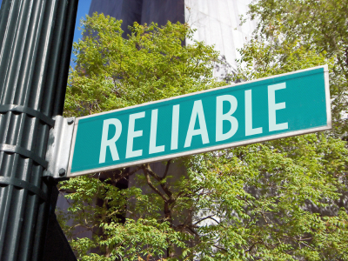
Building Reliable Software
Formal Verification
Proving correctness of programs
Testing
Discovering bugs in programs

Slide 3
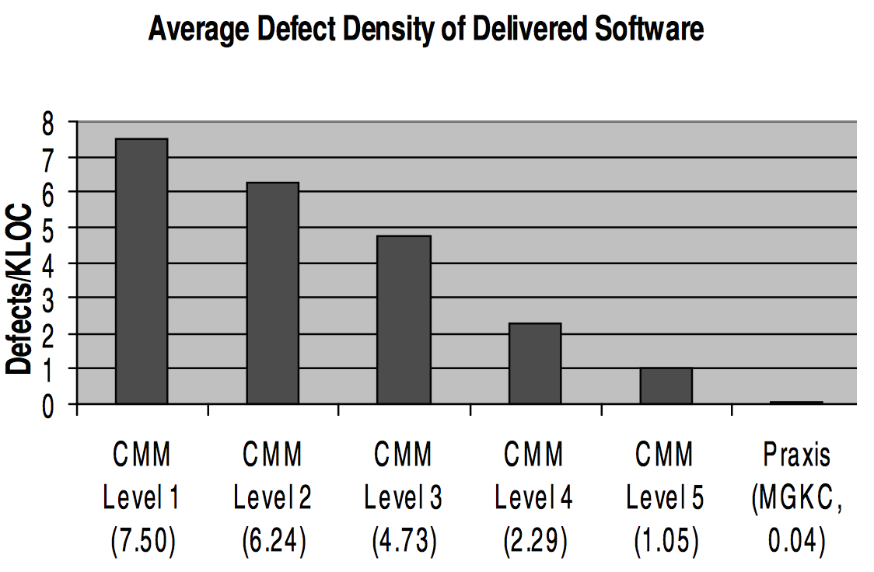
Formal Methods Work
Hall, Anthony. "Realising the Benefits of Formal Methods." J. UCS 13.5 (2007): 669-678.

Slide 4
Thesis
“Certified reasoning improves the correctness and expressivity of automated verification without sacrificing on performance”

Slide 5
Certified Reasoning
Correctness is machine checked
(Decision) Procedures
Proofs
Programs
Using the Coq Proof Assistant

Slide 6
Automated Verification
Hoare Logic
Specify pre and post conditions for each method
Separation Logic
Heap manipulating programs
Separating conjunction “*” denotes disjoint heaps
Using the HIP/SLEEK Verification System

Slide 7
Why Certify?
Correctness
Find bugs in implementation of the verifier
Expressivity
Verifying more properties by extending decision procedures to cover richer domain/logic
Performance
Code generated from certified procedure should be scalable

Slide 8
Thesis Contributions
Certified Decision Procedure (Omega++)
Certified Reasoning with Infinity
Certified Proof (HIPComp)
Specifying Compatible Sharing in Data Structures
Automated Verification of Ramifications in SL
Certified Program (SLEEK DSL)
Verified Subtyping with Traits and Mixins

Slide 9
Certified Reasoning with Infinity

Slide 10
PAInf Domain
Presburger arithmetic (PA) is the first order theory of natural numbers with addition
Linear integer arithmetic with constant multiplication
We present Omega++, a decision procedure for Presburger arithmetic extended with +∞ and -∞
Omega++ is implemented in Coq
Implementation is generated using extraction
Allows using infinity as a ghost constant in specifications

Slide 11
Example
data node{ int val; node next}
sortedll<min> == root::node<min,null>
or root::node<min,p> * p::sortedll<mt> & min <= mt
sortedll<min> == root = null & min = ∞
or root::node<min,p> * p::sortedll<mt>
& min <= mt
val next

Slide 12
Example
node insert(node x, node y)
{// code for insertion into sorted list}
Pre - y::node<v,null>
& x = null
or x::sortedll<a> *
y::node<v,null>
Post - res::sortedll<b>
& x = null & b = v
or res::sortedll<b>
& b = min(a,v)
Pre - x::sortedll<a> * y::node<v,null>
Post - res::sortedll<b>
& b = min(a,v)
More concise specification with infinity

Slide 13
Related Work
 | Domain | Implemented | Certified Proof | Expressivity
[Lasaruk 2009] | PA U {∞} | ✗ | ✗ | Cannot express ordering (no < symbol)
[Kapur 2013] | PA U {-∞,+∞} | ✗ | ✗ | Can express ordering (includes < symbol)
Omega++ | PA U {-∞,+∞} | ✓ | ✓ | Can express ordering, min and max constraints
Lasaruk, Aless, and Thomas Sturm. "Effective quantifier elimination for presburger arithmetic with infinity." Computer Algebra in Scientific Computing. Springer Berlin Heidelberg, 2009.
Kapur, Deepak, et al. "Geometric quantifier elimination heuristics for automatically generating octagonal and max-plus invariants." Automated Reasoning and Mathematics. Springer Berlin Heidelberg, 2013. 189-228.

Slide 14
Omega++ Procedure
Quantifier Elimination
Normalization
Simplification
Omega

Slide 15
Parameterized Semantics
Six different customized semantics
0 * ∞ : {0,⊥,∞}
Choose between a two valued or three valued logic

Slide 16
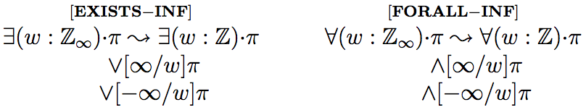
(1) Quantifier Elimination
Reduce quantifiers to finite domain of integers

Slide 17
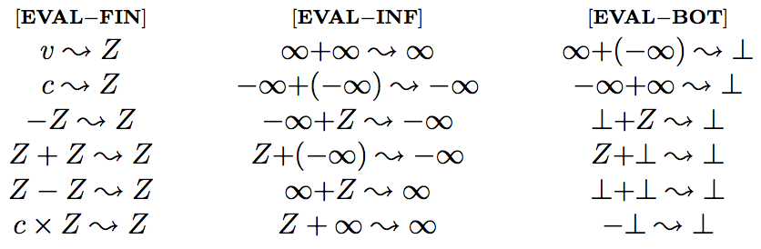
(2) Normalization
Evaluate variables in finite domain plus infinity symbols

Slide 18
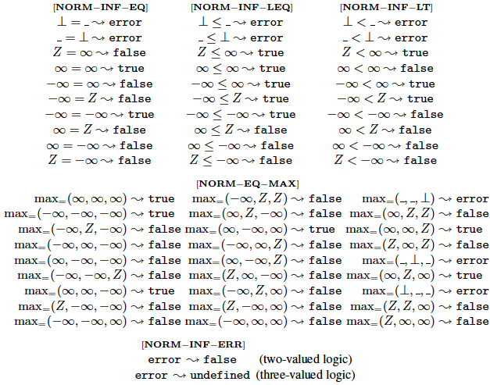
Eliminate infinities

Slide 19
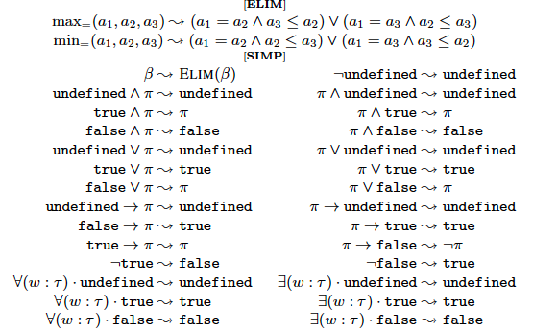
(3) Simplification
Eliminate min max and constant constraints
Propagate undefined

Slide 20
(4) Omega
The formula is now in PA so we can use an existing decision procedure for PA to solve it
Omega Calculator

Slide 21
Implementation
Omega++ is implemented in Coq
Program (in Gallina) and Proof
http://loris-7.ddns.comp.nus.edu.sg/~project/SLPAInf/
OCaml code is generated from Coq using extraction
Extracted code is integrated with HIP/SLEEK
Notes:
Haskell and Scheme code can also be generated we use OCaml as we integrate with HIP/SLEEK

Slide 22
Coq Development
Coq File | Program | Proof | Time (s) | Description
Theory.v | 585 | 737 | 20.68 | Syntax and Semantics
Transformation.v | 380 | 1203 | 31.07 | Normalization
Simplification.v | 0 | 856 | 338.96 | Tactics/lemmas for simplification
Extraction.v | 257 | 0 | 1.27 | Module to extract OCaml code
 | 1192 | 2796 | 391.98 | Total Coq
Ratio of proof to program is 2.35
Proof scripts take 6+ minutes to type check
Simplification procedure was easy to write but difficult to prove due to large number of cases, we use Ltac (Coq’s proof tactic language) to automate the proof search

Slide 23
Correctness
Tool | Sound | Complete | Termination | Semantics | Verified
OCaml Prototype | No | No | Unclear | Unclear | No
Omega++ | Yes | Yes | Guaranteed | Precise | In Coq
Prototype’s version of normalization did additional case analysis. Due to our careful
treatment of quantifier elimination we were able to prove that much of this case analysis was unnecessary in our Coq tool.
The Coq development identified a soundness bug in the OCaml prototype, which allowed the invalid transformation x ≥ y → x+1 > y, which is false when x = y = ∞

Slide 24
Expressivity (and Conciseness)
Benchmark | LOC | Disjuncts (PA) | Time (Ω) | Disjuncts (PAInf) | Time(Ω++)
Insertion Sort | 30 | 4 | 0.14 | 2 | 0.15
Selection Sort | 69 | 14 | 0.36 | 7 | 0.35
BST | 105 | 12 | 0.43 | 6 | 0.35
Bubble Sort | 110 | 12 | 0.29 | 9 | 0.50
Merge Sort | 91 | 6 | 0.32 | 4 | 1.81
Priority Queue | 207 | 16 | 0.84 | 10 | 2.73
Total Correctness | 21 | - | - | 2 | 0.21
Sort Min Max | 79 | - | - | 7 | 1.82

Slide 25
Optimizations
No desugaring of formulas
Handling full constraint language with all operators made the proof more tedious but was important for performance
Support two kinds of quantifiers, over PA and PAInf
Program variables quantify over PA while specification variables over PAInf
Implement formula simplification
Keeps the size small but increased the time taken to check the proof scripts
Treat string (used for variables and arbitrary integers) in Coq as abstract
Use OCaml’s string data type which is more efficient

Slide 26
Performance
Benchmark | Calls | Time (Lasaruk) | Time (Proto) | Time (Ω++)
Insertion Sort | 100 | 4.58 | 0.78 | 0.39
Selection Sort | 245 | >600.00 | 0.62 | 0.78
BST | 116 | 150.00 | 0.48 | 0.50
Bubble Sort | 336 | >600.00 | 1.25 | 1.34
Merge Sort | 155 | >600.00 | 1.05 | 1.92
Priority Queue | 778 | >600.00 | FAIL | 1.20
Total Correctness | 120 | >600.00 | 0.31 | 0.16
Sort Min Max | 376 | >600.00 | 0.29 | 0.19

Slide 27
Specifying Compatible Sharing in Data Structures

Slide 28
Frame Rule
P
P * R
R
Frame Rule
P {c} Q
-------------------
P * R {c} Q * R

Slide 29
From Separation to Sharing
Disjoint Heaps (*)
x::node<a,b> * y::node<c,d>
Aliased Heaps (&)
x::node<a,b> & y::node<c,d>
Overlaid Heaps (&*)
x::node<a,_> &* y::node<_,d>

Slide 30
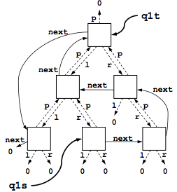
Overlaid Data Structures

Slide 31
Compatible Sharing
Disk IO Scheduler
List of Nodes (ll) and Tree of Nodes (tree)
The linked list and tree represent multiple views over same set of nodes
data node{ int val; node next; node parent; node left; node right;}

Slide 32
Related Work
 | Expressivity | Entailment Procedure | Program Analysis | Local Reasoning | Certified Proof | Properties
[Lee 2011] | List and Tree | ✗ | ✓ | ✗ | ✗ | Shape
[Drăgoi 2013] | Only Lists | ✗ | ✓ | ✓ | ✗ | Shape
HIPComp | User Defined Predicates | ✓ | ✗ | ✓ | ✓ | Shape, Size and Bag
Lee, Oukseh, Hongseok Yang, and Rasmus Petersen. "Program analysis for overlaid data structures." Computer Aided Verification. Springer Berlin Heidelberg, 2011.
Drăgoi, Cezara, Constantin Enea, and Mihaela Sighireanu. "Local Shape Analysis for Overlaid Data Structures." Static Analysis. Springer Berlin Heidelberg, 2013. 150-171.

Slide 33
LL &* Tree
Field Annotations @A – Absent @I – Immutable
ll<S> == root = null & S = {} or root::node<_@I,p,_@A,_@A,_@A>
* p::ll<Sp> & S = Sp U {root}
tree<p,S> == root = null & S = {} or root::node<_@I,_@A,p,l,r>
* l::tree<root,Sl> * r::tree<root,Sr>
& S = Sl U Sr U {root}
x::ll<S> &* t::tree<_,S>
Memory Footprint S – Set of Addresses

Slide 34
Memory Specifications
A memory specification of a predicate is of the form
S->L
S is the set of addresses and
L is the list of field annotations
x::ll<S> &* t::tree<_,S>
XMem(x::ll<S>) =
S->(node<@I,@M,@A,@A,@A>)
XMem(t::tree<_,S>) =
S->(node<@I,@A,@M,@M,@M)
XMem(P) = {}->() XMem(H & P) = XMem(H) XMem(H1 * H2) = XMem (H1) DU XMem(H2)
XMem(H1 &* H2) = XMem(H1) U XMem(H2)
XMem(x::node<v@I,p>) = {x}->(node<@I,@M>) XMem(x::ll<S>) = S->()
Compatible Fields
@A | @M
@M | @A
@I | @I

Slide 35
Compatible Frame Rule
Compatible(P,R)
Compatible(Q,R)
P {c} Q
-----------------------------------
P &* R {c} Q &* R
Same memory and compatible field annotations

Slide 36
DISK IO Scheduler Example
void move_request(node q1s, node q2, node q1t) requires q1s::ll<S> &* q1t::tree<_,S> * q2::ll<T> ensures q1s::ll<Su> &* q1t::tree<_,Su> * q2::ll<Tu> & S = union(Su,{q1s}) & Tu = union(T,{q1s}); {
node c; c = list_remove_first(q1s); if (c == null) return; tree_remove(c,q1t); list_add_first(q2,c); c = null;
}

Slide 37
Implementation
Developed an entailment procedure using memory specification and compatible sharing
HIPComp Tool and Coq Proofs
A prototype in Objective Caml http://loris-7.ddns.comp.nus.edu.sg/~project/HIPComp/
Based on HIP/SLEEK verification system
Benchmark of Programs with Sharing
Examples from papers and system software

Slide 38
Coq Development
Coq File | Proof | Time (s) | Description
PA.v | 355 | 2.40 | Syntax and Semantics of PA
SLPA.v | 416 | 3.38 | Reducing Separation Logic to PA
SLSET.v | 169 | 7.32 | Reducing Separation Logic to MONA
 | 940 | 13.10 | Total Coq
Certified functions XPure (SLPA.v) and XMem (SLSET.v) are required to show the soundness of the compatible frame rule

Slide 39
Correctness
Found two soundness issues
In the paper pen proof of XPure function given in [Chin 2012] a condition was missing (p!=0) in one of the cases
Certifying XMem function helped uncover a soundness bug in the implementation where the order of Matching and Splitting rules was wrong
Chin, Wei-Ngan, et al. "Automated verification of shape, size and bag properties via user-defined predicates in separation logic." Science of Computer Programming 77.9 (2012): 1006-1036.

Slide 40
Expressivity (and Performance)
Program | LOC | Timing (Seconds) | Sharing (%) | Compatibility(%)
PLL (Shape, Size) | 30 | 0.28 | 100 | 11
Compatible Pairs | 12 | 0.09 | 100 | 25
LL &* SortedLL (Shape, Bag) | 175 | 0.61 | 22 | 22
LL &* Tree (Shape) | 70 | 0.24 | 16 | 7
Process Scheduler (Shape) | 70 | 0.47 | 33 | 23
Disk IO Scheduler (Shape) | 88 | 1.30 | 16 | 27
Doubly Circular List (Shape) | 50 | 0.41 | 50 | 32

Slide 41
Conclusions
Omega++ - a certified decision procedure for Presburger arithmetic extended with +∞ and -∞
Specification Mechanism for Overlaid Data Structures
Entailment Procedure for Verifying Programs with Compatible Sharing

Slide 42
Future work
Certified Reasoning for Functional Correctness
Integrate full functional proofs done in Coq with automated proofs generated using HIP/SLEEK
End-to-End Verification
Mathematical Reasoning in Coq
Spatial Reasoning in HIP/SLEEK

Slide 43
Thank You !
Questions ?
Contact
asankhaya@u.nus.edu
Publications
Certified Reasoning with Infinity [FM 15]
Verified Subtyping with Traits and Mixins [FSFMA 14]
Exploiting Undefined Behaviors for Efficient Symbolic Execution [ICSE (Student Research Competition) 14]
HIPimm: Verifying Granular Immutability Guarantees [PEPM 14]
A Refinement Calculus for Promela [ICECCS 13]
Towards Complete Specifications with an Error Calculus [NFM 13]

Slide 44
Additional Slides

Slide 45
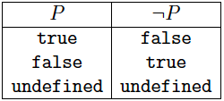
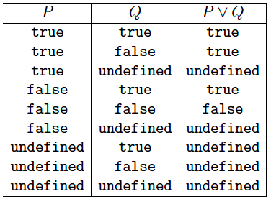
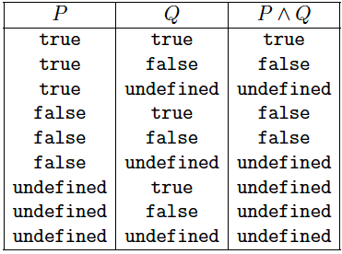
Kleene’s weak three valued logic

Slide 46
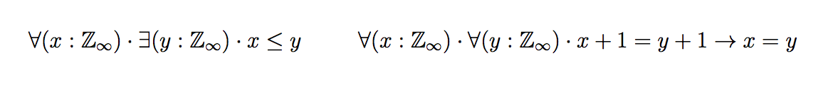
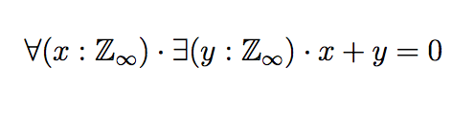
PAInf is a domain extension
Valid both in PA and PAInf
Valid in PA but Invalid in PAInf

Slide 47
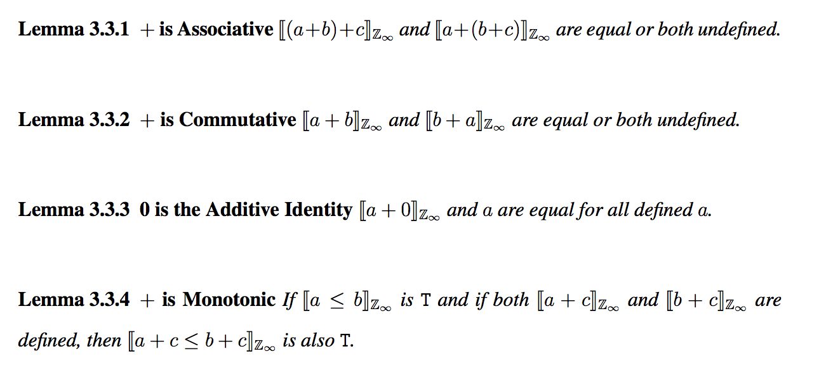
Useful Properties of PAInf domain

Slide 48
Application
Quantifier elimination in PAInf for specification inference
Using [Kapur 2012] we support inference of octagonal size constraints using ghost infinity in the presence of heap-based verification
Kapur, Deepak. "Program analysis using quantifier-elimination heuristics." Theory and Applications of Models of Computation. Springer Berlin Heidelberg, 2012. 94-108.

Slide 49
Specification Inference
Method | Pre | Post | Inferred | Time (Ω++)
Create | True | ll<res,m> | m=n | 0.13
Delete | ll<x,n> | ll<res,m> | n-1 ≤ m | 0.17
Insert | ll<x,n> ∧ x!=null | ll<x,m> | n=m-1 | 0.13
Copy | ll<x,n> * ll<res,m> | ll<x,m> | m=n | 0.16
Remove | ll<x,n> ∧ x!=null | ll<x,m> | n-1 ≤ m ∧ m≤n | 0.19
Return | ll<x,n> | ll<x,m> | m=n ∧ 0≤m | 0.07
Traverse | ll<x,n> | ll<x,m> | m=n | 0.12
Get | ll<x,n> ∧ x!=null | ll<res,m> | m=n-2 ∧ 2≤n | 0.11
Head | ll<x,n> * ll<y,m> | ll<res,n+m-1> | 1=min(n,m) | 0.21

Slide 50
Conclusions
Omega++ - a certified decision procedure for Presburger arithmetic extended with +∞ and -∞
Integrated Omega++ in HIP/SLEEK verification system and evaluated the usefulness for verification and specification inference

Slide 51
Verified Subtyping with Traits and Mixins

Slide 52
Object Oriented Design
S – Single Responsibility
O – Open Close
L – Liskov Substitution
I – Interface Segregation
D – Dependency Inversion
First proposed by Robert C. Martin in comp.object newsgroup in March 1995

Slide 53
Liskov Substitution Principle
“Let q(x) be a property provable about objects x of type T. Then q(y) should be provable for objects y of type S where S is a subtype of T”
- Barbara Liskov and Jeannette Wing

Slide 54
Behavior Subtyping
Useful to reason about design of class hierarchies
Stronger notion than typical subtyping of functions defined in type theory
Function subtyping is based on contravariance of argument types and covariance of the return type
Behavioral subtyping is trivially undecidable
If the property is “this method always terminates”

Slide 55
Contributions
Subtyping with Traits and Mixins in Scala
By checking entailments in separation logic
Extend Scala with a domain specific language (SLEEK DSL)
Allows Scala programmers to insert subtyping checks in their programs
Case study on subtyping in Scala Standard Library
Verified subtyping in 67% of Mixins

Slide 56
Traits and Mixins
Traits
Fine grained unit of reuse
Similar to abstract classes but some methods can have implementations as well
Mixin Composition (Mixin)
A class which contains a combination of methods from other traits and classes
Similar to multiple inheritance if the combination contains all methods of combined classes

Slide 57
Traits Example
trait ICell { def get() : Int def set(x : Int) } trait BICell extends ICell { private var x : Int = 0 def get() { x } def set(x : Int) { this.x = x } }
Similar to an Abstract Class
Implementation of ICell

Slide 58
Traits Example (cont.)
trait Double extends ICell { abstract override def set(x : Int) { super.set(2*x) } } trait Inc extends ICell { abstract override def set(x : Int) { super.set(x+1) } }

Slide 59
Mixins Example
OddICell (odd values)
class OddICell extends BICell with Inc with Double
EvenICell (even values)
class EvenICell extends BICell with Double with Inc
OddICell←Double←Inc←BICell
Class Linearization
EvenICell←Inc←Double←BICell

Slide 60
Scala doesn’t enforce Subtyping
def m (c: BICell with Inc with Double) : Int { c.get } val oic = new OddICell val eic = new EvenICell m(oic) m(eic)
Both calls are allowed by the type system
Only object oic is subtype of c

Slide 61
Verified Subtyping
A mixin can be represented as a separation logic predicate based on class linearization
OddICell←Double←Inc←BICell OddICell<this> == BICell<this,p> * Inc<p,q> * Double<q,null>
EvenICell←Inc←Double←BICell EvenICell<this> == BICell<this,p> * Double<p,q> * Inc<q,null>

Slide 62
From Subtyping to Entailment
Subtyping can be reduced to checking entailment between the predicates
m(oic) OddICell<oic> |- BICell<c,p> * Inc<p,q> * Double<q,null>
Valid
m(eic) EvenICell<eic> |- BICell<c,p> * Inc<p,q> * Double<q,null>
Invalid

Slide 63
SLEEK DSL
Implementation based on SLEEK
An existing separation logic based entailment prover
Supports user defined predicates and user specified lemmas
With Shape, Size, and Bag properties
http://loris-7.ddns.comp.nus.edu.sg/~project/SLEEKDSL/

Slide 64
Implementation Overview
sleek.lib
SLEEK exe
sleek.dsl
sleek.inter
Scala Programs
Scala Interpreter

Slide 65
Scala with SLEEK DSL
Insert checks in Scala programs to verify subtyping using SLEEK DSL
def m (c: BICell with Inc with Double) : Int { c.get } val oic = new OddICell val eic = new EvenICell if (OddICell<oic> |- BICell<c,p> * Inc<p,q> * Double<q,null> ) m(oic) if (EvenICell<eic> |- BICell<c,p> * Inc<p,q> * Double<q,null>) m(eic)

Slide 66
Experiments
Scala Standard Library
Considered four class hierarchies
Exceptions
Maths
Parser Combinators
Collections

Slide 67
Results
Class Hierarchy | Mixins in the Hierarchy | Mixins with Verified Subtyping | Percentage
Exceptions | 11 | 11 | 100
Maths | 5 | 4 | 80
Combinators | 6 | 6 | 100
Collections | 27 | 12 | 44
Total | 49 | 33 | 67
Traits provide more flexibility, 33% of Mixins use Traits in a way that does not conform to subytping

Slide 68
Conclusions
We use entailment proving in separation logic to check subtyping with Traits and Mixins
A domain specific language based on SLEEK to check entailments from Scala programs
Case study based on Scala Standard Library

Slide 69
Perspectives
Lays the foundation for verifying OO Scala programs
Specification reuse with traits and mixins
Inheritance verification
Static and Dynamic Specifications for traits and mixins
Avoid re-verification
Compositional and modular

